Slide 1
dangerouslyirrelevant.org/ act.html
Say hi to your neighbors!

Slide 2

Our changing
world
6 questions
I’d be asking
if I were a
P-12 educator
Dr. Scott McLeod
CASTLE

Slide 3
  Socially functional
  Mastery of information landscape
  Economically productive

Slide 4

Notes:
Not meant to scare you
Sincere questions that I believe you should be thinking about

Slide 5
Percentile change in
importance of task type
in U.S. economy
Abstract
Routine
Manual
Autor, D., Levy, F., & Murnane, R. J. (2003). The skill content of recent technological change:
An empirical exploration. Quarterly Journal of Economics 188, 4. [updated, D. Autor, 2008]

Slide 6
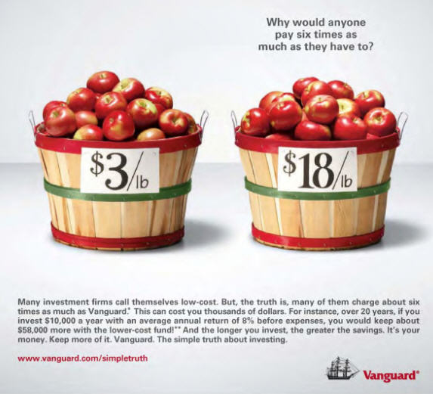

Slide 7
Percentile change in
importance of task type
in U.S. economy
Abstract
Routine
Manual
Autor, D., Levy, F., & Murnane, R. J. (2003). The skill content of recent technological change:
An empirical exploration. Quarterly Journal of Economics 188, 4. [updated, D. Autor, 2008]

Slide 8
MANUFACTURING IN IOWA
% of all Iowa jobs
in May ‘08
% of overall job losses
by Sep ‘09

Slide 9
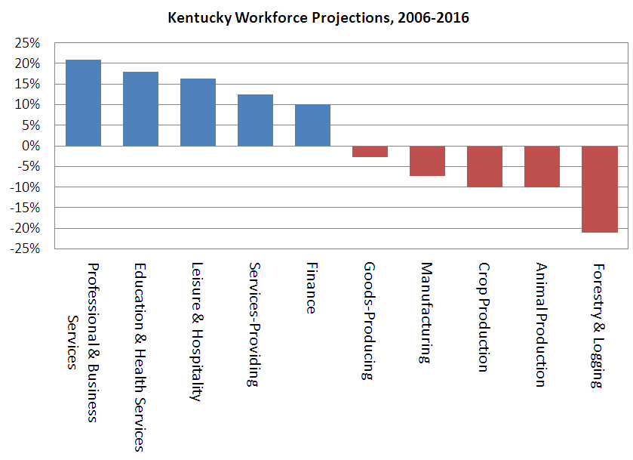

Slide 10


Slide 11
Growth of the creative class
Florida, R. (2002). The rise of the creative class (p. 332). New York, NY: Basic Books.
Notes:
Since 1950…
agriculture = less than 2%
working = primarily high school diploma, some have a little bit of college - factory workers, construction workers, food service workers, custodians, truck drivers – low levels of education, highly manual labor
service = beauticians, secretaries, paralegals, workers in retail stores, tourism and hotel workers, personal health care assistants
creative = scientists, engineers, technology workers, architects, lawyers, doctors, nurses, K-12 educators, university professors, poets, musicians, and entertainers - from 5% in 1900 to 14% in 1945 to 33% in 2008
2005 – Bill Gates - Today, only one-third of our students graduate from high school ready for college, work, and citizenship. . . . The first group goes on to college and careers; the second group will struggle to make a living wage. Let's be clear. Thanks to dedicated teachers and principals around the country, the best-educated kids in the United States are the best-educated kids in the world. We should be proud of that. But only a fraction of our kids are getting the best education.

Slide 12
Growth of the creative class
Notes:
Since 1950…
agriculture = less than 2%
working = primarily high school diploma, some have a little bit of college - factory workers, construction workers, food service workers, custodians, truck drivers – low levels of education, highly manual labor
service = beauticians, secretaries, paralegals, workers in retail stores, tourism and hotel workers, personal health care assistants
creative = scientists, engineers, technology workers, architects, lawyers, doctors, nurses, K-12 educators, university professors, poets, musicians, and entertainers - from 5% in 1900 to 14% in 1945 to 33% in 2008
2005 – Bill Gates - Today, only one-third of our students graduate from high school ready for college, work, and citizenship. . . . The first group goes on to college and careers; the second group will struggle to make a living wage. Let's be clear. Thanks to dedicated teachers and principals around the country, the best-educated kids in the United States are the best-educated kids in the world. We should be proud of that. But only a fraction of our kids are getting the best education.

Slide 13
  Can someone overseas
  do it cheaper?
  Can a computer
  do it faster?

Slide 14

Notes:
New Commission on the Skills of the American Workforce
Today Indian engineers make $7,500 a year against $45,000 for a similarly-qualified American engineer. Why would the world’s employers pay our engineers more? They would be willing to do that only if we could offer something the Indian engineers cannot.
Producing the most important new products and services depends on a deep vein of creativity that is constantly renewing itself, and on a myriad of people who can imagine how people can use things that have never been available before
Creativity and innovation, facility with the use of ideas and abstractions, the self-discipline and organization needed to manage one’s work and drive it through to a successful conclusion, the ability to function well as a member of a team, the ability to use digital technologies to do everything just mentioned…

Slide 15
Hyperconnected global economy
Offshoring
Replacement of jobs with software

Slide 16
Do we really
understand the
global economic
climate?
1

Slide 17
120 119 118 117 116 115 114 113 112 111
110 109 108 107 106 105 104 103 102 101
100 99 98 97 96 95 94 93 92 91
90 89 88 87 86 85 84 83 82 81
80 79 78 77 76 75 74 73 72 71
70 69 68 67 66 65 64 63 62 61
60

Slide 18
60 59 58 57 56 55 54 53 52 51
50 49 48 47 46 45 44 43 42 41
40 39 38 37 36 35 34 33 32 31
30 29 28 27 26 25 24 23 22 21
20 19 18 17 16 15 14 13 12 11
10 9 8 7 6 5 4 3 2 1

Slide 19
The fundamental dilemma
but now are
expected to
do this
Schools were
designed
for this …
Notes:
Since 1950…
agriculture = less than 2%
working = primarily high school diploma, some have a little bit of college - factory workers, construction workers, food service workers, custodians, truck drivers – low levels of education, highly manual labor
service = beauticians, secretaries, paralegals, workers in retail stores, tourism and hotel workers, personal health care assistants
creative = scientists, engineers, technology workers, architects, lawyers, doctors, nurses, K-12 educators, university professors, poets, musicians, and entertainers - from 5% in 1900 to 14% in 1945 to 33% in 2008
2005 – Bill Gates - Today, only one-third of our students graduate from high school ready for college, work, and citizenship. . . . The first group goes on to college and careers; the second group will struggle to make a living wage. Let's be clear. Thanks to dedicated teachers and principals around the country, the best-educated kids in the United States are the best-educated kids in the world. We should be proud of that. But only a fraction of our kids are getting the best education.

Slide 20
What we have right now
uniqueness
uniqueness
one right answer
Notes:
20

Slide 21

Notes:
21

Slide 22


Slide 23

Notes:
23
- not entirely educators’ fault – the system is the issue – governed by an essential 19th century paradigm – one that was appropriate for our grandparents but not our children and grandchildren

Slide 24

Notes:
24

Slide 25
The average fifth grader received five times as much instruction in basic skills as instruction focused on problem solving or reasoning; this ratio was 10:1 in first and third grades.
Robert C. Pianta, et al., Opportunities to Learn in America’s Elementary Classrooms (2007)
[study of 2500+ classrooms in more than 1,000 elementary schools and 400 school districts]

Slide 26
Classrooms in which there was evidence of higher-order thinking: 3 percent. Classrooms in which high-yield [instructional] strategies were being used: 0.2 percent. Classrooms in which fewer than one-half of students were paying attention: 85 percent.
Mike Schmoker, Results Now (2006) [citing a study of 1,500+ classroom observations]

Slide 27
When you code classroom practice for level of cognitive demand . . . 80% of the work is at the factual and procedural level. . . . [Teachers] will do low-level work and call it high-level work.
Richard Elmore, excerpt from Education Leadership as the Practice of Improvement (2006)

Slide 28
The data from our observations in more than 1,000 classrooms support the popular image of a teacher standing or sitting in front of a class imparting knowledge to a group of students. Explaining and lecturing constituted the most frequent teaching activities …
Teachers also spent a substantial amount of time observing students at work or monitoring their seat-work …
Three categories of student activity marked by passivity - written work, listening, and preparing for assignments - dominate … The chances are better than 50–50 that if you were to walk into any of the classrooms of our sample, you would see one of these three activities under way … All three activities are almost exclusively set and monitored by teachers. We saw a contrastingly low incidence of activities invoking active modes of learning.
John Goodlad, A Place Called School (1984)

Slide 29
What students do in the classroom is what they learn (as Dewey would say) . . . Now, what is it that students do in the classroom? Well, mostly, they sit and listen to the teacher. . . . Mostly, they are required to remember. . . . It is practically unheard of for students to play any role in determining what problems are worth studying or what procedures of inquiry ought to be used. . . . Here is the point: Once you have learned how to ask questions – relevant and appropriate and substantial questions – you have learned how to learn and no one can keep you from learning whatever you want or need to know . . . [However,] what students are restricted to (solely and even vengefully) is the process of memorizing . . . somebody else’s answers to somebody else’s questions. It is staggering to consider the implications of this fact. The most important intellectual ability man has yet developed – the art and science of asking questions – is not taught in school! Moreover, it is not “taught” in the most devastating way possible: by arranging the environment so that significant question asking is not valued. It is doubtful if you can think of many schools that include question-asking, or methods of inquiry, as part of their curriculum.
Neil Postman & Charles Weingartner, Teaching as a Subversive Activity (1969)

Slide 30
The chief source of the “problem of discipline” in schools is that … a premium is put on physical quietude; on silence, on rigid uniformity of posture and movement; upon a machine-like simulation of the attitudes of intelligent interest. The teachers’ business is to hold the pupils up to these requirements and to punish the inevitable deviations which occur.
John Dewey, Democracy and Education (1916)

Slide 31

Notes:
For the past five years, the national conversation on education has focused on reading scores, math tests and closing the "achievement gap" between social classes. This is not a story about that conversation.
This is a story about the big public conversation the nation is not having about education, the one that will ultimately determine not merely whether some fraction of our children get "left behind" but also whether an entire generation of kids will fail to make the grade in the global economy because they can't think their way through abstract problems, work in teams, distinguish good information from bad or speak a language other than English.

Slide 32

No generation in history has ever been so
thoroughly prepared for the industrial age.
David Warlick
http://davidwarlick.com/2cents/?p=298
dangerouslyirrelevant.org
Notes:
We desperately need . . . we may not survive without . . . a generation of young people who are imaginative, inventive, fearless learners, and compassionate leaders. Yet, what can we say, as educators, about the students we are producing? We can prove that they can read, do basic math on paper, and they are able to sit for hours filling in bubble sheets.
http://davidwarlick.com/2cents/?p=298

Slide 33


Slide 34
global awareness
effective speaking
critical thinking
problem solving
adaptability
information literacy
collaboration
creativity
media fluency
analytical skills
entrepeneurialism
innovation
effective writing
synthesis
curiosity
Notes:
Wagner: Convergence of college, career, citizenship
1. critical thinking and problem solving in networks of cross-functional teams
world is complex and answers are not in the books
world is moving too fast for inflexible, hierarchical organizations
2. collaboration across networks and leadership by influence rather than positional authority
command and control increasingly less valued in organizations
schools are very much command and control institutions
3. agility and adaptability
intensifying rate of change, overwhelming amount of data, increasing complexity of problems
4. initiative and entrepeneurialism
people who can seek out new opportunities, ideas, and strategies
don’t want students or workers who are apathetic about their experiences
achievement orientation, drive for results, self-starters
5. effective written and oral communication
presentation skills, being clear and concise; creating focus, energy, and passion around the points they want to make
6. accessing and analyzing information
people who can access, evaluate, conceptualize, and synthesize multiple and large streams of incoming information to make meaningful decisions
7. curiosity and imagination
inquisitiveness, analytical skills that are more ‘out of the box’ than in the past, asking great questions is more important than knowing the ‘right answer’

Slide 35
How do we best
support student
acquisition of
“21st century
skills?”
2

Slide 36
120 119 118 117 116 115 114 113 112 111
110 109 108 107 106 105 104 103 102 101
100 99 98 97 96 95 94 93 92 91
90 89 88 87 86 85 84 83 82 81
80 79 78 77 76 75 74 73 72 71
70 69 68 67 66 65 64 63 62 61
60

Slide 37
60 59 58 57 56 55 54 53 52 51
50 49 48 47 46 45 44 43 42 41
40 39 38 37 36 35 34 33 32 31
30 29 28 27 26 25 24 23 22 21
20 19 18 17 16 15 14 13 12 11
10 9 8 7 6 5 4 3 2 1

Slide 38


Slide 39


Slide 40


Slide 41


Slide 42


Slide 43


Slide 44


Slide 45


Slide 46


Slide 47
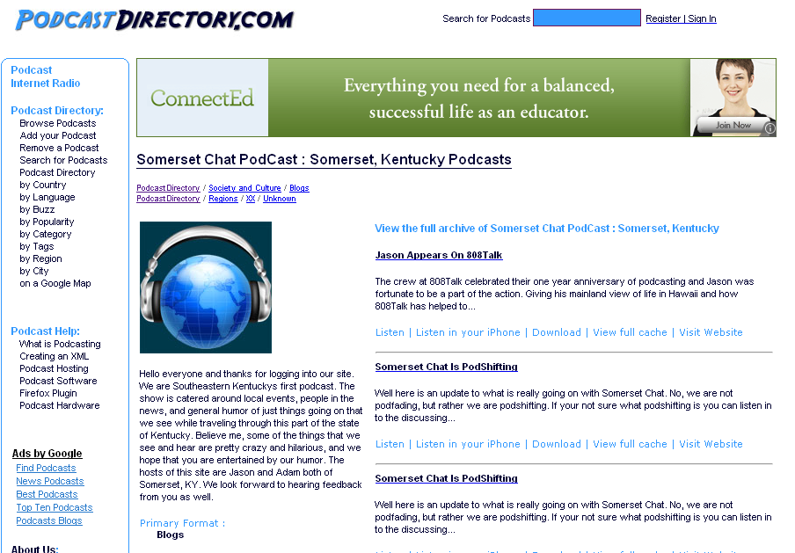

Slide 48


Slide 49


Slide 50


Slide 51
New information landscape

Slide 52


Slide 53


Slide 54


Slide 55
We are hyper-connected

Slide 56



Slide 57


Slide 58


Slide 59


Slide 60


Slide 61


Slide 62


Slide 63


Slide 64
Anytime/anywhere content production, connection, collaboration…

Slide 65
We all now have a voice
(and can find each other, share, connect, collaborate)

Slide 66
newspapers,
magazines

Slide 67
music

Slide 68
radio

Slide 69
television

Slide 70
movies

Slide 71
books,
reading

Slide 72
travel,
travel agencies,
maps

Slide 73
business,
personal finance,
money management

Slide 74
medicine,
health

Slide 75
postal service

Slide 76
real estate

Slide 77
politics

Slide 78
universities

Slide 79
Information-oriented

Slide 80
P-12
schools

Slide 81


Slide 82


Slide 83
Are we
preparing
students for
the new
information
landscape?
3

Slide 84
120 119 118 117 116 115 114 113 112 111
110 109 108 107 106 105 104 103 102 101
100 99 98 97 96 95 94 93 92 91
90 89 88 87 86 85 84 83 82 81
80 79 78 77 76 75 74 73 72 71
70 69 68 67 66 65 64 63 62 61
60

Slide 85
60 59 58 57 56 55 54 53 52 51
50 49 48 47 46 45 44 43 42 41
40 39 38 37 36 35 34 33 32 31
30 29 28 27 26 25 24 23 22 21
20 19 18 17 16 15 14 13 12 11
10 9 8 7 6 5 4 3 2 1

Slide 86
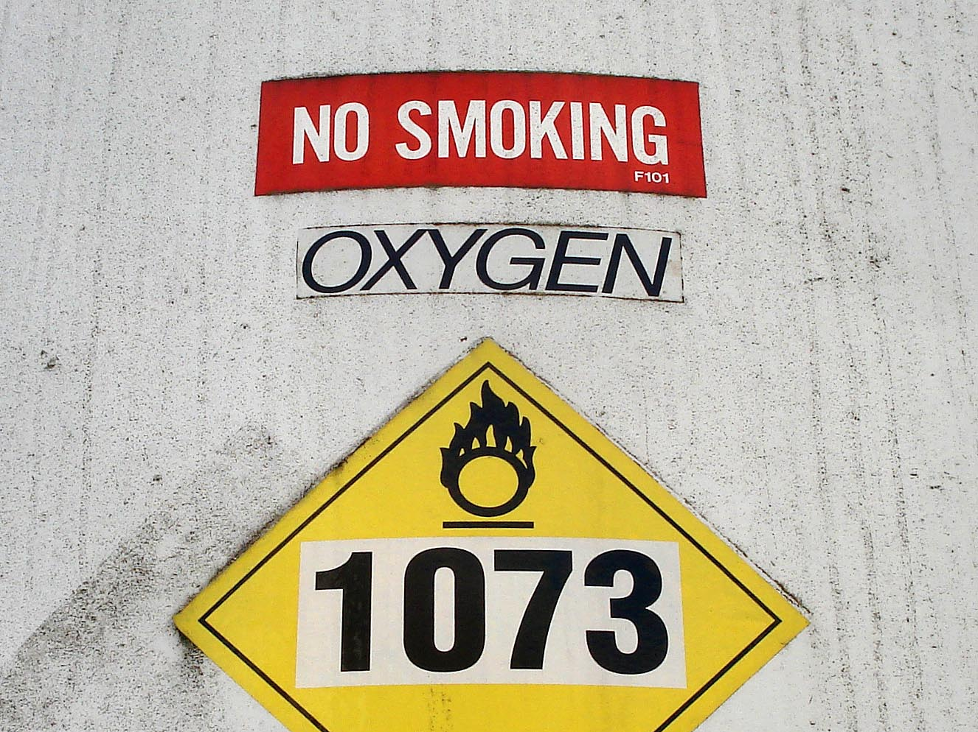
Notes:
Technology needs to be like oxygen. Ubiquitous, necessary, and invisible.
- Chris Lehmann

Slide 87
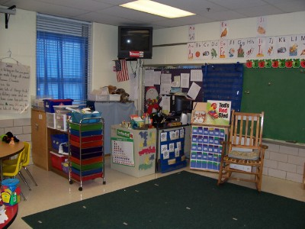

Slide 88
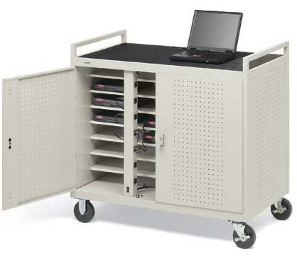

Slide 89
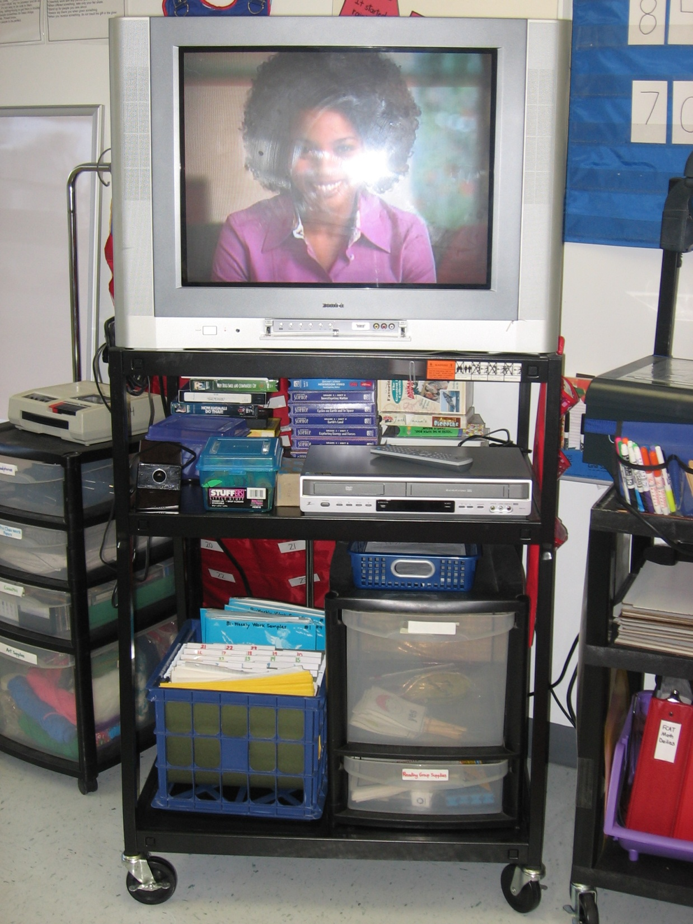

Slide 90
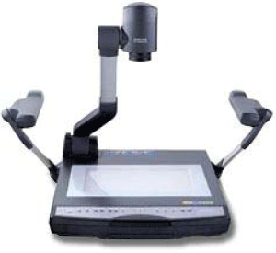

Slide 91
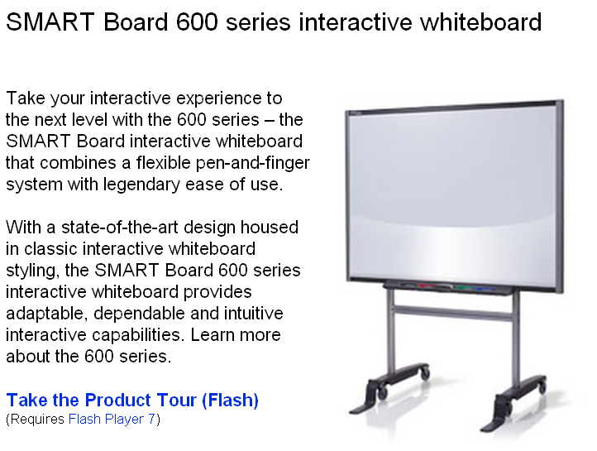

Slide 92
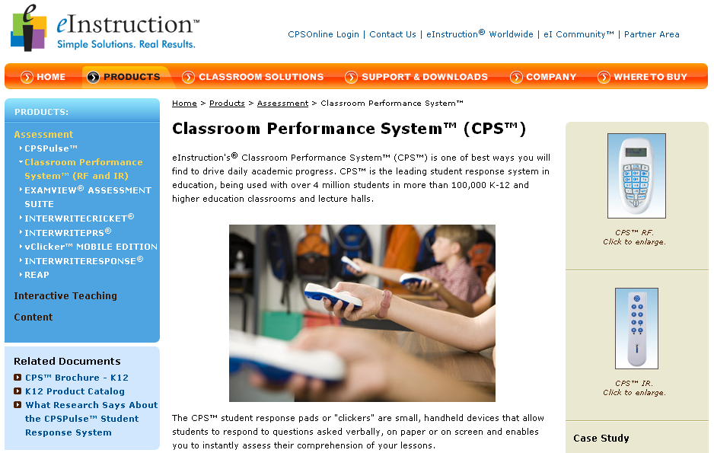

Slide 93
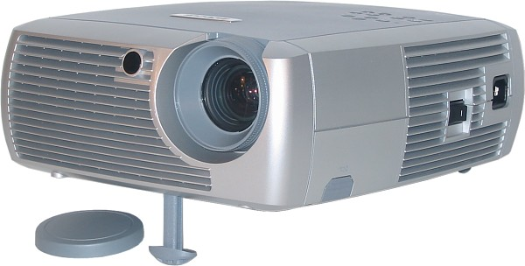

Slide 94
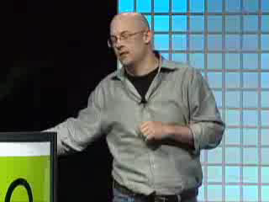

Slide 95
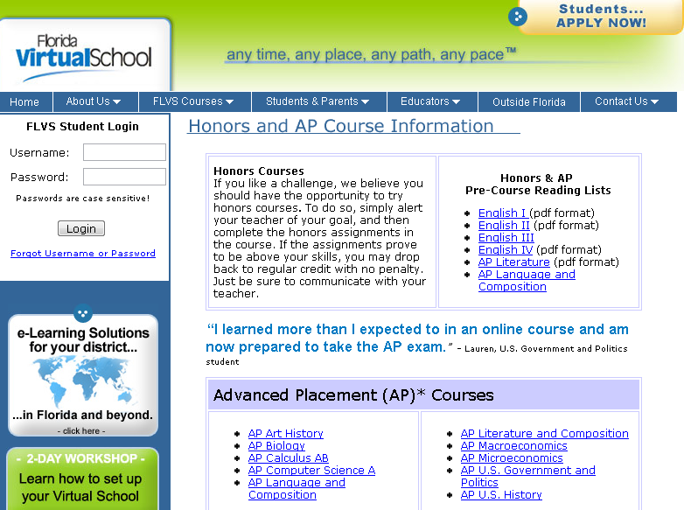

Slide 96


Slide 97
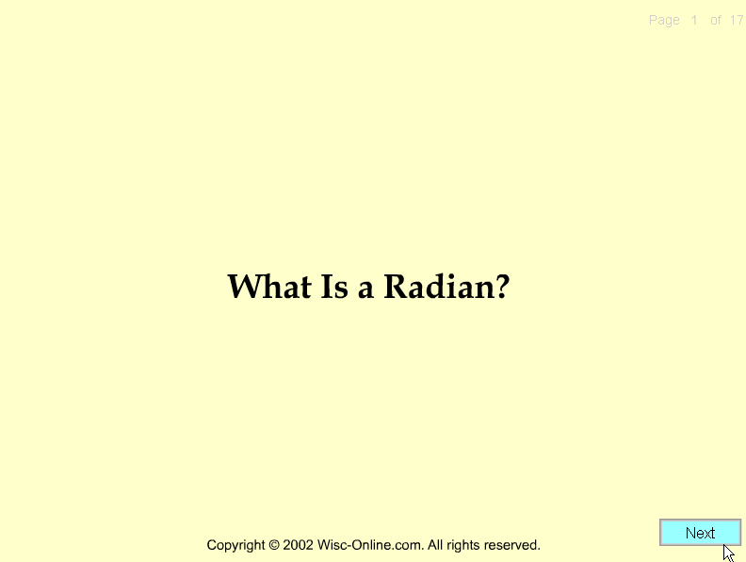

Slide 98
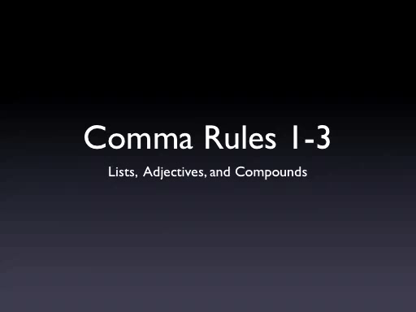

Slide 99
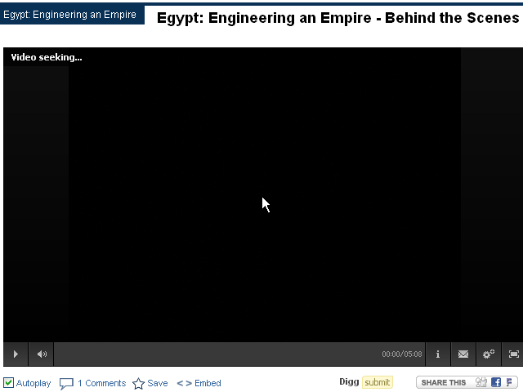

Slide 100


Slide 101
Are we ready
for an era of
personalized
learning?
4

Slide 102
120 119 118 117 116 115 114 113 112 111
110 109 108 107 106 105 104 103 102 101
100 99 98 97 96 95 94 93 92 91
90 89 88 87 86 85 84 83 82 81
80 79 78 77 76 75 74 73 72 71
70 69 68 67 66 65 64 63 62 61
60

Slide 103
60 59 58 57 56 55 54 53 52 51
50 49 48 47 46 45 44 43 42 41
40 39 38 37 36 35 34 33 32 31
30 29 28 27 26 25 24 23 22 21
20 19 18 17 16 15 14 13 12 11
10 9 8 7 6 5 4 3 2 1

Slide 104
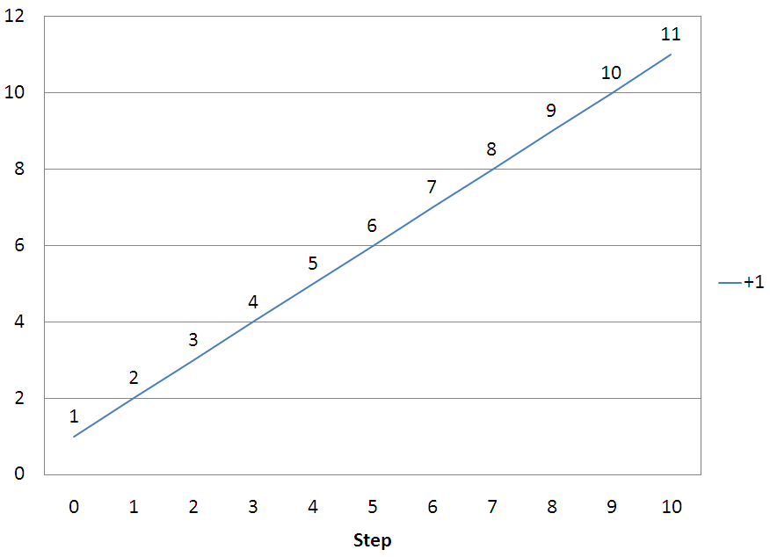

Slide 105
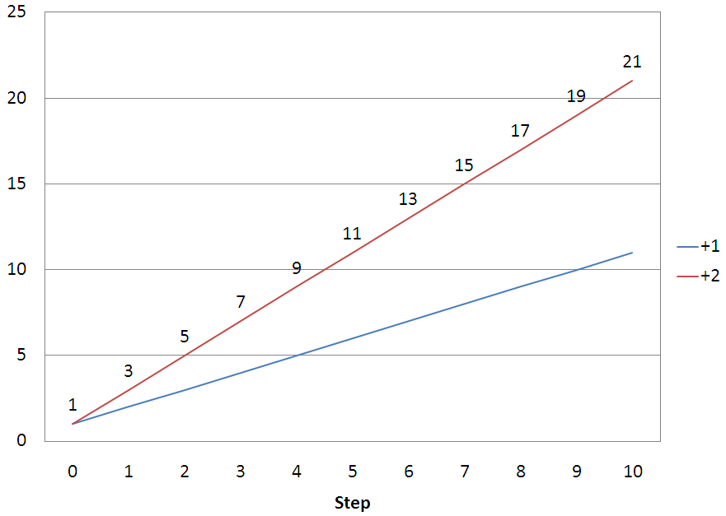

Slide 106
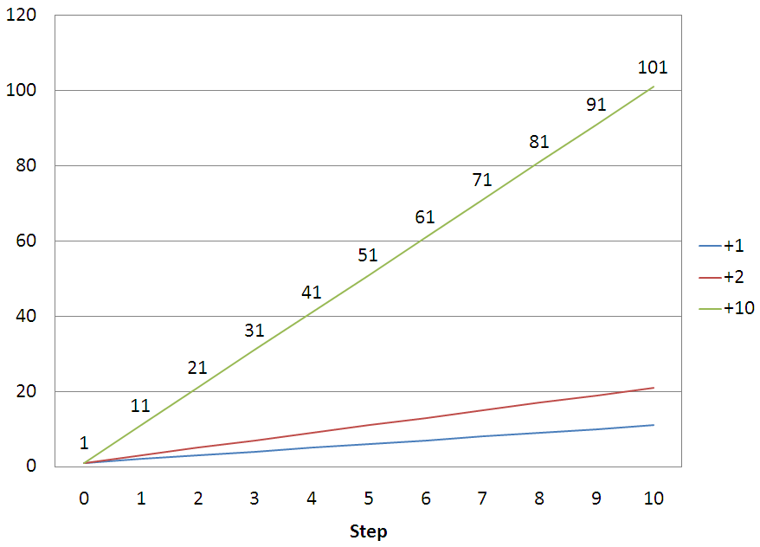

Slide 107
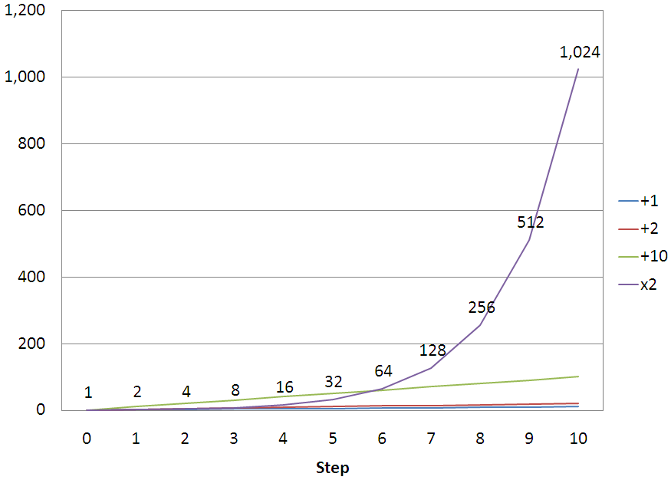

Slide 108
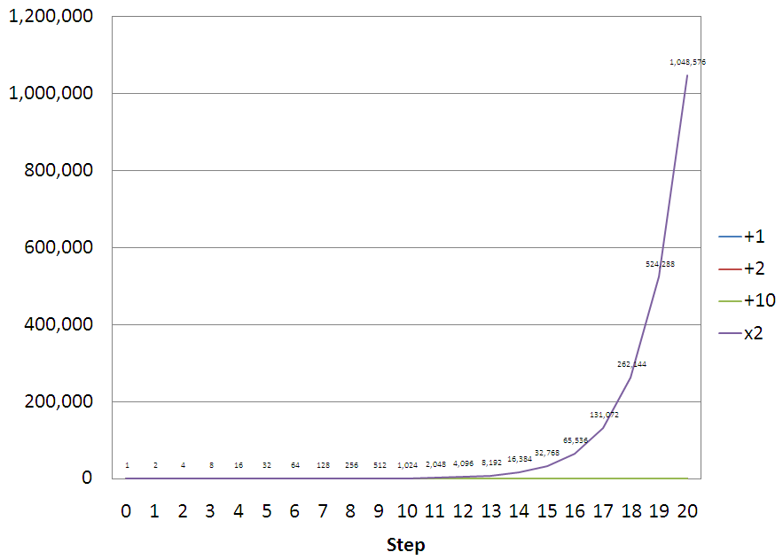

Slide 109
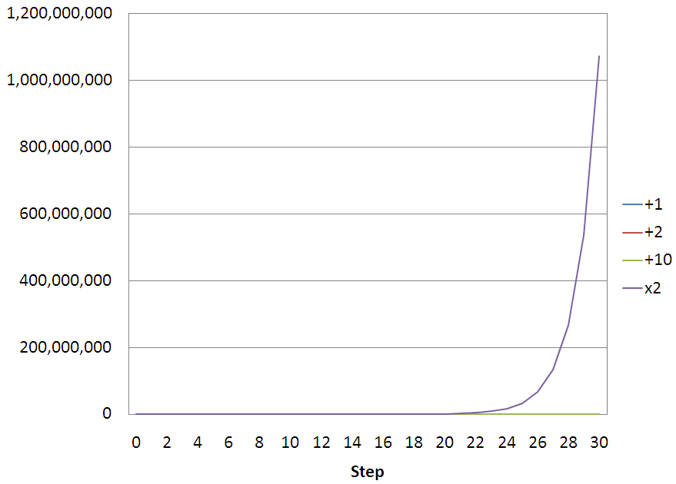

Slide 110
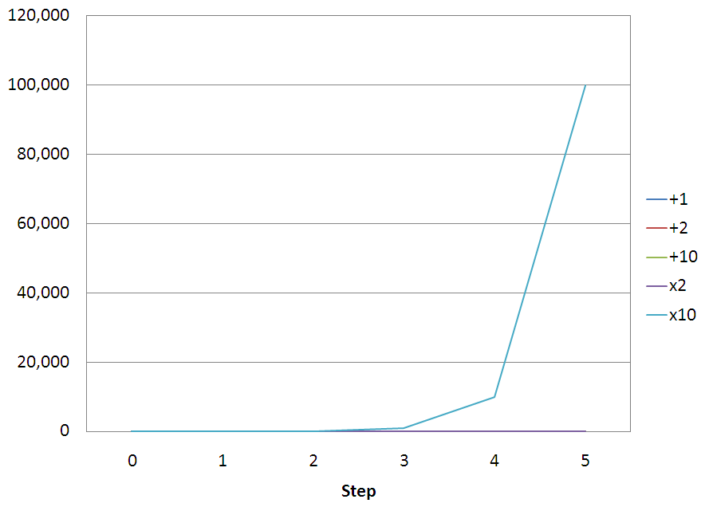

Slide 111
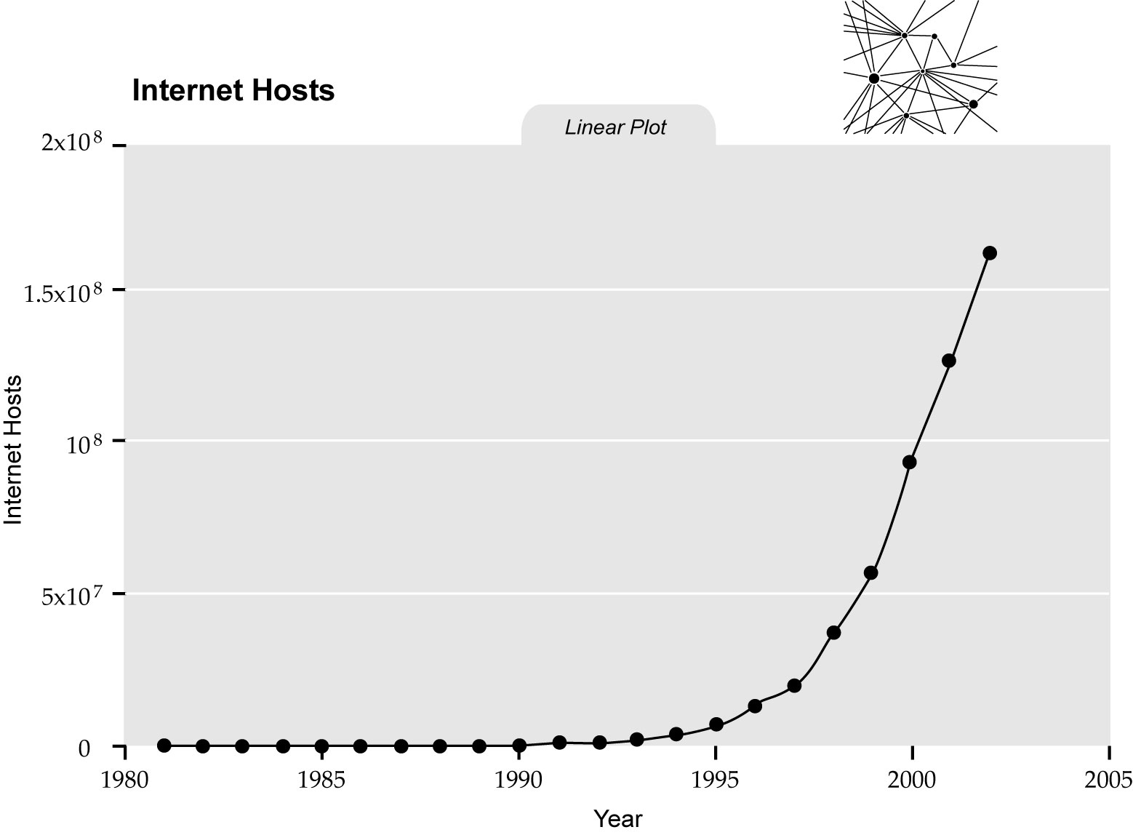
singularity.com/charts

Slide 112
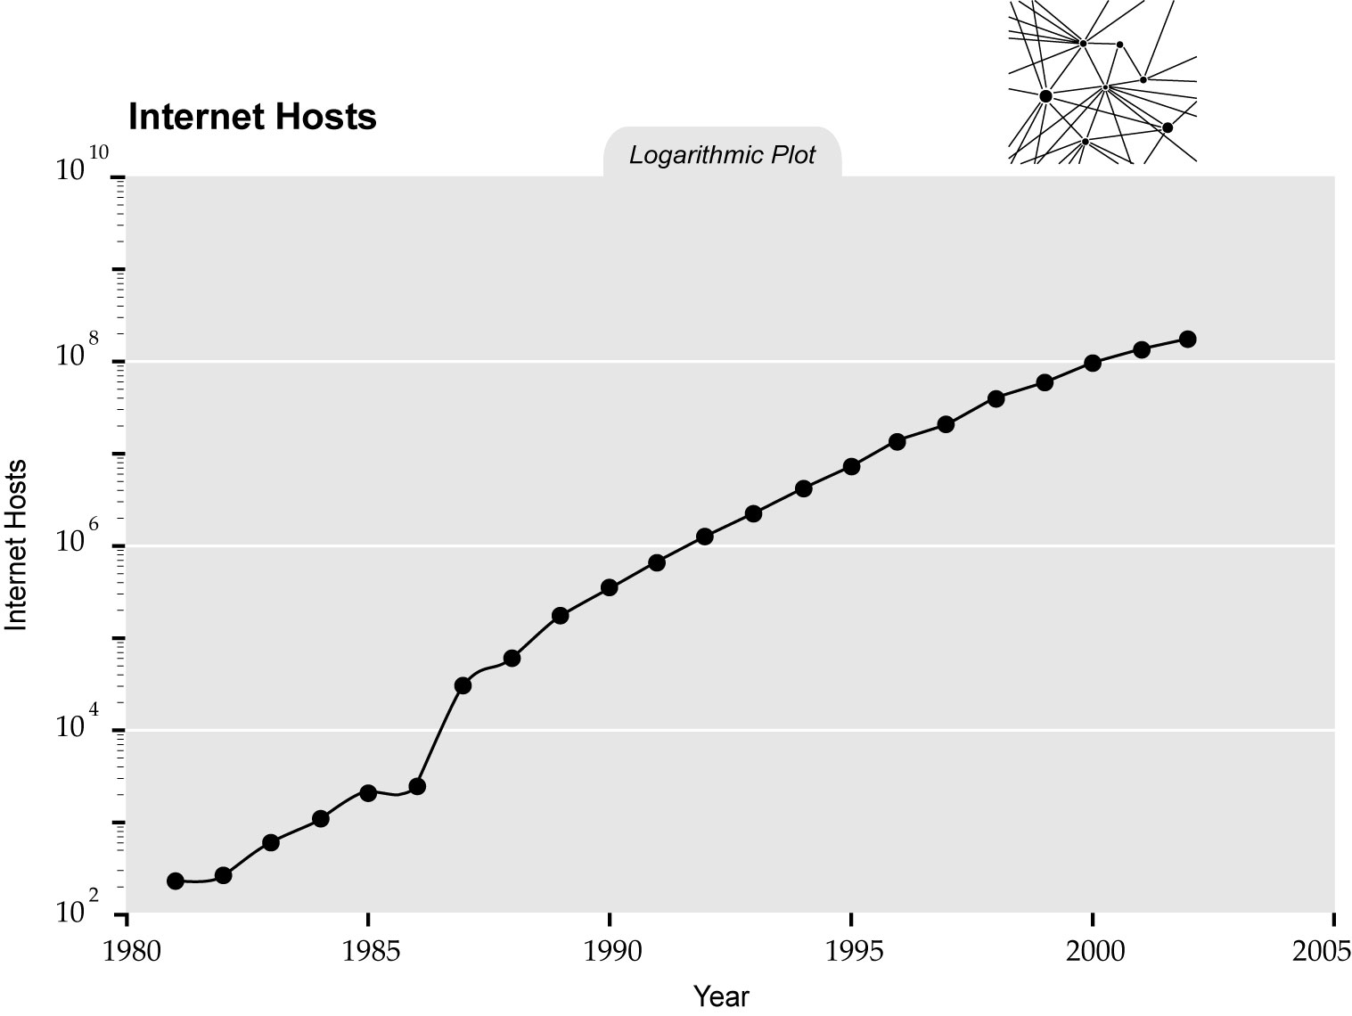
singularity.com/charts

Slide 113
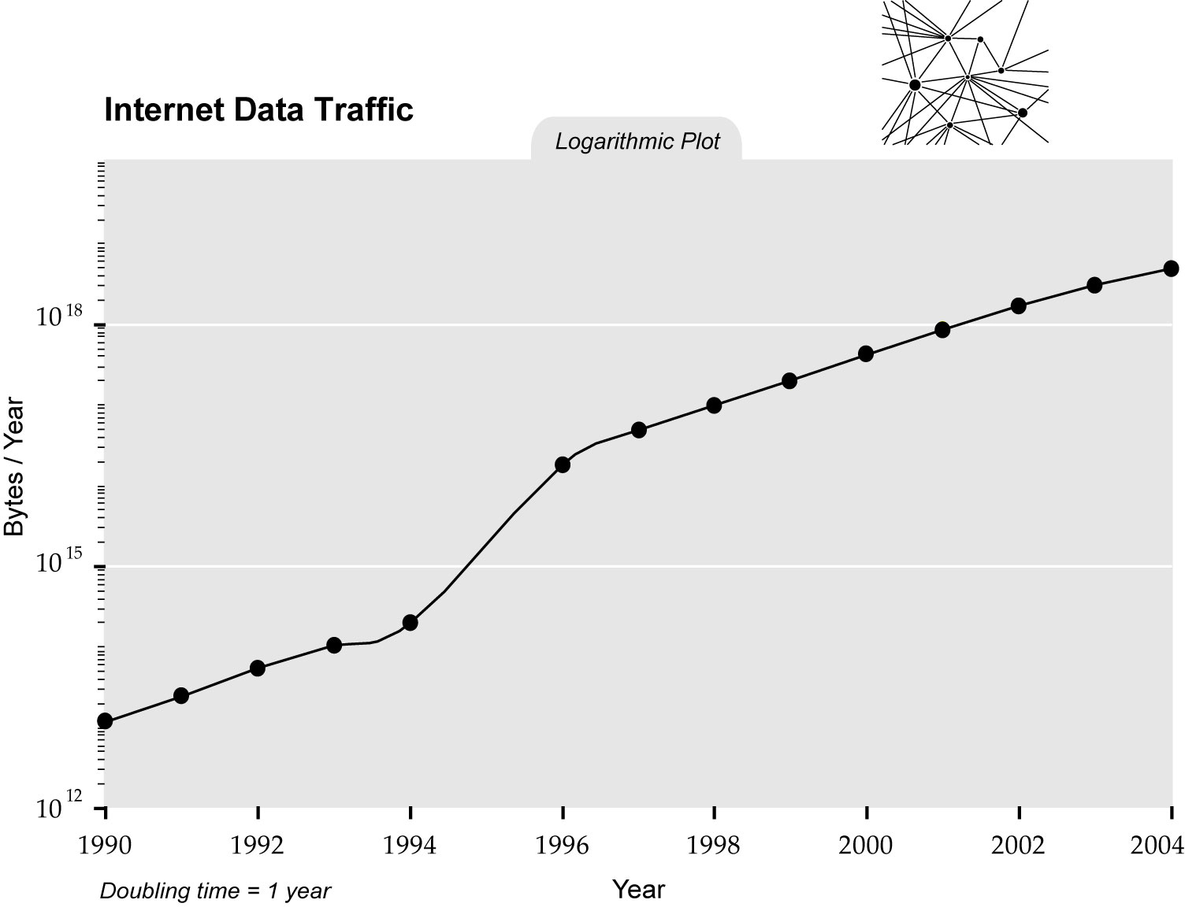
singularity.com/charts

Slide 114
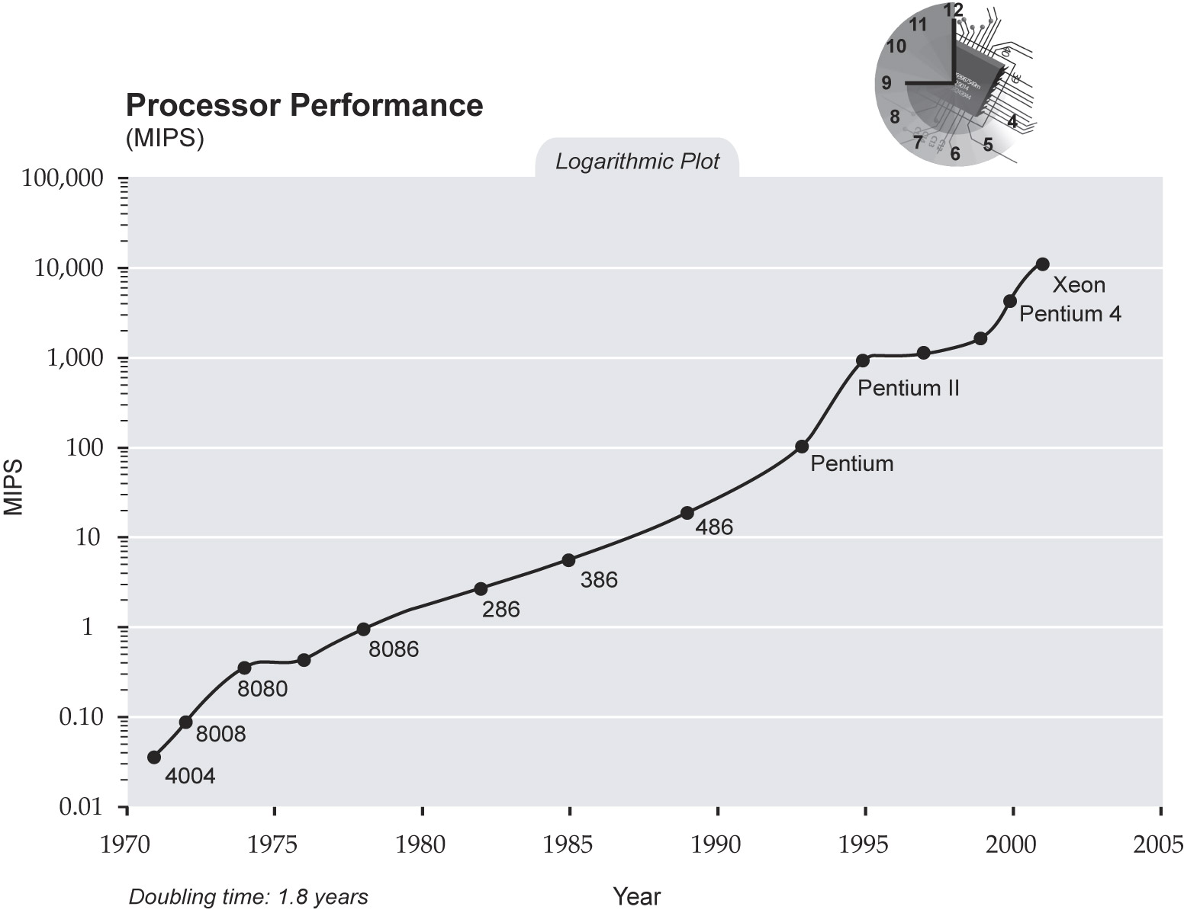
singularity.com/charts

Slide 115
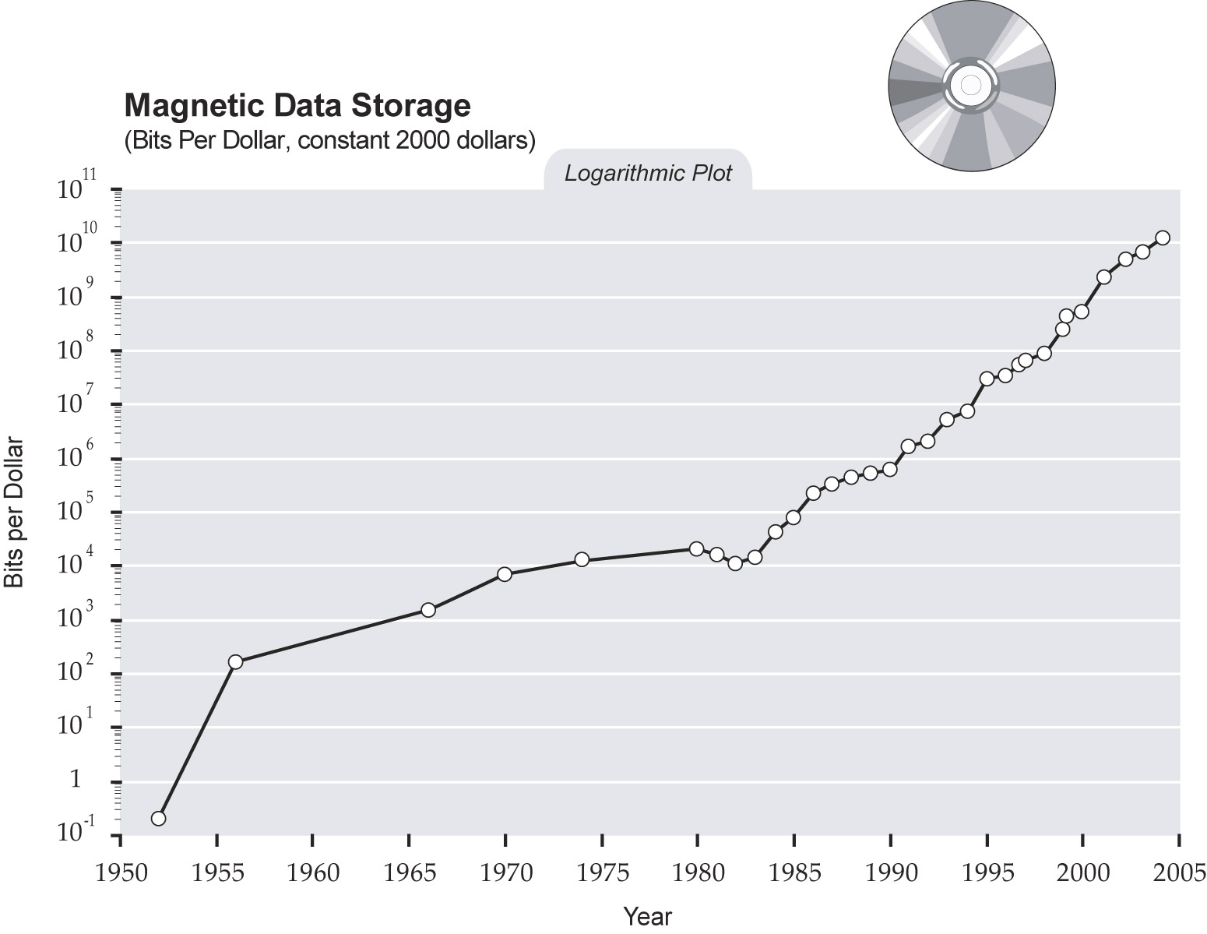
singularity.com/charts

Slide 116
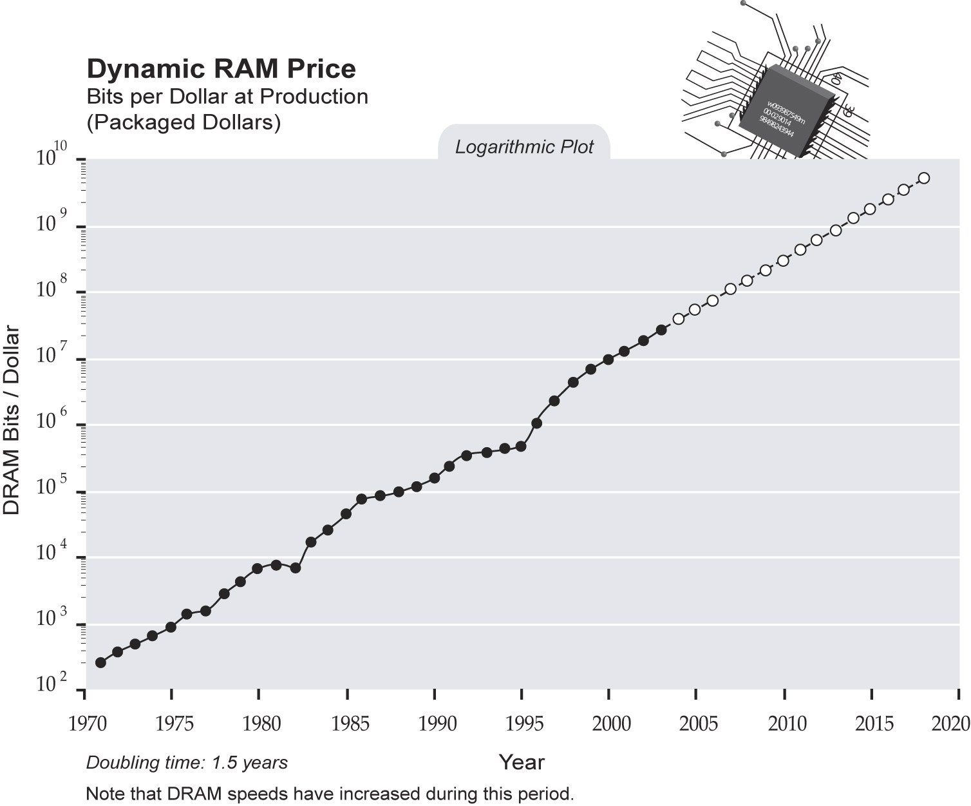
singularity.com/charts

Slide 117
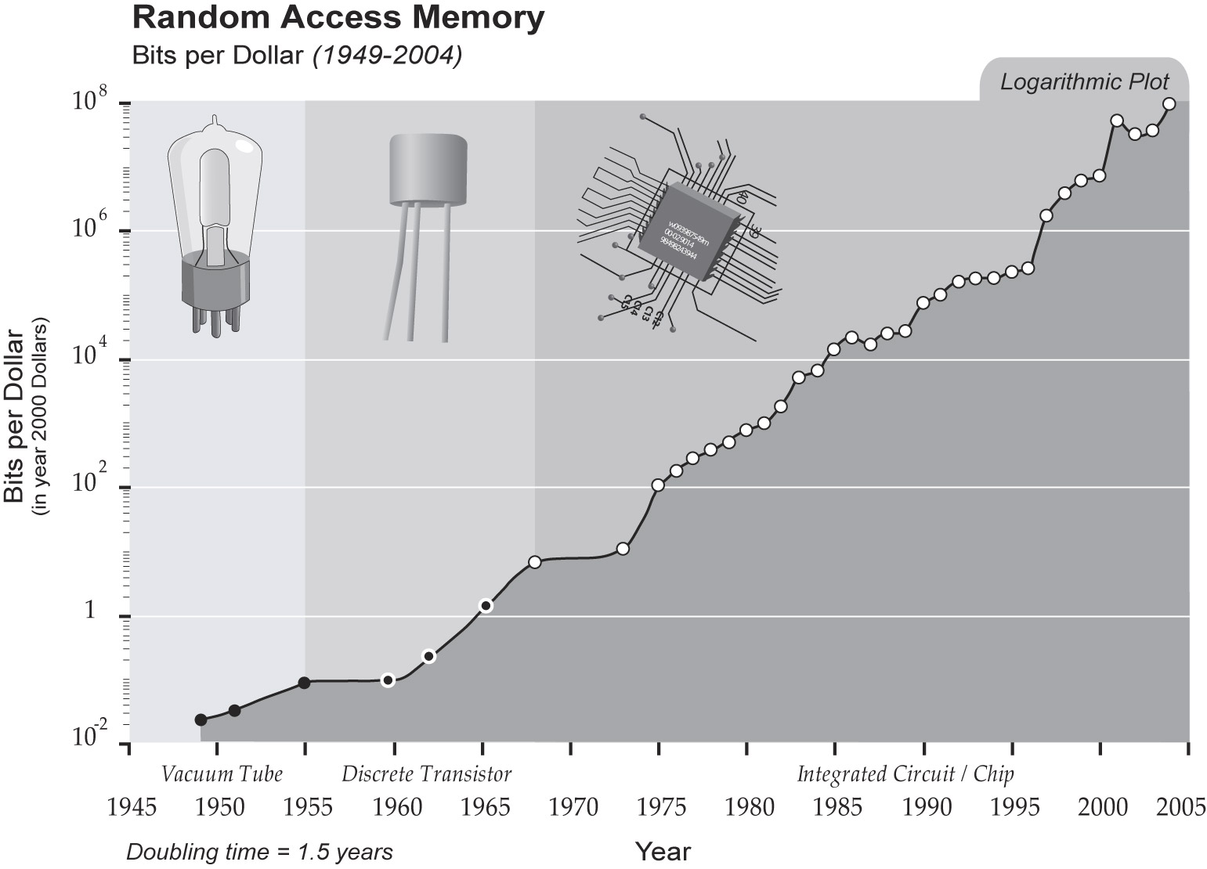
singularity.com/charts

Slide 118
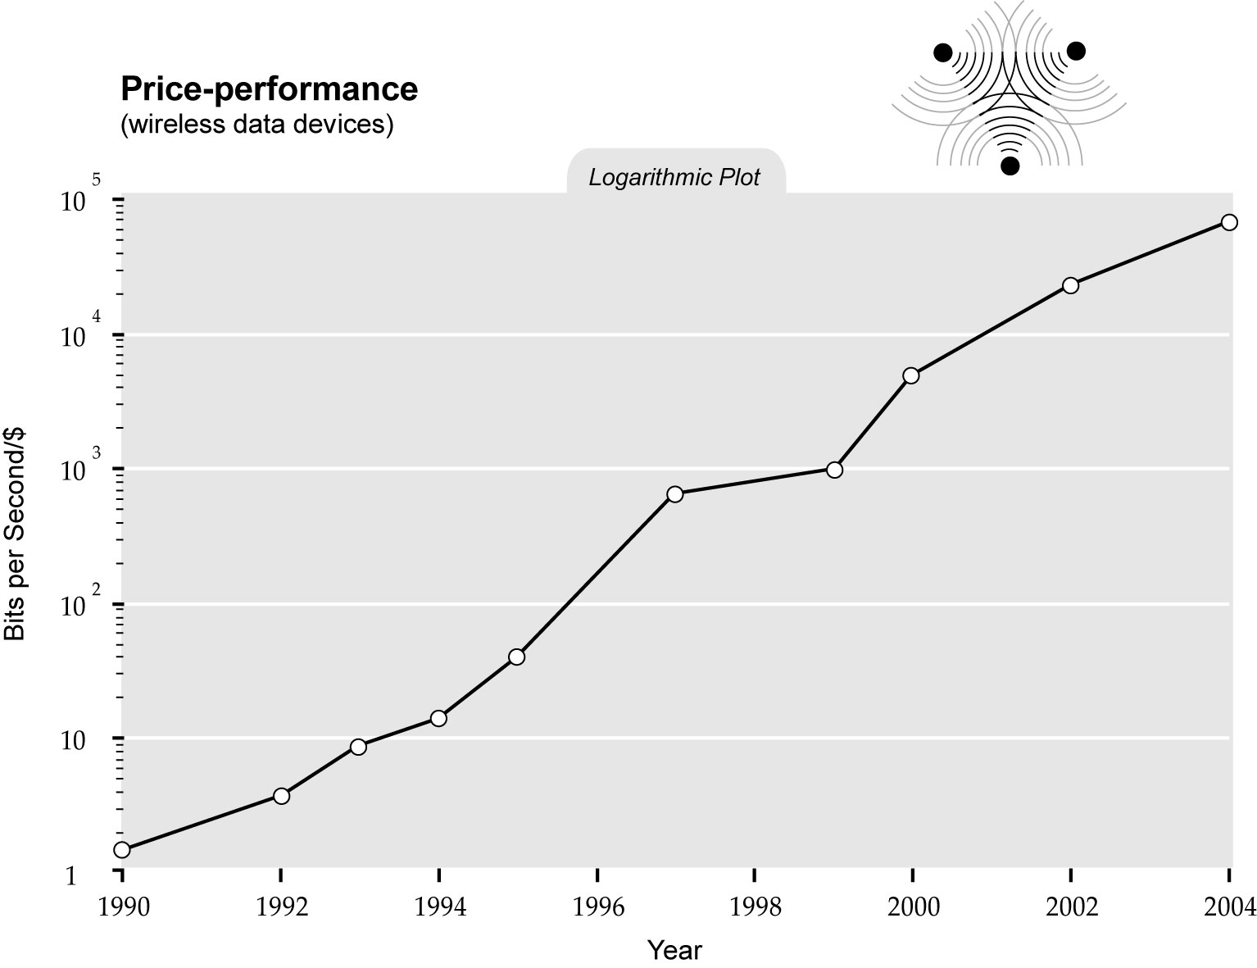
singularity.com/charts

Slide 119
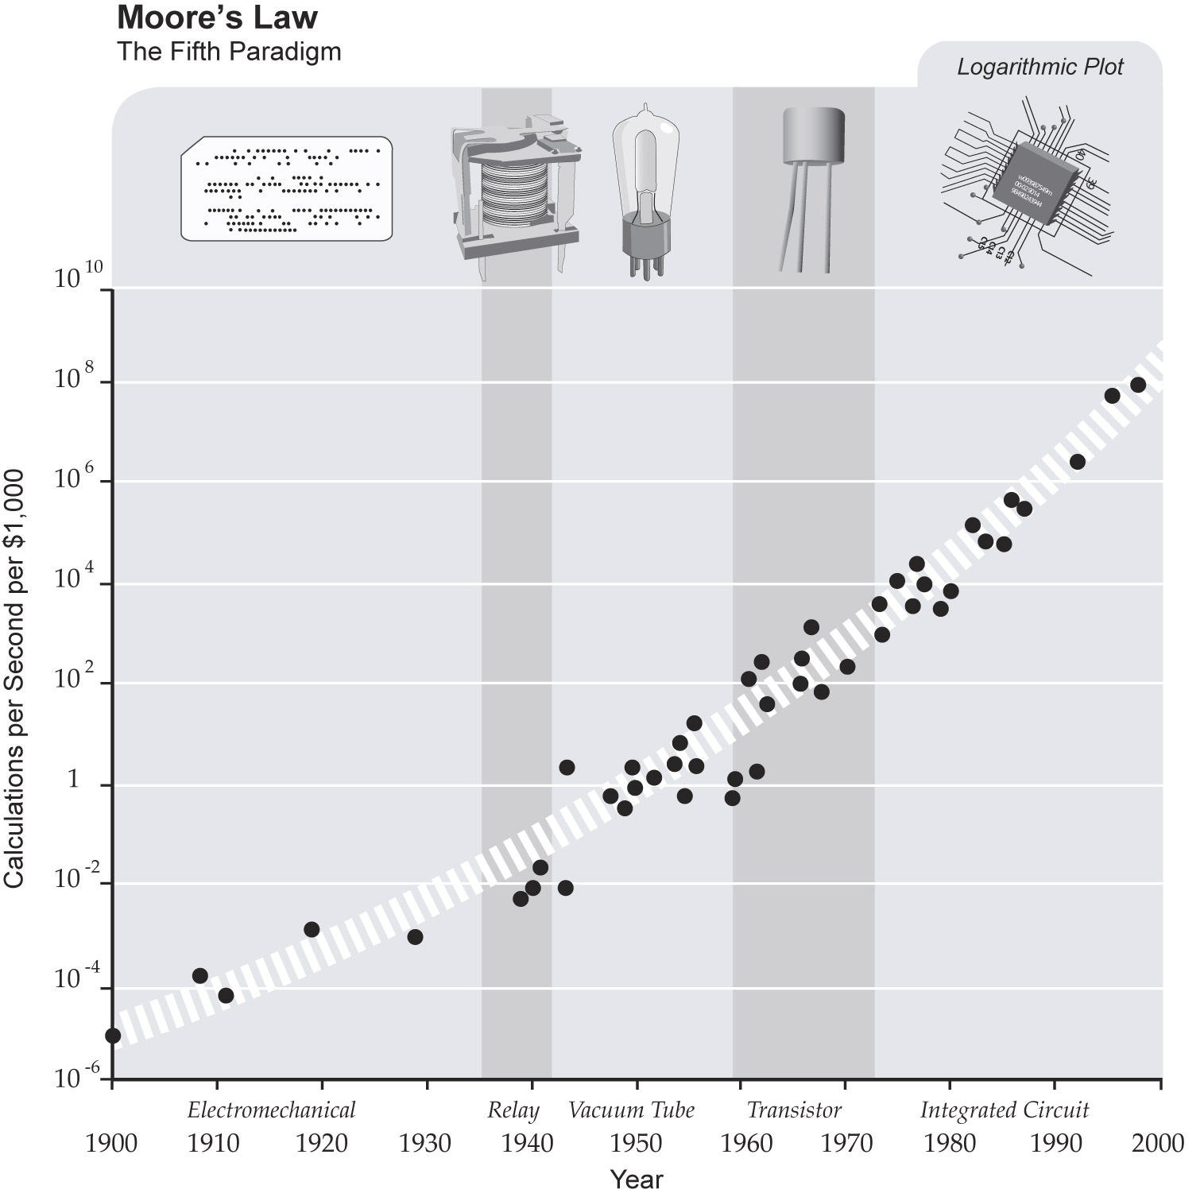
singularity.com/charts

Slide 120
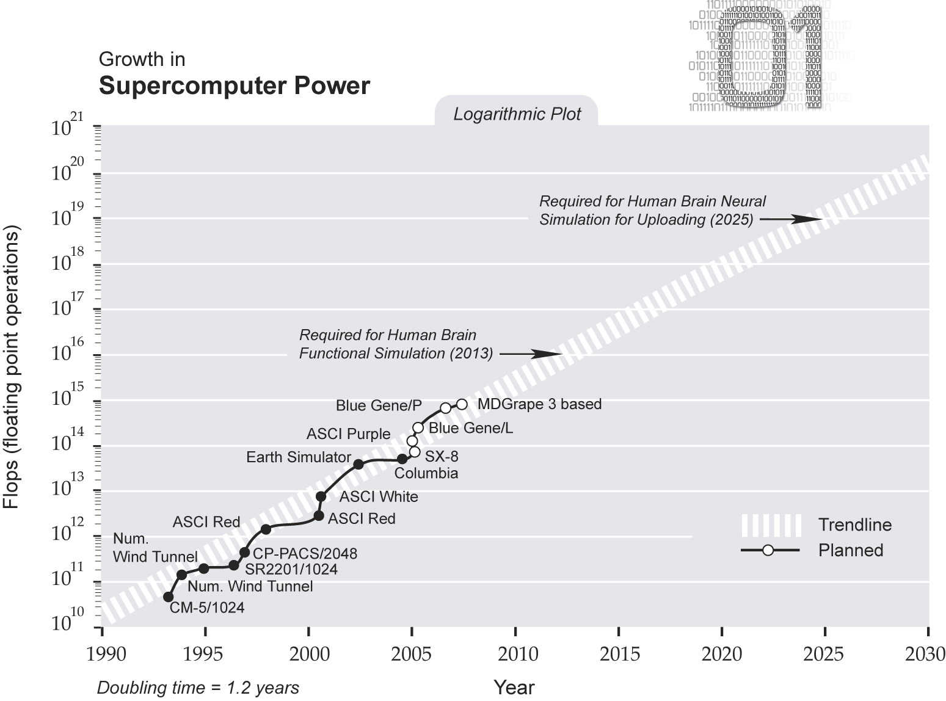
singularity.com/charts

Slide 121
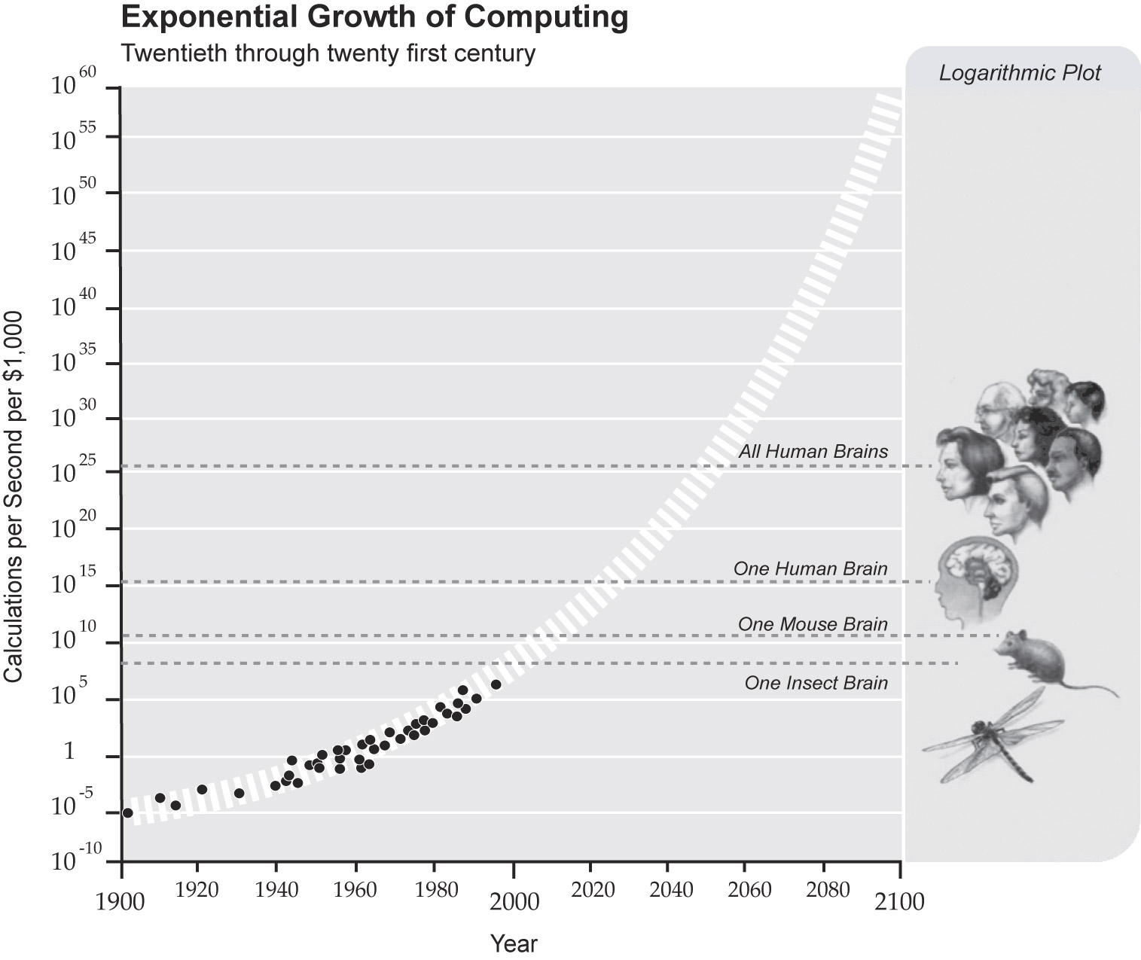
singularity.com/charts

Slide 122
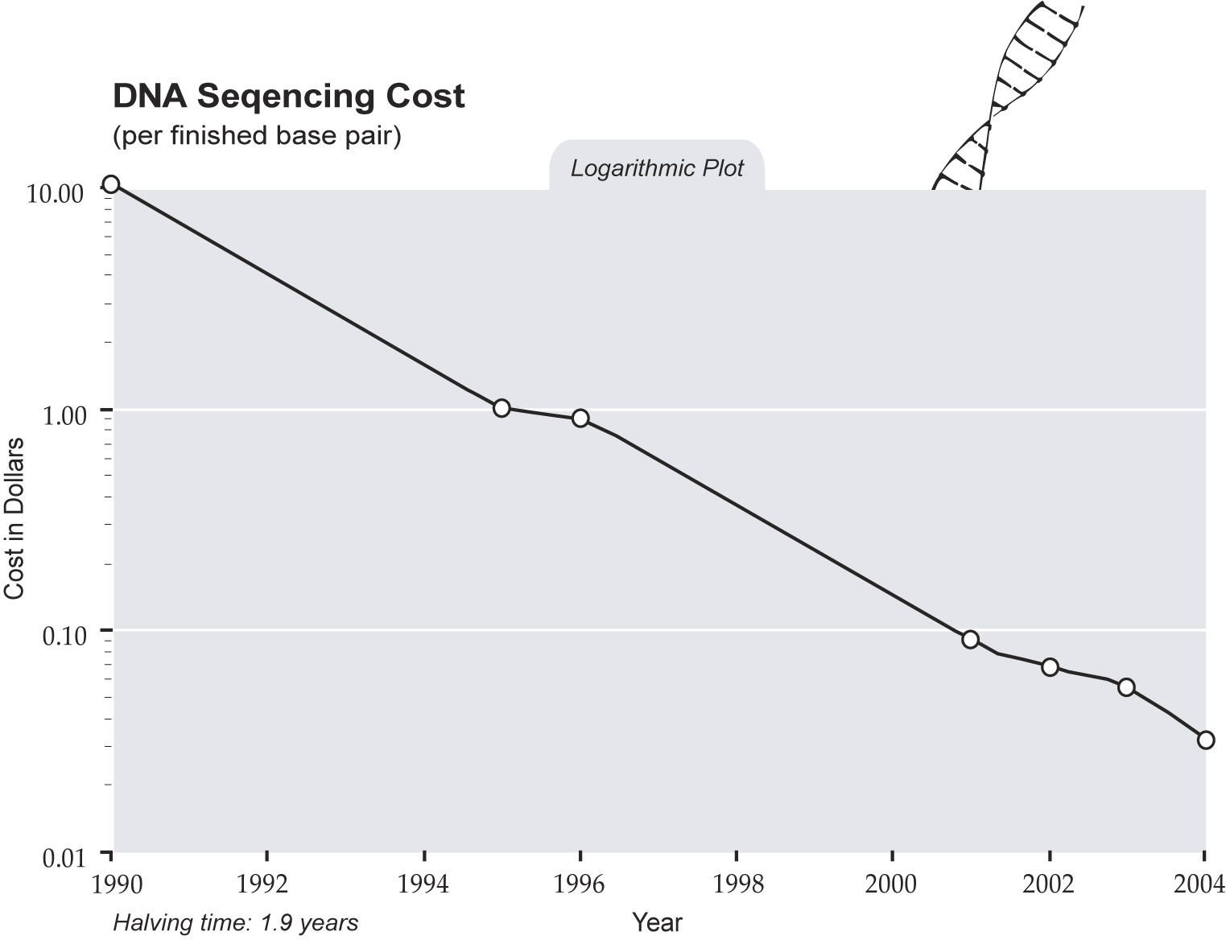
singularity.com/charts

Slide 123
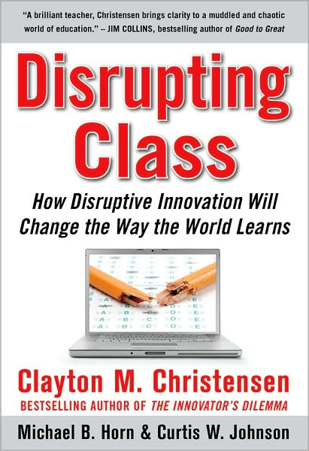

Slide 124
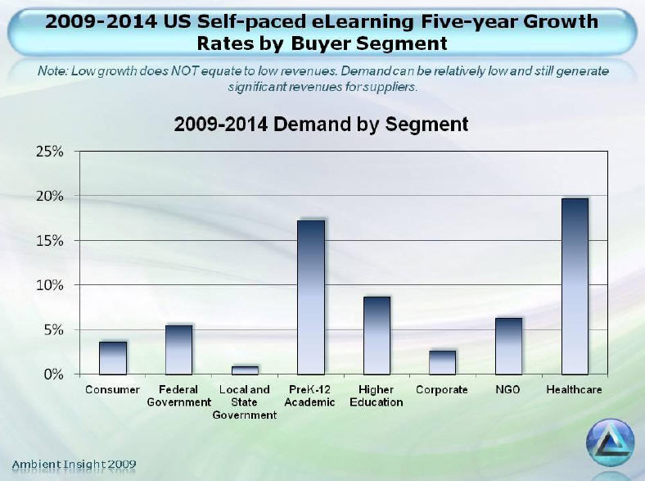
Notes:
Ambient Insight: Worldwide eLearning to grow 12.8% per year from ‘09-’14. Doubling every 6 years. Now a $27 billion industry; will be $50 billion industry by 2014. Growing fastest in developing world.

Slide 125


Slide 126


Slide 127

Notes:
We need to somehow
change faster
No one jumps a 20 foot chasm in two
10 foot jumps. – Miguel Guhlin
When the world changes so fast that we have no reasonable way to forecast what it will look like in a mere decade or two, all we can do is teach kids how to be adaptive – to be learners in the truest sense of the word –
We’ve always talked about preparing lifelong learners in schools, but our practices typically haven’t matched our rhetoric. It’s time to put some bite into our toothless vision statements and recognize that we have to teach kids how to learn to learn if they want to be successful in this new technology-suffused, globally-interconnected world
Credits: http://tinyurl.com/2urbsm and http://tinyurl.com/37em64 (see Guhlin comment)
http://remoteaccess.typepad.com/remote_access/
2006/06/literacy_as_bat.html (see Guhlin comment)
http://headrush.typepad.com/creating_passionate_users/2005/03/incremental_vs_.html

Slide 128
Is my school
facilitating
linear or
exponential
change?
5

Slide 129
120 119 118 117 116 115 114 113 112 111
110 109 108 107 106 105 104 103 102 101
100 99 98 97 96 95 94 93 92 91
90 89 88 87 86 85 84 83 82 81
80 79 78 77 76 75 74 73 72 71
70 69 68 67 66 65 64 63 62 61
60

Slide 130
60 59 58 57 56 55 54 53 52 51
50 49 48 47 46 45 44 43 42 41
40 39 38 37 36 35 34 33 32 31
30 29 28 27 26 25 24 23 22 21
20 19 18 17 16 15 14 13 12 11
10 9 8 7 6 5 4 3 2 1

Slide 137
I'm not sure you appreciate how far along are most of the schools here today. We're far from average in terms of our implementation of technology.

Slide 138

Notes:
138
We can’t be refugees
We have to be honest with ourselves
- most teachers and administrators (and professors) are refugees when it comes to most of this
- not worth the time investment to learn
- satisfied with the status quo

Slide 139
Do I truly
“get it?”
Am I doing
what I
should be?
6

Slide 140
120 119 118 117 116 115 114 113 112 111
110 109 108 107 106 105 104 103 102 101
100 99 98 97 96 95 94 93 92 91
90 89 88 87 86 85 84 83 82 81
80 79 78 77 76 75 74 73 72 71
70 69 68 67 66 65 64 63 62 61
60

Slide 141
60 59 58 57 56 55 54 53 52 51
50 49 48 47 46 45 44 43 42 41
40 39 38 37 36 35 34 33 32 31
30 29 28 27 26 25 24 23 22 21
20 19 18 17 16 15 14 13 12 11
10 9 8 7 6 5 4 3 2 1

Slide 142
  Socially functional
  Mastery of information landscape
  Economically productive

Slide 143

Notes:
Anticipatory v. reactionary

Slide 144

Notes:
Future oriented v. compliance oriented

Slide 145

No one will thank you
for taking care of today
if you have failed
to take care of tomorrow.
Joel Barker

Slide 146


Slide 147

Notes:
147

Slide 148
Where can I
access Scott’s
materials?
7

Slide 149
Thank you!
Scott McLeod, J.D., Ph.D.
Director, CASTLE
dangerouslyirrelevant.org/act.html
Notes:
149
URL

Slide 150
Photo credits
http://www.flickr.com/photos/stolensnapshot/3352221864/in/set-72157615125530681/
http://www.flickr.com/photos/45635774@N00/3440080595/

