Slide 1
Percentile change in
importance of task type
in U.S. economy
Abstract
Routine
Manual
Autor, D., Levy, F., & Murnane, R. J. (2003). The skill content of recent technological change:
An empirical exploration. Quarterly Journal of Economics 188, 4. [updated, D. Autor, 2008]

Slide 2
The fundamental dilemma
but now are
expected to
do this
Schools were
designed
for this …
Florida, R. (2002). The rise of the creative class (p. 332). New York, NY: Basic Books.

Slide 3

Notes:
3

Slide 4

No generation in history has ever been so
thoroughly prepared for the industrial age.
David Warlick
http://davidwarlick.com/2cents/?p=298
dangerouslyirrelevant.org

Slide 5
global awareness
effective speaking
critical thinking
problem solving
adaptability
information literacy
collaboration
creativity
media fluency
analytical skills
entrepeneurialism
innovation
effective writing
synthesis
curiosity

Slide 6
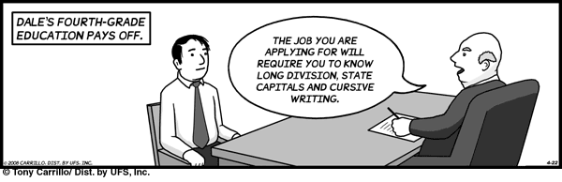
Notes:
6

Slide 7


Slide 8


Slide 9
O
2
Notes:
Technology needs to be like oxygen. Ubiquitous, necessary, and invisible.
- Chris Lehmann

Slide 10


Slide 11

If the leaders
don’t get it,
it’s not going
to happen.
dangerouslyirrelevant.org
Notes:
Licensed under a Creative Commons attribution-share alike license.
http://creativecommons.org/licenses/by-sa/3.0
Scott McLeod, J.D., Ph.D.
scottmcleod.net/contact
dangerouslyirrelevant.org
schooltechleadership.org

Slide 12
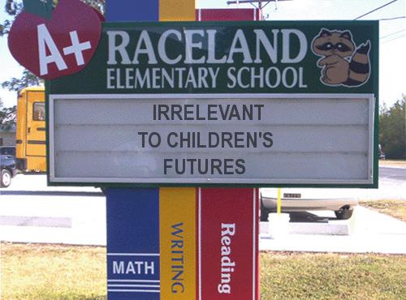
Notes:
12

Slide 13
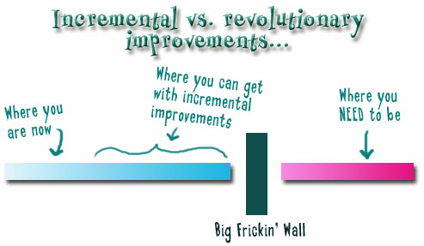

Slide 14


Slide 15

No one will thank you
for taking care of today
if you have failed
to take care of tomorrow.
Joel Barker

