Slide 1
The impact of digital technologies on schools, universities, and our personal lives
Dr. Scott McLeod
CASTLE

Slide 2
dangerouslyirrelevant.org/ big12alumni
Say hi to
your neighbor(s)!

Slide 3
6 questions
I’d be asking…

Slide 4
Everything is moving to the Web

Slide 5
EVERYTHING is moving to the Web
(really)

Slide 6
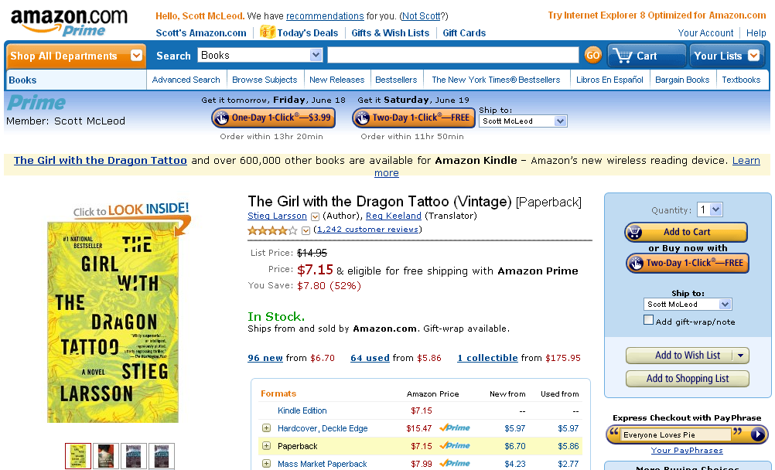

Slide 7
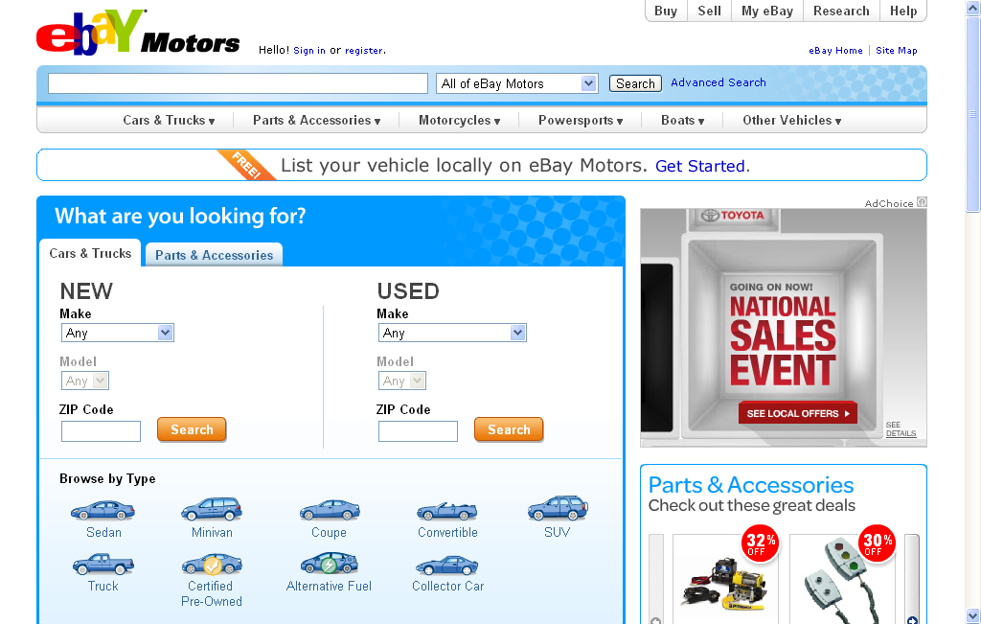

Slide 8
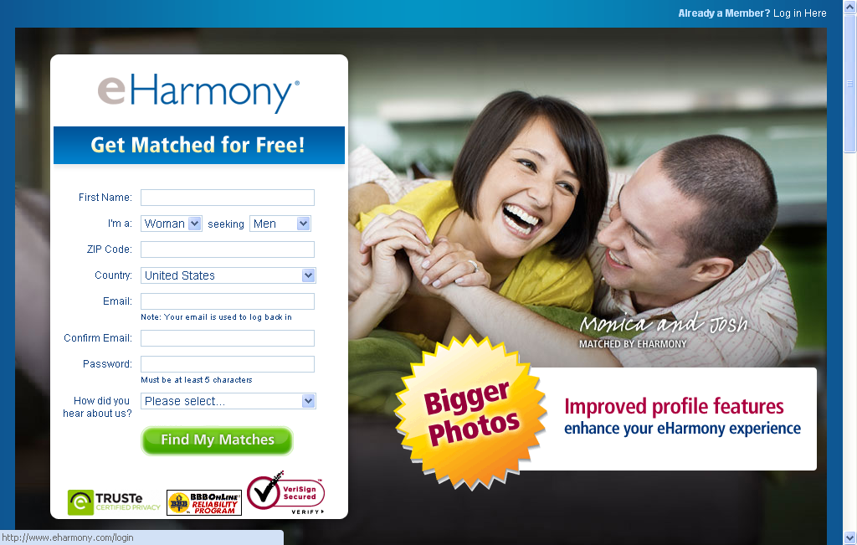

Slide 9
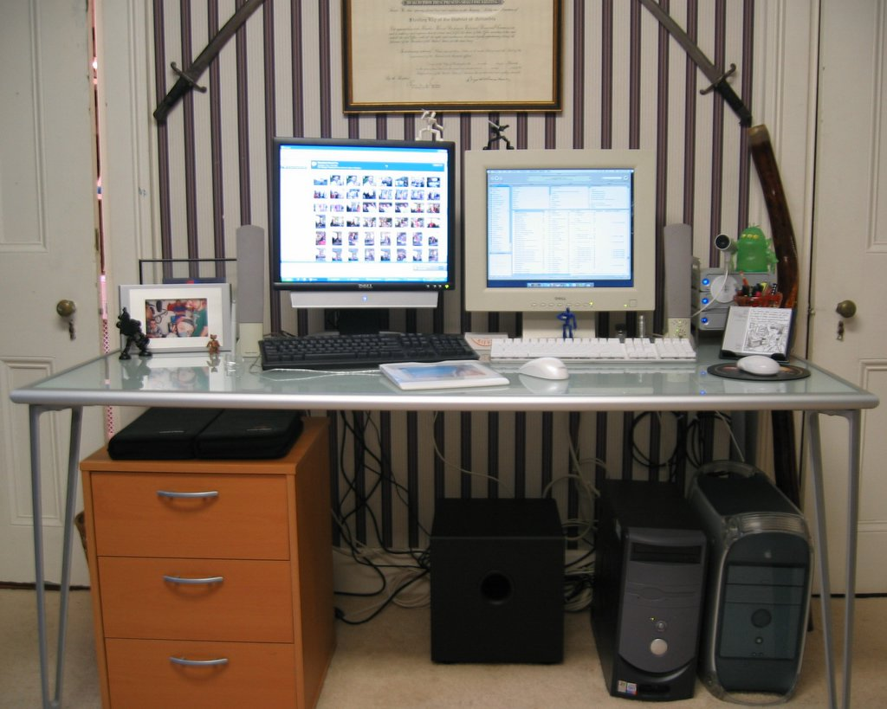

Slide 10


Slide 11


Slide 12
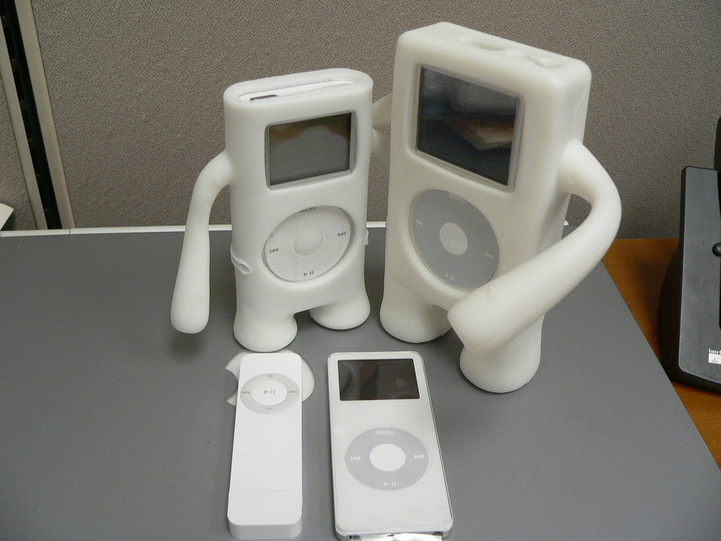

Slide 13
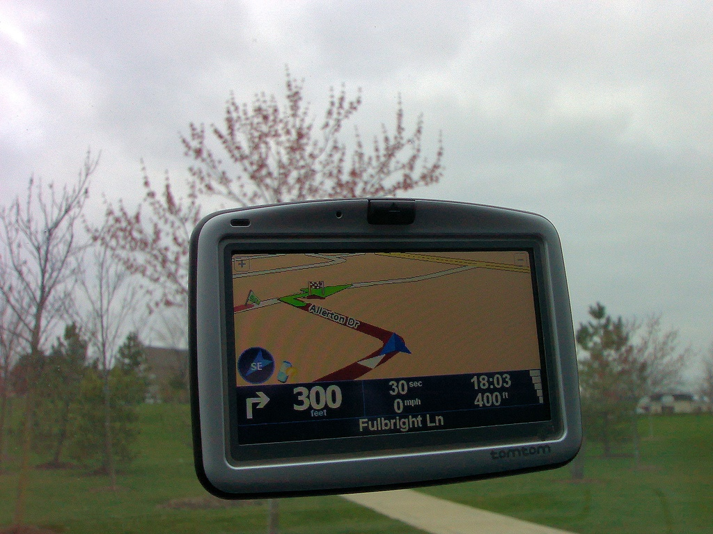

Slide 14
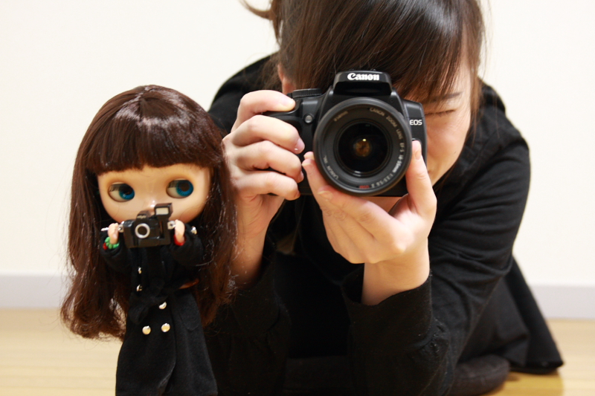

Slide 15
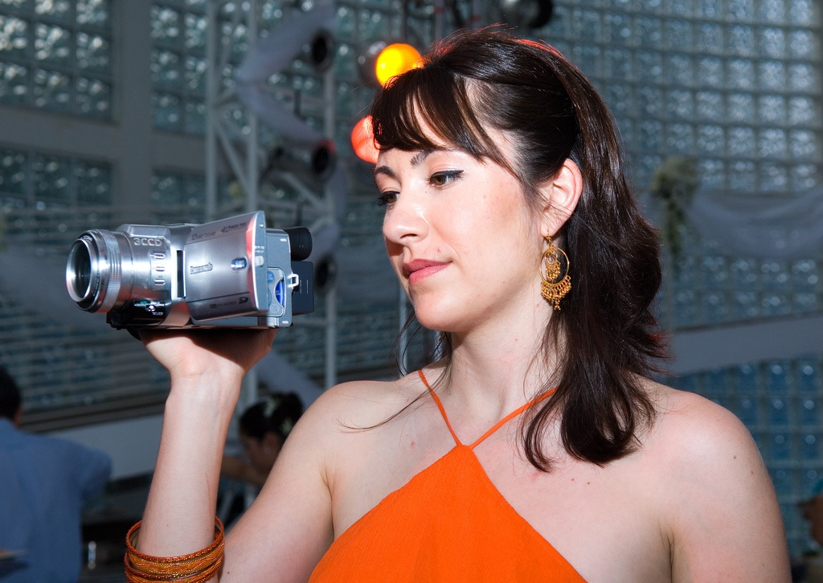

Slide 16
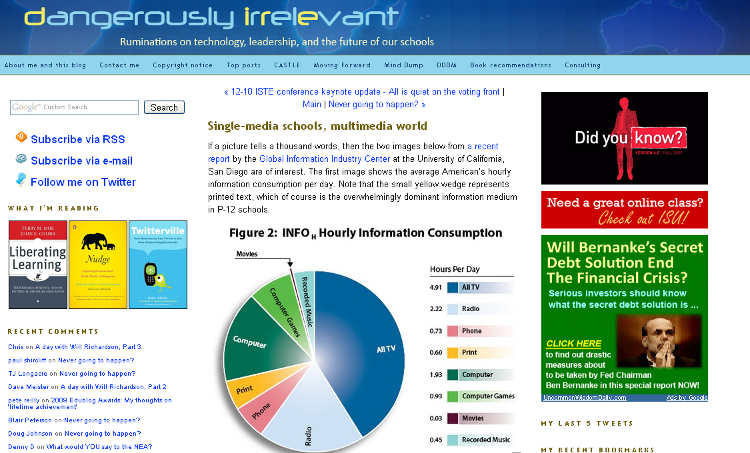

Slide 17
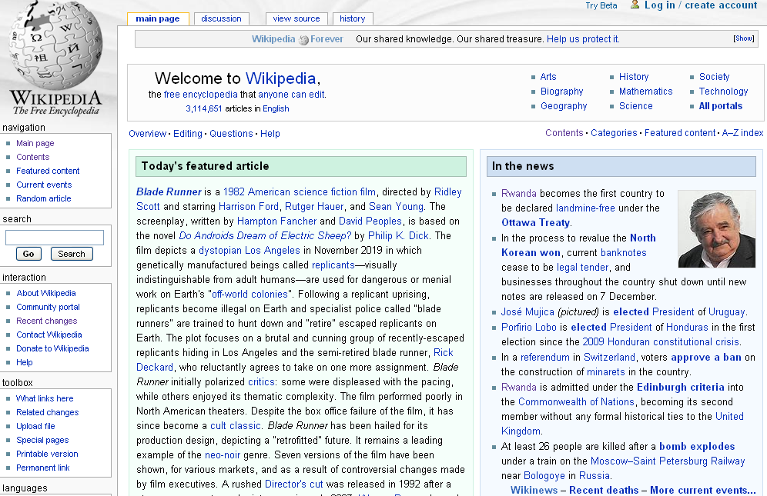

Slide 18
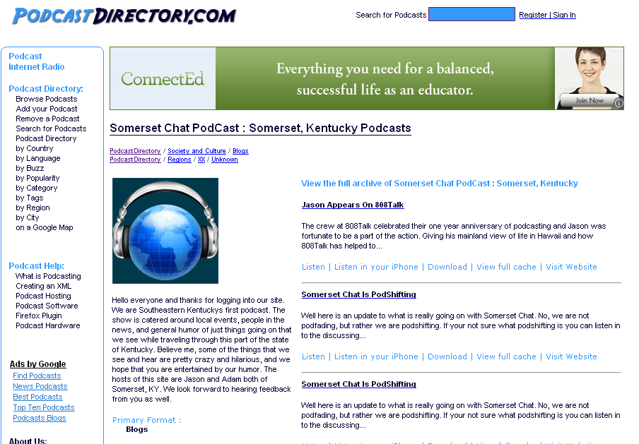

Slide 19
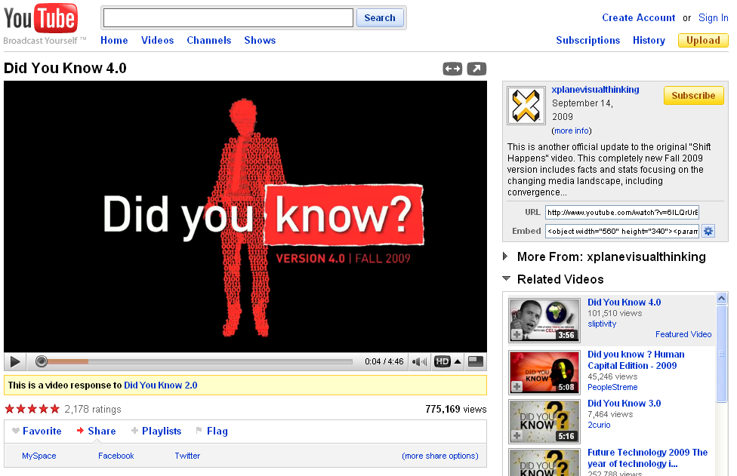

Slide 20
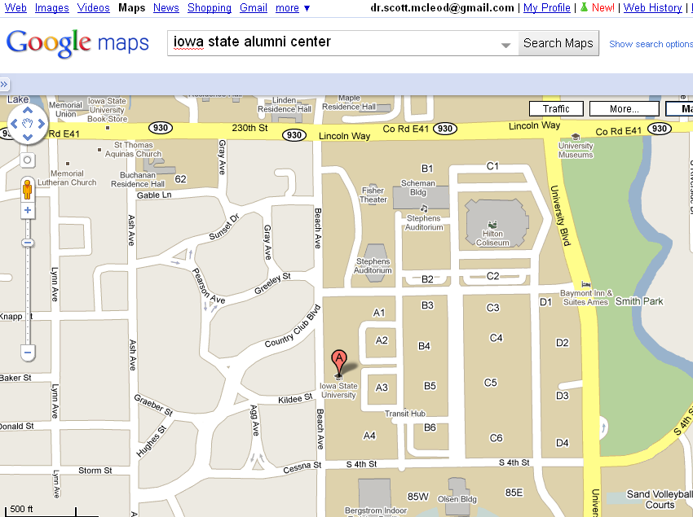

Slide 21
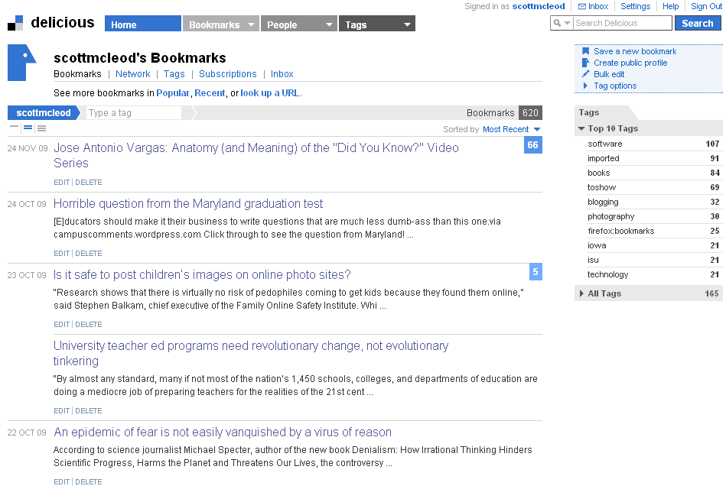

Slide 22
New information landscape

Slide 23


Slide 24
We are hyper-connected

Slide 25



Slide 26
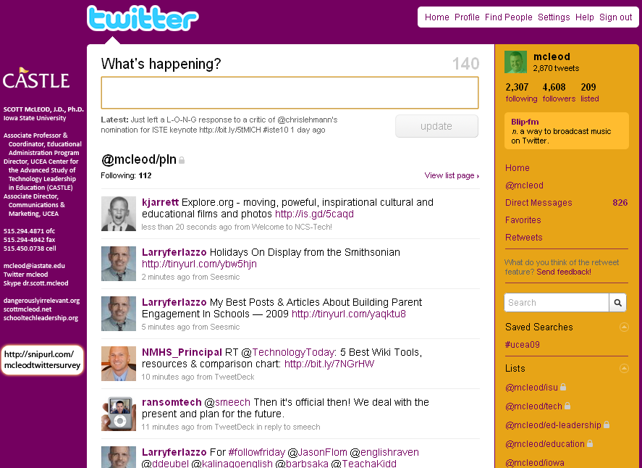

Slide 27
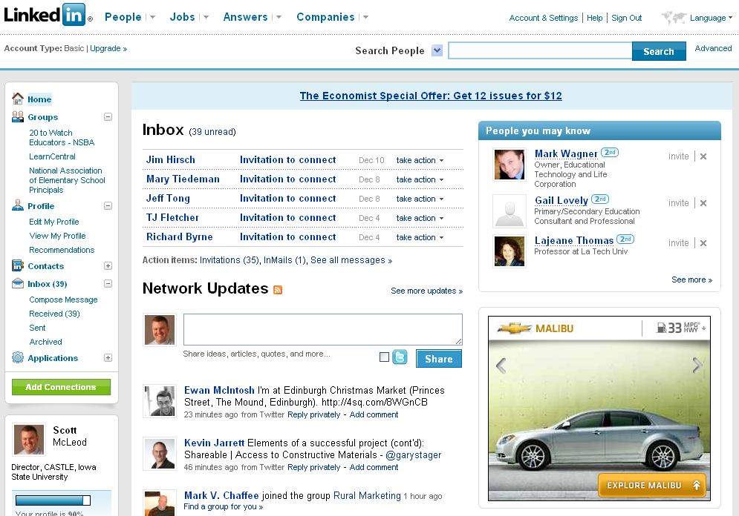

Slide 28
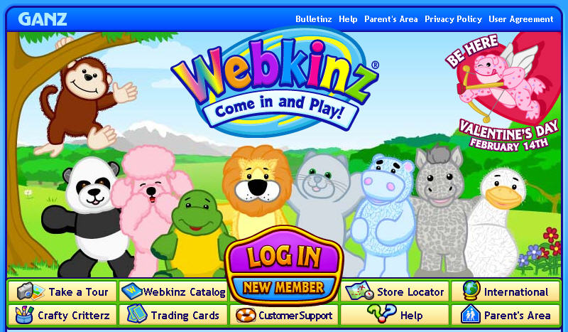

Slide 29
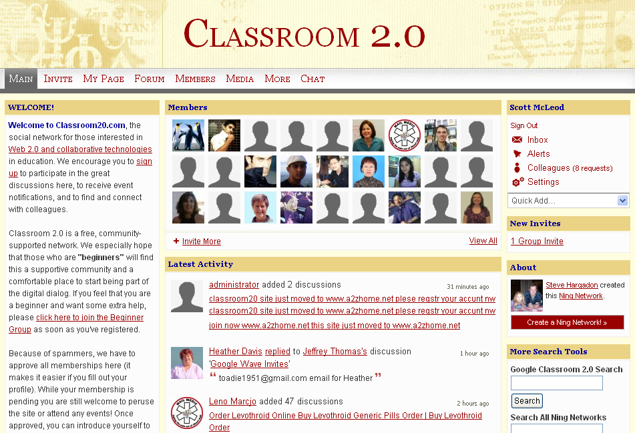

Slide 30
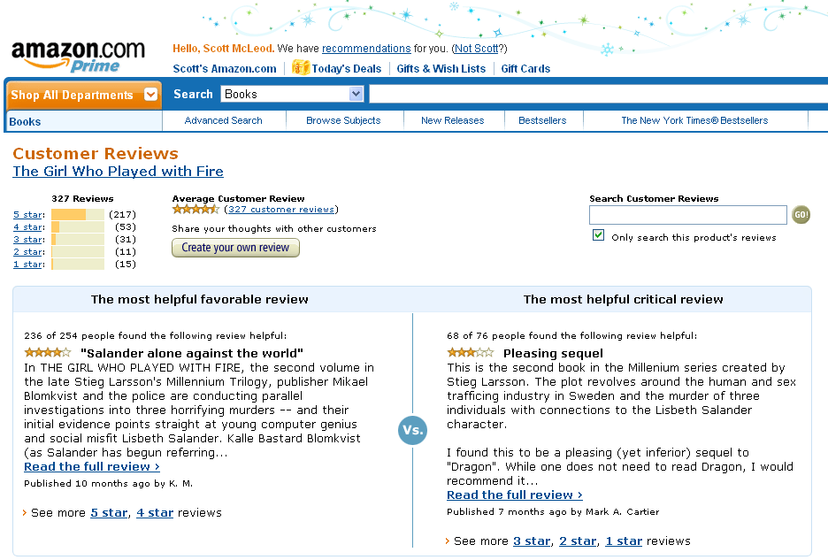

Slide 31
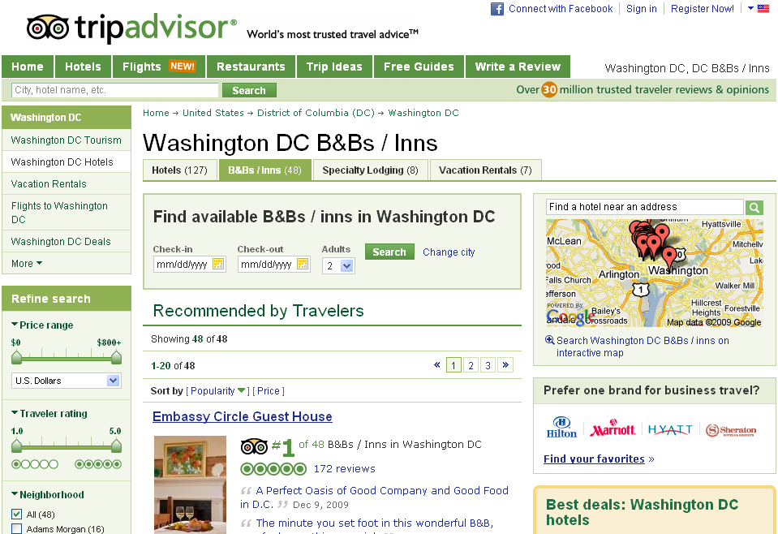

Slide 32
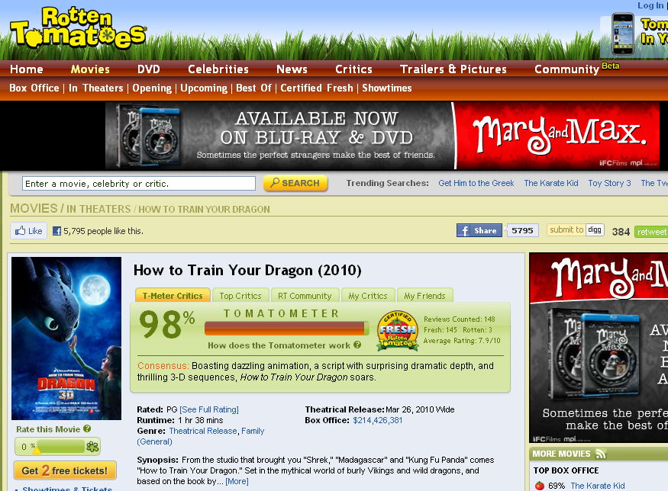

Slide 33
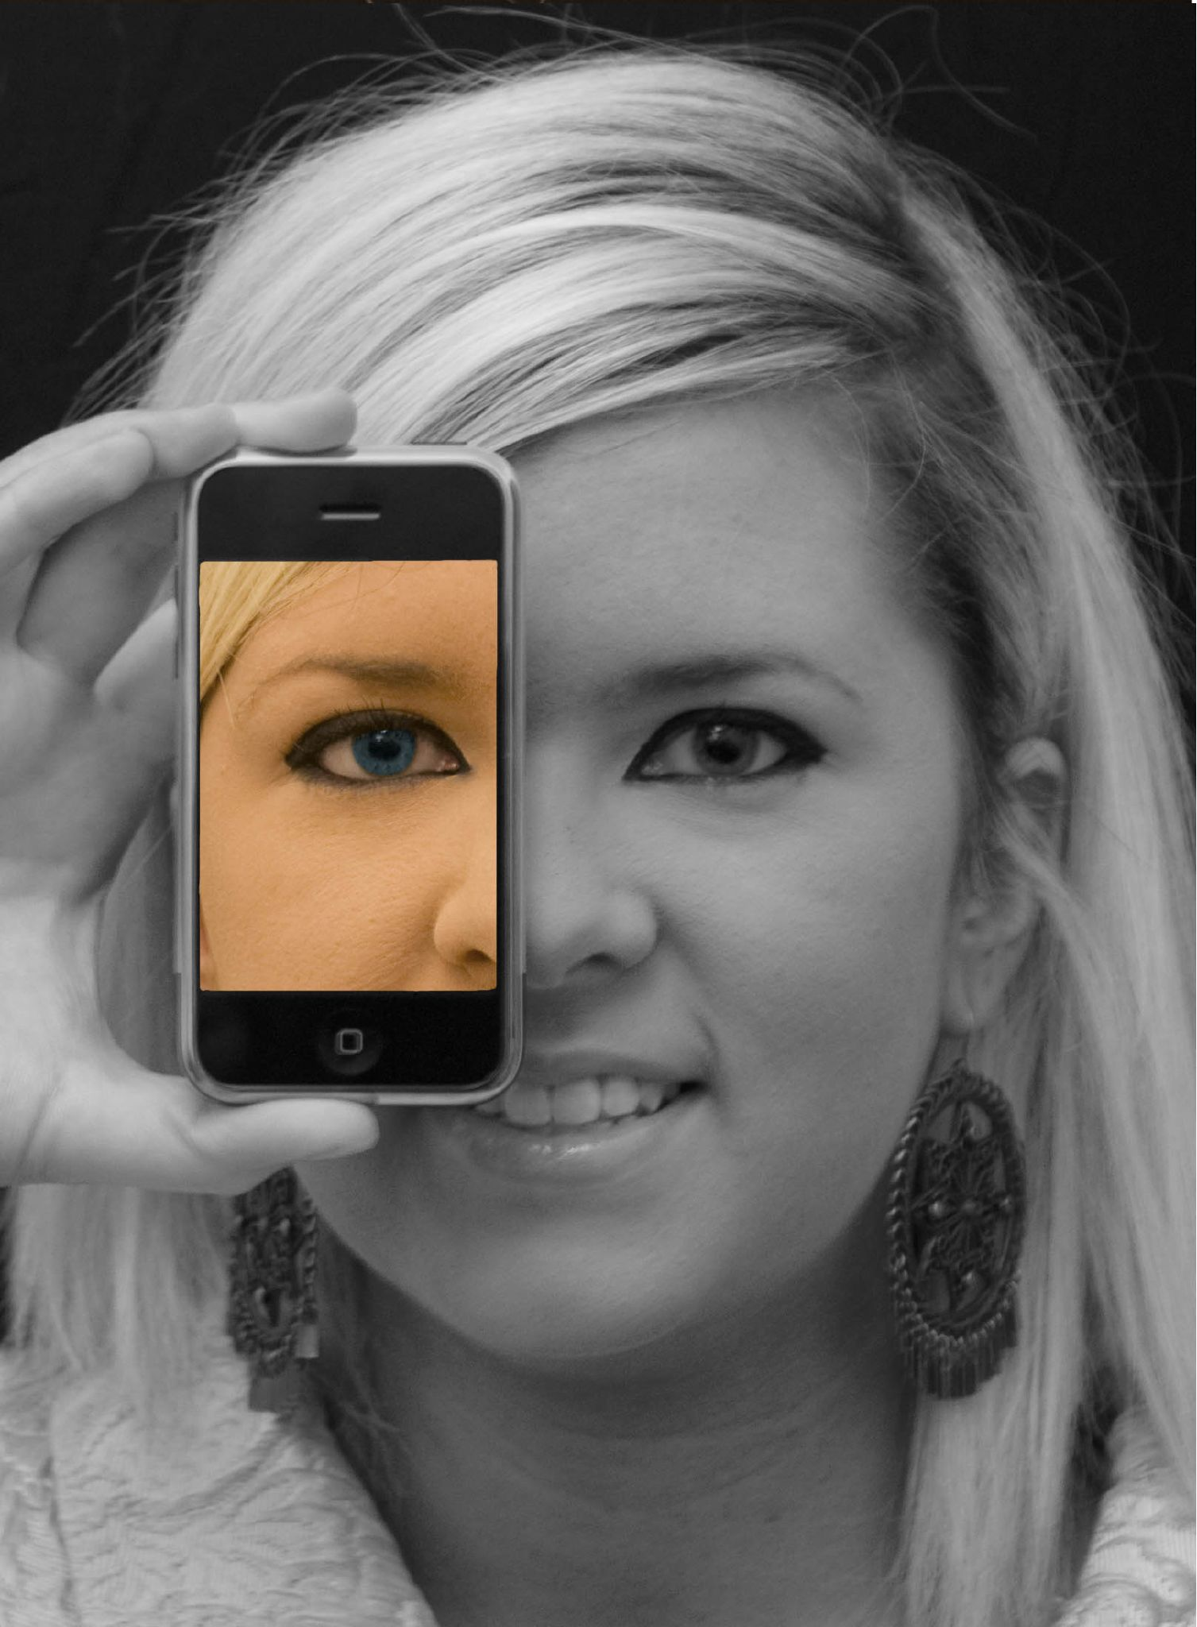

Slide 34
We all now have a voice
(and can find each other, share, connect, collaborate)

Slide 35
Anytime/anywhere content production, connection, collaboration…

Slide 36
How much are YOU living in this new information landscape?
(and, if you’re not, why not?)

Slide 37
The Web reduces friction

Slide 38
The long tail

Slide 39
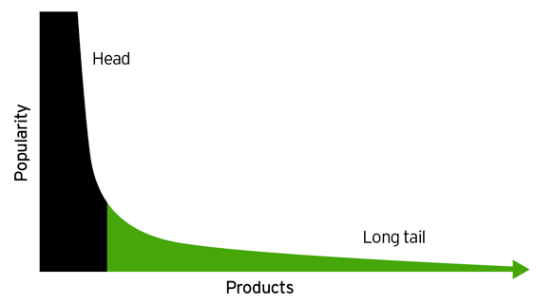
http://goo.gl/R6pd

Slide 40
“Other” is the leading brand

Slide 41
The Web enables abundance

Slide 42
Abundance of channels

Slide 43
Abundance of choices

Slide 44
The Web is egalitarian

Slide 45
Attention economy

Slide 46
Conversation follows quality

Slide 47
Being good is just the
“green fee”

Slide 48
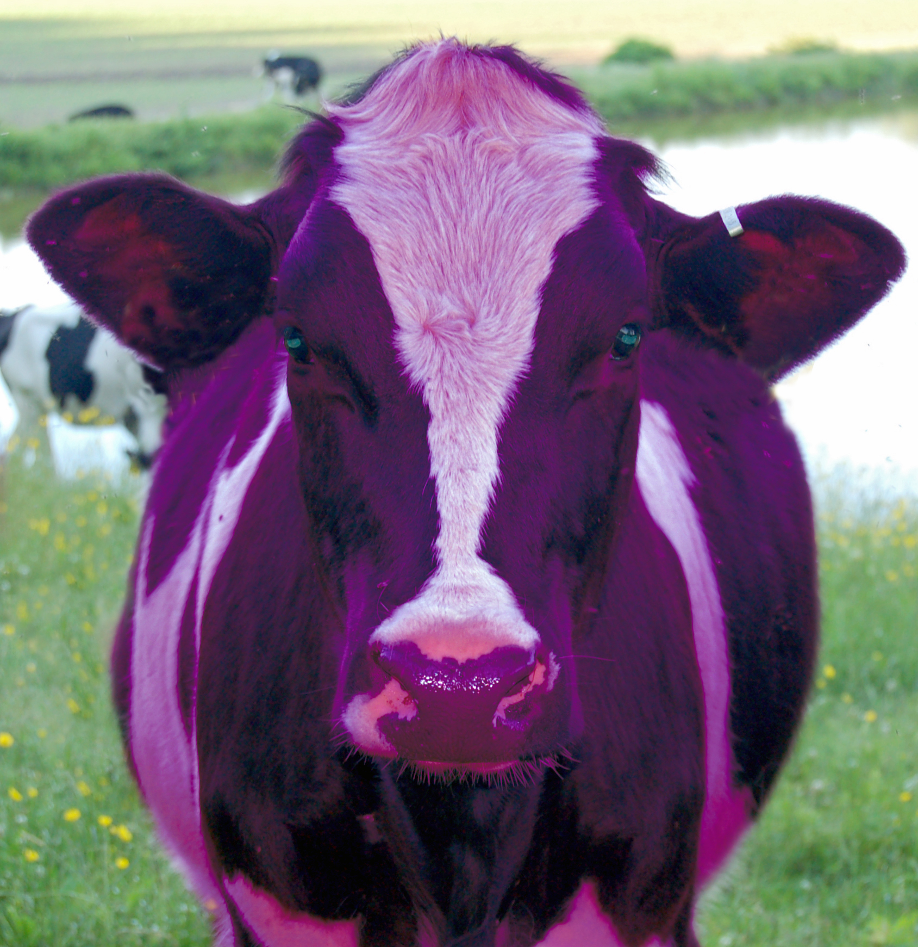
Product, pricing, promotion, and …
Notes:
the marketer’s sacred herd of P words

Slide 49
We are ALL marketers now

Slide 50
Eyeball voting

Slide 51
What are we doing that deserves their attention?
What’s our value proposition?
Are we remarkable?
Do they agree?

Slide 52

Notes:
Video: Social Media Revolution 2

Slide 53
What’s our social media strategy?
(do we know what we’re doing?)

Slide 54
open

Slide 55
more
transparent

Slide 56
more
accessible

Slide 57
more
convenient

Slide 58
more immediate /
real time

Slide 59
networked

Slide 60
connected

Slide 61
shared

Slide 62
collaborative

Slide 63
interactive

Slide 64
individualized

Slide 65
empowering

Slide 66
flexible

Slide 67
adaptive

Slide 68
less dependent
on ‘experts’

Slide 69
rapidly-changing

Slide 70
more
comprehensive

Slide 71
searchable

Slide 72
often ‘crowdsourced’

Slide 73
creative

Slide 74
multimodal /
multimedia

Slide 75
more efficient

Slide 76
often
less expensive

Slide 77
global

Slide 78
less dependent
on geography

Slide 79
less dependent
on physical media

Slide 80
technology-suffused

Slide 81
How are we intentionally, purposively incorporating these characteristics by design into what we do?
(do we know what we’re doing?)

Slide 82
The Web commodifies everything

Slide 83
WAY too many channels

Slide 84


Slide 85
We are all now
free range learners

Slide 86
If you’re a commodity,
you’re dead

Slide 87
If you’re unhelpful,
you’re ignored

Slide 88
If you’re invisible,
you’re irrelevant

Slide 89
Web site
E-mail
Facebook (#2)
YouTube (#3)
Twitter (#11)
LinkedIn (#28)
Flickr (#32)
Ning (#133)
Google (#1)

Slide 90
Web site
E-mail
Facebook (#2)
YouTube (#3)
Twitter (#11)
LinkedIn (#28)
Flickr (#32)
Ning (#133)
Google (#1)

Slide 91
Are we visible and findable
(in their spaces)?
Are we helpful
(in their eyes)?
(do we know what we’re doing?)
Notes:
Facebook?

Slide 92
Customers control the conversation

Slide 93
It’s not about you

Slide 94
It’s their
time / interest / community, not yours

Slide 95
Can’t buy trust

Slide 96
Can’t buy incoming links

Slide 97
Can’t buy attention

Slide 98
Can’t buy permission

Slide 99
When there are a billion information streams,
to whom do they turn?

Slide 100
They turn to trusted voices
who can give them
what they want

Slide 101
What do they want?
How do we build trust?

Slide 102
Information
and resources

Slide 103
Personalized / individualized

Slide 104
Interactivity

Slide 105
Relationship with us

Slide 106
Relationship with each other

Slide 107
To be valued

Slide 108
Things we can do

Slide 109
Listen

Slide 110
Be helpful

Slide 111
Harness their ideas

Slide 112
Leverage their knowledge

Slide 113
Give them opportunities
to interact and collaborate

Slide 114
Give our evangelists
a megaphone
[are we shareable?]

Slide 115
What’s our social media strategy?
(do we know what we’re doing?)

Slide 116
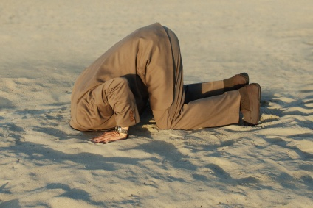
Notes:
116

Slide 117

CHANGE
OR DIE

Slide 118
How are we keeping ourselves informed and up-to-date?

Slide 119
Completely off-topic…

Slide 120
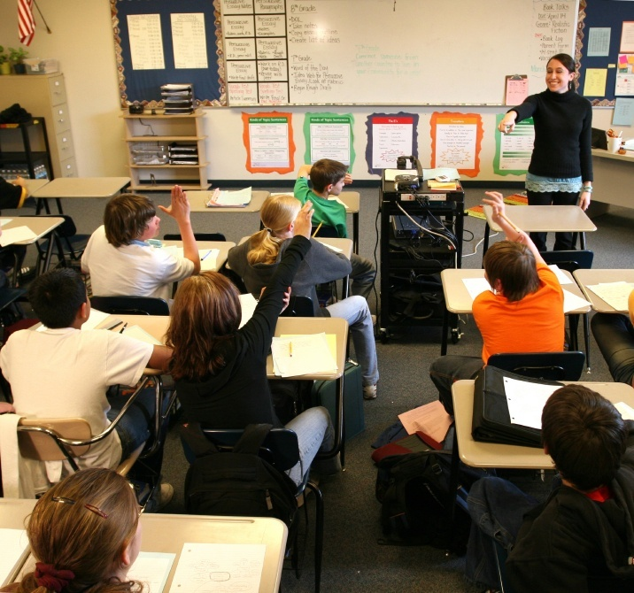
Notes:
120

Slide 121
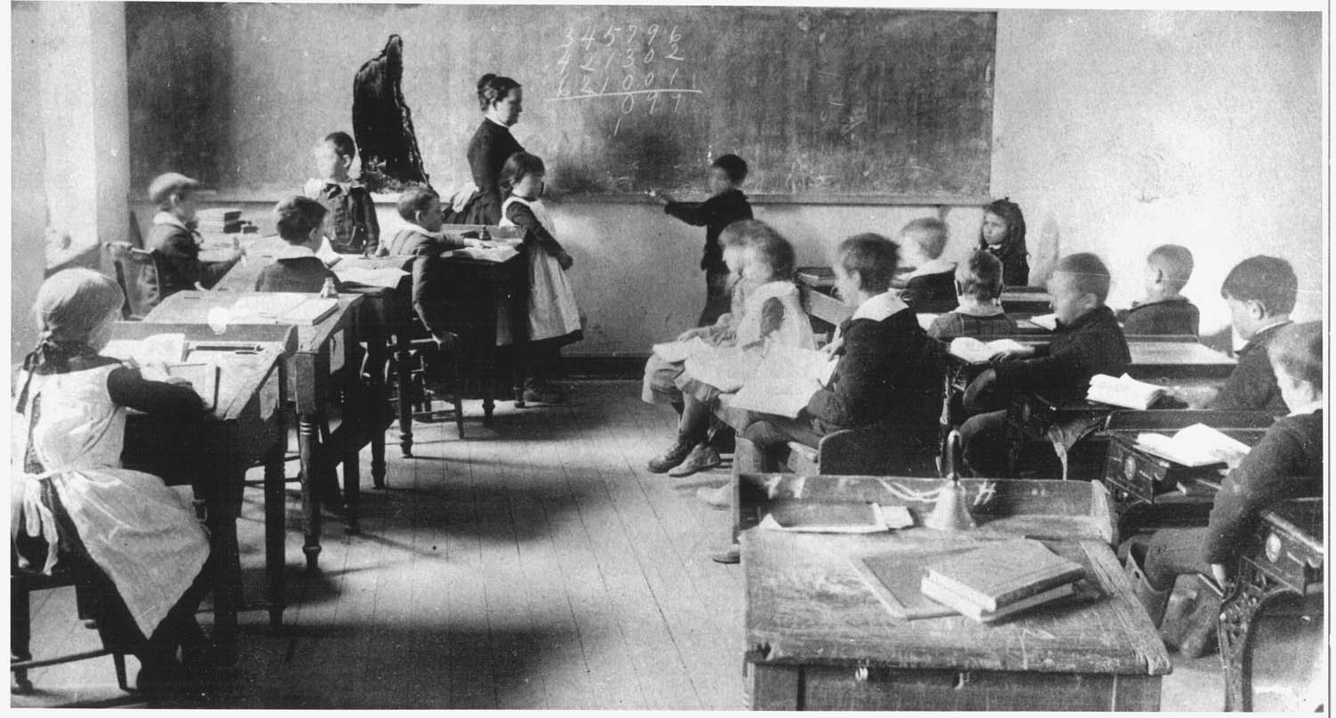
Notes:
121

Slide 122


Slide 123
THANK YOU!
dangerouslyirrelevant.org/
big12alumni

