Slide 1

Two big shifts
AND
One big problem
Dr. Scott McLeod
CASTLE
Notes:
All of my materials are licensed under a Creative Commons attribution-share alike license (http://creativecommons.org/licenses/by-sa/3.0). That means not only that you are welcome to share and/or remix my content but that you are encouraged to do so! All I ask is that you properly credit me for my content and that you not place any greater copyright restrictions than I have on the content that utilizes my material. If possible, including the URL of Dangerously Irrelevant in your content would be most appreciated.
Scott McLeod, J.D., Ph.D.
dangerouslyirrelevant.org
schooltechleadership.org
dangerouslyirrelevant.org/contact.html

Slide 2
Say hi to your neighbors!

Slide 3
#cpstt

Slide 4
  Societally functional
  Mastery of information landscape
  Economically productive

Slide 5
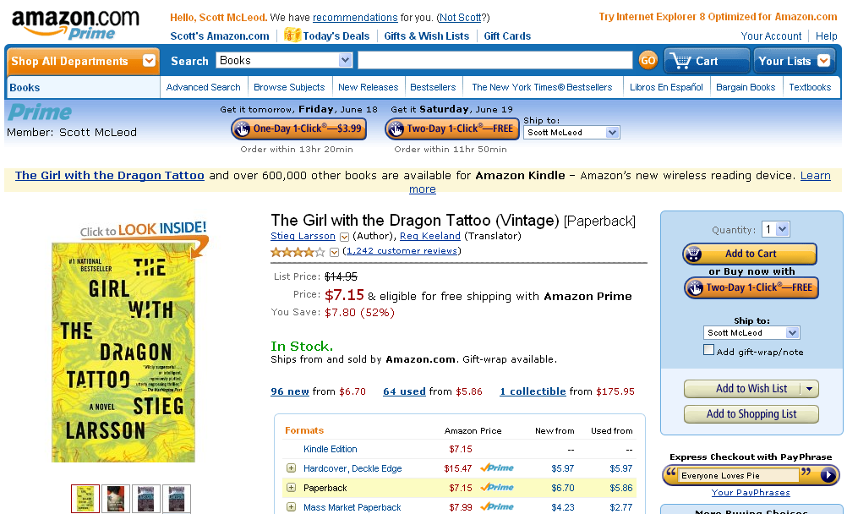

Slide 6
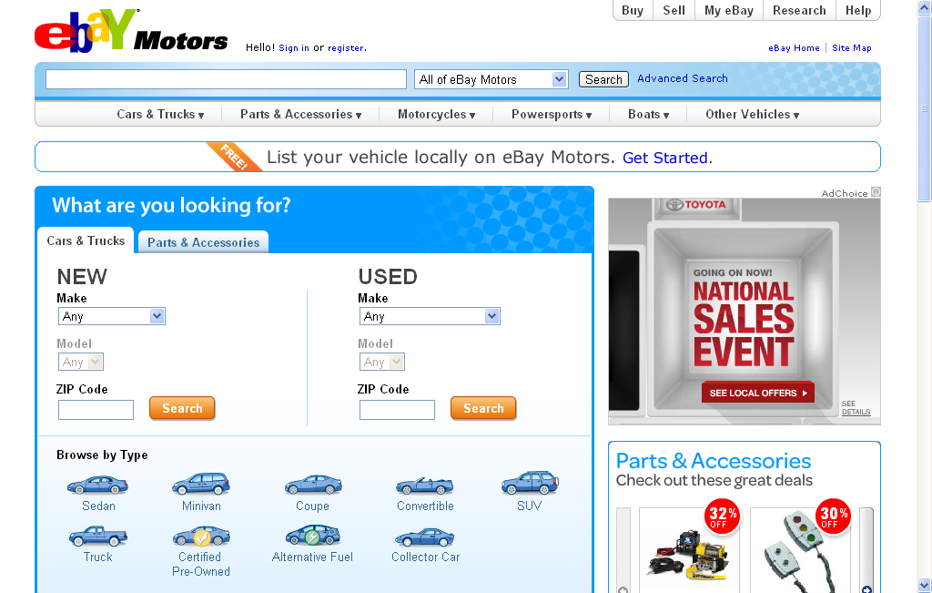

Slide 7


Slide 8


Slide 9


Slide 10


Slide 11


Slide 12


Slide 13


Slide 14


Slide 15


Slide 16


Slide 17


Slide 18


Slide 19


Slide 20


Slide 21


Slide 22


Slide 23


Slide 24
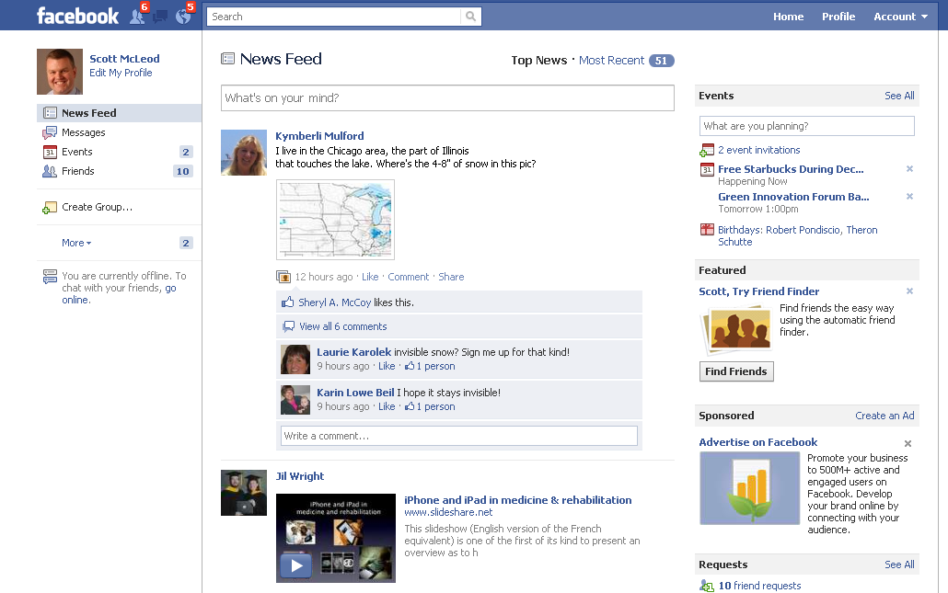

Slide 25


Slide 26


Slide 27


Slide 28


Slide 29


Slide 30


Slide 31
[ pause ]

Slide 32
0
0
5
4
3
2
1
0
0
9
8
7
6
5
4
3
2
1
0
9
8
7
6
5
4
3
2
1
0
9
8
7
6
5
4
3
2
1
0
9
8
7
6
5
4
3
2
1
0
9
8
7
6
5
4
3
2
1
0
9
8
7
6
5
4
3
2
1
0
0
2
0
1
Hours
Minutes
Seconds

Slide 33
0
0
5
4
3
2
1
0
0
9
8
7
6
5
4
3
2
1
0
9
8
7
6
5
4
3
2
1
0
9
8
7
6
5
4
3
2
1
0
9
8
7
6
5
4
3
2
1
0
9
8
7
6
5
4
3
2
1
0
9
8
7
6
5
4
3
2
1
0
0
1
0
0
Hours
Minutes
Seconds

Slide 34

CHANGE
OR DIE

Slide 35

Notes:
http://www.flickr.com/photos/deks/711658920/sizes/z/

Slide 36

Notes:
http://www.flickr.com/photos/13638129@N00/118245563/

Slide 37

Notes:
http://www.flickr.com/photos/sepblog/3527825643/sizes/o/

Slide 38

Notes:
http://www.flickr.com/photos/77136818@N00/3202144482/

Slide 39

Notes:
http://www.flickr.com/photos/7337467@N04/3052065204/

Slide 40

Notes:
http://www.flickr.com/photos/48973657@N00/4556156477/

Slide 41

Notes:
http://www.flickr.com/photos/20532289@N00/59083917/

Slide 42

Notes:
http://www.flickr.com/photos/88442983@N00/1604241264/

Slide 43

Notes:
http://www.flickr.com/photos/28473961@N02/4320982975/

Slide 44
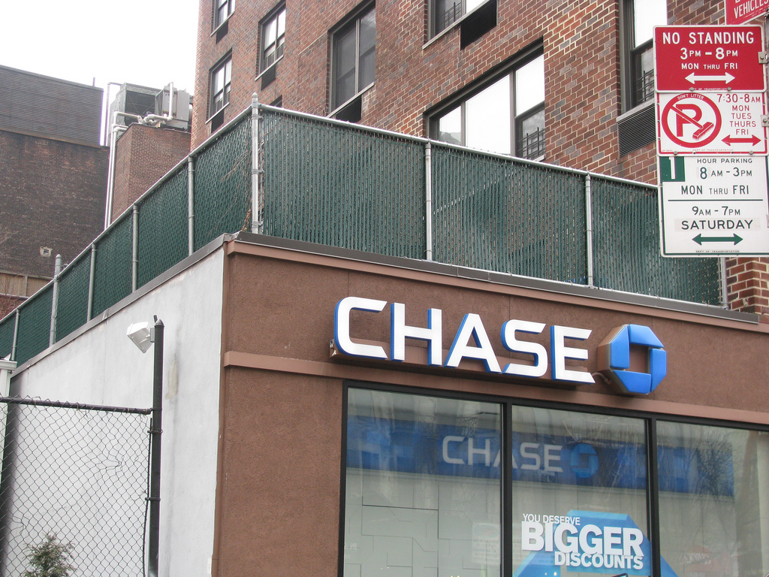
Notes:
http://www.flickr.com/photos/28473961@N02/3347811470/

Slide 45

Notes:
http://www.flickr.com/photos/26416016@N02/4479154715/

Slide 46

Notes:
http://www.flickr.com/photos/40645538@N00/4004791663/

Slide 47

Notes:
http://www.flickr.com/photos/9031691@N08/2670224692/

Slide 48

Notes:
http://www.flickr.com/photos/28473961@N02/2757755401/

Slide 49
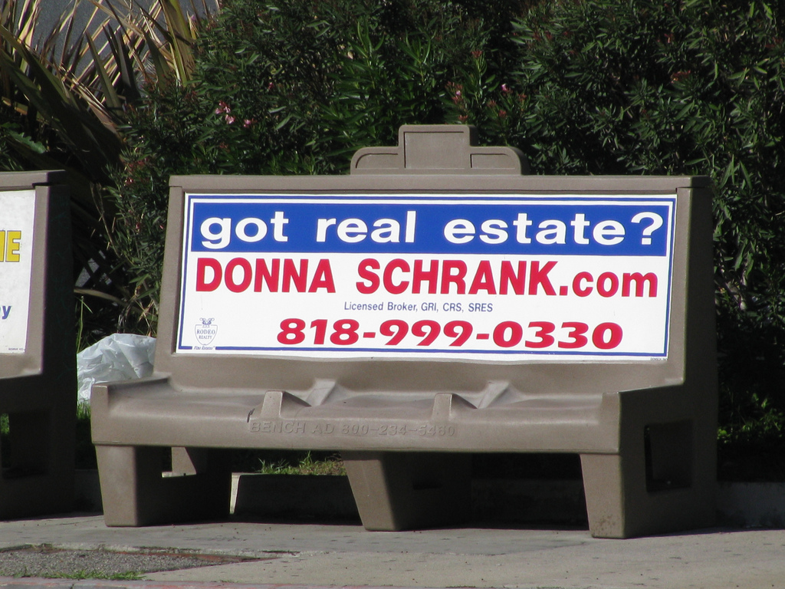
Notes:
http://www.flickr.com/photos/28473961@N02/3229296247/

Slide 50

Notes:
http://www.flickr.com/photos/28567825@N03/5129325457/

Slide 51

Notes:
http://www.flickr.com/photos/47477979@N00/2453748088/

Slide 52

Notes:
http://www.flickr.com/photos/30624156@N00/4820259304/

Slide 53
CHANGE
OR DIE

Slide 54
Percentile change in
importance of task type
in U.S. economy
Abstract
Routine
Manual
Autor, D., Levy, F., & Murnane, R. J. (2003). The skill content of recent technological change:
An empirical exploration. Quarterly Journal of Economics 188, 4. [updated, D. Autor, 2008]

Slide 55
global awareness
effective speaking
critical thinking
problem solving
adaptability
information literacy
collaboration
creativity
media fluency
analytical skills
entrepeneurialism
innovation
effective writing
synthesis
curiosity

Slide 56
Florida, R. (2002). The rise of the creative class (p. 332). New York, NY: Basic Books.

Slide 57
  Can someone overseas
  do it cheaper?
  Can a computer
  do it faster?

Slide 58


Slide 59


Slide 60
2.5 billion

Slide 61


Slide 62
[ pause ]

Slide 63
0
0
5
4
3
2
1
0
0
9
8
7
6
5
4
3
2
1
0
9
8
7
6
5
4
3
2
1
0
9
8
7
6
5
4
3
2
1
0
9
8
7
6
5
4
3
2
1
0
9
8
7
6
5
4
3
2
1
0
9
8
7
6
5
4
3
2
1
0
0
2
0
1
Hours
Minutes
Seconds

Slide 64
0
0
5
4
3
2
1
0
0
9
8
7
6
5
4
3
2
1
0
9
8
7
6
5
4
3
2
1
0
9
8
7
6
5
4
3
2
1
0
9
8
7
6
5
4
3
2
1
0
9
8
7
6
5
4
3
2
1
0
9
8
7
6
5
4
3
2
1
0
0
1
0
0
Hours
Minutes
Seconds

Slide 65
  Societally functional
  Mastery of information landscape
  Economically productive

Slide 66

Notes:
66

Slide 67
The fundamental dilemma
but now are
expected to
do this
Schools were
designed
for this …

Slide 68
What we have right now
uniqueness
uniqueness
one right answer
Notes:
68

Slide 69

Notes:
THIS SLIDE IS COPYRIGHT-PROTECTED. I GOT SPECIAL PERMISSION FROM THE CARTOONIST, TONY CARRILLO, TO USE IT.
69

Slide 70


Slide 71

Notes:
71

Slide 72

Notes:
72

Slide 73

Notes:
For the past five years, the national conversation on education has focused on reading scores, math tests and closing the "achievement gap" between social classes. This is not a story about that conversation.
This is a story about the big public conversation the nation is not having about education, the one that will ultimately determine not merely whether some fraction of our children get "left behind" but also whether an entire generation of kids will fail to make the grade in the global economy because they can't think their way through abstract problems, work in teams, distinguish good information from bad or speak a language other than English.

Slide 74

While we teach whatever we teach at school, the kids go home and learn the skills they need to survive and prosper in an interconnected global economy.
Clarence Fisher
Notes:
As a result…
http://remoteaccess.typepad.com/remote_access/2005/11/educational_lea.html
Incrementally changing our teaching methods, slowly bringing people up to speed . . . worked fine when ideas of literacy and education were not rapidly changing; but they are. We need to be able to leapfrog in our understandings, in our methods, and in our tools, allowing us to move to where the kids are. If we do not become leaders to our students, we will be followers, seen as irrelevant, and left to cry in our books.

Slide 75

No generation in history has ever been so
thoroughly prepared for the industrial age.
David Warlick
http://davidwarlick.com/2cents/?p=298
dangerouslyirrelevant.org

Slide 76
0
0
5
4
3
2
1
0
0
9
8
7
6
5
4
3
2
1
0
9
8
7
6
5
4
3
2
1
0
9
8
7
6
5
4
3
2
1
0
9
8
7
6
5
4
3
2
1
0
9
8
7
6
5
4
3
2
1
0
9
8
7
6
5
4
3
2
1
0
0
2
0
1
Hours
Minutes
Seconds

Slide 77
0
0
5
4
3
2
1
0
0
9
8
7
6
5
4
3
2
1
0
9
8
7
6
5
4
3
2
1
0
9
8
7
6
5
4
3
2
1
0
9
8
7
6
5
4
3
2
1
0
9
8
7
6
5
4
3
2
1
0
9
8
7
6
5
4
3
2
1
0
0
1
0
0
Hours
Minutes
Seconds

Slide 78

Notes:
http://www.flickr.com/photos/38765959@N00/2579097926/

Slide 79


Slide 80


Slide 81


Slide 82

Notes:
We need to somehow
change faster
No one jumps a 20 foot chasm in two
10 foot jumps. – Miguel Guhlin
When the world changes so fast that we have no reasonable way to forecast what it will look like in a mere decade or two, all we can do is teach kids how to be adaptive – to be learners in the truest sense of the word –
We’ve always talked about preparing lifelong learners in schools, but our practices typically haven’t matched our rhetoric. It’s time to put some bite into our toothless vision statements and recognize that we have to teach kids how to learn to learn if they want to be successful in this new technology-suffused, globally-interconnected world
Credits: http://tinyurl.com/2urbsm and http://tinyurl.com/37em64 (see Guhlin comment)
http://remoteaccess.typepad.com/remote_access/
2006/06/literacy_as_bat.html (see Guhlin comment)
http://headrush.typepad.com/creating_passionate_users/2005/03/incremental_vs_.html

Slide 83

Notes:
Anticipatory v. reactionary

Slide 84

Notes:
Future oriented v. compliance oriented

Slide 85
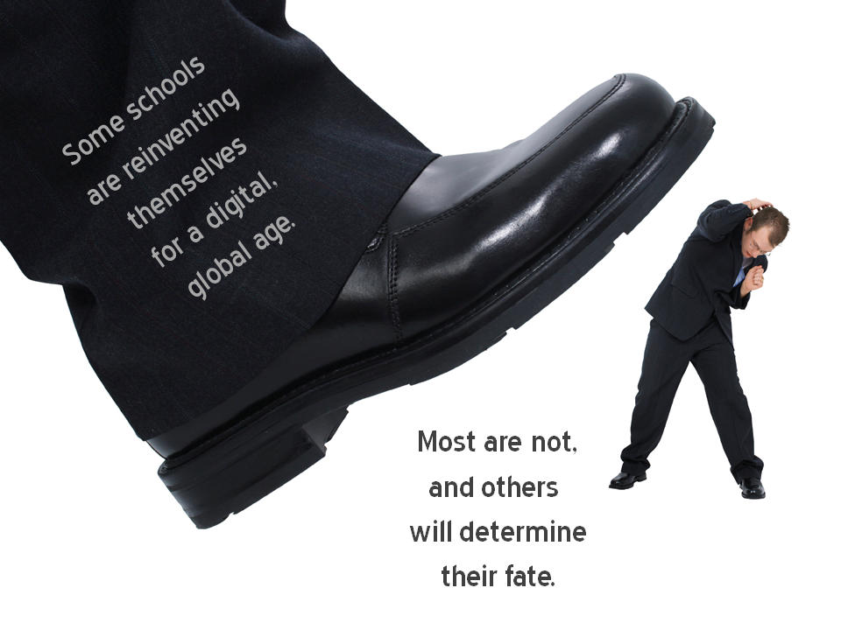
Notes:
Licensed under a Creative Commons attribution-share alike license.
http://creativecommons.org/licenses/by-sa/3.0
Scott McLeod, J.D., Ph.D.
dangerouslyirrelevant.org
schooltechleadership.org
dangerouslyirrelevant.org/contact.html

Slide 86


Slide 87
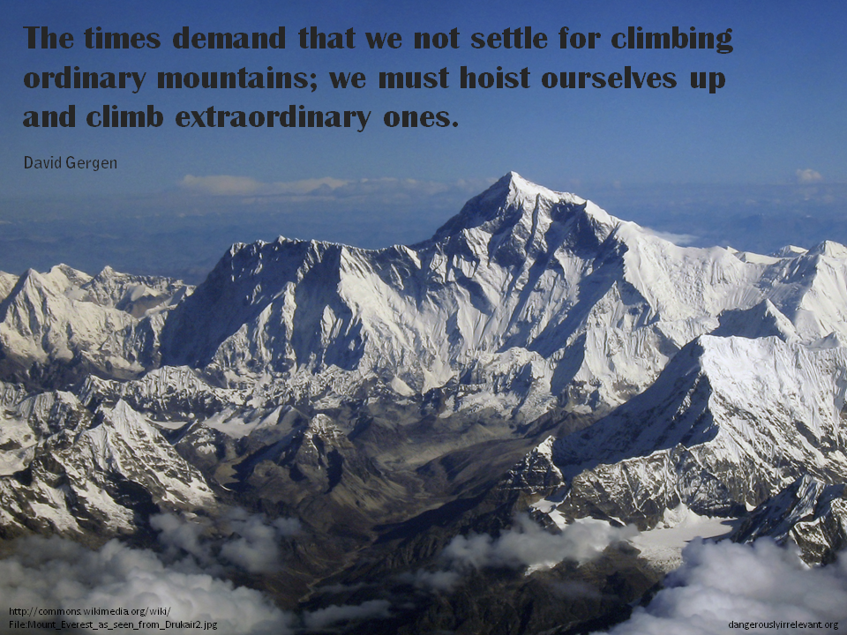

Slide 88

The people in charge
of leading school
organizations into the
21st century …
often are the
least knowledgeable
about the 21st century.
dangerouslyirrelevant.org
Notes:
Licensed under a Creative Commons attribution-share alike license.
http://creativecommons.org/licenses/by-sa/3.0
Scott McLeod, J.D., Ph.D.
scottmcleod.net/contact
dangerouslyirrelevant.org
schooltechleadership.org

Slide 89

If the leaders
don’t get it,
it’s not going
to happen.
dangerouslyirrelevant.org
Notes:
Licensed under a Creative Commons attribution-share alike license.
http://creativecommons.org/licenses/by-sa/3.0
Scott McLeod, J.D., Ph.D.
scottmcleod.net/contact
dangerouslyirrelevant.org
schooltechleadership.org

Slide 90


Slide 91

No one will thank you
for taking care of today
if you have failed
to take care of tomorrow.
Joel Barker

Slide 92

Notes:
92

Slide 93
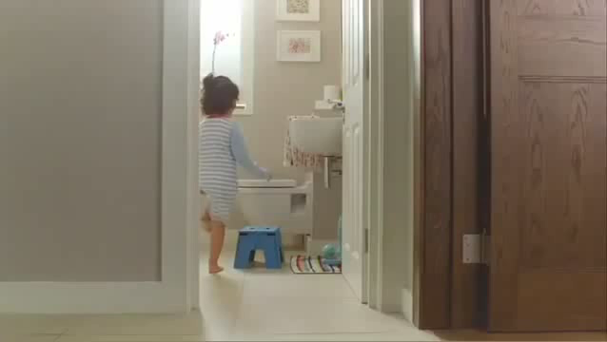

Slide 94
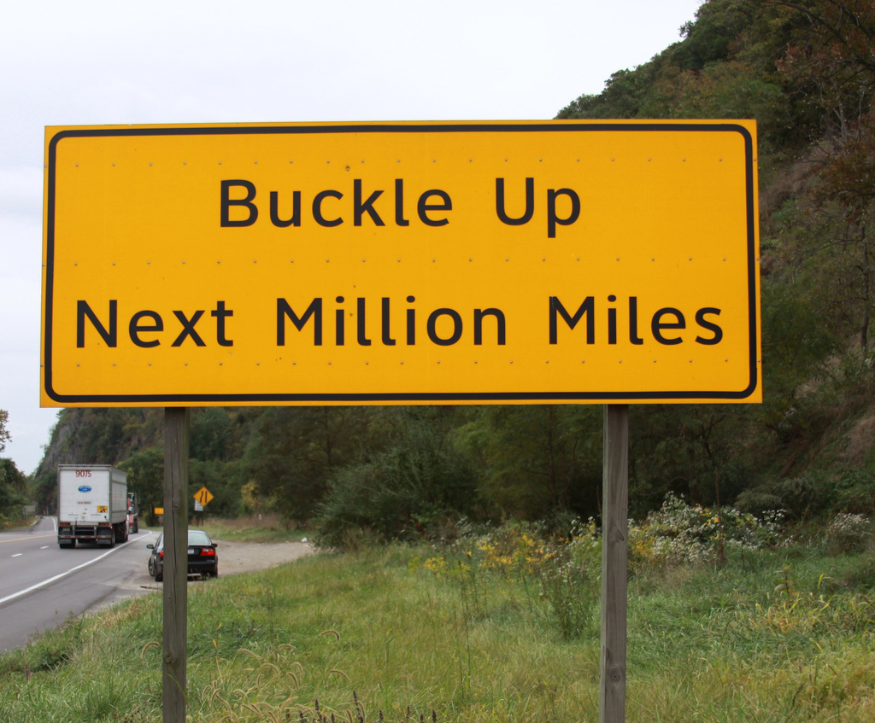

Slide 95
Thank you!
Scott McLeod, J.D., Ph.D.
Director, CASTLE
scottmcleod.net/chicago
Notes:
95
All of my materials are licensed under a Creative Commons attribution-share alike license (http://creativecommons.org/licenses/by-sa/3.0). That means not only that you are welcome to share and/or remix my content but that you are encouraged to do so! All I ask is that you properly credit me for my content and that you not place any greater copyright restrictions than I have on the content that utilizes my material. If possible, including the URL of Dangerously Irrelevant in your content would be most appreciated.
Scott McLeod, J.D., Ph.D.
dangerouslyirrelevant.org
schooltechleadership.org
dangerouslyirrelevant.org/contact.html

