Slide 1
Preparing students for what is and will be,
NOT what was
Dr. Scott McLeod
CASTLE
Notes:
All of my materials are licensed under a Creative Commons attribution-share alike license (http://creativecommons.org/licenses/by-sa/3.0). That means not only that you are welcome to share and/or remix my content but that you are encouraged to do so! All I ask is that you properly credit me for my content and that you not place any greater copyright restrictions than I have on the content that utilizes my material. If possible, including the URL of Dangerously Irrelevant in your content would be most appreciated.
Scott McLeod, J.D., Ph.D.
dangerouslyirrelevant.org
schooltechleadership.org
dangerouslyirrelevant.org/contact.html

Slide 2
Say hi to your neighbors!

Slide 3
Socially functional
Mastery of information landscape
Economically productive

Slide 4
New information landscape

Slide 7
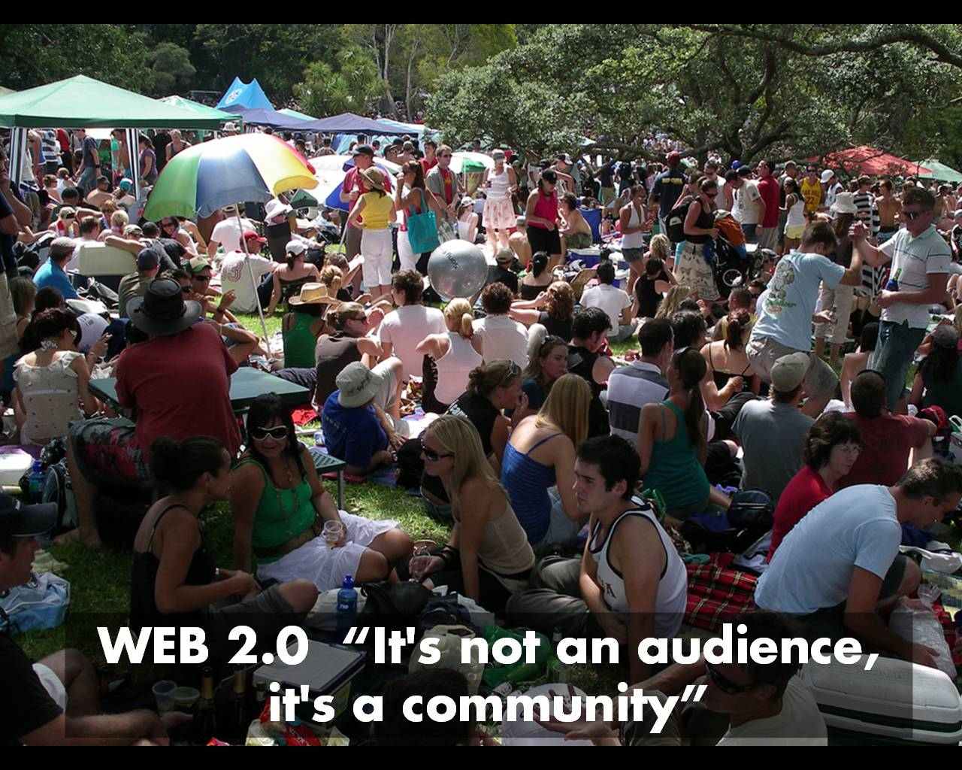

Slide 8
We are hyper-connected

Slide 10
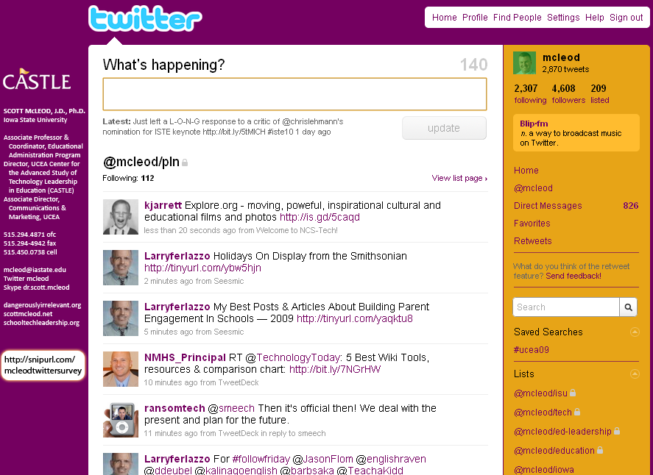

Slide 11
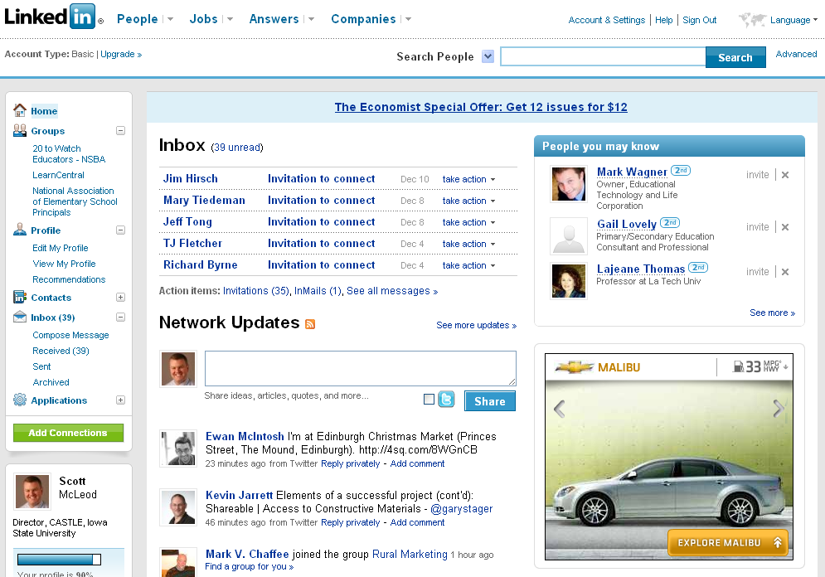

Slide 13
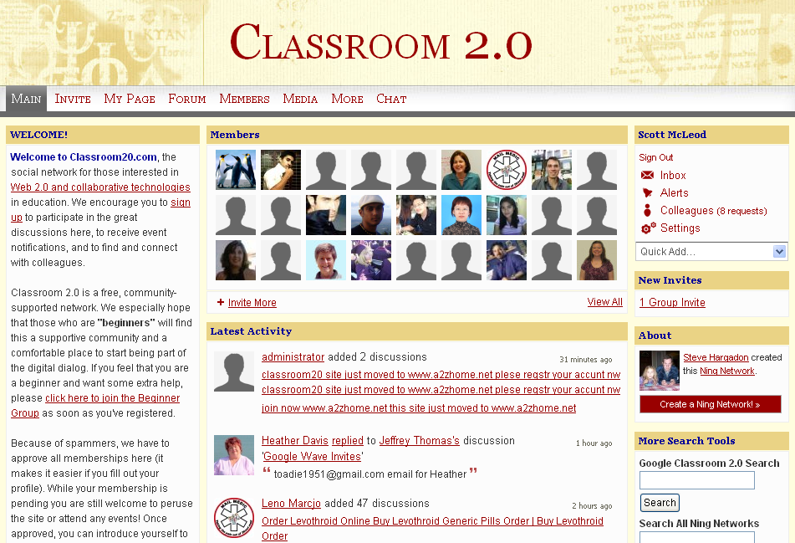

Slide 16
[ pause ]

Slide 17
120 119 118 117 116 115 114 113 112 111
110 109 108 107 106 105 104 103 102 101
100 99 98 97 96 95 94 93 92 91
90 89 88 87 86 85 84 83 82 81
80 79 78 77 76 75 74 73 72 71
70 69 68 67 66 65 64 63 62 61
60

Slide 18
60 59 58 57 56 55 54 53 52 51
50 49 48 47 46 45 44 43 42 41
40 39 38 37 36 35 34 33 32 31
30 29 28 27 26 25 24 23 22 21
20 19 18 17 16 15 14 13 12 11
10 9 8 7 6 5 4 3 2 1

Slide 19
CHANGE
OR DIE

Slide 20
newspapers,
magazines

Slide 21
music

Slide 22
radio

Slide 23
television

Slide 24
movies

Slide 25
books,
reading

Slide 26
maps, travel,
travel agencies

Slide 27
business,
personal finance,
money management

Slide 28
medicine,
health

Slide 29
postal service

Slide 30
real estate

Slide 31
politics

Slide 32
universities

Slide 33
Information-oriented

Slide 34
P-12
schools

Slide 35
CHANGE
OR DIE

Slide 36
Percentile change in importance of task type in U.S. economy
Abstract
Routine
Manual
Autor, D., Levy, F., & Murnane, R. J. (2003). The skill content of recent technological change: An empirical exploration. Quarterly Journal of Economics 188, 4. [updated, D. Autor, 2008]

Slide 37
global awareness
effective speaking
critical thinking
problem solving
adaptability
information literacy
collaboration
creativity
media fluency
analytical skills
entrepeneurialism
innovation
effective writing
synthesis
curiosity

Slide 38
Growth of the creative class
Florida, R. (2002). The rise of the creative class (p. 332). New York, NY: Basic Books.

Slide 39
Growth of the creative class
Florida, R. (2002). The rise of the creative class (p. 332). New York, NY: Basic Books.

Slide 40
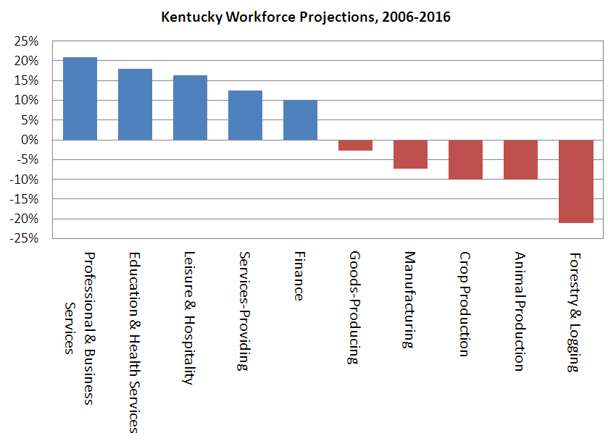

Slide 42
Globalization of economy

Slide 43
Can someone overseas do it cheaper?
Can a computer do it faster?

Slide 45
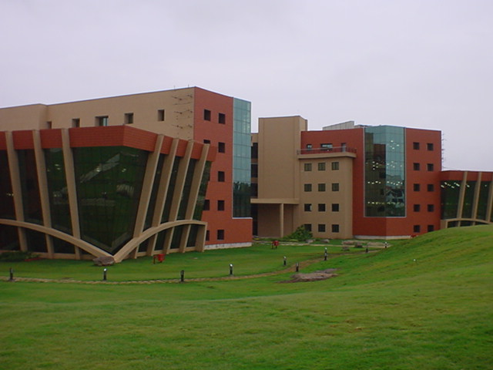

Slide 46
2.5 billion

Slide 47
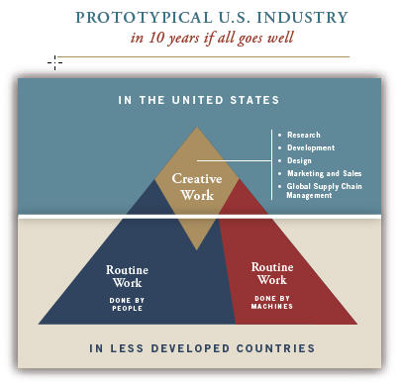

Slide 48
[ pause ]

Slide 49
120 119 118 117 116 115 114 113 112 111
110 109 108 107 106 105 104 103 102 101
100 99 98 97 96 95 94 93 92 91
90 89 88 87 86 85 84 83 82 81
80 79 78 77 76 75 74 73 72 71
70 69 68 67 66 65 64 63 62 61
60

Slide 50
60 59 58 57 56 55 54 53 52 51
50 49 48 47 46 45 44 43 42 41
40 39 38 37 36 35 34 33 32 31
30 29 28 27 26 25 24 23 22 21
20 19 18 17 16 15 14 13 12 11
10 9 8 7 6 5 4 3 2 1

Slide 51
Socially functional
Mastery of information landscape
Economically productive

Slide 52
Notes:
52

Slide 53
The fundamental dilemma
but now are expected to
do this
Schools were designed for this …

Slide 54
What we have right now
uniqueness
uniqueness
one right answer
Notes:
54

Slide 55
Notes:
THIS SLIDE IS COPYRIGHT-PROTECTED. I GOT SPECIAL PERMISSION FROM THE CARTOONIST, TONY CARRILLO, TO USE IT.
55

Slide 56
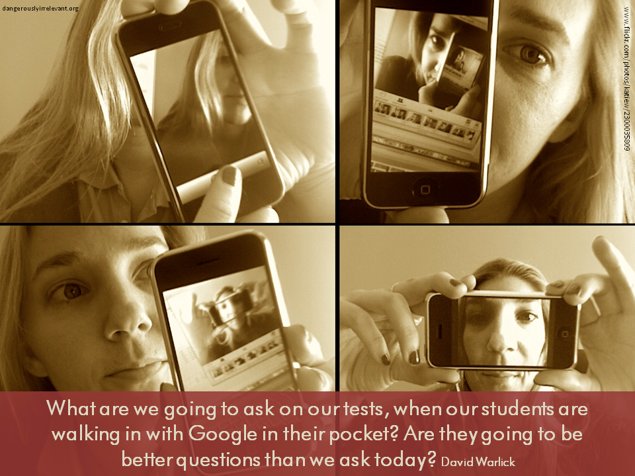

Slide 57
Notes:
57

Slide 58
Notes:
58

Slide 59
The chief source of the “problem of discipline” in schools is that … a premium is put on physical quietude; on silence, on rigid uniformity of posture and movement; upon a machine-like simulation of the attitudes of intelligent interest. The teachers’ business is to hold the pupils up to these requirements and to punish the inevitable deviations which occur.
John Dewey, Democracy and Education (1916)

Slide 60
Once you have learned how to ask questions – relevant and appropriate and substantial questions – you have learned how to learn and no one can keep you from learning whatever you want or need to know . . . [However,] what students are restricted to (solely and even vengefully) is the process of memorizing . . . somebody else’s answers to somebody else’s questions. . . . It is doubtful if you can think of many schools that include question-asking, or methods of inquiry, as part of their curriculum.
Neil Postman & Charles Weingartner, Teaching as a Subversive Activity (1969)

Slide 61
The data from our observations in more than 1,000 classrooms support the popular image of a teacher standing or sitting in front of a class imparting knowledge to a group of students. Explaining and lecturing constituted the most frequent teaching activities …
Three categories of student activity marked by passivity - written work, listening, and preparing for assignments - dominate …
John Goodlad, A Place Called School (1984)

Slide 62
When you code classroom practice for level of cognitive demand . . . 80% of the work is at the factual and procedural level. . . . [Teachers] will do low-level work and call it high-level work.
Richard Elmore, excerpt from Education Leadership as the Practice of Improvement (2006)

Slide 63
Classrooms in which there was evidence of higher-order thinking: 3 percent. . . .
Classrooms in which fewer than one-half of students were paying attention: 85 percent.
Mike Schmoker, Results Now (2006) [citing a study of 1,500+ classroom observations]

Slide 64
The average fifth grader received five times as much instruction in basic skills as instruction focused on problem solving or reasoning; this ratio was 10:1 in first and third grades.
Robert C. Pianta, et al., Opportunities to Learn in America’s Elementary Classrooms (2007) [study of 2500+ classrooms in more than 1,000 elementary schools and 400 school districts]

Slide 66
Notes:
For the past five years, the national conversation on education has focused on reading scores, math tests and closing the "achievement gap" between social classes. This is not a story about that conversation.
This is a story about the big public conversation the nation is not having about education, the one that will ultimately determine not merely whether some fraction of our children get "left behind" but also whether an entire generation of kids will fail to make the grade in the global economy because they can't think their way through abstract problems, work in teams, distinguish good information from bad or speak a language other than English.

Slide 67
While we teach whatever we teach at school, the kids go home and learn the skills they need to survive and prosper in an interconnected global economy.
Clarence Fisher
Notes:
As a result…
http://remoteaccess.typepad.com/remote_access/2005/11/educational_lea.html
Incrementally changing our teaching methods, slowly bringing people up to speed . . . worked fine when ideas of literacy and education were not rapidly changing; but they are. We need to be able to leapfrog in our understandings, in our methods, and in our tools, allowing us to move to where the kids are. If we do not become leaders to our students, we will be followers, seen as irrelevant, and left to cry in our books.

Slide 68
No generation in history has ever been so thoroughly prepared for the industrial age.
David Warlick
http://davidwarlick.com/2cents/?p=298
dangerouslyirrelevant.org

Slide 69
[ pause ]

Slide 70
120 119 118 117 116 115 114 113 112 111
110 109 108 107 106 105 104 103 102 101
100 99 98 97 96 95 94 93 92 91
90 89 88 87 86 85 84 83 82 81
80 79 78 77 76 75 74 73 72 71
70 69 68 67 66 65 64 63 62 61
60

Slide 71
60 59 58 57 56 55 54 53 52 51
50 49 48 47 46 45 44 43 42 41
40 39 38 37 36 35 34 33 32 31
30 29 28 27 26 25 24 23 22 21
20 19 18 17 16 15 14 13 12 11
10 9 8 7 6 5 4 3 2 1

Slide 72
The future (and present) of learning

Slide 73
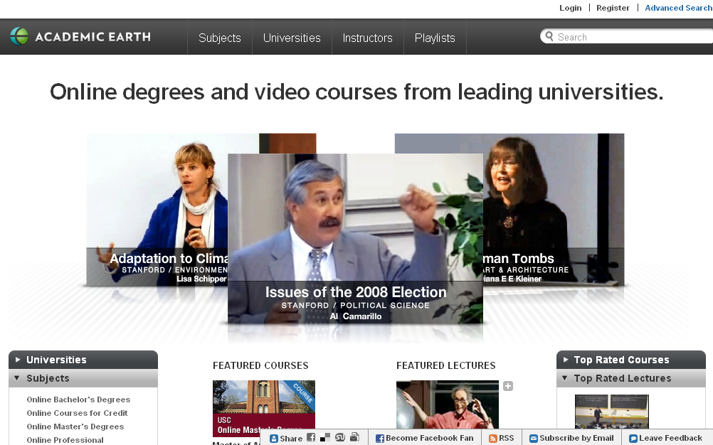

Slide 80
open

Slide 81
more accessible

Slide 82
more comprehensive

Slide 83
less dependent on physical media

Slide 84
less dependent on geography

Slide 85
mobile

Slide 86
more immediate /
real time

Slide 87
more convenient

Slide 88
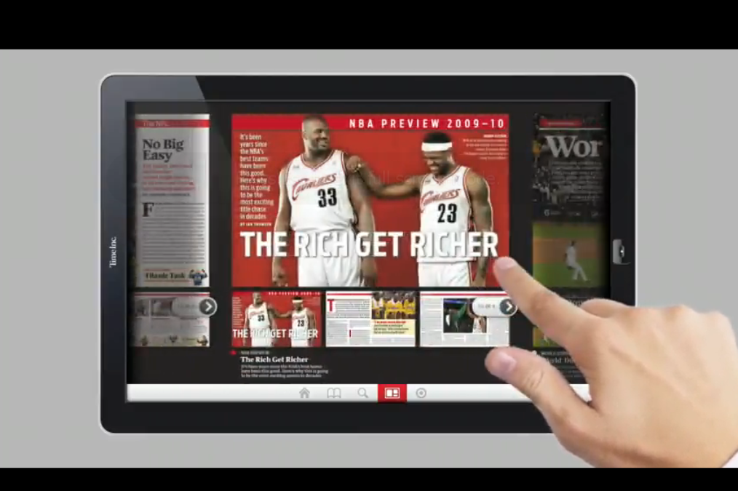

Slide 89
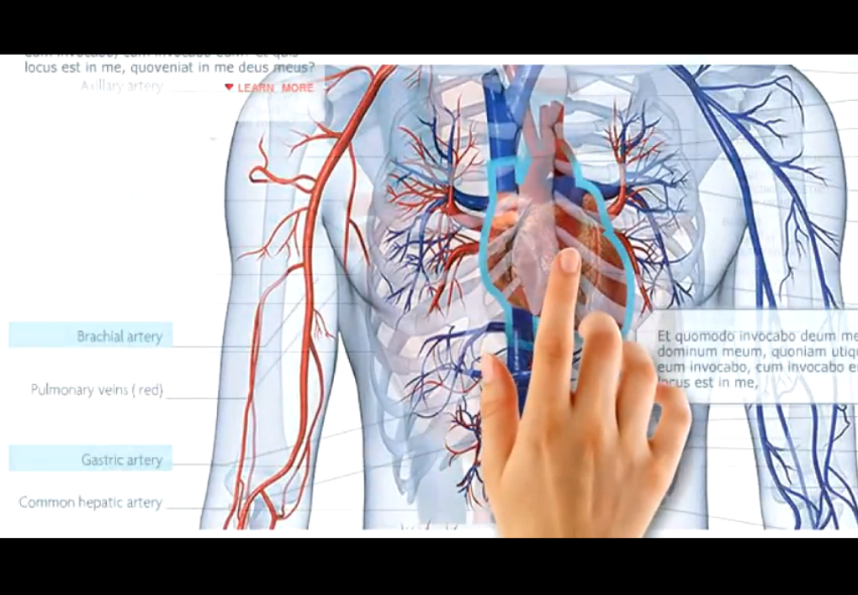

Slide 90
multimodal / multimedia

Slide 91
interactive

Slide 92
3-D

Slide 94
immersive

Slide 95
what you can do with what you know
v.
what you know

Slide 97
individualized

Slide 98
flexible

Slide 99
adaptive

Slide 100
personalized

Slide 101
Takeaways

Slide 102
K-12 education is facing multiple disruptive innovations.

Slide 103
The existing educational model is not a given.

Slide 104
This is sneaking up on most school organizations.

Slide 105
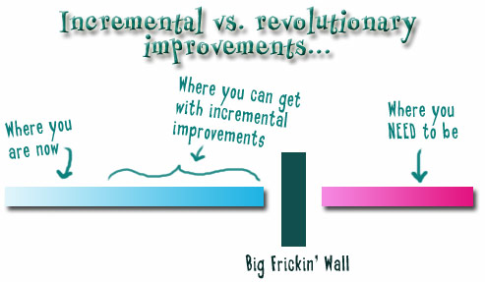
Notes:
We need to somehow change faster
No one jumps a 20 foot chasm in two
10 foot jumps. – Miguel Guhlin
When the world changes so fast that we have no reasonable way to forecast what it will look like in a mere decade or two, all we can do is teach kids how to be adaptive – to be learners in the truest sense of the word –
We’ve always talked about preparing lifelong learners in schools, but our practices typically haven’t matched our rhetoric. It’s time to put some bite into our toothless vision statements and recognize that we have to teach kids how to learn to learn if they want to be successful in this new technology-suffused, globally-interconnected world
Credits: http://tinyurl.com/2urbsm and http://tinyurl.com/37em64 (see Guhlin comment)
http://remoteaccess.typepad.com/remote_access/ 2006/06/literacy_as_bat.html (see Guhlin comment)
http://headrush.typepad.com/creating_passionate_users/2005/03/incremental_vs_.html

Slide 106
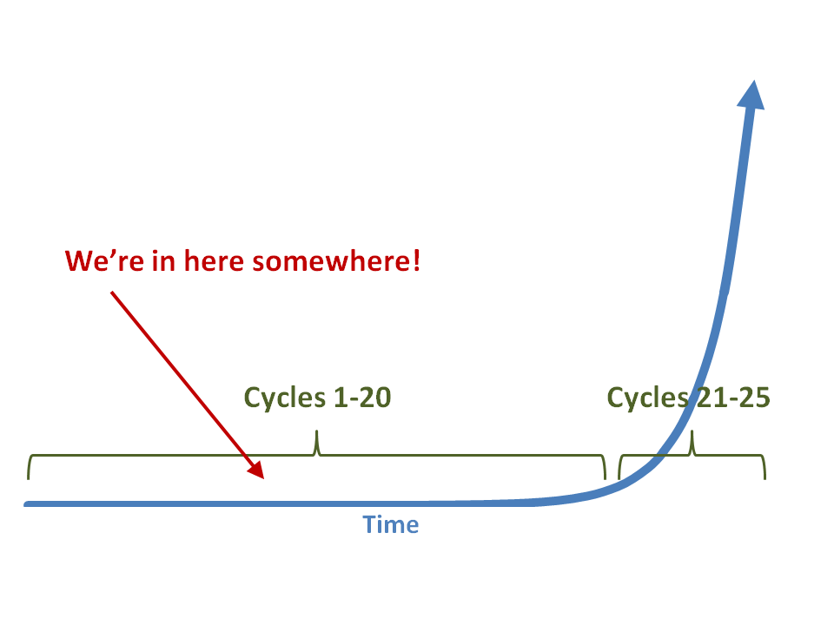

Slide 107
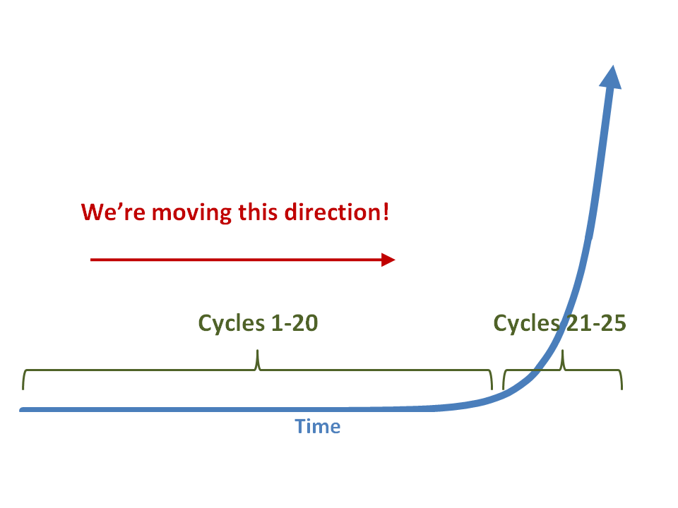

Slide 108
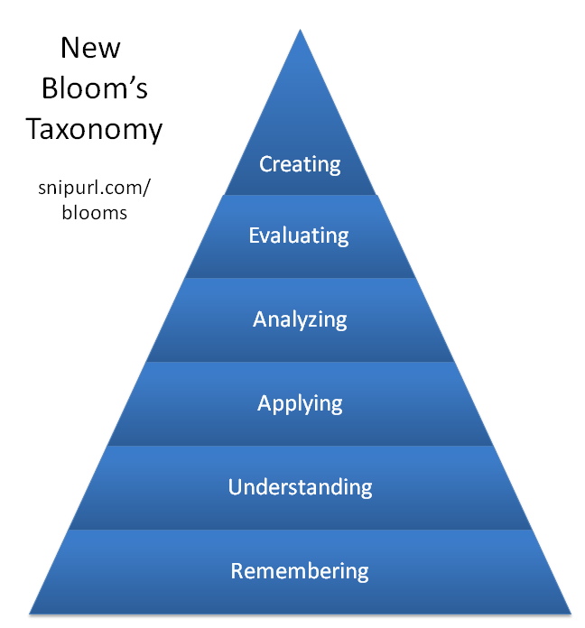

Slide 110
Federal, state, and local laws, policies, and funding support
Competency-based curricula that emphasize 21st century skills
Preservice and inservice training for teachers and administrators
Statewide no-cost or low-cost broadband wireless access
Computing device in every student’s hands
P-20 coordination, cooperation, and vertical articulation
Robust statewide online learning infrastructure for students and teachers
Monitoring, assessment, and evaluation
Mindset shift: The digital, global age is here!
Notes:
Curricula that emphasize 21st century skills. Instead of simply adding on 21st century skills to our existing content-based standards, put them at the core of new, more focused curricula.
Preservice and inservice training for teachers and administrators. Training in colleges and universities. Training on the job. Regular, frequent, strategic, and ongoing.
Robust statewide online learning infrastructure for students and teachers.Because of resources or geography, high-level and credit recovery courses aren’t available to many students. Training opportunities aren’t available to educators. A vibrant system of online courses can help.
Computing device in every student’s hands. Laptops. Netbooks. Smartphones. Devices that have some power, are mobile, allow students to type, and can access the Internet.
Statewide no-cost or low-cost broadband wireless access. High-speed wireless in every corner of the state.
P-20 coordination, cooperation, and vertical articulation. Curricular, programmatic, workforce development, and other alignment across the P-20 spectrum.
Some supports need to be in place to facilitate effective implementation…
Federal, state, and local laws, policies, and funding support. A thoughtful, helpful array of legal, policy, and funding supports for what needs to be done.
Monitoring, assessment, and evaluation. Regular, frequent, ongoing. To inform practice, not just for accountability.
Mindset shift. The digital, global age is here. It’s time to learn how to survive and thrive in it rather than being afraid of it or ignoring it.

Slide 111
Federal, state, and local laws, policies, and funding support
Competency-based curricula that emphasize 21st century skills
Preservice and inservice training for teachers and administrators
Statewide no-cost or low-cost broadband wireless access
Computing device in every student’s hands
P-20 coordination, cooperation, and vertical articulation
Robust statewide online learning infrastructure for students and teachers
Monitoring, assessment, and evaluation
Mindset shift: The digital, global age is here!
Notes:
Curricula that emphasize 21st century skills. Instead of simply adding on 21st century skills to our existing content-based standards, put them at the core of new, more focused curricula.
Preservice and inservice training for teachers and administrators. Training in colleges and universities. Training on the job. Regular, frequent, strategic, and ongoing.
Robust statewide online learning infrastructure for students and teachers.Because of resources or geography, high-level and credit recovery courses aren’t available to many students. Training opportunities aren’t available to educators. A vibrant system of online courses can help.
Computing device in every student’s hands. Laptops. Netbooks. Smartphones. Devices that have some power, are mobile, allow students to type, and can access the Internet.
Statewide no-cost or low-cost broadband wireless access. High-speed wireless in every corner of the state.
P-20 coordination, cooperation, and vertical articulation. Curricular, programmatic, workforce development, and other alignment across the P-20 spectrum.
Some supports need to be in place to facilitate effective implementation…
Federal, state, and local laws, policies, and funding support. A thoughtful, helpful array of legal, policy, and funding supports for what needs to be done.
Monitoring, assessment, and evaluation. Regular, frequent, ongoing. To inform practice, not just for accountability.
Mindset shift. The digital, global age is here. It’s time to learn how to survive and thrive in it rather than being afraid of it or ignoring it.

Slide 112
Federal, state, and local laws, policies, and funding support
Competency-based curricula that emphasize 21st century skills
Preservice and inservice training for teachers and administrators
Statewide no-cost or low-cost broadband wireless access
Computing device in every student’s hands
P-20 coordination, cooperation, and vertical articulation
Robust statewide online learning infrastructure for students and teachers
Monitoring, assessment, and evaluation
Mindset shift: The digital, global age is here!
Notes:
Curricula that emphasize 21st century skills. Instead of simply adding on 21st century skills to our existing content-based standards, put them at the core of new, more focused curricula.
Preservice and inservice training for teachers and administrators. Training in colleges and universities. Training on the job. Regular, frequent, strategic, and ongoing.
Robust statewide online learning infrastructure for students and teachers.Because of resources or geography, high-level and credit recovery courses aren’t available to many students. Training opportunities aren’t available to educators. A vibrant system of online courses can help.
Computing device in every student’s hands. Laptops. Netbooks. Smartphones. Devices that have some power, are mobile, allow students to type, and can access the Internet.
Statewide no-cost or low-cost broadband wireless access. High-speed wireless in every corner of the state.
P-20 coordination, cooperation, and vertical articulation. Curricular, programmatic, workforce development, and other alignment across the P-20 spectrum.
Some supports need to be in place to facilitate effective implementation…
Federal, state, and local laws, policies, and funding support. A thoughtful, helpful array of legal, policy, and funding supports for what needs to be done.
Monitoring, assessment, and evaluation. Regular, frequent, ongoing. To inform practice, not just for accountability.
Mindset shift. The digital, global age is here. It’s time to learn how to survive and thrive in it rather than being afraid of it or ignoring it.

Slide 113
Federal, state, and local laws, policies, and funding support
Competency-based curricula that emphasize 21st century skills
Preservice and inservice training for teachers and administrators
Statewide no-cost or low-cost broadband wireless access
Computing device in every student’s hands
P-20 coordination, cooperation, and vertical articulation
Robust statewide online learning infrastructure for students and teachers
Monitoring, assessment, and evaluation
Mindset shift: The digital, global age is here!
Notes:
Curricula that emphasize 21st century skills. Instead of simply adding on 21st century skills to our existing content-based standards, put them at the core of new, more focused curricula.
Preservice and inservice training for teachers and administrators. Training in colleges and universities. Training on the job. Regular, frequent, strategic, and ongoing.
Robust statewide online learning infrastructure for students and teachers.Because of resources or geography, high-level and credit recovery courses aren’t available to many students. Training opportunities aren’t available to educators. A vibrant system of online courses can help.
Computing device in every student’s hands. Laptops. Netbooks. Smartphones. Devices that have some power, are mobile, allow students to type, and can access the Internet.
Statewide no-cost or low-cost broadband wireless access. High-speed wireless in every corner of the state.
P-20 coordination, cooperation, and vertical articulation. Curricular, programmatic, workforce development, and other alignment across the P-20 spectrum.
Some supports need to be in place to facilitate effective implementation…
Federal, state, and local laws, policies, and funding support. A thoughtful, helpful array of legal, policy, and funding supports for what needs to be done.
Monitoring, assessment, and evaluation. Regular, frequent, ongoing. To inform practice, not just for accountability.
Mindset shift. The digital, global age is here. It’s time to learn how to survive and thrive in it rather than being afraid of it or ignoring it.

Slide 114
Federal, state, and local laws, policies, and funding support
Competency-based curricula that emphasize 21st century skills
Preservice and inservice training for teachers and administrators
Statewide no-cost or low-cost broadband wireless access
Computing device in every student’s hands
P-20 coordination, cooperation, and vertical articulation
Robust statewide online learning infrastructure for students and teachers
Monitoring, assessment, and evaluation
Mindset shift: The digital, global age is here!
Notes:
Curricula that emphasize 21st century skills. Instead of simply adding on 21st century skills to our existing content-based standards, put them at the core of new, more focused curricula.
Preservice and inservice training for teachers and administrators. Training in colleges and universities. Training on the job. Regular, frequent, strategic, and ongoing.
Robust statewide online learning infrastructure for students and teachers.Because of resources or geography, high-level and credit recovery courses aren’t available to many students. Training opportunities aren’t available to educators. A vibrant system of online courses can help.
Computing device in every student’s hands. Laptops. Netbooks. Smartphones. Devices that have some power, are mobile, allow students to type, and can access the Internet.
Statewide no-cost or low-cost broadband wireless access. High-speed wireless in every corner of the state.
P-20 coordination, cooperation, and vertical articulation. Curricular, programmatic, workforce development, and other alignment across the P-20 spectrum.
Some supports need to be in place to facilitate effective implementation…
Federal, state, and local laws, policies, and funding support. A thoughtful, helpful array of legal, policy, and funding supports for what needs to be done.
Monitoring, assessment, and evaluation. Regular, frequent, ongoing. To inform practice, not just for accountability.
Mindset shift. The digital, global age is here. It’s time to learn how to survive and thrive in it rather than being afraid of it or ignoring it.

Slide 115
Federal, state, and local laws, policies, and funding support
Competency-based curricula that emphasize 21st century skills
Preservice and inservice training for teachers and administrators
Statewide no-cost or low-cost broadband wireless access
Computing device in every student’s hands
P-20 coordination, cooperation, and vertical articulation
Robust statewide online learning infrastructure for students and teachers
Monitoring, assessment, and evaluation
Mindset shift: The digital, global age is here!
Notes:
Curricula that emphasize 21st century skills. Instead of simply adding on 21st century skills to our existing content-based standards, put them at the core of new, more focused curricula.
Preservice and inservice training for teachers and administrators. Training in colleges and universities. Training on the job. Regular, frequent, strategic, and ongoing.
Robust statewide online learning infrastructure for students and teachers.Because of resources or geography, high-level and credit recovery courses aren’t available to many students. Training opportunities aren’t available to educators. A vibrant system of online courses can help.
Computing device in every student’s hands. Laptops. Netbooks. Smartphones. Devices that have some power, are mobile, allow students to type, and can access the Internet.
Statewide no-cost or low-cost broadband wireless access. High-speed wireless in every corner of the state.
P-20 coordination, cooperation, and vertical articulation. Curricular, programmatic, workforce development, and other alignment across the P-20 spectrum.
Some supports need to be in place to facilitate effective implementation…
Federal, state, and local laws, policies, and funding support. A thoughtful, helpful array of legal, policy, and funding supports for what needs to be done.
Monitoring, assessment, and evaluation. Regular, frequent, ongoing. To inform practice, not just for accountability.
Mindset shift. The digital, global age is here. It’s time to learn how to survive and thrive in it rather than being afraid of it or ignoring it.

Slide 116
Federal, state, and local laws, policies, and funding support
Competency-based curricula that emphasize 21st century skills
Preservice and inservice training for teachers and administrators
Statewide no-cost or low-cost broadband wireless access
Computing device in every student’s hands
P-20 coordination, cooperation, and vertical articulation
Robust statewide online learning infrastructure for students and teachers
Monitoring, assessment, and evaluation
Mindset shift: The digital, global age is here!
Notes:
Curricula that emphasize 21st century skills. Instead of simply adding on 21st century skills to our existing content-based standards, put them at the core of new, more focused curricula.
Preservice and inservice training for teachers and administrators. Training in colleges and universities. Training on the job. Regular, frequent, strategic, and ongoing.
Robust statewide online learning infrastructure for students and teachers.Because of resources or geography, high-level and credit recovery courses aren’t available to many students. Training opportunities aren’t available to educators. A vibrant system of online courses can help.
Computing device in every student’s hands. Laptops. Netbooks. Smartphones. Devices that have some power, are mobile, allow students to type, and can access the Internet.
Statewide no-cost or low-cost broadband wireless access. High-speed wireless in every corner of the state.
P-20 coordination, cooperation, and vertical articulation. Curricular, programmatic, workforce development, and other alignment across the P-20 spectrum.
Some supports need to be in place to facilitate effective implementation…
Federal, state, and local laws, policies, and funding support. A thoughtful, helpful array of legal, policy, and funding supports for what needs to be done.
Monitoring, assessment, and evaluation. Regular, frequent, ongoing. To inform practice, not just for accountability.
Mindset shift. The digital, global age is here. It’s time to learn how to survive and thrive in it rather than being afraid of it or ignoring it.

Slide 117
Federal, state, and local laws, policies, and funding support
Competency-based curricula that emphasize 21st century skills
Preservice and inservice training for teachers and administrators
Statewide no-cost or low-cost broadband wireless access
Computing device in every student’s hands
P-20 coordination, cooperation, and vertical articulation
Robust statewide online learning infrastructure for students and teachers
Monitoring, assessment, and evaluation
Mindset shift: The digital, global age is here!
Notes:
Curricula that emphasize 21st century skills. Instead of simply adding on 21st century skills to our existing content-based standards, put them at the core of new, more focused curricula.
Preservice and inservice training for teachers and administrators. Training in colleges and universities. Training on the job. Regular, frequent, strategic, and ongoing.
Robust statewide online learning infrastructure for students and teachers.Because of resources or geography, high-level and credit recovery courses aren’t available to many students. Training opportunities aren’t available to educators. A vibrant system of online courses can help.
Computing device in every student’s hands. Laptops. Netbooks. Smartphones. Devices that have some power, are mobile, allow students to type, and can access the Internet.
Statewide no-cost or low-cost broadband wireless access. High-speed wireless in every corner of the state.
P-20 coordination, cooperation, and vertical articulation. Curricular, programmatic, workforce development, and other alignment across the P-20 spectrum.
Some supports need to be in place to facilitate effective implementation…
Federal, state, and local laws, policies, and funding support. A thoughtful, helpful array of legal, policy, and funding supports for what needs to be done.
Monitoring, assessment, and evaluation. Regular, frequent, ongoing. To inform practice, not just for accountability.
Mindset shift. The digital, global age is here. It’s time to learn how to survive and thrive in it rather than being afraid of it or ignoring it.

Slide 118
Federal, state, and local laws, policies, and funding support
Competency-based curricula that emphasize 21st century skills
Preservice and inservice training for teachers and administrators
Statewide no-cost or low-cost broadband wireless access
Computing device in every student’s hands
P-20 coordination, cooperation, and vertical articulation
Robust statewide online learning infrastructure for students and teachers
Monitoring, assessment, and evaluation
Mindset shift: The digital, global age is here!
Notes:
Curricula that emphasize 21st century skills. Instead of simply adding on 21st century skills to our existing content-based standards, put them at the core of new, more focused curricula.
Preservice and inservice training for teachers and administrators. Training in colleges and universities. Training on the job. Regular, frequent, strategic, and ongoing.
Robust statewide online learning infrastructure for students and teachers.Because of resources or geography, high-level and credit recovery courses aren’t available to many students. Training opportunities aren’t available to educators. A vibrant system of online courses can help.
Computing device in every student’s hands. Laptops. Netbooks. Smartphones. Devices that have some power, are mobile, allow students to type, and can access the Internet.
Statewide no-cost or low-cost broadband wireless access. High-speed wireless in every corner of the state.
P-20 coordination, cooperation, and vertical articulation. Curricular, programmatic, workforce development, and other alignment across the P-20 spectrum.
Some supports need to be in place to facilitate effective implementation…
Federal, state, and local laws, policies, and funding support. A thoughtful, helpful array of legal, policy, and funding supports for what needs to be done.
Monitoring, assessment, and evaluation. Regular, frequent, ongoing. To inform practice, not just for accountability.
Mindset shift. The digital, global age is here. It’s time to learn how to survive and thrive in it rather than being afraid of it or ignoring it.

Slide 120
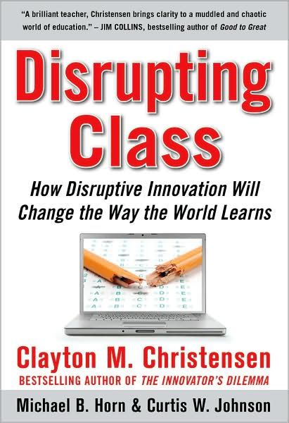

Slide 121
Notes:
Anticipatory v. reactionary

Slide 122
Notes:
Future oriented v. compliance oriented

Slide 123
The people in charge of leading school organizations into the 21st century …
often are the least knowledgeable about the 21st century.
dangerouslyirrelevant.org
Notes:
Licensed under a Creative Commons attribution-share alike license.
http://creativecommons.org/licenses/by-sa/3.0
Scott McLeod, J.D., Ph.D.
scottmcleod.net/contact
dangerouslyirrelevant.org
schooltechleadership.org

Slide 124
If the leaders don’t get it,
it’s not going to happen.
dangerouslyirrelevant.org
Notes:
Licensed under a Creative Commons attribution-share alike license.
http://creativecommons.org/licenses/by-sa/3.0
Scott McLeod, J.D., Ph.D.
scottmcleod.net/contact
dangerouslyirrelevant.org
schooltechleadership.org

Slide 126
Am I facilitating linear or exponential change in my school?

Slide 127
Am I modeling for students and staff these new literacies?
Notes:
Blogging
Wikis
Podcasting
Online video
Social networking
RSS readers
Active consumption AND PRODUCTION of digital content?
Student projects that are doing this stuff?
Web is now social – are you living the INTERACTIVE Web (why not?)

Slide 128
Do I truly “get it?” Am I doing what I should be?

Slide 129
No one will thank you
for taking care of today
if you have failed
to take care of tomorrow.
Joel Barker

Slide 130
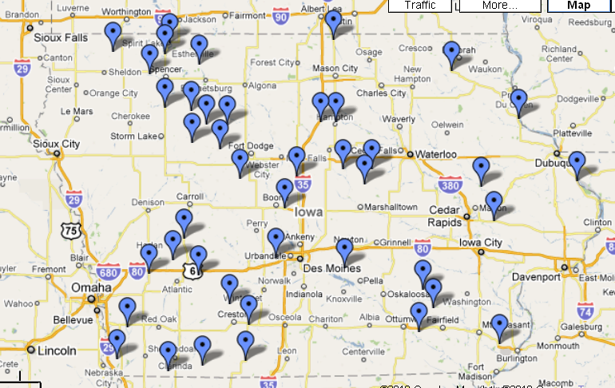

Slide 131
Notes:
Licensed under a Creative Commons attribution-share alike license.
http://creativecommons.org/licenses/by-sa/3.0
Scott McLeod, J.D., Ph.D.
dangerouslyirrelevant.org
schooltechleadership.org
dangerouslyirrelevant.org/contact.html

Slide 135
Notes:
135

Slide 136
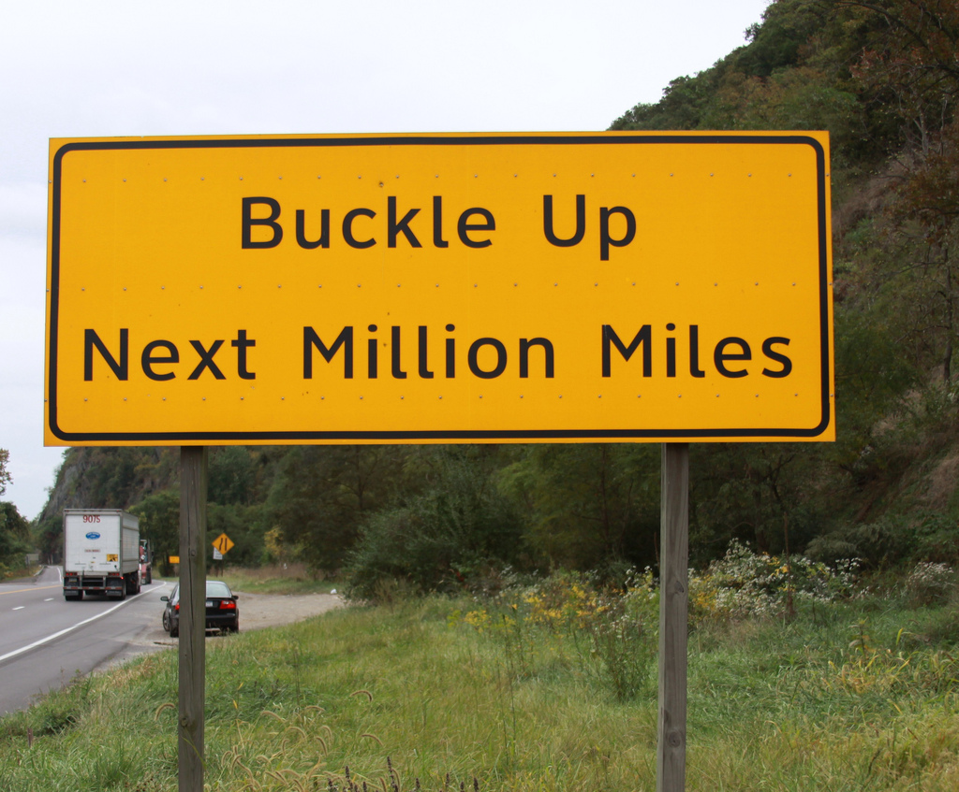

Slide 137
Thank you!
Scott McLeod, J.D., Ph.D.
Director, CASTLE
dangerouslyirrelevant.org/kentucky
Notes:
137
All of my materials are licensed under a Creative Commons attribution-share alike license (http://creativecommons.org/licenses/by-sa/3.0). That means not only that you are welcome to share and/or remix my content but that you are encouraged to do so! All I ask is that you properly credit me for my content and that you not place any greater copyright restrictions than I have on the content that utilizes my material. If possible, including the URL of Dangerously Irrelevant in your content would be most appreciated.
Scott McLeod, J.D., Ph.D.
dangerouslyirrelevant.org
schooltechleadership.org
dangerouslyirrelevant.org/contact.html

