Slide 1
dangerouslyirrelevant.org/ nebraska
#edadtech

Slide 2
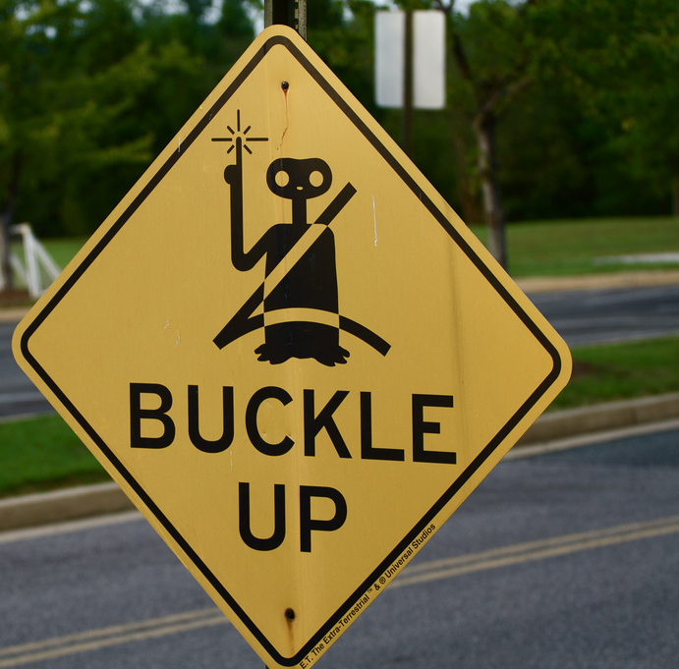
Fasten your seatbelts:
The future of
learning is
coming fast!
Dr. Scott McLeod
CASTLE

Slide 3
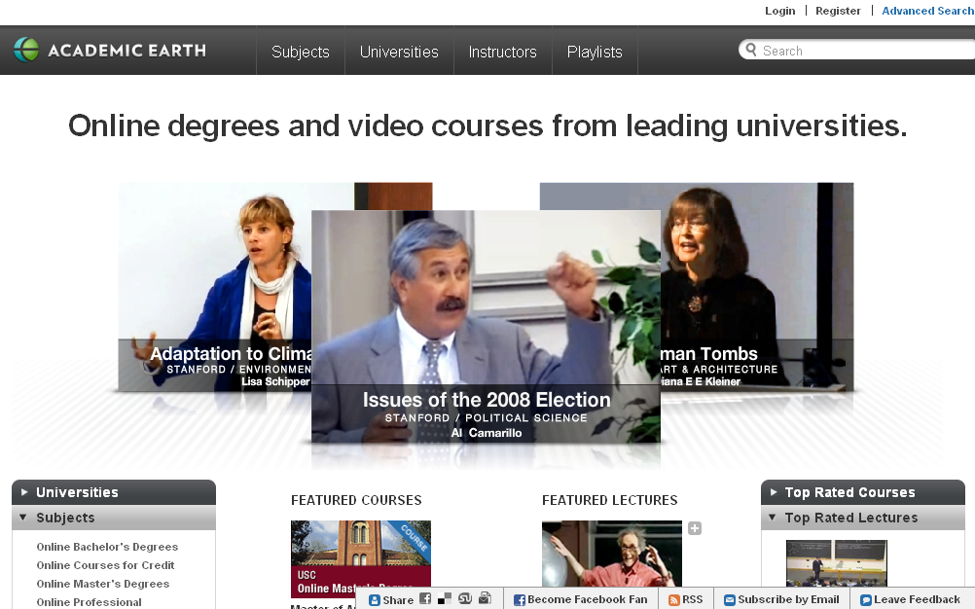

Slide 4
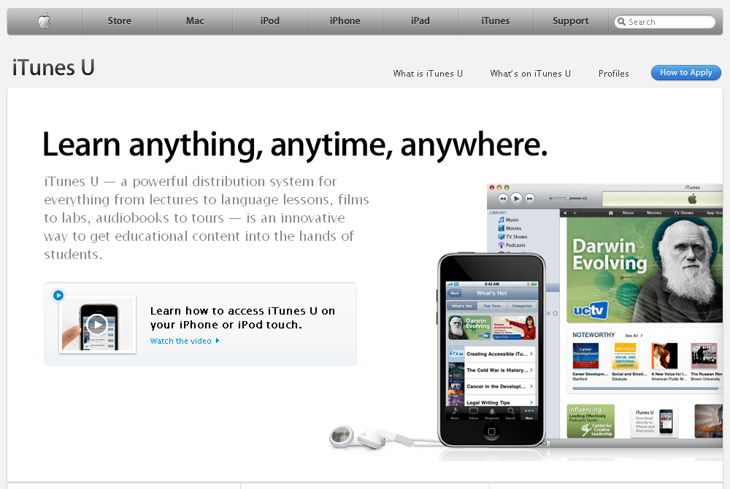

Slide 5
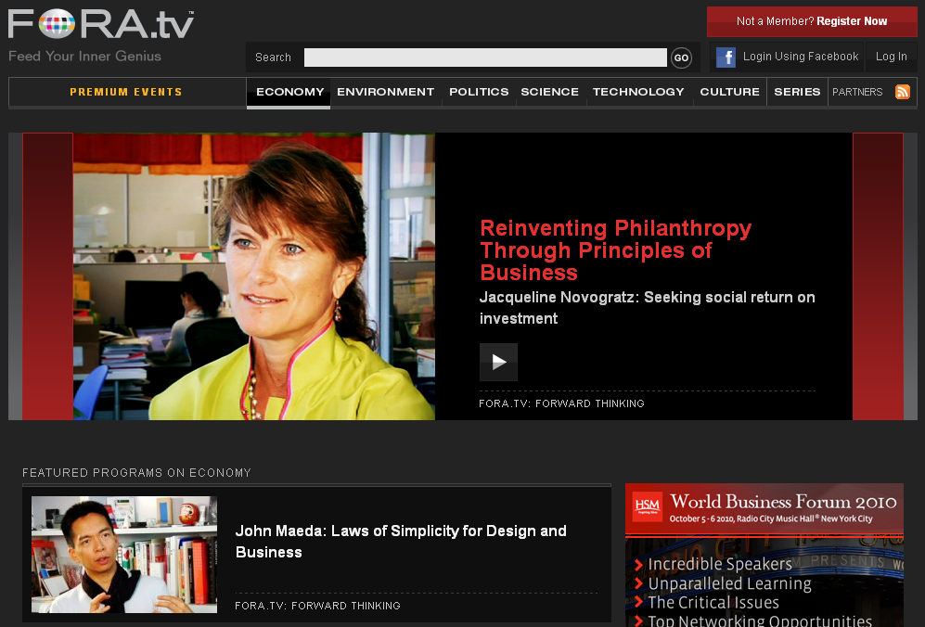

Slide 6
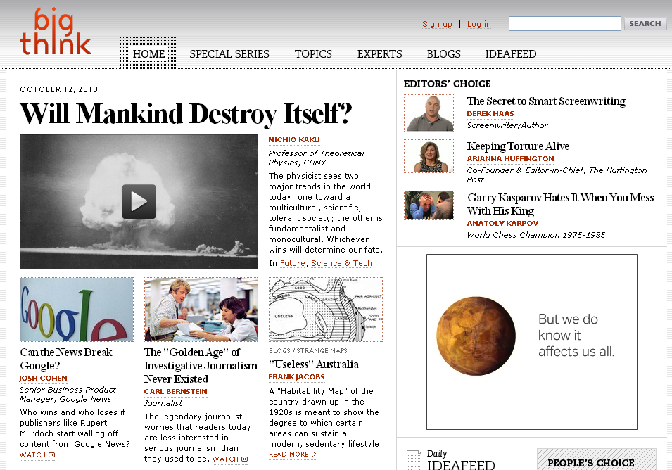

Slide 7
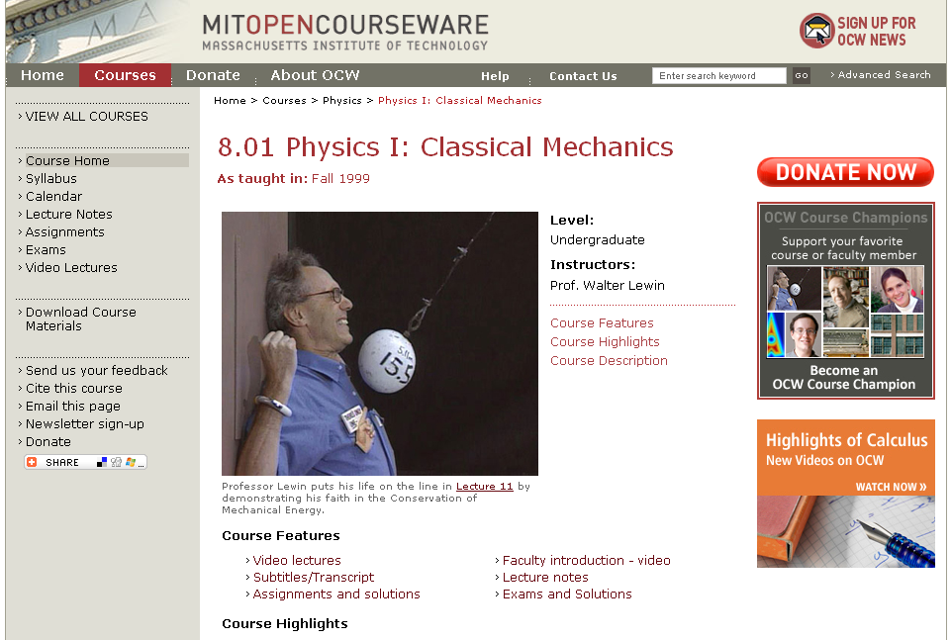

Slide 8
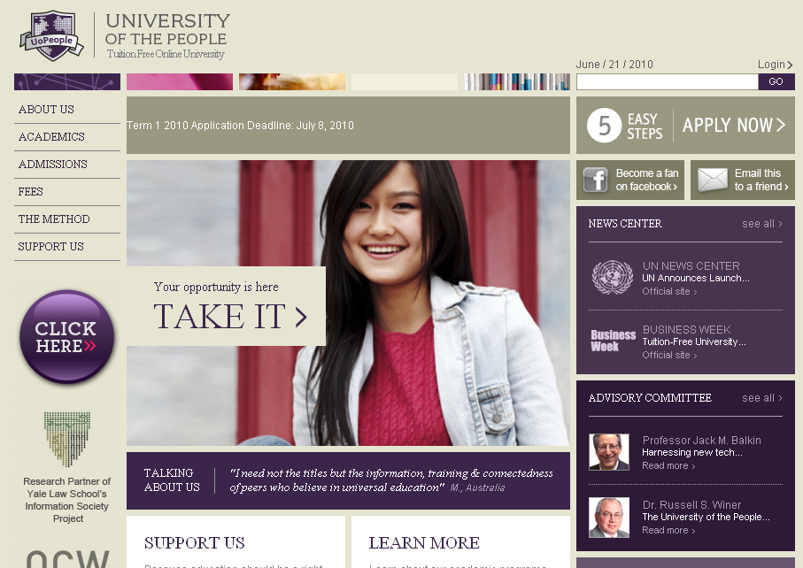

Slide 9
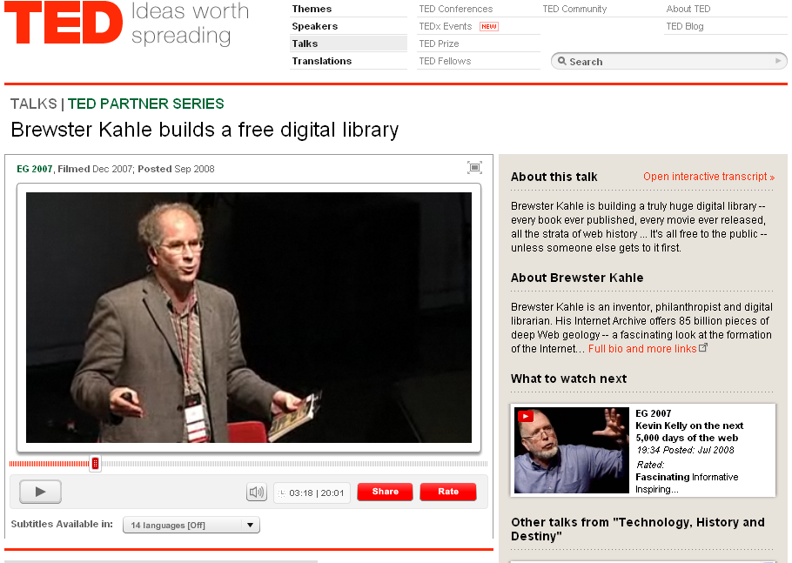

Slide 10
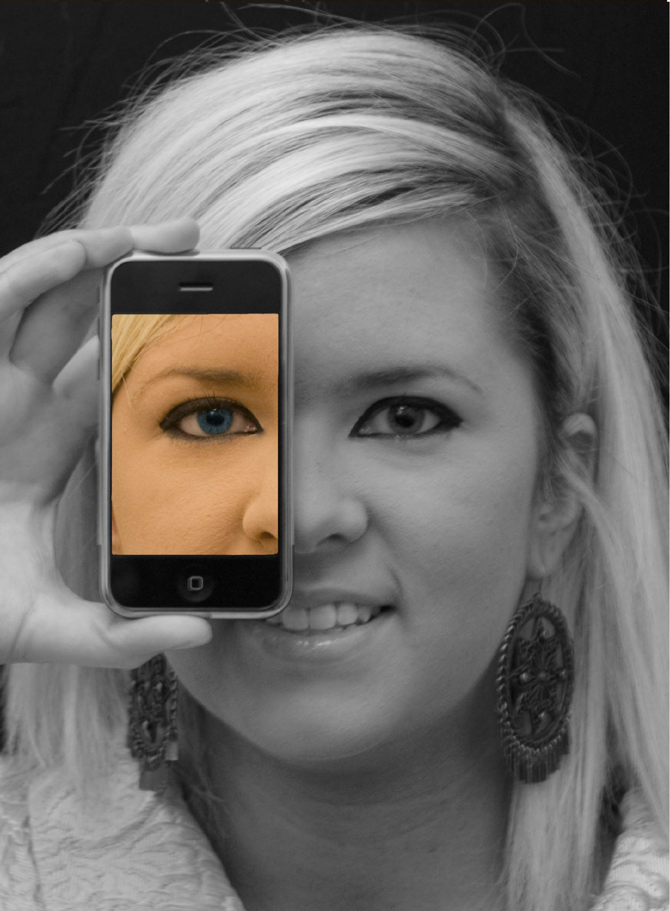

Slide 11
open

Slide 12
more accessible

Slide 13
more comprehensive

Slide 14
less dependent on physical media

Slide 15
less dependent on geography

Slide 16
mobile

Slide 17
more immediate /
real time

Slide 18
more convenient

Slide 19
[pause]

Slide 20
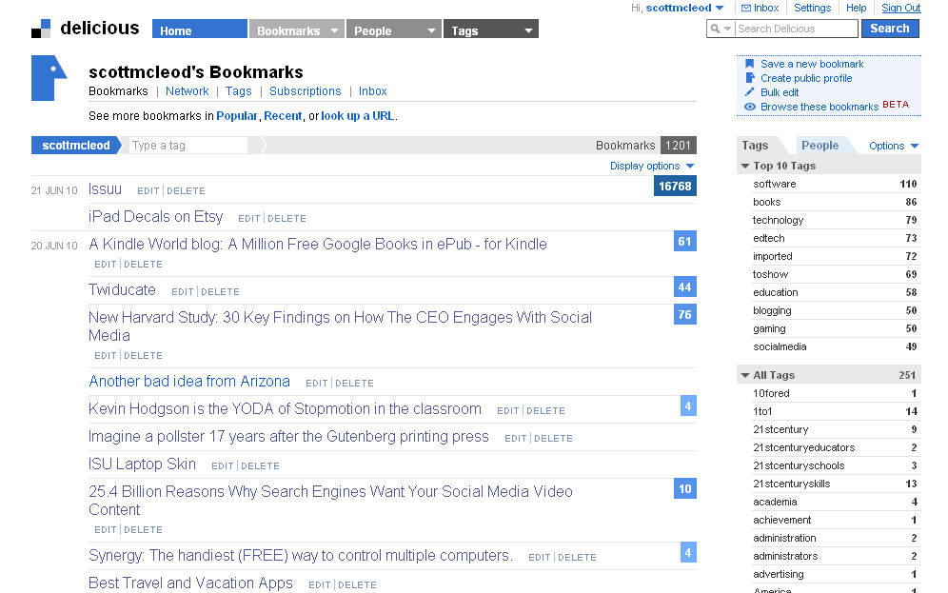

Slide 21
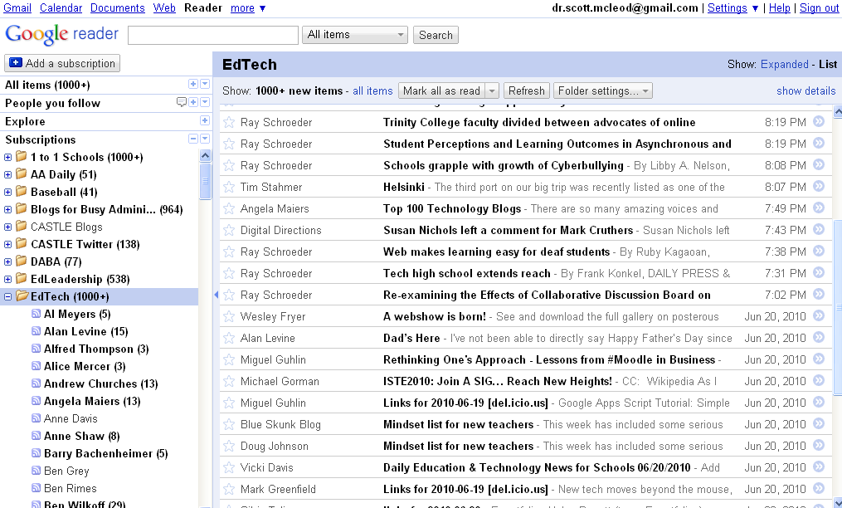

Slide 22
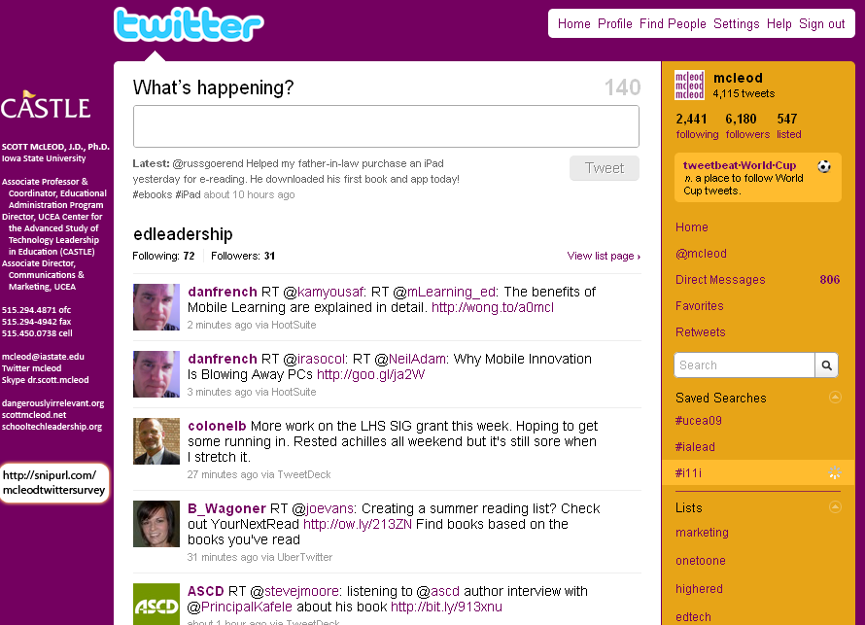

Slide 23
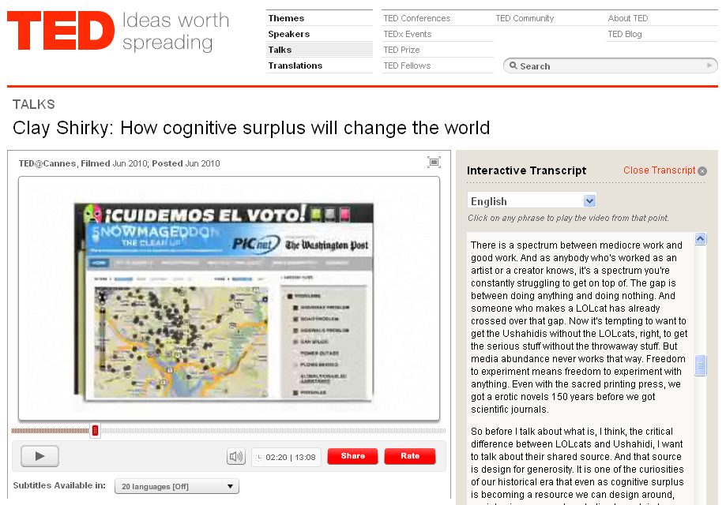

Slide 24
networked

Slide 25
connected

Slide 26
collaborative

Slide 27
often ‘crowdsourced’

Slide 28
less dependent on ‘experts’

Slide 29
shared

Slide 30
[pause]

Slide 31
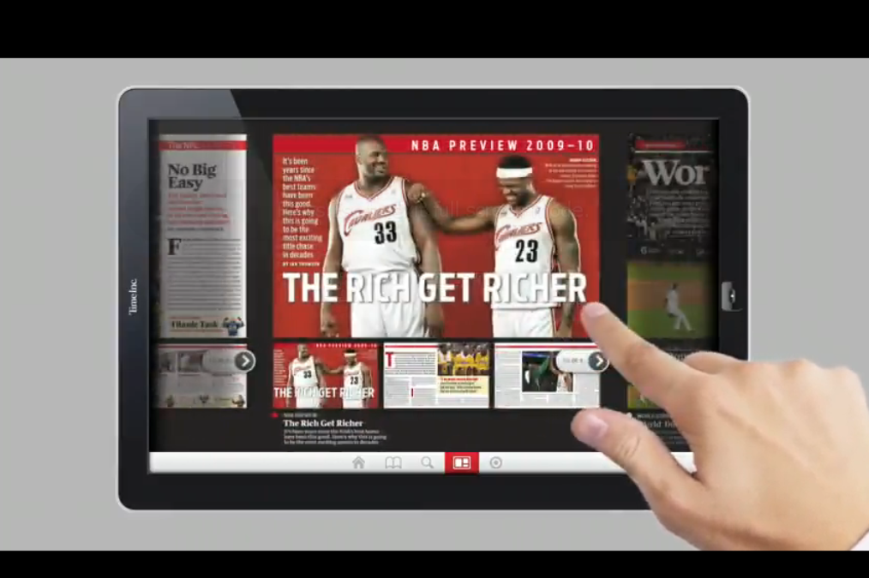

Slide 32
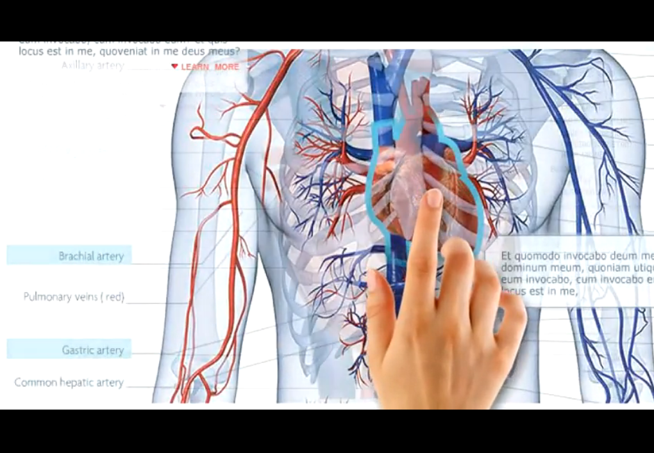

Slide 33
multimodal / multimedia

Slide 34
interactive

Slide 35
3-D

Slide 36
[pause]

Slide 37
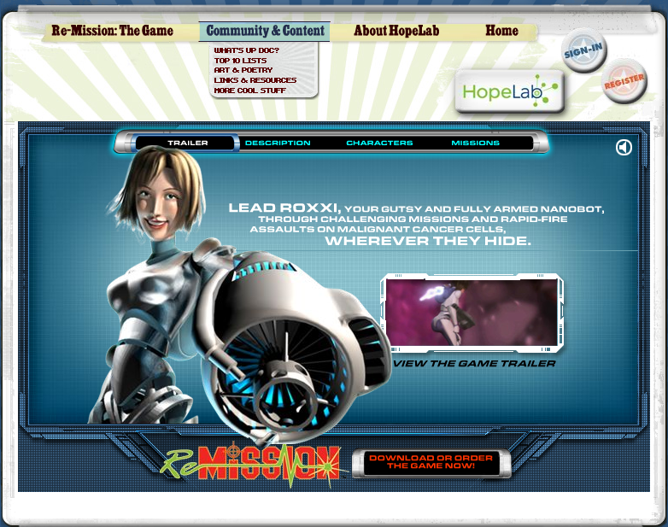
Notes:
Re-Mission

Slide 38
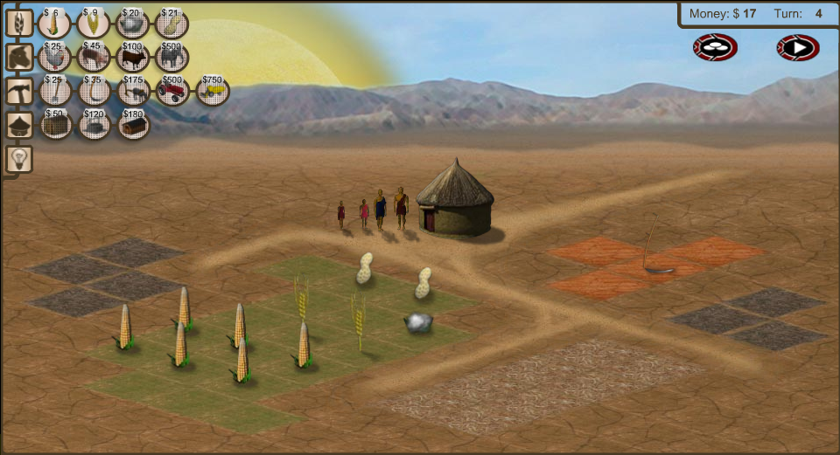
Notes:
3rd World Farmer

Slide 39
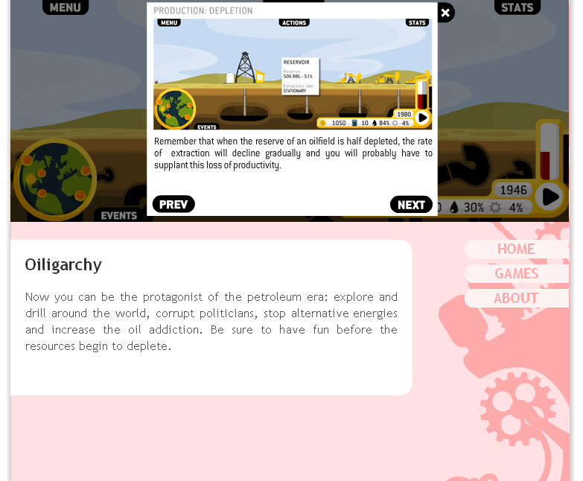

Slide 40
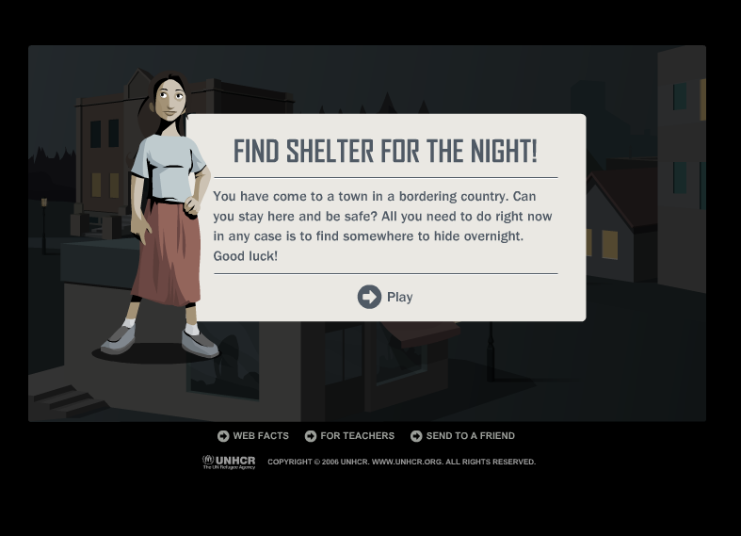
Notes:
Against All Odds, United Nations High Commissioner for Refugees

Slide 41
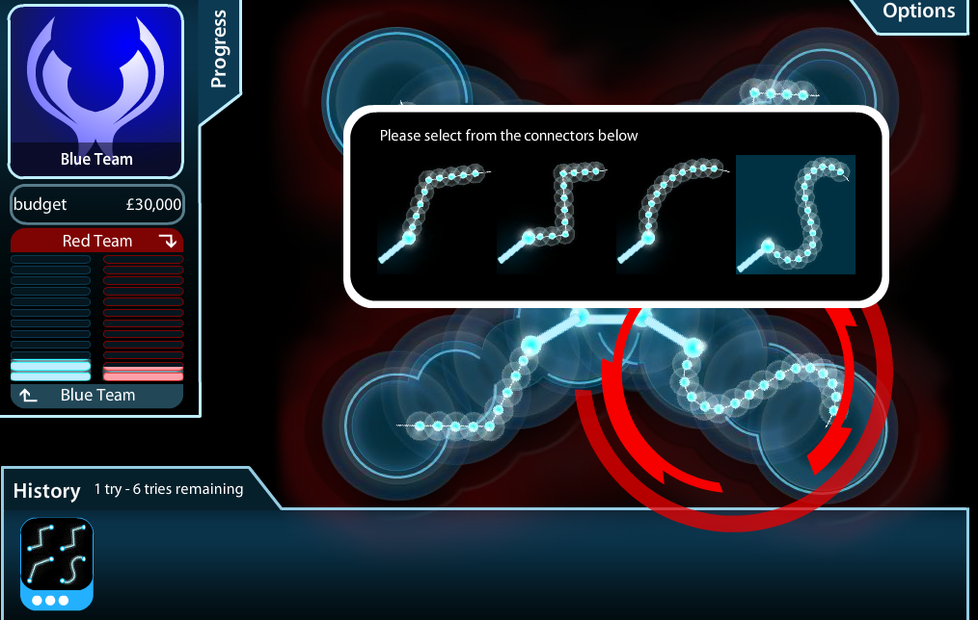
Notes:
Masterminding Molecules

Slide 42

Notes:
Conspiracy Code

Slide 43
immersive

Slide 44
[pause]

Slide 45
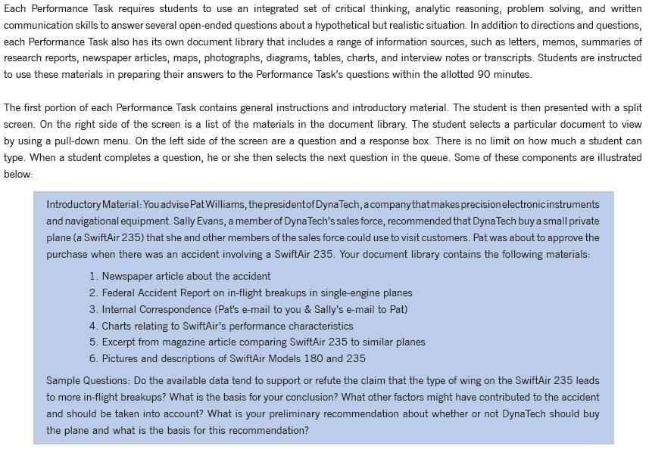

Slide 46
what you can do with what you know
v.
what you know

Slide 47
[pause]

Slide 48
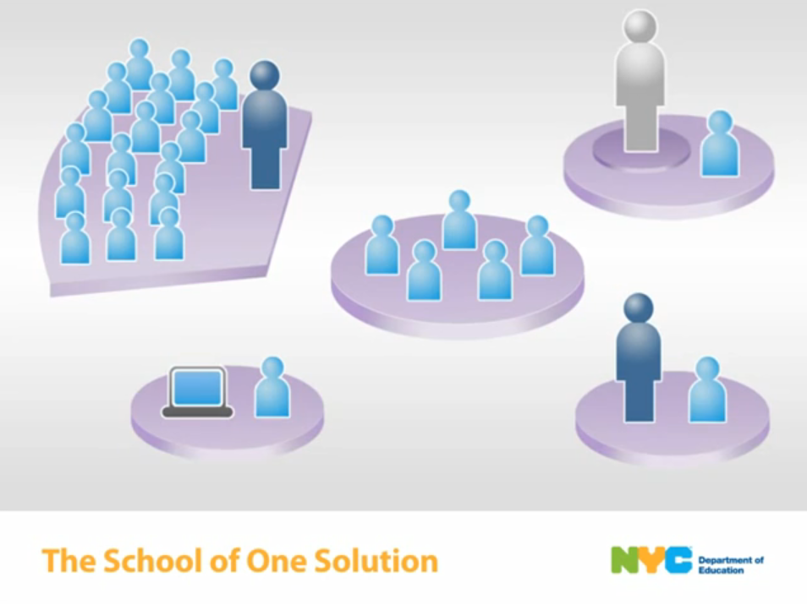

Slide 49
individualized

Slide 50
flexible

Slide 51
adaptive

Slide 52
personalized

Slide 53
[pause]

Slide 54
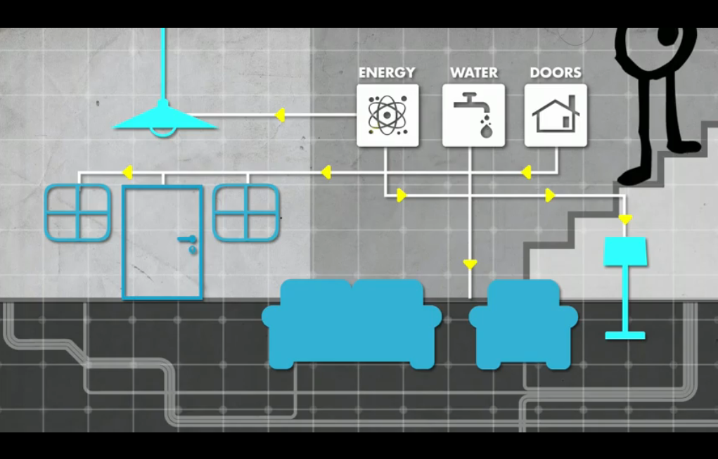

Slide 55
[pause]

Slide 56
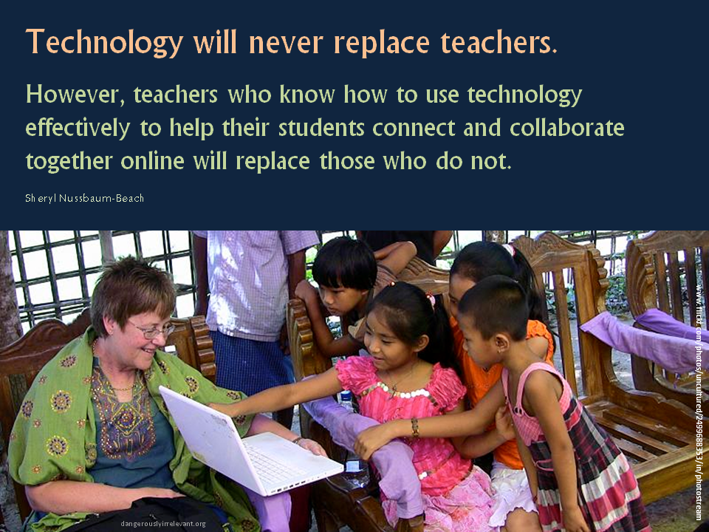

Slide 57
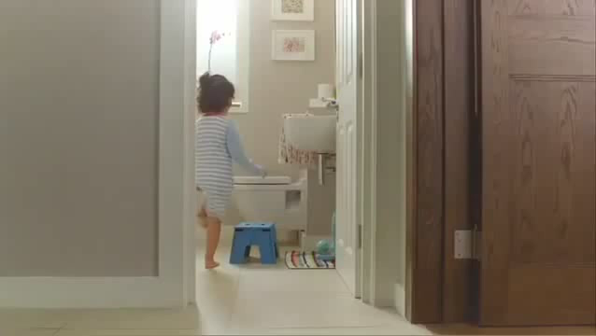

Slide 58
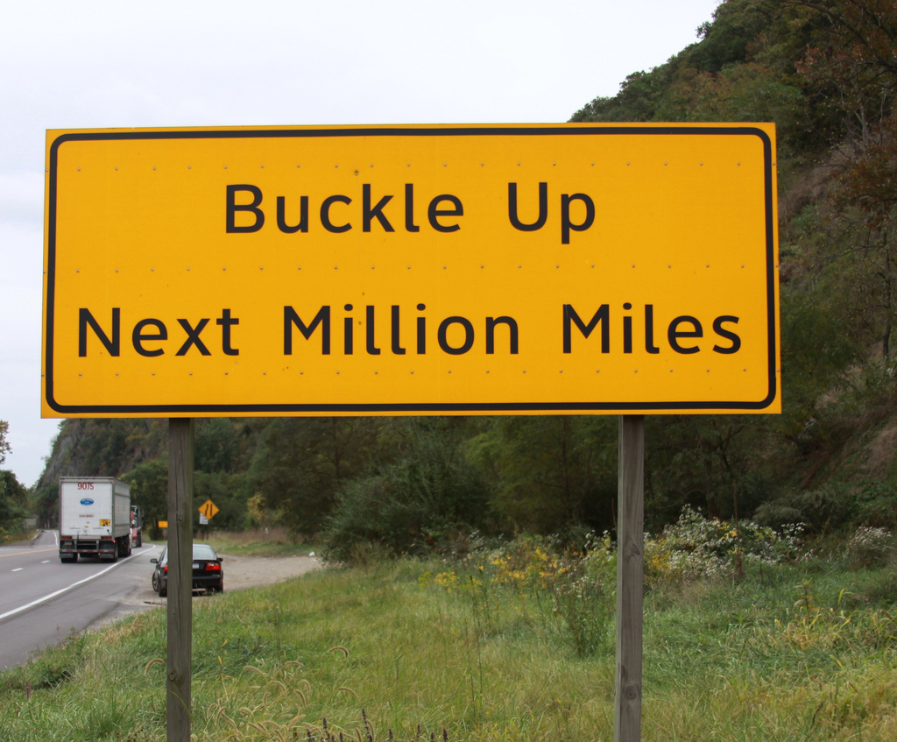

Slide 59
THANK YOU!
dangerouslyirrelevant.org/nebraska

