Slide 1
Can we try to get a laptop at each table?
Also, say hi to your neighbors!

Slide 2
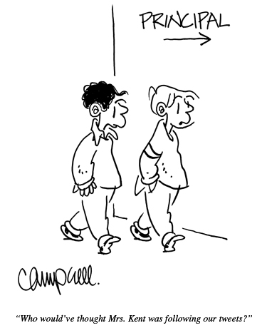
dangerouslyirrelevant.org/ wasda

Slide 3

2 big shifts
and
1 big problem
Dr. Scott McLeod
CASTLE
Notes:
All of my materials are licensed under a Creative Commons attribution-share alike license (http://creativecommons.org/licenses/by-sa/3.0). That means not only that you are welcome to share and/or remix my content but that you are encouraged to do so! All I ask is that you properly credit me for my content and that you not place any greater copyright restrictions than I have on the content that utilizes my material. If possible, including the URL of Dangerously Irrelevant in your content would be most appreciated.
Scott McLeod, J.D., Ph.D.
dangerouslyirrelevant.org
schooltechleadership.org
dangerouslyirrelevant.org/contact.html

Slide 4
  Socially functional
  Mastery of information landscape
  Economically productive

Slide 5


Slide 6
Everything is moving to the Web

Slide 7
EVERYTHING is moving to the Web
(really)

Slide 8


Slide 9
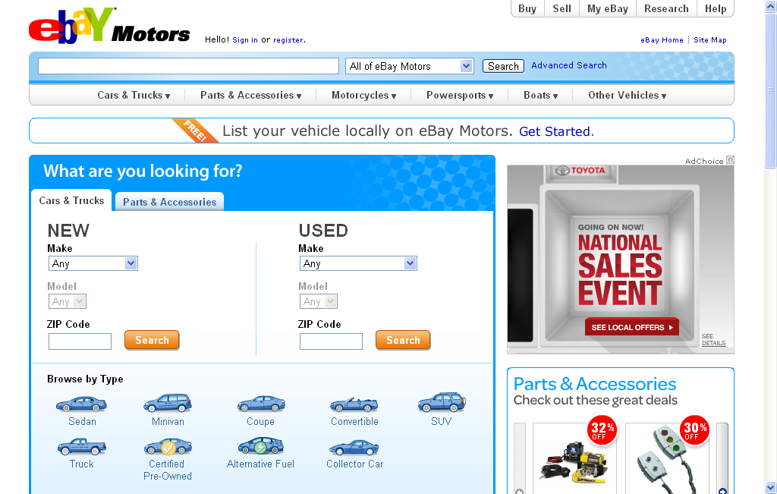

Slide 10


Slide 11
Big shift 1

Slide 12
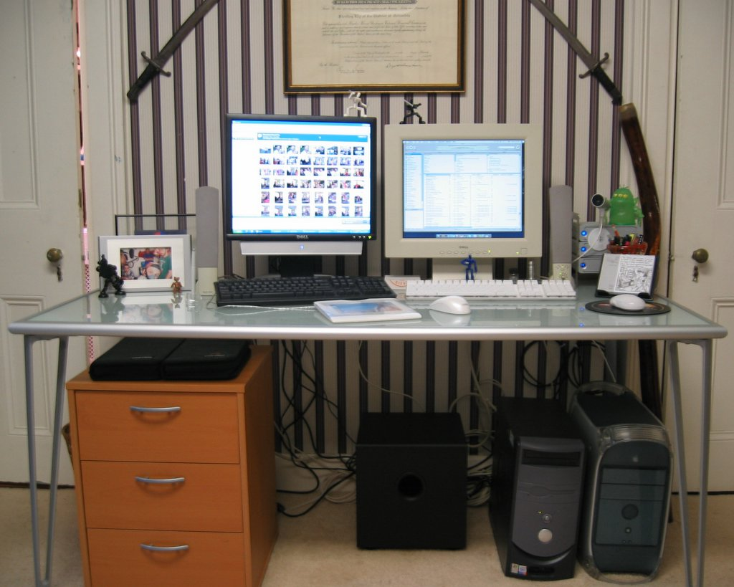

Slide 13


Slide 14


Slide 15
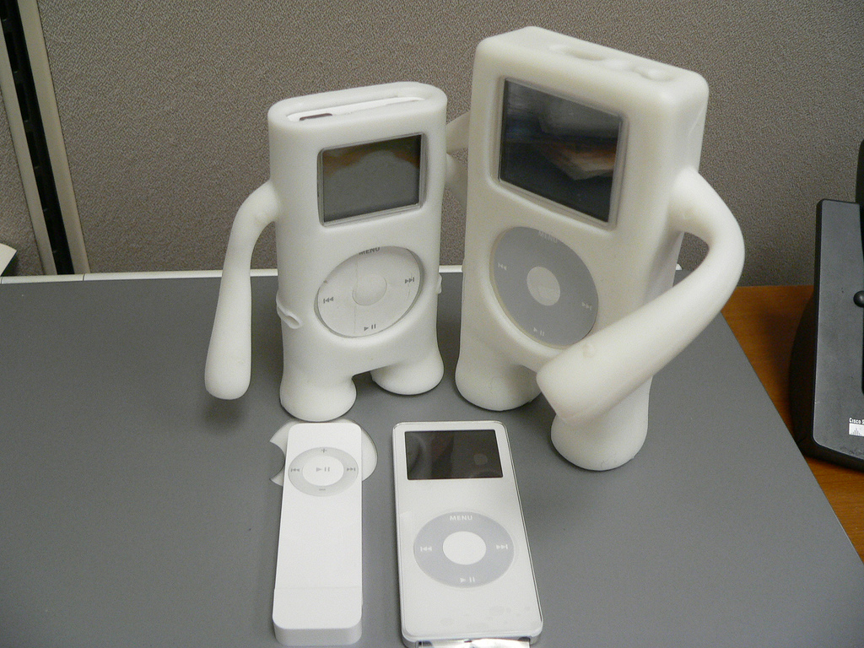

Slide 16
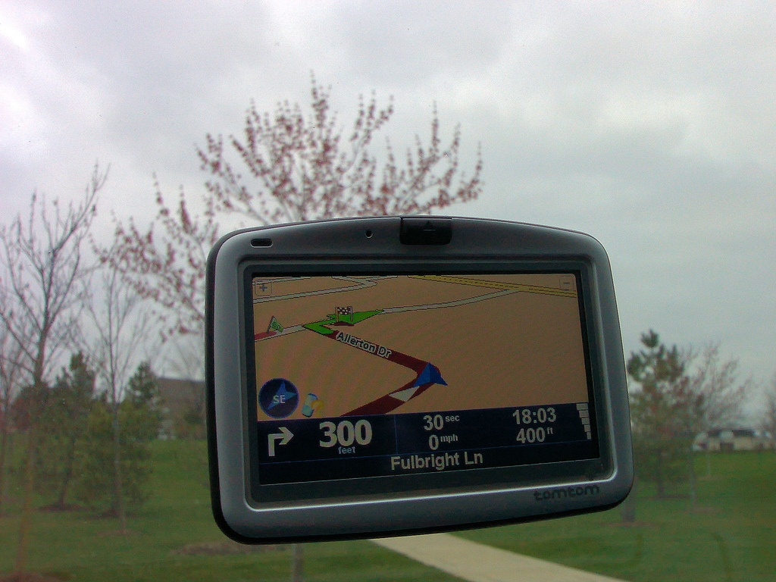

Slide 17


Slide 18


Slide 19
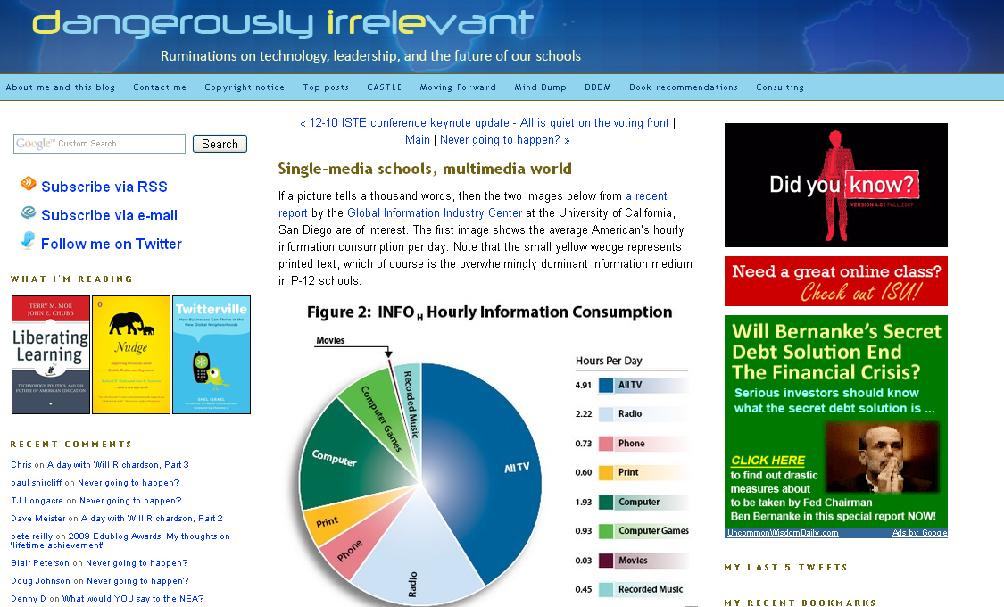

Slide 20
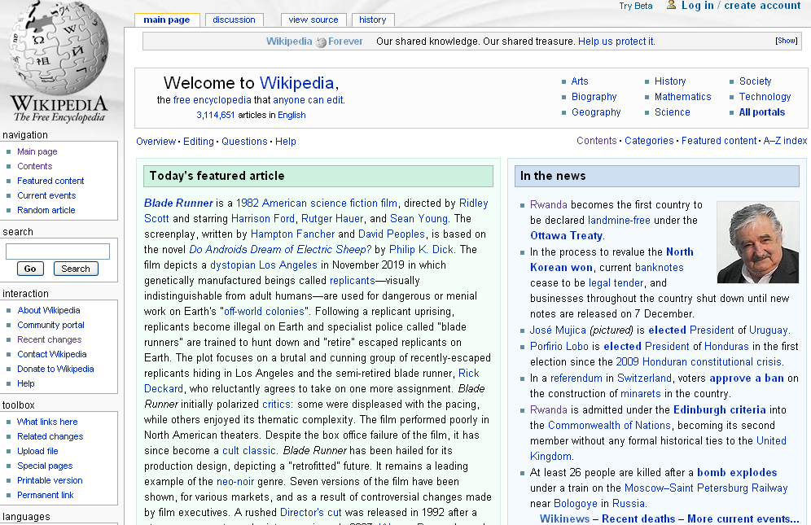

Slide 21
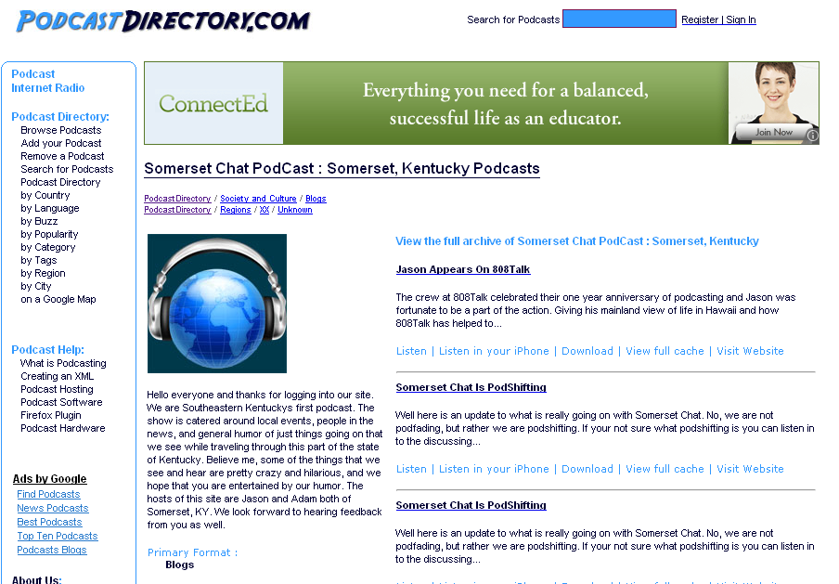

Slide 22
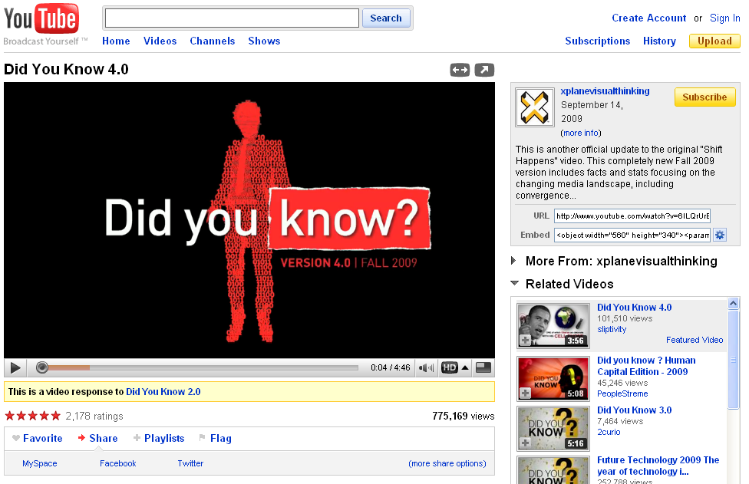

Slide 23
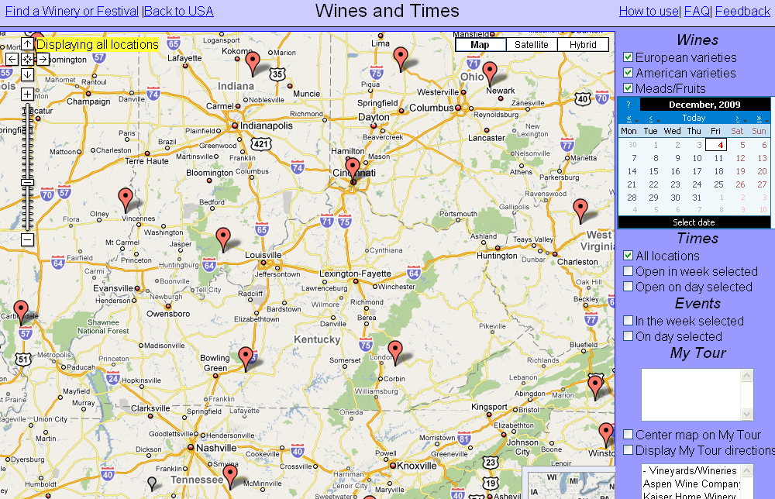

Slide 24
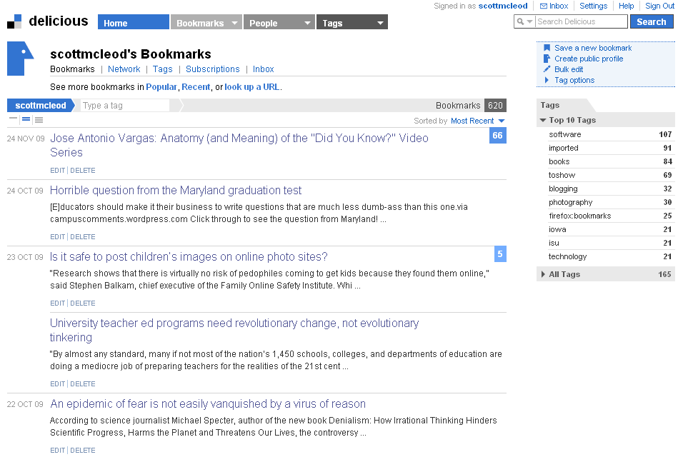

Slide 25
New information landscape

Slide 26


Slide 27


Slide 28
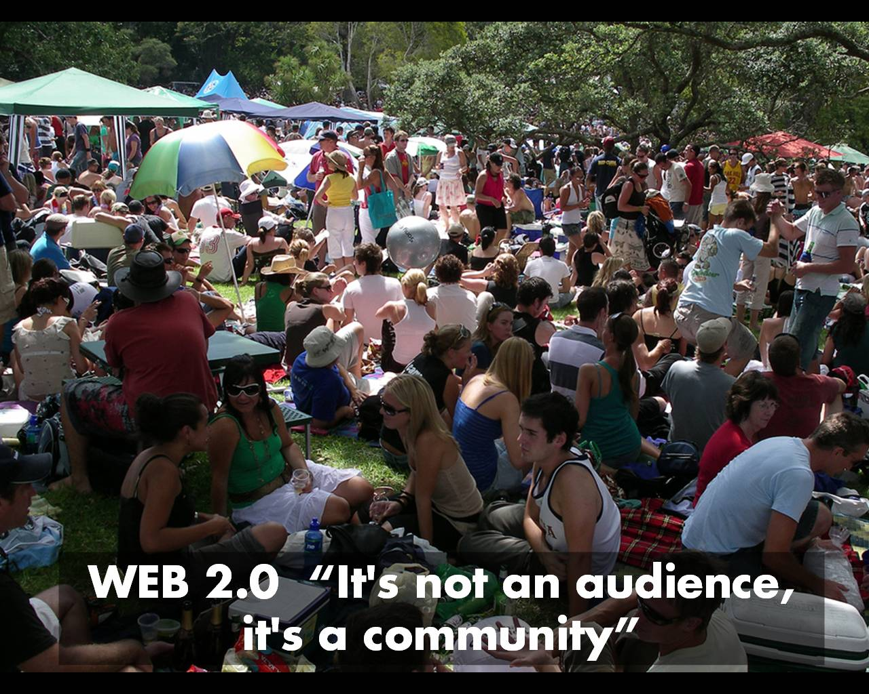

Slide 29
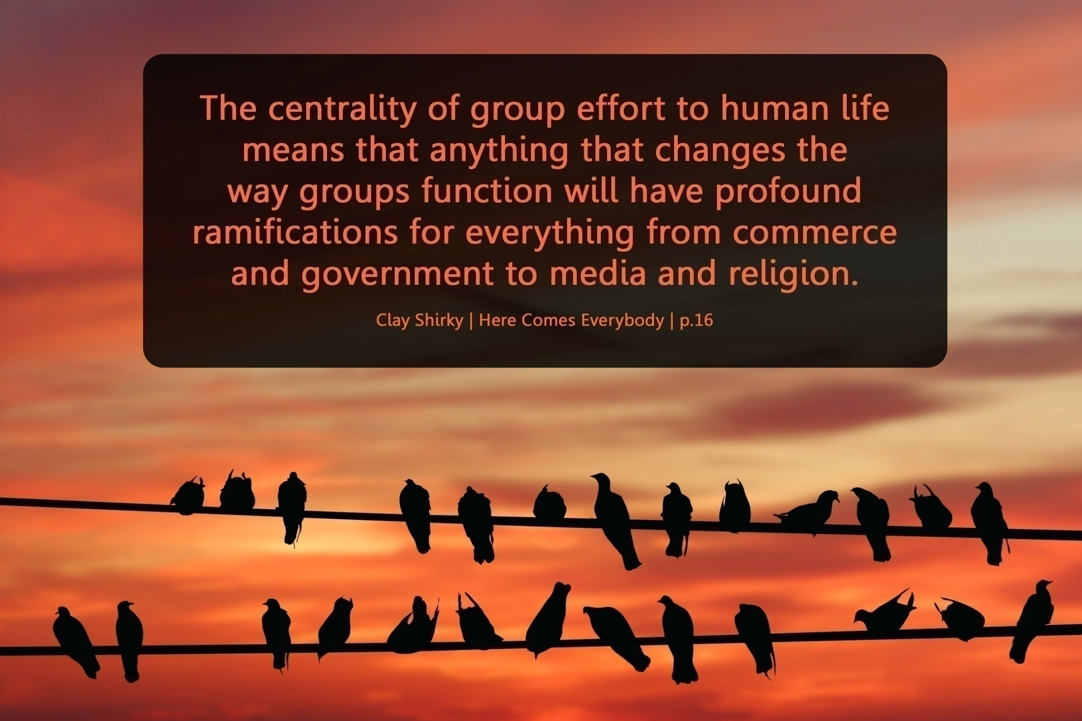

Slide 30
We are hyper-connected

Slide 31



Slide 32
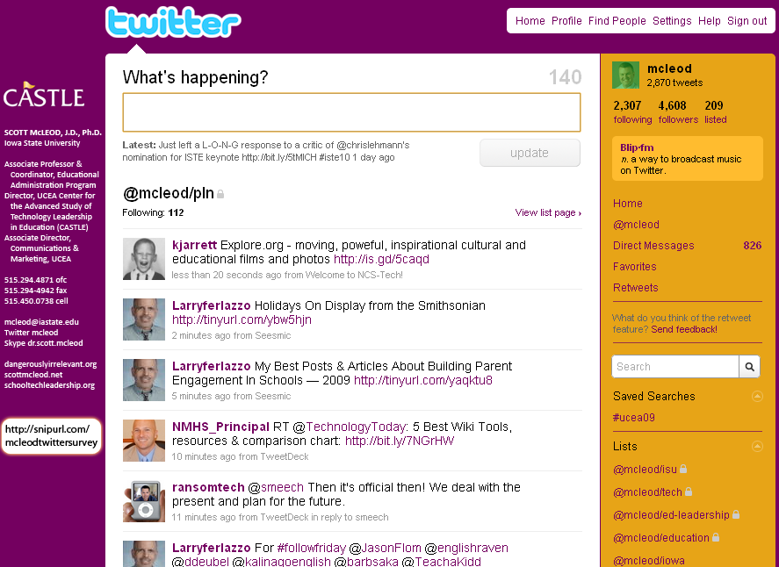

Slide 33
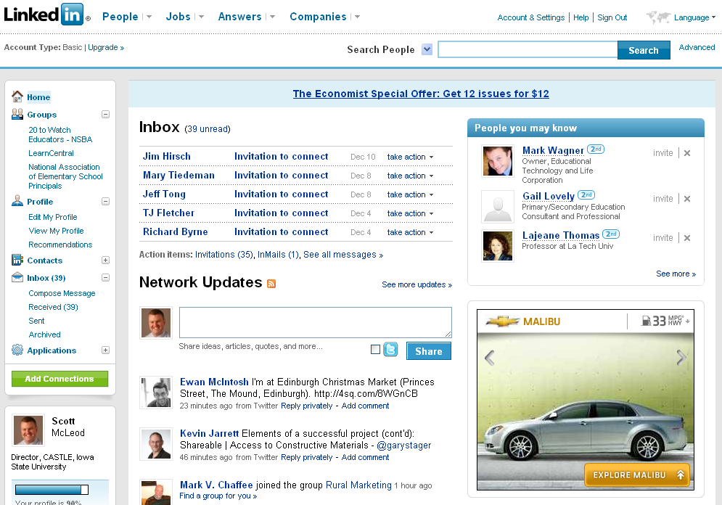

Slide 34


Slide 35
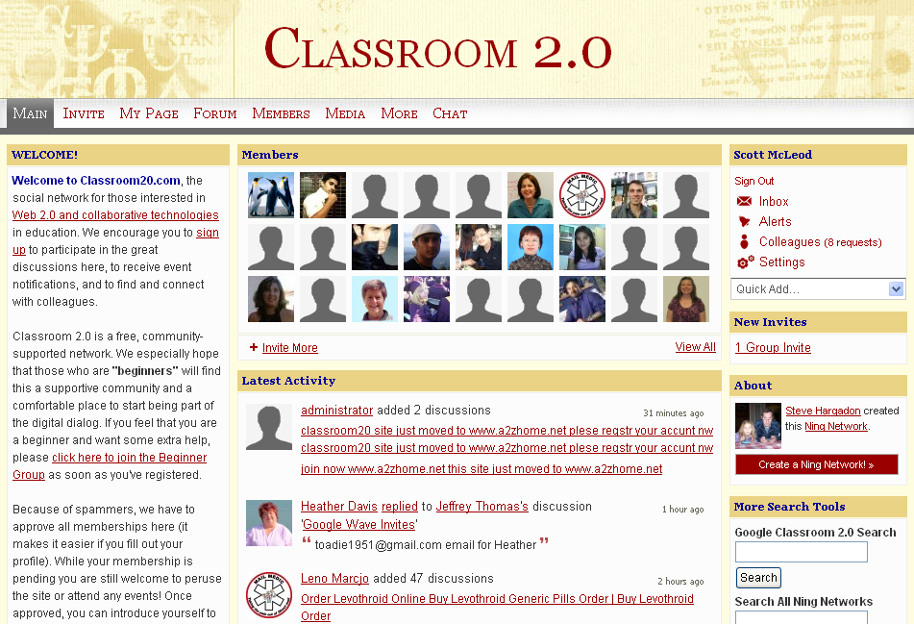

Slide 36
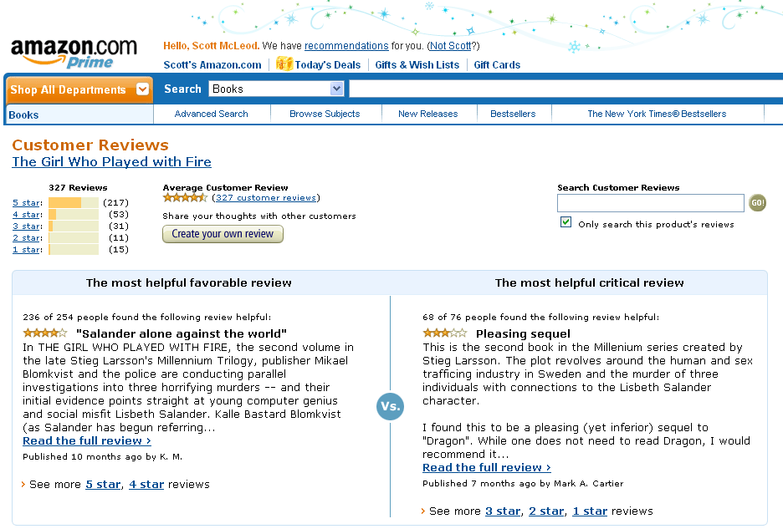

Slide 37
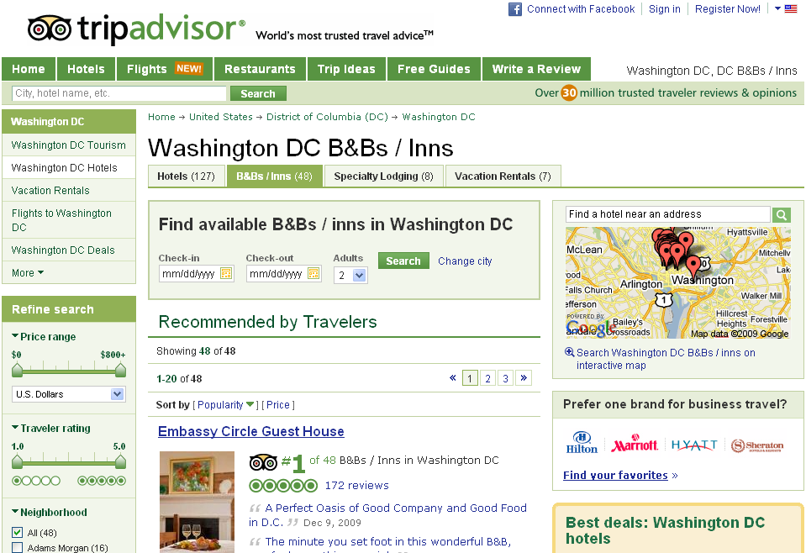

Slide 38


Slide 39


Slide 40


Slide 41
We all now have a voice
(and can find each other, share, connect, collaborate)

Slide 42
Anytime/anywhere content production, connection, collaboration…

Slide 43
[ pause ]

Slide 44
Lightning round

Slide 45

CHANGE
OR DIE

Slide 46
newspapers,
magazines

Slide 47
music

Slide 48
radio

Slide 49
television

Slide 50
movies

Slide 51
books,
reading

Slide 52
maps, travel,
travel agencies

Slide 53
business,
personal finance,
money management

Slide 54
medicine,
health

Slide 55
postal service

Slide 56
real estate

Slide 57
politics

Slide 58
universities

Slide 59
Information-oriented

Slide 60
P-12
schools

Slide 61
CHANGE
OR DIE

Slide 62
[ pause ]

Slide 63
Big shift 2

Slide 64
Percentile change in
importance of task type
in U.S. economy
Abstract
Routine
Manual
Autor, D., Levy, F., & Murnane, R. J. (2003). The skill content of recent technological change:
An empirical exploration. Quarterly Journal of Economics 188, 4. [updated, D. Autor, 2008]

Slide 65
global awareness
effective speaking
critical thinking
problem solving
adaptability
information literacy
collaboration
creativity
media fluency
analytical skills
entrepeneurialism
innovation
effective writing
synthesis
curiosity

Slide 66
Growth of the creative class
Florida, R. (2002). The rise of the creative class (p. 332). New York, NY: Basic Books.

Slide 67
Growth of the creative class
Florida, R. (2002). The rise of the creative class (p. 332). New York, NY: Basic Books.

Slide 68
MANUFACTURING IN IOWA
% of all Iowa jobs
in May ‘08
% of overall job losses
by Sep ‘09

Slide 69
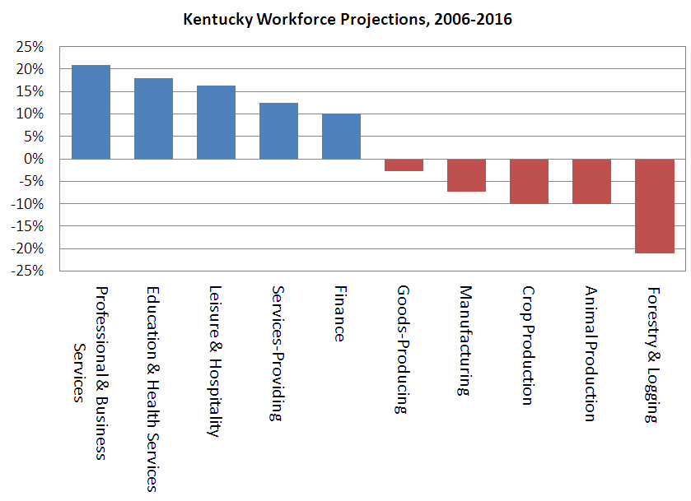

Slide 70
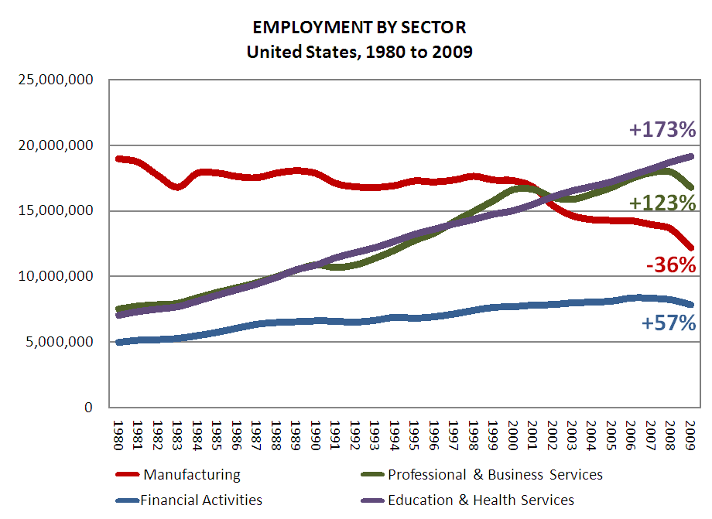

Slide 71
Globalization of economy

Slide 72
  Can someone overseas
  do it cheaper?
  Can a computer
  do it faster?

Slide 73


Slide 74
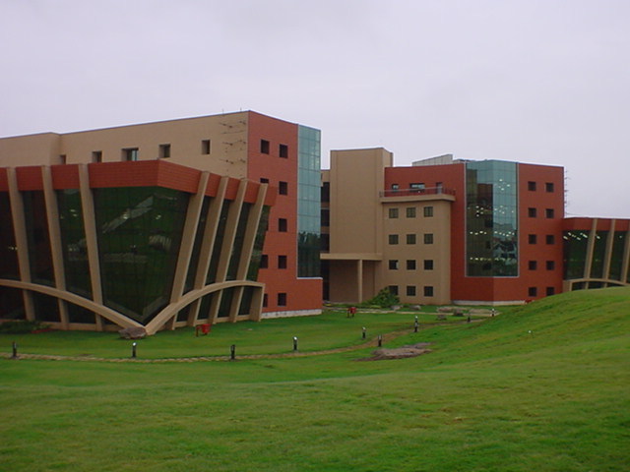

Slide 75
2.5 billion

Slide 76
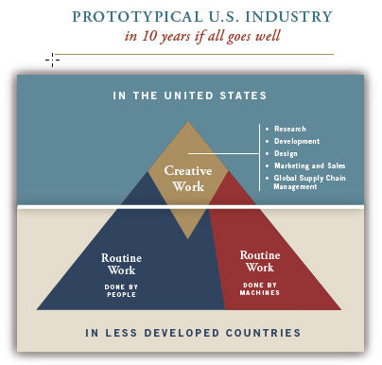

Slide 77
Hyperconnected global economy
Offshoring
Replacement of jobs with software

Slide 78
Characteristics of the job
NOT
Characteristics of the person

Slide 79
[ pause ]

Slide 80
1 big problem

Slide 81
  Socially functional
  Mastery of information landscape
  Economically productive

Slide 82

Notes:
82

Slide 83
The fundamental dilemma
but now are
expected to
do this
Schools were
designed
for this …

Slide 84
What we have right now
uniqueness
uniqueness
one right answer
Notes:
84

Slide 85
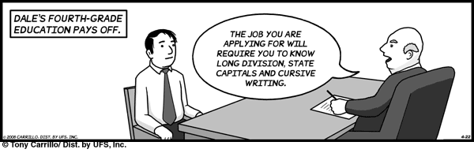
Notes:
THIS SLIDE IS COPYRIGHT-PROTECTED. I GOT SPECIAL PERMISSION FROM THE CARTOONIST, TONY CARRILLO, TO USE IT.
85

Slide 86
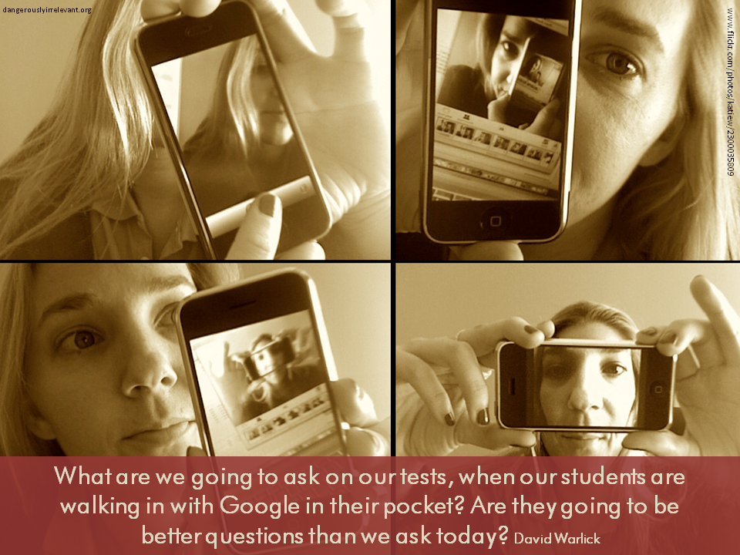

Slide 87

Notes:
87

Slide 88
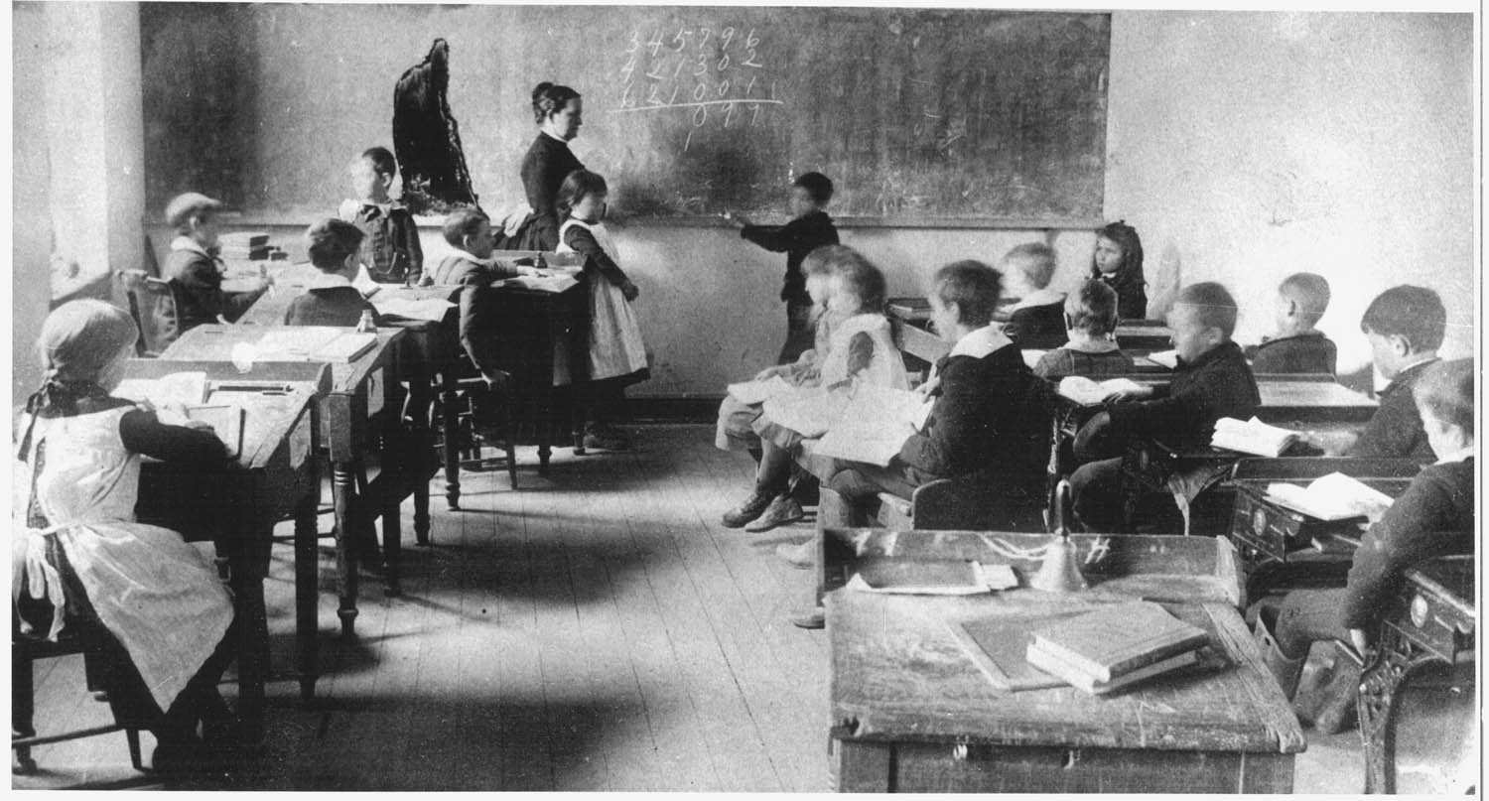
Notes:
88

Slide 89
The chief source of the “problem of discipline” in schools is that … a premium is put on physical quietude; on silence, on rigid uniformity of posture and movement; upon a machine-like simulation of the attitudes of intelligent interest. The teachers’ business is to hold the pupils up to these requirements and to punish the inevitable deviations which occur.
John Dewey, Democracy and Education (1916)

Slide 90
Once you have learned how to ask questions – relevant and appropriate and substantial questions – you have learned how to learn and no one can keep you from learning whatever you want or need to know . . . [However,] what students are restricted to (solely and even vengefully) is the process of memorizing . . . somebody else’s answers to somebody else’s questions. . . . It is doubtful if you can think of many schools that include question-asking, or methods of inquiry, as part of their curriculum.
Neil Postman & Charles Weingartner, Teaching as a Subversive Activity (1969)

Slide 91
The data from our observations in more than 1,000 classrooms support the popular image of a teacher standing or sitting in front of a class imparting knowledge to a group of students. Explaining and lecturing constituted the most frequent teaching activities …
Three categories of student activity marked by passivity - written work, listening, and preparing for assignments - dominate …
John Goodlad, A Place Called School (1984)

Slide 92
When you code classroom practice for level of cognitive demand . . . 80% of the work is at the factual and procedural level. . . . [Teachers] will do low-level work and call it high-level work.
Richard Elmore, excerpt from Education Leadership as the Practice of Improvement (2006)

Slide 93
Classrooms in which there was evidence of higher-order thinking: 3 percent. . . .
Classrooms in which fewer than one-half of students were paying attention: 85 percent.
Mike Schmoker, Results Now (2006) [citing a study of 1,500+ classroom observations]

Slide 94
The average fifth grader received five times as much instruction in basic skills as instruction focused on problem solving or reasoning; this ratio was 10:1 in first and third grades.
Robert C. Pianta, et al., Opportunities to Learn in America’s Elementary Classrooms (2007)
[study of 2500+ classrooms in more than 1,000 elementary schools and 400 school districts]

Slide 95

Notes:
For the past five years, the national conversation on education has focused on reading scores, math tests and closing the "achievement gap" between social classes. This is not a story about that conversation.
This is a story about the big public conversation the nation is not having about education, the one that will ultimately determine not merely whether some fraction of our children get "left behind" but also whether an entire generation of kids will fail to make the grade in the global economy because they can't think their way through abstract problems, work in teams, distinguish good information from bad or speak a language other than English.

Slide 96

While we teach whatever we teach at school, the kids go home and learn the skills they need to survive and prosper in an interconnected global economy.
Clarence Fisher
Notes:
As a result…
http://remoteaccess.typepad.com/remote_access/2005/11/educational_lea.html
Incrementally changing our teaching methods, slowly bringing people up to speed . . . worked fine when ideas of literacy and education were not rapidly changing; but they are. We need to be able to leapfrog in our understandings, in our methods, and in our tools, allowing us to move to where the kids are. If we do not become leaders to our students, we will be followers, seen as irrelevant, and left to cry in our books.

Slide 97

No generation in history has ever been so
thoroughly prepared for the industrial age.
David Warlick
http://davidwarlick.com/2cents/?p=298
dangerouslyirrelevant.org

Slide 98


Slide 99
[ pause ]

Slide 100
Takeaways

Slide 101
K-12 education is facing multiple disruptive innovations.

Slide 102
The existing educational model is not a given.

Slide 103
This is sneaking up on most school organizations.

Slide 104
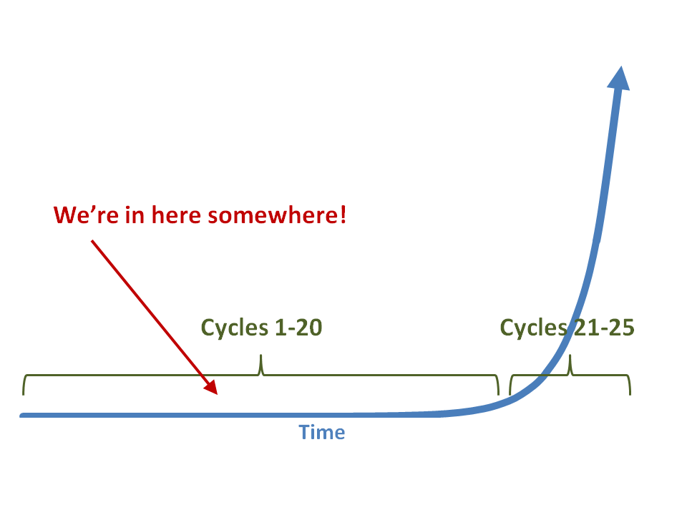

Slide 105
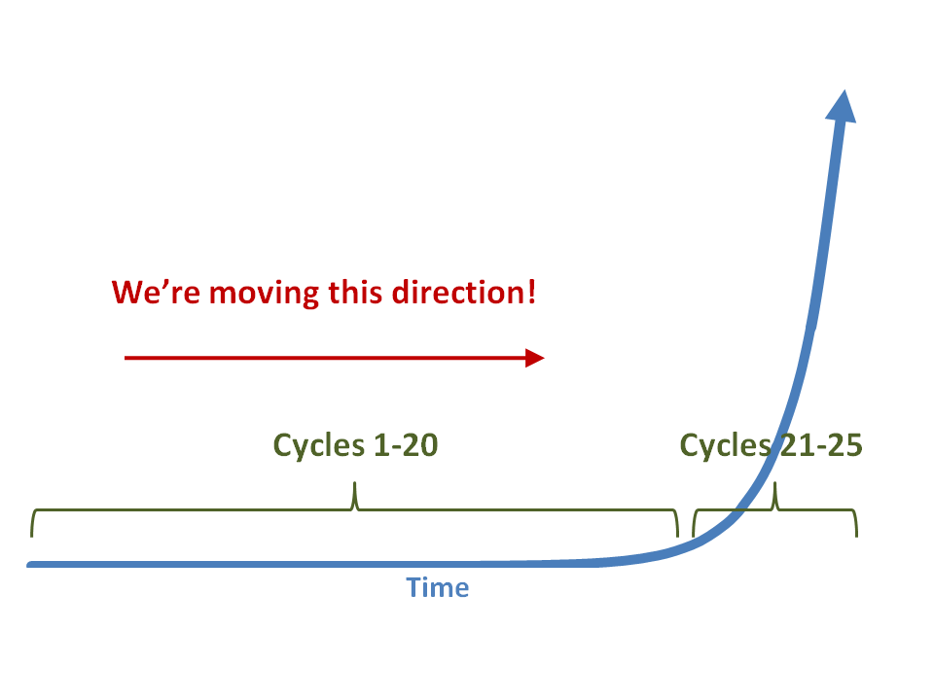

Slide 106
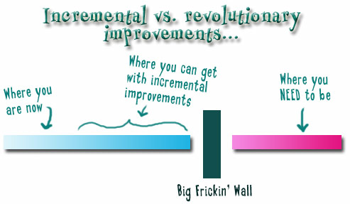
Notes:
We need to somehow
change faster
No one jumps a 20 foot chasm in two
10 foot jumps. – Miguel Guhlin
When the world changes so fast that we have no reasonable way to forecast what it will look like in a mere decade or two, all we can do is teach kids how to be adaptive – to be learners in the truest sense of the word –
We’ve always talked about preparing lifelong learners in schools, but our practices typically haven’t matched our rhetoric. It’s time to put some bite into our toothless vision statements and recognize that we have to teach kids how to learn to learn if they want to be successful in this new technology-suffused, globally-interconnected world
Credits: http://tinyurl.com/2urbsm and http://tinyurl.com/37em64 (see Guhlin comment)
http://remoteaccess.typepad.com/remote_access/
2006/06/literacy_as_bat.html (see Guhlin comment)
http://headrush.typepad.com/creating_passionate_users/2005/03/incremental_vs_.html

Slide 107


Slide 108
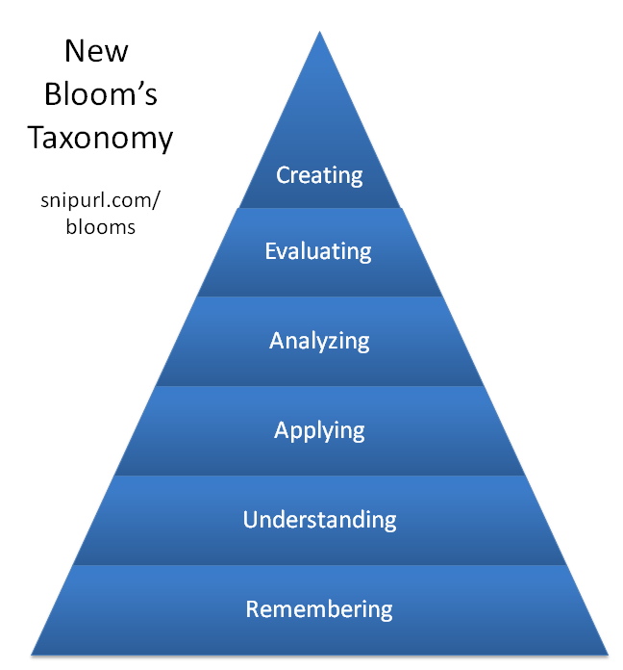

Slide 109


Slide 110
Federal, state, and local
laws, policies, and
funding support
Competency-based curricula that emphasize 21st century skills
Preservice and inservice training for teachers and administrators
Statewide
no-cost or
low-cost broadband wireless access
Computing device in every student’s hands
P-20 coordination, cooperation,
and vertical articulation
Robust statewide
online learning infrastructure for students and teachers
Monitoring, assessment,
and evaluation
Mindset shift:
The digital, global
age is here!
Notes:
Curricula that emphasize 21st century skills. Instead of simply adding on 21st century skills to our existing content-based standards, put them at the core of new, more focused curricula.
Preservice and inservice training for teachers and administrators. Training in colleges and universities. Training on the job. Regular, frequent, strategic, and ongoing.
Robust statewide online learning infrastructure for students and teachers.Because of resources or geography, high-level and credit recovery courses aren’t available to many students. Training opportunities aren’t available to educators. A vibrant system of online courses can help.
Computing device in every student’s hands. Laptops. Netbooks. Smartphones. Devices that have some power, are mobile, allow students to type, and can access the Internet.
Statewide no-cost or low-cost broadband wireless access. High-speed wireless in every corner of the state.
P-20 coordination, cooperation, and vertical articulation. Curricular, programmatic, workforce development, and other alignment across the P-20 spectrum.
Some supports need to be in place to facilitate effective implementation…
Federal, state, and local laws, policies, and funding support. A thoughtful, helpful array of legal, policy, and funding supports for what needs to be done.
Monitoring, assessment, and evaluation. Regular, frequent, ongoing. To inform practice, not just for accountability.
Mindset shift. The digital, global age is here. It’s time to learn how to survive and thrive in it rather than being afraid of it or ignoring it.

Slide 111
Federal, state, and local
laws, policies, and
funding support
Competency-based curricula that emphasize 21st century skills
Preservice and inservice training for teachers and administrators
Statewide
no-cost or
low-cost broadband wireless access
Computing device in every student’s hands
P-20 coordination, cooperation,
and vertical articulation
Robust statewide
online learning infrastructure for students and teachers
Monitoring, assessment,
and evaluation
Mindset shift:
The digital, global
age is here!
Notes:
Curricula that emphasize 21st century skills. Instead of simply adding on 21st century skills to our existing content-based standards, put them at the core of new, more focused curricula.
Preservice and inservice training for teachers and administrators. Training in colleges and universities. Training on the job. Regular, frequent, strategic, and ongoing.
Robust statewide online learning infrastructure for students and teachers.Because of resources or geography, high-level and credit recovery courses aren’t available to many students. Training opportunities aren’t available to educators. A vibrant system of online courses can help.
Computing device in every student’s hands. Laptops. Netbooks. Smartphones. Devices that have some power, are mobile, allow students to type, and can access the Internet.
Statewide no-cost or low-cost broadband wireless access. High-speed wireless in every corner of the state.
P-20 coordination, cooperation, and vertical articulation. Curricular, programmatic, workforce development, and other alignment across the P-20 spectrum.
Some supports need to be in place to facilitate effective implementation…
Federal, state, and local laws, policies, and funding support. A thoughtful, helpful array of legal, policy, and funding supports for what needs to be done.
Monitoring, assessment, and evaluation. Regular, frequent, ongoing. To inform practice, not just for accountability.
Mindset shift. The digital, global age is here. It’s time to learn how to survive and thrive in it rather than being afraid of it or ignoring it.

Slide 112
Federal, state, and local
laws, policies, and
funding support
Competency-based curricula that emphasize 21st century skills
Preservice and inservice training for teachers and administrators
Statewide
no-cost or
low-cost broadband wireless access
Computing device in every student’s hands
P-20 coordination, cooperation,
and vertical articulation
Robust statewide
online learning infrastructure for students and teachers
Monitoring, assessment,
and evaluation
Mindset shift:
The digital, global
age is here!
Notes:
Curricula that emphasize 21st century skills. Instead of simply adding on 21st century skills to our existing content-based standards, put them at the core of new, more focused curricula.
Preservice and inservice training for teachers and administrators. Training in colleges and universities. Training on the job. Regular, frequent, strategic, and ongoing.
Robust statewide online learning infrastructure for students and teachers.Because of resources or geography, high-level and credit recovery courses aren’t available to many students. Training opportunities aren’t available to educators. A vibrant system of online courses can help.
Computing device in every student’s hands. Laptops. Netbooks. Smartphones. Devices that have some power, are mobile, allow students to type, and can access the Internet.
Statewide no-cost or low-cost broadband wireless access. High-speed wireless in every corner of the state.
P-20 coordination, cooperation, and vertical articulation. Curricular, programmatic, workforce development, and other alignment across the P-20 spectrum.
Some supports need to be in place to facilitate effective implementation…
Federal, state, and local laws, policies, and funding support. A thoughtful, helpful array of legal, policy, and funding supports for what needs to be done.
Monitoring, assessment, and evaluation. Regular, frequent, ongoing. To inform practice, not just for accountability.
Mindset shift. The digital, global age is here. It’s time to learn how to survive and thrive in it rather than being afraid of it or ignoring it.

Slide 113
Federal, state, and local
laws, policies, and
funding support
Competency-based curricula that emphasize 21st century skills
Preservice and inservice training for teachers and administrators
Statewide
no-cost or
low-cost broadband wireless access
Computing device in every student’s hands
P-20 coordination, cooperation,
and vertical articulation
Robust statewide
online learning infrastructure for students and teachers
Monitoring, assessment,
and evaluation
Mindset shift:
The digital, global
age is here!
Notes:
Curricula that emphasize 21st century skills. Instead of simply adding on 21st century skills to our existing content-based standards, put them at the core of new, more focused curricula.
Preservice and inservice training for teachers and administrators. Training in colleges and universities. Training on the job. Regular, frequent, strategic, and ongoing.
Robust statewide online learning infrastructure for students and teachers.Because of resources or geography, high-level and credit recovery courses aren’t available to many students. Training opportunities aren’t available to educators. A vibrant system of online courses can help.
Computing device in every student’s hands. Laptops. Netbooks. Smartphones. Devices that have some power, are mobile, allow students to type, and can access the Internet.
Statewide no-cost or low-cost broadband wireless access. High-speed wireless in every corner of the state.
P-20 coordination, cooperation, and vertical articulation. Curricular, programmatic, workforce development, and other alignment across the P-20 spectrum.
Some supports need to be in place to facilitate effective implementation…
Federal, state, and local laws, policies, and funding support. A thoughtful, helpful array of legal, policy, and funding supports for what needs to be done.
Monitoring, assessment, and evaluation. Regular, frequent, ongoing. To inform practice, not just for accountability.
Mindset shift. The digital, global age is here. It’s time to learn how to survive and thrive in it rather than being afraid of it or ignoring it.

Slide 114
Federal, state, and local
laws, policies, and
funding support
Competency-based curricula that emphasize 21st century skills
Preservice and inservice training for teachers and administrators
Statewide
no-cost or
low-cost broadband wireless access
Computing device in every student’s hands
P-20 coordination, cooperation,
and vertical articulation
Robust statewide
online learning infrastructure for students and teachers
Monitoring, assessment,
and evaluation
Mindset shift:
The digital, global
age is here!
Notes:
Curricula that emphasize 21st century skills. Instead of simply adding on 21st century skills to our existing content-based standards, put them at the core of new, more focused curricula.
Preservice and inservice training for teachers and administrators. Training in colleges and universities. Training on the job. Regular, frequent, strategic, and ongoing.
Robust statewide online learning infrastructure for students and teachers.Because of resources or geography, high-level and credit recovery courses aren’t available to many students. Training opportunities aren’t available to educators. A vibrant system of online courses can help.
Computing device in every student’s hands. Laptops. Netbooks. Smartphones. Devices that have some power, are mobile, allow students to type, and can access the Internet.
Statewide no-cost or low-cost broadband wireless access. High-speed wireless in every corner of the state.
P-20 coordination, cooperation, and vertical articulation. Curricular, programmatic, workforce development, and other alignment across the P-20 spectrum.
Some supports need to be in place to facilitate effective implementation…
Federal, state, and local laws, policies, and funding support. A thoughtful, helpful array of legal, policy, and funding supports for what needs to be done.
Monitoring, assessment, and evaluation. Regular, frequent, ongoing. To inform practice, not just for accountability.
Mindset shift. The digital, global age is here. It’s time to learn how to survive and thrive in it rather than being afraid of it or ignoring it.

Slide 115
Federal, state, and local
laws, policies, and
funding support
Competency-based curricula that emphasize 21st century skills
Preservice and inservice training for teachers and administrators
Statewide
no-cost or
low-cost broadband wireless access
Computing device in every student’s hands
P-20 coordination, cooperation,
and vertical articulation
Robust statewide
online learning infrastructure for students and teachers
Monitoring, assessment,
and evaluation
Mindset shift:
The digital, global
age is here!
Notes:
Curricula that emphasize 21st century skills. Instead of simply adding on 21st century skills to our existing content-based standards, put them at the core of new, more focused curricula.
Preservice and inservice training for teachers and administrators. Training in colleges and universities. Training on the job. Regular, frequent, strategic, and ongoing.
Robust statewide online learning infrastructure for students and teachers.Because of resources or geography, high-level and credit recovery courses aren’t available to many students. Training opportunities aren’t available to educators. A vibrant system of online courses can help.
Computing device in every student’s hands. Laptops. Netbooks. Smartphones. Devices that have some power, are mobile, allow students to type, and can access the Internet.
Statewide no-cost or low-cost broadband wireless access. High-speed wireless in every corner of the state.
P-20 coordination, cooperation, and vertical articulation. Curricular, programmatic, workforce development, and other alignment across the P-20 spectrum.
Some supports need to be in place to facilitate effective implementation…
Federal, state, and local laws, policies, and funding support. A thoughtful, helpful array of legal, policy, and funding supports for what needs to be done.
Monitoring, assessment, and evaluation. Regular, frequent, ongoing. To inform practice, not just for accountability.
Mindset shift. The digital, global age is here. It’s time to learn how to survive and thrive in it rather than being afraid of it or ignoring it.

Slide 116
Federal, state, and local
laws, policies, and
funding support
Competency-based curricula that emphasize 21st century skills
Preservice and inservice training for teachers and administrators
Statewide
no-cost or
low-cost broadband wireless access
Computing device in every student’s hands
P-20 coordination, cooperation,
and vertical articulation
Robust statewide
online learning infrastructure for students and teachers
Monitoring, assessment,
and evaluation
Mindset shift:
The digital, global
age is here!
Notes:
Curricula that emphasize 21st century skills. Instead of simply adding on 21st century skills to our existing content-based standards, put them at the core of new, more focused curricula.
Preservice and inservice training for teachers and administrators. Training in colleges and universities. Training on the job. Regular, frequent, strategic, and ongoing.
Robust statewide online learning infrastructure for students and teachers.Because of resources or geography, high-level and credit recovery courses aren’t available to many students. Training opportunities aren’t available to educators. A vibrant system of online courses can help.
Computing device in every student’s hands. Laptops. Netbooks. Smartphones. Devices that have some power, are mobile, allow students to type, and can access the Internet.
Statewide no-cost or low-cost broadband wireless access. High-speed wireless in every corner of the state.
P-20 coordination, cooperation, and vertical articulation. Curricular, programmatic, workforce development, and other alignment across the P-20 spectrum.
Some supports need to be in place to facilitate effective implementation…
Federal, state, and local laws, policies, and funding support. A thoughtful, helpful array of legal, policy, and funding supports for what needs to be done.
Monitoring, assessment, and evaluation. Regular, frequent, ongoing. To inform practice, not just for accountability.
Mindset shift. The digital, global age is here. It’s time to learn how to survive and thrive in it rather than being afraid of it or ignoring it.

Slide 117
Federal, state, and local
laws, policies, and
funding support
Competency-based curricula that emphasize 21st century skills
Preservice and inservice training for teachers and administrators
Statewide
no-cost or
low-cost broadband wireless access
Computing device in every student’s hands
P-20 coordination, cooperation,
and vertical articulation
Robust statewide
online learning infrastructure for students and teachers
Monitoring, assessment,
and evaluation
Mindset shift:
The digital, global
age is here!
Notes:
Curricula that emphasize 21st century skills. Instead of simply adding on 21st century skills to our existing content-based standards, put them at the core of new, more focused curricula.
Preservice and inservice training for teachers and administrators. Training in colleges and universities. Training on the job. Regular, frequent, strategic, and ongoing.
Robust statewide online learning infrastructure for students and teachers.Because of resources or geography, high-level and credit recovery courses aren’t available to many students. Training opportunities aren’t available to educators. A vibrant system of online courses can help.
Computing device in every student’s hands. Laptops. Netbooks. Smartphones. Devices that have some power, are mobile, allow students to type, and can access the Internet.
Statewide no-cost or low-cost broadband wireless access. High-speed wireless in every corner of the state.
P-20 coordination, cooperation, and vertical articulation. Curricular, programmatic, workforce development, and other alignment across the P-20 spectrum.
Some supports need to be in place to facilitate effective implementation…
Federal, state, and local laws, policies, and funding support. A thoughtful, helpful array of legal, policy, and funding supports for what needs to be done.
Monitoring, assessment, and evaluation. Regular, frequent, ongoing. To inform practice, not just for accountability.
Mindset shift. The digital, global age is here. It’s time to learn how to survive and thrive in it rather than being afraid of it or ignoring it.

Slide 118
Federal, state, and local
laws, policies, and
funding support
Competency-based curricula that emphasize 21st century skills
Preservice and inservice training for teachers and administrators
Statewide
no-cost or
low-cost broadband wireless access
Computing device in every student’s hands
P-20 coordination, cooperation,
and vertical articulation
Robust statewide
online learning infrastructure for students and teachers
Monitoring, assessment,
and evaluation
Mindset shift:
The digital, global
age is here!
Notes:
Curricula that emphasize 21st century skills. Instead of simply adding on 21st century skills to our existing content-based standards, put them at the core of new, more focused curricula.
Preservice and inservice training for teachers and administrators. Training in colleges and universities. Training on the job. Regular, frequent, strategic, and ongoing.
Robust statewide online learning infrastructure for students and teachers.Because of resources or geography, high-level and credit recovery courses aren’t available to many students. Training opportunities aren’t available to educators. A vibrant system of online courses can help.
Computing device in every student’s hands. Laptops. Netbooks. Smartphones. Devices that have some power, are mobile, allow students to type, and can access the Internet.
Statewide no-cost or low-cost broadband wireless access. High-speed wireless in every corner of the state.
P-20 coordination, cooperation, and vertical articulation. Curricular, programmatic, workforce development, and other alignment across the P-20 spectrum.
Some supports need to be in place to facilitate effective implementation…
Federal, state, and local laws, policies, and funding support. A thoughtful, helpful array of legal, policy, and funding supports for what needs to be done.
Monitoring, assessment, and evaluation. Regular, frequent, ongoing. To inform practice, not just for accountability.
Mindset shift. The digital, global age is here. It’s time to learn how to survive and thrive in it rather than being afraid of it or ignoring it.

Slide 119
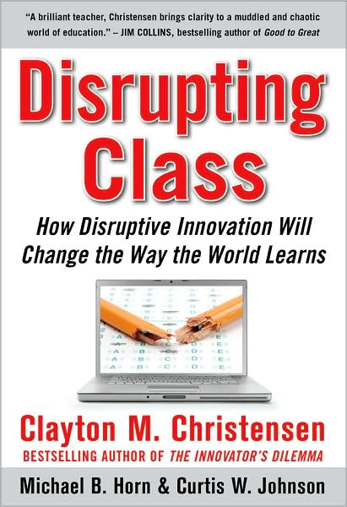

Slide 120

Notes:
Anticipatory v. reactionary

Slide 121

Notes:
Future oriented v. compliance oriented

Slide 122

The people in charge
of leading school
organizations into the
21st century …
often are the
least knowledgeable
about the 21st century.
dangerouslyirrelevant.org
Notes:
Licensed under a Creative Commons attribution-share alike license.
http://creativecommons.org/licenses/by-sa/3.0
Scott McLeod, J.D., Ph.D.
scottmcleod.net/contact
dangerouslyirrelevant.org
schooltechleadership.org

Slide 123

If the leaders
don’t get it,
it’s not going
to happen.
dangerouslyirrelevant.org
Notes:
Licensed under a Creative Commons attribution-share alike license.
http://creativecommons.org/licenses/by-sa/3.0
Scott McLeod, J.D., Ph.D.
scottmcleod.net/contact
dangerouslyirrelevant.org
schooltechleadership.org

Slide 124


Slide 125
Am I
facilitating
linear or
exponential
change
in my school?

Slide 126
Am I modeling
for students and staff these
new literacies?
Notes:
Blogging
Wikis
Podcasting
Online video
Social networking
RSS readers
Active consumption AND PRODUCTION of digital content?
Student projects that are doing this stuff?
Web is now social – are you living the INTERACTIVE Web (why not?)

Slide 127
Do I truly
“get it?”
Am I doing
what I
should be?

Slide 128

No one will thank you
for taking care of today
if you have failed
to take care of tomorrow.
Joel Barker

Slide 129
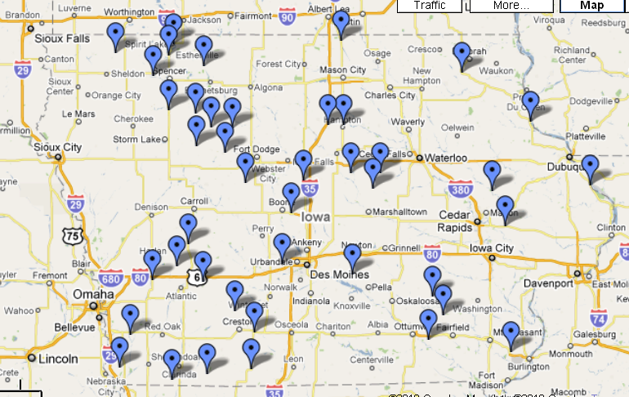

Slide 130

Notes:
Licensed under a Creative Commons attribution-share alike license.
http://creativecommons.org/licenses/by-sa/3.0
Scott McLeod, J.D., Ph.D.
dangerouslyirrelevant.org
schooltechleadership.org
dangerouslyirrelevant.org/contact.html

Slide 131
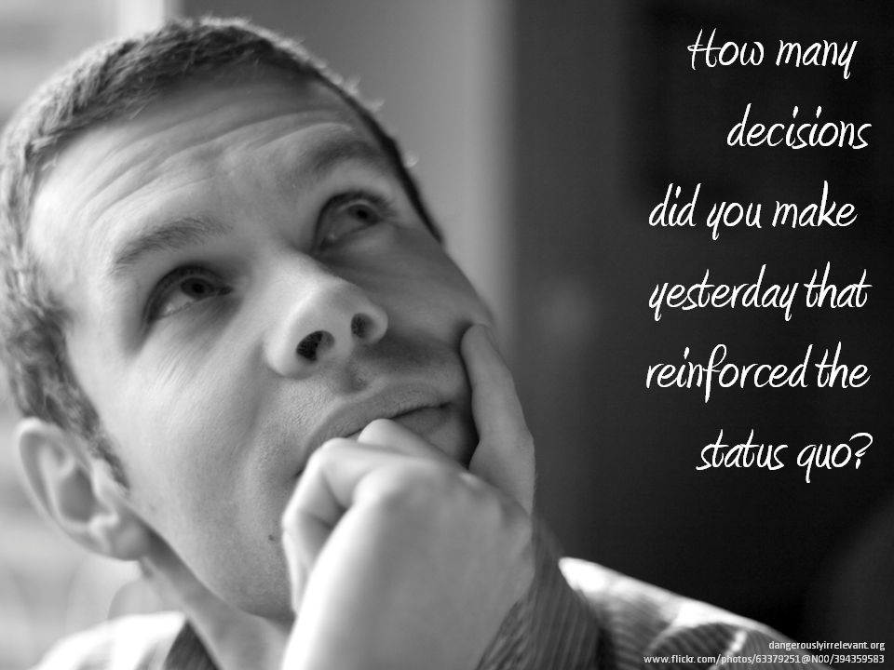

Slide 132


Slide 133
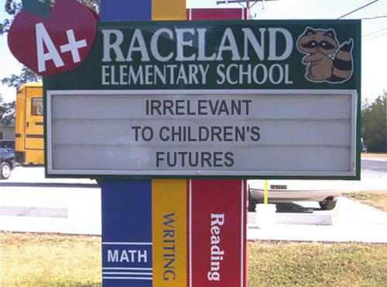
Notes:
133

Slide 134
Thank you!
Scott McLeod, J.D., Ph.D.
Director, CASTLE
dangerouslyirrelevant.org/wasda
Notes:
134
All of my materials are licensed under a Creative Commons attribution-share alike license (http://creativecommons.org/licenses/by-sa/3.0). That means not only that you are welcome to share and/or remix my content but that you are encouraged to do so! All I ask is that you properly credit me for my content and that you not place any greater copyright restrictions than I have on the content that utilizes my material. If possible, including the URL of Dangerously Irrelevant in your content would be most appreciated.
Scott McLeod, J.D., Ph.D.
dangerouslyirrelevant.org
schooltechleadership.org
dangerouslyirrelevant.org/contact.html

Slide 135
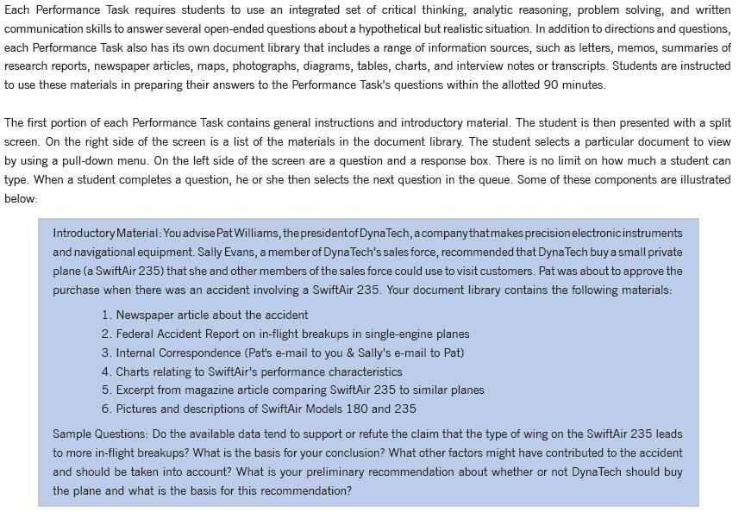

Slide 136


