Slide 1
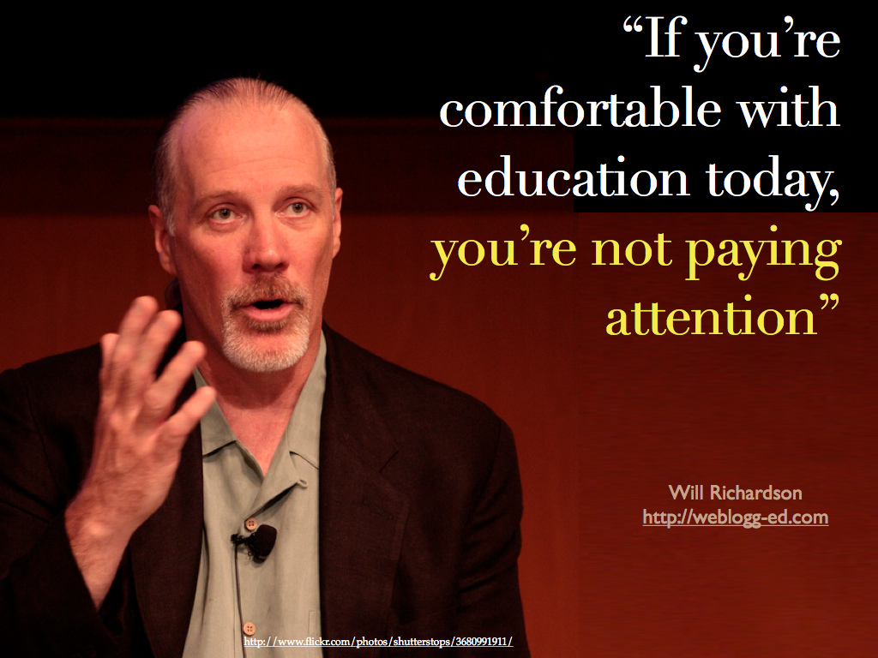

Slide 2

Two big
shifts.
One big
problem.
Dr. Scott McLeod
CASTLE

Slide 3
Our new
information
landscape

Slide 4
Our new
economic
landscape

Slide 5
  Societally functional
  Mastery of information landscape
  Economically productive

Slide 6
Our new
information
landscape

Slide 7


Slide 8


Slide 9


Slide 10


Slide 11


Slide 12


Slide 13


Slide 14


Slide 15


Slide 16


Slide 17


Slide 18


Slide 19


Slide 20



Slide 21


Slide 22


Slide 23


Slide 24


Slide 25


Slide 26


Slide 27


Slide 28


Slide 29


Slide 30


Slide 31
We all now have a voice

Slide 32
We can easily find each other

Slide 33
We can easily work together

Slide 34


Slide 35


Slide 36
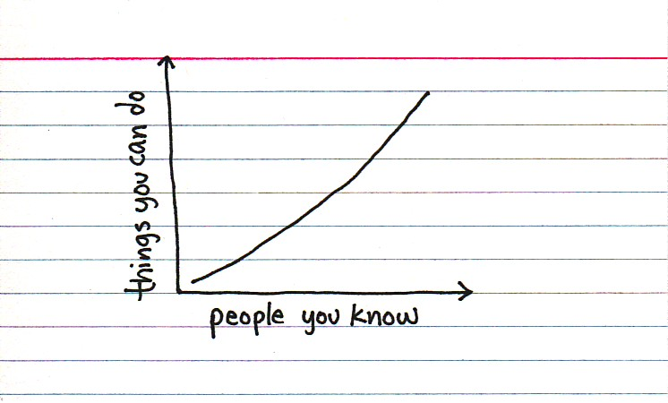

Slide 37


Slide 38

Notes:
http://www.flickr.com/photos/deks/711658920/sizes/z/

Slide 39

Notes:
http://www.flickr.com/photos/sepblog/3527825643/sizes/o/

Slide 40

Notes:
http://www.flickr.com/photos/13638129@N00/118245563/

Slide 41

Notes:
http://www.flickr.com/photos/7337467@N04/3052065204/

Slide 42

Notes:
http://www.flickr.com/photos/77136818@N00/3202144482/

Slide 43

Notes:
http://www.flickr.com/photos/20532289@N00/59083917/

Slide 44

Notes:
http://www.flickr.com/photos/48973657@N00/4556156477/

Slide 45

Notes:
http://www.flickr.com/photos/88442983@N00/1604241264/

Slide 46

Notes:
http://www.flickr.com/photos/28473961@N02/3229296247/

Slide 47

Notes:
http://www.flickr.com/photos/28473961@N02/4320982975/

Slide 48

Notes:
http://www.flickr.com/photos/28473961@N02/2757755401/

Slide 49

Notes:
http://www.flickr.com/photos/26416016@N02/4479154715/

Slide 50

Notes:
http://www.flickr.com/photos/9031691@N08/2670224692/

Slide 51

Notes:
http://www.flickr.com/photos/28567825@N03/5129325457/

Slide 52

Notes:
http://www.flickr.com/photos/47477979@N00/2453748088/

Slide 53

CHANGE
OR DIE

Slide 54

Notes:
http://www.flickr.com/photos/30624156@N00/4820259304/

Slide 55
Our new
economic
landscape

Slide 56
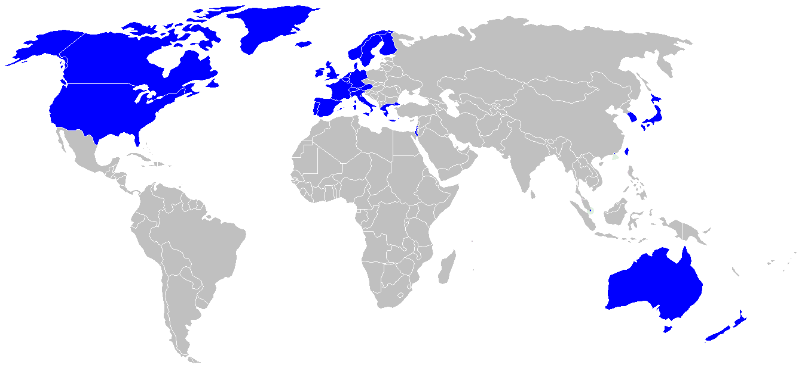

Slide 57
Percentile change in
importance of task type
in U.S. economy
Abstract
Routine
Manual
Autor, D., Levy, F., & Murnane, R. J. (2003). The skill content of recent technological change:
An empirical exploration. Quarterly Journal of Economics 188, 4. [updated, D. Autor, 2008]

Slide 58
location
dependent?
location
independent?

Slide 59
global awareness
effective speaking
critical thinking
problem solving
adaptability
information literacy
collaboration
creativity
media fluency
analytical skills
entrepeneurialism
innovation
effective writing
synthesis
curiosity

Slide 60
Percentile change in
importance of task type
in U.S. economy
Abstract
Routine
Manual
Autor, D., Levy, F., & Murnane, R. J. (2003). The skill content of recent technological change:
An empirical exploration. Quarterly Journal of Economics 188, 4. [updated, D. Autor, 2008]

Slide 61
Growth of the creative class
Florida, R. (2002). The rise of the creative class (p. 332). New York, NY: Basic Books.

Slide 62
Percentile change in
importance of task type
in U.S. economy
Abstract
Routine
Manual
Autor, D., Levy, F., & Murnane, R. J. (2003). The skill content of recent technological change:
An empirical exploration. Quarterly Journal of Economics 188, 4. [updated, D. Autor, 2008]

Slide 63


Slide 64
low skill
low wage
low skill
high wage
high skill
high wage

Slide 65
low skill
low wage
low skill
high wage
high skill
high wage

Slide 66
  Can someone overseas
  do it cheaper?
  Can a computer
  do it faster?

Slide 67


Slide 68


Slide 69
2.5 billion

Slide 70

I sell books!
I’m an
accountant!
I have
an idea!

Slide 71


Slide 72


Slide 73


Slide 74


Slide 75
  Societally functional
  Mastery of information landscape
  Economically productive

Slide 76

Notes:
76

Slide 77
The fundamental dilemma
but now are
expected to
do this
Schools were
designed
for this …

Slide 78
What we have right now
uniqueness
uniqueness
one right answer
Notes:
78

Slide 79

Notes:
THIS SLIDE IS COPYRIGHT-PROTECTED. I GOT SPECIAL PERMISSION FROM THE CARTOONIST, TONY CARRILLO, TO USE IT.
79

Slide 80


Slide 81

Notes:
81

Slide 82

Notes:
82

Slide 83

While we teach whatever we teach at school, the kids go home and learn the skills they need to survive and prosper in an interconnected global economy.
Clarence Fisher
Notes:
As a result…
http://remoteaccess.typepad.com/remote_access/2005/11/educational_lea.html
Incrementally changing our teaching methods, slowly bringing people up to speed . . . worked fine when ideas of literacy and education were not rapidly changing; but they are. We need to be able to leapfrog in our understandings, in our methods, and in our tools, allowing us to move to where the kids are. If we do not become leaders to our students, we will be followers, seen as irrelevant, and left to cry in our books.

Slide 84

No generation in history has ever been so
thoroughly prepared for the industrial age.
David Warlick
http://davidwarlick.com/2cents/?p=298
dangerouslyirrelevant.org

Slide 85


Slide 86


Slide 87


Slide 88

Notes:
Licensed under a Creative Commons attribution-share alike license.
http://creativecommons.org/licenses/by-sa/3.0
Scott McLeod, J.D., Ph.D.
dangerouslyirrelevant.org
schooltechleadership.org
dangerouslyirrelevant.org/contact.html

Slide 89

Notes:
Anticipatory v. reactionary

Slide 90

Notes:
Future oriented v. compliance oriented

Slide 91

The people in charge
of leading school
organizations into the
21st century …
often are the
least knowledgeable
about the 21st century.
dangerouslyirrelevant.org
Notes:
Licensed under a Creative Commons attribution-share alike license.
http://creativecommons.org/licenses/by-sa/3.0
Scott McLeod, J.D., Ph.D.
scottmcleod.net/contact
dangerouslyirrelevant.org
schooltechleadership.org

Slide 92

If the leaders
don’t get it,
it’s not going
to happen.
dangerouslyirrelevant.org
Notes:
Licensed under a Creative Commons attribution-share alike license.
http://creativecommons.org/licenses/by-sa/3.0
Scott McLeod, J.D., Ph.D.
scottmcleod.net/contact
dangerouslyirrelevant.org
schooltechleadership.org

Slide 93


Slide 94


Slide 95


Slide 96
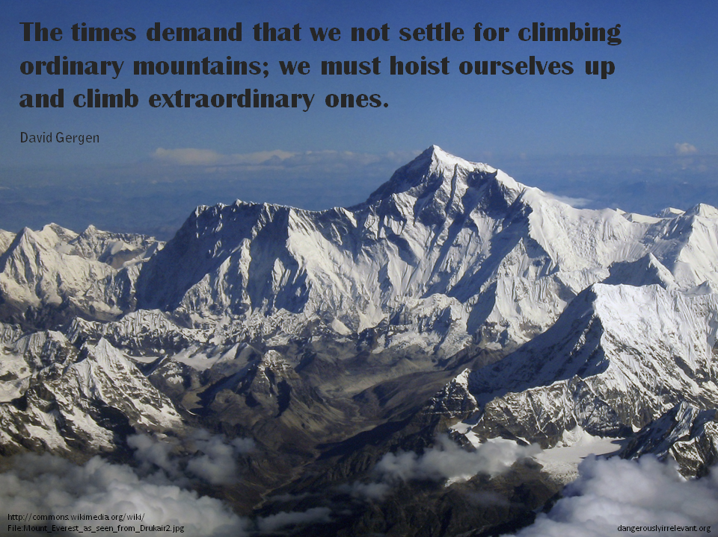

Slide 97

Notes:
We need to somehow
change faster
No one jumps a 20 foot chasm in two
10 foot jumps. – Miguel Guhlin
When the world changes so fast that we have no reasonable way to forecast what it will look like in a mere decade or two, all we can do is teach kids how to be adaptive – to be learners in the truest sense of the word –
We’ve always talked about preparing lifelong learners in schools, but our practices typically haven’t matched our rhetoric. It’s time to put some bite into our toothless vision statements and recognize that we have to teach kids how to learn to learn if they want to be successful in this new technology-suffused, globally-interconnected world
Credits: http://tinyurl.com/2urbsm and http://tinyurl.com/37em64 (see Guhlin comment)
http://remoteaccess.typepad.com/remote_access/
2006/06/literacy_as_bat.html (see Guhlin comment)
http://headrush.typepad.com/creating_passionate_users/2005/03/incremental_vs_.html

Slide 98

No one will thank you
for taking care of today
if you have failed
to take care of tomorrow.
Joel Barker

Slide 99

Notes:
99

Slide 100
Thank you!
Scott McLeod, J.D., Ph.D.
Director, CASTLE
scottmcleod.net/schools
Notes:
100
All of my materials are licensed under a Creative Commons attribution-share alike license (http://creativecommons.org/licenses/by-sa/3.0). That means not only that you are welcome to share and/or remix my content but that you are encouraged to do so! All I ask is that you properly credit me for my content and that you not place any greater copyright restrictions than I have on the content that utilizes my material. If possible, including the URL of Dangerously Irrelevant in your content would be most appreciated.
Scott McLeod, J.D., Ph.D.
dangerouslyirrelevant.org
schooltechleadership.org
dangerouslyirrelevant.org/contact.html

Slide 101


Slide 102
