Slide 1

Fasten
your
seatbelts!
The future of learning
is coming up fast!
Dr. Scott McLeod
CASTLE

Slide 2
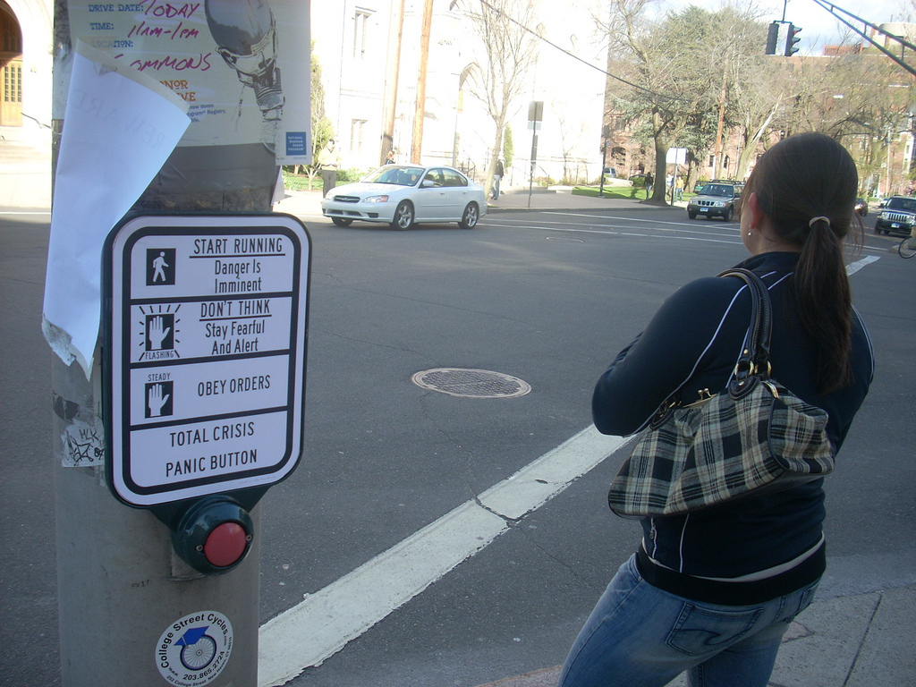
flickr.com/photos/28017515@N03/3470276439/in/photostream

Slide 3
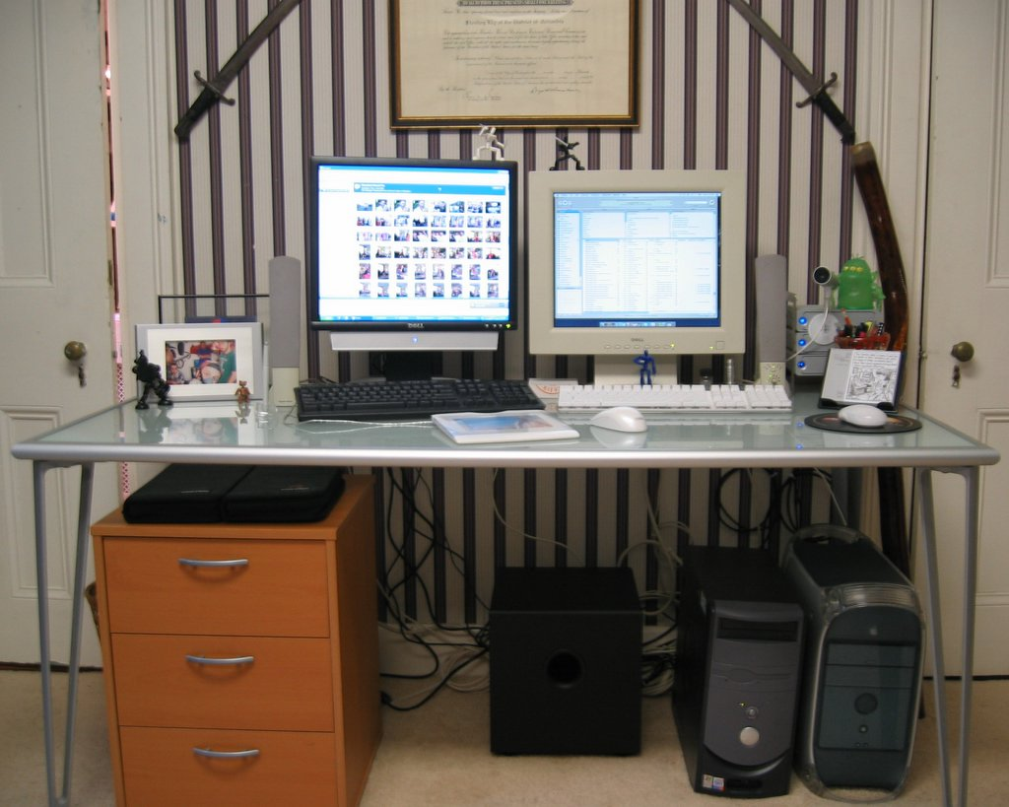

Slide 4
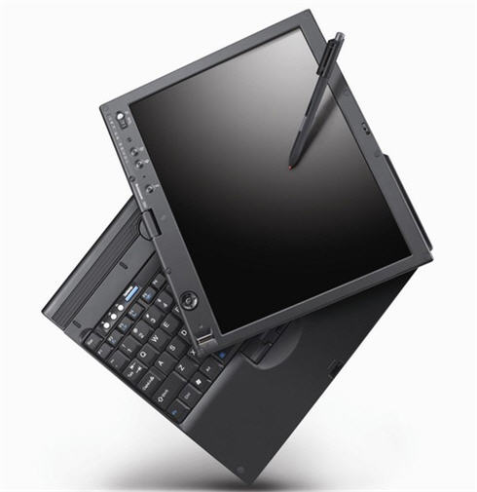

Slide 5
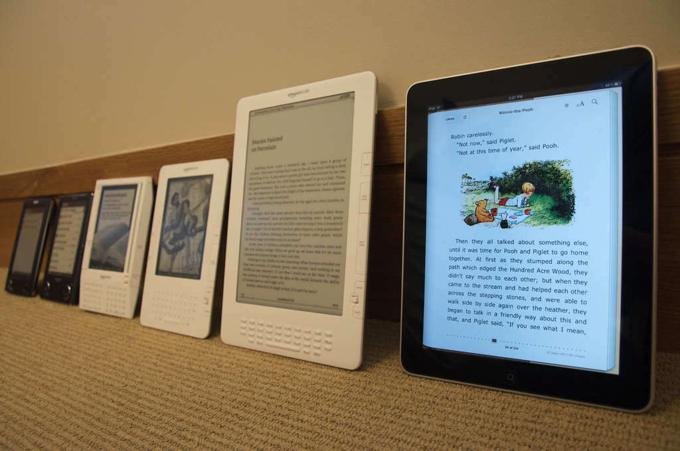
Notes:
http://www.flickr.com/photos/jblyberg/4505413539/sizes/l/in/photostream/

Slide 6


Slide 7
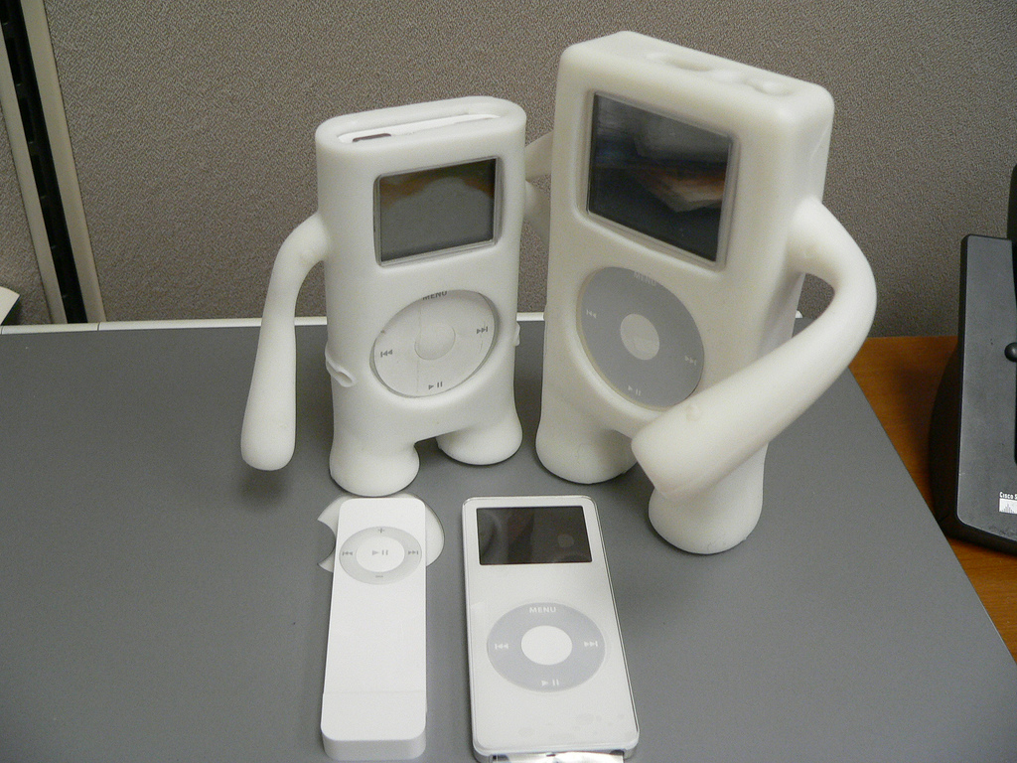

Slide 8
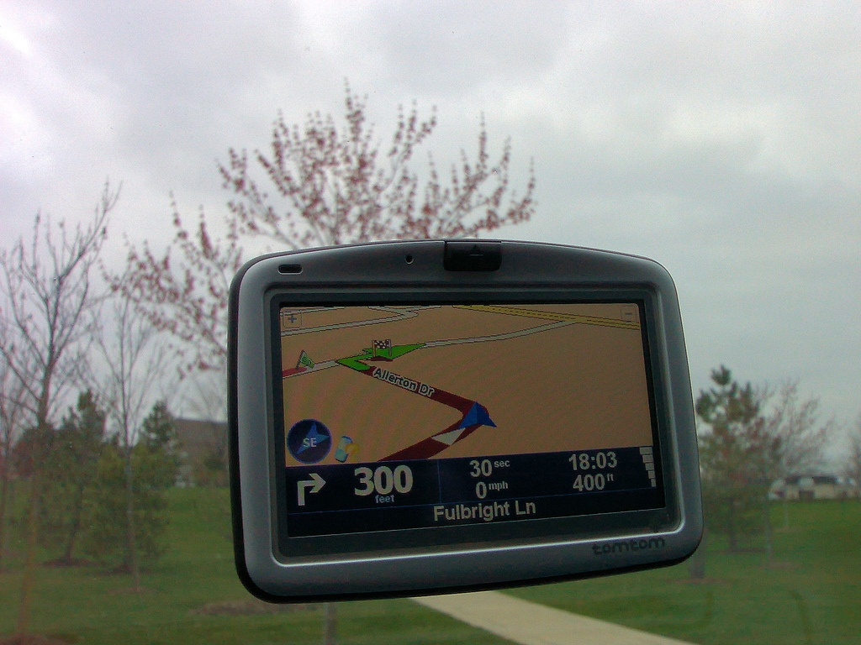

Slide 9
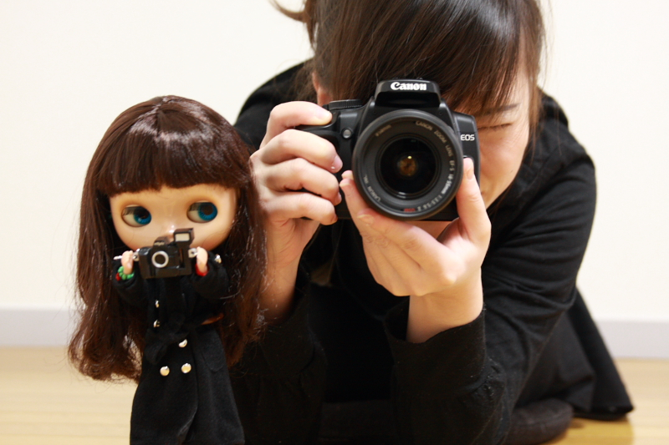

Slide 10
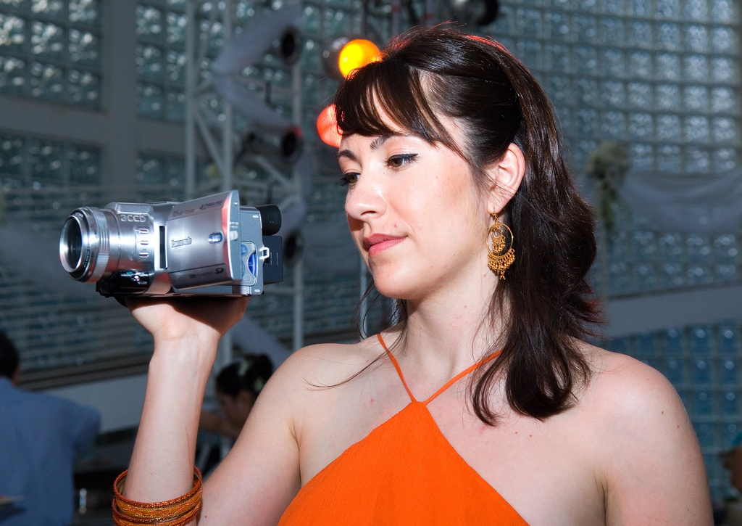

Slide 11
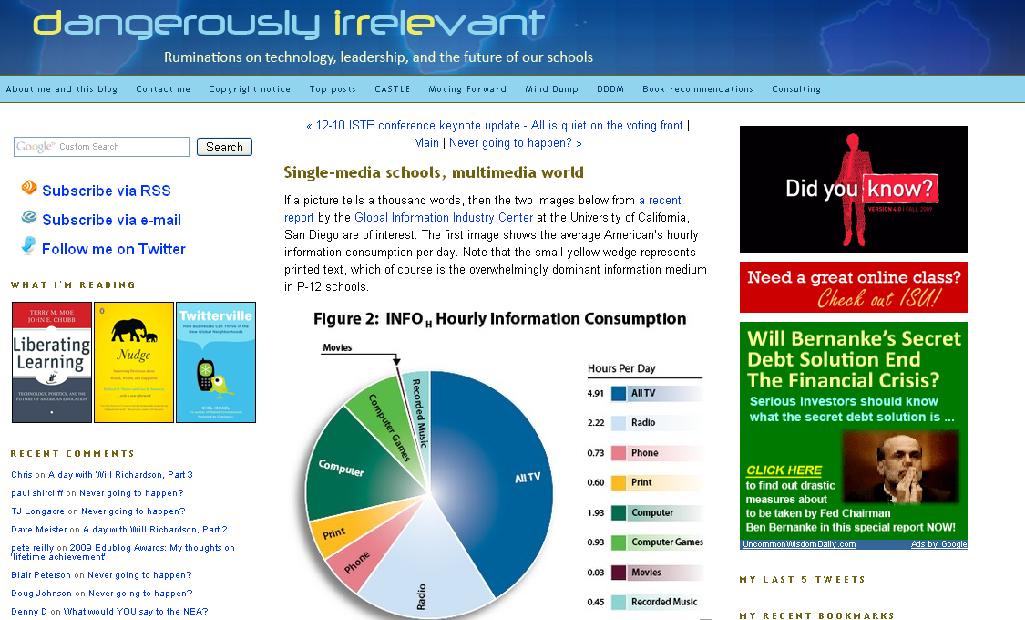

Slide 12
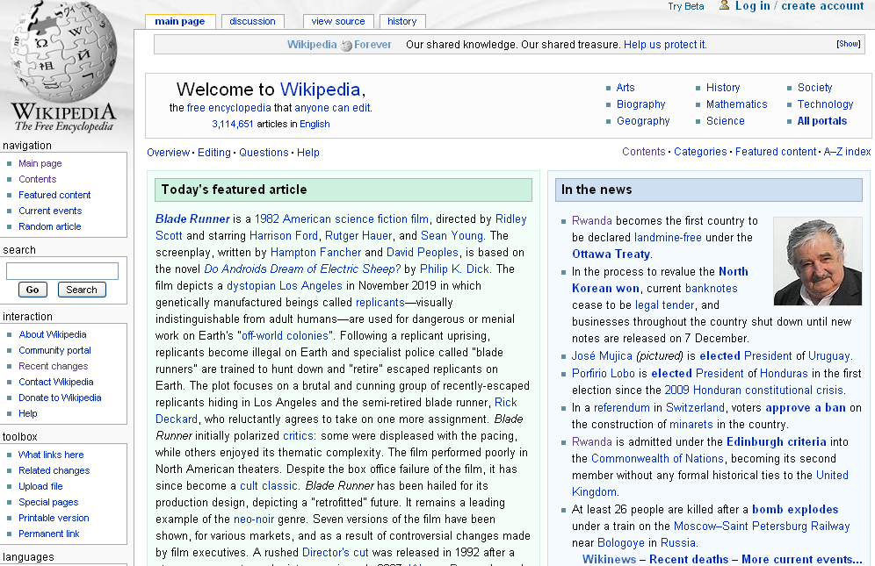

Slide 13
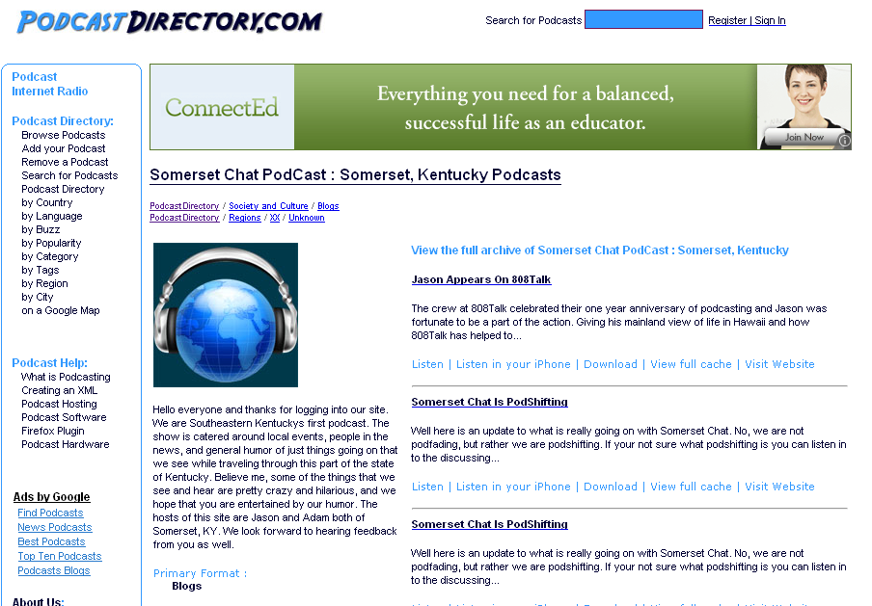

Slide 14
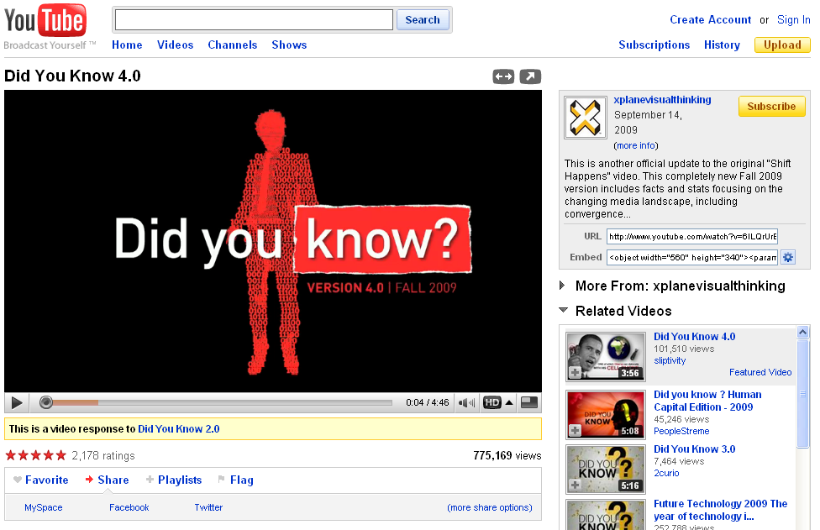

Slide 15
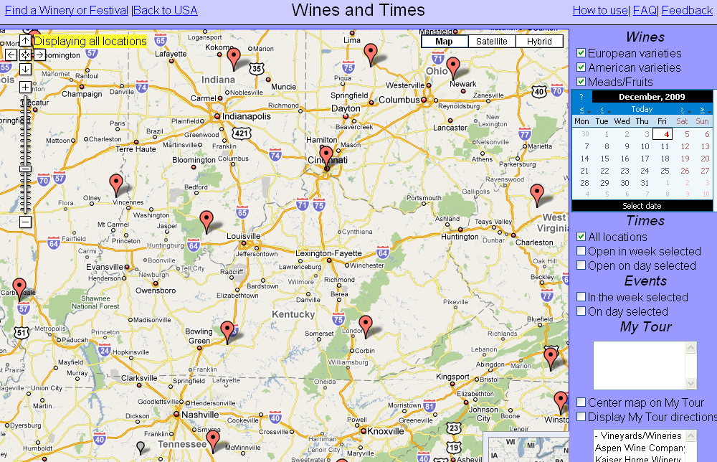

Slide 16
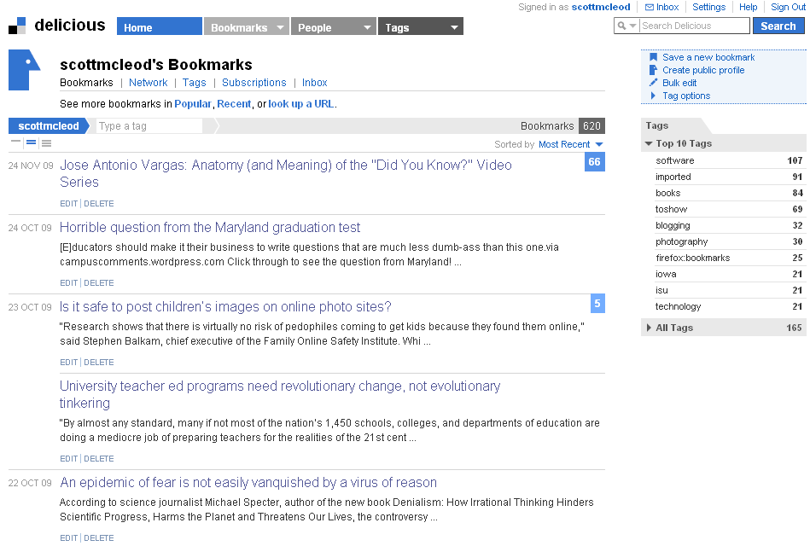

Slide 17
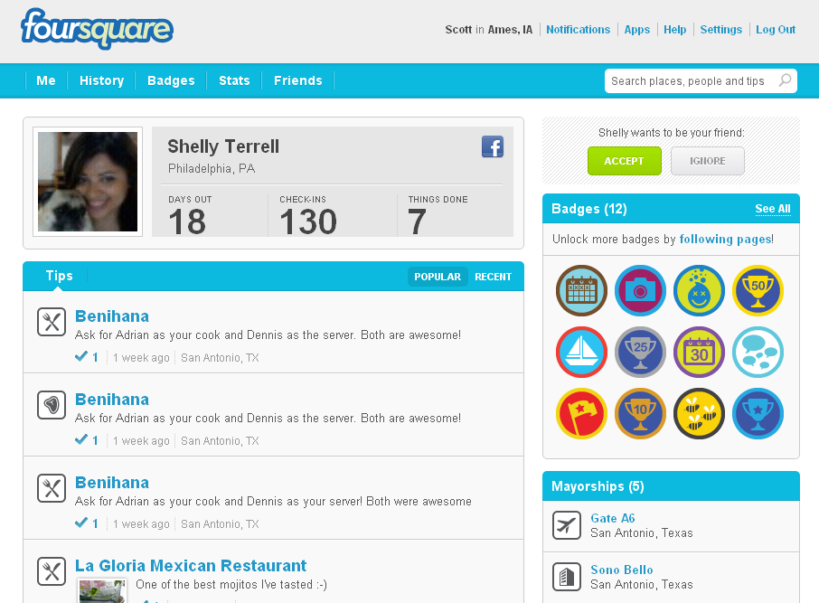

Slide 18
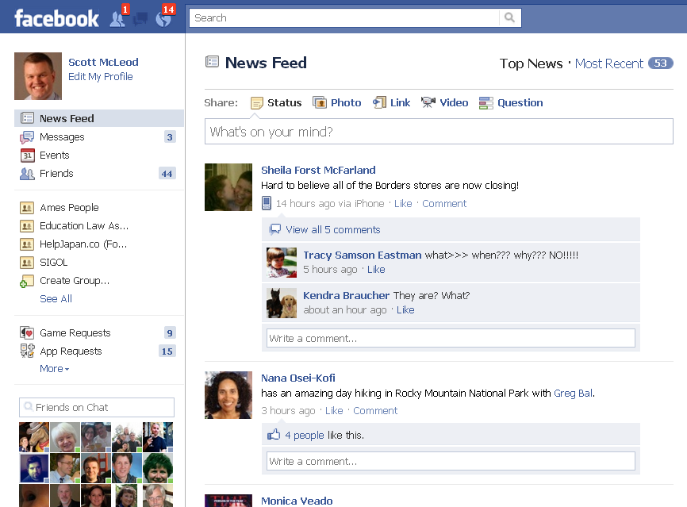

Slide 19
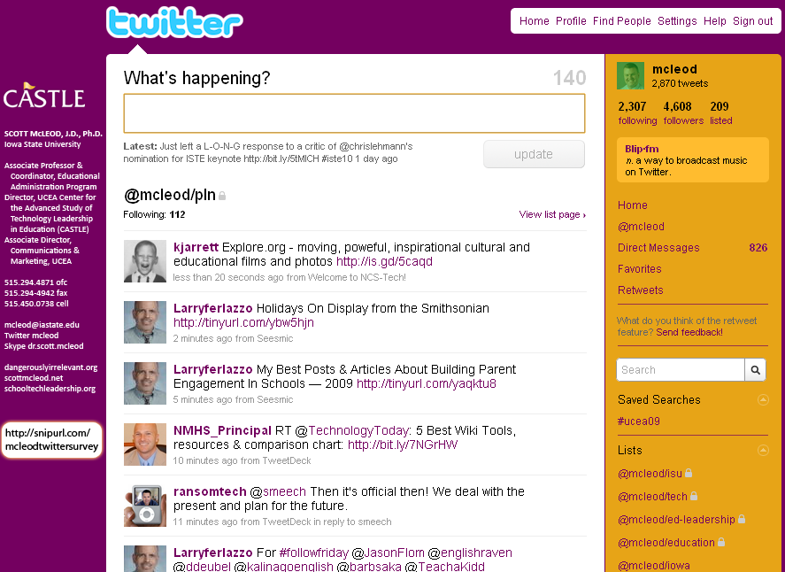

Slide 20
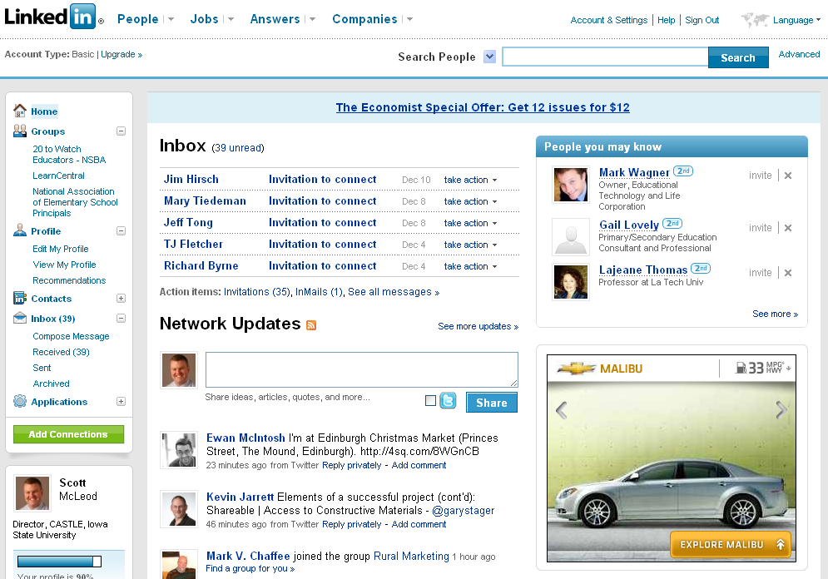

Slide 21
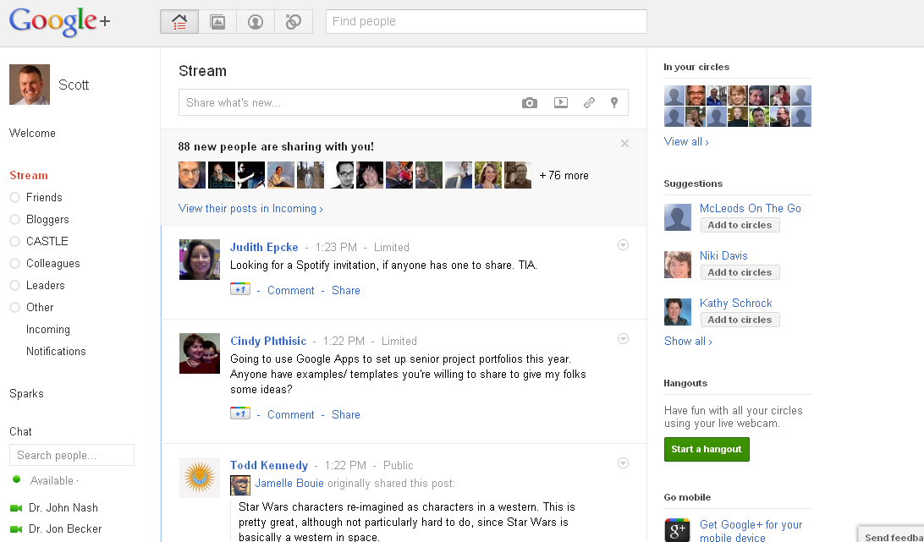

Slide 22


Slide 23
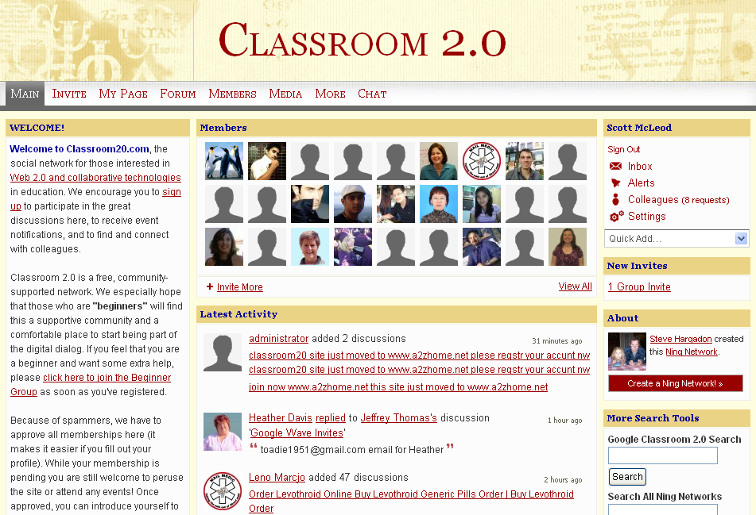

Slide 24
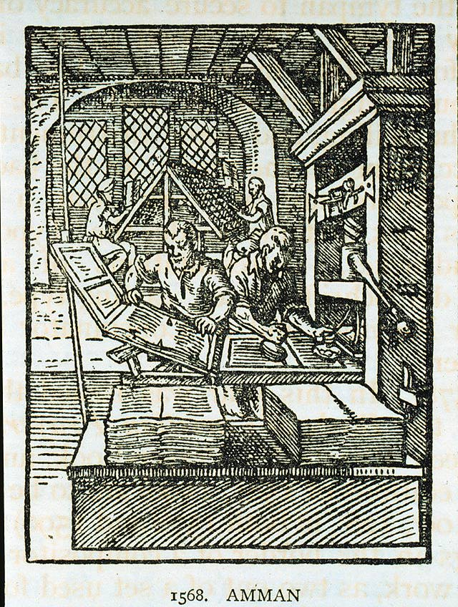

Slide 25
We all now have a voice

Slide 26
We can easily find each other

Slide 27
We can easily work together

Slide 28
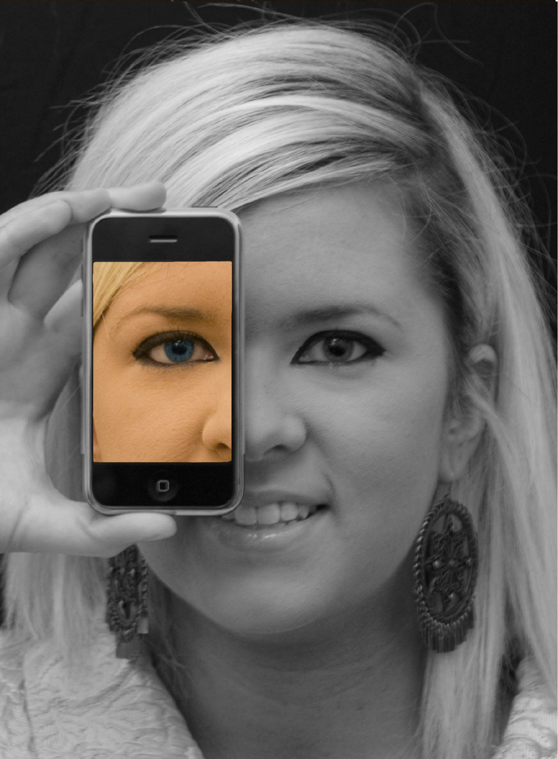

Slide 29
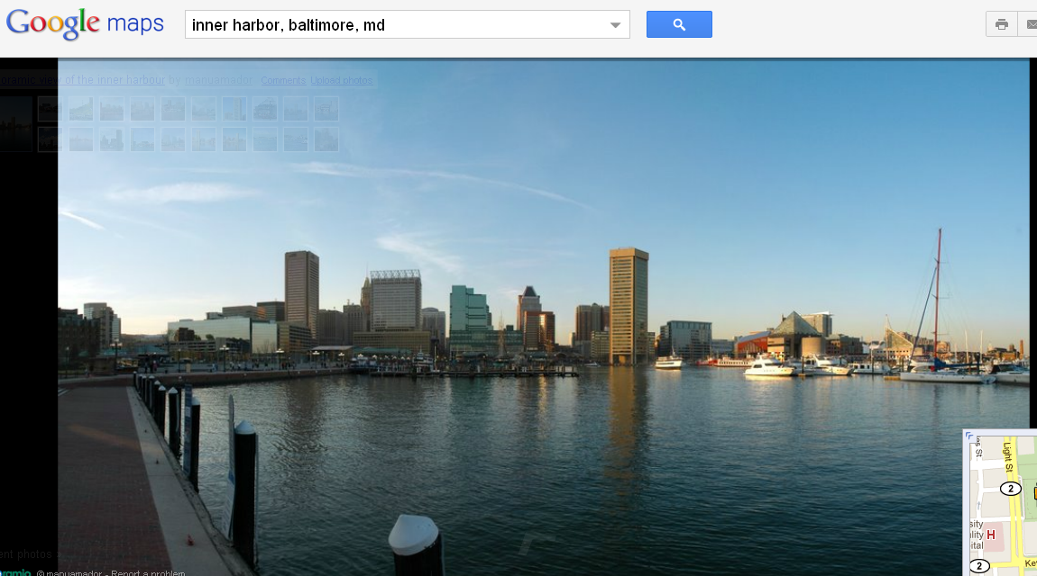

Slide 30
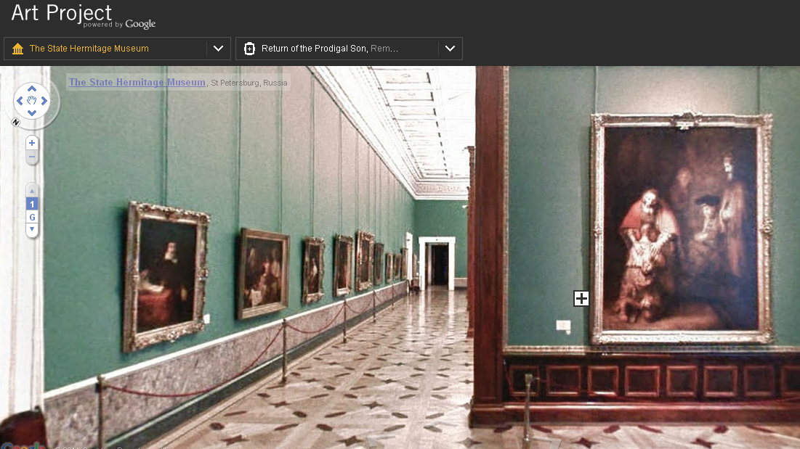

Slide 31
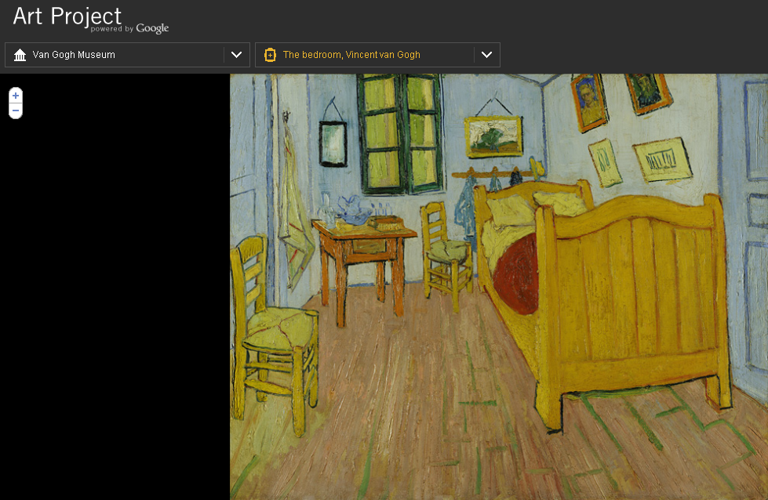

Slide 32
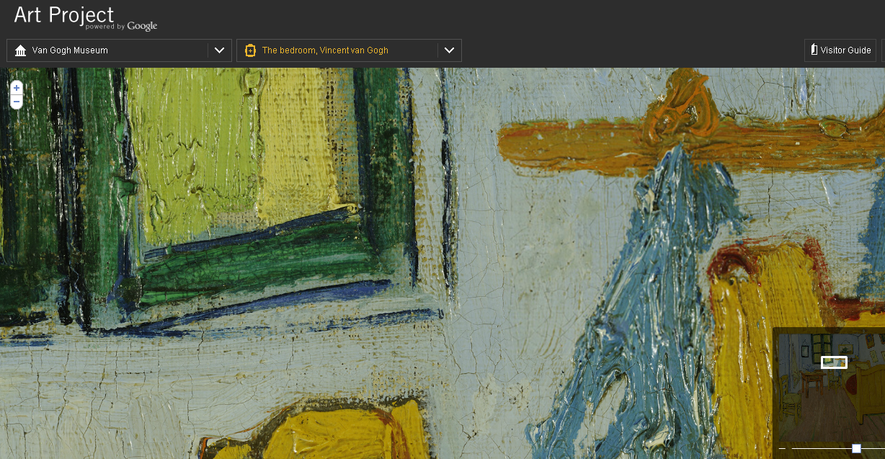

Slide 33
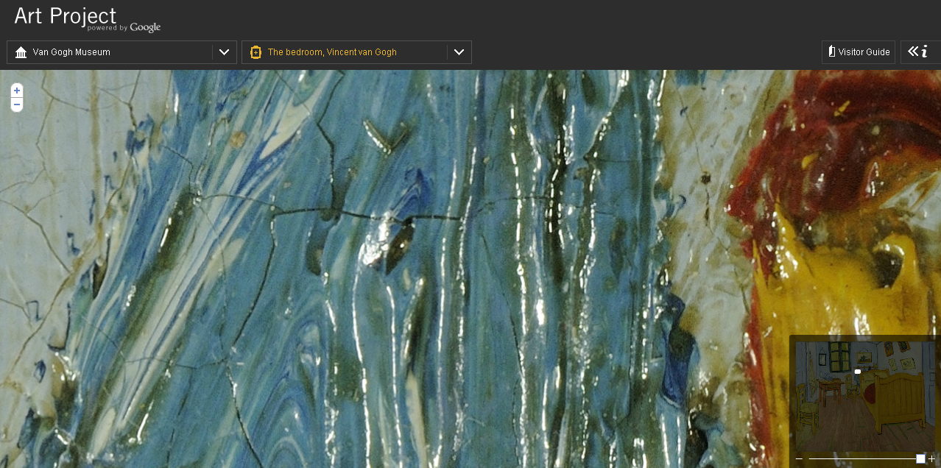

Slide 34


Slide 35
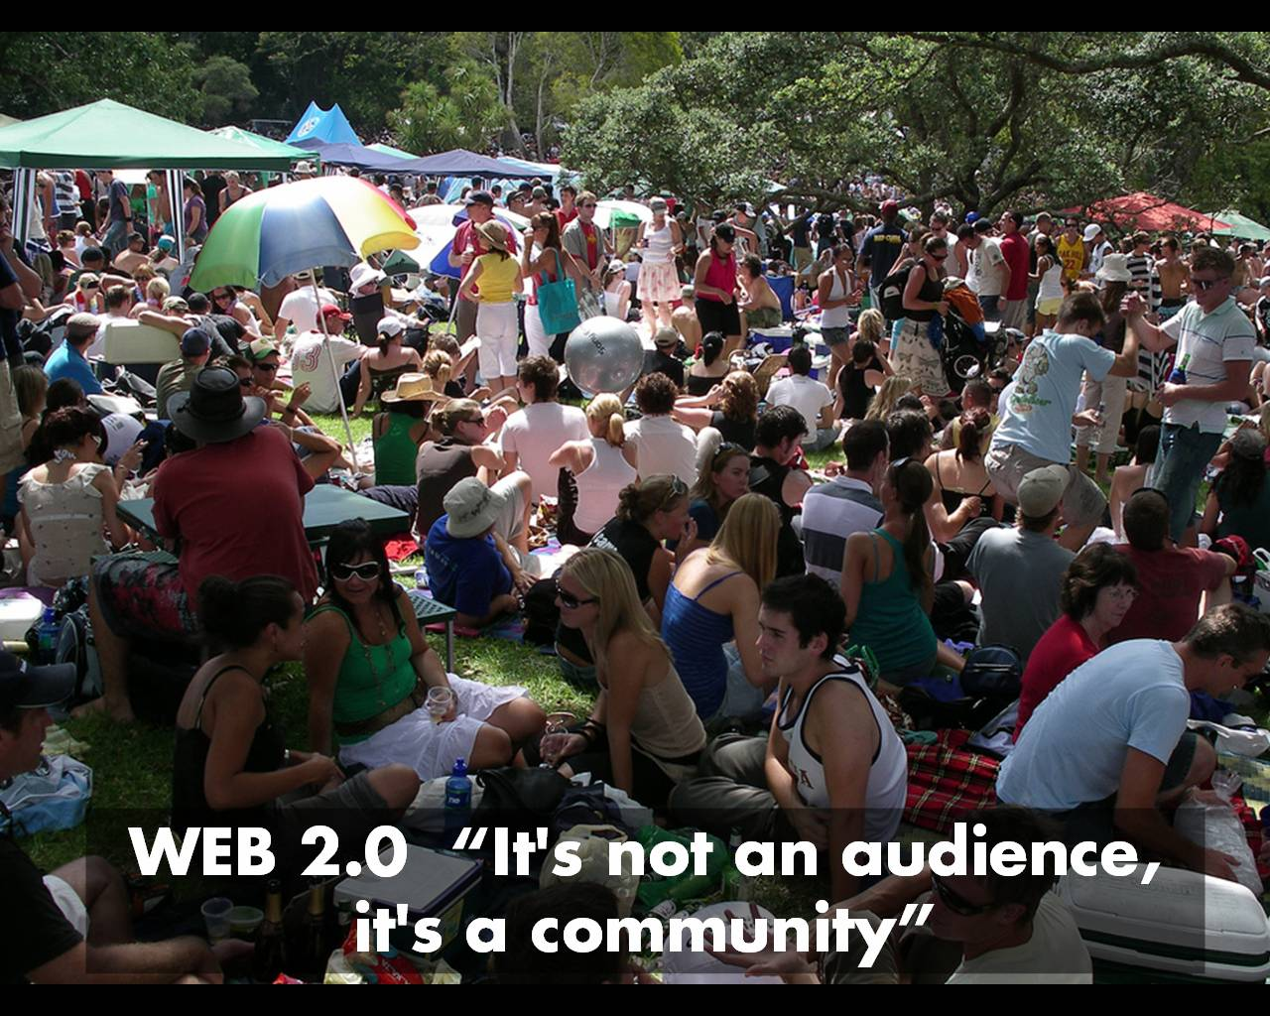

Slide 36
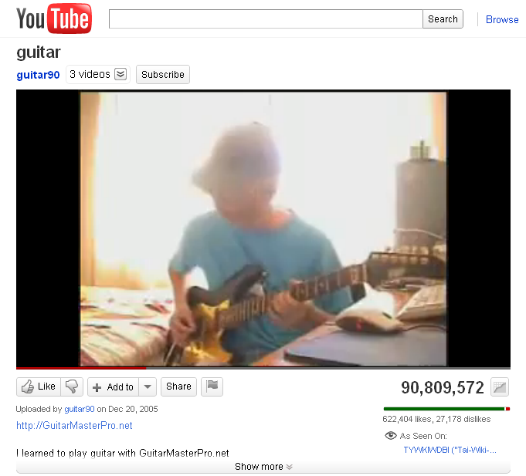

Slide 37
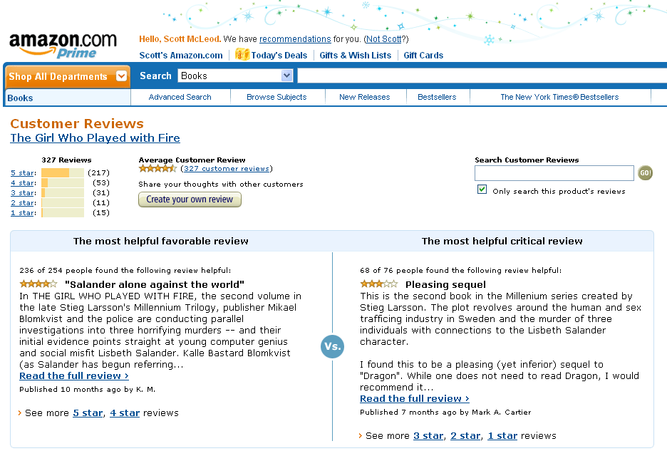

Slide 38


Slide 39


Slide 40


Slide 41


Slide 42
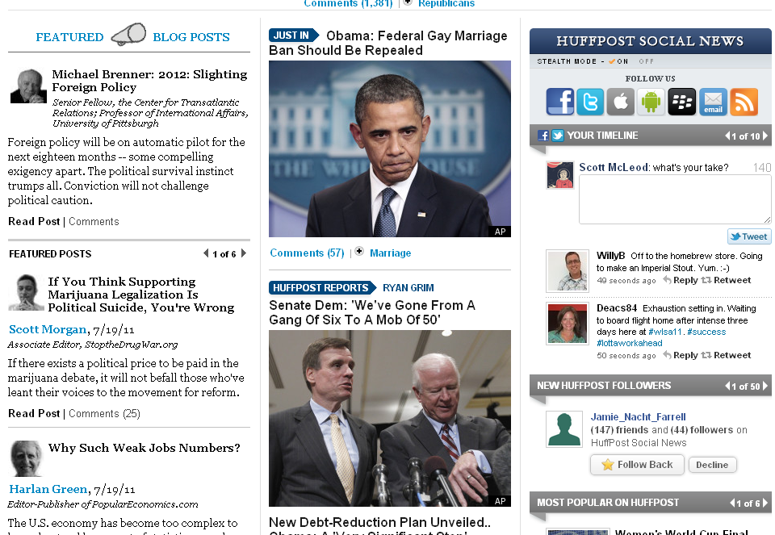

Slide 43
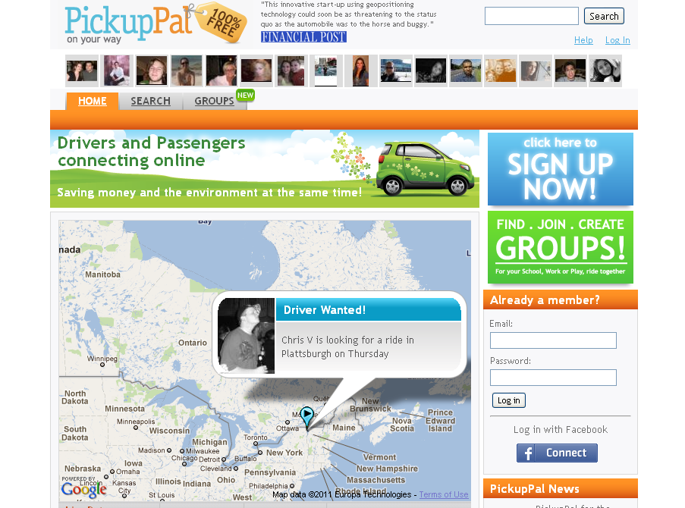

Slide 44
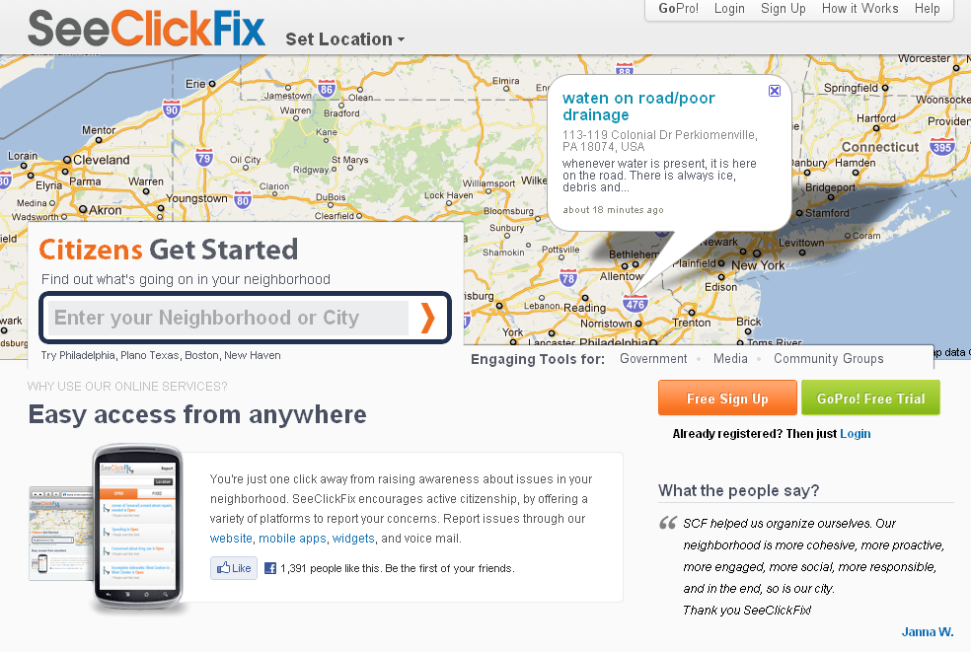

Slide 45
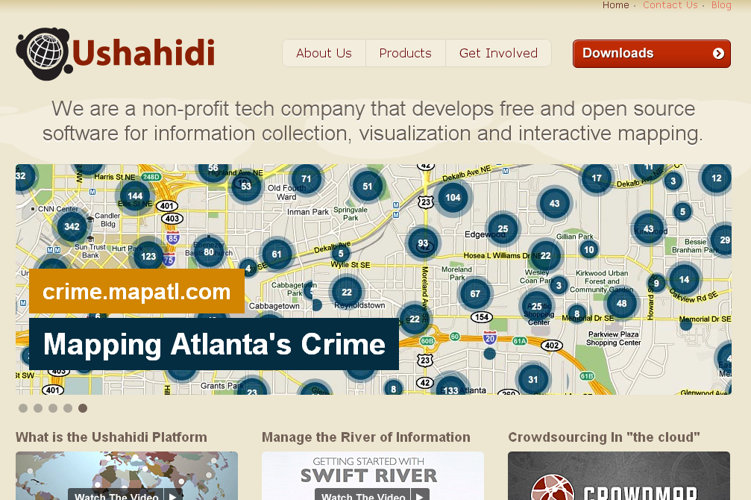

Slide 46


Slide 47
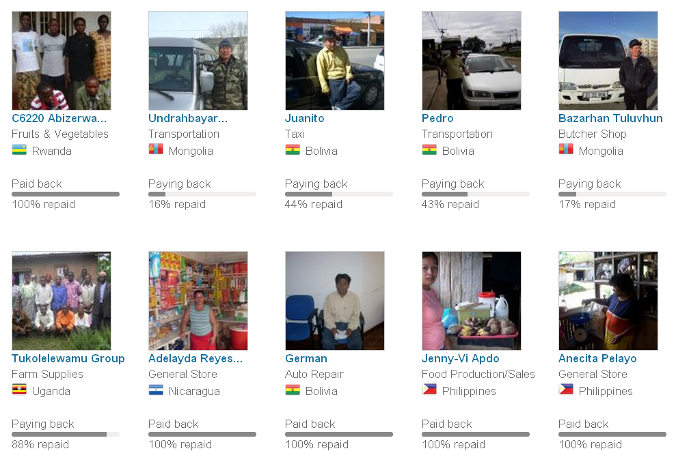

Slide 48
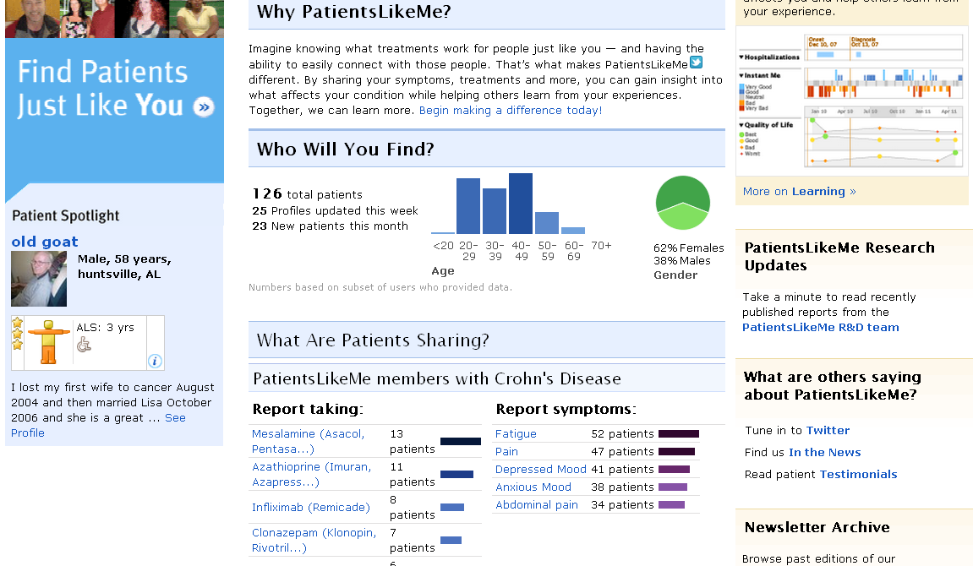

Slide 49
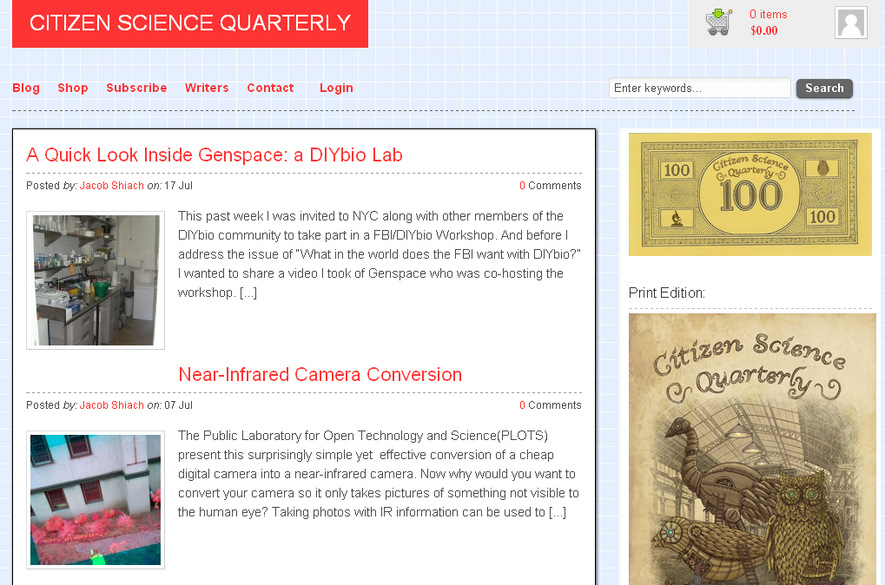

Slide 50
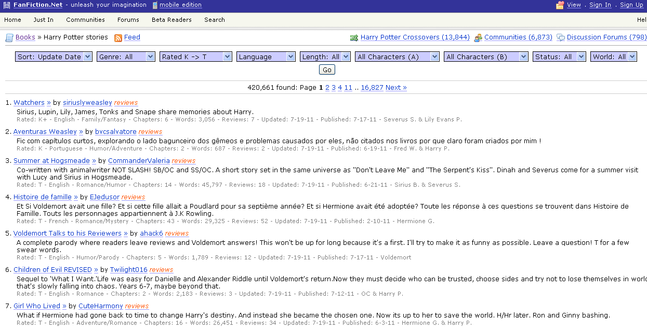

Slide 51
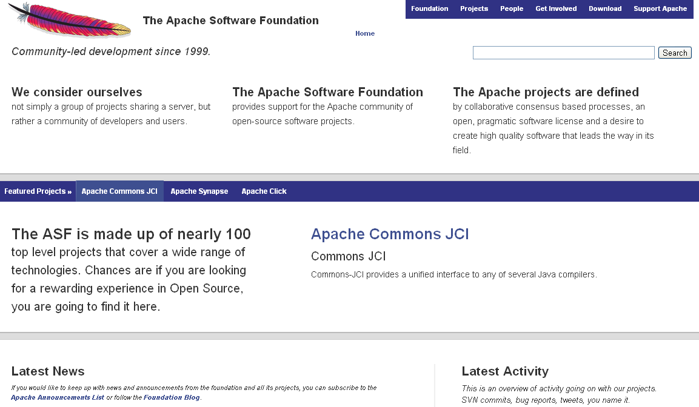

Slide 52
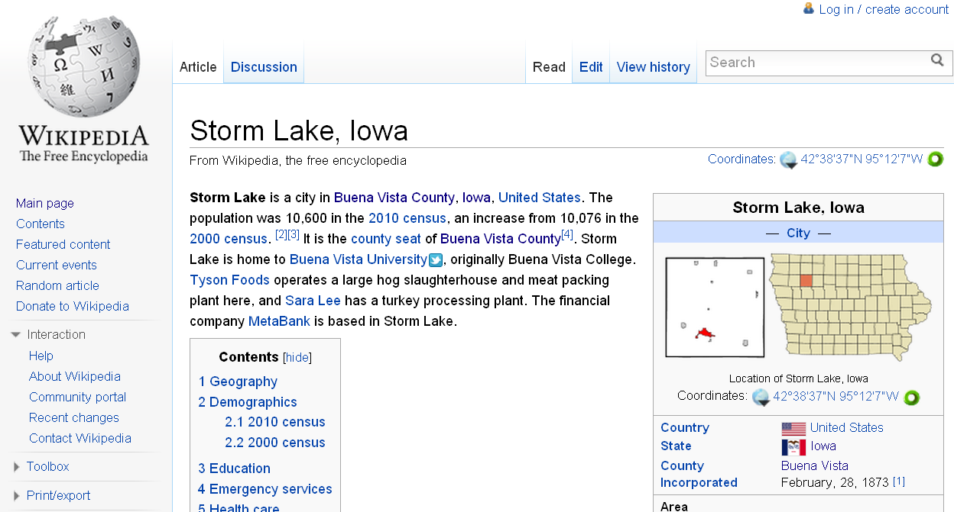

Slide 53

Notes:
http://www.flickr.com/photos/deks/711658920/sizes/z/

Slide 54

Notes:
http://www.flickr.com/photos/sepblog/3527825643/sizes/o/

Slide 55
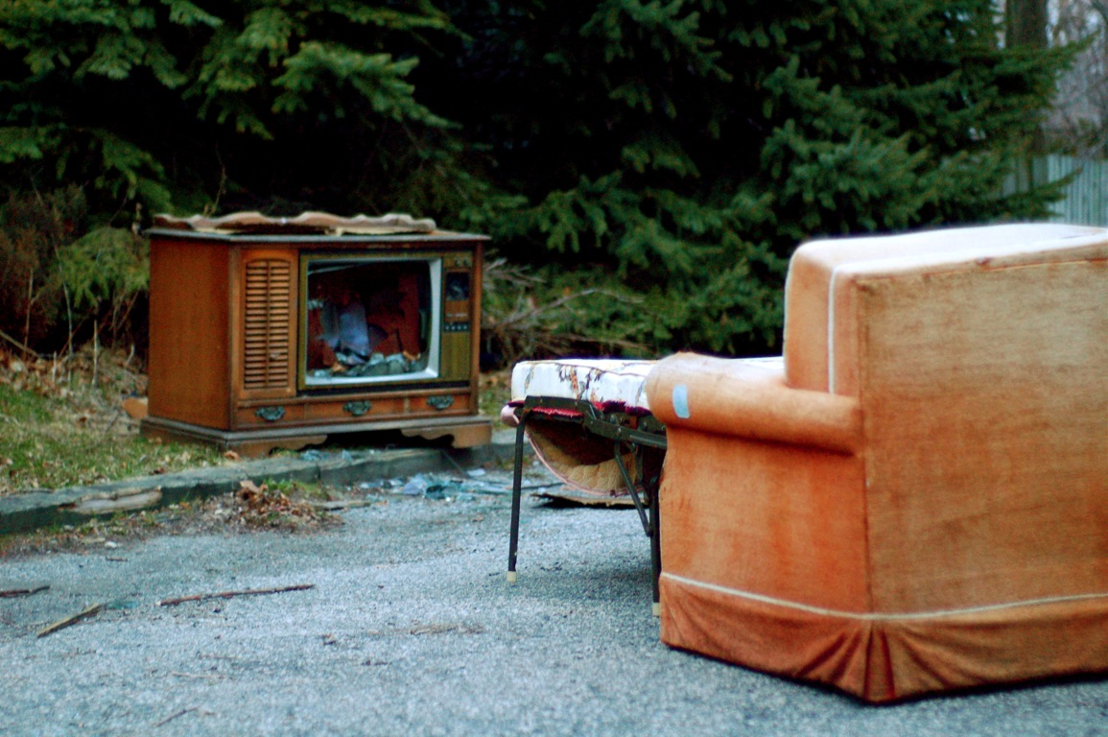
Notes:
http://www.flickr.com/photos/13638129@N00/118245563/

Slide 56
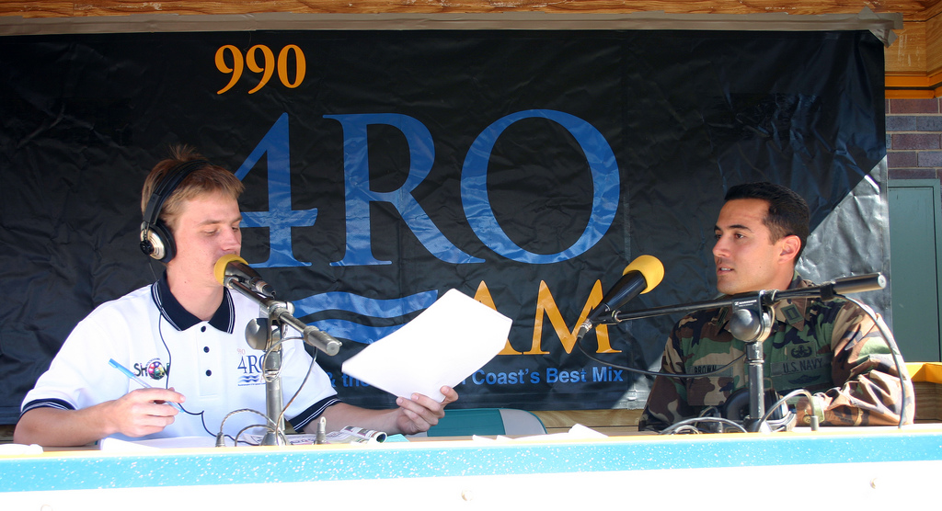
Notes:
http://www.flickr.com/photos/7337467@N04/3052065204/

Slide 57
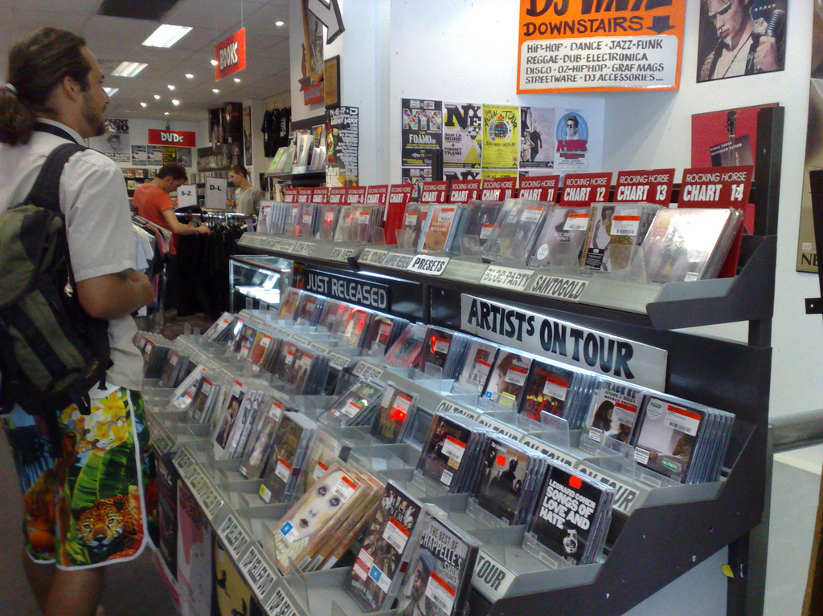
Notes:
http://www.flickr.com/photos/77136818@N00/3202144482/

Slide 58
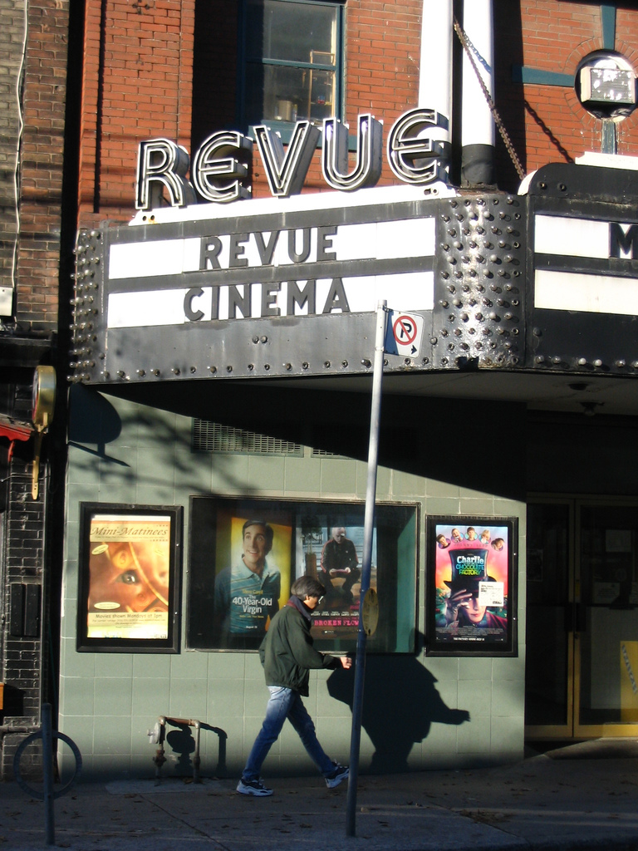
Notes:
http://www.flickr.com/photos/20532289@N00/59083917/

Slide 59

Notes:
http://www.flickr.com/photos/48973657@N00/4556156477/

Slide 60
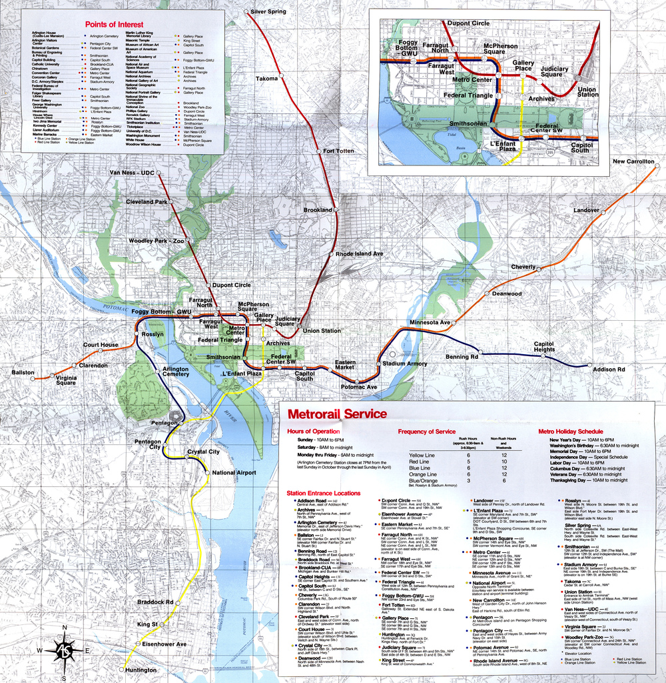
Notes:
http://www.flickr.com/photos/88442983@N00/1604241264/

Slide 61

Notes:
http://www.flickr.com/photos/28473961@N02/3229296247/

Slide 62
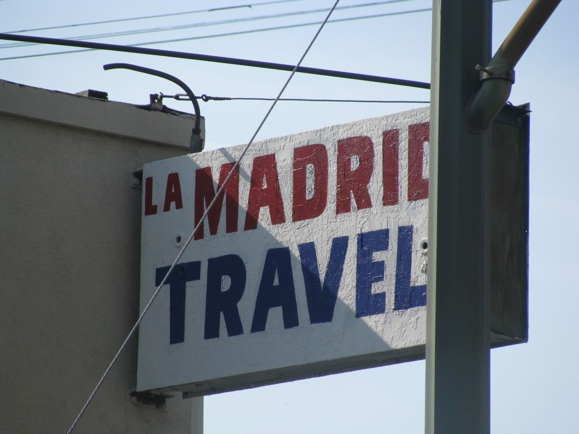
Notes:
http://www.flickr.com/photos/28473961@N02/4320982975/

Slide 63
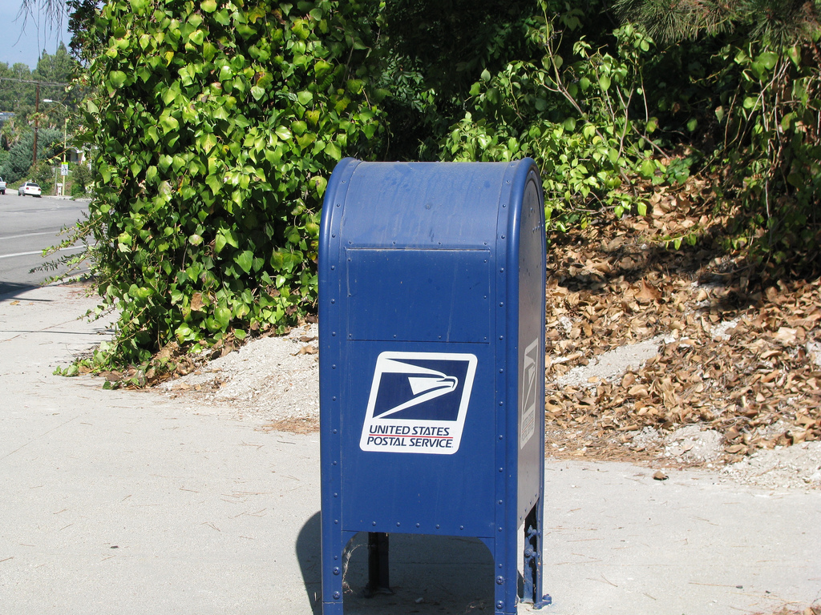
Notes:
http://www.flickr.com/photos/28473961@N02/2757755401/

Slide 64
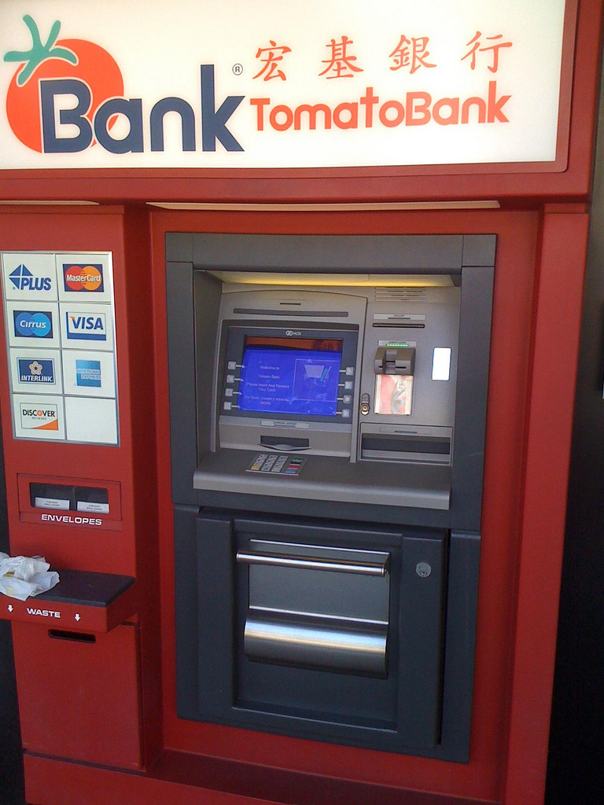
Notes:
http://www.flickr.com/photos/26416016@N02/4479154715/

Slide 65
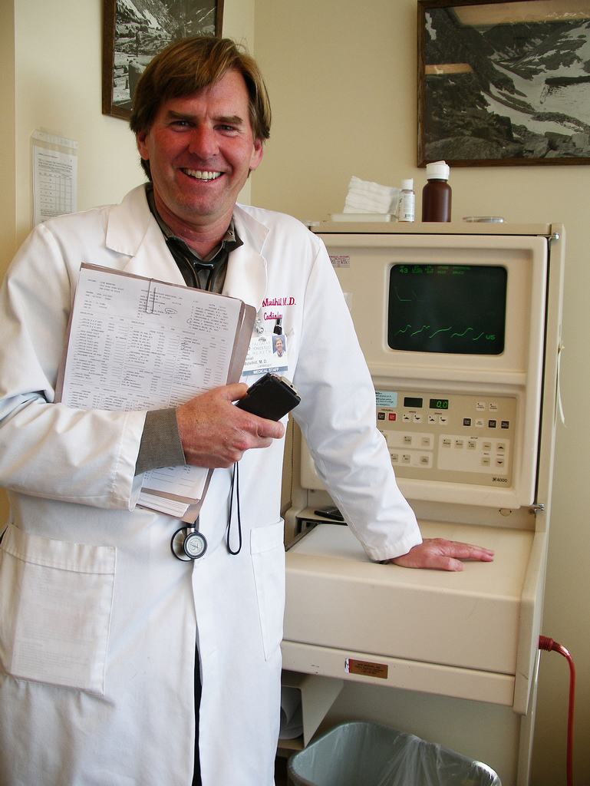
Notes:
http://www.flickr.com/photos/9031691@N08/2670224692/

Slide 66

Notes:
http://www.flickr.com/photos/28567825@N03/5129325457/

Slide 67
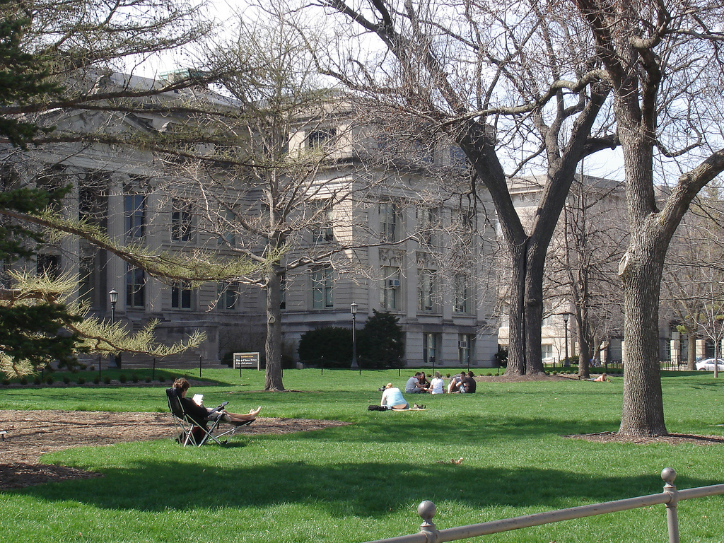
Notes:
http://www.flickr.com/photos/47477979@N00/2453748088/

Slide 68

CHANGE
OR DIE

Slide 69

Notes:
http://www.flickr.com/photos/30624156@N00/4820259304/

Slide 70


Slide 71
location
dependent?
location
independent?

Slide 72

I sell books!
I’m an
accountant!
I have
an idea!

Slide 73
Percentile change in
importance of task type
in U.S. economy
Abstract
Routine
Manual
Autor, D., Levy, F., & Murnane, R. J. (2003). The skill content of recent technological change:
An empirical exploration. Quarterly Journal of Economics 188, 4. [updated, D. Autor, 2008]

Slide 74


Slide 75
global awareness
effective speaking
critical thinking
problem solving
adaptability
information literacy
collaboration
creativity
media fluency
analytical skills
entrepeneurialism
innovation
effective writing
synthesis
curiosity

Slide 76
Growth of the creative class
Florida, R. (2002). The rise of the creative class (p. 332). New York, NY: Basic Books.

Slide 77
low skill
low wage
low skill
high wage
high skill
high wage

Slide 78
low skill
low wage
low skill
high wage
high skill
high wage

Slide 79
  Can someone overseas
  do it cheaper?
  Can a computer
  do it faster?

Slide 80


Slide 81


Slide 82
2.5 billion

Slide 83


Slide 84


Slide 85


Slide 86


Slide 87


Slide 88


Slide 89


Slide 90


Slide 91


Slide 92


Slide 93


Slide 94


Slide 95

Notes:
Re-Mission

Slide 96

Notes:
3rd World Farmer

Slide 97


Slide 98

Notes:
Against All Odds, United Nations High Commissioner for Refugees

Slide 99

Notes:
Masterminding Molecules

Slide 100

Notes:
Conspiracy Code

Slide 101


Slide 102
  Societally functional
  Mastery of information landscape
  Economically productive

Slide 103

Notes:
103

Slide 104


Slide 105


Slide 106


Slide 107
The fundamental dilemma
but now are
expected to
do this
Schools were
designed
for this …

Slide 108
What we have right now
uniqueness
uniqueness
one right answer
Notes:
108

Slide 109

Notes:
THIS SLIDE IS COPYRIGHT-PROTECTED. I GOT SPECIAL PERMISSION FROM THE CARTOONIST, TONY CARRILLO, TO USE IT.
109

Slide 110


Slide 111

Notes:
111

Slide 112

Notes:
112

Slide 113

No generation in history has ever been so
thoroughly prepared for the industrial age.
David Warlick
http://davidwarlick.com/2cents/?p=298
dangerouslyirrelevant.org

Slide 114


Slide 115


Slide 116


Slide 117

The people in charge
of leading school
organizations into the
21st century …
often are the
least knowledgeable
about the 21st century.
dangerouslyirrelevant.org
Notes:
Licensed under a Creative Commons attribution-share alike license.
http://creativecommons.org/licenses/by-sa/3.0
Scott McLeod, J.D., Ph.D.
scottmcleod.net/contact
dangerouslyirrelevant.org
schooltechleadership.org

Slide 118

If the leaders
don’t get it,
it’s not going
to happen.
dangerouslyirrelevant.org
Notes:
Licensed under a Creative Commons attribution-share alike license.
http://creativecommons.org/licenses/by-sa/3.0
Scott McLeod, J.D., Ph.D.
scottmcleod.net/contact
dangerouslyirrelevant.org
schooltechleadership.org

Slide 119

Notes:
Licensed under a Creative Commons attribution-share alike license.
http://creativecommons.org/licenses/by-sa/3.0
Scott McLeod, J.D., Ph.D.
dangerouslyirrelevant.org
schooltechleadership.org
dangerouslyirrelevant.org/contact.html

Slide 120


Slide 121


Slide 122

Notes:
We need to somehow
change faster
No one jumps a 20 foot chasm in two
10 foot jumps. – Miguel Guhlin
When the world changes so fast that we have no reasonable way to forecast what it will look like in a mere decade or two, all we can do is teach kids how to be adaptive – to be learners in the truest sense of the word –
We’ve always talked about preparing lifelong learners in schools, but our practices typically haven’t matched our rhetoric. It’s time to put some bite into our toothless vision statements and recognize that we have to teach kids how to learn to learn if they want to be successful in this new technology-suffused, globally-interconnected world
Credits: http://tinyurl.com/2urbsm and http://tinyurl.com/37em64 (see Guhlin comment)
http://remoteaccess.typepad.com/remote_access/
2006/06/literacy_as_bat.html (see Guhlin comment)
http://headrush.typepad.com/creating_passionate_users/2005/03/incremental_vs_.html

Slide 123

No one will thank you
for taking care of today
if you have failed
to take care of tomorrow.
Joel Barker

Slide 124


Slide 125

flickr.com/photos/28017515@N03/3470276351/in/photostream

Slide 126

Notes:
126

Slide 127


Slide 128
Thank you!
Scott McLeod, J.D., Ph.D.
Director, CASTLE
scottmcleod.net/workshops
Notes:
128
All of my materials are licensed under a Creative Commons attribution-share alike license (http://creativecommons.org/licenses/by-sa/3.0). That means not only that you are welcome to share and/or remix my content but that you are encouraged to do so! All I ask is that you properly credit me for my content and that you not place any greater copyright restrictions than I have on the content that utilizes my material. If possible, including the URL of Dangerously Irrelevant in your content would be most appreciated.
Scott McLeod, J.D., Ph.D.
dangerouslyirrelevant.org
schooltechleadership.org
dangerouslyirrelevant.org/contact.html

