Slide 1
Our new
information
landscape

Slide 2
Our new
economic
landscape

Slide 3
  Societally functional
  Mastery of information landscape
  Economically productive

Slide 4
Our new
information
landscape

Slide 5


Slide 6


Slide 7


Slide 8
We all now have a voice

Slide 9
We can easily find each other

Slide 10
We can easily work together

Slide 11


Slide 12


Slide 13

Notes:
http://www.flickr.com/photos/deks/711658920/sizes/z/

Slide 14

Notes:
http://www.flickr.com/photos/sepblog/3527825643/sizes/o/

Slide 15

Notes:
http://www.flickr.com/photos/13638129@N00/118245563/

Slide 16

Notes:
http://www.flickr.com/photos/7337467@N04/3052065204/

Slide 17

Notes:
http://www.flickr.com/photos/77136818@N00/3202144482/

Slide 18

Notes:
http://www.flickr.com/photos/20532289@N00/59083917/

Slide 19

Notes:
http://www.flickr.com/photos/48973657@N00/4556156477/

Slide 20

Notes:
http://www.flickr.com/photos/88442983@N00/1604241264/

Slide 21

Notes:
http://www.flickr.com/photos/28473961@N02/3229296247/

Slide 22

Notes:
http://www.flickr.com/photos/28473961@N02/4320982975/

Slide 23

Notes:
http://www.flickr.com/photos/28473961@N02/2757755401/

Slide 24

Notes:
http://www.flickr.com/photos/26416016@N02/4479154715/

Slide 25

Notes:
http://www.flickr.com/photos/9031691@N08/2670224692/

Slide 26

Notes:
http://www.flickr.com/photos/28567825@N03/5129325457/

Slide 27

Notes:
http://www.flickr.com/photos/47477979@N00/2453748088/

Slide 28

CHANGE
OR DIE

Slide 29
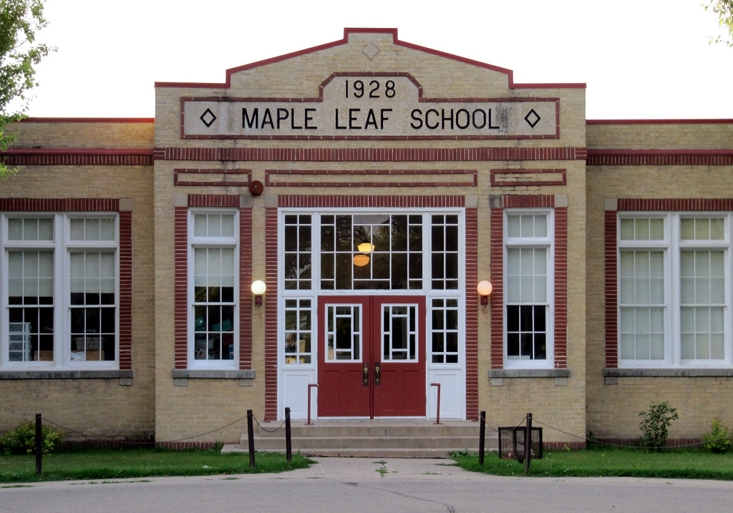
Notes:
http://www.flickr.com/photos/30624156@N00/4820259304/

Slide 30
Our new
economic
landscape

Slide 31
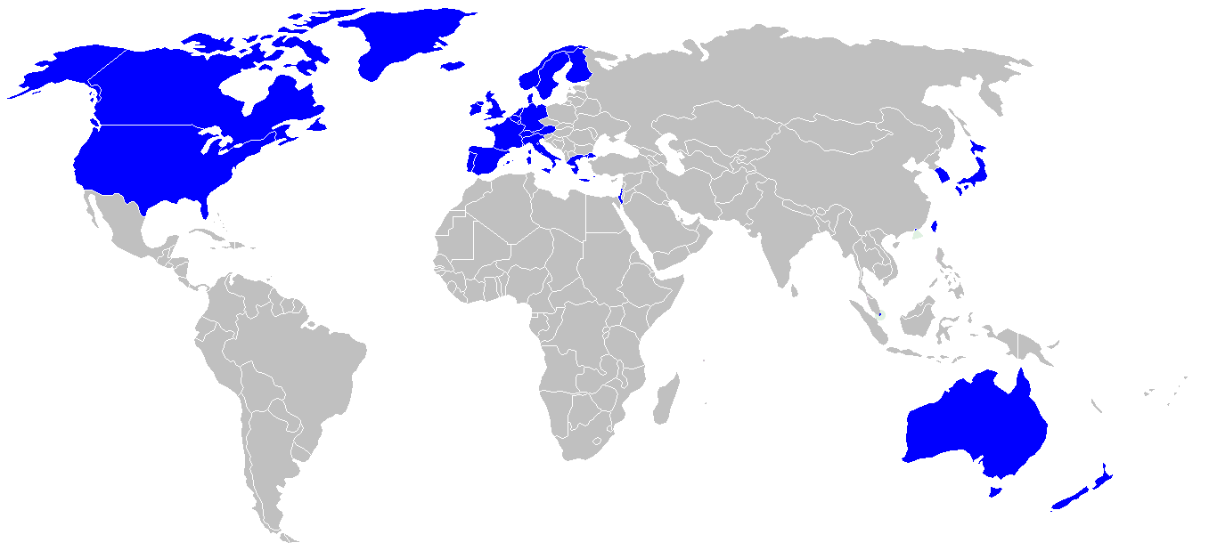

Slide 32
location
dependent?
location
independent?

Slide 33
Percentile change in
importance of task type
in U.S. economy
Abstract
Routine
Manual
Autor, D., Levy, F., & Murnane, R. J. (2003). The skill content of recent technological change:
An empirical exploration. Quarterly Journal of Economics 188, 4. [updated, D. Autor, 2008]

Slide 34
global awareness
effective speaking
critical thinking
problem solving
adaptability
information literacy
collaboration
creativity
media fluency
analytical skills
entrepeneurialism
innovation
effective writing
synthesis
curiosity

Slide 35
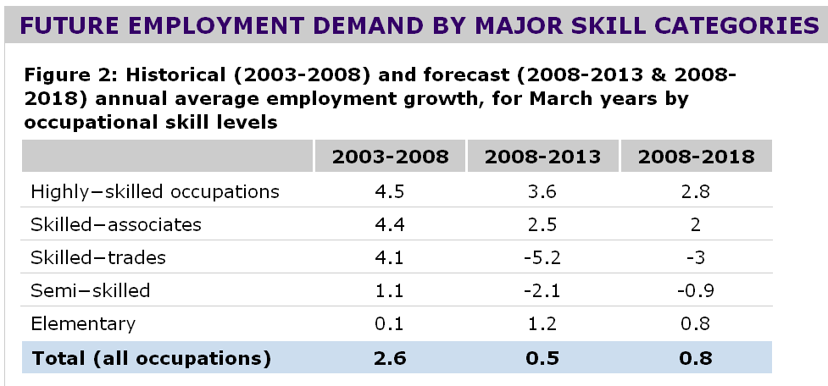

Slide 36


Slide 37
low skill
low wage
low skill
high wage
high skill
high wage

Slide 38
low skill
low wage
low skill
high wage
high skill
high wage

Slide 39
low skill
low wage
low skill
medium wage
high skill
high wage

Slide 40
  Can someone overseas
  do it cheaper?
  Can a computer
  do it faster?

Slide 41


Slide 42


Slide 43
2.5 billion

Slide 44

I sell books!
I’m an
accountant!
I have
an idea!

Slide 45


Slide 46


Slide 47


Slide 48
  Societally functional
  Mastery of information landscape
  Economically productive

Slide 49

Notes:
49

Slide 50
The fundamental dilemma
but now are
expected to
do this
Schools were
designed
for this …

Slide 51
What we have right now
uniqueness
uniqueness
one right answer
Notes:
51

Slide 52

Notes:
THIS SLIDE IS COPYRIGHT-PROTECTED. I GOT SPECIAL PERMISSION FROM THE CARTOONIST, TONY CARRILLO, TO USE IT.
52

Slide 53


Slide 54

Notes:
54

Slide 55

Notes:
55

Slide 56

While we teach whatever we teach at school, the kids go home and learn the skills they need to survive and prosper in an interconnected global economy.
Clarence Fisher
Notes:
As a result…
http://remoteaccess.typepad.com/remote_access/2005/11/educational_lea.html
Incrementally changing our teaching methods, slowly bringing people up to speed . . . worked fine when ideas of literacy and education were not rapidly changing; but they are. We need to be able to leapfrog in our understandings, in our methods, and in our tools, allowing us to move to where the kids are. If we do not become leaders to our students, we will be followers, seen as irrelevant, and left to cry in our books.

Slide 57

No generation in history has ever been so
thoroughly prepared for the industrial age.
David Warlick
http://davidwarlick.com/2cents/?p=298
dangerouslyirrelevant.org

Slide 58


Slide 59


Slide 60


Slide 61

Notes:
We need to somehow
change faster
No one jumps a 20 foot chasm in two
10 foot jumps. – Miguel Guhlin
When the world changes so fast that we have no reasonable way to forecast what it will look like in a mere decade or two, all we can do is teach kids how to be adaptive – to be learners in the truest sense of the word –
We’ve always talked about preparing lifelong learners in schools, but our practices typically haven’t matched our rhetoric. It’s time to put some bite into our toothless vision statements and recognize that we have to teach kids how to learn to learn if they want to be successful in this new technology-suffused, globally-interconnected world
Credits: http://tinyurl.com/2urbsm and http://tinyurl.com/37em64 (see Guhlin comment)
http://remoteaccess.typepad.com/remote_access/
2006/06/literacy_as_bat.html (see Guhlin comment)
http://headrush.typepad.com/creating_passionate_users/2005/03/incremental_vs_.html

Slide 62
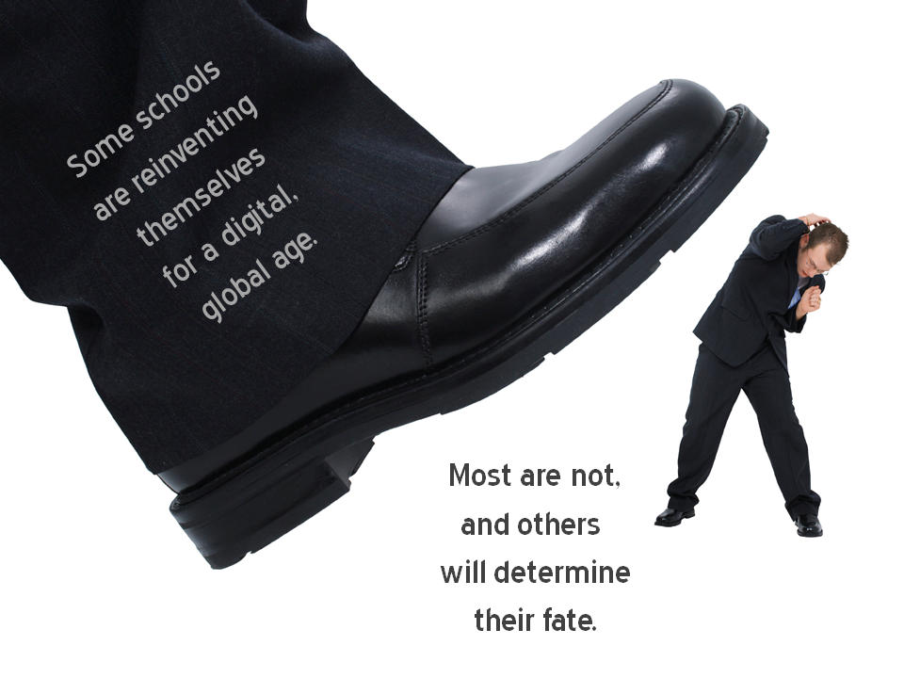
Notes:
Licensed under a Creative Commons attribution-share alike license.
http://creativecommons.org/licenses/by-sa/3.0
Scott McLeod, J.D., Ph.D.
dangerouslyirrelevant.org
schooltechleadership.org
dangerouslyirrelevant.org/contact.html

Slide 63


Slide 64
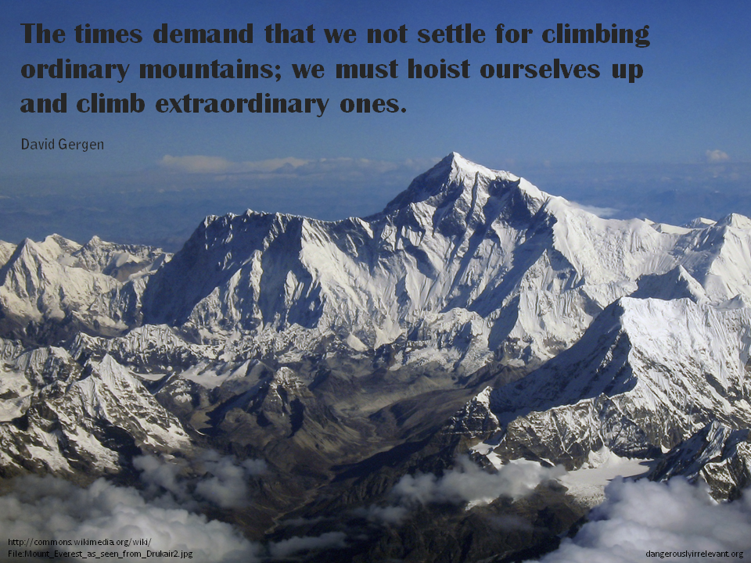

Slide 65

No one will thank you
for taking care of today
if you have failed
to take care of tomorrow.
Joel Barker

Slide 66

Notes:
66

Slide 67
Thank you!
Scott McLeod, J.D., Ph.D.
Director, CASTLE
www.scottmcleod.net
Notes:
67
All of my materials are licensed under a Creative Commons attribution-share alike license (http://creativecommons.org/licenses/by-sa/3.0). That means not only that you are welcome to share and/or remix my content but that you are encouraged to do so! All I ask is that you properly credit me for my content and that you not place any greater copyright restrictions than I have on the content that utilizes my material. If possible, including the URL of Dangerously Irrelevant in your content would be most appreciated.
Scott McLeod, J.D., Ph.D.
dangerouslyirrelevant.org
schooltechleadership.org
dangerouslyirrelevant.org/contact.html

