Slide 1

Two big
shifts and
one big
problem
Dr. Scott McLeod
CASTLE

Slide 2
#latsconf
@mcleod

Slide 3
scottmcleod.net
(click on Workshops)

Slide 4
Big shifts

Slide 5
Aging of
society

Slide 6
Climate
change

Slide 7
Geopolitical
reascendance
of Asia

Slide 8
Big shifts?

Slide 9
Our new
information
landscape

Slide 10
Our new
economic
landscape

Slide 11
Our new
information
landscape

Slide 12
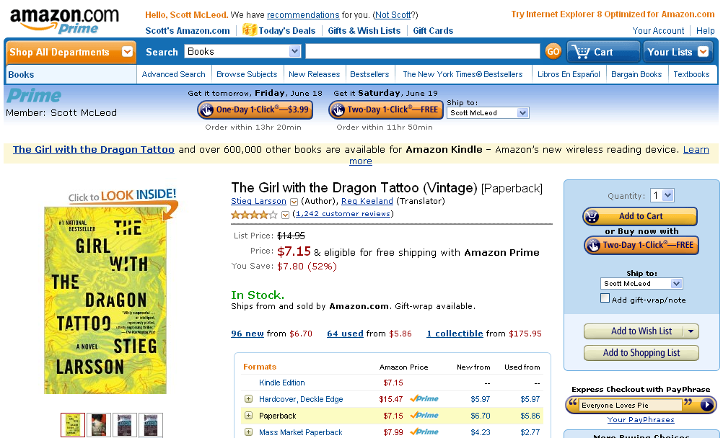

Slide 13
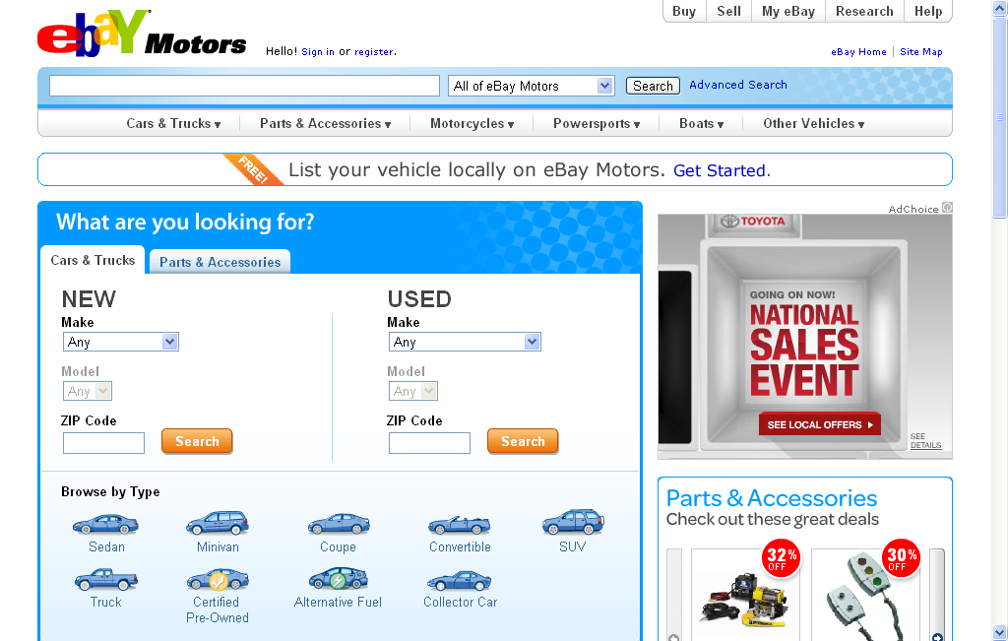

Slide 14


Slide 15


Slide 16
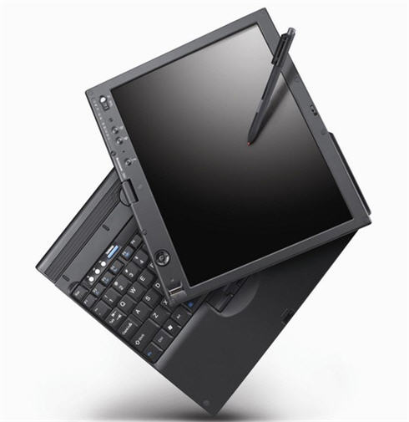

Slide 17


Slide 18


Slide 19


Slide 20


Slide 21


Slide 22


Slide 23


Slide 24
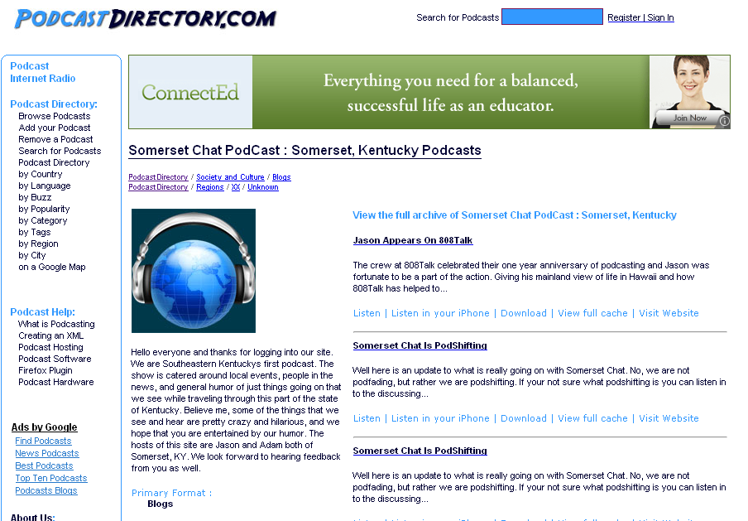

Slide 25


Slide 26


Slide 27


Slide 28


Slide 29


Slide 30


Slide 31
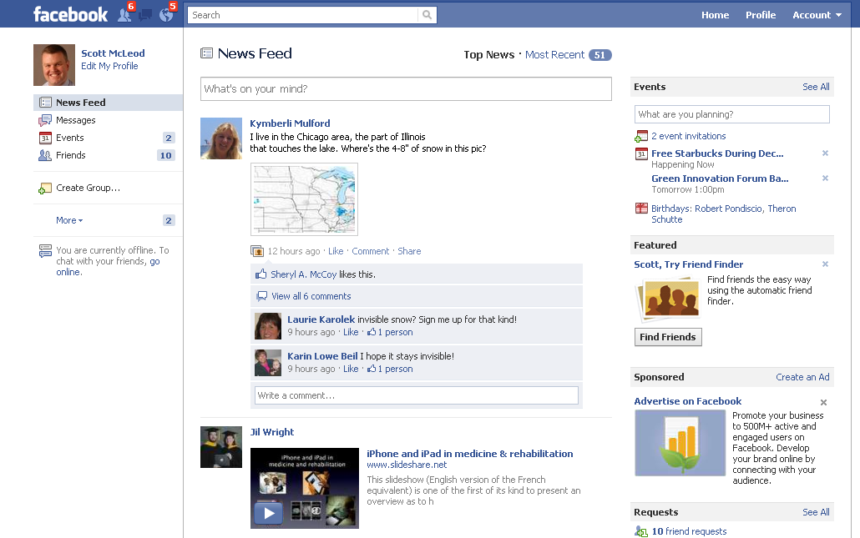

Slide 32


Slide 33


Slide 34


Slide 35


Slide 36
We all now have a voice

Slide 37
We can easily find each other

Slide 38
We can easily work together

Slide 39


Slide 40


Slide 41
discuss

Slide 42
0
0
5
4
3
2
1
0
0
9
8
7
6
5
4
3
2
1
0
9
8
7
6
5
4
3
2
1
0
9
8
7
6
5
4
3
2
1
0
9
8
7
6
5
4
3
2
1
0
9
8
7
6
5
4
3
2
1
0
9
8
7
6
5
4
3
2
1
0
0
2
0
1
Hours
Minutes
Seconds

Slide 43
0
0
5
4
3
2
1
0
0
9
8
7
6
5
4
3
2
1
0
9
8
7
6
5
4
3
2
1
0
9
8
7
6
5
4
3
2
1
0
9
8
7
6
5
4
3
2
1
0
9
8
7
6
5
4
3
2
1
0
9
8
7
6
5
4
3
2
1
0
0
1
0
0
Hours
Minutes
Seconds

Slide 44

Notes:
Back in the day we used to have vinyl records.

Slide 45
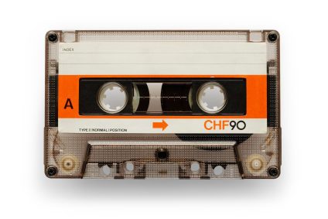
Notes:
The vinyl record was eventually replaced by the cassette tape

Slide 46

Notes:
Which was then replaced by the music CD

Slide 47
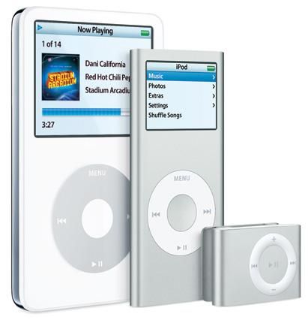
Notes:
Which is now being replaced by portable music players such as the iPod.
The cassette tape was a DI to the vinyl record paradigm. The music CD was a DI to the cassette tape paradigm. And iPods and other portable music players are proving to be DIs to the music CD paradigm.

Slide 48
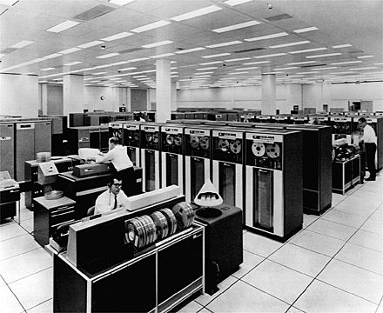
Notes:
Here’s another example. We used to have mainframe computers that ran reel-to-reel tape.

Slide 49
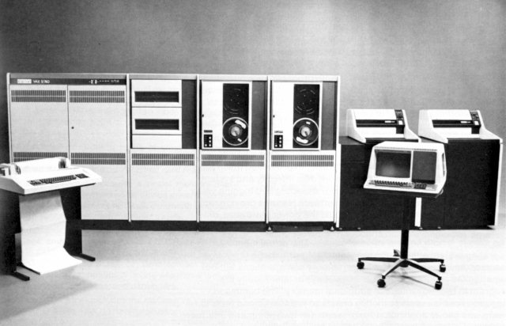
Notes:
Those were replaced by minicomputers

Slide 50

Notes:
Which were then replaced by personal computers

Slide 51
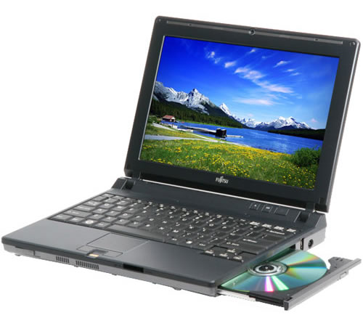
Notes:
Which are increasingly being replaced by portable computers. The laptop is looking like it’s a DI to desktop PCs, which were DIs for minicomputers, which were DIs to the old mainframe computers.

Slide 52
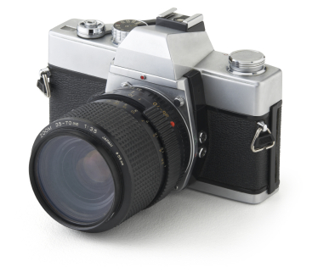
Notes:
Similarly, film cameras

Slide 53
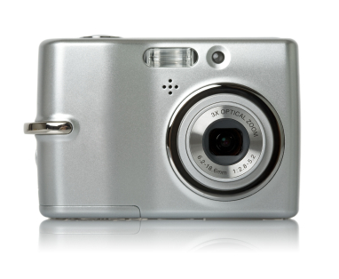
Notes:
Have for the most part been replaced by digital cameras

Slide 54

Notes:
In the financial services arena, previously-dominant stock brokerages…

Slide 55

Notes:
Are increasingly facing pressure from online brokerages such as ETrade which allow customers to purchase stocks directly. As we can see, DIs arise in the service industries too.

Slide 56
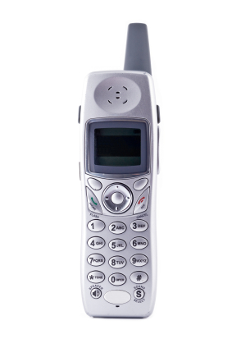
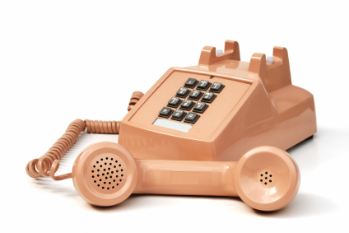
more than
needed
Notes:
The first line is the ‘more than needed’ line. Christensen has a fancier term for this line, but I like this one.
An example of the ‘more than needed’ line relates to those push-button phones that connect to the wall that many of us still have. If you recall, over time these phones have gotten fancier and fancier. Some became cordless, for example, or could be used as intercom systems. Similarly, the phone company began to offer us new ‘services’ such as call waiting or caller ID in order to make additional money. But for many folks, the regular phone worked just fine. Most of the new features were more than they needed.
[When this occurs, Christensen calls this situation performance oversupply.]

Slide 57
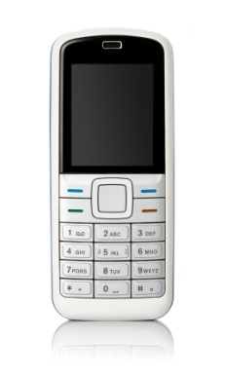
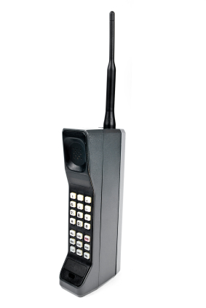
good
enough
Notes:
The second line is the ‘good enough’ line (which, of course, also has a fancier name in Christensen’s books).
For example, when the first mobile phones came out, they were big, heavy, and expensive. Over time, however, they got better and better, until eventually they were ‘good enough’ for the mainstream public.

Slide 58
more than
needed
good
enough
Notes:
In both cases, the lines of progress – represented here by green lines – are what Christensen calls SIs. SIs are gradual, continual improvements of current products for existing customers. Over time, products get better and better as organizations strive to maintain and grow market share. As this occurs, products get less expensive, add more features, etc.

Slide 59
more than
needed
good
enough
Notes:
What happens when a brand new technology comes along that is not a SI? For example, the first mobile phone was not a refinement of the wired, push button phone. It was not a SI. Instead, it was a completely new telephone technology.
Well, what happens when a new technology like the mobile phone enters the market is that most existing customers are NOT interested. Their current phone works fine – it’s good enough. In fact, on a number of different fronts, the new technology is much WORSE than the old one. Why would customers be interested in that?

Slide 60
more than
needed
good
enough
Notes:
In this case, the phone company logically and rationally listens to its current customers, the ones that generate all of its revenue. It continues to engage in SI, improving its current products and ignoring the new technology because it doesn’t meet the needs of its customer base.

Slide 61
more than
needed
good
enough
Notes:
What happens, however, is that the new technology finds a new group of people who ARE interested in it. Rather than taking away existing customers, the new technology finds a whole new bunch of folks that need it. For instance, when the first mobile phones came out, their disadvantages made them distinctly unattractive to the mainstream market. But there was a different, smaller, unserved market that jumped on mobile phones right away despite their shortcomings.
The key thing to remember about all of this is that, over time, many new technologies get better as they continue along their own SI path serving their new markets. Each change for the better attracts new customers, and the technology gets refined even more and makes even more progress. At some point the new technology actually gets “good enough” for the mainstream, at which point things get interesting.

Slide 62
more than
needed
good
enough
Notes:
Why? Because when a DI crosses the ‘good enough’ line, folks start buying it in droves because it has other advantages such as reliability, convenience, size, or price.
When this occurs, the new technology officially becomes a DI, so-called because, as more and more customers start buying the new technology, it completely disrupts the old market. The old technology eventually disappears due to lack of customers. Cell phones are a classic example of this, as more and more people simply cancel their wired phone service altogether.

Slide 63
good
enough
Notes:
Pretty soon all you have left is the DI.

Slide 64
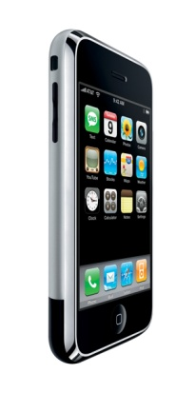
more than
needed
good
enough
Notes:
The new organizations then proceed to engage in SI just like the old ones did …

Slide 65
more than
needed
good
enough
?
Notes:
…, until a new DI comes along and starts the process all over again.

Slide 66

Notes:
http://www.flickr.com/photos/deks/711658920/sizes/z/

Slide 67

Notes:
http://www.flickr.com/photos/13638129@N00/118245563/

Slide 68

Notes:
http://www.flickr.com/photos/sepblog/3527825643/sizes/o/

Slide 69

Notes:
http://www.flickr.com/photos/77136818@N00/3202144482/

Slide 70

Notes:
http://www.flickr.com/photos/7337467@N04/3052065204/

Slide 71

Notes:
http://www.flickr.com/photos/48973657@N00/4556156477/

Slide 72

Notes:
http://www.flickr.com/photos/20532289@N00/59083917/

Slide 73

Notes:
http://www.flickr.com/photos/88442983@N00/1604241264/

Slide 74

Notes:
http://www.flickr.com/photos/28473961@N02/4320982975/

Slide 75
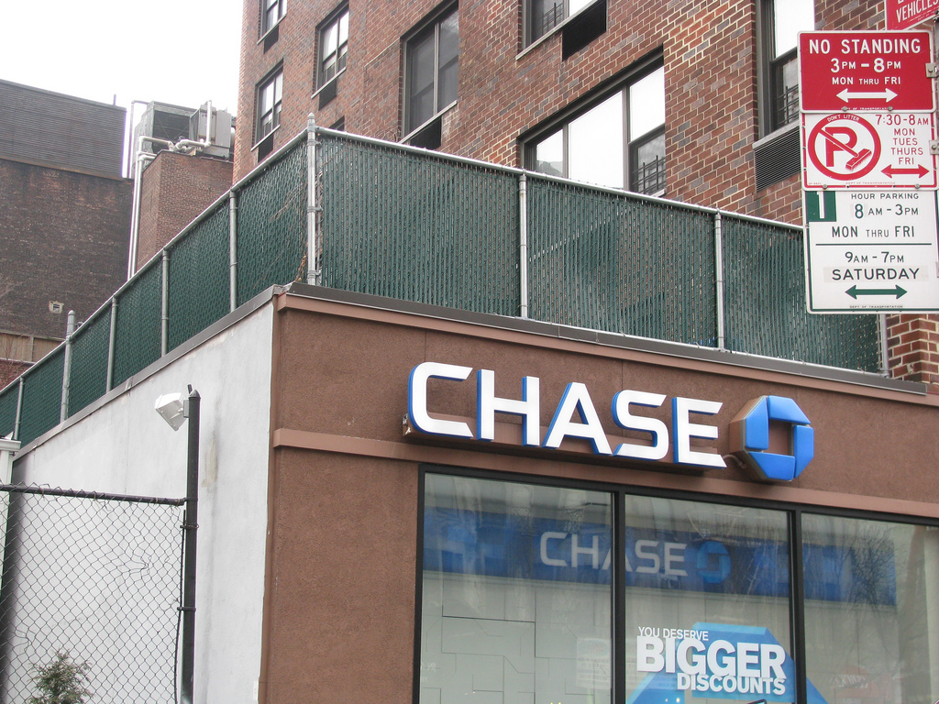
Notes:
http://www.flickr.com/photos/28473961@N02/3347811470/

Slide 76

Notes:
http://www.flickr.com/photos/26416016@N02/4479154715/

Slide 77

Notes:
http://www.flickr.com/photos/40645538@N00/4004791663/

Slide 78

Notes:
http://www.flickr.com/photos/9031691@N08/2670224692/

Slide 79

Notes:
http://www.flickr.com/photos/28473961@N02/2757755401/

Slide 80

Notes:
http://www.flickr.com/photos/28473961@N02/3229296247/

Slide 81
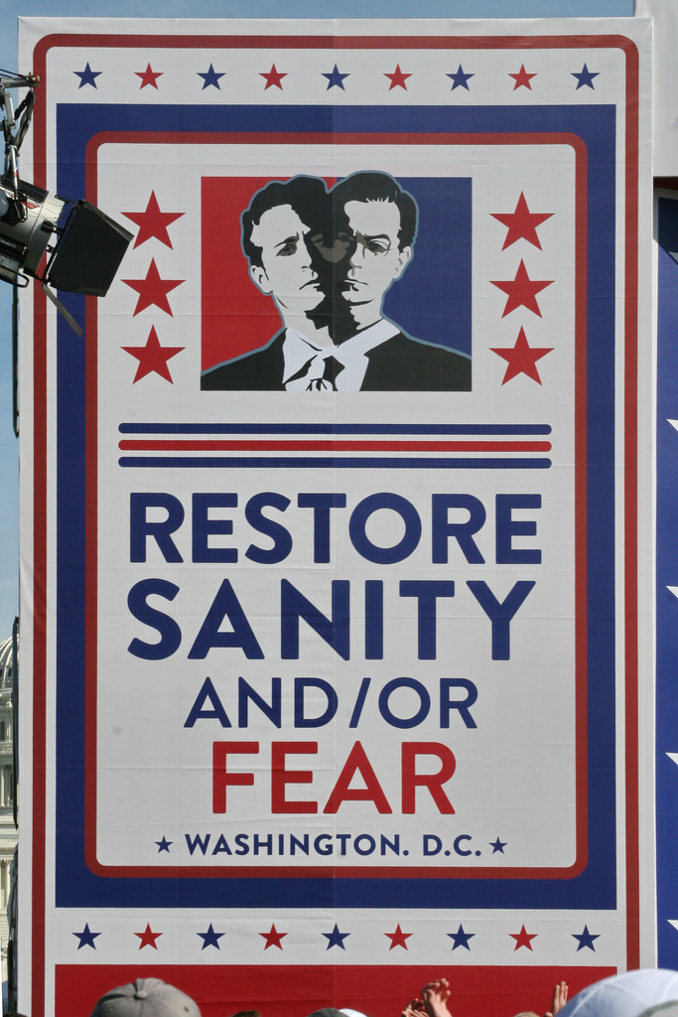
Notes:
http://www.flickr.com/photos/28567825@N03/5129325457/

Slide 82

Notes:
http://www.flickr.com/photos/47477979@N00/2453748088/

Slide 83
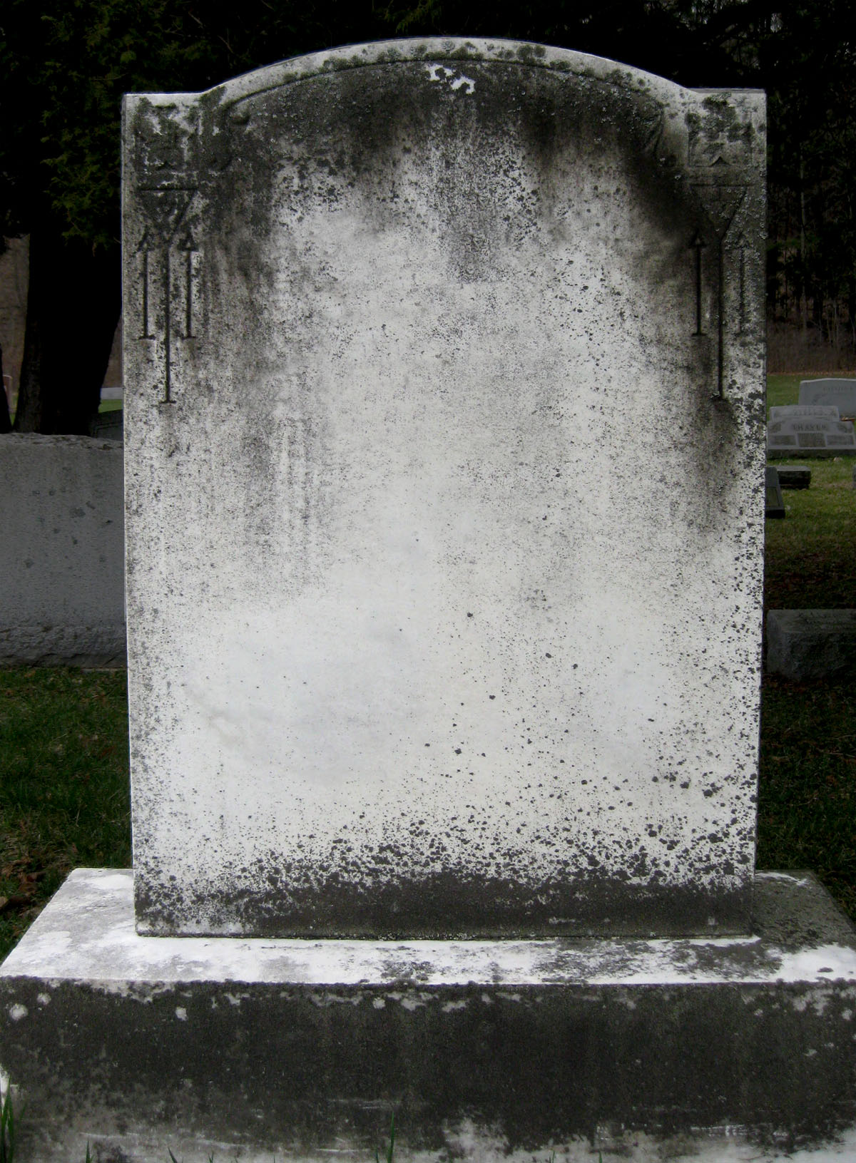
CHANGE
OR DIE

Slide 84

Notes:
http://www.flickr.com/photos/30624156@N00/4820259304/

Slide 85
CHANGE
OR DIE

Slide 86
discuss

Slide 87
0
0
5
4
3
2
1
0
0
9
8
7
6
5
4
3
2
1
0
9
8
7
6
5
4
3
2
1
0
9
8
7
6
5
4
3
2
1
0
9
8
7
6
5
4
3
2
1
0
9
8
7
6
5
4
3
2
1
0
9
8
7
6
5
4
3
2
1
0
0
2
0
1
Hours
Minutes
Seconds

Slide 88
0
0
5
4
3
2
1
0
0
9
8
7
6
5
4
3
2
1
0
9
8
7
6
5
4
3
2
1
0
9
8
7
6
5
4
3
2
1
0
9
8
7
6
5
4
3
2
1
0
9
8
7
6
5
4
3
2
1
0
9
8
7
6
5
4
3
2
1
0
0
1
0
0
Hours
Minutes
Seconds

Slide 89
Our new
economic
landscape

Slide 90
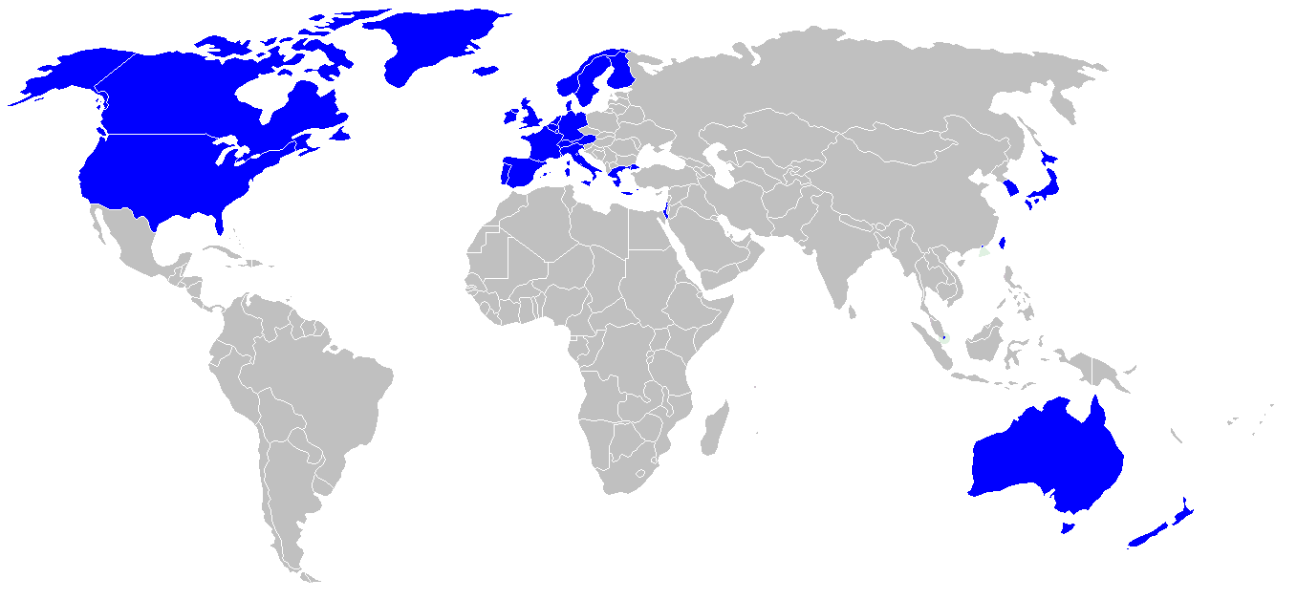

Slide 91
location
dependent?
location
independent?

Slide 92
Percentile change in
importance of task type
in U.S. economy
Abstract
Routine
Manual
Autor, D., Levy, F., & Murnane, R. J. (2003). The skill content of recent technological change:
An empirical exploration. Quarterly Journal of Economics 188, 4. [updated, D. Autor, 2008]

Slide 93
global awareness
effective speaking
critical thinking
problem solving
adaptability
information literacy
collaboration
creativity
media fluency
analytical skills
entrepeneurialism
innovation
effective writing
synthesis
curiosity

Slide 94
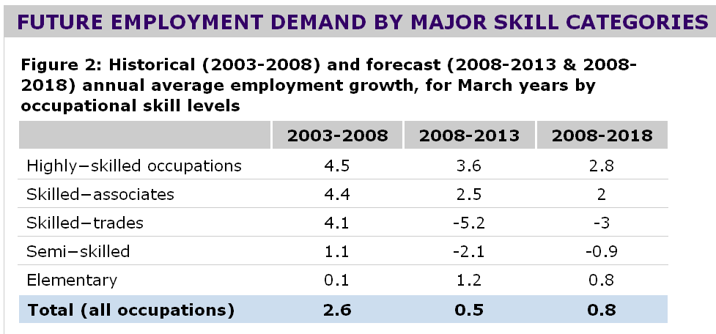

Slide 95


Slide 96
low skill
low wage
low skill
high wage
high skill
high wage

Slide 97
low skill
low wage
low skill
high wage
high skill
high wage

Slide 98
low skill
low wage
low skill
medium wage
high skill
high wage

Slide 99
  Can someone overseas
  do it cheaper?
  Can a computer
  do it faster?

Slide 100


Slide 101


Slide 102
2.5 billion

Slide 103

I sell books!
I’m an
accountant!
I have
an idea!

Slide 104


Slide 105


Slide 106


Slide 108
discuss

Slide 109
0
0
5
4
3
2
1
0
0
9
8
7
6
5
4
3
2
1
0
9
8
7
6
5
4
3
2
1
0
9
8
7
6
5
4
3
2
1
0
9
8
7
6
5
4
3
2
1
0
9
8
7
6
5
4
3
2
1
0
9
8
7
6
5
4
3
2
1
0
0
2
0
1
Hours
Minutes
Seconds

Slide 110
0
0
5
4
3
2
1
0
0
9
8
7
6
5
4
3
2
1
0
9
8
7
6
5
4
3
2
1
0
9
8
7
6
5
4
3
2
1
0
9
8
7
6
5
4
3
2
1
0
9
8
7
6
5
4
3
2
1
0
9
8
7
6
5
4
3
2
1
0
0
1
0
0
Hours
Minutes
Seconds

Slide 111
  Societally functional
  Mastery of information landscape
  Economically productive

Slide 112

Notes:
112

Slide 113
The fundamental dilemma
but now are
expected to
do this
Schools were
designed
for this …

Slide 114
What we have right now
uniqueness
uniqueness
one right answer
Notes:
114

Slide 115

Notes:
THIS SLIDE IS COPYRIGHT-PROTECTED. I GOT SPECIAL PERMISSION FROM THE CARTOONIST, TONY CARRILLO, TO USE IT.
115

Slide 116


Slide 117

Notes:
117

Slide 118

Notes:
118

Slide 119

No generation in history has ever been so
thoroughly prepared for the industrial age.
David Warlick
http://davidwarlick.com/2cents/?p=298
dangerouslyirrelevant.org

Slide 120
discuss

Slide 121
0
0
5
4
3
2
1
0
0
9
8
7
6
5
4
3
2
1
0
9
8
7
6
5
4
3
2
1
0
9
8
7
6
5
4
3
2
1
0
9
8
7
6
5
4
3
2
1
0
9
8
7
6
5
4
3
2
1
0
9
8
7
6
5
4
3
2
1
0
0
2
0
1
Hours
Minutes
Seconds

Slide 122
0
0
5
4
3
2
1
0
0
9
8
7
6
5
4
3
2
1
0
9
8
7
6
5
4
3
2
1
0
9
8
7
6
5
4
3
2
1
0
9
8
7
6
5
4
3
2
1
0
9
8
7
6
5
4
3
2
1
0
9
8
7
6
5
4
3
2
1
0
0
1
0
0
Hours
Minutes
Seconds

Slide 123


Slide 124


Slide 125


Slide 126
Implementation

Slide 127

Notes:
We need to somehow
change faster
No one jumps a 20 foot chasm in two
10 foot jumps. – Miguel Guhlin
When the world changes so fast that we have no reasonable way to forecast what it will look like in a mere decade or two, all we can do is teach kids how to be adaptive – to be learners in the truest sense of the word –
We’ve always talked about preparing lifelong learners in schools, but our practices typically haven’t matched our rhetoric. It’s time to put some bite into our toothless vision statements and recognize that we have to teach kids how to learn to learn if they want to be successful in this new technology-suffused, globally-interconnected world
Credits: http://tinyurl.com/2urbsm and http://tinyurl.com/37em64 (see Guhlin comment)
http://remoteaccess.typepad.com/remote_access/
2006/06/literacy_as_bat.html (see Guhlin comment)
http://headrush.typepad.com/creating_passionate_users/2005/03/incremental_vs_.html

Slide 128

Notes:
Anticipatory v. reactionary

Slide 129

Notes:
Future oriented v. compliance oriented

Slide 130


Slide 131

Notes:
Licensed under a Creative Commons attribution-share alike license.
http://creativecommons.org/licenses/by-sa/3.0
Scott McLeod, J.D., Ph.D.
dangerouslyirrelevant.org
schooltechleadership.org
dangerouslyirrelevant.org/contact.html

Slide 132
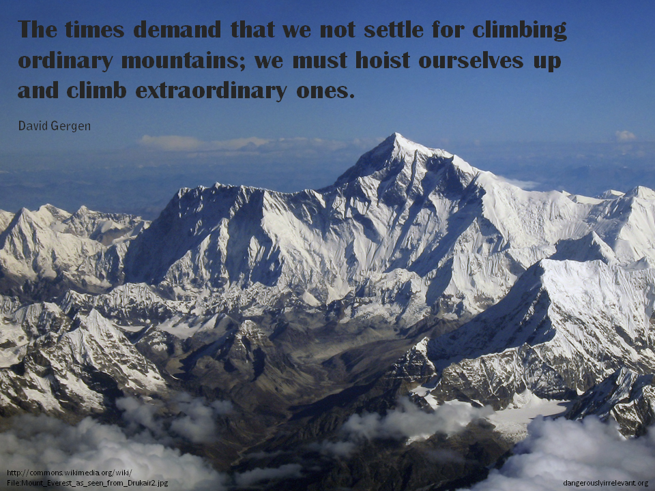

Slide 133
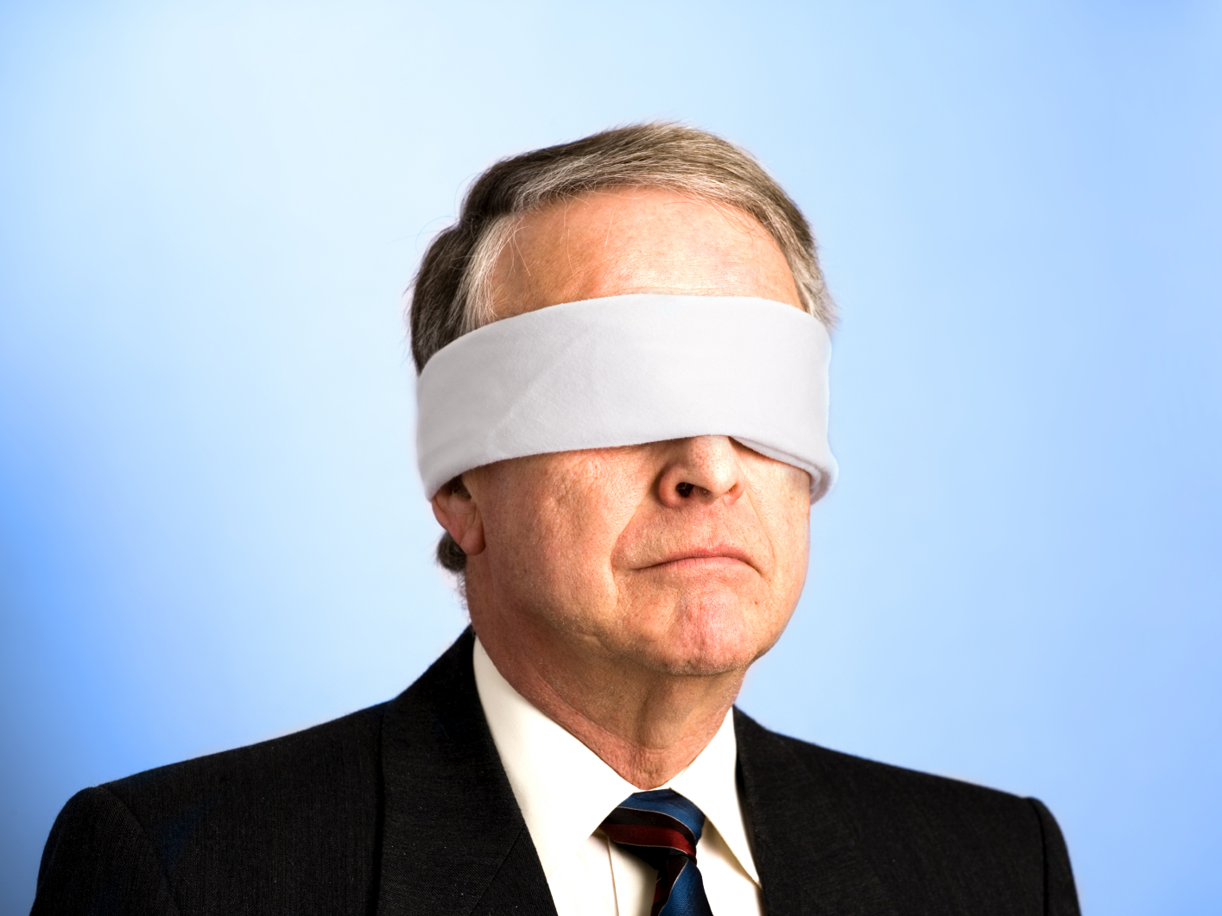
The people in charge
of leading school
organizations into the
21st century …
often are the
least knowledgeable
about the 21st century.
dangerouslyirrelevant.org
Notes:
Licensed under a Creative Commons attribution-share alike license.
http://creativecommons.org/licenses/by-sa/3.0
Scott McLeod, J.D., Ph.D.
scottmcleod.net/contact
dangerouslyirrelevant.org
schooltechleadership.org

Slide 134

If the leaders
don’t get it,
it’s not going
to happen.
dangerouslyirrelevant.org
Notes:
Licensed under a Creative Commons attribution-share alike license.
http://creativecommons.org/licenses/by-sa/3.0
Scott McLeod, J.D., Ph.D.
scottmcleod.net/contact
dangerouslyirrelevant.org
schooltechleadership.org

Slide 135


Slide 136

No one will thank you
for taking care of today
if you have failed
to take care of tomorrow.
Joel Barker

Slide 137
Big questions

Slide 138

Notes:
138

Slide 139
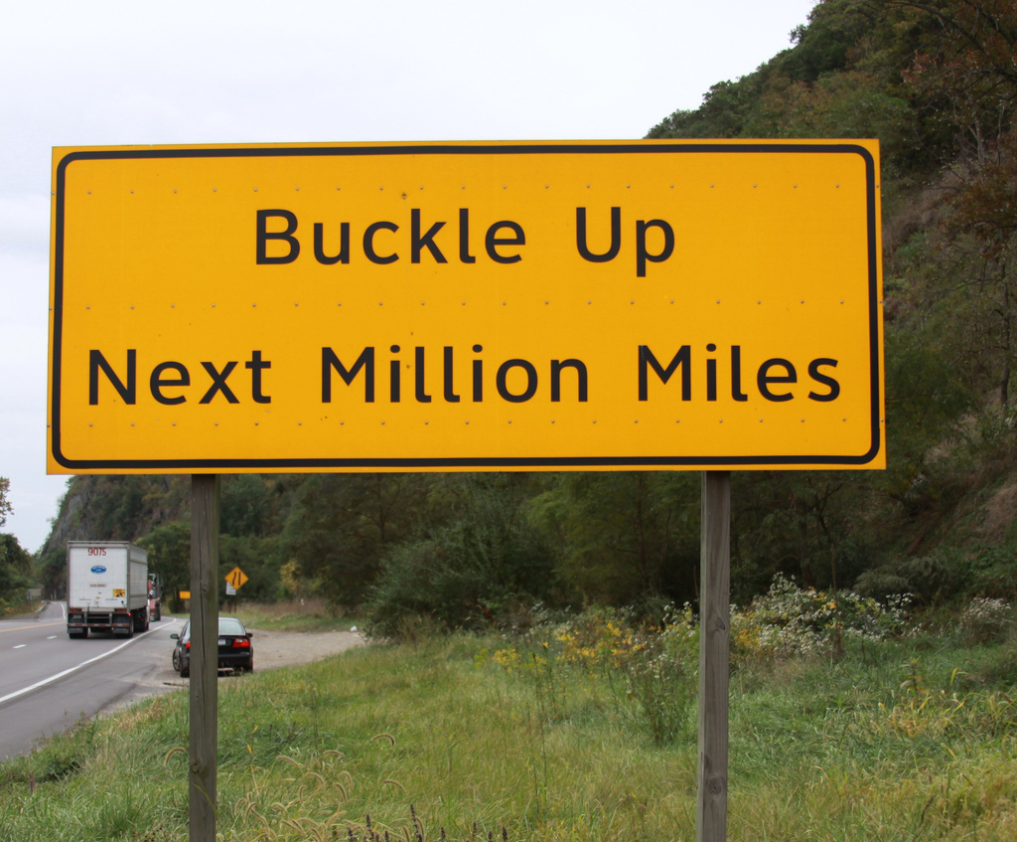

Slide 140
Thank you!
Scott McLeod, J.D., Ph.D.
Director, CASTLE
scottmcleod.net
Notes:
140
All of my materials are licensed under a Creative Commons attribution-share alike license (http://creativecommons.org/licenses/by-sa/3.0). That means not only that you are welcome to share and/or remix my content but that you are encouraged to do so! All I ask is that you properly credit me for my content and that you not place any greater copyright restrictions than I have on the content that utilizes my material. If possible, including the URL of Dangerously Irrelevant in your content would be most appreciated.
Scott McLeod, J.D., Ph.D.
dangerouslyirrelevant.org
schooltechleadership.org
dangerouslyirrelevant.org/contact.html

