Slide 1

Two big
shifts and
one big
problem
Dr. Scott McLeod
CASTLE

Slide 2
scottmcleod.net
(click on Workshops)

Slide 3

Notes:
Back in the day we used to have vinyl records.

Slide 4
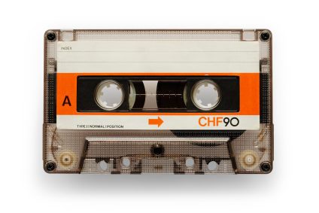
Notes:
The vinyl record was eventually replaced by the cassette tape

Slide 5

Notes:
Which was then replaced by the music CD

Slide 6
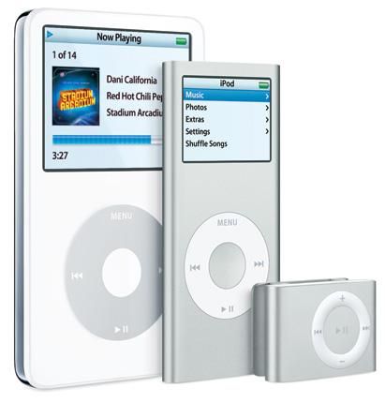
Notes:
Which is now being replaced by portable music players such as the iPod.
The cassette tape was a DI to the vinyl record paradigm. The music CD was a DI to the cassette tape paradigm. And iPods and other portable music players are proving to be DIs to the music CD paradigm.

Slide 7
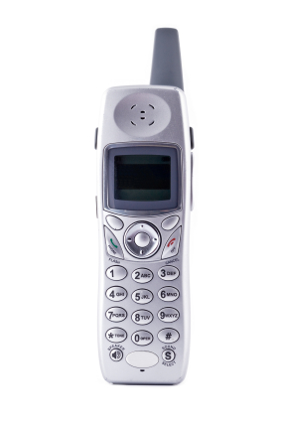
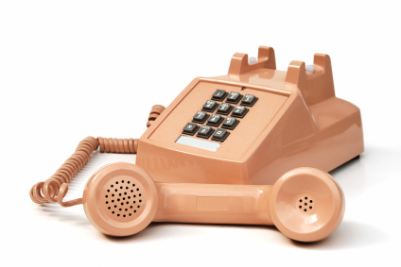
more than
needed
Notes:
The first line is the ‘more than needed’ line. Christensen has a fancier term for this line, but I like this one.
An example of the ‘more than needed’ line relates to those push-button phones that connect to the wall that many of us still have. If you recall, over time these phones have gotten fancier and fancier. Some became cordless, for example, or could be used as intercom systems. Similarly, the phone company began to offer us new ‘services’ such as call waiting or caller ID in order to make additional money. But for many folks, the regular phone worked just fine. Most of the new features were more than they needed.
[When this occurs, Christensen calls this situation performance oversupply.]

Slide 8
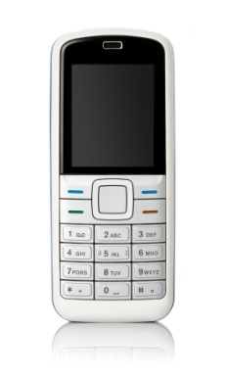
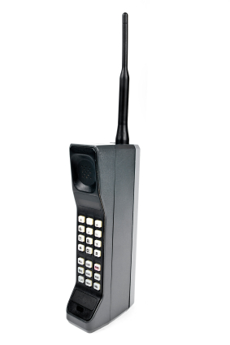
good
enough
Notes:
The second line is the ‘good enough’ line (which, of course, also has a fancier name in Christensen’s books).
For example, when the first mobile phones came out, they were big, heavy, and expensive. Over time, however, they got better and better, until eventually they were ‘good enough’ for the mainstream public.

Slide 9
more than
needed
good
enough
Notes:
In both cases, the lines of progress – represented here by green lines – are what Christensen calls SIs. SIs are gradual, continual improvements of current products for existing customers. Over time, products get better and better as organizations strive to maintain and grow market share. As this occurs, products get less expensive, add more features, etc.

Slide 10
more than
needed
good
enough
Notes:
What happens when a brand new technology comes along that is not a SI? For example, the first mobile phone was not a refinement of the wired, push button phone. It was not a SI. Instead, it was a completely new telephone technology.
Well, what happens when a new technology like the mobile phone enters the market is that most existing customers are NOT interested. Their current phone works fine – it’s good enough. In fact, on a number of different fronts, the new technology is much WORSE than the old one. Why would customers be interested in that?

Slide 11
more than
needed
good
enough
Notes:
In this case, the phone company logically and rationally listens to its current customers, the ones that generate all of its revenue. It continues to engage in SI, improving its current products and ignoring the new technology because it doesn’t meet the needs of its customer base.

Slide 12
more than
needed
good
enough
Notes:
What happens, however, is that the new technology finds a new group of people who ARE interested in it. Rather than taking away existing customers, the new technology finds a whole new bunch of folks that need it. For instance, when the first mobile phones came out, their disadvantages made them distinctly unattractive to the mainstream market. But there was a different, smaller, unserved market that jumped on mobile phones right away despite their shortcomings.
The key thing to remember about all of this is that, over time, many new technologies get better as they continue along their own SI path serving their new markets. Each change for the better attracts new customers, and the technology gets refined even more and makes even more progress. At some point the new technology actually gets “good enough” for the mainstream, at which point things get interesting.

Slide 13
more than
needed
good
enough
Notes:
Why? Because when a DI crosses the ‘good enough’ line, folks start buying it in droves because it has other advantages such as reliability, convenience, size, or price.
When this occurs, the new technology officially becomes a DI, so-called because, as more and more customers start buying the new technology, it completely disrupts the old market. The old technology eventually disappears due to lack of customers. Cell phones are a classic example of this, as more and more people simply cancel their wired phone service altogether.

Slide 14
good
enough
Notes:
Pretty soon all you have left is the DI.

Slide 15
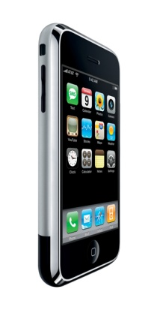
more than
needed
good
enough
Notes:
The new organizations then proceed to engage in SI just like the old ones did …

Slide 16
more than
needed
good
enough
?
Notes:
…, until a new DI comes along and starts the process all over again.

Slide 17
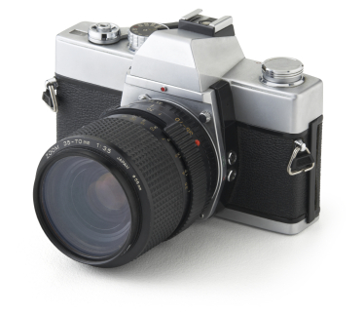
Notes:
Similarly, film cameras

Slide 18
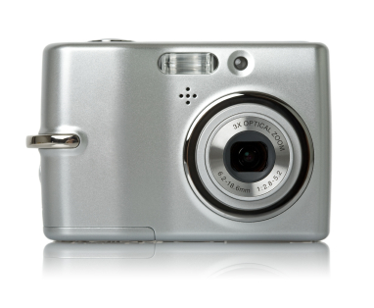
Notes:
Have for the most part been replaced by digital cameras

Slide 19

Notes:
In the financial services arena, previously-dominant stock brokerages…

Slide 20

Notes:
Are increasingly facing pressure from online brokerages such as ETrade which allow customers to purchase stocks directly. As we can see, DIs arise in the service industries too.

Slide 21
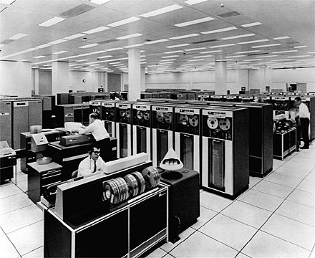
Notes:
Here’s another example. We used to have mainframe computers that ran reel-to-reel tape.

Slide 22
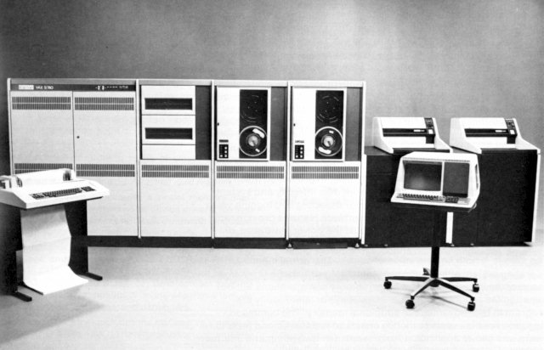
Notes:
Those were replaced by minicomputers

Slide 23

Notes:
Which were then replaced by personal computers

Slide 24
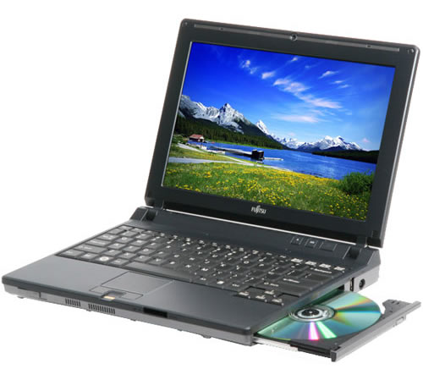
Notes:
Which are increasingly being replaced by portable computers. The laptop is looking like it’s a DI to desktop PCs, which were DIs for minicomputers, which were DIs to the old mainframe computers.

Slide 25


Slide 26
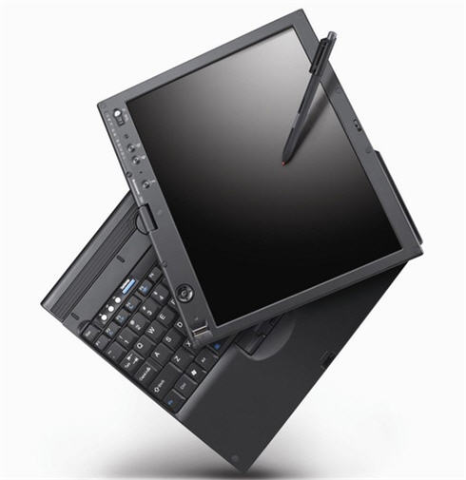

Slide 27


Slide 28


Slide 29


Slide 30


Slide 31


Slide 32


Slide 33


Slide 34
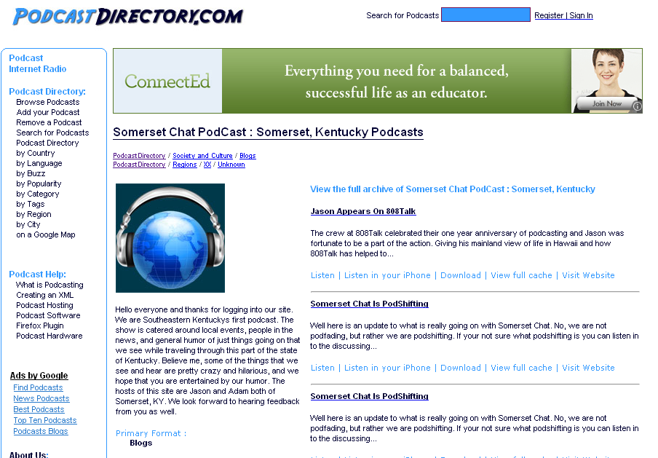

Slide 35


Slide 36


Slide 37


Slide 38


Slide 39
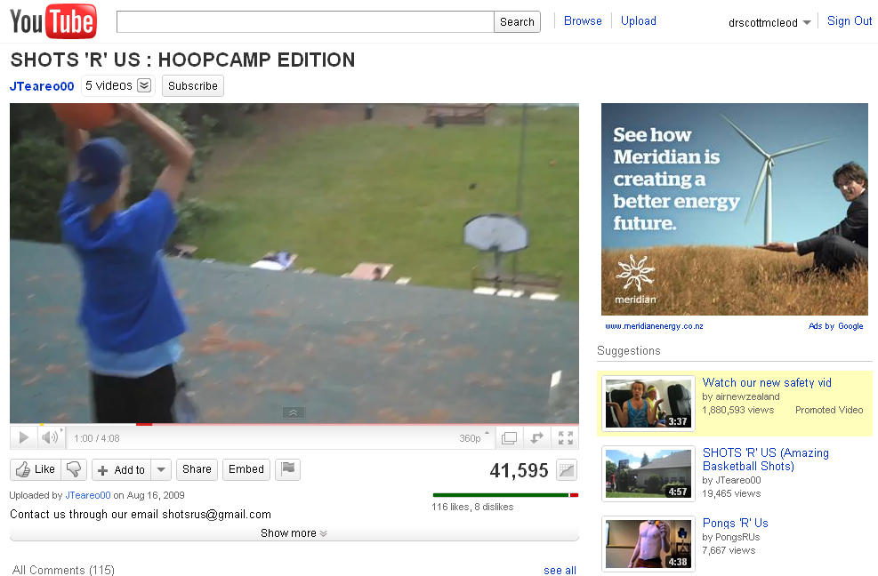

Slide 40
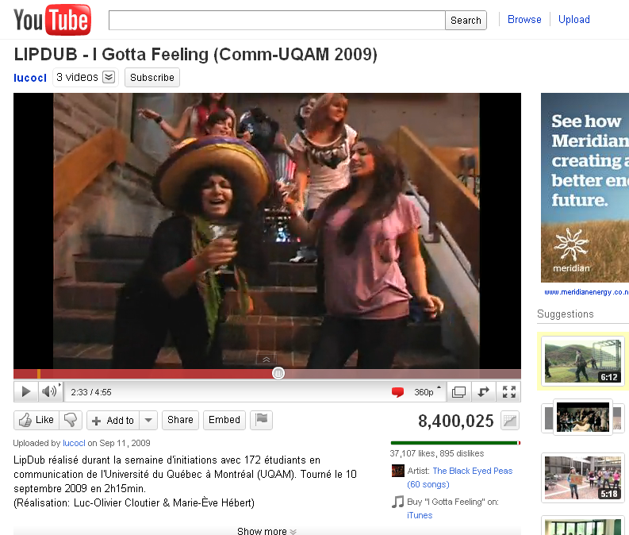

Slide 41
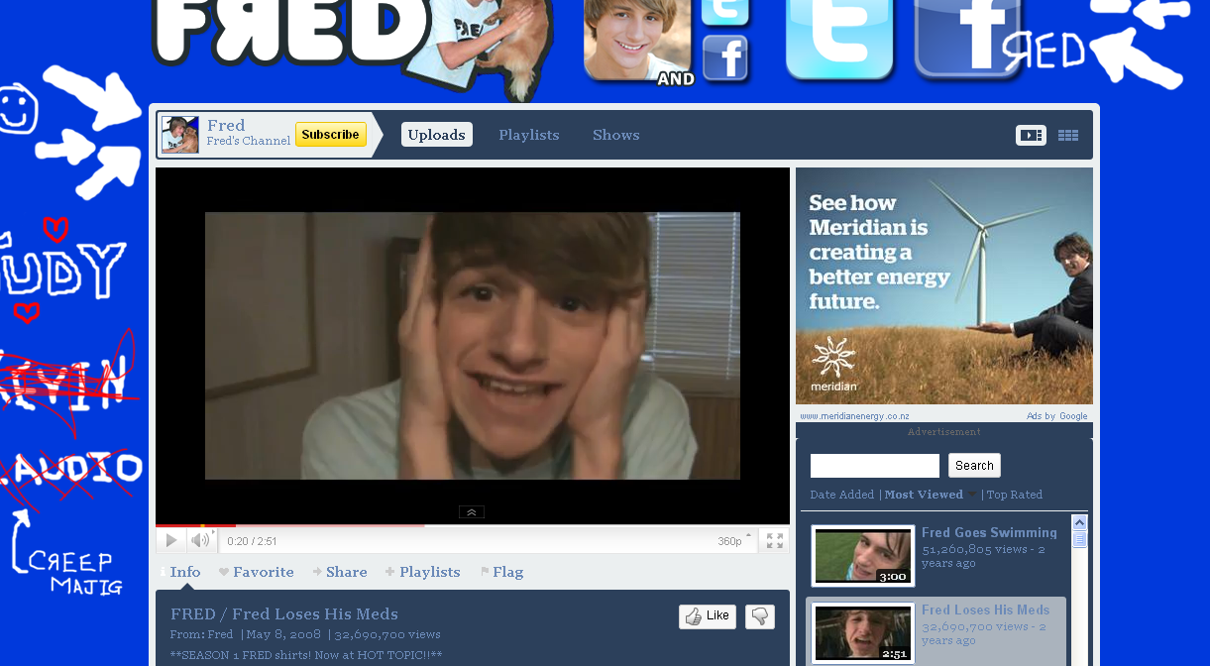

Slide 42
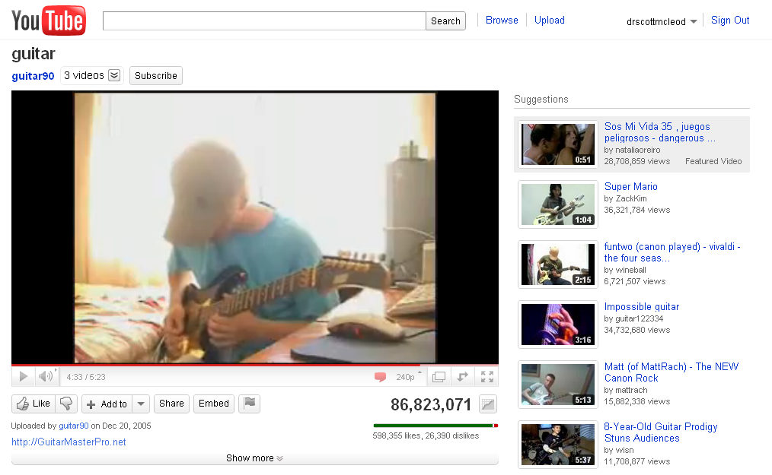

Slide 43


Slide 44


Slide 45
We all now have a voice

Slide 46
We can easily find each other

Slide 47
We can easily work together

Slide 48

Notes:
http://www.flickr.com/photos/deks/711658920/sizes/z/

Slide 49

Notes:
http://www.flickr.com/photos/77136818@N00/3202144482/

Slide 50

Notes:
http://www.flickr.com/photos/48973657@N00/4556156477/

Slide 51

Notes:
http://www.flickr.com/photos/13638129@N00/118245563/

Slide 52

Notes:
http://www.flickr.com/photos/7337467@N04/3052065204/

Slide 53

Notes:
http://www.flickr.com/photos/sepblog/3527825643/sizes/o/

Slide 54

Notes:
http://www.flickr.com/photos/20532289@N00/59083917/

Slide 55
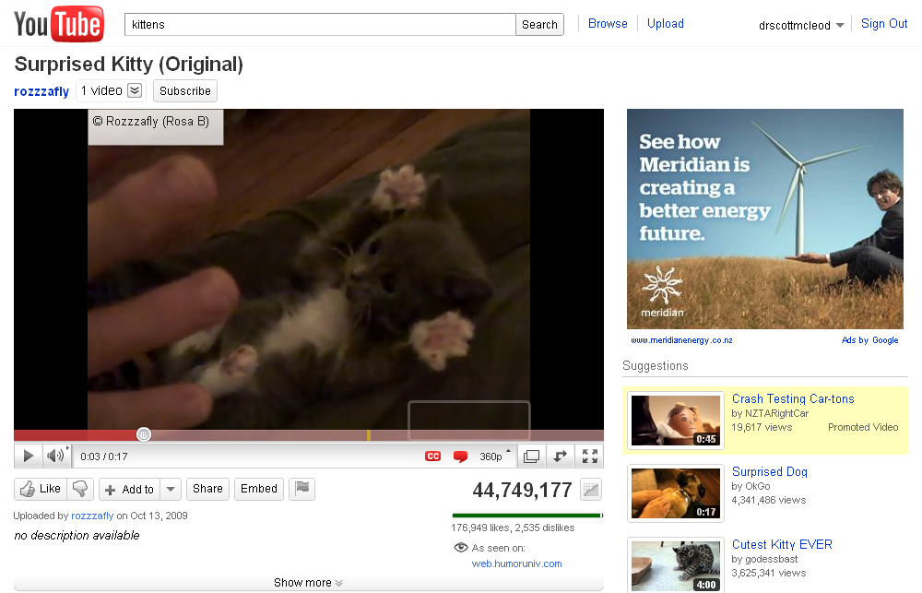

Slide 56
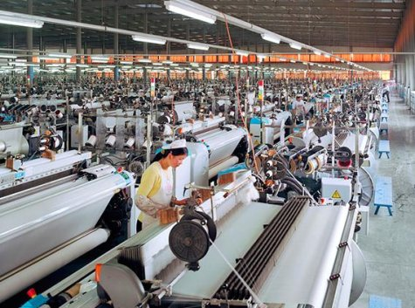

Slide 57
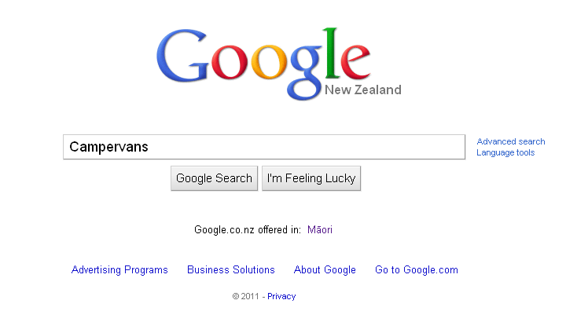

Slide 58
location
dependent?
location
independent?

Slide 59


Slide 60
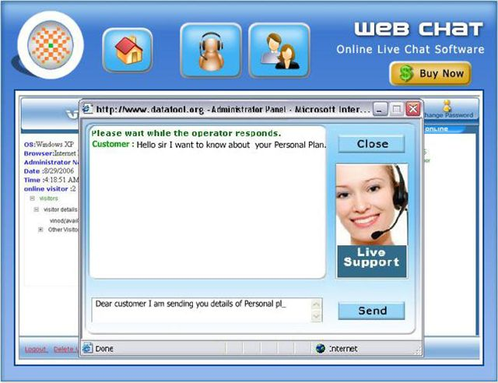

Slide 61
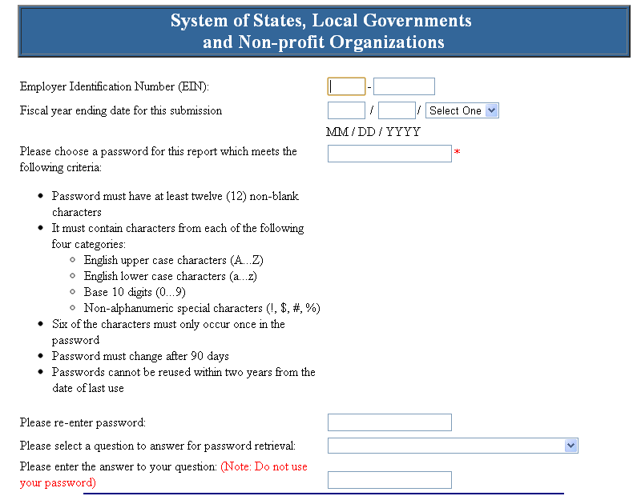

Slide 62
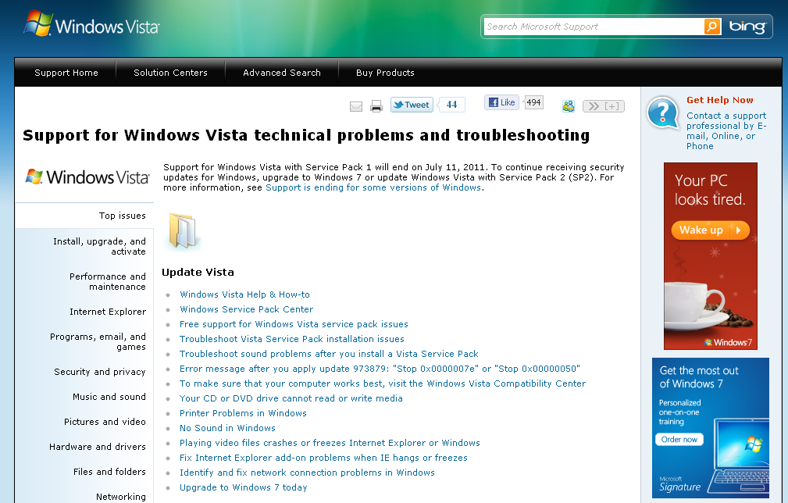

Slide 63
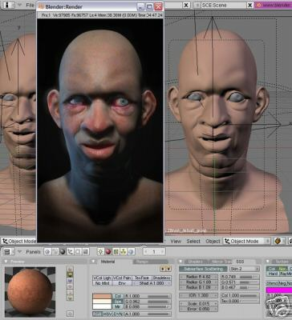

Slide 64

Notes:
http://www.flickr.com/photos/28473961@N02/3229296247/

Slide 65

Notes:
http://www.flickr.com/photos/26416016@N02/4479154715/

Slide 66
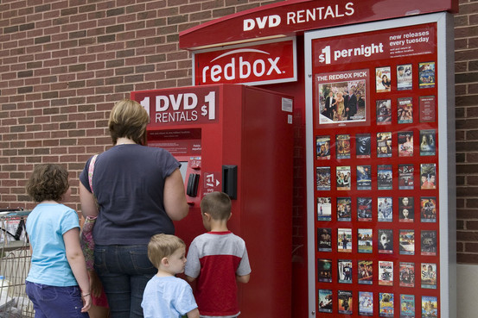

Slide 67
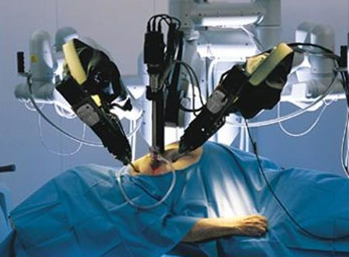

Slide 68

Notes:
http://www.flickr.com/photos/9031691@N08/2670224692/

Slide 69

Notes:
http://www.flickr.com/photos/40645538@N00/4004791663/

Slide 70
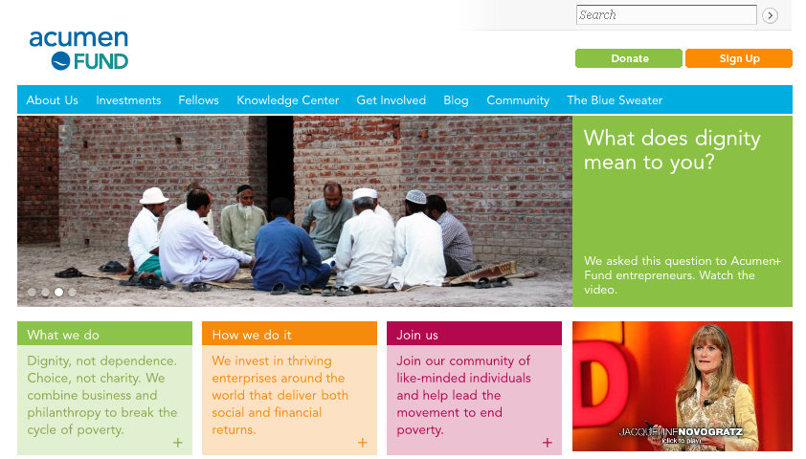

Slide 71
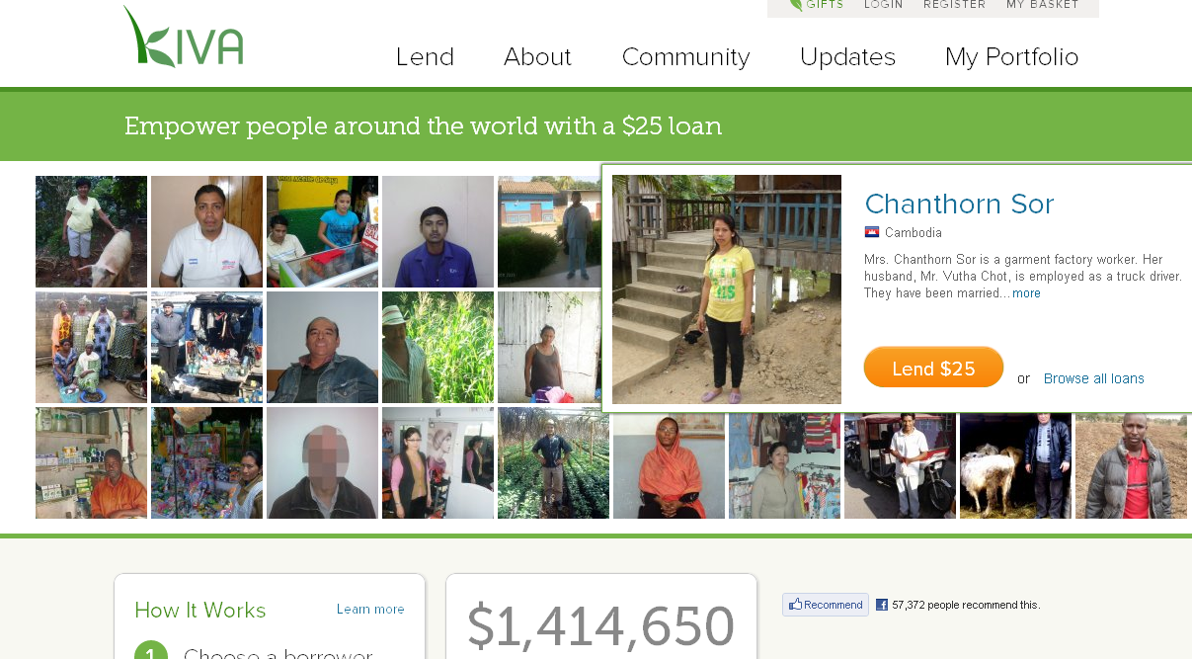

Slide 72
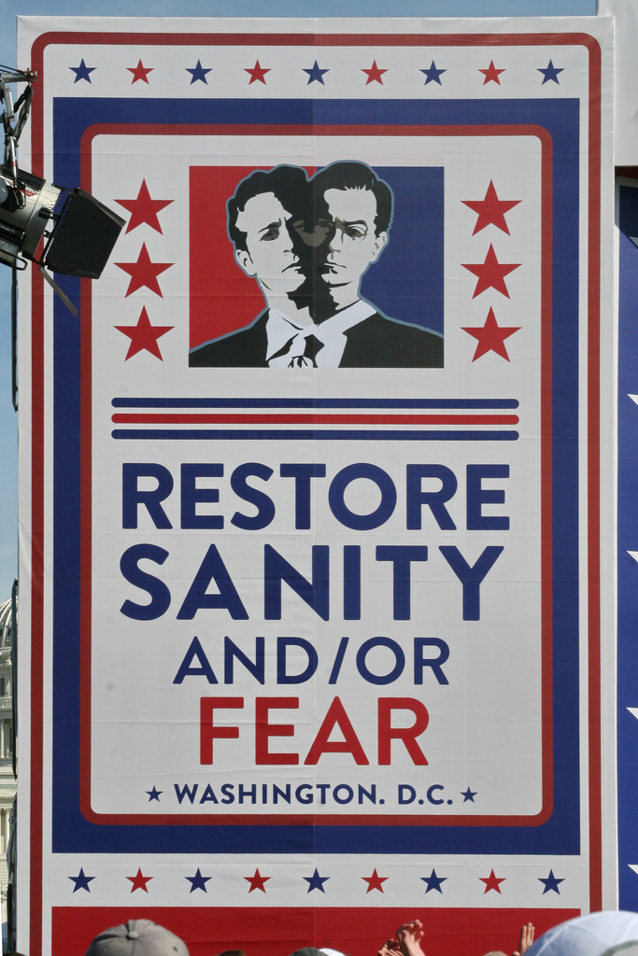
Notes:
http://www.flickr.com/photos/28567825@N03/5129325457/

Slide 73
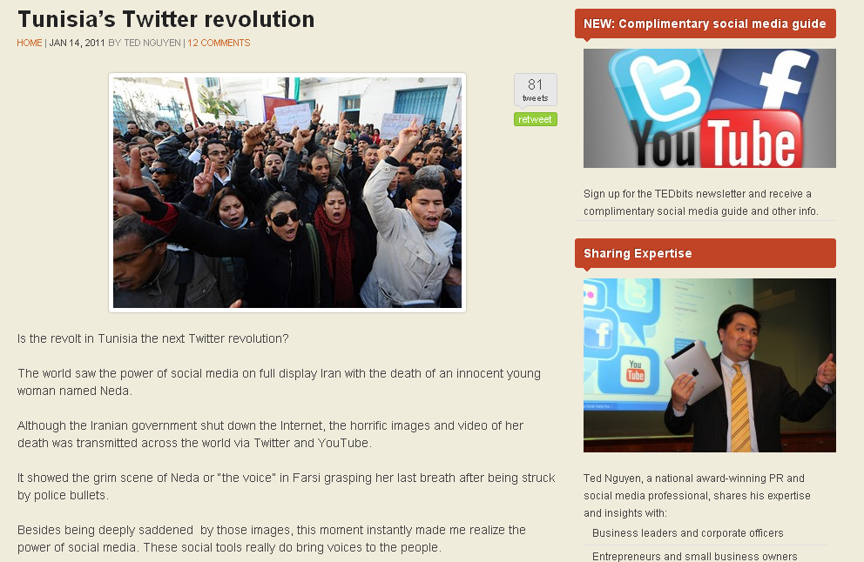

Slide 74

Notes:
http://www.flickr.com/photos/28473961@N02/4320982975/

Slide 75

Notes:
http://www.flickr.com/photos/28473961@N02/2757755401/

Slide 76
Percentile change in
importance of task type
in U.S. economy
Abstract
Routine
Manual
Autor, D., Levy, F., & Murnane, R. J. (2003). The skill content of recent technological change:
An empirical exploration. Quarterly Journal of Economics 188, 4. [updated, D. Autor, 2008]

Slide 77
global awareness
effective speaking
critical thinking
problem solving
adaptability
information literacy
collaboration
creativity
media fluency
analytical skills
entrepeneurialism
innovation
effective writing
synthesis
curiosity

Slide 78
Growth of the creative class
Florida, R. (2002). The rise of the creative class (p. 332). New York, NY: Basic Books.

Slide 79
Growth of the creative class
Florida, R. (2002). The rise of the creative class (p. 332). New York, NY: Basic Books.

Slide 80


Slide 81

I sell books!
I’m an
accountant!
I have
an idea!

Slide 82
  Can someone overseas
  do it cheaper?
  Can a computer
  do it faster?

Slide 83


Slide 84


Slide 85


Slide 86
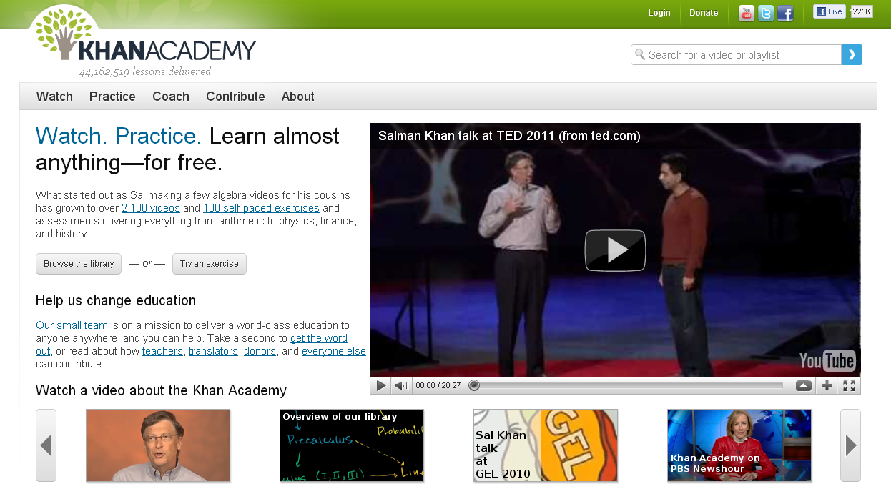

Slide 87
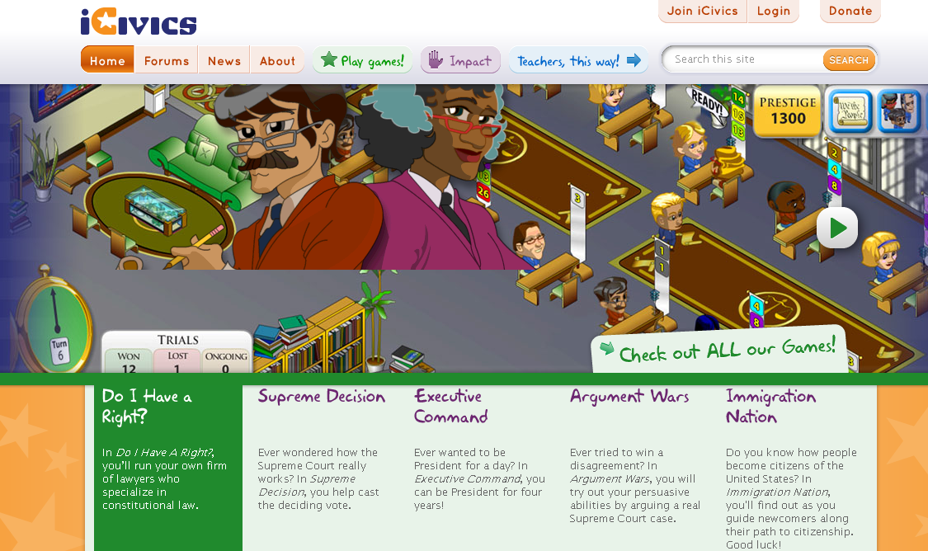

Slide 88
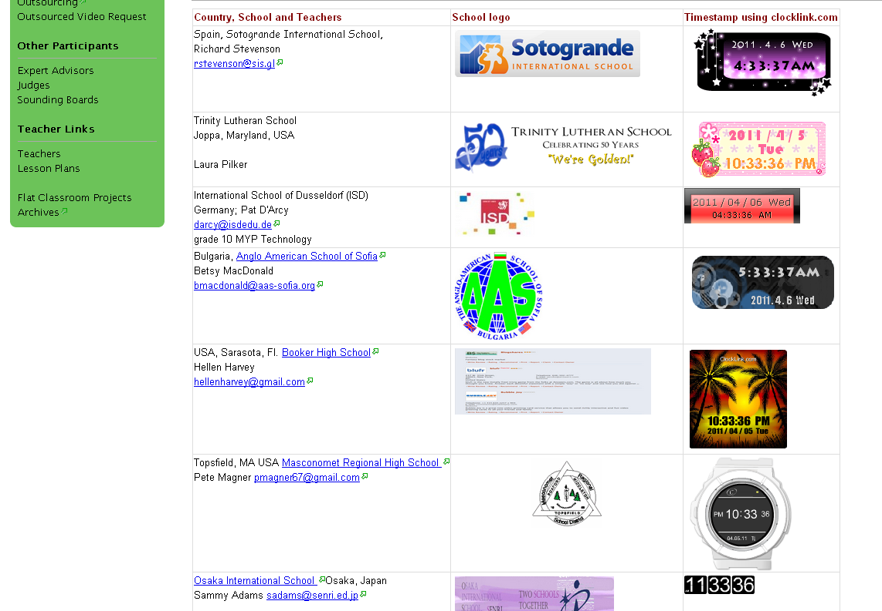

Slide 89


Slide 90


Slide 91
What we have right now
uniqueness
uniqueness
one right answer
Notes:
91

Slide 92

Notes:
THIS SLIDE IS COPYRIGHT-PROTECTED. I GOT SPECIAL PERMISSION FROM THE CARTOONIST, TONY CARRILLO, TO USE IT.
92

Slide 93


Slide 94

Notes:
94

Slide 95

Notes:
95

Slide 96

No generation in history has ever been so
thoroughly prepared for the industrial age.
David Warlick
http://davidwarlick.com/2cents/?p=298
dangerouslyirrelevant.org

Slide 97

If the leaders
don’t get it,
it’s not going
to happen.
dangerouslyirrelevant.org
Notes:
Licensed under a Creative Commons attribution-share alike license.
http://creativecommons.org/licenses/by-sa/3.0
Scott McLeod, J.D., Ph.D.
scottmcleod.net/contact
dangerouslyirrelevant.org
schooltechleadership.org

Slide 98
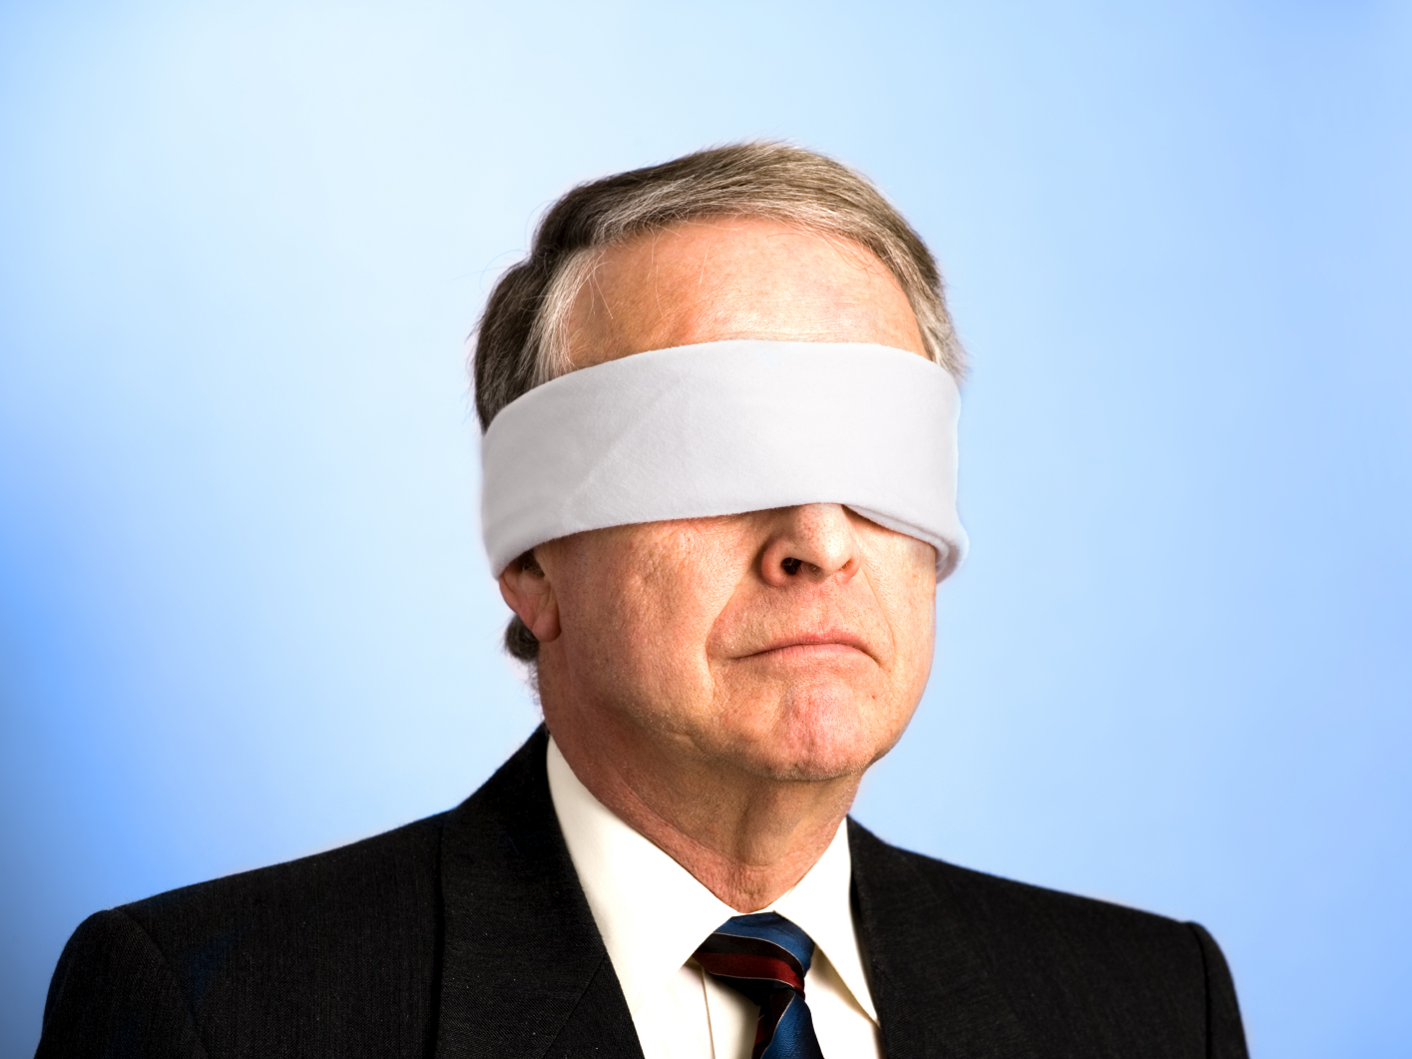
The people in charge
of leading school
organizations into the
21st century …
often are the
least knowledgeable
about the 21st century.
dangerouslyirrelevant.org
Notes:
Licensed under a Creative Commons attribution-share alike license.
http://creativecommons.org/licenses/by-sa/3.0
Scott McLeod, J.D., Ph.D.
scottmcleod.net/contact
dangerouslyirrelevant.org
schooltechleadership.org

Slide 99


Slide 100


Slide 101

CHANGE
OR DIE

Slide 102

Notes:
102

Slide 103


Slide 104

Notes:
Future oriented v. compliance oriented

Slide 105


Slide 106
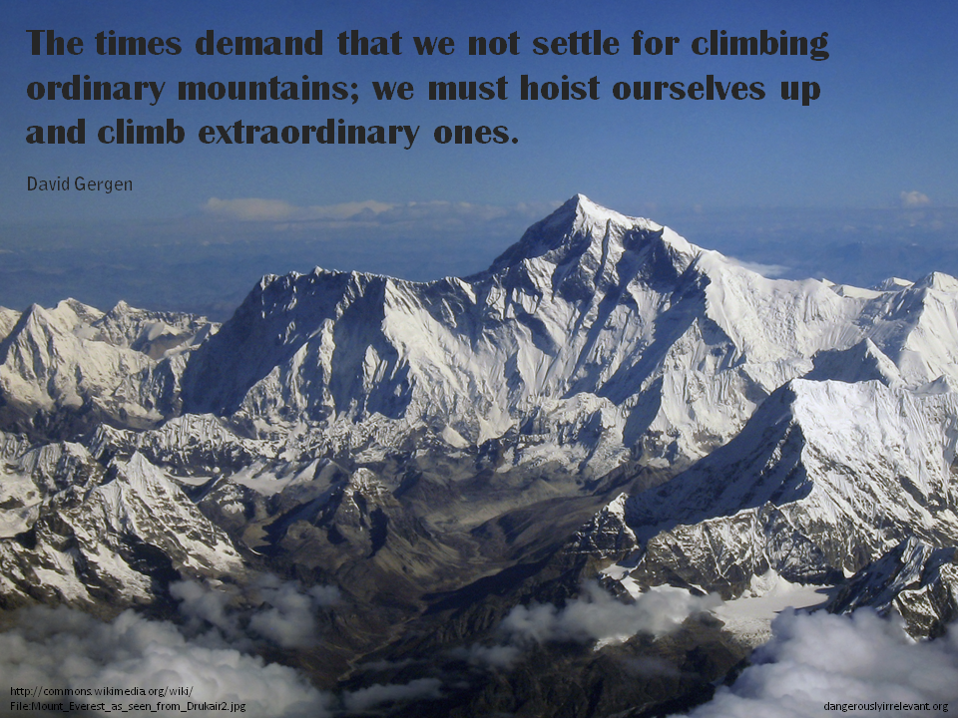

Slide 107
Big questions

Slide 108
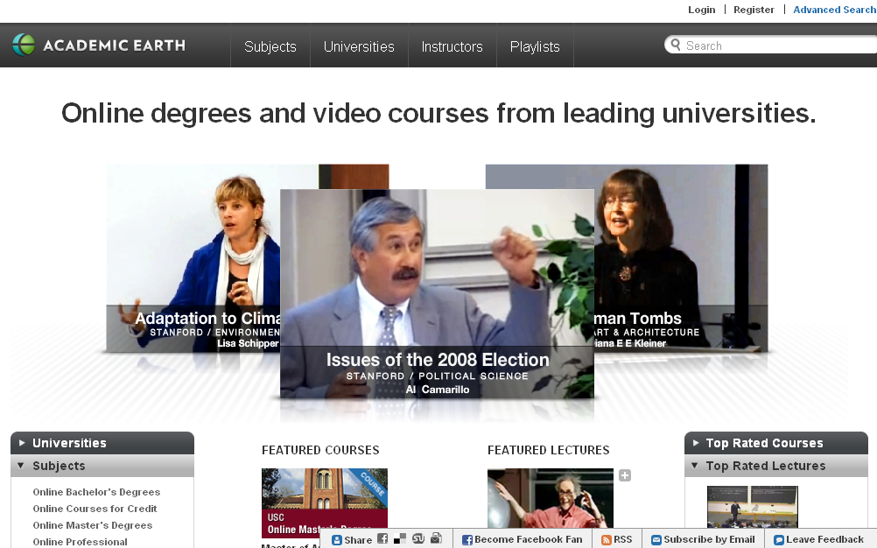

Slide 109
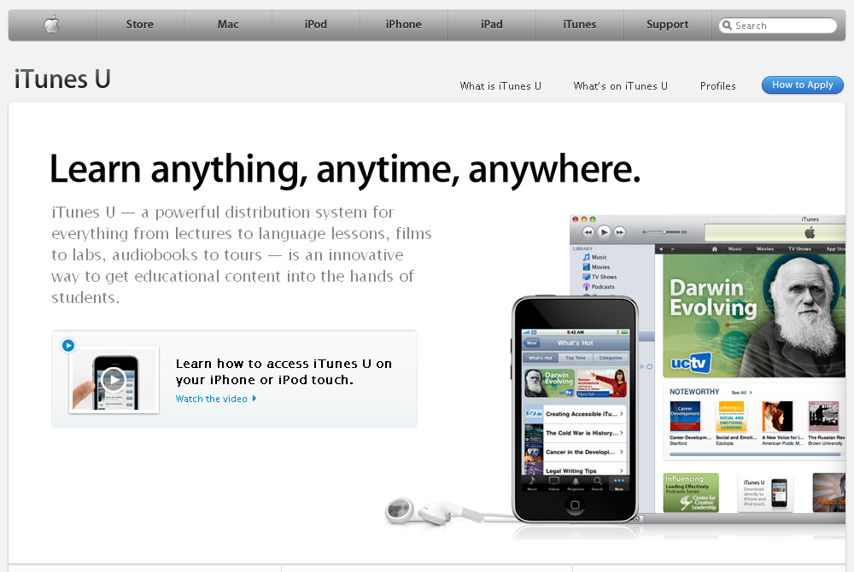

Slide 110
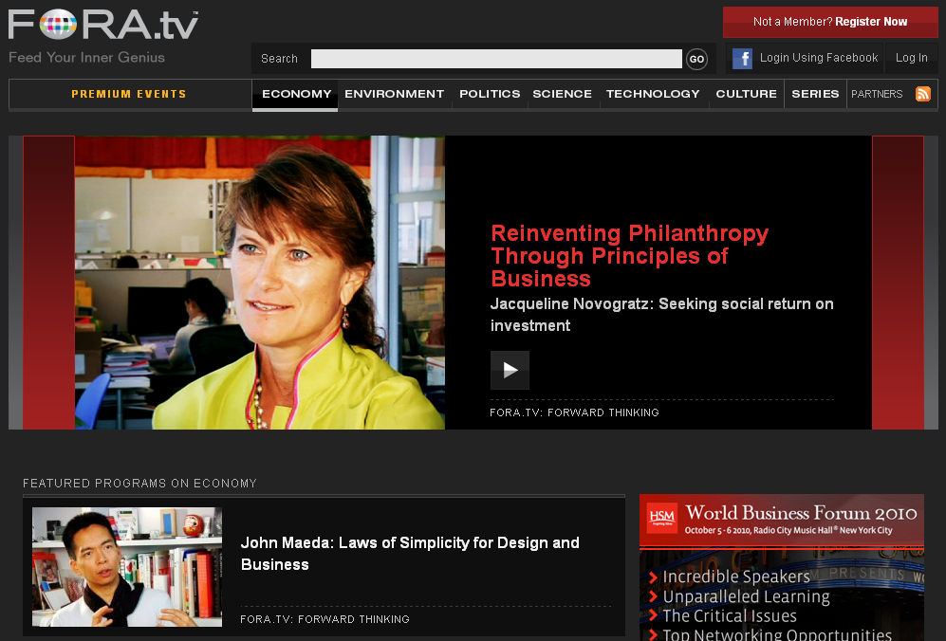

Slide 111
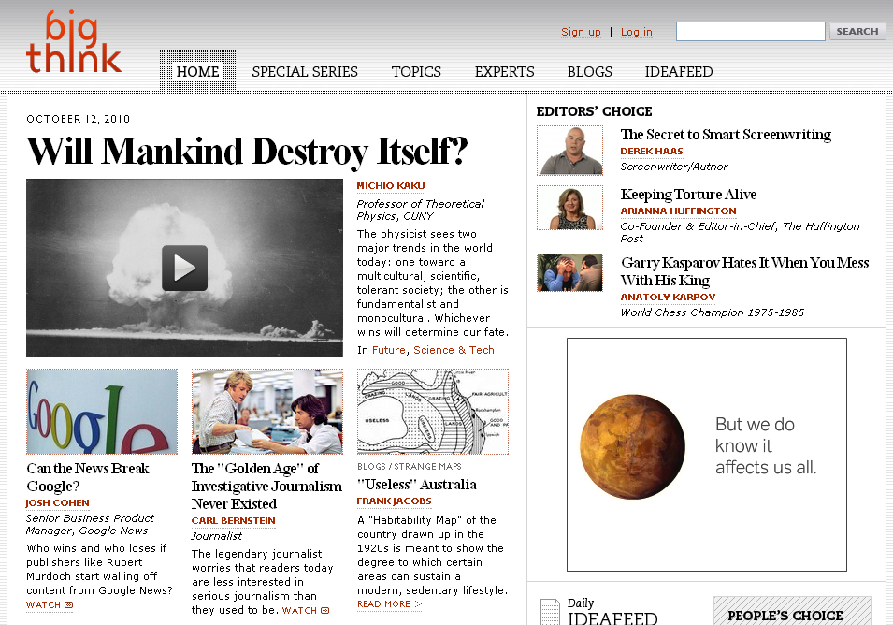

Slide 112
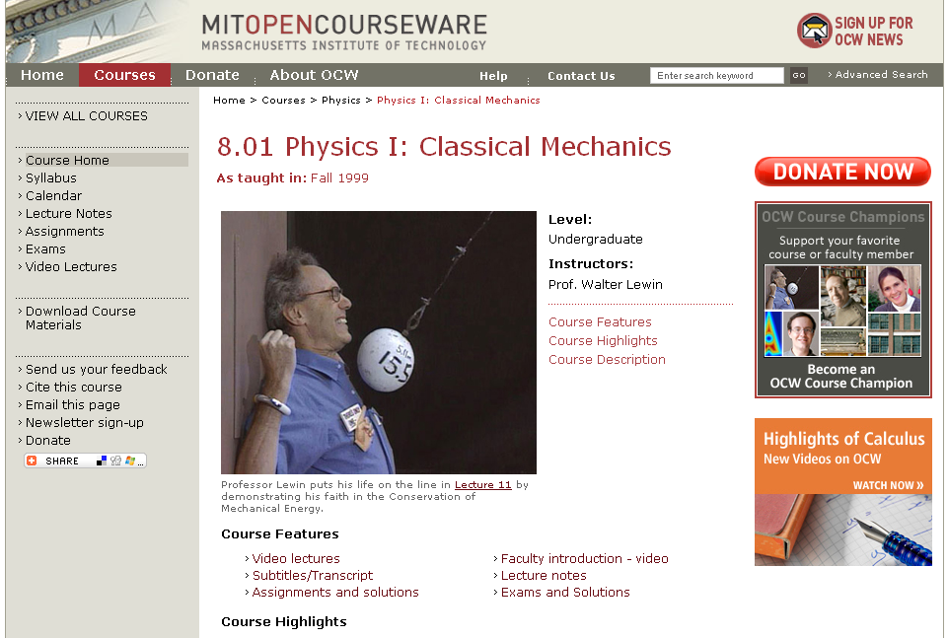

Slide 113


Slide 114
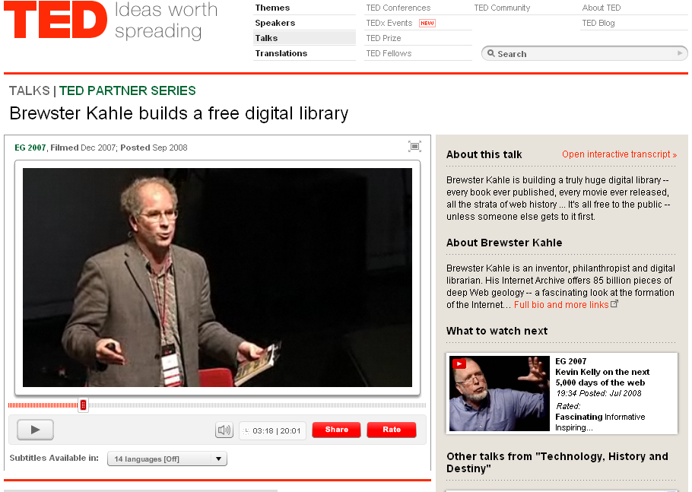

Slide 115

Notes:
We need to somehow
change faster
No one jumps a 20 foot chasm in two
10 foot jumps. – Miguel Guhlin
When the world changes so fast that we have no reasonable way to forecast what it will look like in a mere decade or two, all we can do is teach kids how to be adaptive – to be learners in the truest sense of the word –
We’ve always talked about preparing lifelong learners in schools, but our practices typically haven’t matched our rhetoric. It’s time to put some bite into our toothless vision statements and recognize that we have to teach kids how to learn to learn if they want to be successful in this new technology-suffused, globally-interconnected world
Credits: http://tinyurl.com/2urbsm and http://tinyurl.com/37em64 (see Guhlin comment)
http://remoteaccess.typepad.com/remote_access/
2006/06/literacy_as_bat.html (see Guhlin comment)
http://headrush.typepad.com/creating_passionate_users/2005/03/incremental_vs_.html

Slide 116
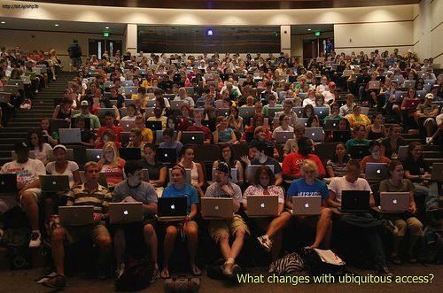

Slide 117

No one will thank you
for taking care of today
if you have failed
to take care of tomorrow.
Joel Barker

Slide 118

Notes:
118

Slide 119


Slide 120


Slide 121
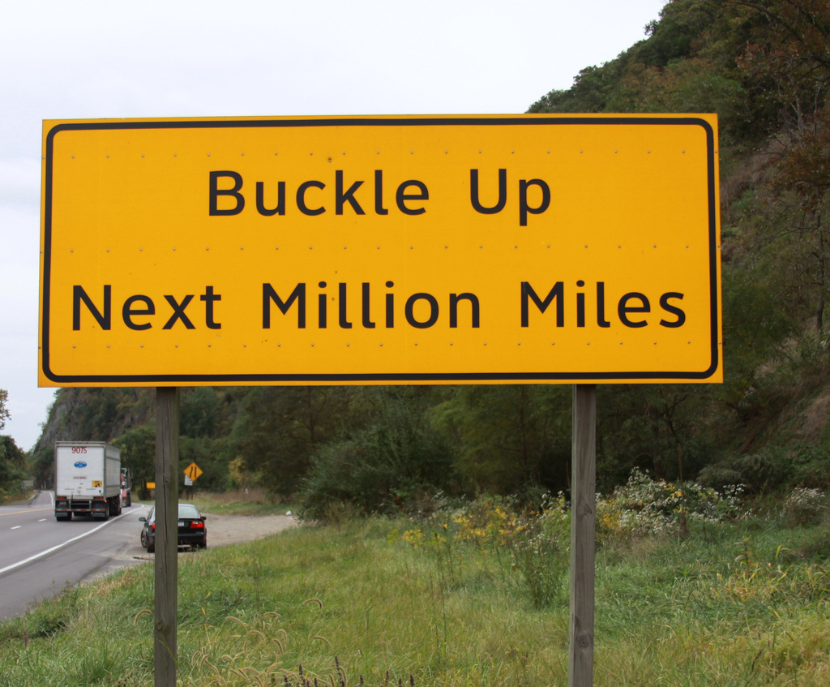

Slide 122
Thank you!
Scott McLeod, J.D., Ph.D.
Director, CASTLE
scottmcleod.net
Notes:
122
All of my materials are licensed under a Creative Commons attribution-share alike license (http://creativecommons.org/licenses/by-sa/3.0). That means not only that you are welcome to share and/or remix my content but that you are encouraged to do so! All I ask is that you properly credit me for my content and that you not place any greater copyright restrictions than I have on the content that utilizes my material. If possible, including the URL of Dangerously Irrelevant in your content would be most appreciated.
Scott McLeod, J.D., Ph.D.
dangerouslyirrelevant.org
schooltechleadership.org
dangerouslyirrelevant.org/contact.html

