Slide 1
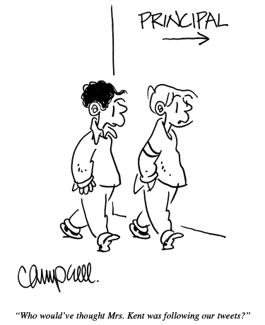
scottmcleod.net/workshops
“Who would’ve thought Mrs. Kent was following our tweets?”

Slide 2
Let’s talk technology leadership!
Dr. Scott McLeod
CASTLE
Notes:
All of my materials are licensed under a Creative Commons attribution-share alike license (http://creativecommons.org/licenses/by-sa/3.0). That means not only that you are welcome to share and/or remix my content but that you are encouraged to do so! All I ask is that you properly credit me for my content and that you not place any greater copyright restrictions than I have on the content that utilizes my material. If possible, including the URL of Dangerously Irrelevant in your content would be most appreciated.
Scott McLeod, J.D., Ph.D.
dangerouslyirrelevant.org
schooltechleadership.org
dangerouslyirrelevant.org/contact.html

Slide 3
Big shifts?

Slide 4
Aging of
society

Slide 5
Climate
change

Slide 6
Geopolitical
reascendance
of Asia

Slide 7
Big shifts?

Slide 8
Our new
information
landscape

Slide 9
We all now have a voice

Slide 10
We can easily find each other

Slide 11
We can easily work together

Slide 14
CHANGE
OR DIE

Slide 15
Our new
economic
landscape

Slide 16
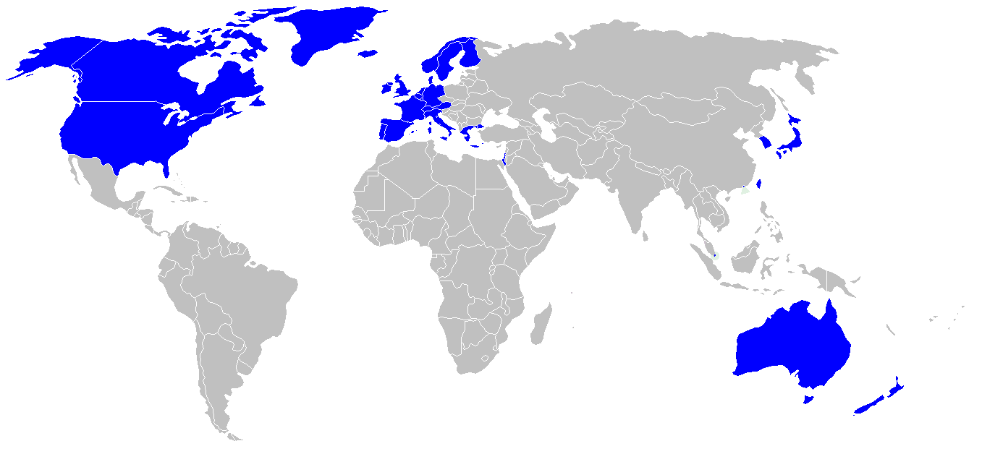

Slide 17
location dependent?
location independent?

Slide 18
Can someone overseas do it cheaper?

Slide 19
2.5 billion

Slide 20
Can someone overseas do it cheaper?
Can a computer do it faster?

Slide 21
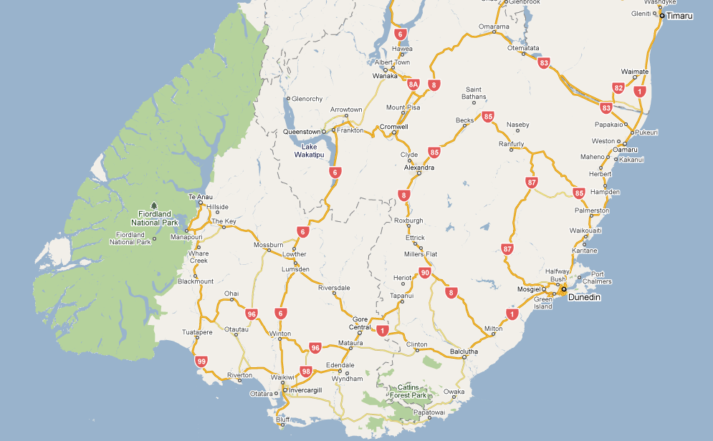
I sell books!
I’m an
accountant!
I have
an idea!

Slide 24
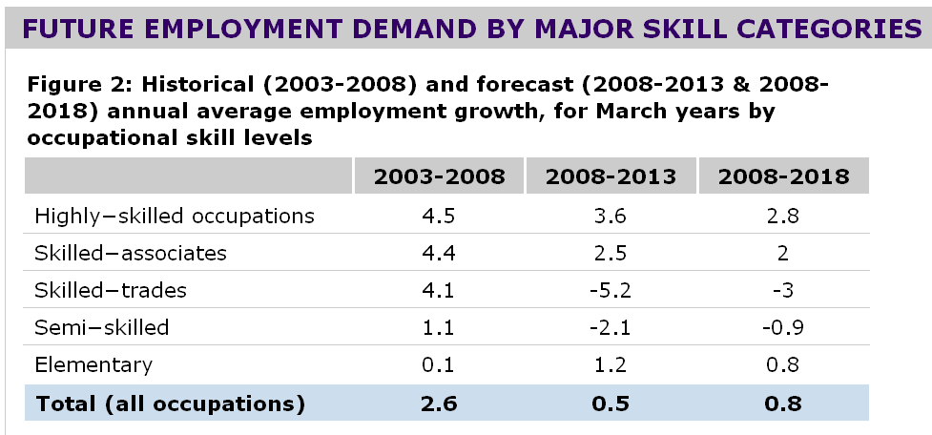

Slide 25
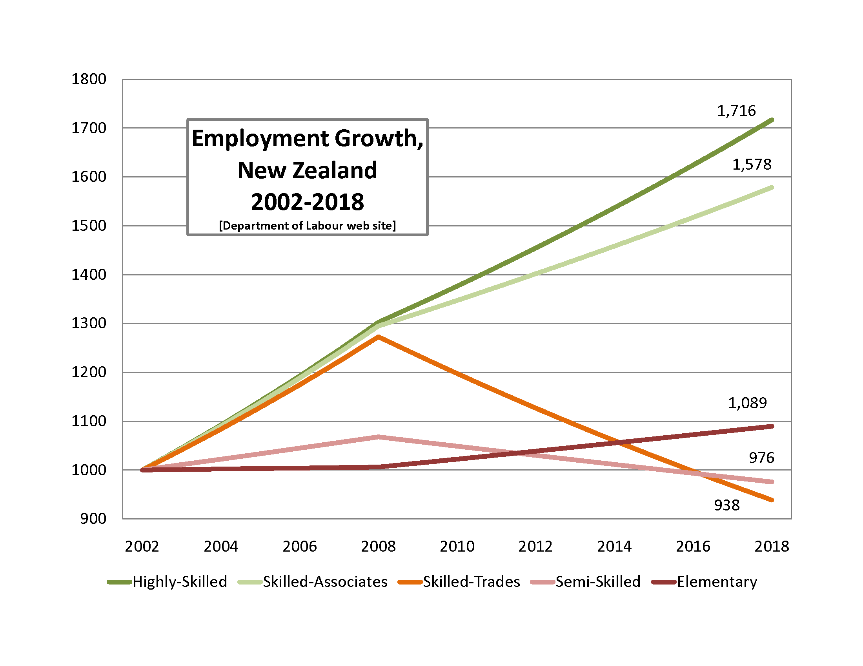

Slide 26
Percentile change in importance of task type in U.S. economy
Abstract
Routine
Manual
Autor, D., Levy, F., & Murnane, R. J. (2003). The skill content of recent technological change: An empirical exploration. Quarterly Journal of Economics 188, 4. [updated, D. Autor, 2008]

Slide 27
global awareness
effective speaking
critical thinking
problem solving
adaptability
information literacy
collaboration
creativity
media fluency
analytical skills
entrepeneurialism
innovation
effective writing
synthesis
curiosity

Slide 28
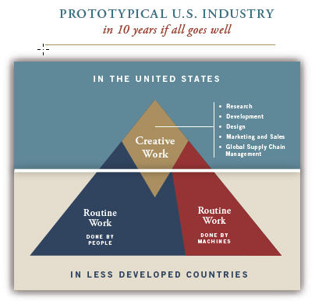

Slide 29
low skill
low wage
low skill
high wage
high skill
high wage

Slide 30
low skill
low wage
low skill
high wage
high skill
high wage

Slide 31
Socially functional
Mastery of information landscape
Economically productive

Slide 32
Notes:
32

Slide 33
Notes:
33

Slide 34
Notes:
34

Slide 35
The fundamental dilemma
but now are expected to
do this
Schools were designed for this …

Slide 37
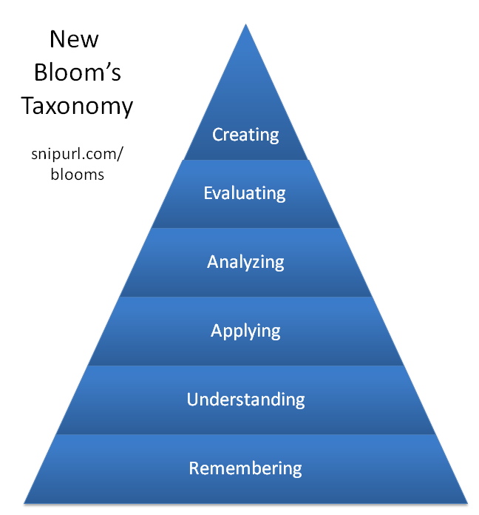

Slide 39
Notes:
Future oriented v. compliance oriented

Slide 40
The people in charge of leading school organizations into the 21st century …
often are the least knowledgeable about the 21st century.
dangerouslyirrelevant.org
Notes:
Licensed under a Creative Commons attribution-share alike license.
http://creativecommons.org/licenses/by-sa/3.0
Scott McLeod, J.D., Ph.D.
scottmcleod.net/contact
dangerouslyirrelevant.org
schooltechleadership.org

Slide 41
If the leaders don’t get it,
it’s not going to happen.
dangerouslyirrelevant.org
Notes:
Licensed under a Creative Commons attribution-share alike license.
http://creativecommons.org/licenses/by-sa/3.0
Scott McLeod, J.D., Ph.D.
scottmcleod.net/contact
dangerouslyirrelevant.org
schooltechleadership.org

Slide 43
What does
effective
21st century
school leadership
look like?

Slide 44
Potential
impacts?

Slide 45
Barriers and challenges?

Slide 46
Making it all work?

Slide 47
discuss

Slide 48
Notes:
48

Slide 49
Thank you!
Scott McLeod, J.D., Ph.D.
Director, CASTLE
scottmcleod.net/workshops
Notes:
49
All of my materials are licensed under a Creative Commons attribution-share alike license (http://creativecommons.org/licenses/by-sa/3.0). That means not only that you are welcome to share and/or remix my content but that you are encouraged to do so! All I ask is that you properly credit me for my content and that you not place any greater copyright restrictions than I have on the content that utilizes my material. If possible, including the URL of Dangerously Irrelevant in your content would be most appreciated.
Scott McLeod, J.D., Ph.D.
dangerouslyirrelevant.org
schooltechleadership.org
dangerouslyirrelevant.org/contact.html

Slide 50
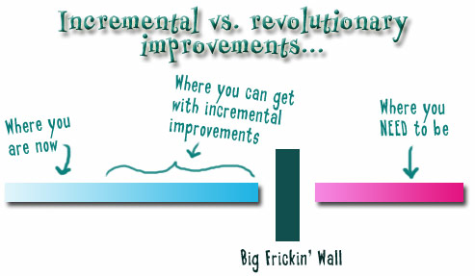
Notes:
We need to somehow change faster
No one jumps a 20 foot chasm in two
10 foot jumps. – Miguel Guhlin
When the world changes so fast that we have no reasonable way to forecast what it will look like in a mere decade or two, all we can do is teach kids how to be adaptive – to be learners in the truest sense of the word –
We’ve always talked about preparing lifelong learners in schools, but our practices typically haven’t matched our rhetoric. It’s time to put some bite into our toothless vision statements and recognize that we have to teach kids how to learn to learn if they want to be successful in this new technology-suffused, globally-interconnected world
Credits: http://tinyurl.com/2urbsm and http://tinyurl.com/37em64 (see Guhlin comment)
http://remoteaccess.typepad.com/remote_access/ 2006/06/literacy_as_bat.html (see Guhlin comment)
http://headrush.typepad.com/creating_passionate_users/2005/03/incremental_vs_.html

Slide 51
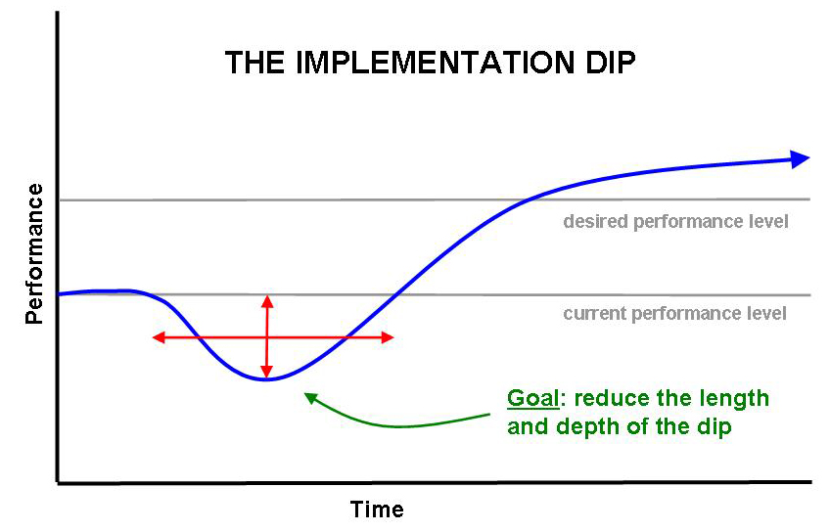

Slide 52
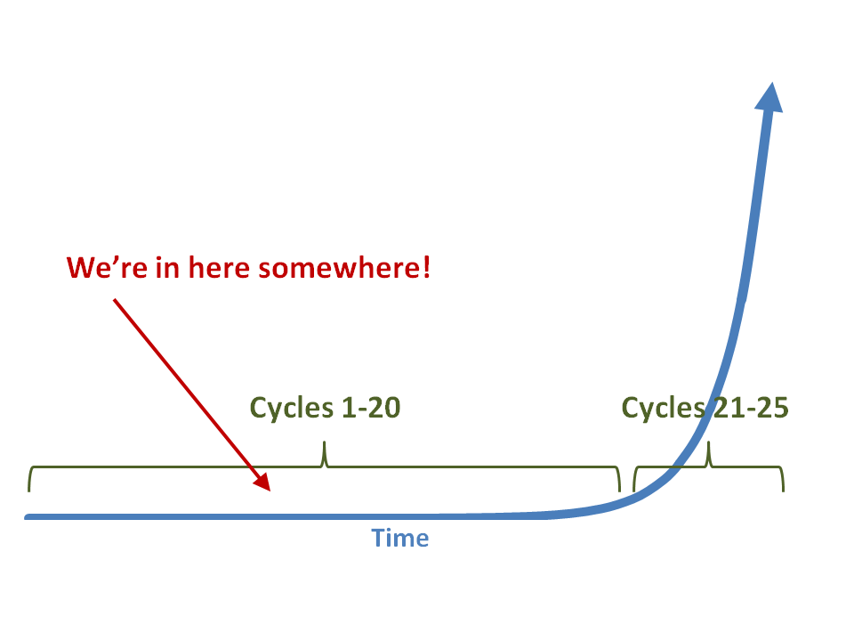

Slide 53
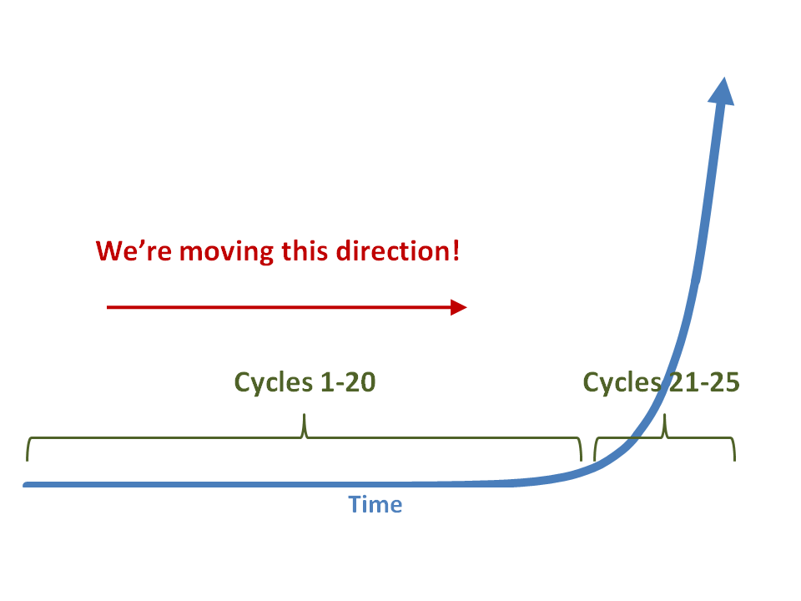

Slide 55
What we have right now
uniqueness
uniqueness
one right answer
Notes:
55

Slide 56
Notes:
THIS SLIDE IS COPYRIGHT-PROTECTED. I GOT SPECIAL PERMISSION FROM THE CARTOONIST, TONY CARRILLO, TO USE IT.
56

Slide 57
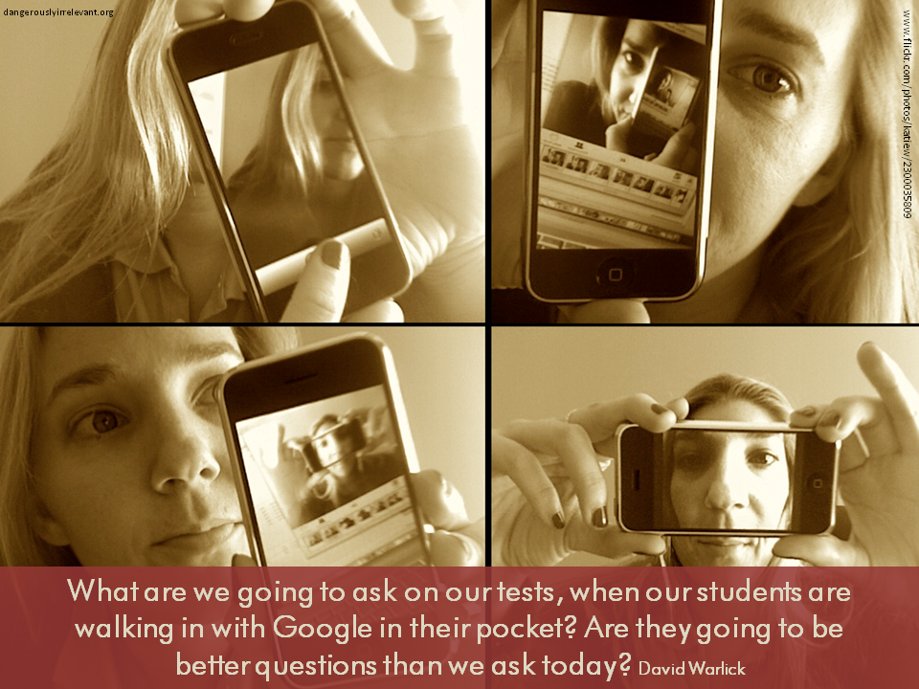

Slide 58
Growth of the creative class
Florida, R. (2002). The rise of the creative class (p. 332). New York, NY: Basic Books.

Slide 59
Growth of the creative class
Florida, R. (2002). The rise of the creative class (p. 332). New York, NY: Basic Books.

Slide 60
Bolman & Deal
Structural
Human resource
Political
Symbolic

Slide 61
Structural. Leaders who make change using this approach focus on structural elements within the organization as well as strategy, implementation, and adaptation.
Notes:
So what is a DI?
Well, before I begin to describe in detail what a disruptive innovation is, let me give you a few examples to help you understand the concept.

Slide 62
Human resource. Leaders who approach change from a human resource frame focus on people. This approach emphasizes support, empowerment, staff development, and responsiveness to employee needs.
Notes:
So what is a DI?
Well, before I begin to describe in detail what a disruptive innovation is, let me give you a few examples to help you understand the concept.

Slide 63
Political. Leaders who use a political approach to facilitate change focus on the political realities that exist within and outside organizations. This approach emphasizes dealing with interest groups (and their varying agendas), building power bases, coalition-building, negotiating conflicts over limited resources, and creating compromises.
Notes:
So what is a DI?
Well, before I begin to describe in detail what a disruptive innovation is, let me give you a few examples to help you understand the concept.

Slide 64
Symbolic. Leaders who make change using a symbolic approach focus on vision and inspiration. Symbolic leaders feel that people need to believe that their personal work, and the work of the organization, is important and meaningful. Traditions, ceremonies, and rituals are very important to the symbolic approach.
Notes:
So what is a DI?
Well, before I begin to describe in detail what a disruptive innovation is, let me give you a few examples to help you understand the concept.

