Slide 1
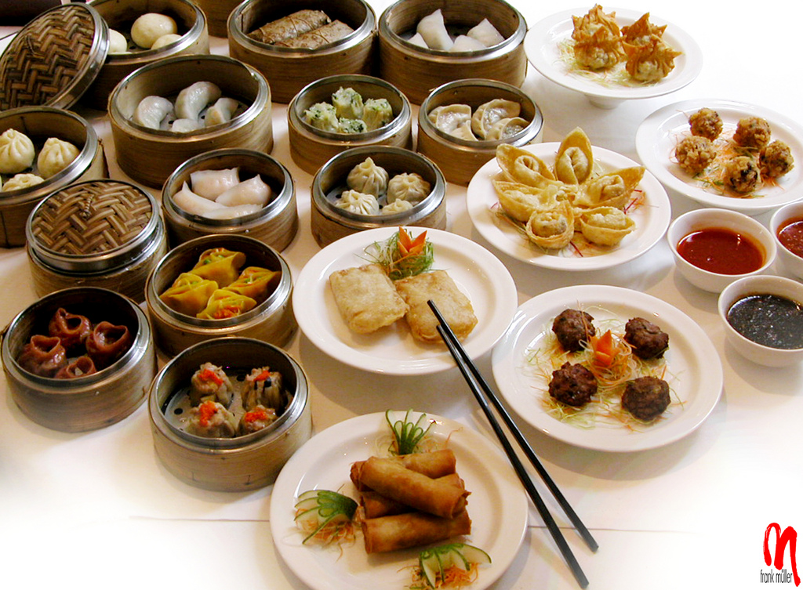
Notes:
Dim sum
http://www.flickr.com/photos/32760034@N08/3749732833/

Slide 2
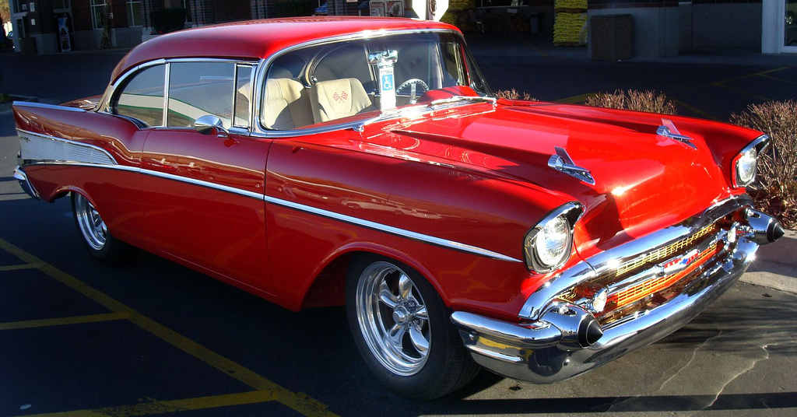
Notes:
‘57 Chevy parts
http://www.flickr.com/photos/19779889@N00/2005105598/

Slide 3
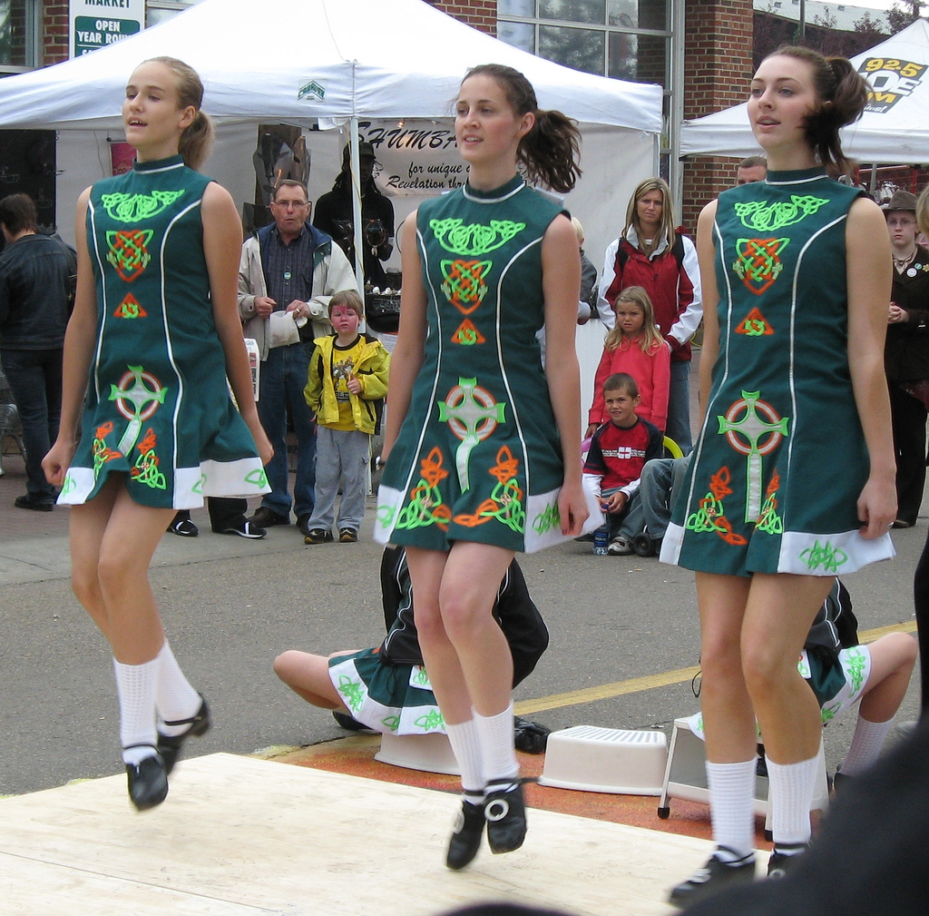
Notes:
Irish dancing classes for your daughter
http://www.flickr.com/photos/95104082@N00/1177130116/

Slide 4
Notes:
Purebreed pug
http://www.flickr.com/photos/purprin/3655887487/in/photostream/

Slide 5
Notes:
Japanese sword
http://www.flickr.com/photos/monana7/121253717/

Slide 6
Notes:
Home insurance
http://www.flickr.com/photos/tankgirlrs/4733429765/

Slide 7
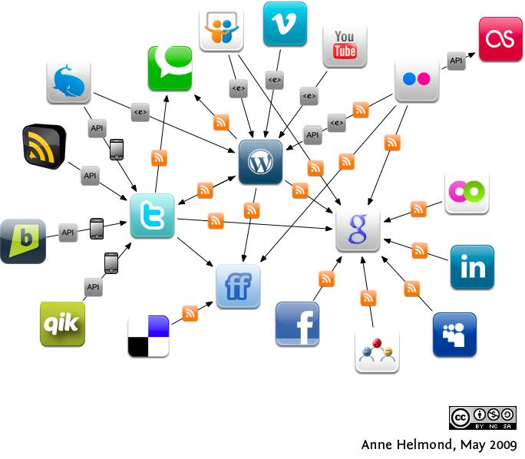
Notes:
Social media strategist for new business venture
http://www.flickr.com/photos/7849372@N04/3582297307/

Slide 9
Who’s teaching your
students how to be
findable?

