Slide 1
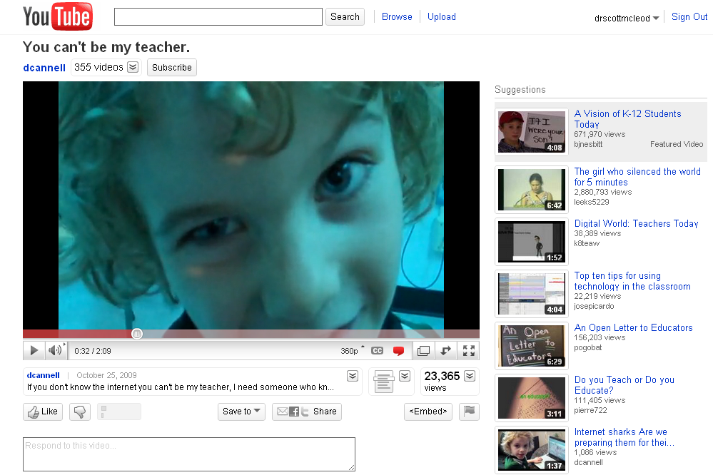

Slide 2
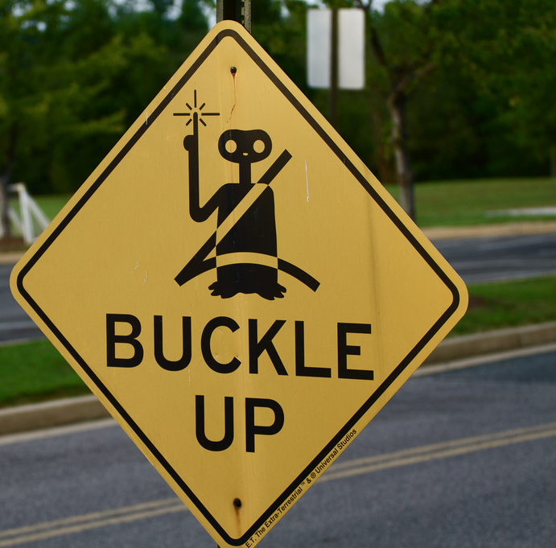
Fasten your seatbelts:
The future of
learning is
coming fast!
Dr. Scott McLeod
CASTLE

Slide 3
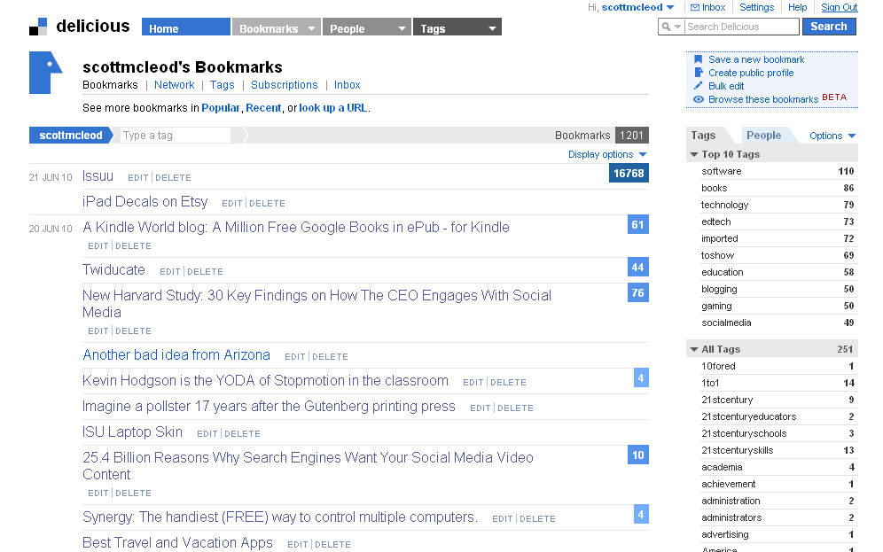

Slide 4
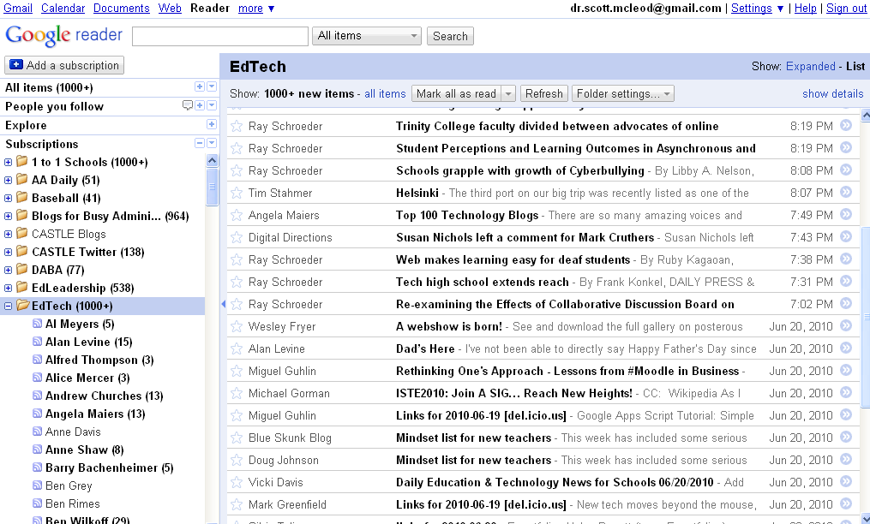

Slide 5
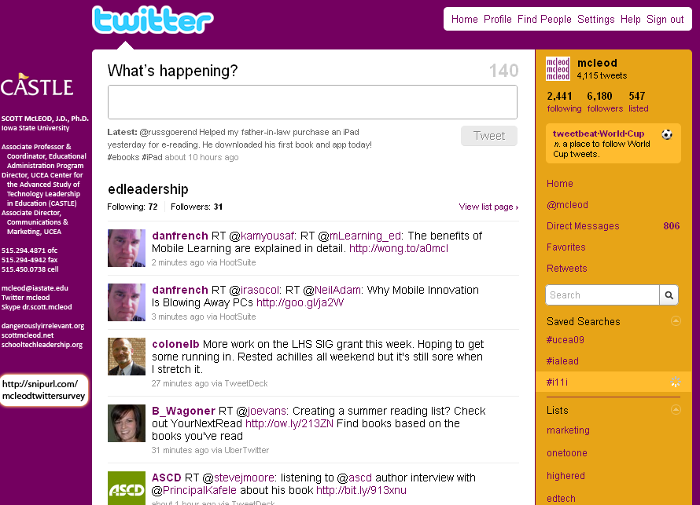

Slide 6
networked

Slide 7
connected

Slide 8
less dependent on ‘experts’

Slide 9
shared

Slide 10
empowering

Slide 11
[pause]

Slide 12
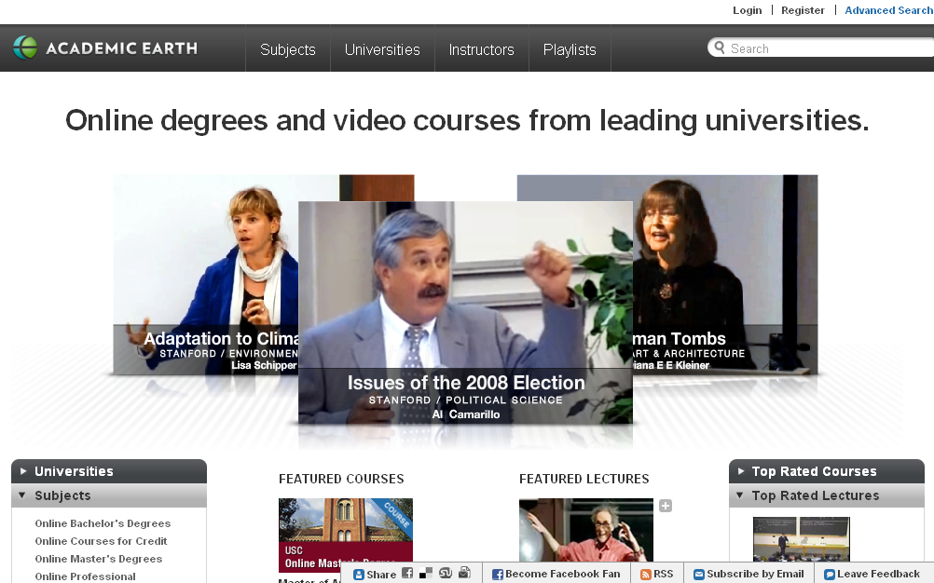

Slide 13
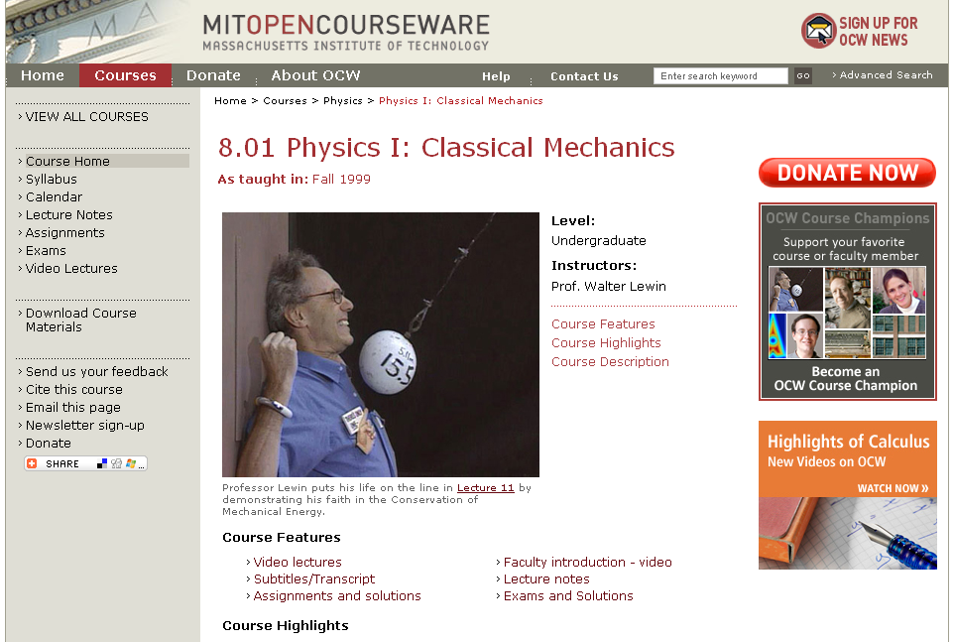

Slide 14
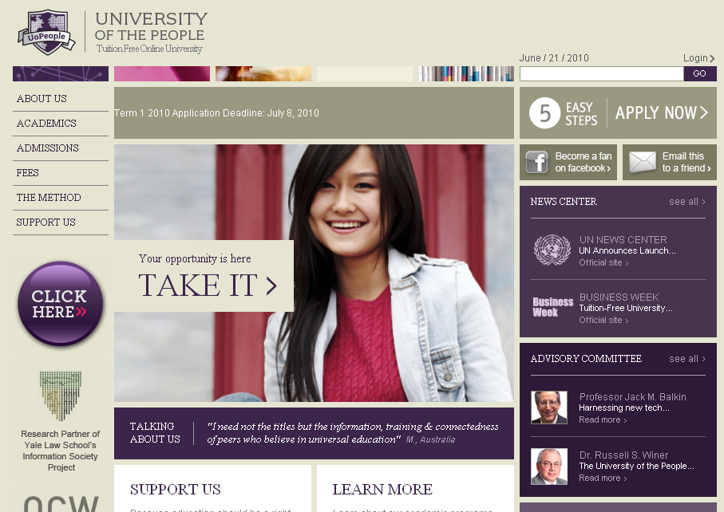

Slide 15
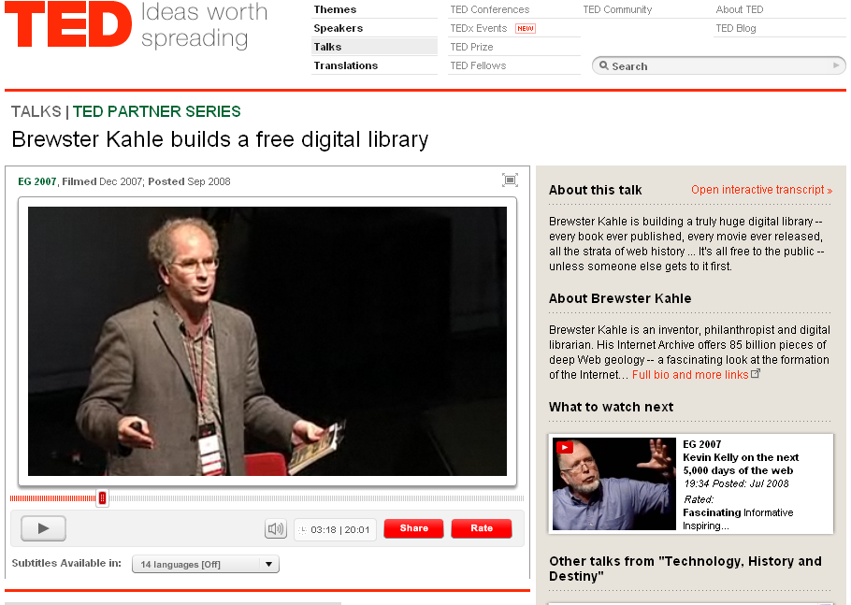

Slide 16
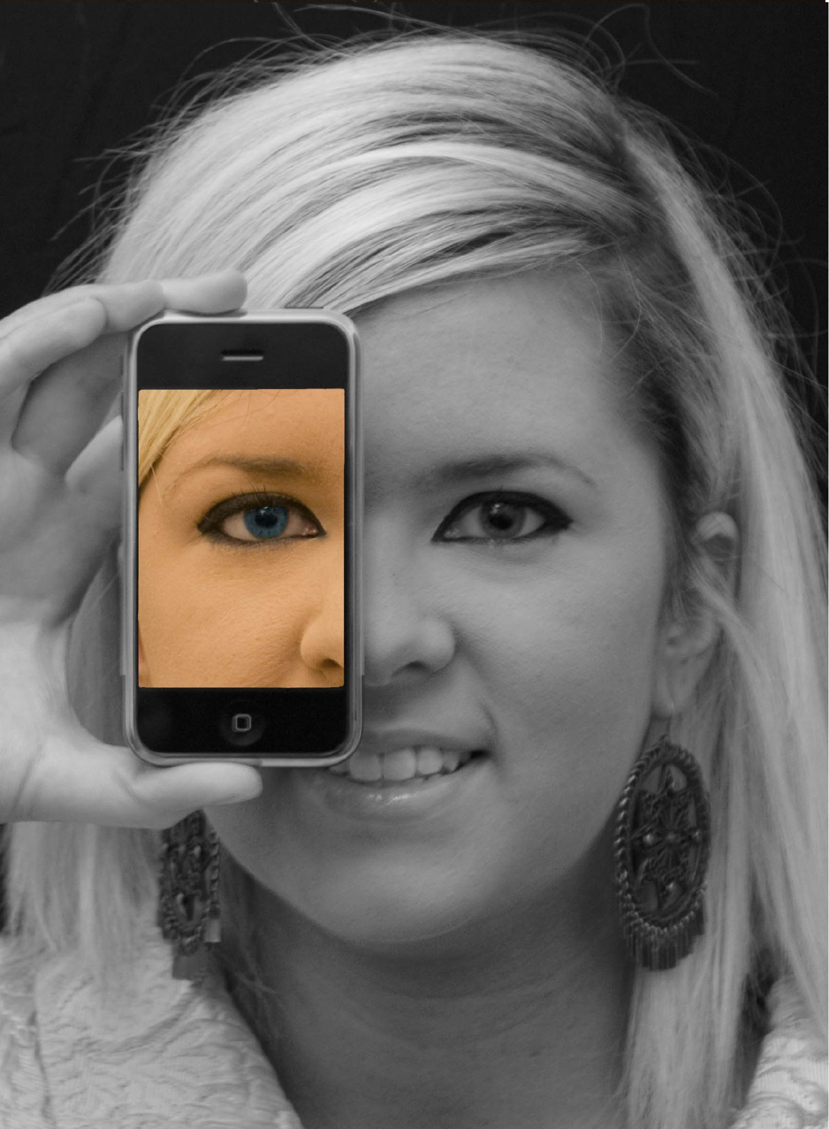

Slide 17
open

Slide 18
more accessible

Slide 19
more comprehensive

Slide 20
less dependent on physical media

Slide 21
less dependent on geography

Slide 22
mobile

Slide 23
more immediate /
real time

Slide 24
more convenient

Slide 25
[pause]

Slide 26
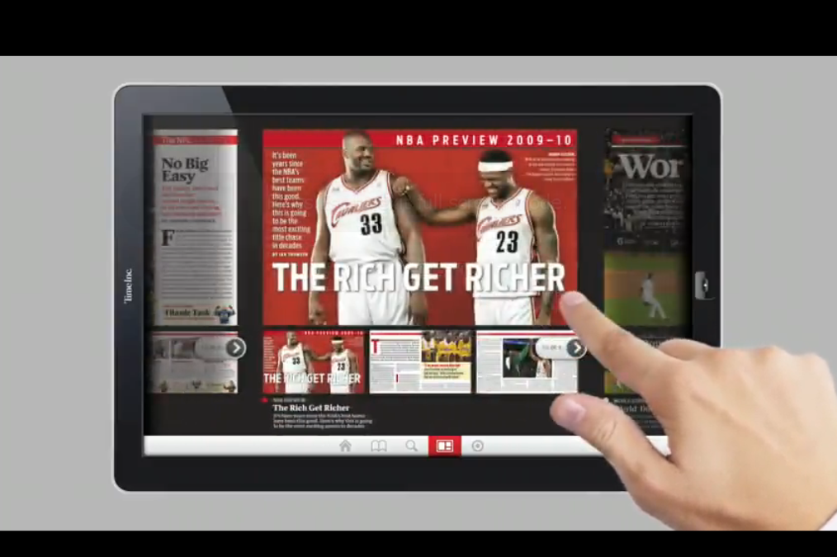

Slide 27
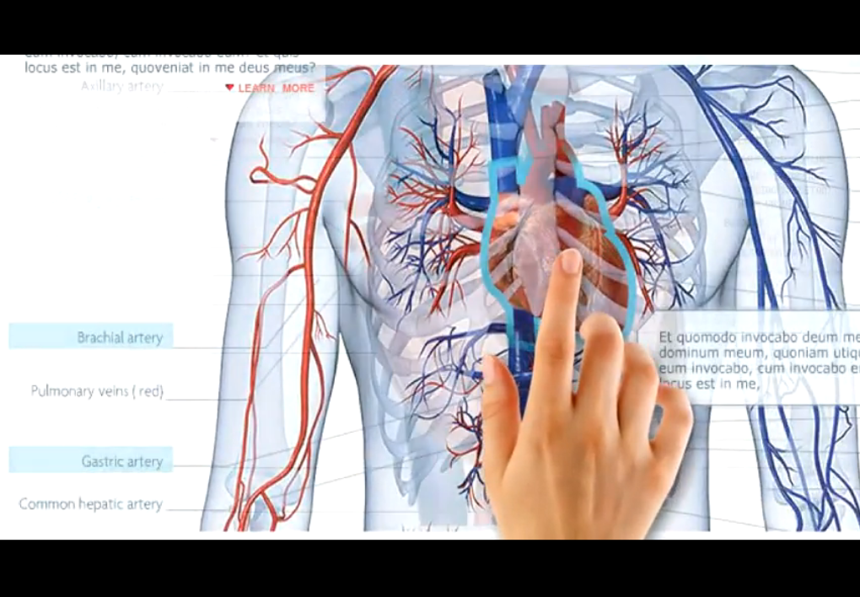

Slide 28
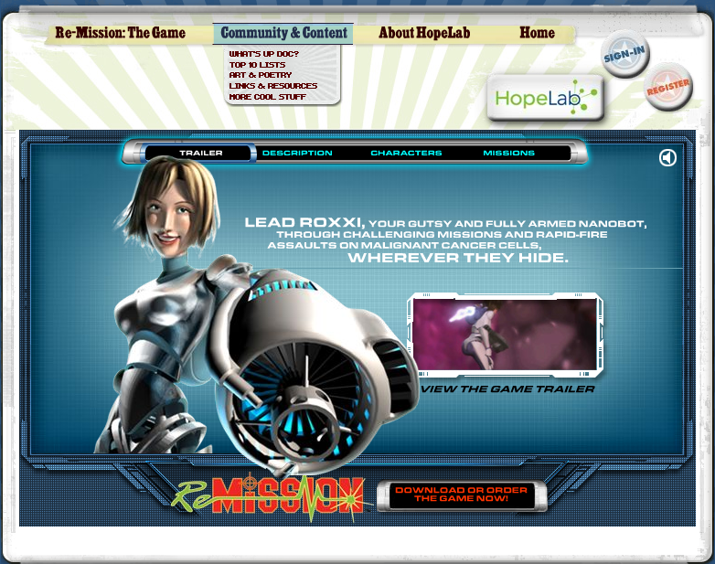
Notes:
Re-Mission

Slide 29
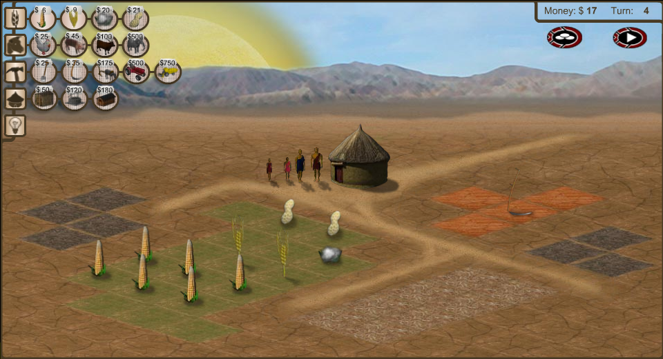
Notes:
3rd World Farmer

Slide 30
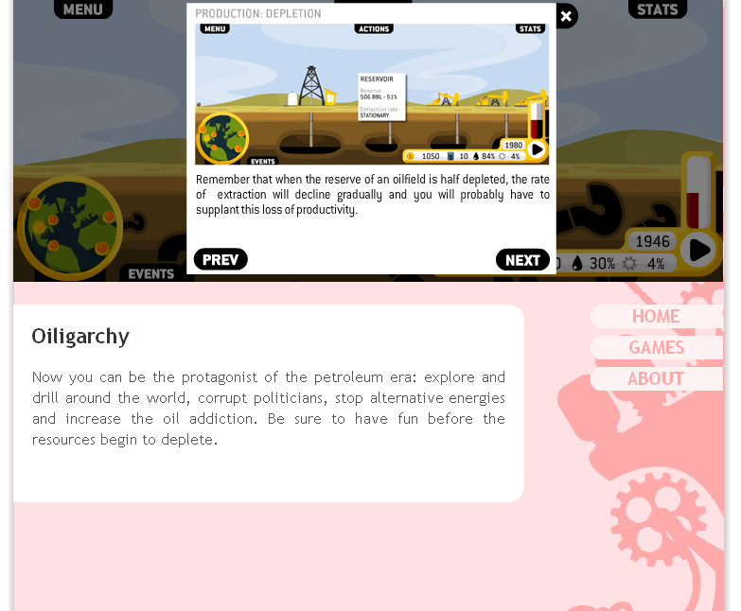

Slide 31
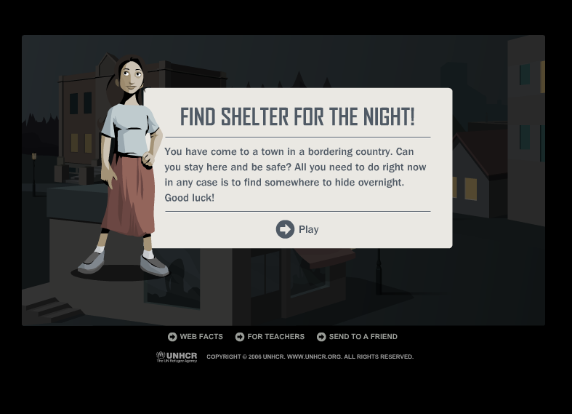
Notes:
Against All Odds, United Nations High Commissioner for Refugees

Slide 32
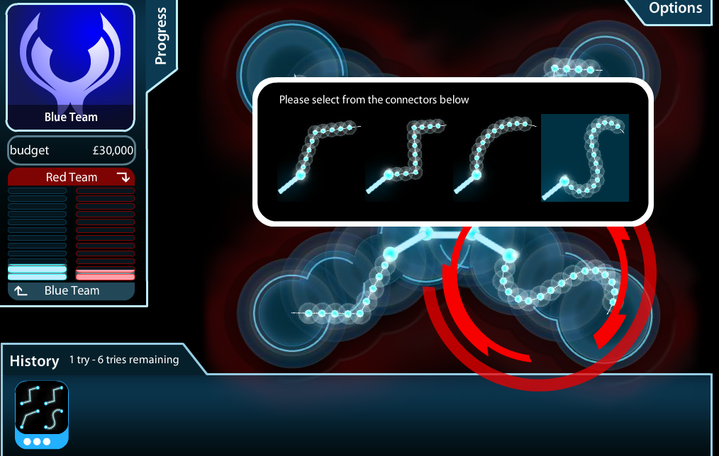
Notes:
Masterminding Molecules

Slide 33
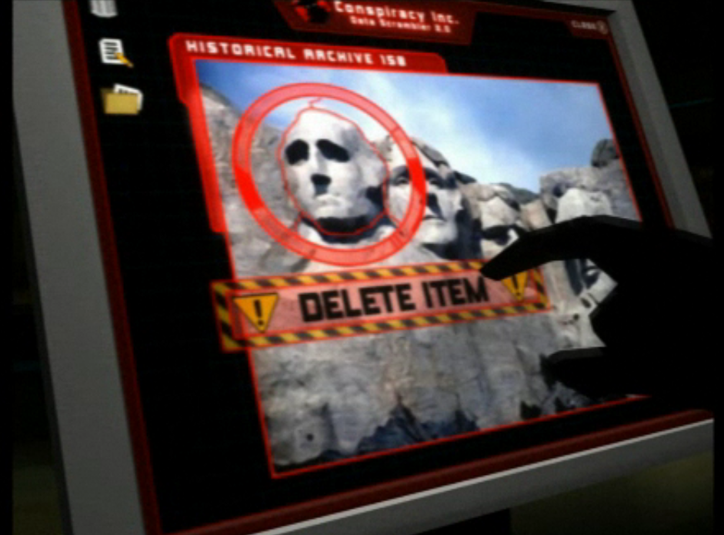
Notes:
Conspiracy Code

Slide 34
multimodal / multimedia

Slide 35
interactive

Slide 36
3-D

Slide 37
immersive

Slide 38
[pause]

Slide 39
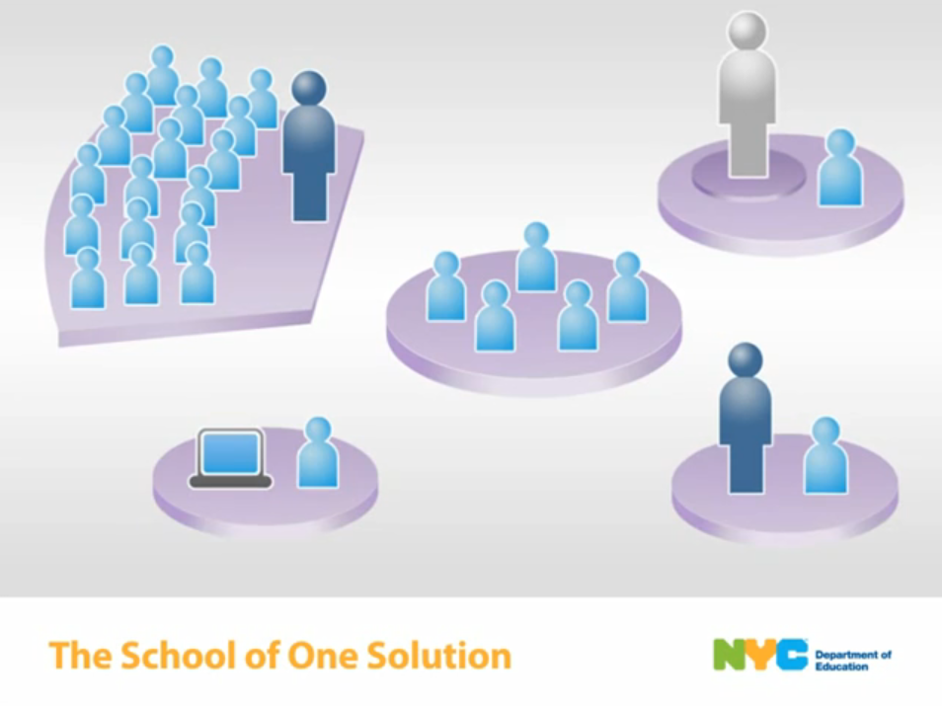

Slide 40
individualized

Slide 41
flexible

Slide 42
adaptive

Slide 43
[pause]

Slide 44
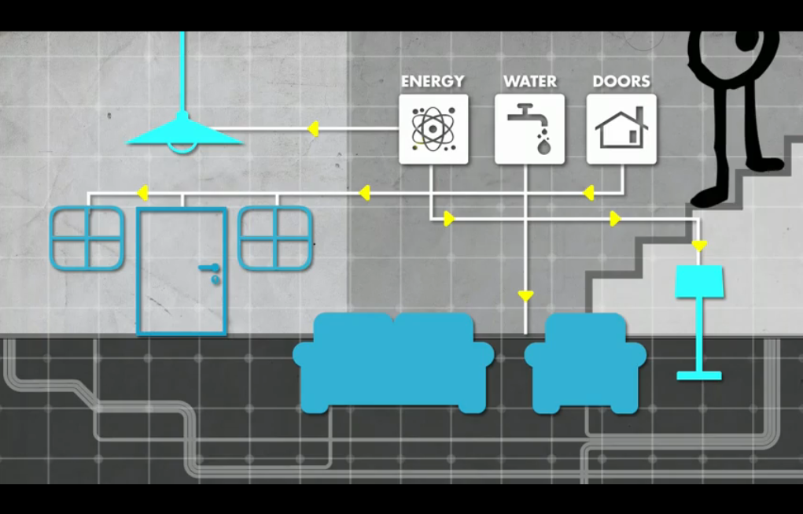

Slide 45
[pause]

Slide 46
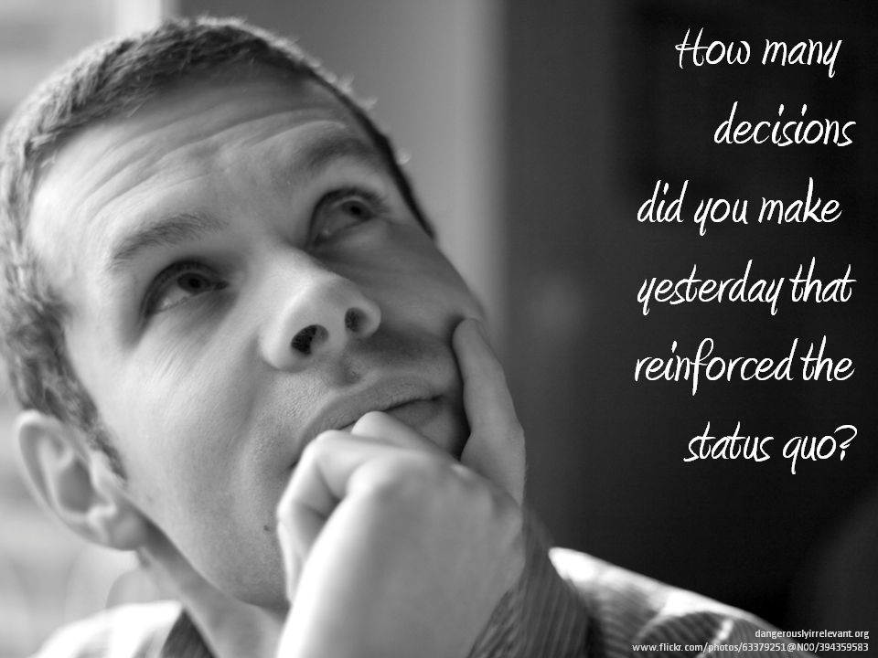

Slide 47
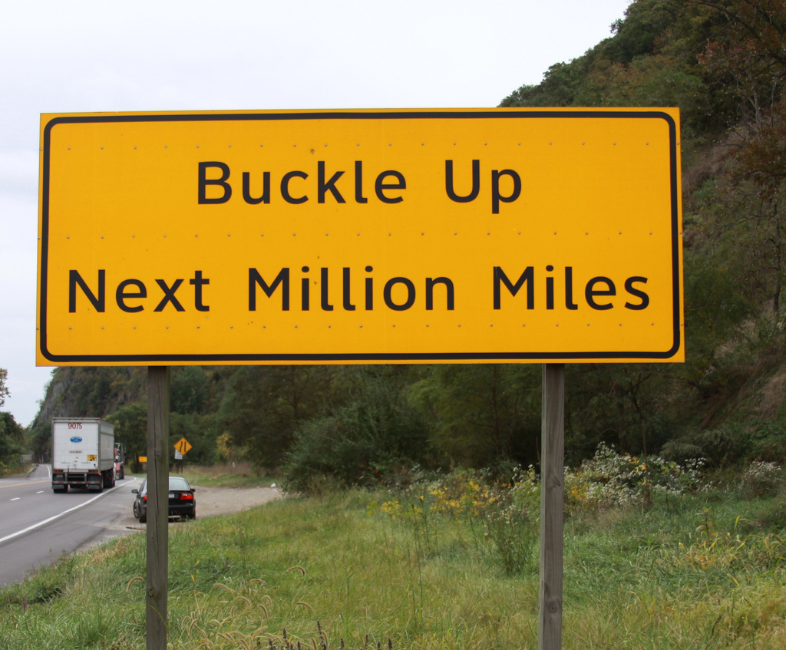

Slide 48
THANK YOU!
dangerouslyirrelevant.org/belmondklemme

Slide 49
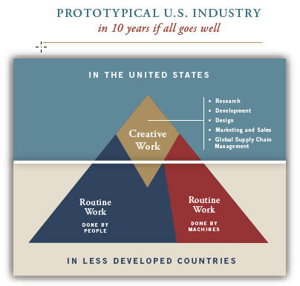
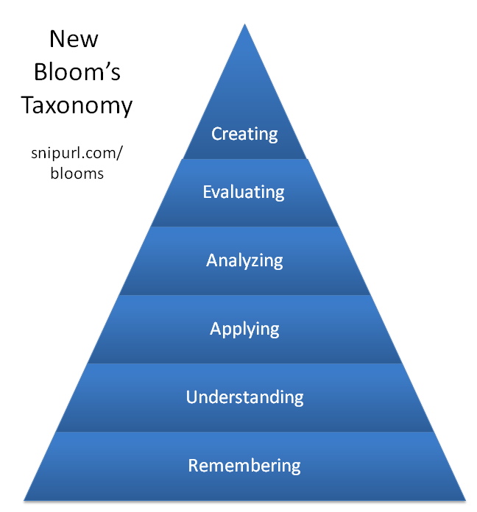

Slide 50


Slide 52
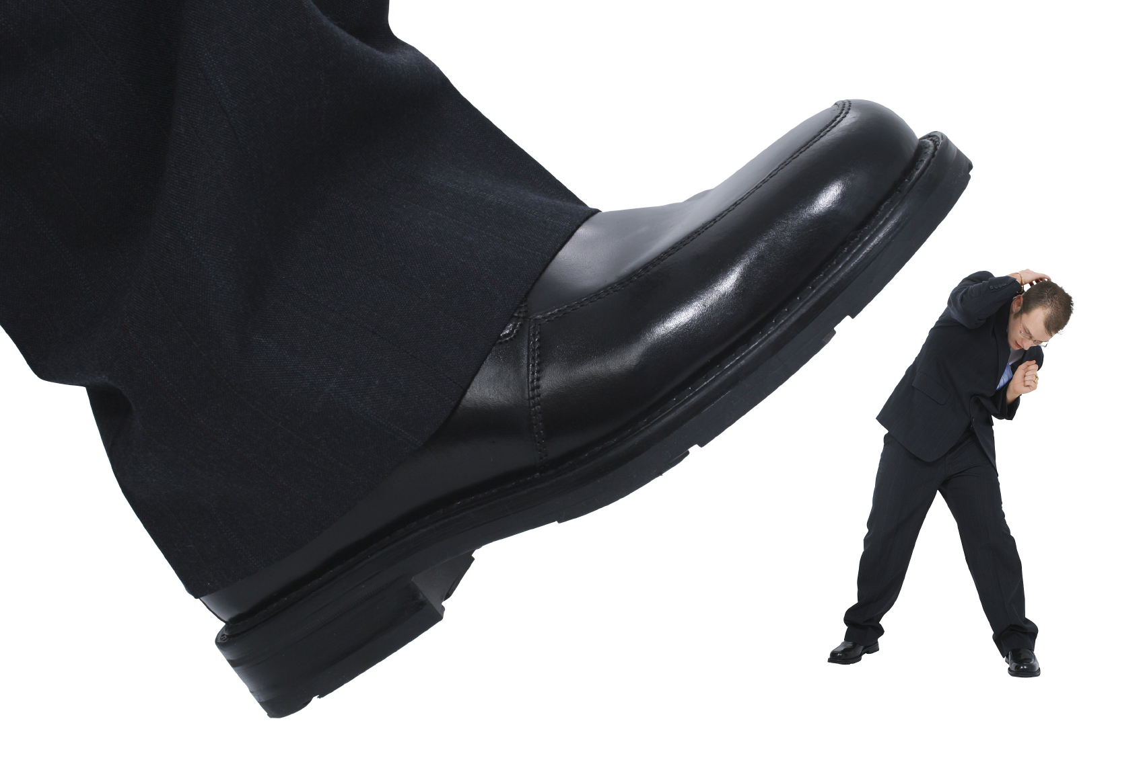
Some schools are reinventing themselves for a digital, global age.
Most are not,
and others will determine their fate.
Notes:
Licensed under a Creative Commons attribution-share alike license.
http://creativecommons.org/licenses/by-sa/3.0
Scott McLeod, J.D., Ph.D.
dangerouslyirrelevant.org
schooltechleadership.org
dangerouslyirrelevant.org/contact.html

Slide 53
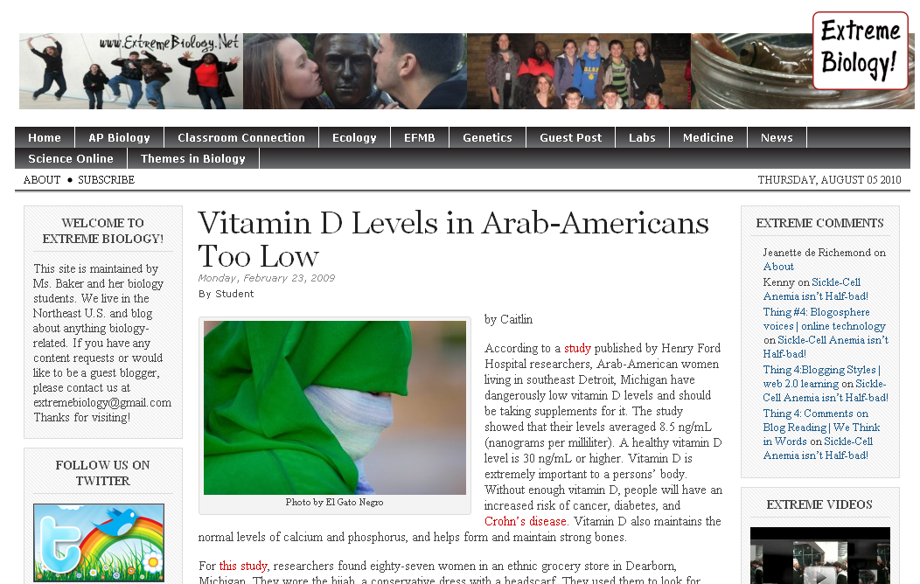

Slide 54
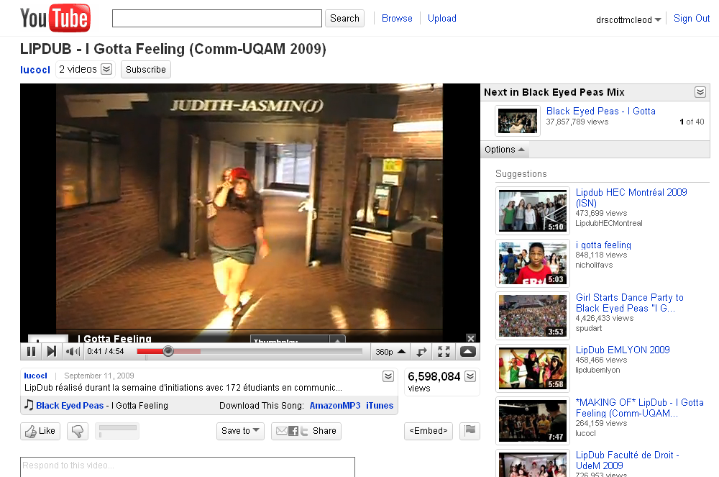

Slide 55
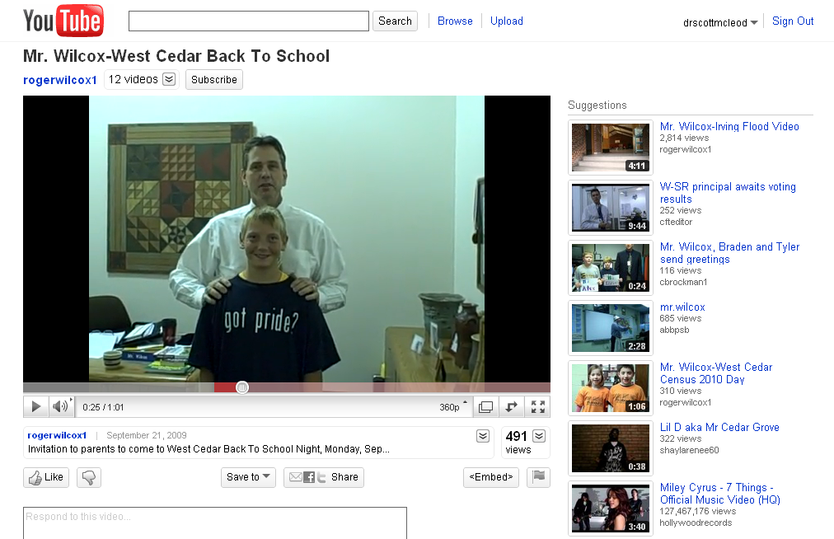

Slide 56
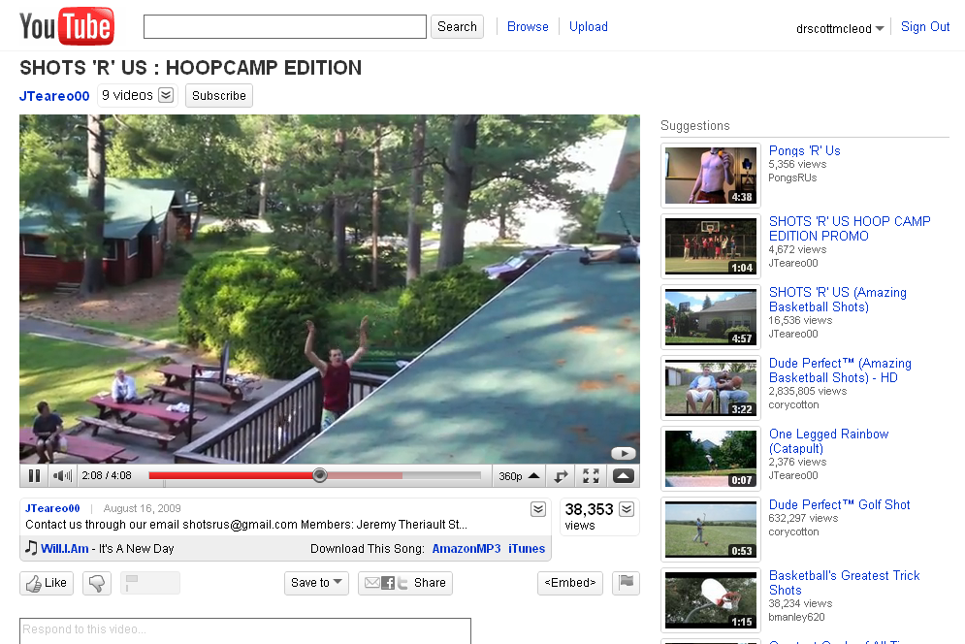

Slide 57
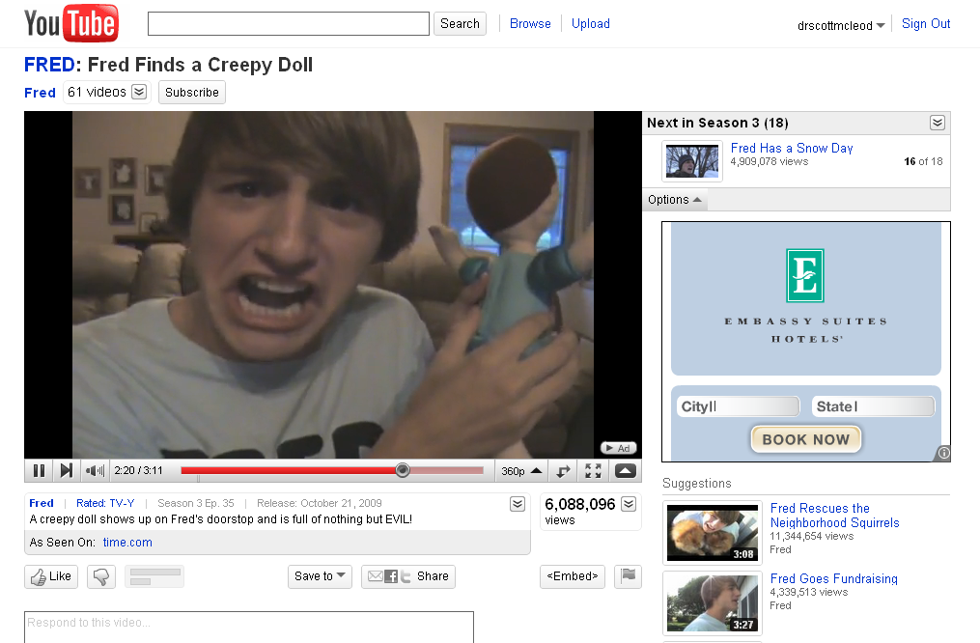

Slide 58
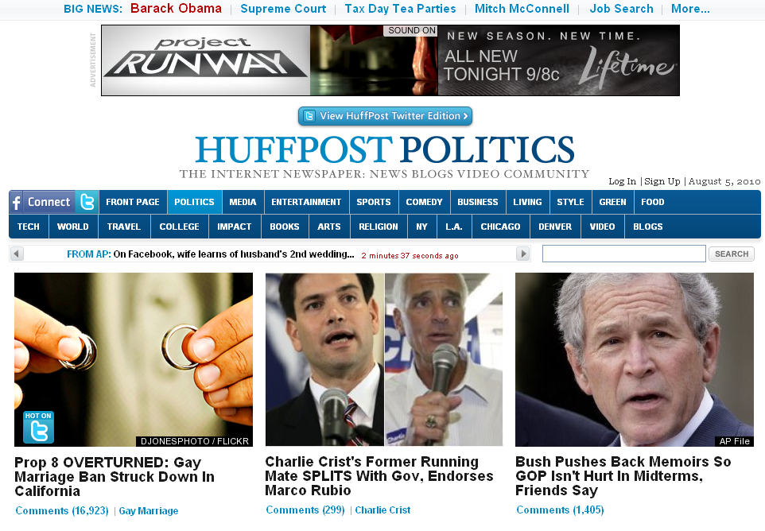

Slide 59
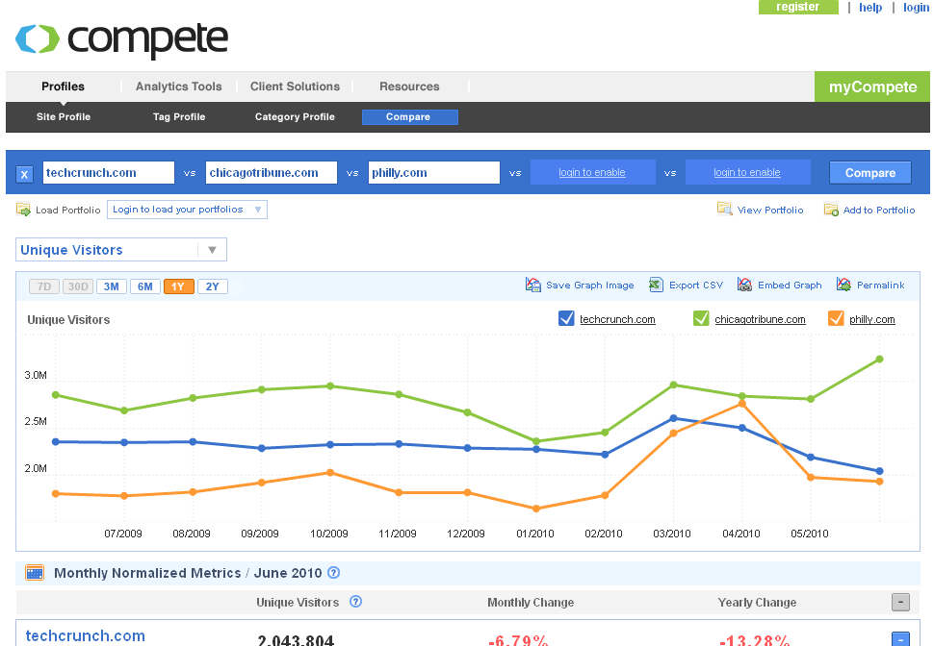

Slide 60
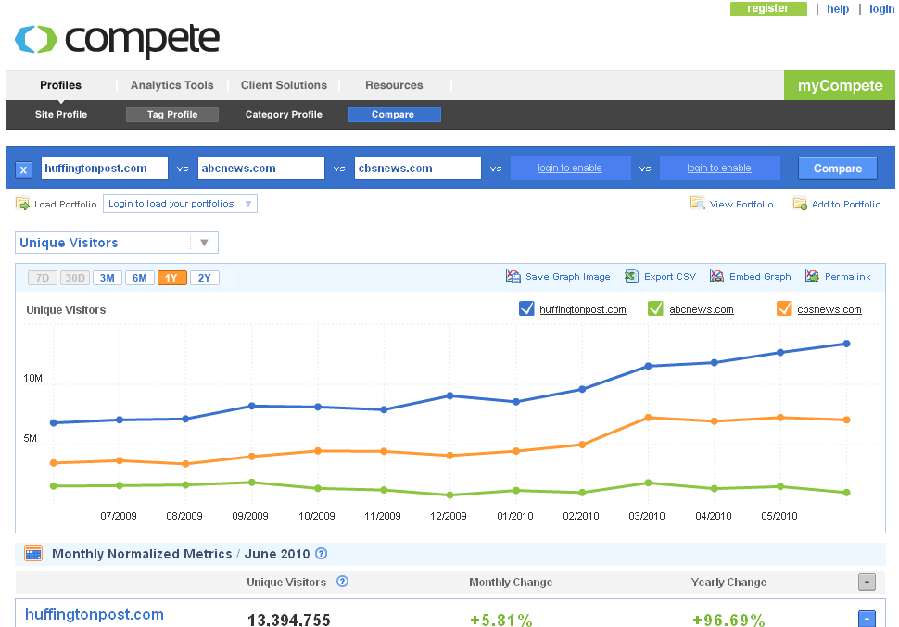

Slide 61
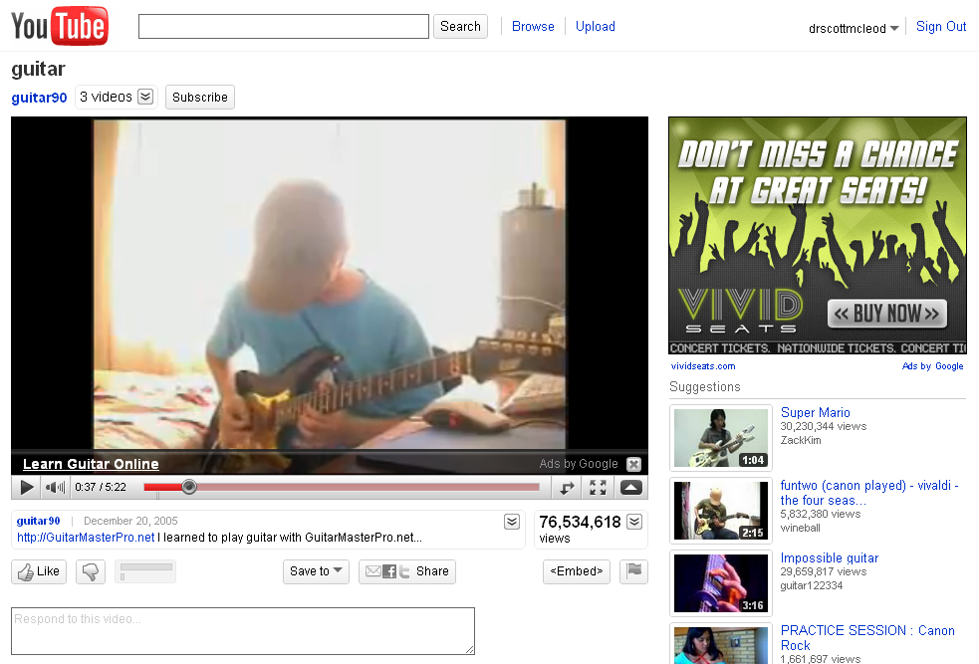

Slide 62
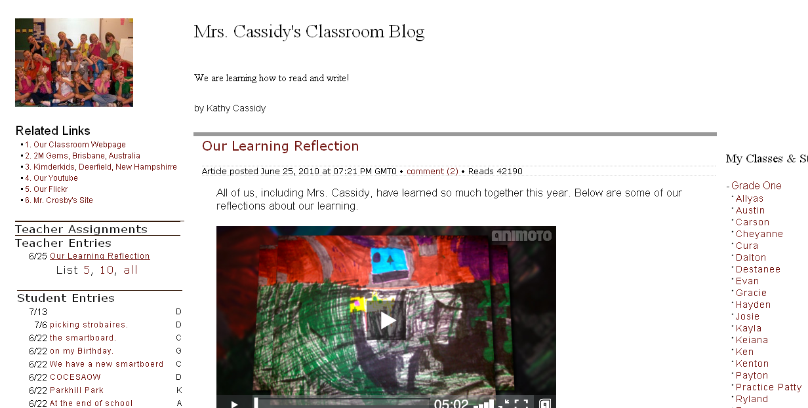

Slide 63
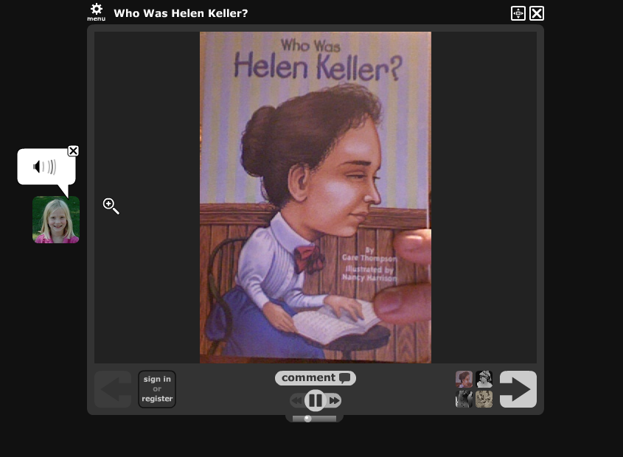

Slide 64
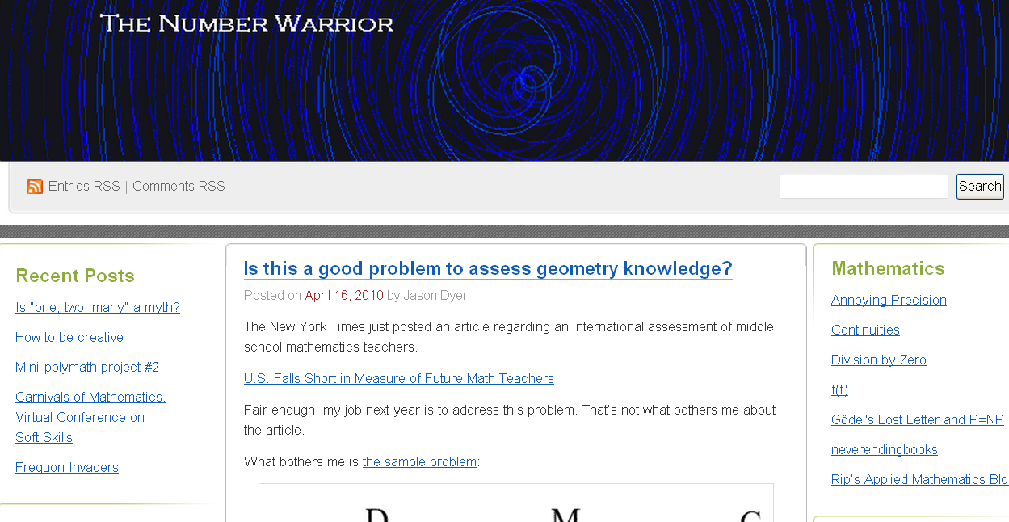

Slide 65
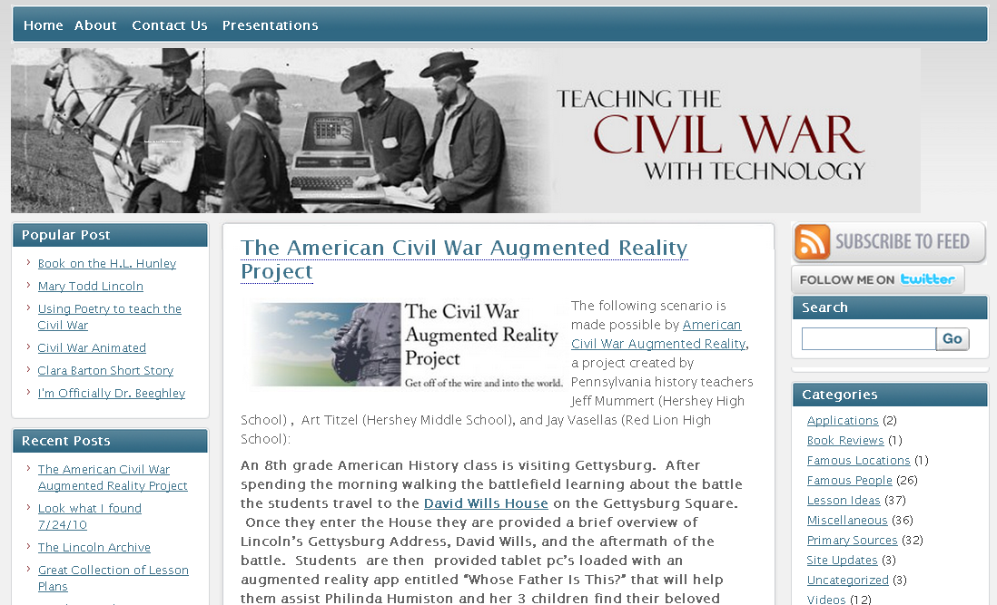

Slide 66
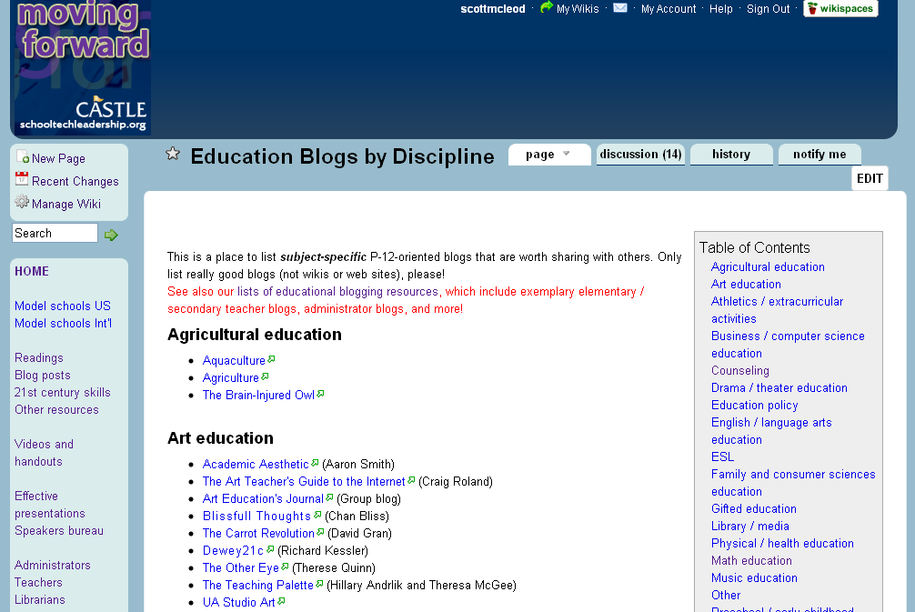

Slide 67
THANK YOU!
dangerouslyirrelevant.org/belmondklemme

Slide 68
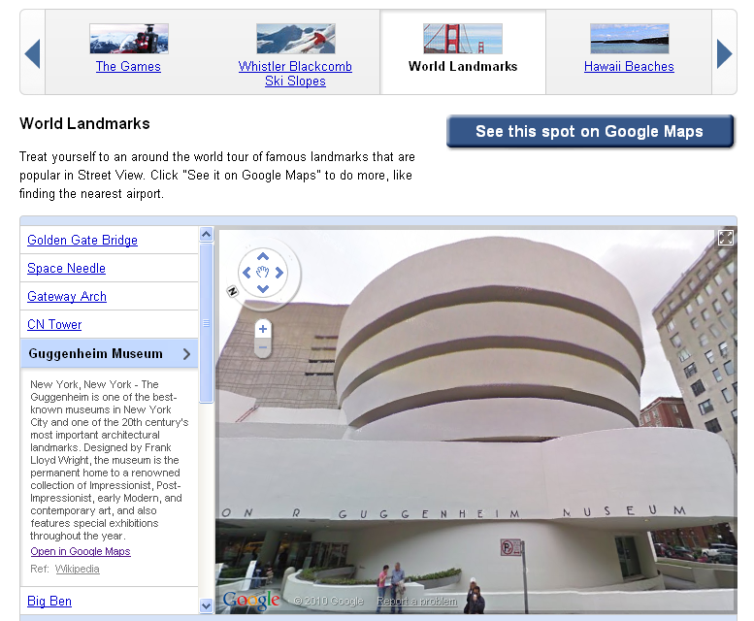

Slide 69
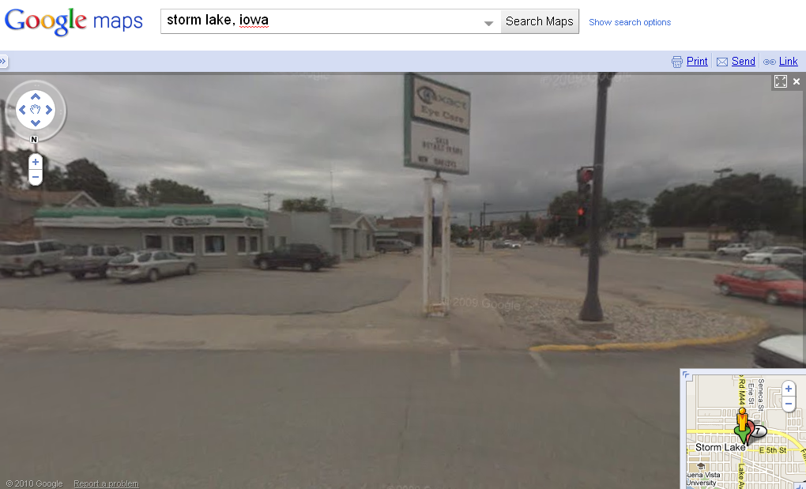

Slide 70
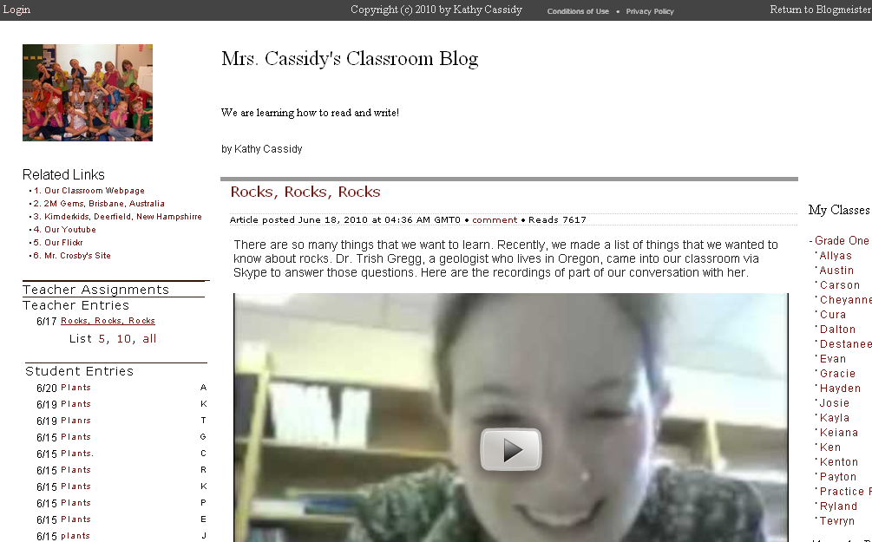

Slide 71
searchable

Slide 72
collaborative

Slide 73
often ‘crowdsourced’

Slide 74
creative

Slide 75
more efficient

Slide 76
often less expensive

Slide 77
global

Slide 78
rapidly-changing

Slide 79
technology-suffused

Slide 80
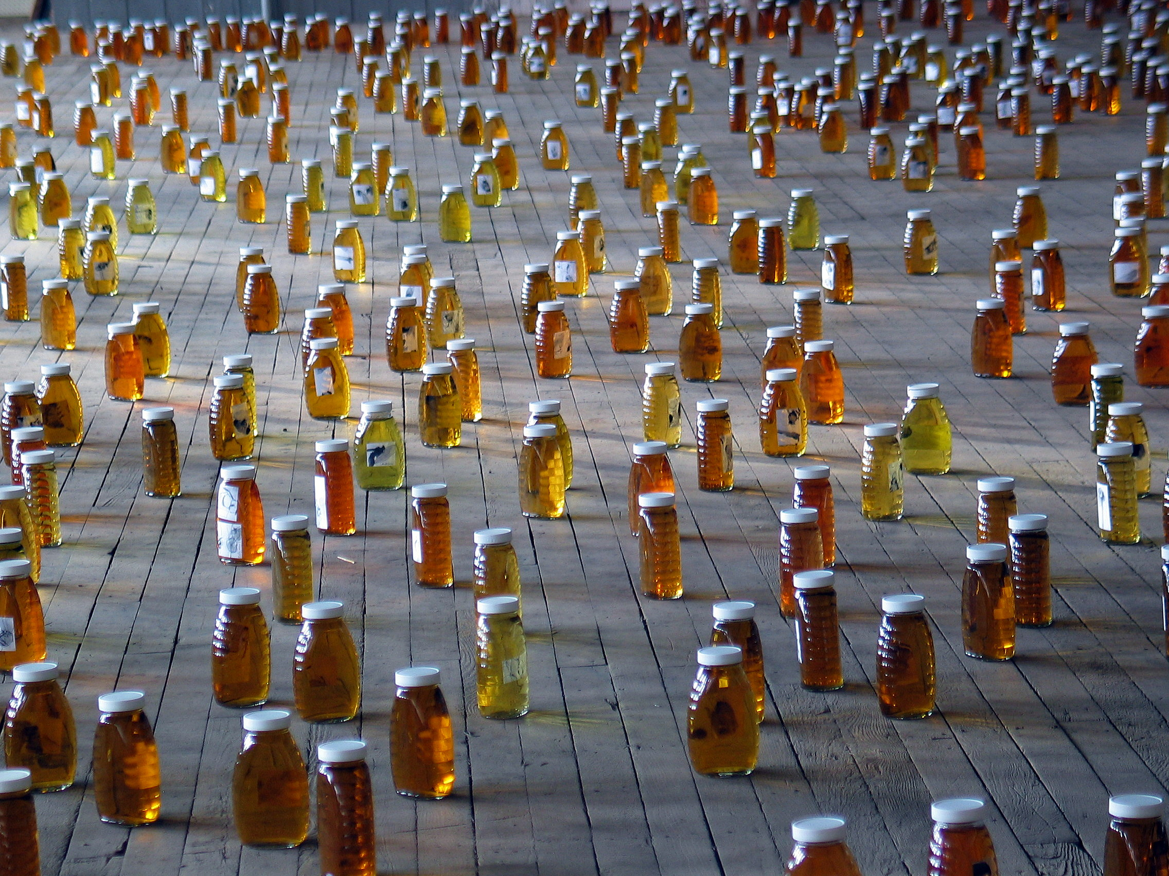
www.flickr.com/photos/jahansell/251755048
dangerouslyirrelevant.org
Our kids have tasted the honey.
Notes:
Licensed under a Creative Commons attribution-share alike license.
http://creativecommons.org/licenses/by-sa/3.0
Scott McLeod, J.D., Ph.D.
scottmcleod.net/contact
dangerouslyirrelevant.org
schooltechleadership.org
Our kids have tasted the honey.
www.flickr.com/photos/jahansell/251755048

Slide 88
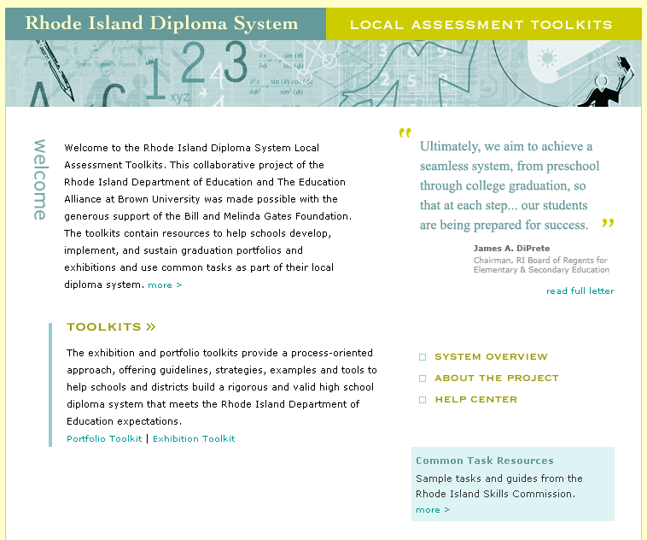

Slide 89
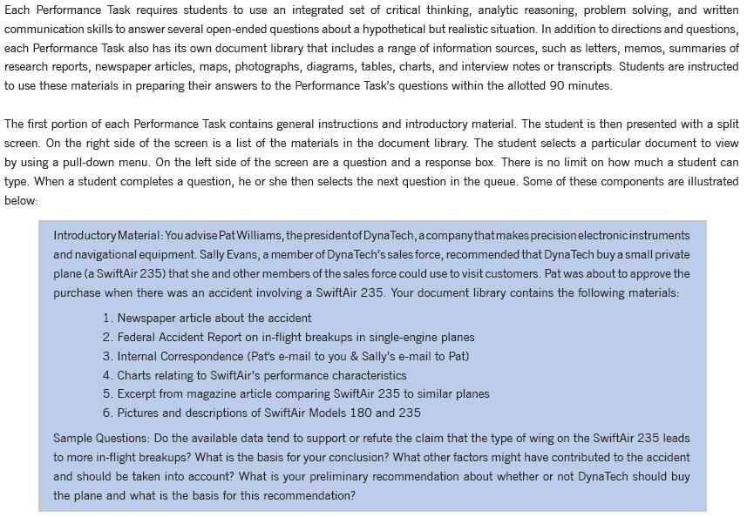

Slide 90
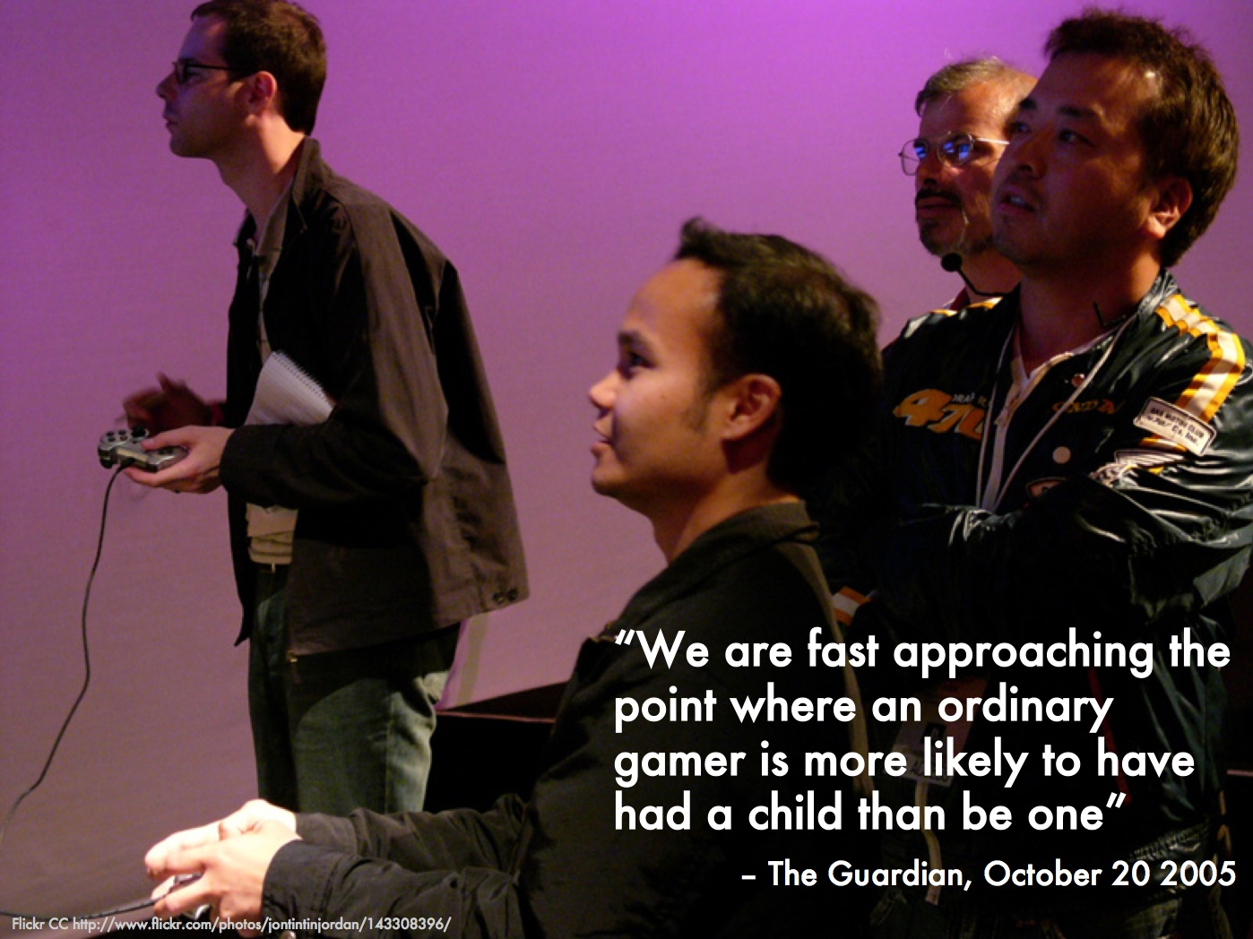

Slide 91
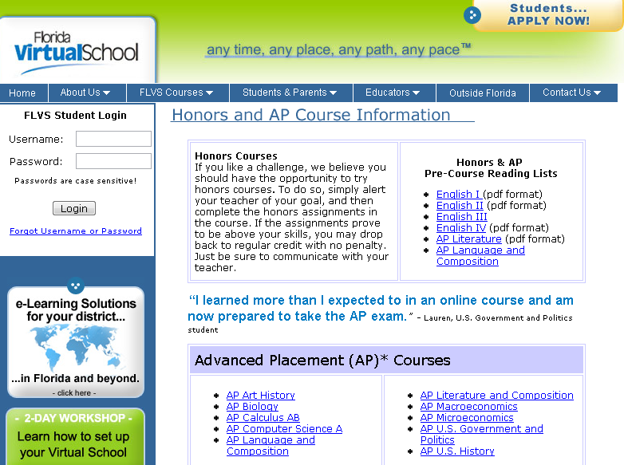

Slide 92
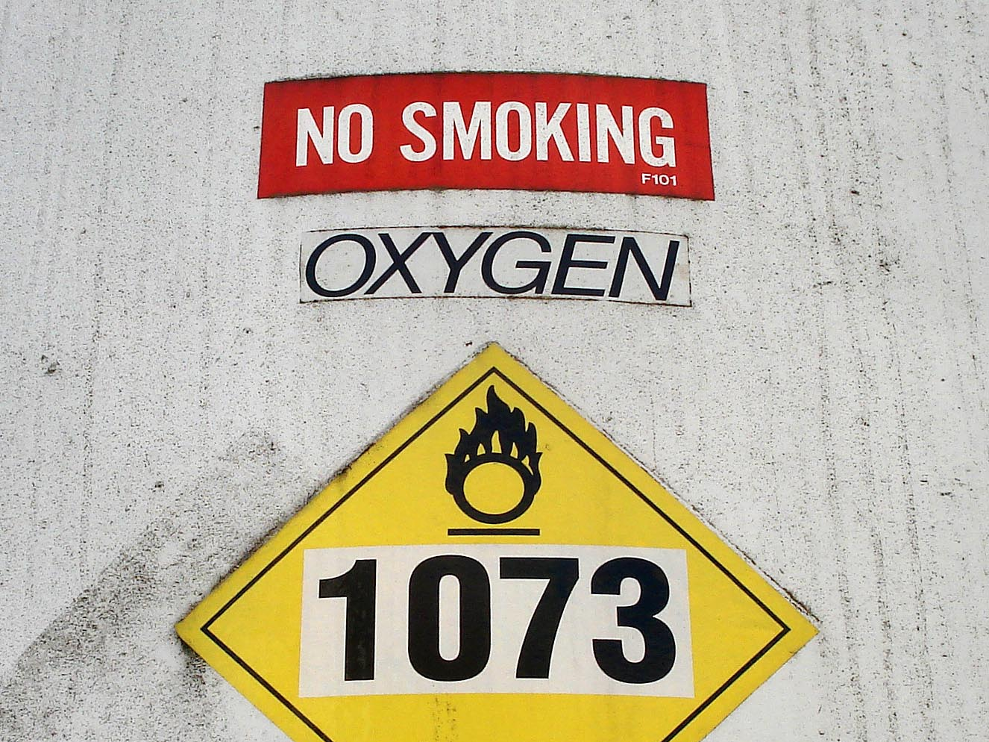
Notes:
Technology needs to be like oxygen. Ubiquitous, necessary, and invisible.
- Chris Lehmann

Slide 93
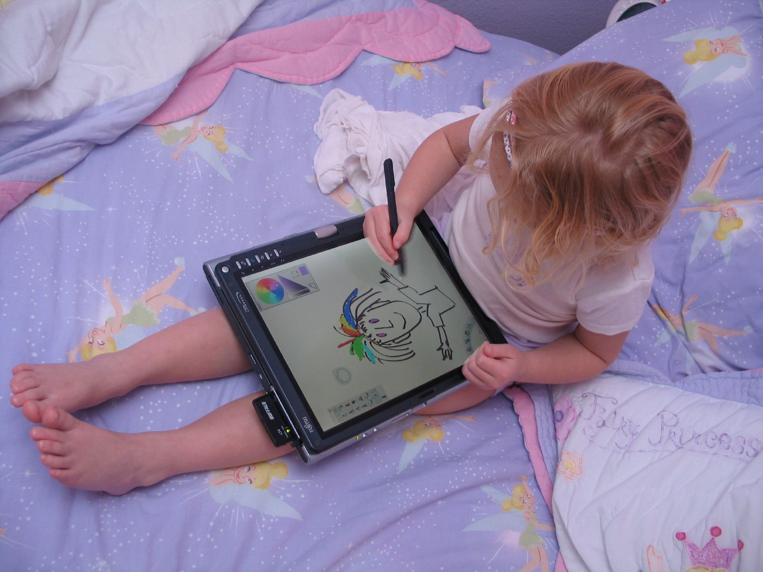

Slide 94
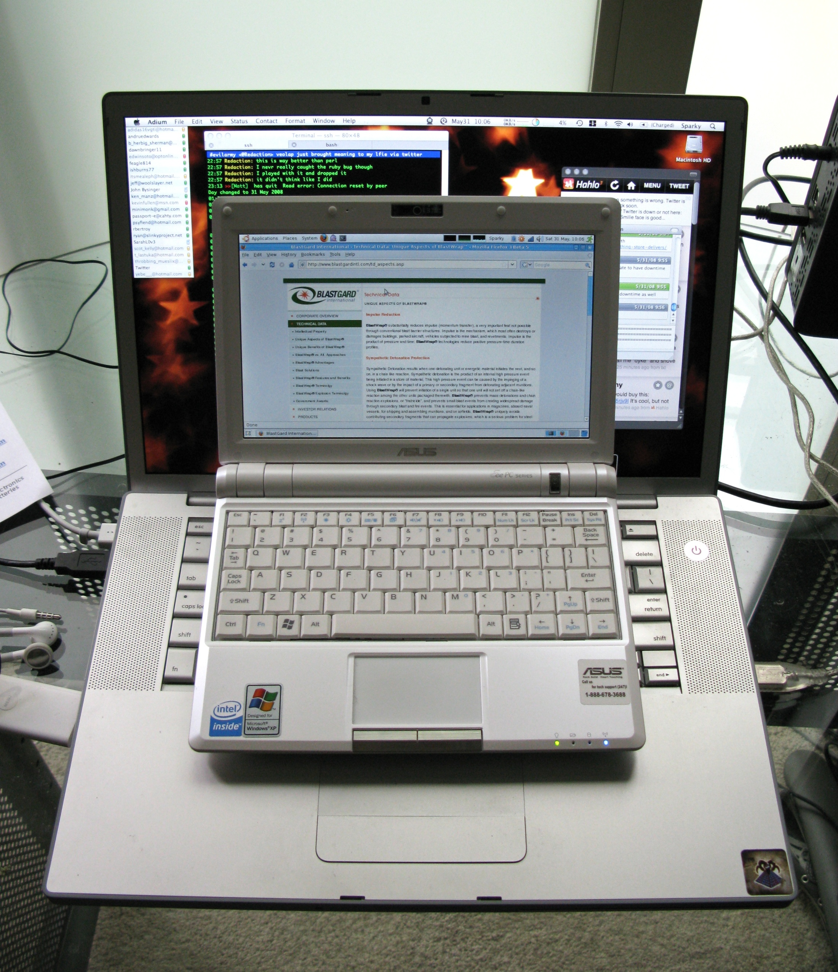

Slide 95


Slide 96
[pause]

Slide 97


Slide 98


Slide 99


