Slide 1
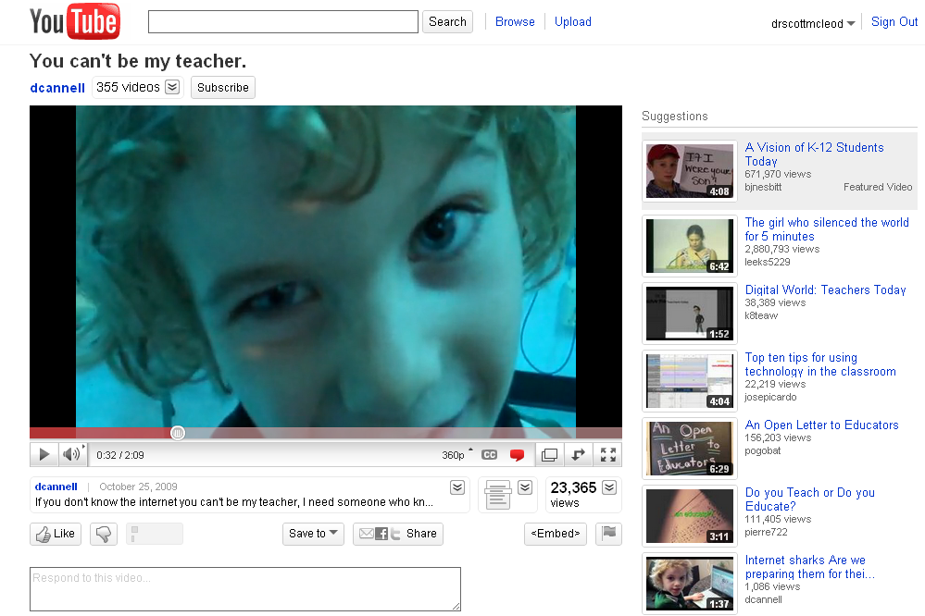

Slide 2
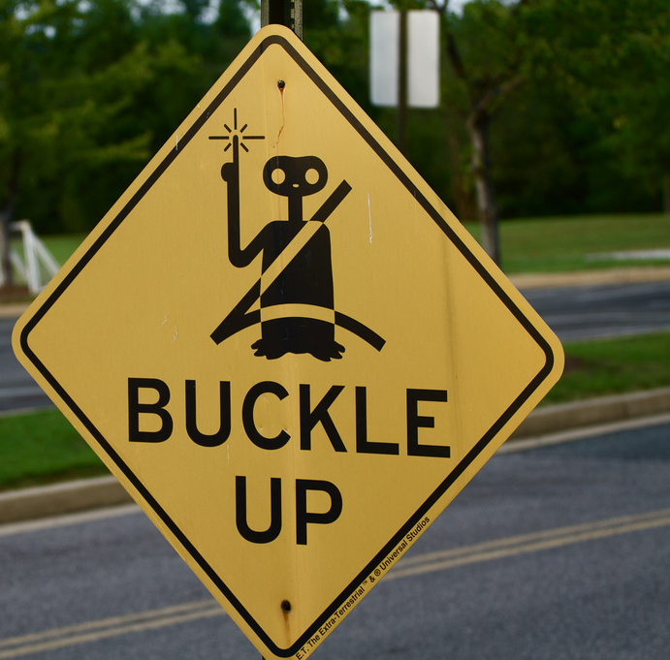
Fasten your seatbelts:
The future of
learning is
coming fast!
Dr. Scott McLeod
CASTLE

Slide 3
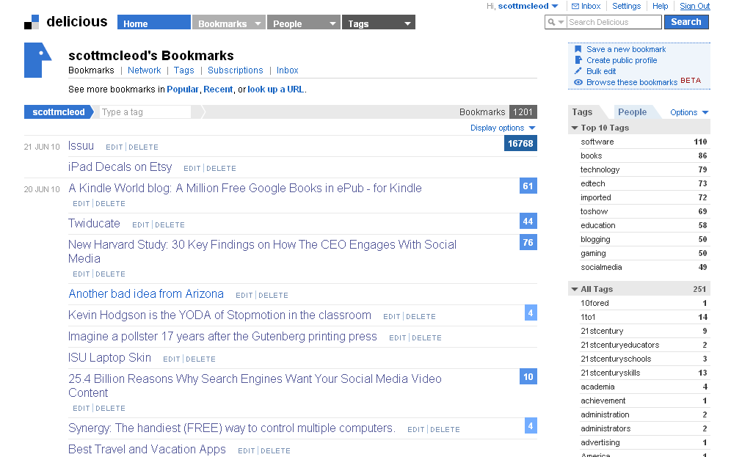

Slide 4
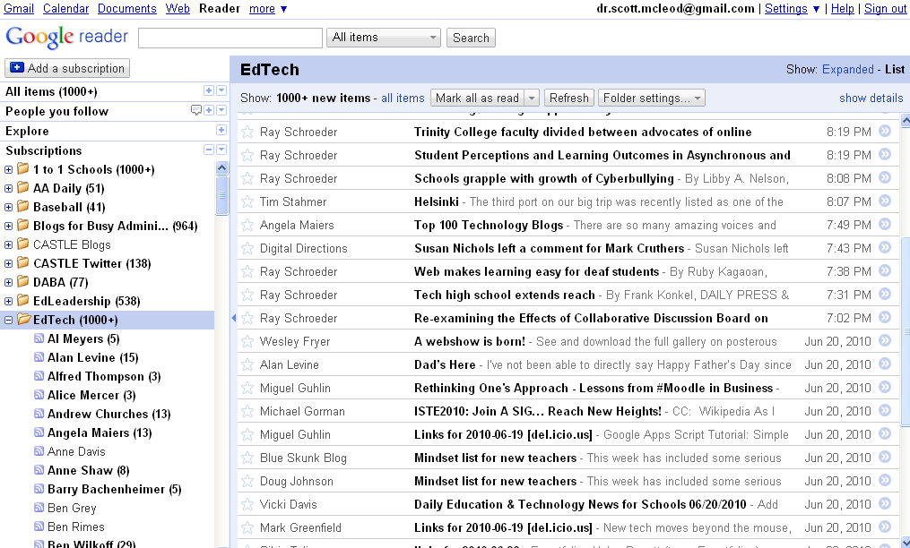

Slide 5
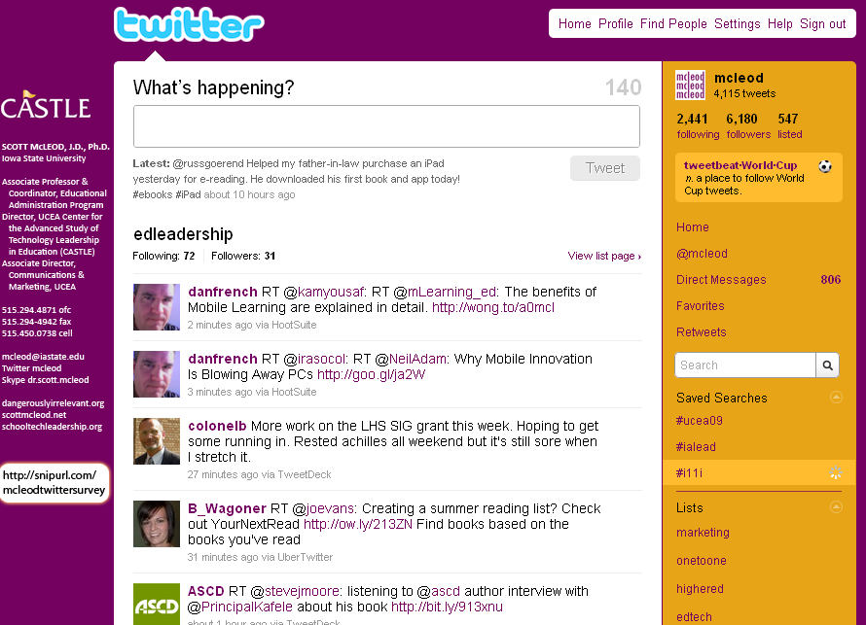

Slide 6
networked

Slide 7
connected

Slide 8
less dependent on ‘experts’

Slide 9
shared

Slide 10
empowering

Slide 11
[pause]

Slide 12
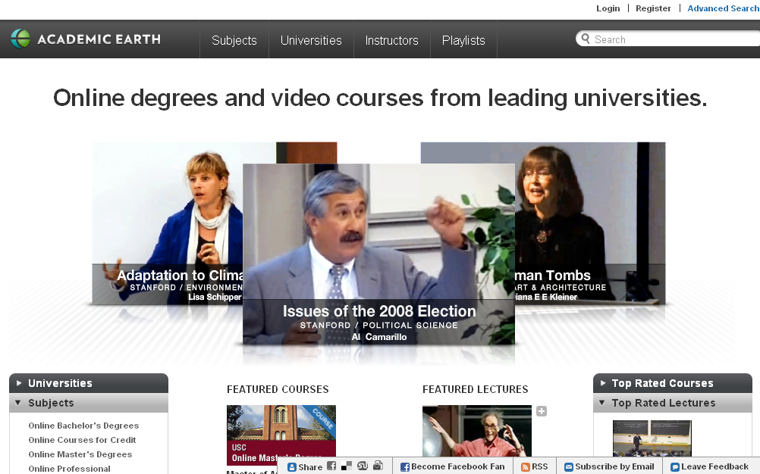

Slide 14
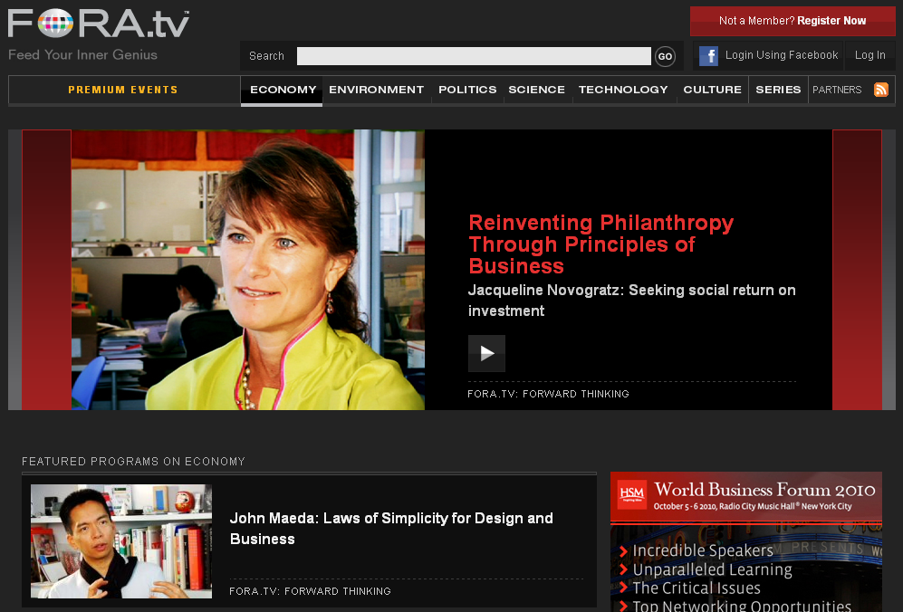

Slide 16
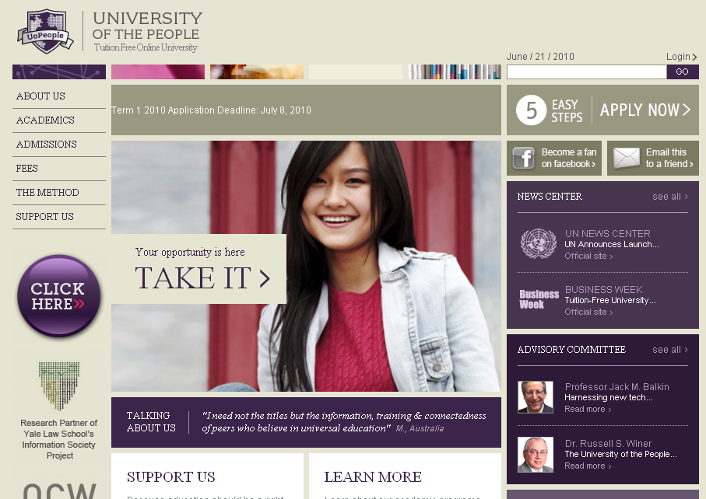

Slide 18
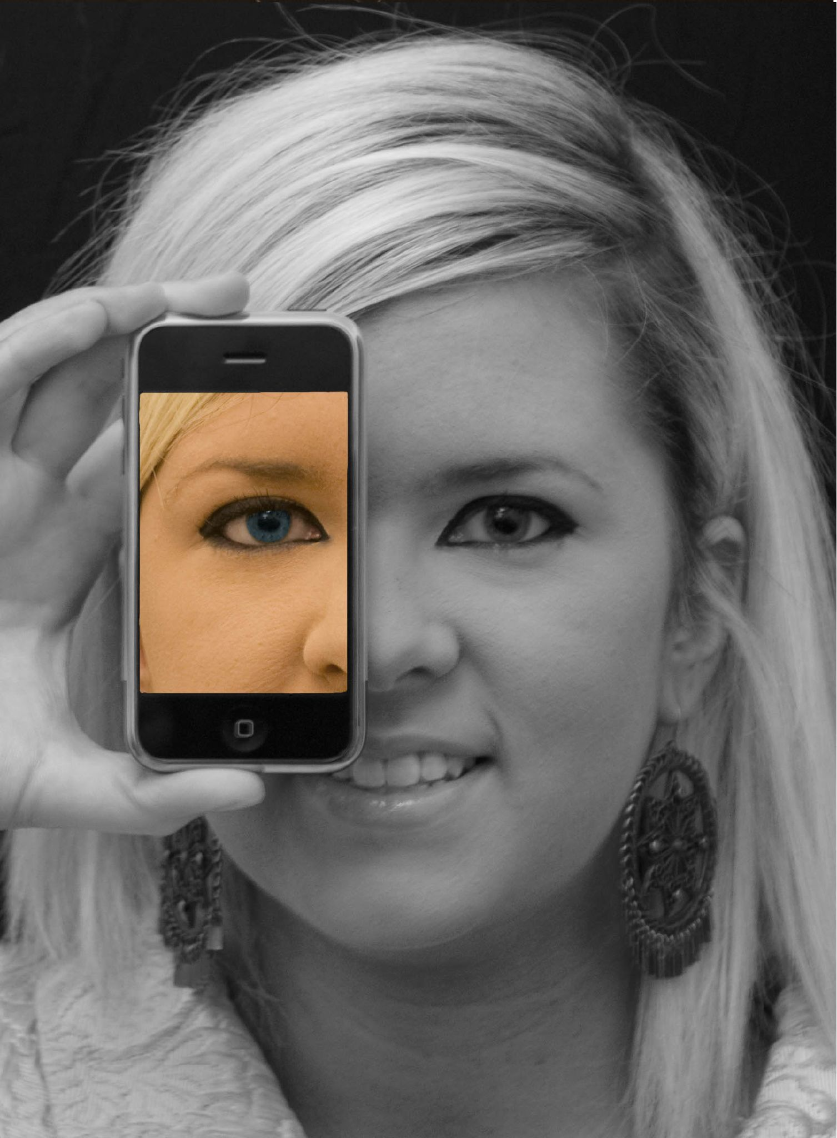

Slide 19
open

Slide 20
more accessible

Slide 21
more comprehensive

Slide 22
less dependent on physical media

Slide 23
less dependent on geography

Slide 24
mobile

Slide 25
more immediate /
real time

Slide 26
more convenient

Slide 27
[pause]

Slide 28
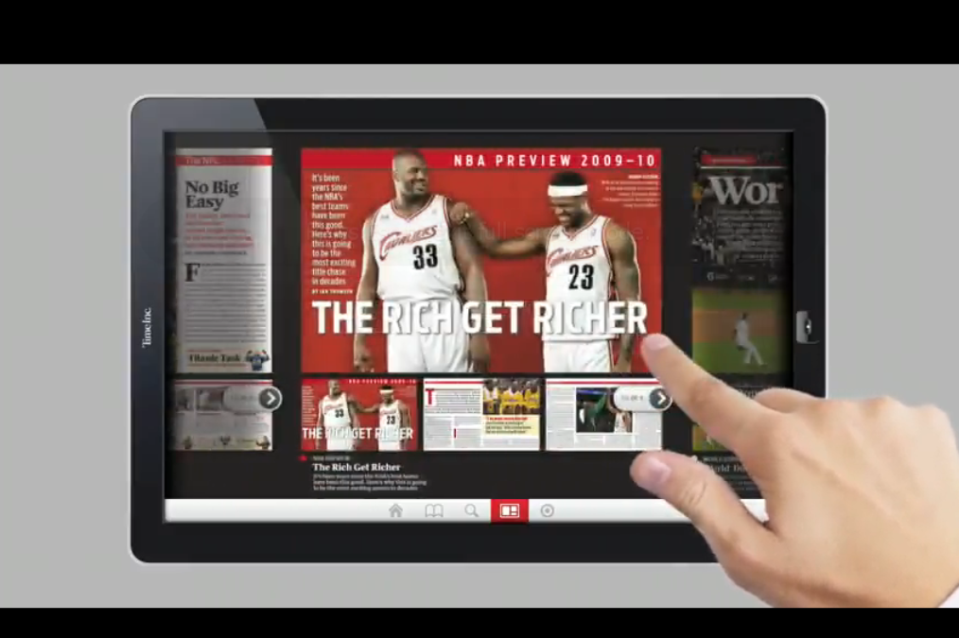

Slide 29
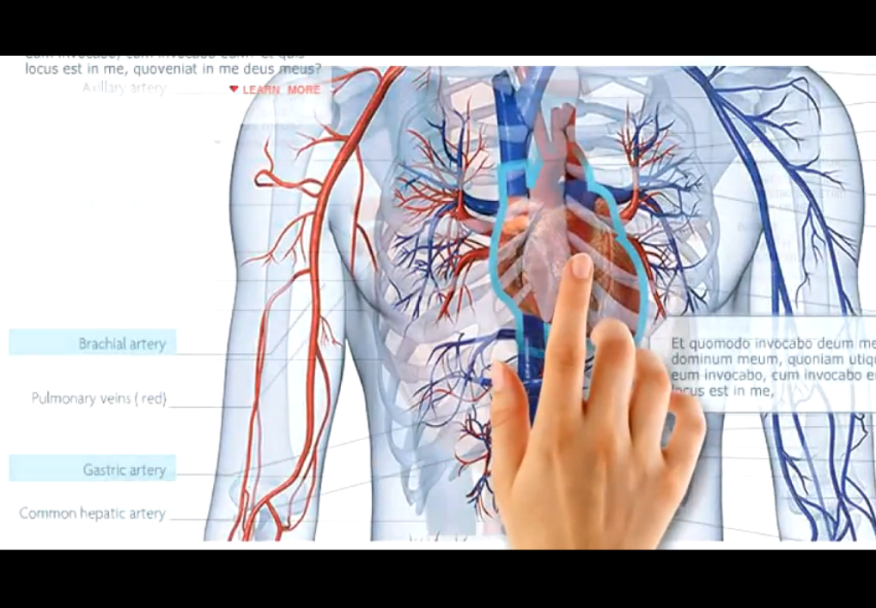

Slide 30
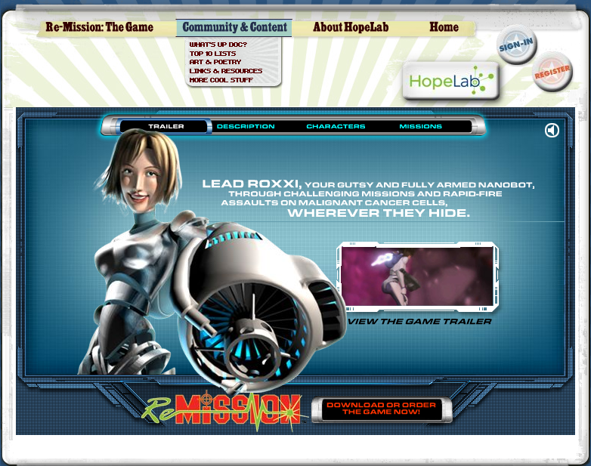
Notes:
Re-Mission

Slide 31
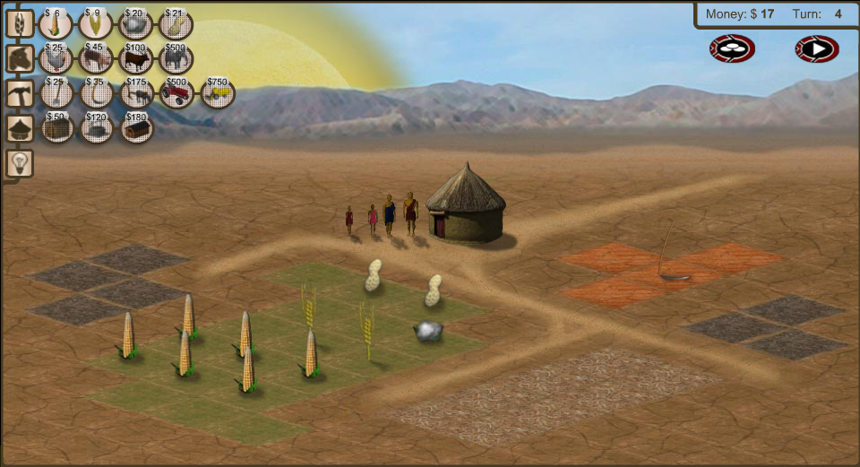
Notes:
3rd World Farmer

Slide 32
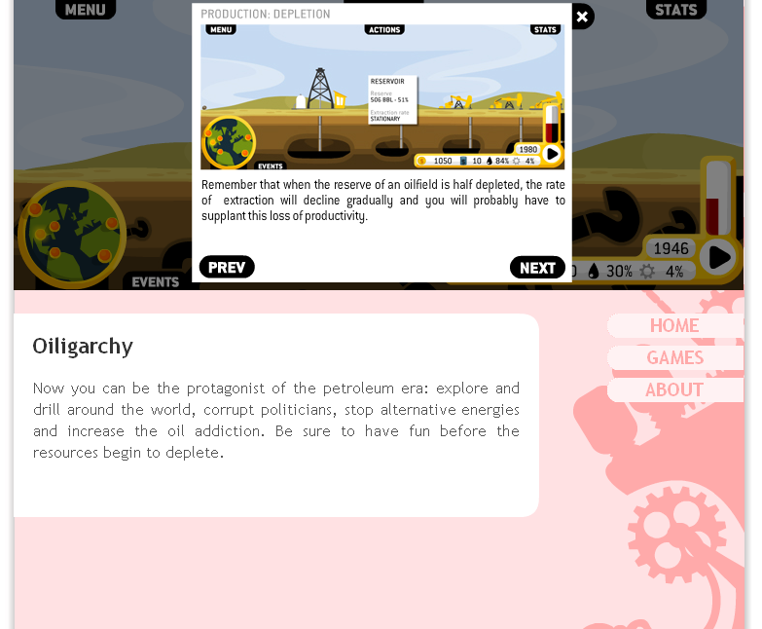

Slide 33
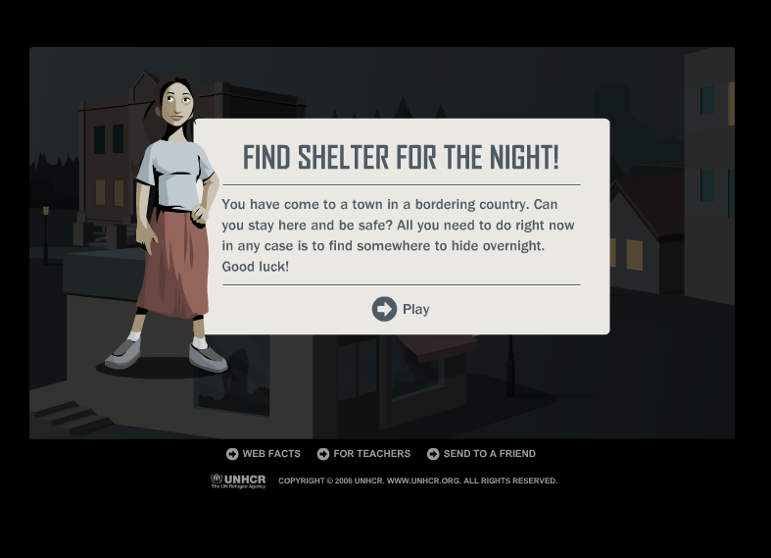
Notes:
Against All Odds, United Nations High Commissioner for Refugees

Slide 34
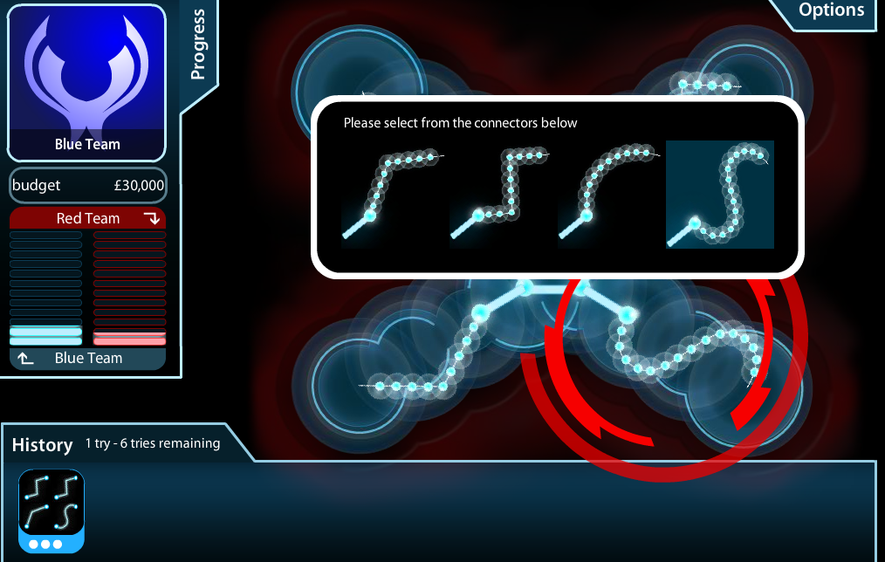
Notes:
Masterminding Molecules

Slide 35
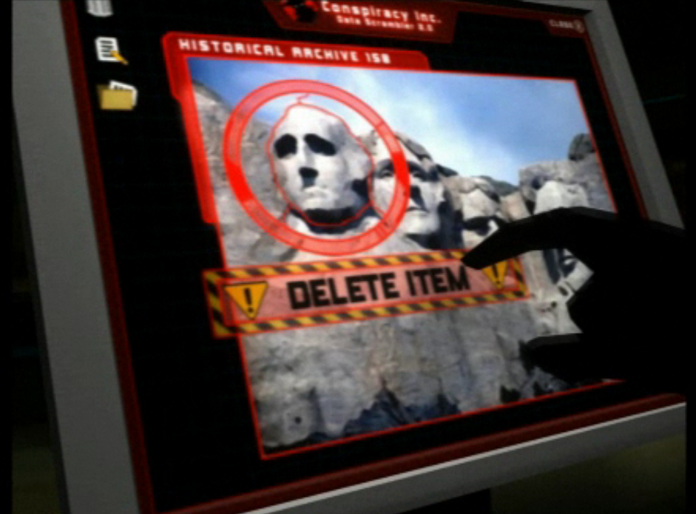
Notes:
Conspiracy Code

Slide 36
multimodal / multimedia

Slide 37
interactive

Slide 38
3-D

Slide 39
immersive

Slide 40
[pause]

Slide 42
individualized

Slide 43
flexible

Slide 44
adaptive

Slide 45
personalized

Slide 46
[pause]

Slide 48
[pause]

Slide 49
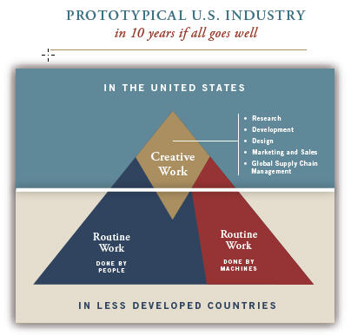
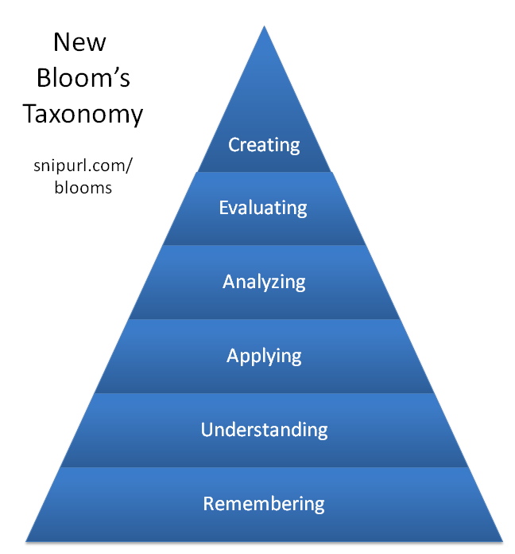

Slide 52
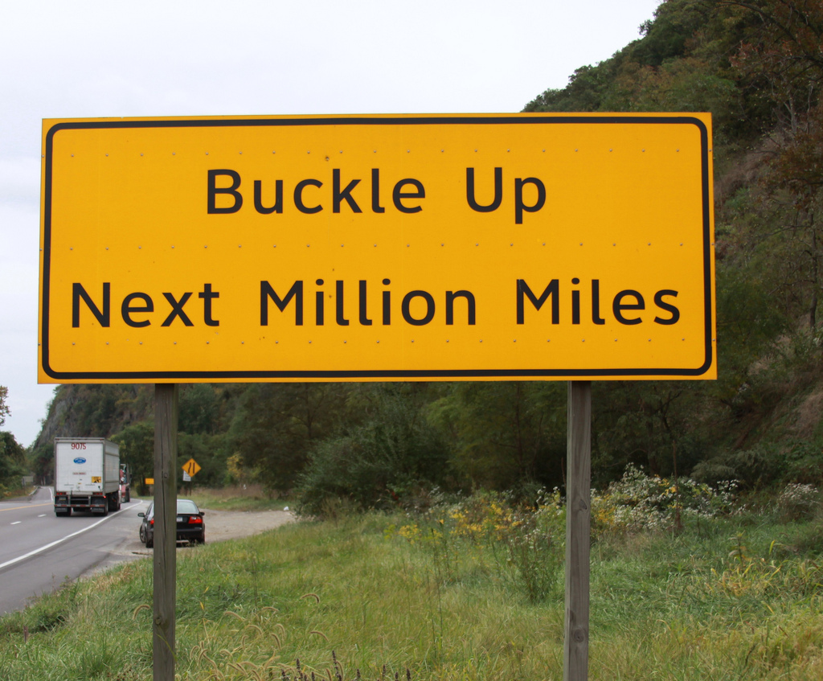

Slide 53
THANK YOU!
dangerouslyirrelevant.org/muscatine

