Slide 1
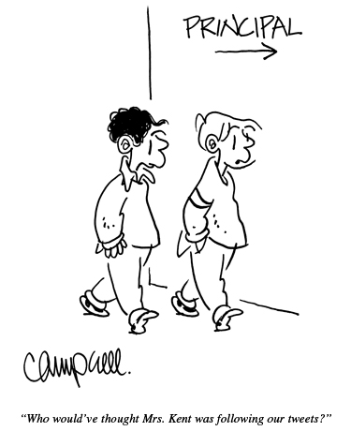
dangerouslyirrelevant.org/adphila

Slide 2

2 big shifts
and
1 big problem
Dr. Scott McLeod
CASTLE
Notes:
All of my materials are licensed under a Creative Commons attribution-share alike license (http://creativecommons.org/licenses/by-sa/3.0). That means not only that you are welcome to share and/or remix my content but that you are encouraged to do so! All I ask is that you properly credit me for my content and that you not place any greater copyright restrictions than I have on the content that utilizes my material. If possible, including the URL of Dangerously Irrelevant in your content would be most appreciated.
Scott McLeod, J.D., Ph.D.
dangerouslyirrelevant.org
schooltechleadership.org
dangerouslyirrelevant.org/contact.html

Slide 3
  Socially functional
  Mastery of information landscape
  Economically productive

Slide 4
Big shift 1

Slide 5
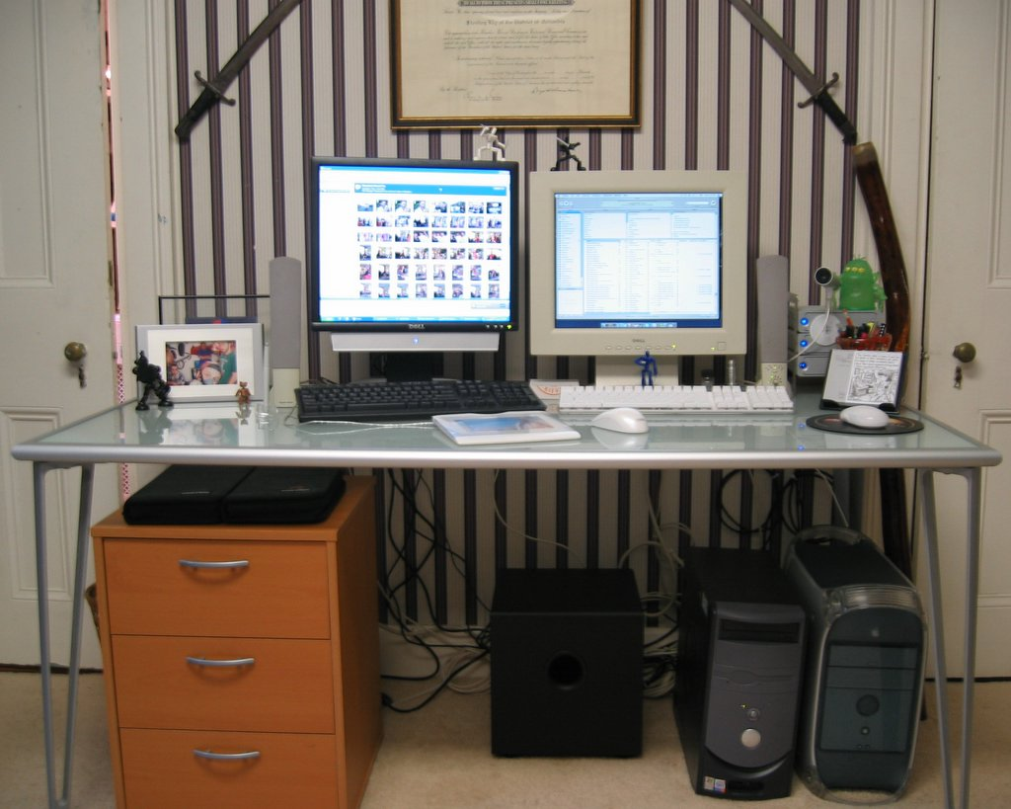

Slide 6


Slide 7


Slide 8
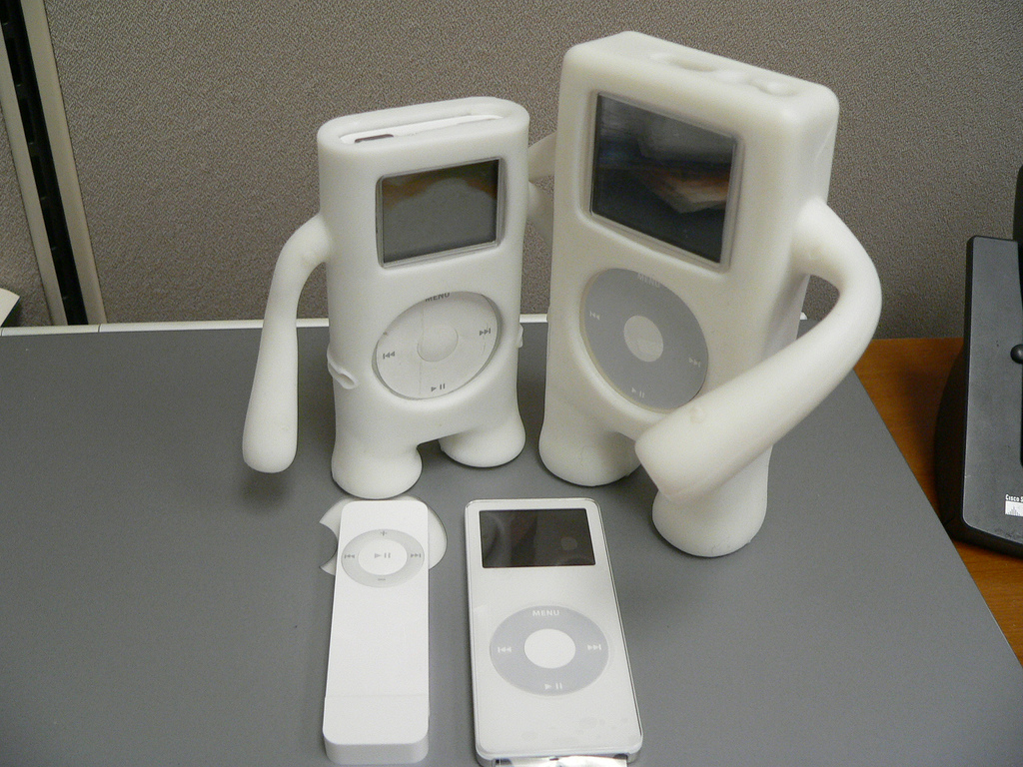

Slide 9
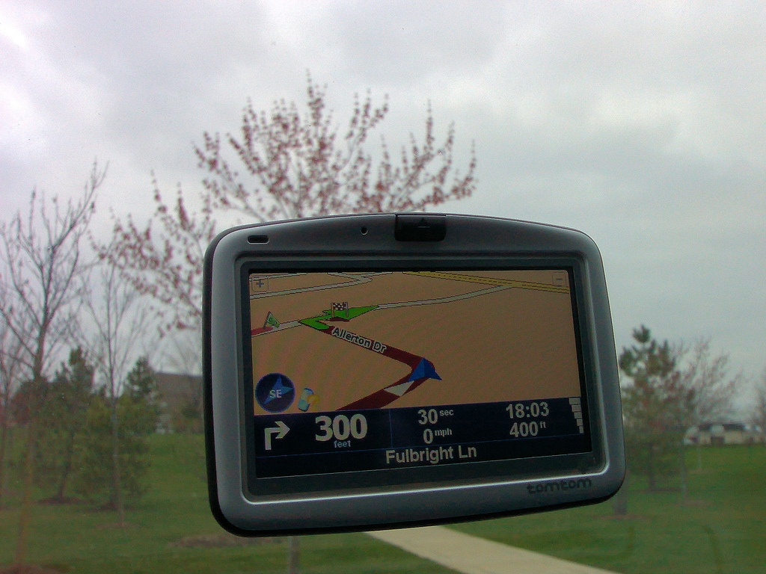

Slide 10
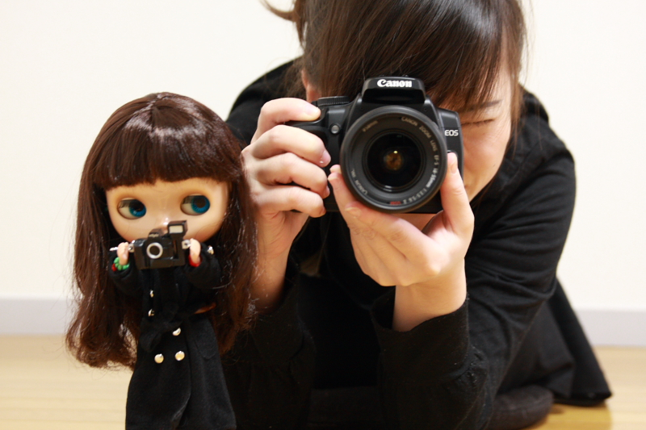

Slide 11
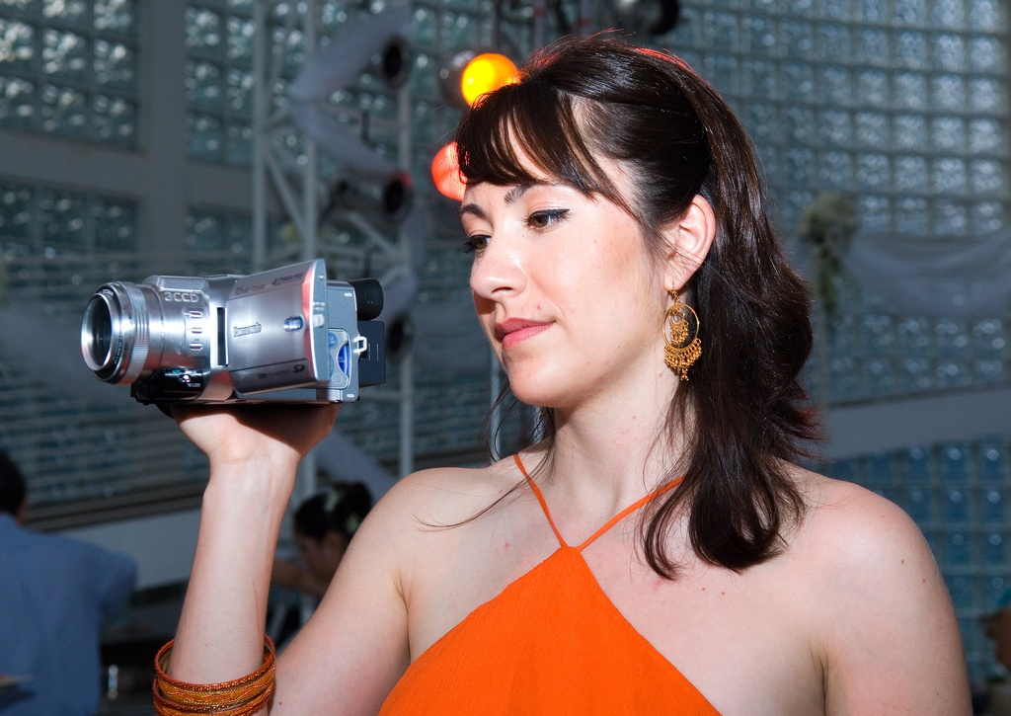

Slide 12
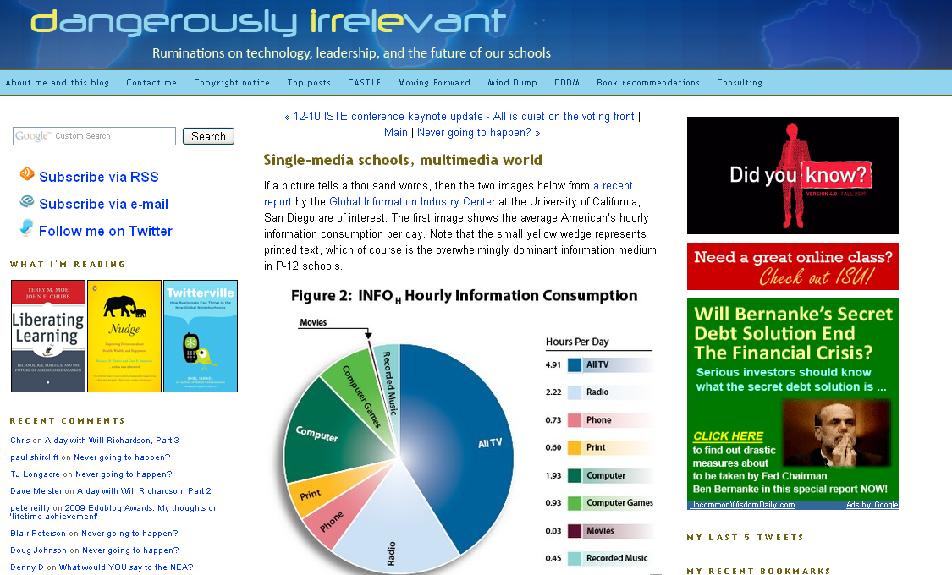

Slide 13
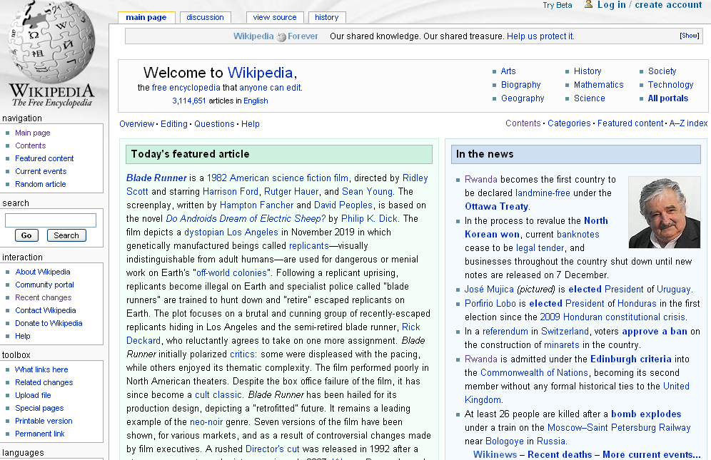

Slide 14
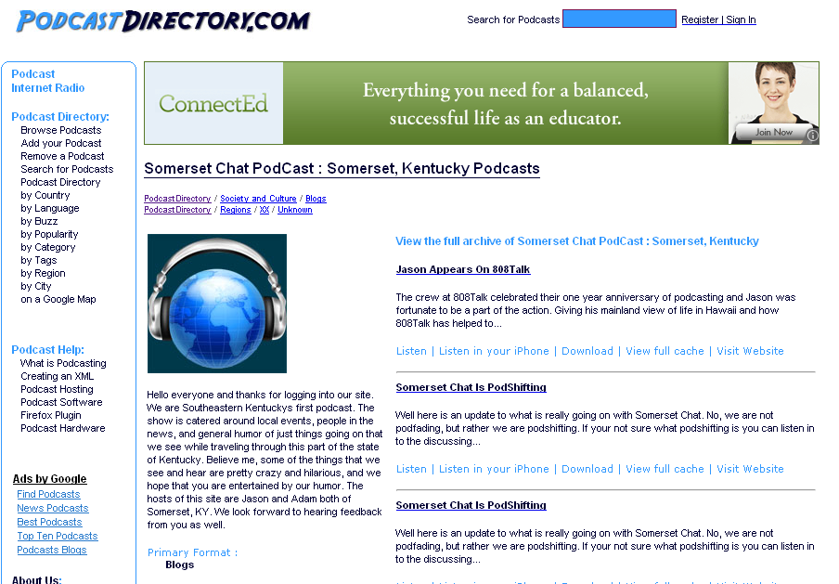

Slide 15
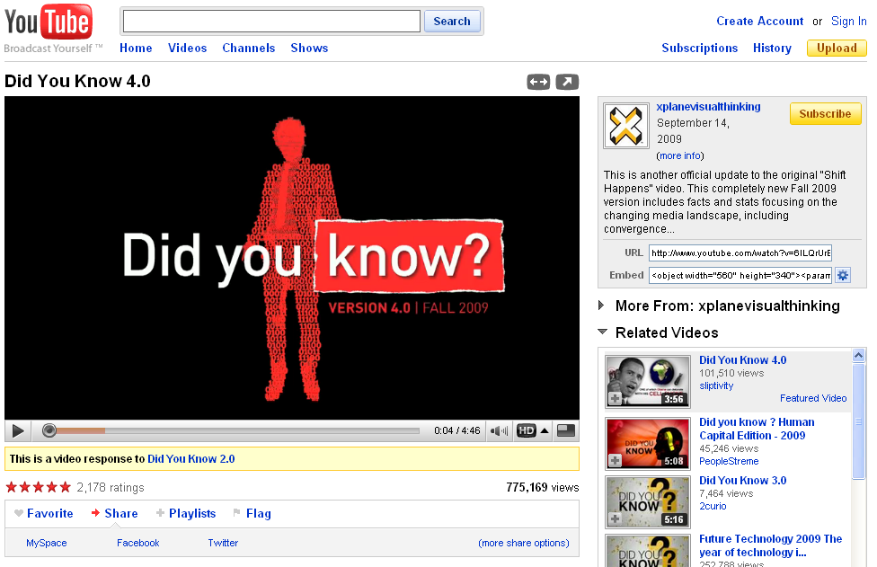

Slide 16
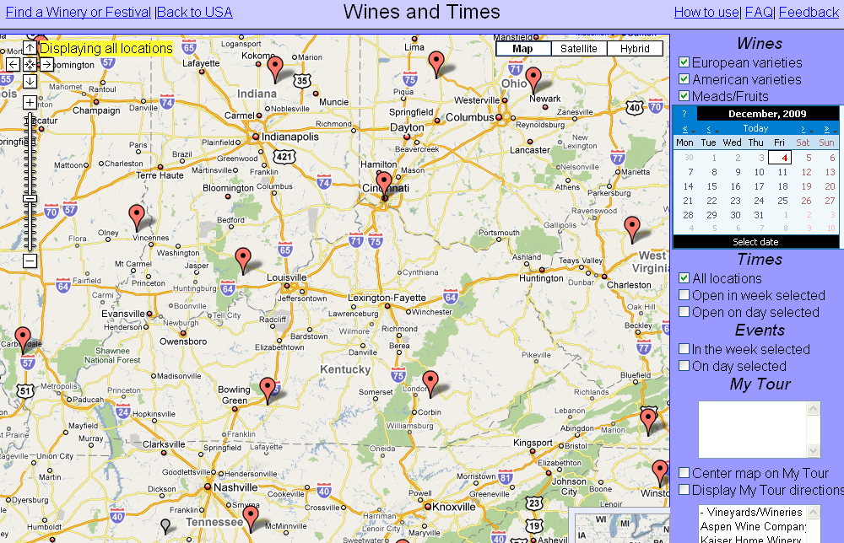

Slide 17
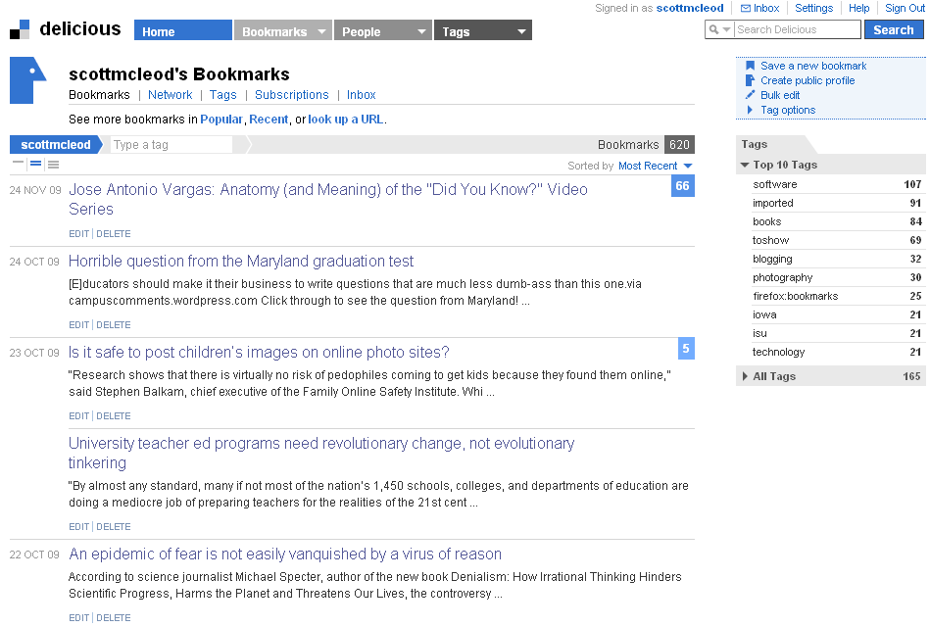

Slide 18
New information landscape

Slide 19


Slide 20


Slide 21
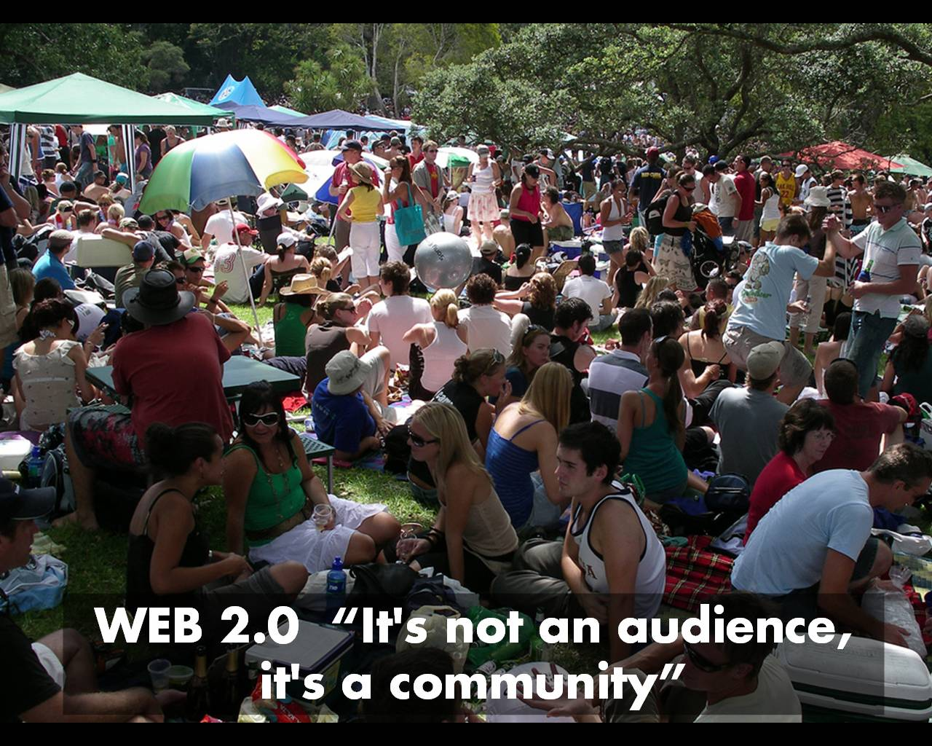

Slide 22
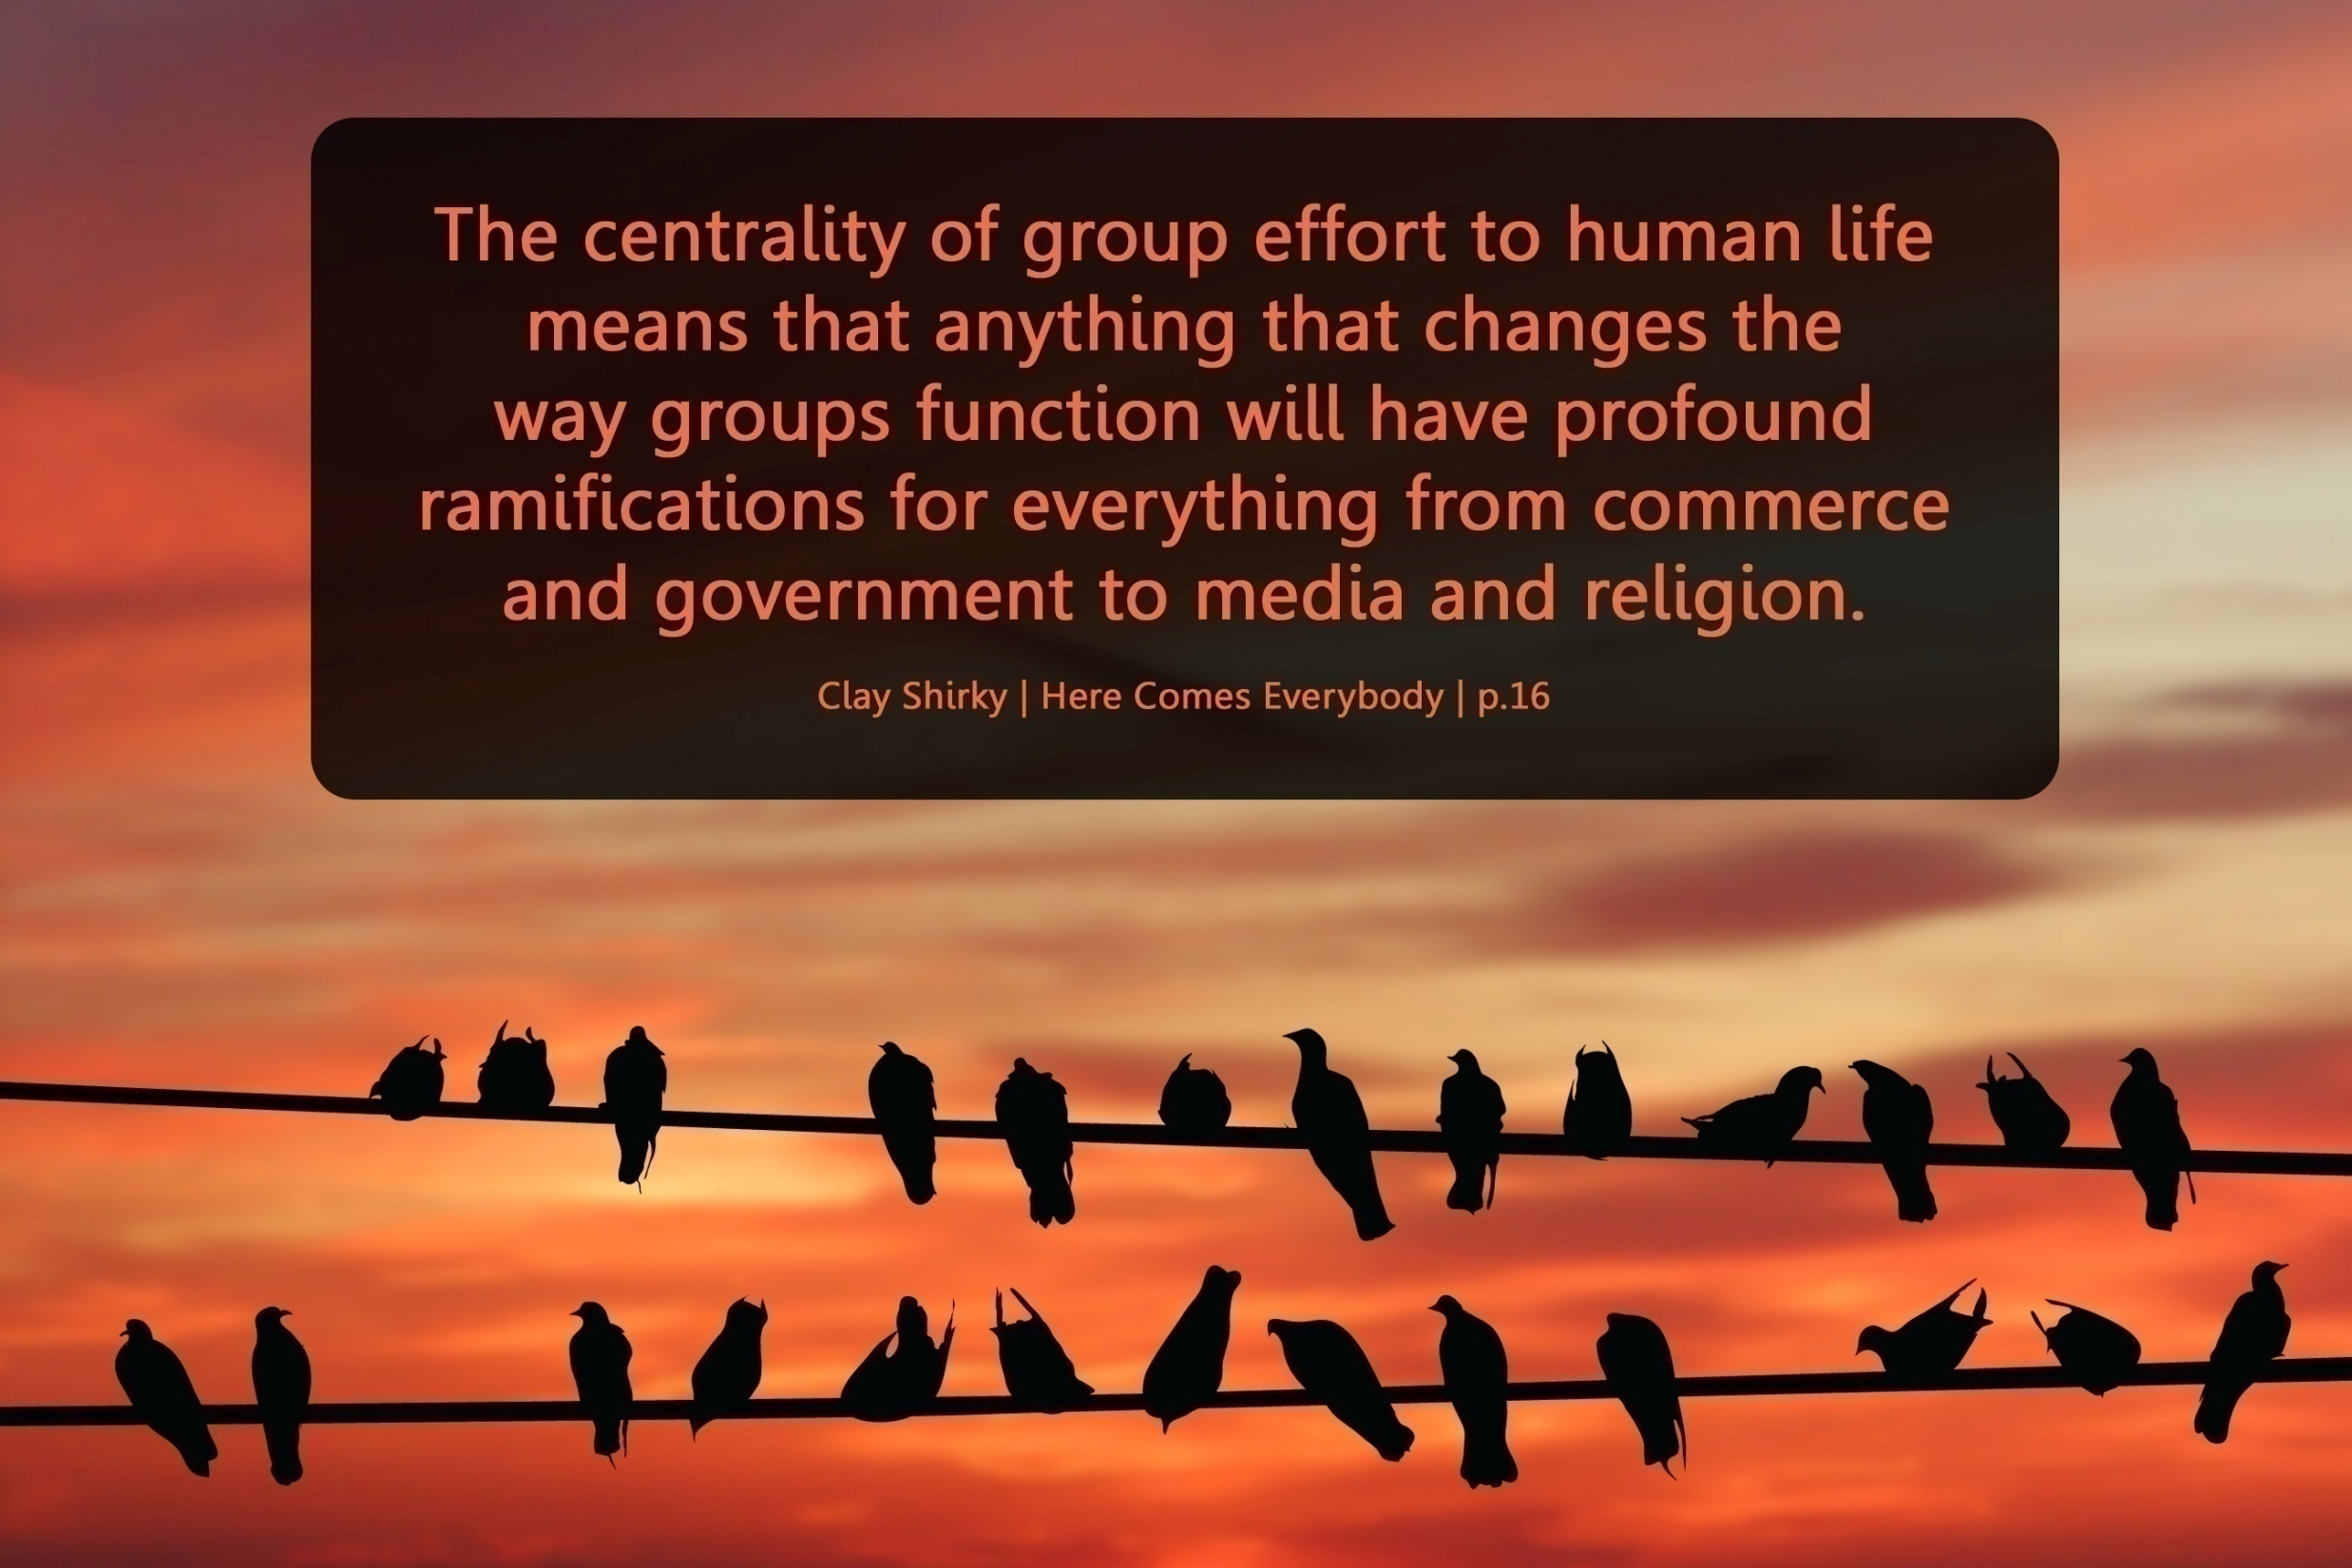

Slide 23
We are hyper-connected

Slide 24



Slide 25
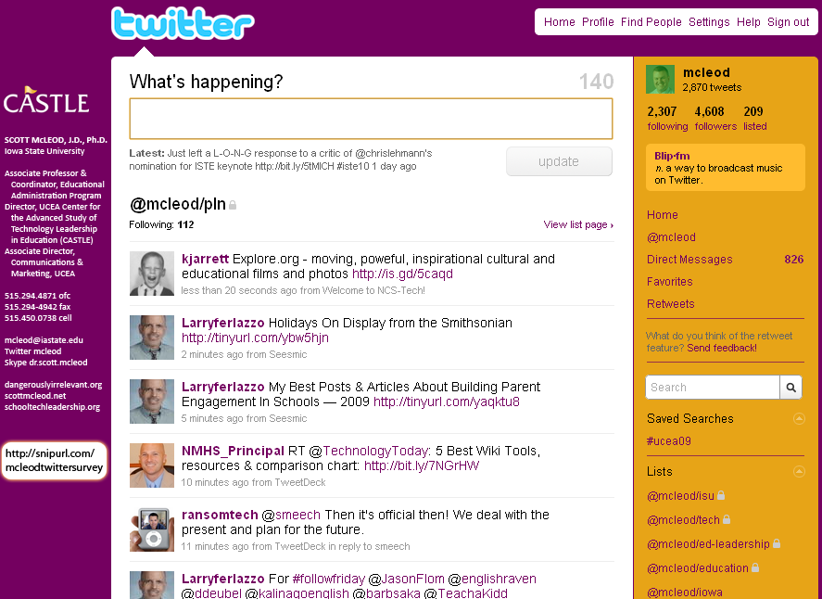

Slide 26
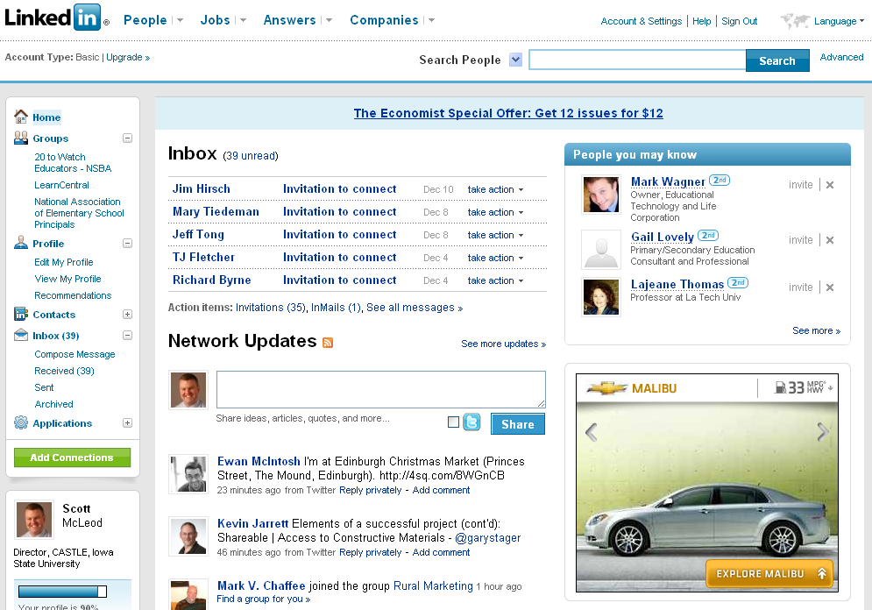

Slide 27


Slide 28
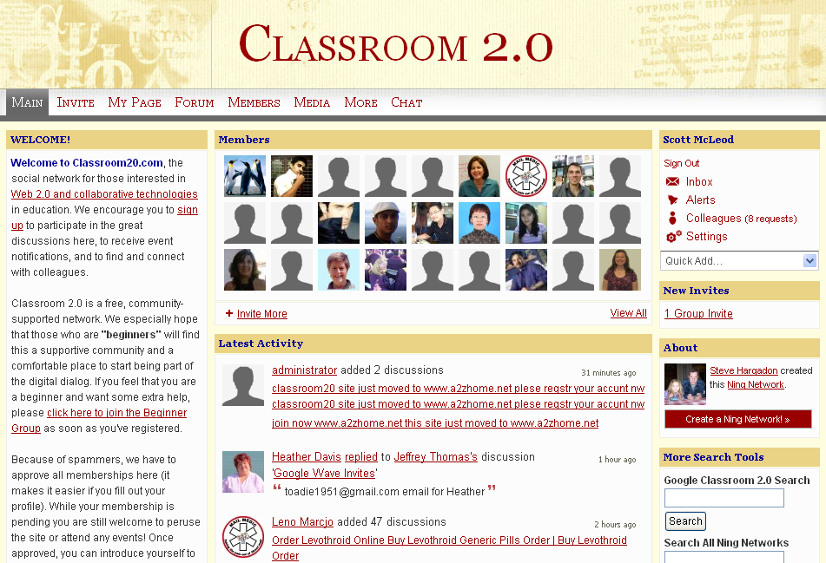

Slide 29


Slide 30


Slide 31
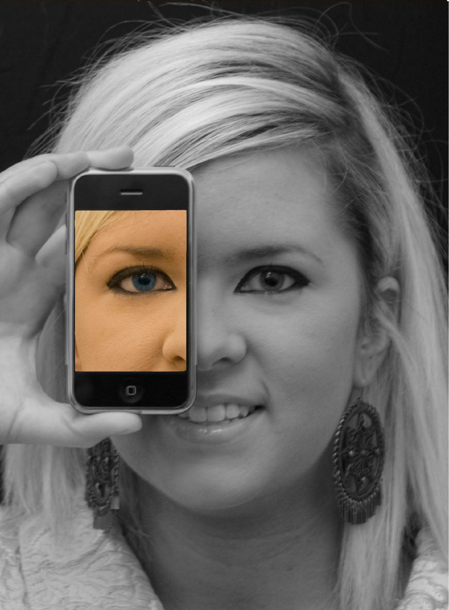

Slide 32
We all now have a voice
(and can find each other, share, connect, collaborate)

Slide 33
Anytime/anywhere content production, connection, collaboration…

Slide 34
[ pause ]

Slide 35

CHANGE
OR DIE

Slide 36
Lightning round

Slide 37
newspapers,
magazines

Slide 38
music

Slide 39
radio

Slide 40
television

Slide 41
movies

Slide 42
books,
reading

Slide 43
maps, travel,
travel agencies

Slide 44
business,
personal finance,
money management

Slide 45
medicine,
health

Slide 46
postal service

Slide 47
real estate

Slide 48
politics

Slide 49
universities

Slide 50
Information-oriented

Slide 51
P-12
schools

Slide 52
[ pause ]

Slide 53
Big shift 2

Slide 54
Percentile change in
importance of task type
in U.S. economy
Abstract
Routine
Manual
Autor, D., Levy, F., & Murnane, R. J. (2003). The skill content of recent technological change:
An empirical exploration. Quarterly Journal of Economics 188, 4. [updated, D. Autor, 2008]

Slide 55
global awareness
effective speaking
critical thinking
problem solving
adaptability
information literacy
collaboration
creativity
media fluency
analytical skills
entrepeneurialism
innovation
effective writing
synthesis
curiosity

Slide 56
Growth of the creative class
Florida, R. (2002). The rise of the creative class (p. 332). New York, NY: Basic Books.

Slide 57
Growth of the creative class
Florida, R. (2002). The rise of the creative class (p. 332). New York, NY: Basic Books.

Slide 58
MANUFACTURING IN IOWA
% of all Iowa jobs
in May ‘08
% of overall job losses
by Sep ‘09

Slide 59
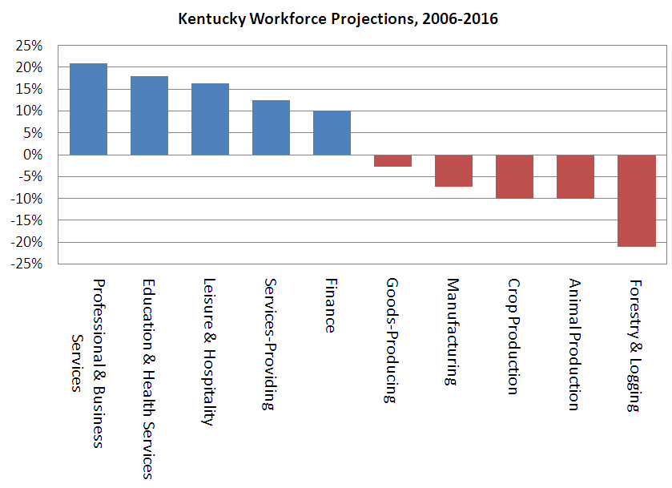

Slide 60
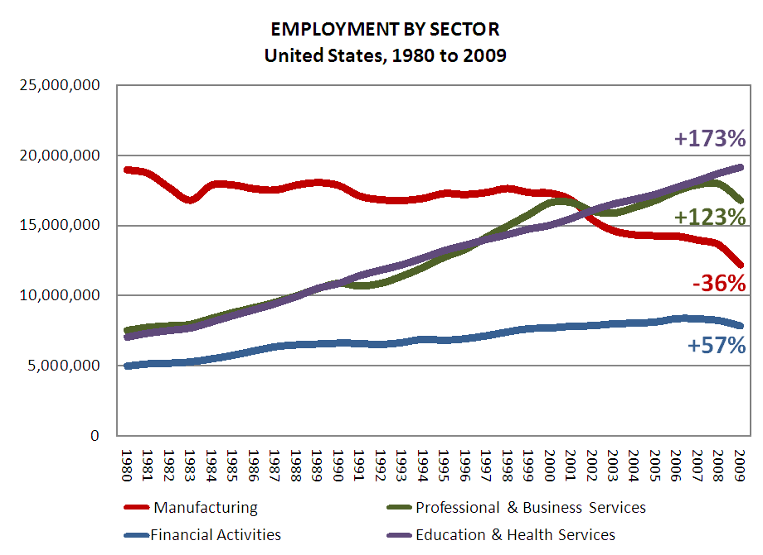

Slide 61
Globalization of economy

Slide 62
  Can someone overseas
  do it cheaper?
  Can a computer
  do it faster?

Slide 63
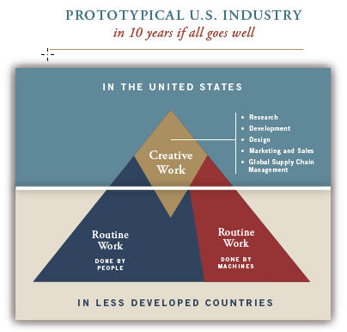

Slide 64
Hyperconnected global economy
Offshoring
Replacement of jobs with software

Slide 65
Characteristics of the job
NOT
Characteristics of the person

Slide 66
[ pause ]

Slide 67
1 big problem

Slide 68
  Socially functional
  Mastery of information landscape
  Economically productive

Slide 69

Notes:
69

Slide 70
The fundamental dilemma
but now are
expected to
do this
Schools were
designed
for this …

Slide 71
What we have right now
uniqueness
uniqueness
one right answer
Notes:
71

Slide 72
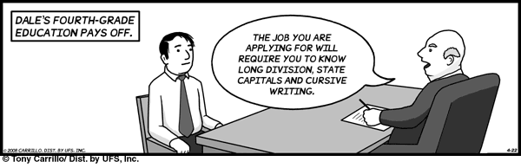
Notes:
THIS SLIDE IS COPYRIGHT-PROTECTED. I GOT SPECIAL PERMISSION FROM THE CARTOONIST, TONY CARRILLO, TO USE IT.
72

Slide 73
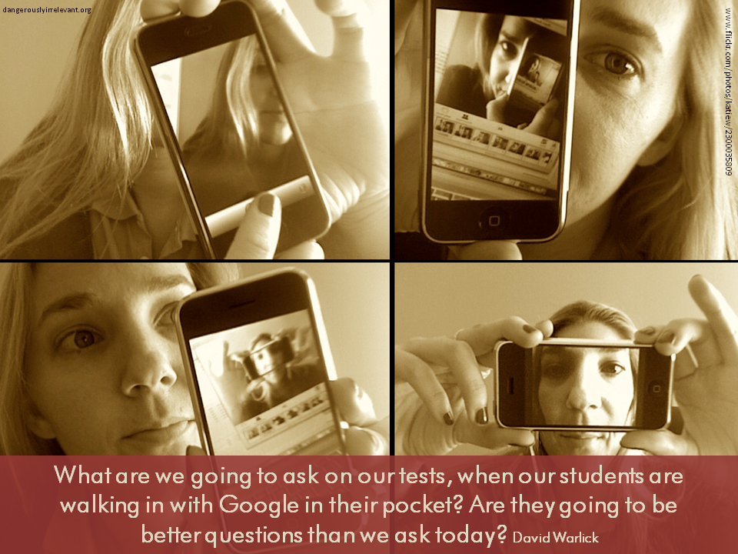

Slide 74

Notes:
74

Slide 75
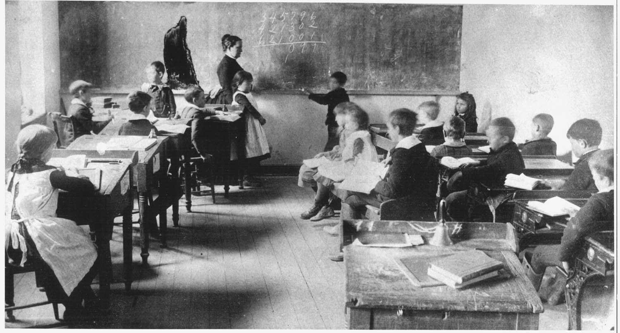
Notes:
75

Slide 76

No generation in history has ever been so
thoroughly prepared for the industrial age.
David Warlick
http://davidwarlick.com/2cents/?p=298
dangerouslyirrelevant.org

Slide 77


Slide 78
[ pause ]

Slide 79
Takeaways

Slide 80
K-12 education is facing multiple disruptive innovations.

Slide 81
The existing educational model is not a given.

Slide 82
This is sneaking up on most school organizations.

Slide 83
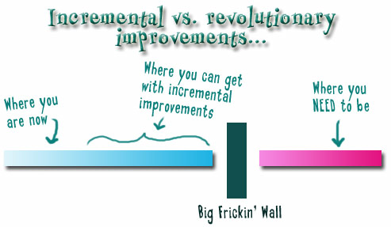
Notes:
We need to somehow
change faster
No one jumps a 20 foot chasm in two
10 foot jumps. – Miguel Guhlin
When the world changes so fast that we have no reasonable way to forecast what it will look like in a mere decade or two, all we can do is teach kids how to be adaptive – to be learners in the truest sense of the word –
We’ve always talked about preparing lifelong learners in schools, but our practices typically haven’t matched our rhetoric. It’s time to put some bite into our toothless vision statements and recognize that we have to teach kids how to learn to learn if they want to be successful in this new technology-suffused, globally-interconnected world
Credits: http://tinyurl.com/2urbsm and http://tinyurl.com/37em64 (see Guhlin comment)
http://remoteaccess.typepad.com/remote_access/
2006/06/literacy_as_bat.html (see Guhlin comment)
http://headrush.typepad.com/creating_passionate_users/2005/03/incremental_vs_.html

Slide 84
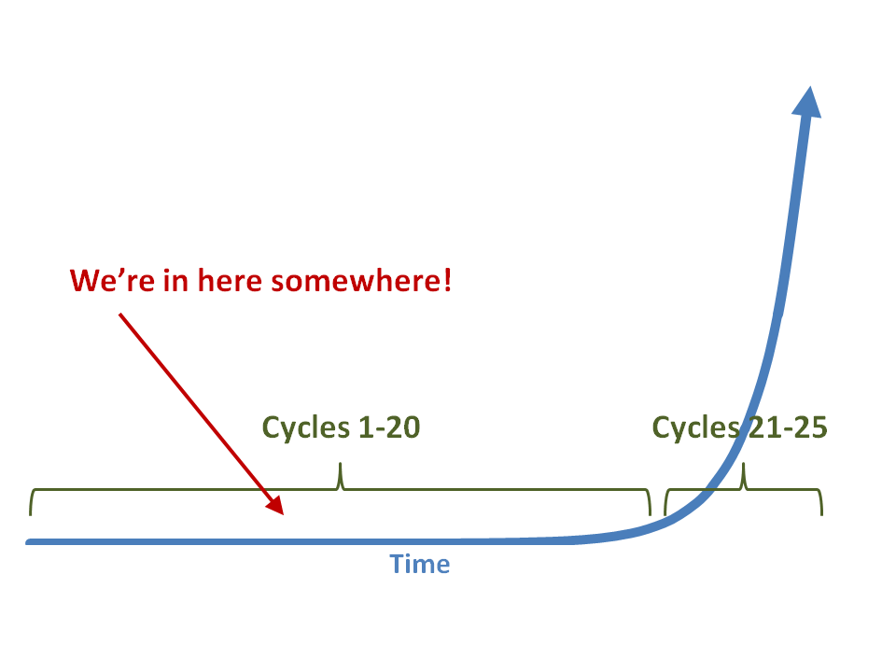

Slide 85
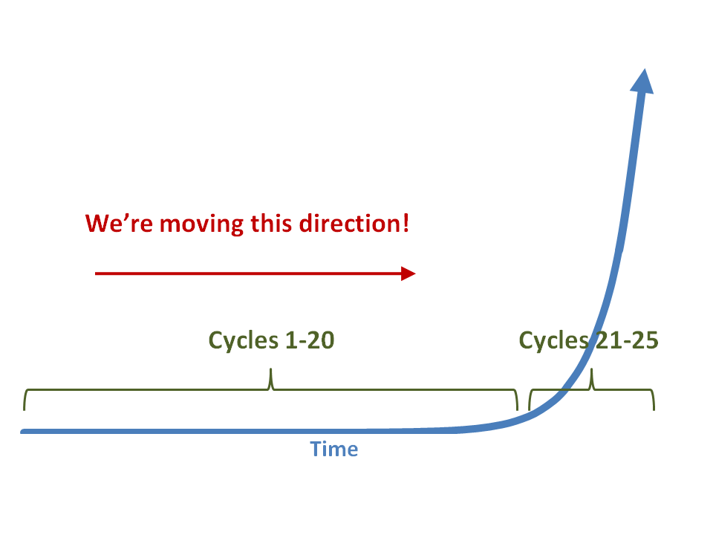

Slide 86
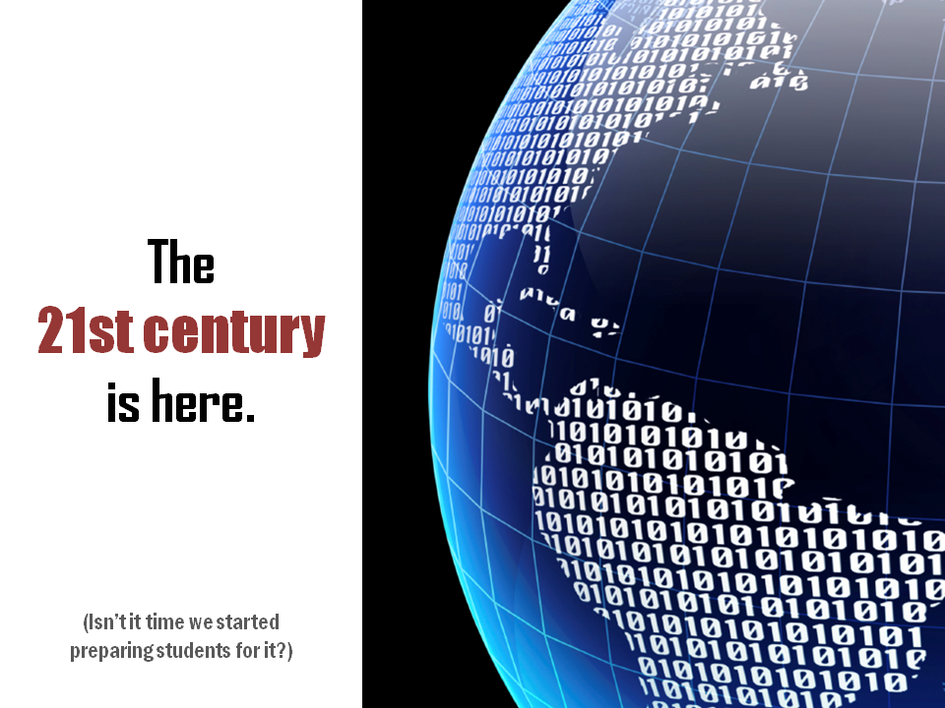

Slide 87
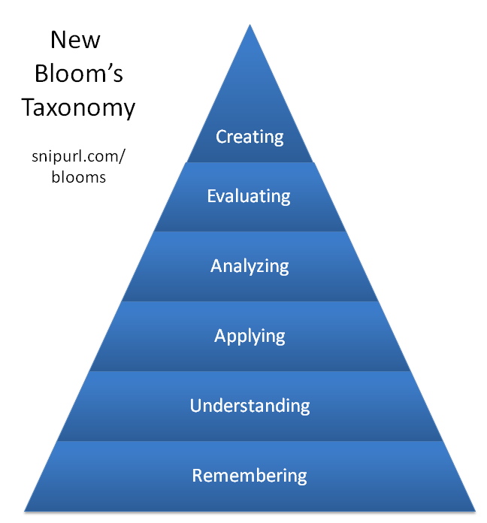

Slide 88


Slide 89

No one will thank you
for taking care of today
if you have failed
to take care of tomorrow.
Joel Barker

Slide 90
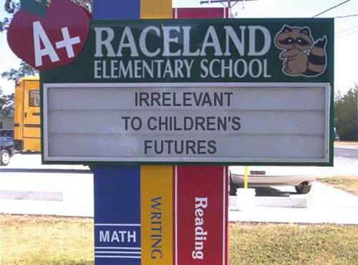
Notes:
90

Slide 91
Thank you!
Scott McLeod, J.D., Ph.D.
Director, CASTLE
dangerouslyirrelevant.org/adphila
Notes:
91
All of my materials are licensed under a Creative Commons attribution-share alike license (http://creativecommons.org/licenses/by-sa/3.0). That means not only that you are welcome to share and/or remix my content but that you are encouraged to do so! All I ask is that you properly credit me for my content and that you not place any greater copyright restrictions than I have on the content that utilizes my material. If possible, including the URL of Dangerously Irrelevant in your content would be most appreciated.
Scott McLeod, J.D., Ph.D.
dangerouslyirrelevant.org
schooltechleadership.org
dangerouslyirrelevant.org/contact.html

