Slide 1
Say hi to your neighbors!

Slide 2
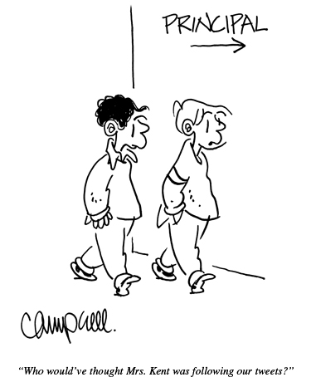
dangerouslyirrelevant.org/ belmondklemme

Slide 3

2 big shifts
and
1 big problem
Dr. Scott McLeod
CASTLE
Notes:
All of my materials are licensed under a Creative Commons attribution-share alike license (http://creativecommons.org/licenses/by-sa/3.0). That means not only that you are welcome to share and/or remix my content but that you are encouraged to do so! All I ask is that you properly credit me for my content and that you not place any greater copyright restrictions than I have on the content that utilizes my material. If possible, including the URL of Dangerously Irrelevant in your content would be most appreciated.
Scott McLeod, J.D., Ph.D.
dangerouslyirrelevant.org
schooltechleadership.org
dangerouslyirrelevant.org/contact.html

Slide 4
  Socially functional
  Mastery of information landscape
  Economically productive

Slide 5


Slide 6
Everything is moving to the Web

Slide 7
EVERYTHING is moving to the Web
(really)

Slide 8


Slide 9


Slide 10


Slide 11
Big shift 1

Slide 12
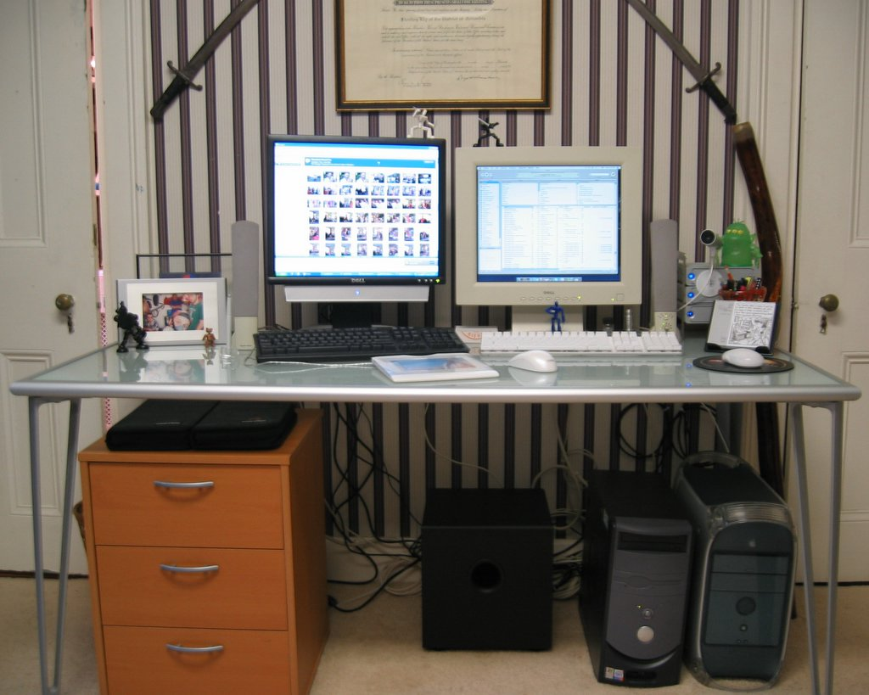

Slide 13


Slide 14


Slide 15
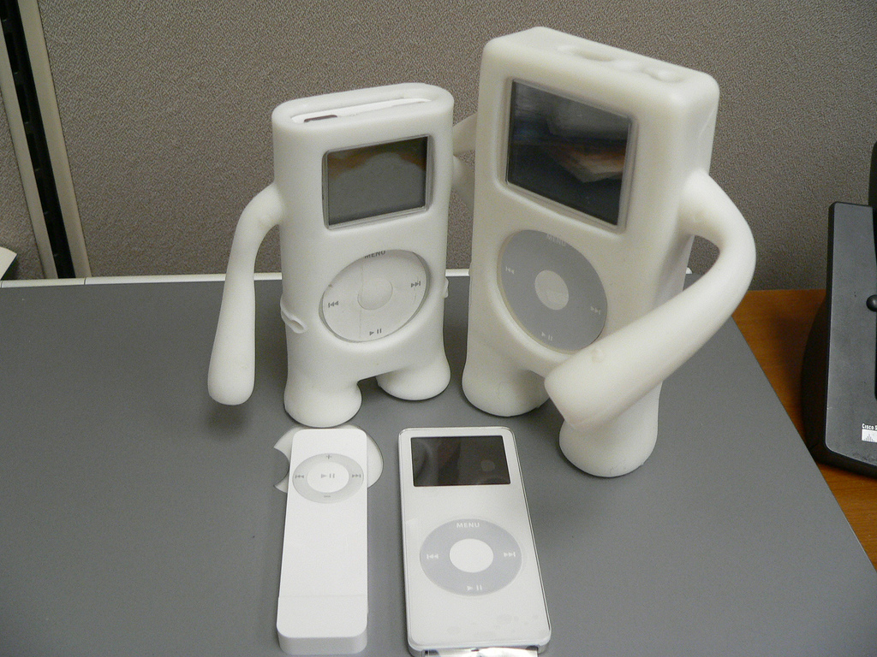

Slide 16
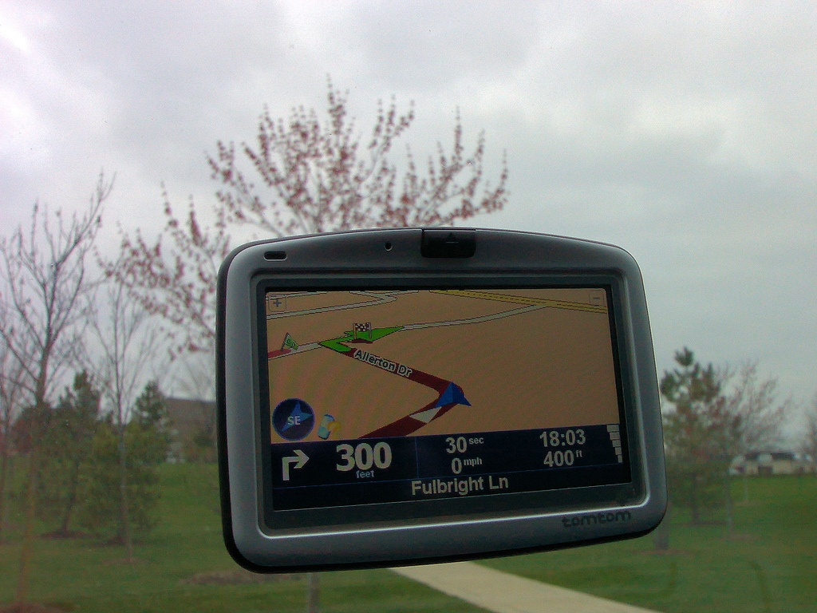

Slide 17
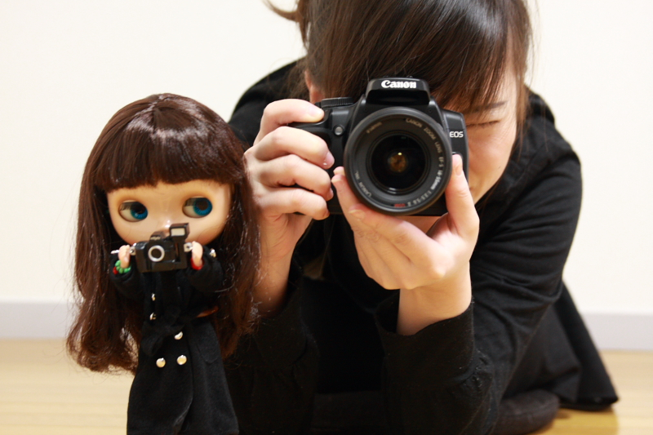

Slide 18
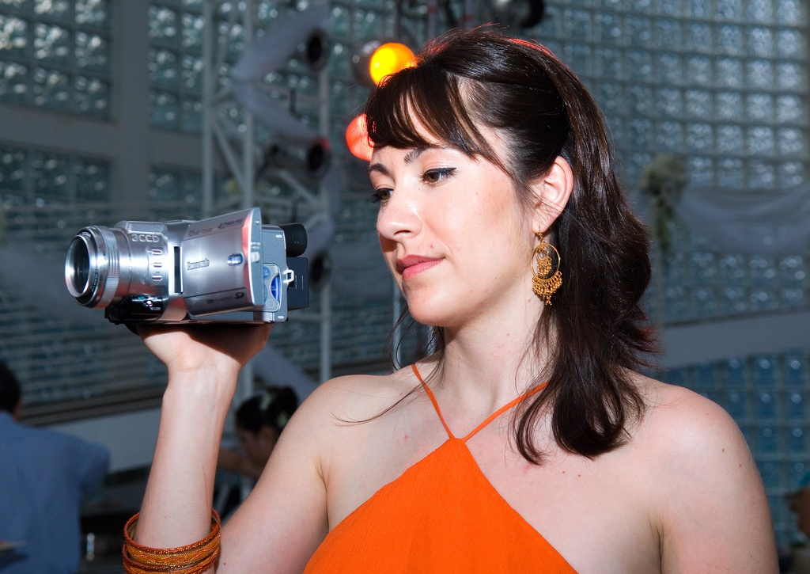

Slide 19
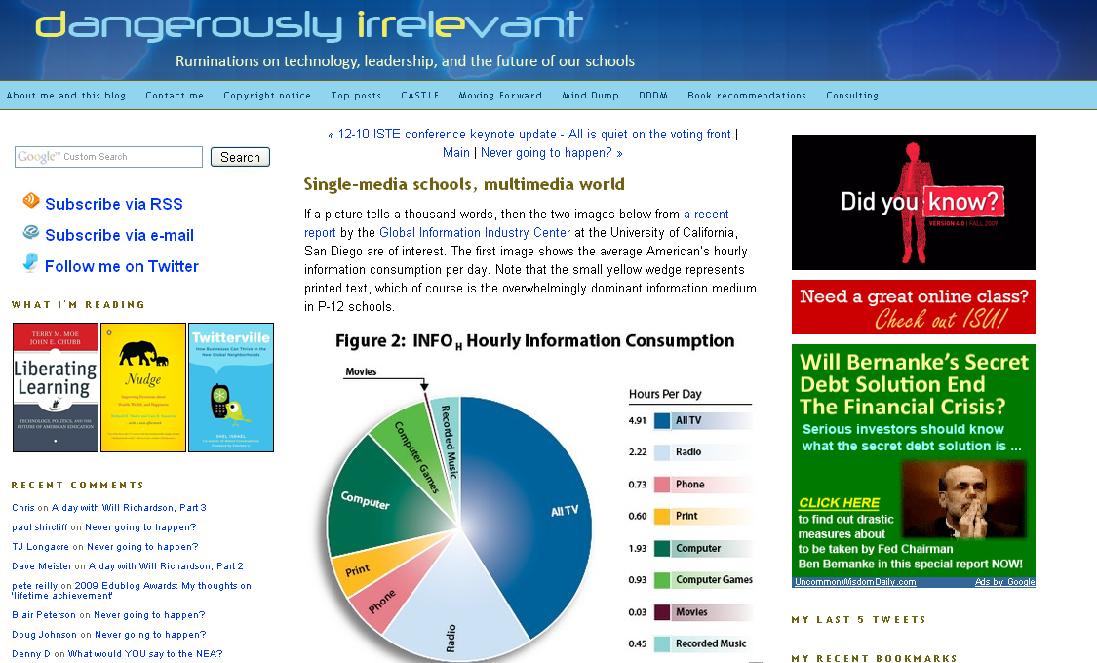

Slide 20
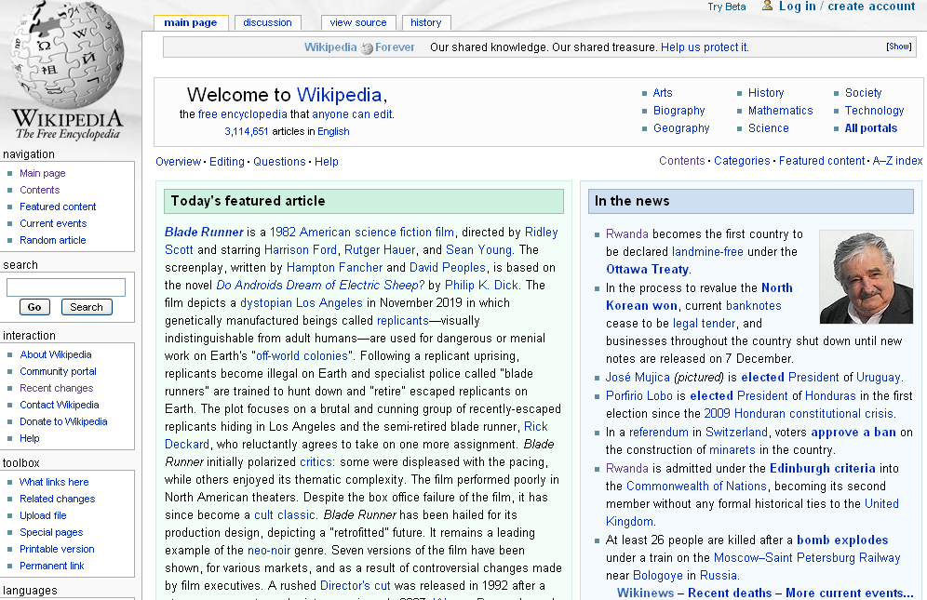

Slide 21
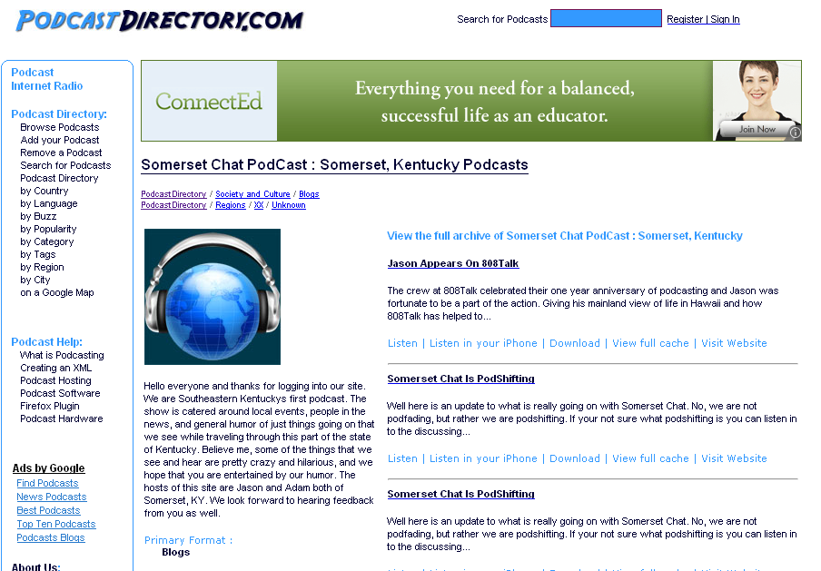

Slide 22
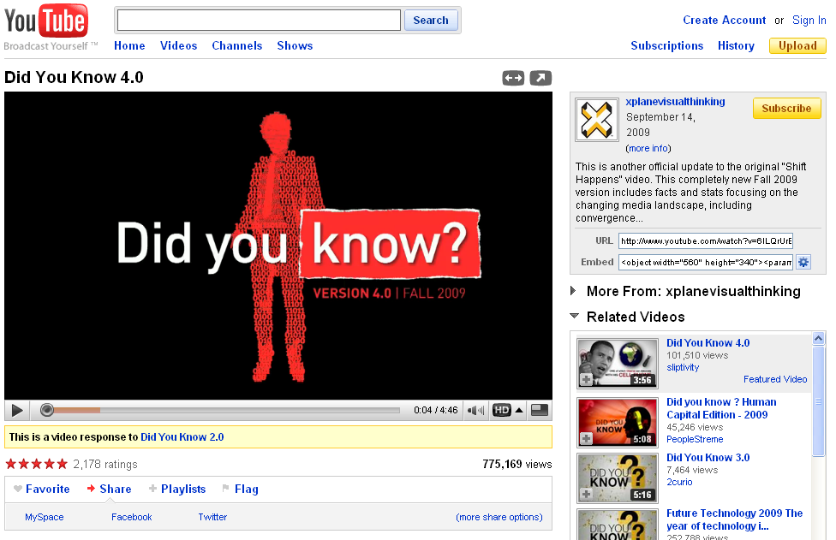

Slide 23
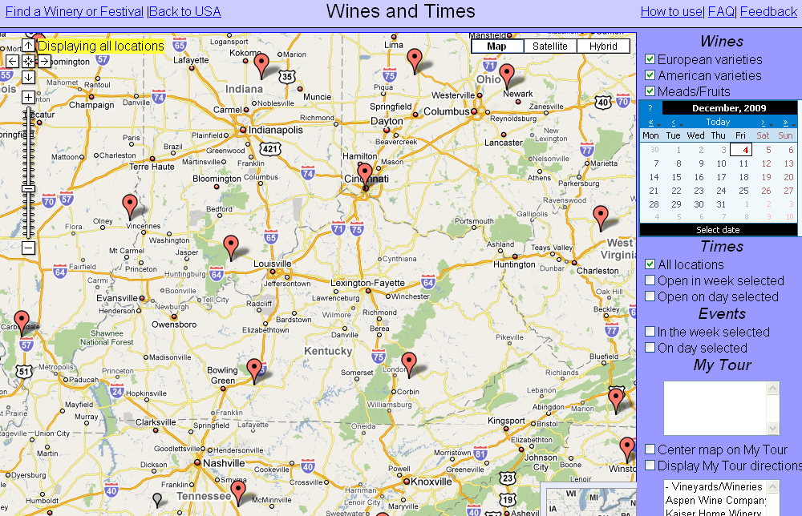

Slide 24
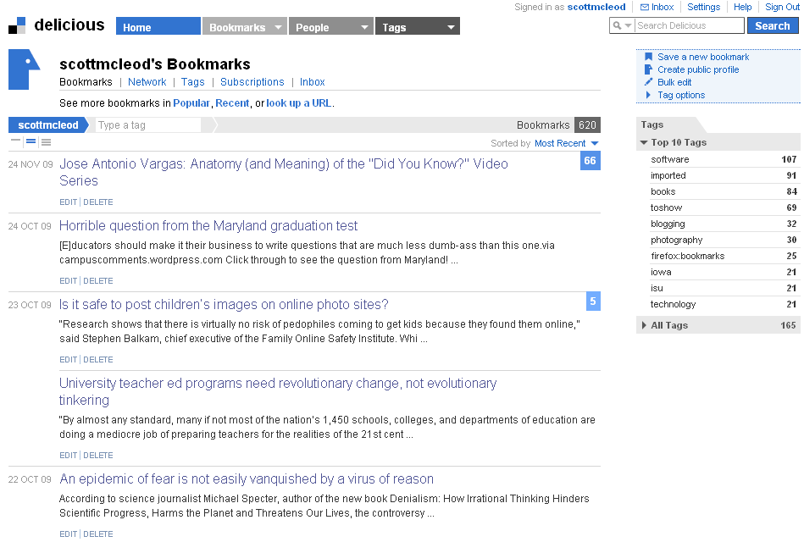

Slide 25
New information landscape

Slide 26
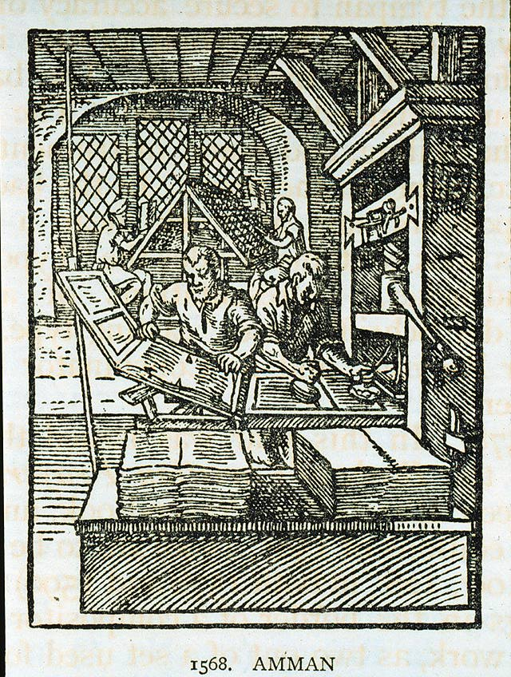

Slide 27


Slide 28
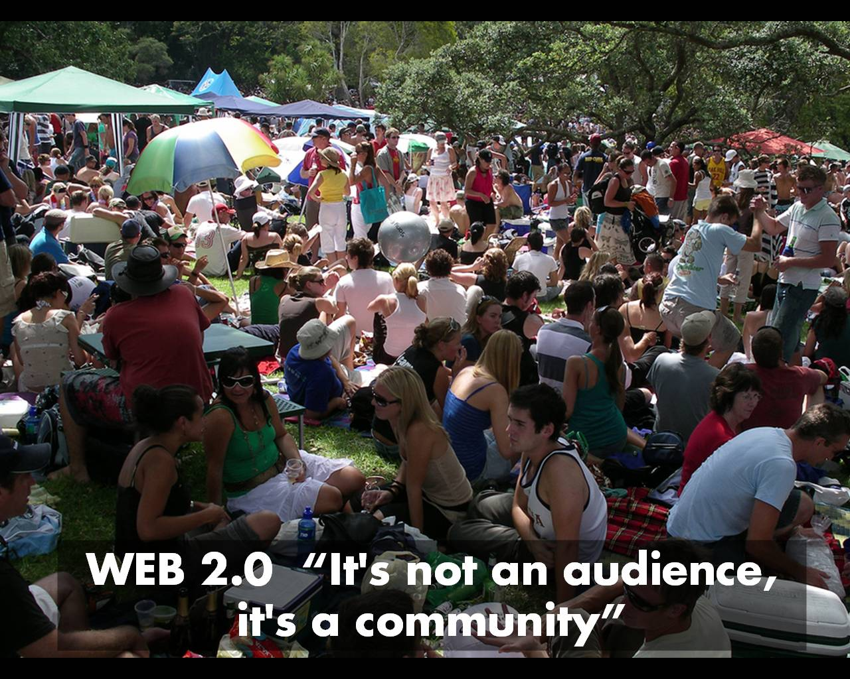

Slide 29
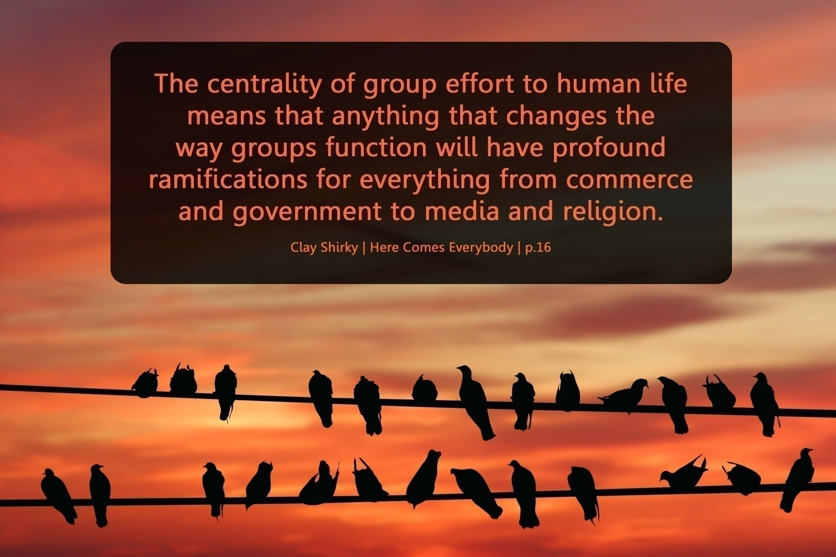

Slide 30
We are hyper-connected

Slide 31



Slide 32
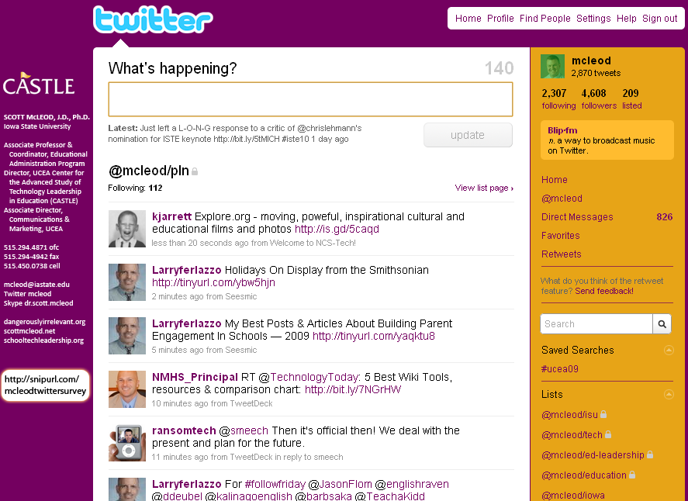

Slide 33
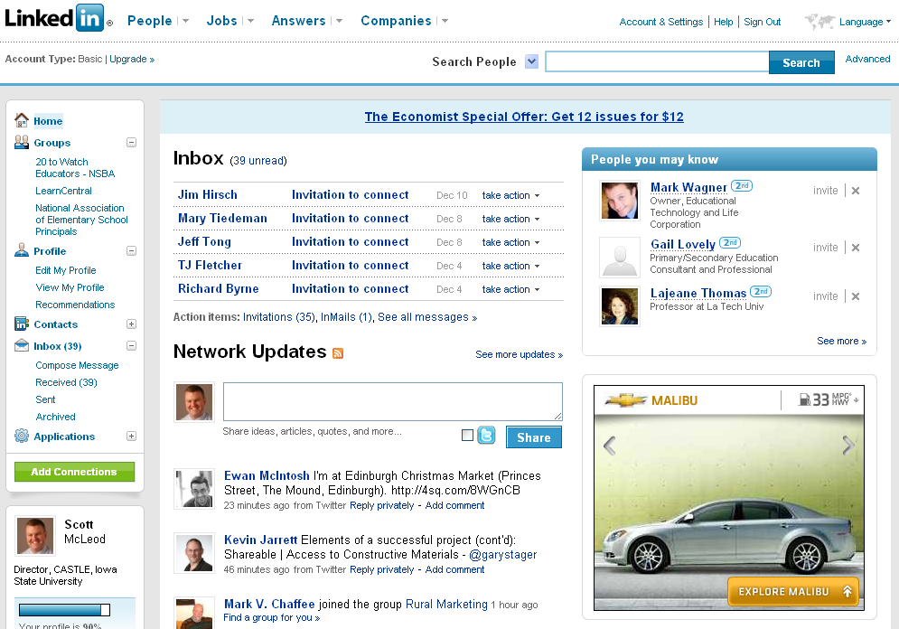

Slide 34


Slide 35
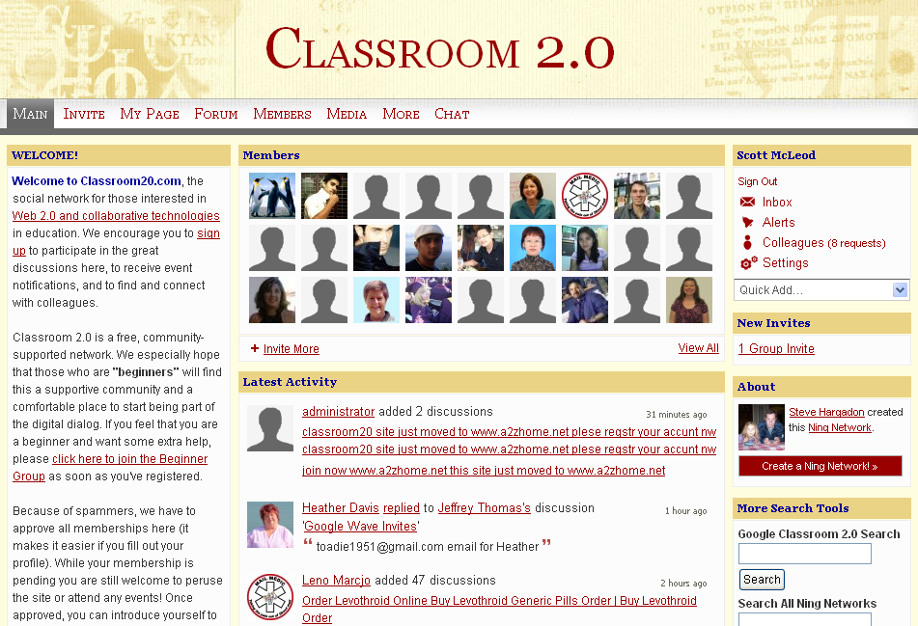

Slide 36


Slide 37


Slide 38


Slide 39
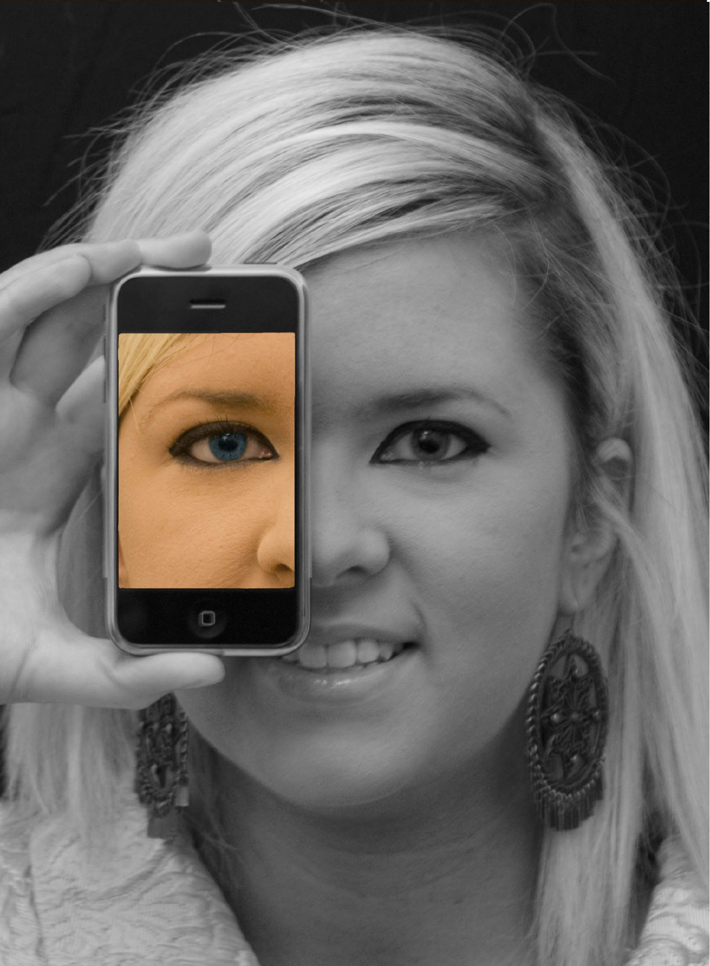

Slide 40
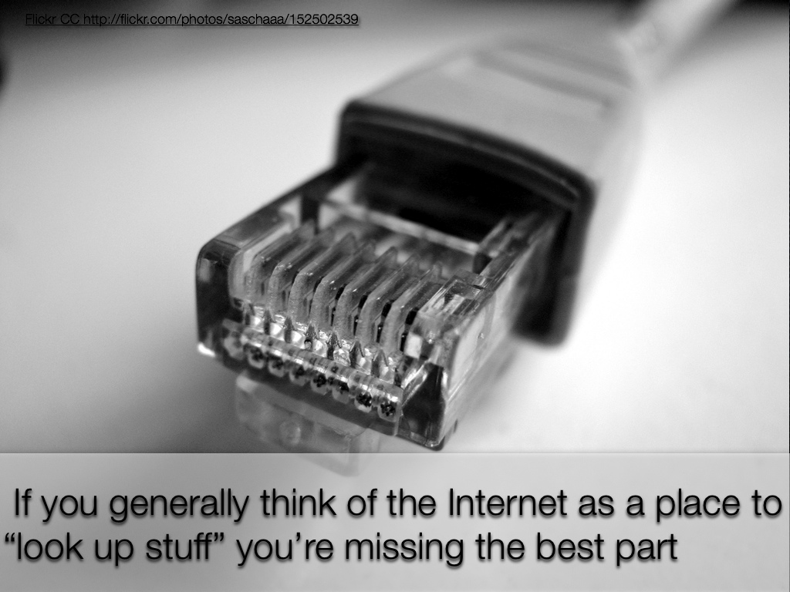

Slide 41
We all now have a voice
(and can find each other, share, connect, collaborate)

Slide 42
Anytime/anywhere content production, connection, collaboration…

Slide 43
[ pause ]

Slide 44

CHANGE
OR DIE

Slide 45
Lightning round

Slide 46
newspapers,
magazines

Slide 47
music

Slide 48
radio

Slide 49
television

Slide 50
movies

Slide 51
books,
reading

Slide 52
maps, travel,
travel agencies

Slide 53
business,
personal finance,
money management

Slide 54
medicine,
health

Slide 55
postal service

Slide 56
real estate

Slide 57
politics

Slide 58
universities

Slide 59
Information-oriented

Slide 60
P-12
schools

Slide 61
[ pause ]

Slide 62
Big shift 2

Slide 63
Percentile change in
importance of task type
in U.S. economy
Abstract
Routine
Manual
Autor, D., Levy, F., & Murnane, R. J. (2003). The skill content of recent technological change:
An empirical exploration. Quarterly Journal of Economics 188, 4. [updated, D. Autor, 2008]

Slide 64
global awareness
effective speaking
critical thinking
problem solving
adaptability
information literacy
collaboration
creativity
media fluency
analytical skills
entrepeneurialism
innovation
effective writing
synthesis
curiosity

Slide 65
Growth of the creative class
Florida, R. (2002). The rise of the creative class (p. 332). New York, NY: Basic Books.

Slide 66
Growth of the creative class
Florida, R. (2002). The rise of the creative class (p. 332). New York, NY: Basic Books.

Slide 67
MANUFACTURING IN IOWA
% of all Iowa jobs
in May ‘08
% of overall job losses
by Sep ‘09

Slide 68
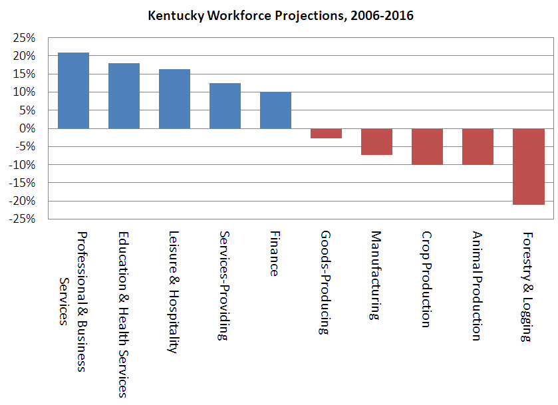

Slide 69
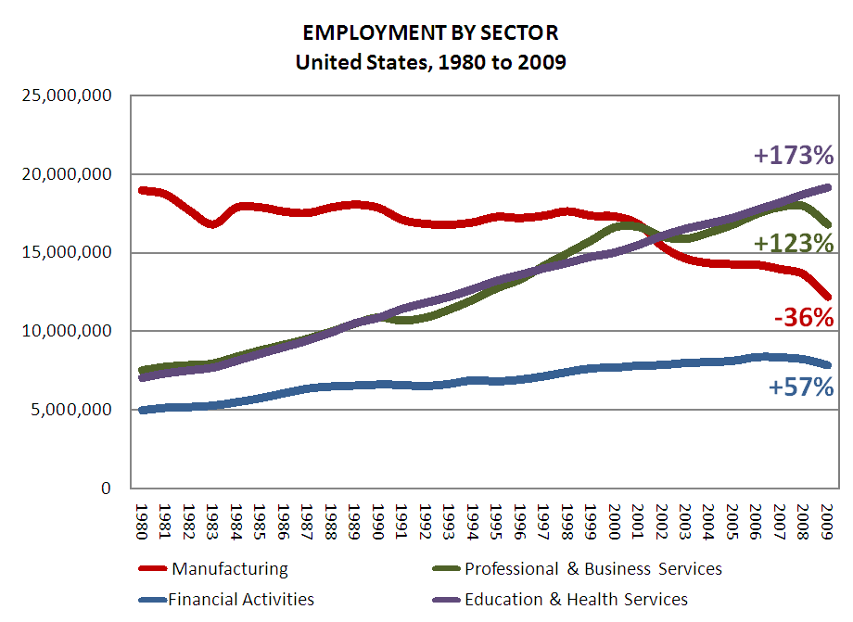

Slide 70
Globalization of economy

Slide 71
  Can someone overseas
  do it cheaper?
  Can a computer
  do it faster?

Slide 72


Slide 73
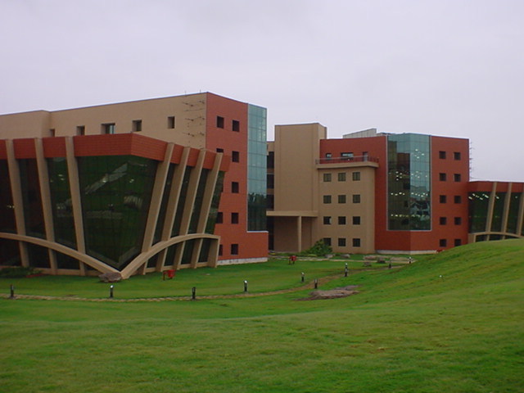

Slide 74
2.5 billion

Slide 75
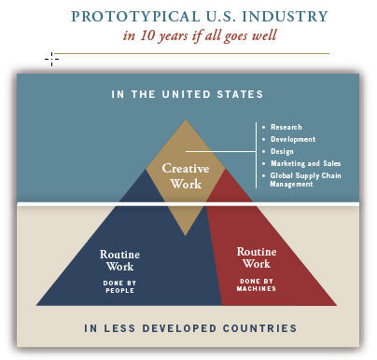

Slide 76
Hyperconnected global economy
Offshoring
Replacement of jobs with software

Slide 77
Characteristics of the job
NOT
Characteristics of the person

Slide 78
[ pause ]

Slide 79
1 big problem

Slide 80
  Socially functional
  Mastery of information landscape
  Economically productive

Slide 81

Notes:
81

Slide 82
The fundamental dilemma
but now are
expected to
do this
Schools were
designed
for this …

Slide 83
What we have right now
uniqueness
uniqueness
one right answer
Notes:
83

Slide 84
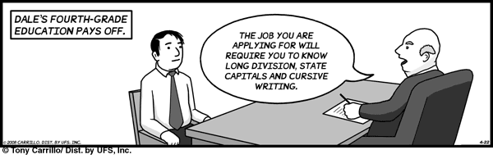
Notes:
THIS SLIDE IS COPYRIGHT-PROTECTED. I GOT SPECIAL PERMISSION FROM THE CARTOONIST, TONY CARRILLO, TO USE IT.
84

Slide 85
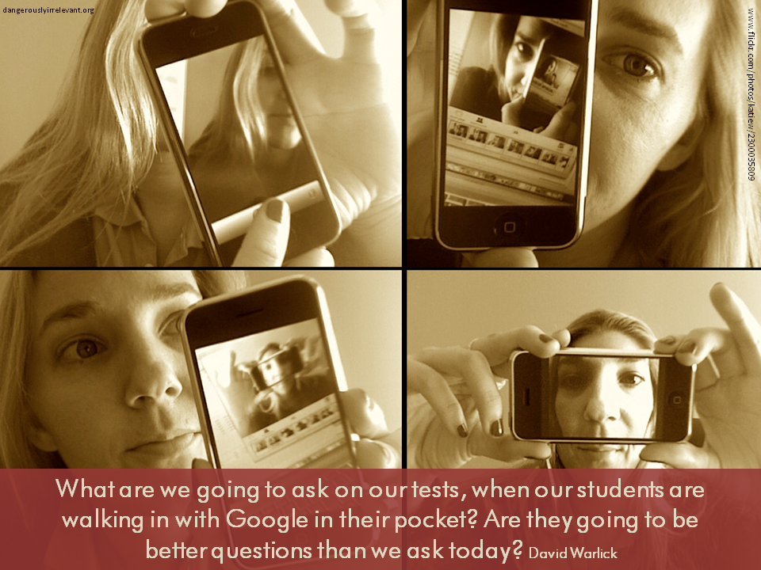

Slide 86

Notes:
86

Slide 87
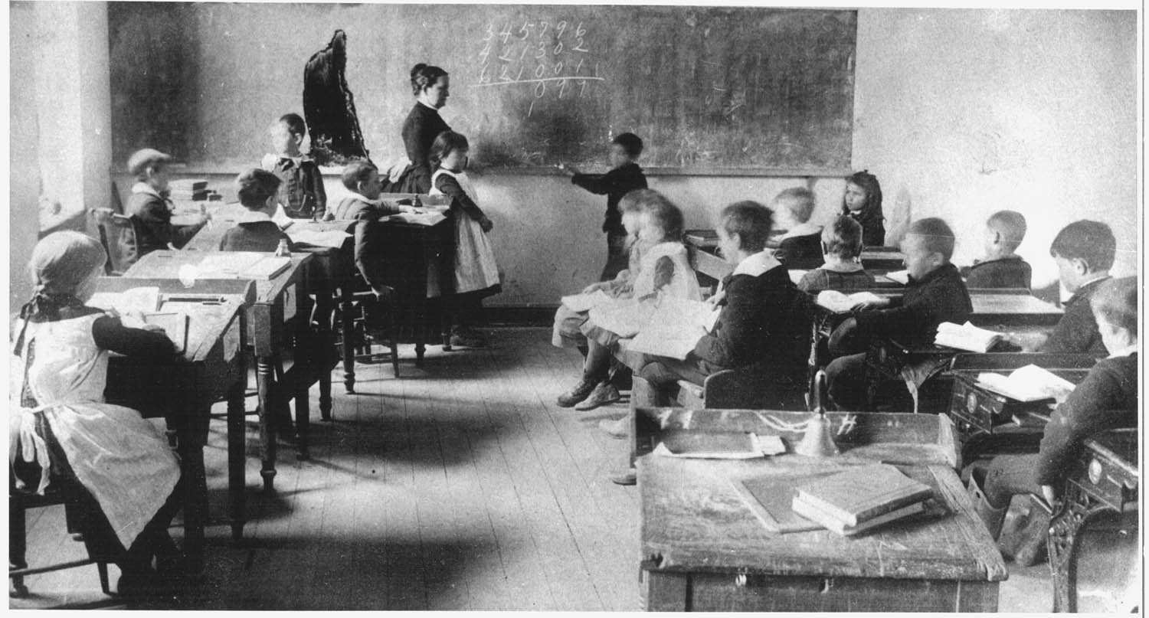
Notes:
87

Slide 88
The average fifth grader received five times as much instruction in basic skills as instruction focused on problem solving or reasoning; this ratio was 10:1 in first and third grades.
Robert C. Pianta, et al., Opportunities to Learn in America’s Elementary Classrooms (2007)
[study of 2500+ classrooms in more than 1,000 elementary schools and 400 school districts]

Slide 89
Classrooms in which there was evidence of higher-order thinking: 3 percent.
Classrooms in which high-yield [instructional] strategies were being used: 0.2 percent. Classrooms in which fewer than one-half of students were paying attention: 85 percent.
Mike Schmoker, Results Now (2006) [citing a study of 1,500+ classroom observations]

Slide 90
When you code classroom practice for level of cognitive demand . . . 80% of the work is at the factual and procedural level. . . . [Teachers] will do low-level work and call it high-level work.
Richard Elmore, excerpt from Education Leadership as the Practice of Improvement (2006)

Slide 91
The data from our observations in more than 1,000 classrooms support the popular image of a teacher standing or sitting in front of a class imparting knowledge to a group of students. Explaining and lecturing constituted the most frequent teaching activities …
Teachers also spent a substantial amount of time observing students at work or monitoring their seat-work …
Three categories of student activity marked by passivity - written work, listening, and preparing for assignments - dominate … The chances are better than 50–50 that if you were to walk into any of the classrooms of our sample, you would see one of these three activities under way … All three activities are almost exclusively set and monitored by teachers. We saw a contrastingly low incidence of activities invoking active modes of learning.
John Goodlad, A Place Called School (1984)

Slide 92
What students do in the classroom is what they learn (as Dewey would say) . . . Now, what is it that students do in the classroom? Well, mostly, they sit and listen to the teacher. . . . Mostly, they are required to remember. . . . It is practically unheard of for students to play any role in determining what problems are worth studying or what procedures of inquiry ought to be used. . . . Here is the point: Once you have learned how to ask questions – relevant and appropriate and substantial questions – you have learned how to learn and no one can keep you from learning whatever you want or need to know . . . [However,] what students are restricted to (solely and even vengefully) is the process of memorizing . . . somebody else’s answers to somebody else’s questions. It is staggering to consider the implications of this fact. The most important intellectual ability man has yet developed – the art and science of asking questions – is not taught in school! Moreover, it is not “taught” in the most devastating way possible: by arranging the environment so that significant question asking is not valued. It is doubtful if you can think of many schools that include question-asking, or methods of inquiry, as part of their curriculum.
Neil Postman & Charles Weingartner, Teaching as a Subversive Activity (1969)

Slide 93
The chief source of the “problem of discipline” in schools is that … a premium is put on physical quietude; on silence, on rigid uniformity of posture and movement; upon a machine-like simulation of the attitudes of intelligent interest. The teachers’ business is to hold the pupils up to these requirements and to punish the inevitable deviations which occur.
John Dewey, Democracy and Education (1916)

Slide 94

Notes:
For the past five years, the national conversation on education has focused on reading scores, math tests and closing the "achievement gap" between social classes. This is not a story about that conversation.
This is a story about the big public conversation the nation is not having about education, the one that will ultimately determine not merely whether some fraction of our children get "left behind" but also whether an entire generation of kids will fail to make the grade in the global economy because they can't think their way through abstract problems, work in teams, distinguish good information from bad or speak a language other than English.

Slide 95

While we teach whatever we teach at school, the kids go home and learn the skills they need to survive and prosper in an interconnected global economy.
Clarence Fisher
Notes:
As a result…
http://remoteaccess.typepad.com/remote_access/2005/11/educational_lea.html
Incrementally changing our teaching methods, slowly bringing people up to speed . . . worked fine when ideas of literacy and education were not rapidly changing; but they are. We need to be able to leapfrog in our understandings, in our methods, and in our tools, allowing us to move to where the kids are. If we do not become leaders to our students, we will be followers, seen as irrelevant, and left to cry in our books.

Slide 96

No generation in history has ever been so
thoroughly prepared for the industrial age.
David Warlick
http://davidwarlick.com/2cents/?p=298
dangerouslyirrelevant.org

Slide 97


Slide 98
[ pause ]

Slide 99
Takeaways

Slide 100
K-12 education is facing multiple disruptive innovations.

Slide 101
The existing educational model is not a given.

Slide 102
This is sneaking up on most school organizations.

Slide 103
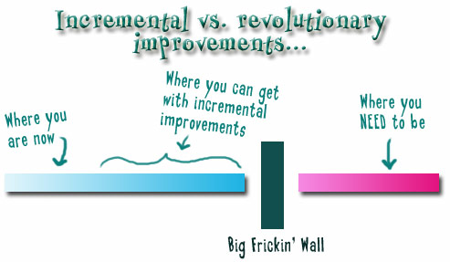
Notes:
We need to somehow
change faster
No one jumps a 20 foot chasm in two
10 foot jumps. – Miguel Guhlin
When the world changes so fast that we have no reasonable way to forecast what it will look like in a mere decade or two, all we can do is teach kids how to be adaptive – to be learners in the truest sense of the word –
We’ve always talked about preparing lifelong learners in schools, but our practices typically haven’t matched our rhetoric. It’s time to put some bite into our toothless vision statements and recognize that we have to teach kids how to learn to learn if they want to be successful in this new technology-suffused, globally-interconnected world
Credits: http://tinyurl.com/2urbsm and http://tinyurl.com/37em64 (see Guhlin comment)
http://remoteaccess.typepad.com/remote_access/
2006/06/literacy_as_bat.html (see Guhlin comment)
http://headrush.typepad.com/creating_passionate_users/2005/03/incremental_vs_.html

Slide 104
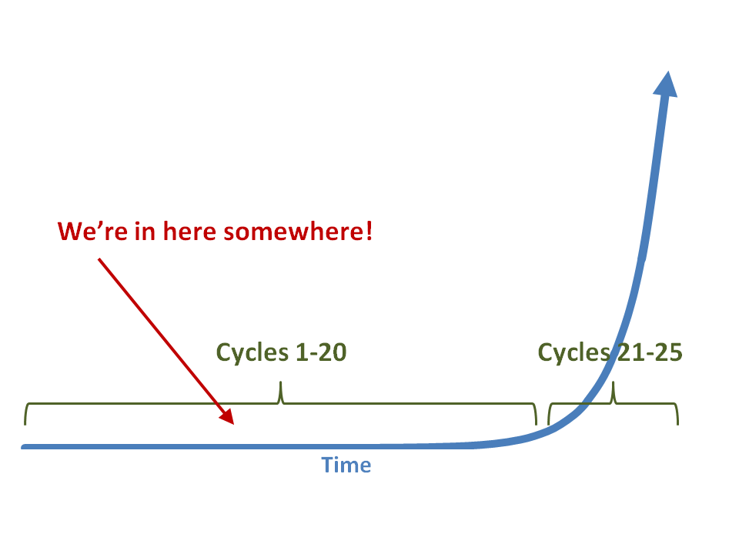

Slide 105
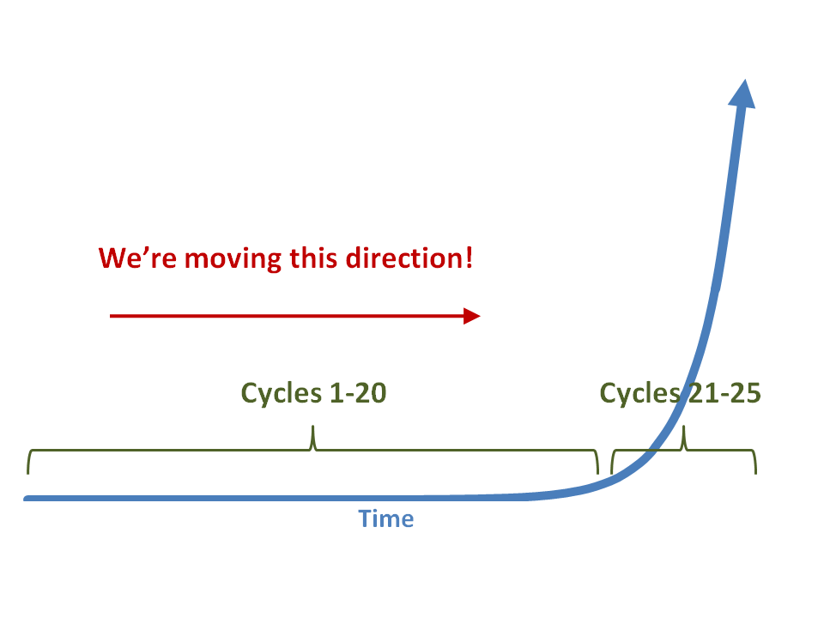

Slide 106


Slide 107
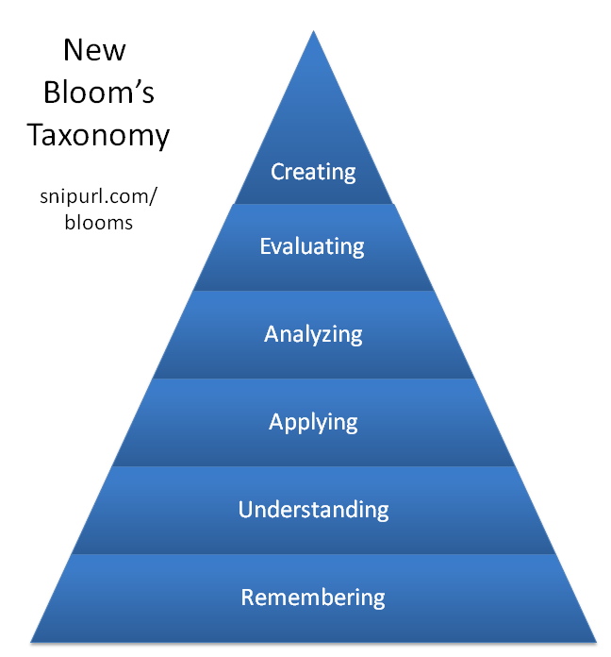

Slide 108


Slide 109
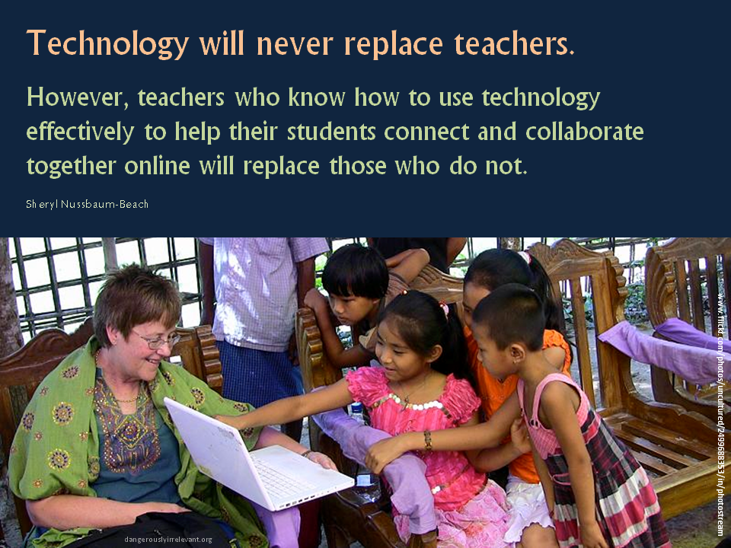

Slide 110
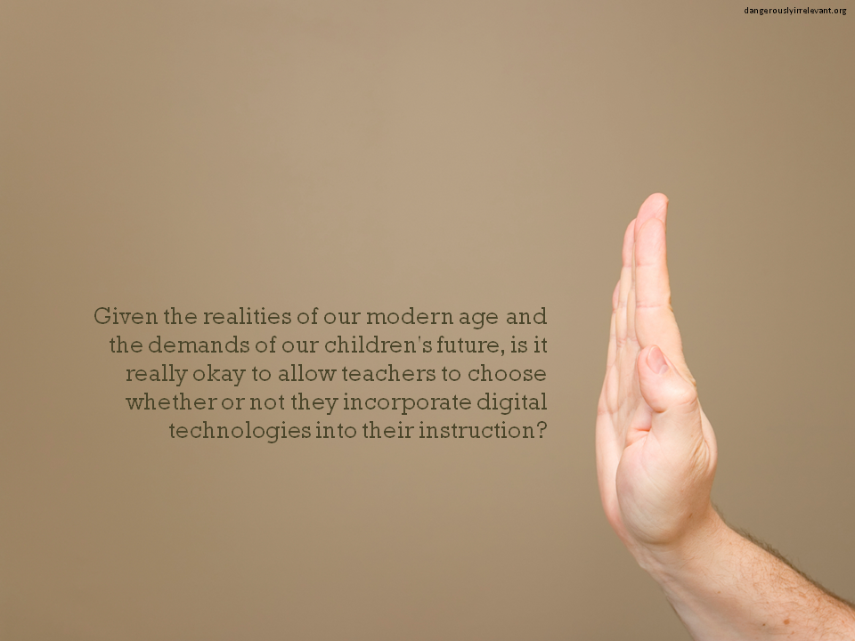

Slide 111

Notes:
Anticipatory v. reactionary

Slide 112

Notes:
Future oriented v. compliance oriented

Slide 113

The people in charge
of leading school
organizations into the
21st century …
often are the
least knowledgeable
about the 21st century.
dangerouslyirrelevant.org
Notes:
Licensed under a Creative Commons attribution-share alike license.
http://creativecommons.org/licenses/by-sa/3.0
Scott McLeod, J.D., Ph.D.
scottmcleod.net/contact
dangerouslyirrelevant.org
schooltechleadership.org

Slide 114

If the leaders
don’t get it,
it’s not going
to happen.
dangerouslyirrelevant.org
Notes:
Licensed under a Creative Commons attribution-share alike license.
http://creativecommons.org/licenses/by-sa/3.0
Scott McLeod, J.D., Ph.D.
scottmcleod.net/contact
dangerouslyirrelevant.org
schooltechleadership.org

Slide 115


Slide 116
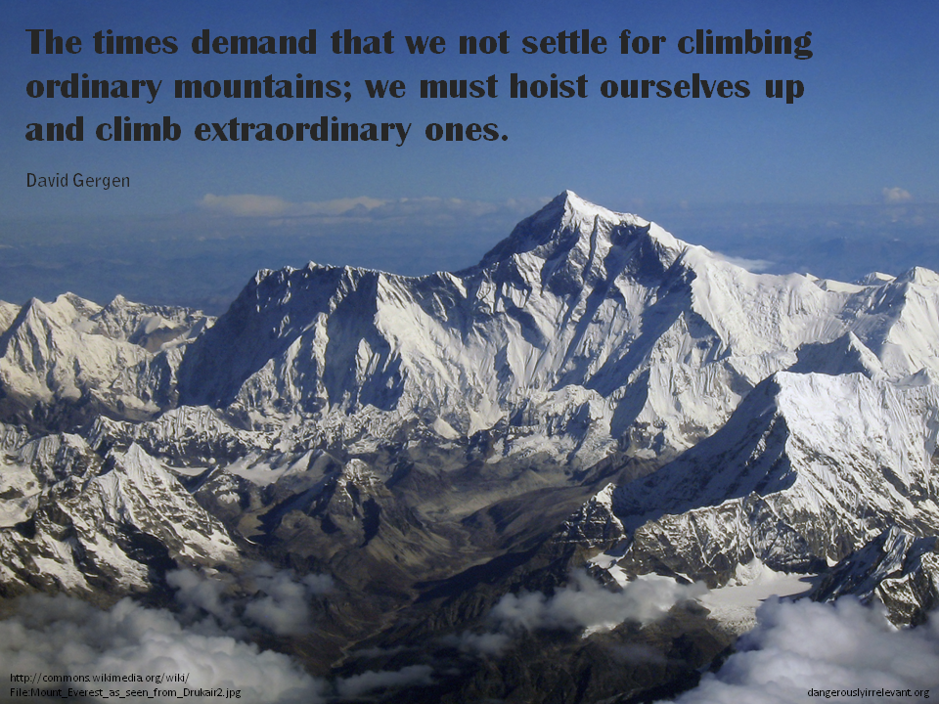

Slide 117

No one will thank you
for taking care of today
if you have failed
to take care of tomorrow.
Joel Barker

Slide 118
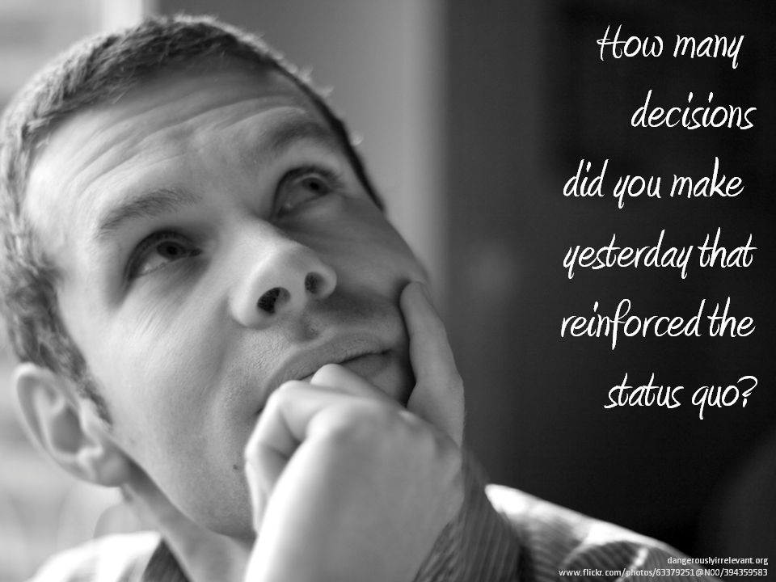

Slide 119
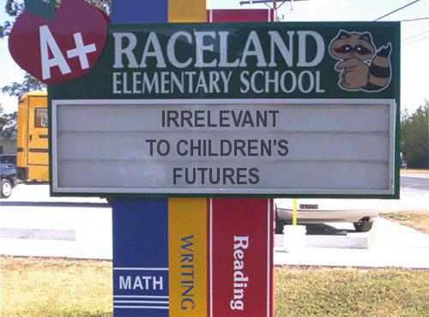
Notes:
119

Slide 120
Thank you!
Scott McLeod, J.D., Ph.D.
Director, CASTLE
dangerouslyirrelevant.org/belmondklemme
Notes:
120
All of my materials are licensed under a Creative Commons attribution-share alike license (http://creativecommons.org/licenses/by-sa/3.0). That means not only that you are welcome to share and/or remix my content but that you are encouraged to do so! All I ask is that you properly credit me for my content and that you not place any greater copyright restrictions than I have on the content that utilizes my material. If possible, including the URL of Dangerously Irrelevant in your content would be most appreciated.
Scott McLeod, J.D., Ph.D.
dangerouslyirrelevant.org
schooltechleadership.org
dangerouslyirrelevant.org/contact.html

