Slide 1

2 big shifts
and
1 big problem
Dr. Scott McLeod
CASTLE
Notes:
All of my materials are licensed under a Creative Commons attribution-share alike license (http://creativecommons.org/licenses/by-sa/3.0). That means not only that you are welcome to share and/or remix my content but that you are encouraged to do so! All I ask is that you properly credit me for my content and that you not place any greater copyright restrictions than I have on the content that utilizes my material. If possible, including the URL of Dangerously Irrelevant in your content would be most appreciated.
Scott McLeod, J.D., Ph.D.
dangerouslyirrelevant.org
schooltechleadership.org
dangerouslyirrelevant.org/contact.html

Slide 2
  Socially functional
  Mastery of information landscape
  Economically productive

Slide 3
Big shift 1

Slide 4
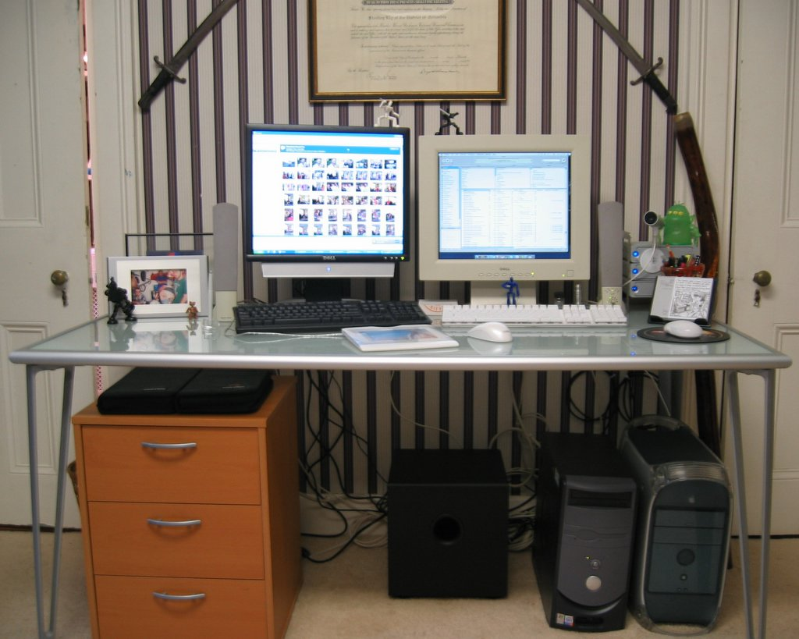

Slide 5


Slide 6


Slide 7
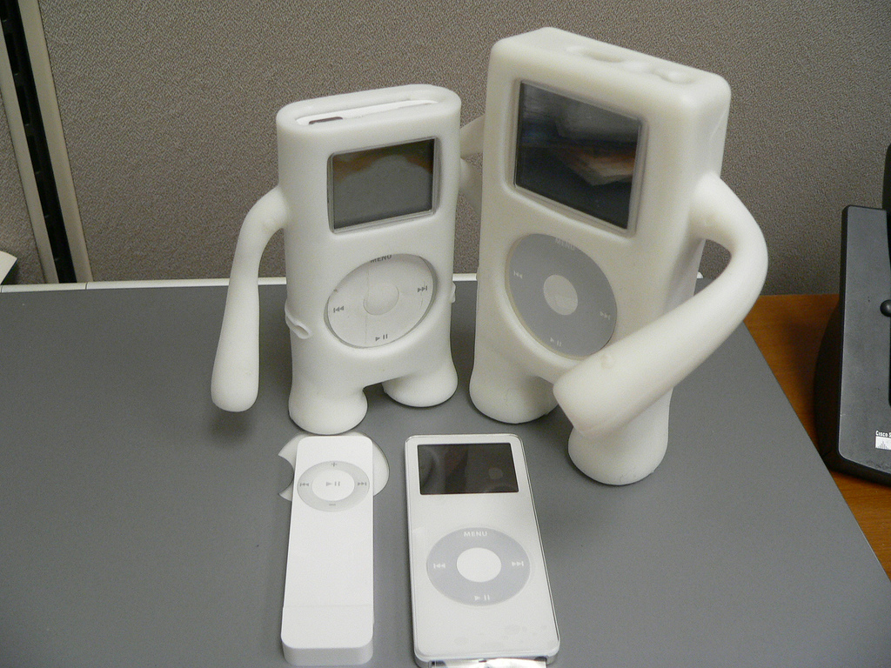

Slide 8
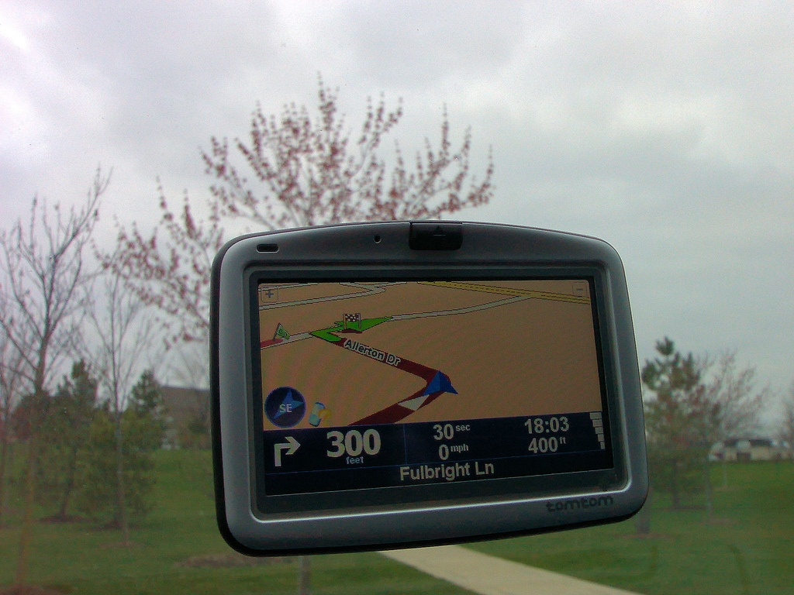

Slide 9
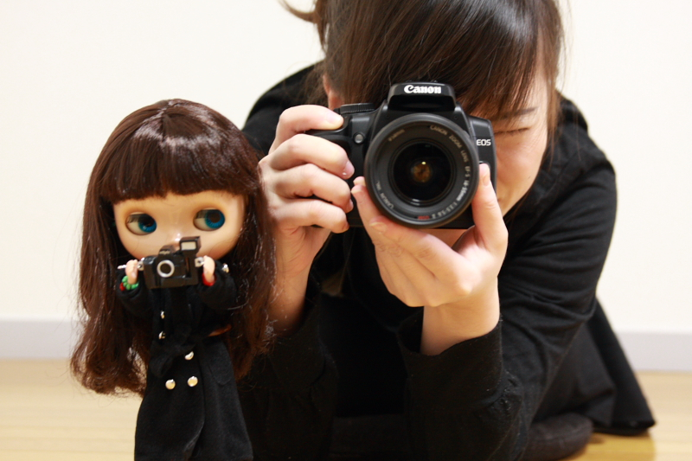

Slide 10
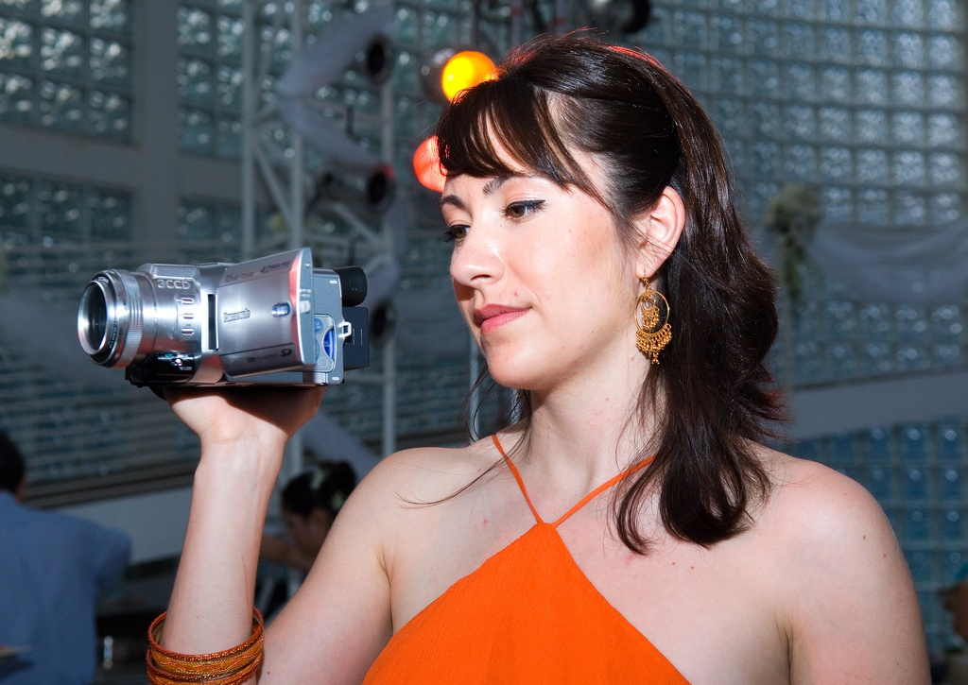

Slide 11
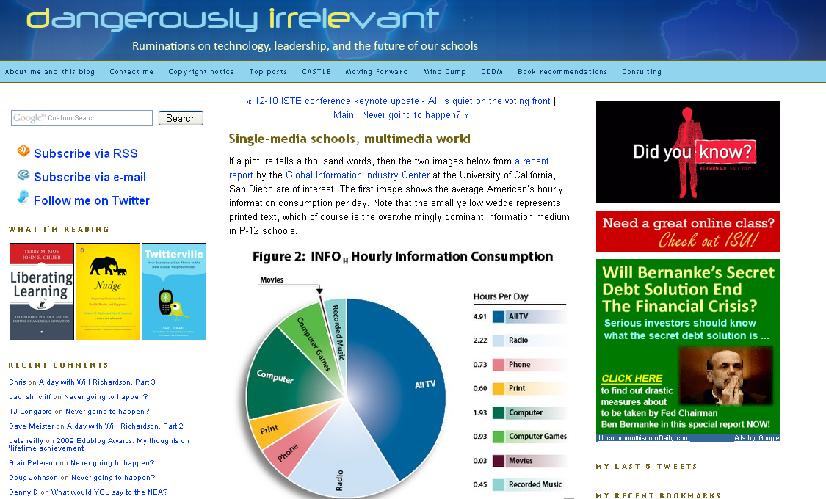

Slide 12
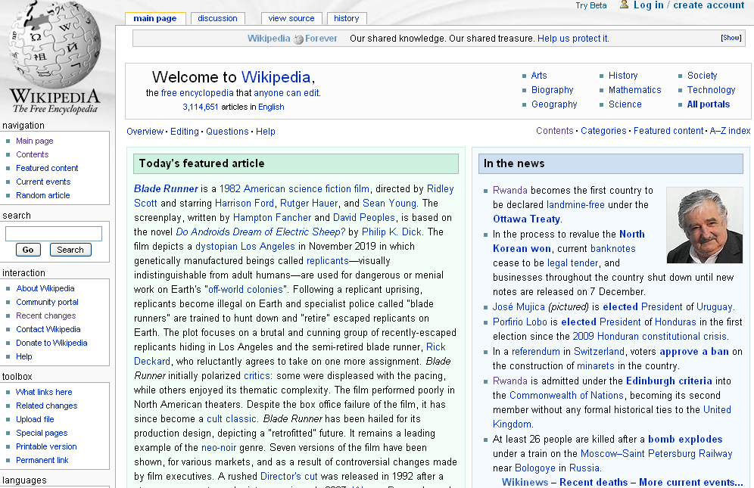

Slide 13
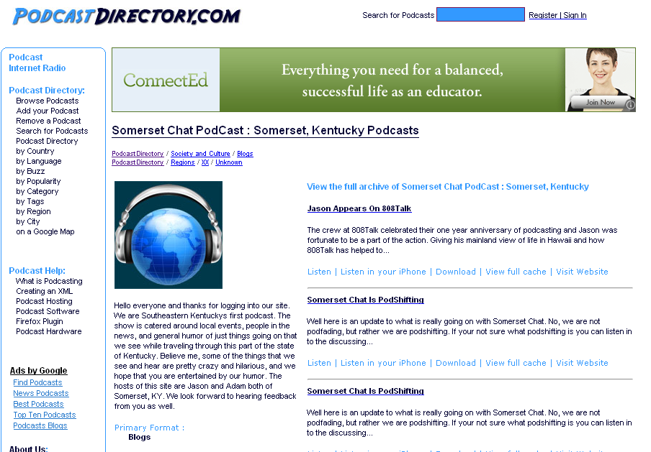

Slide 14
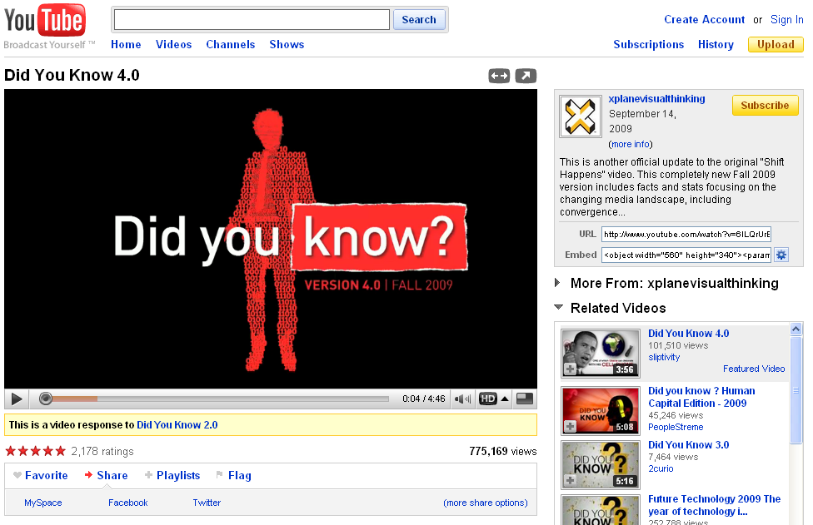

Slide 15
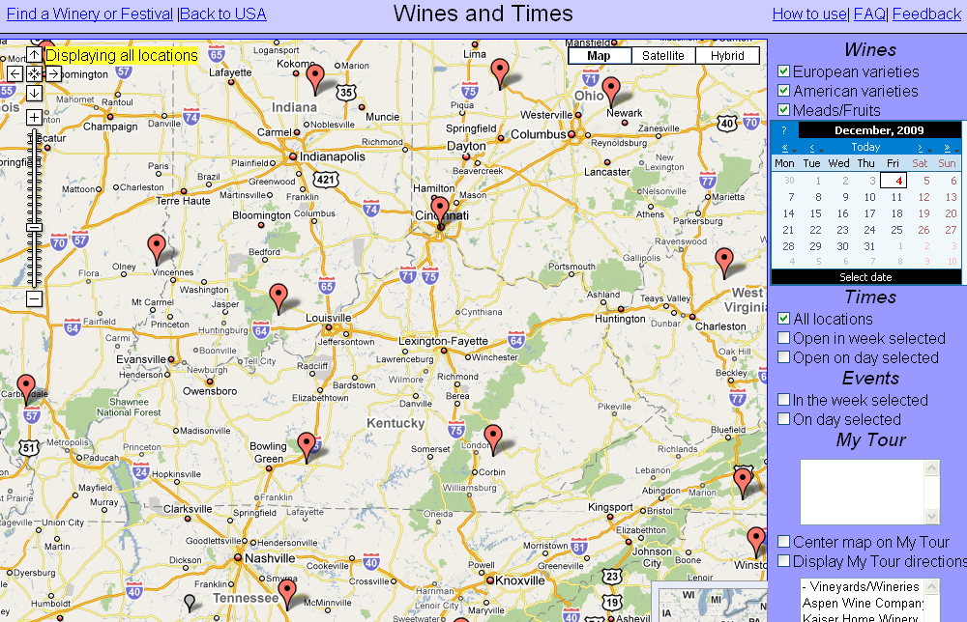

Slide 16
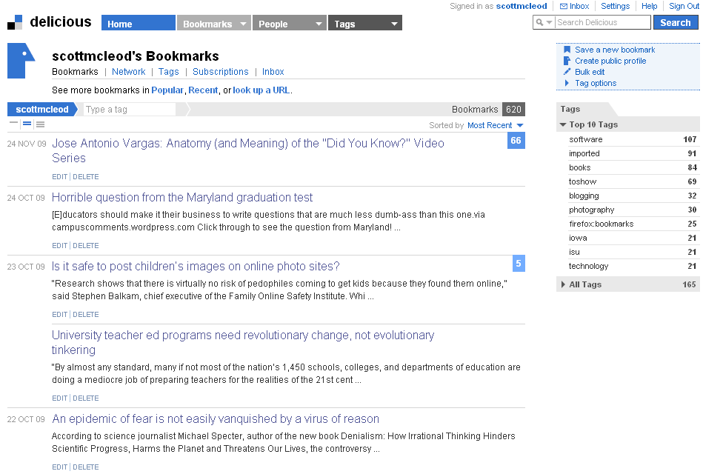

Slide 17
New information landscape

Slide 18


Slide 19


Slide 20
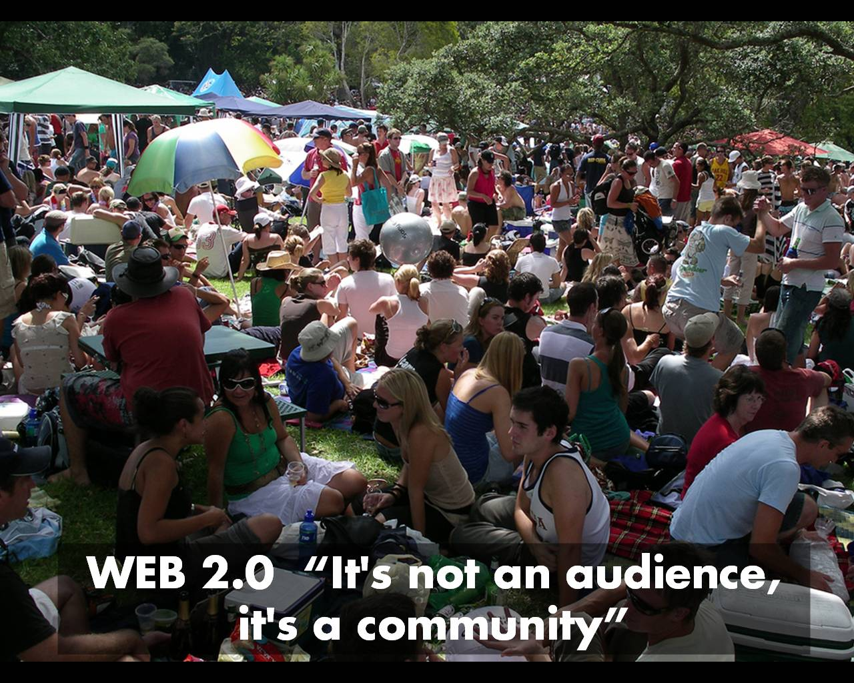

Slide 21
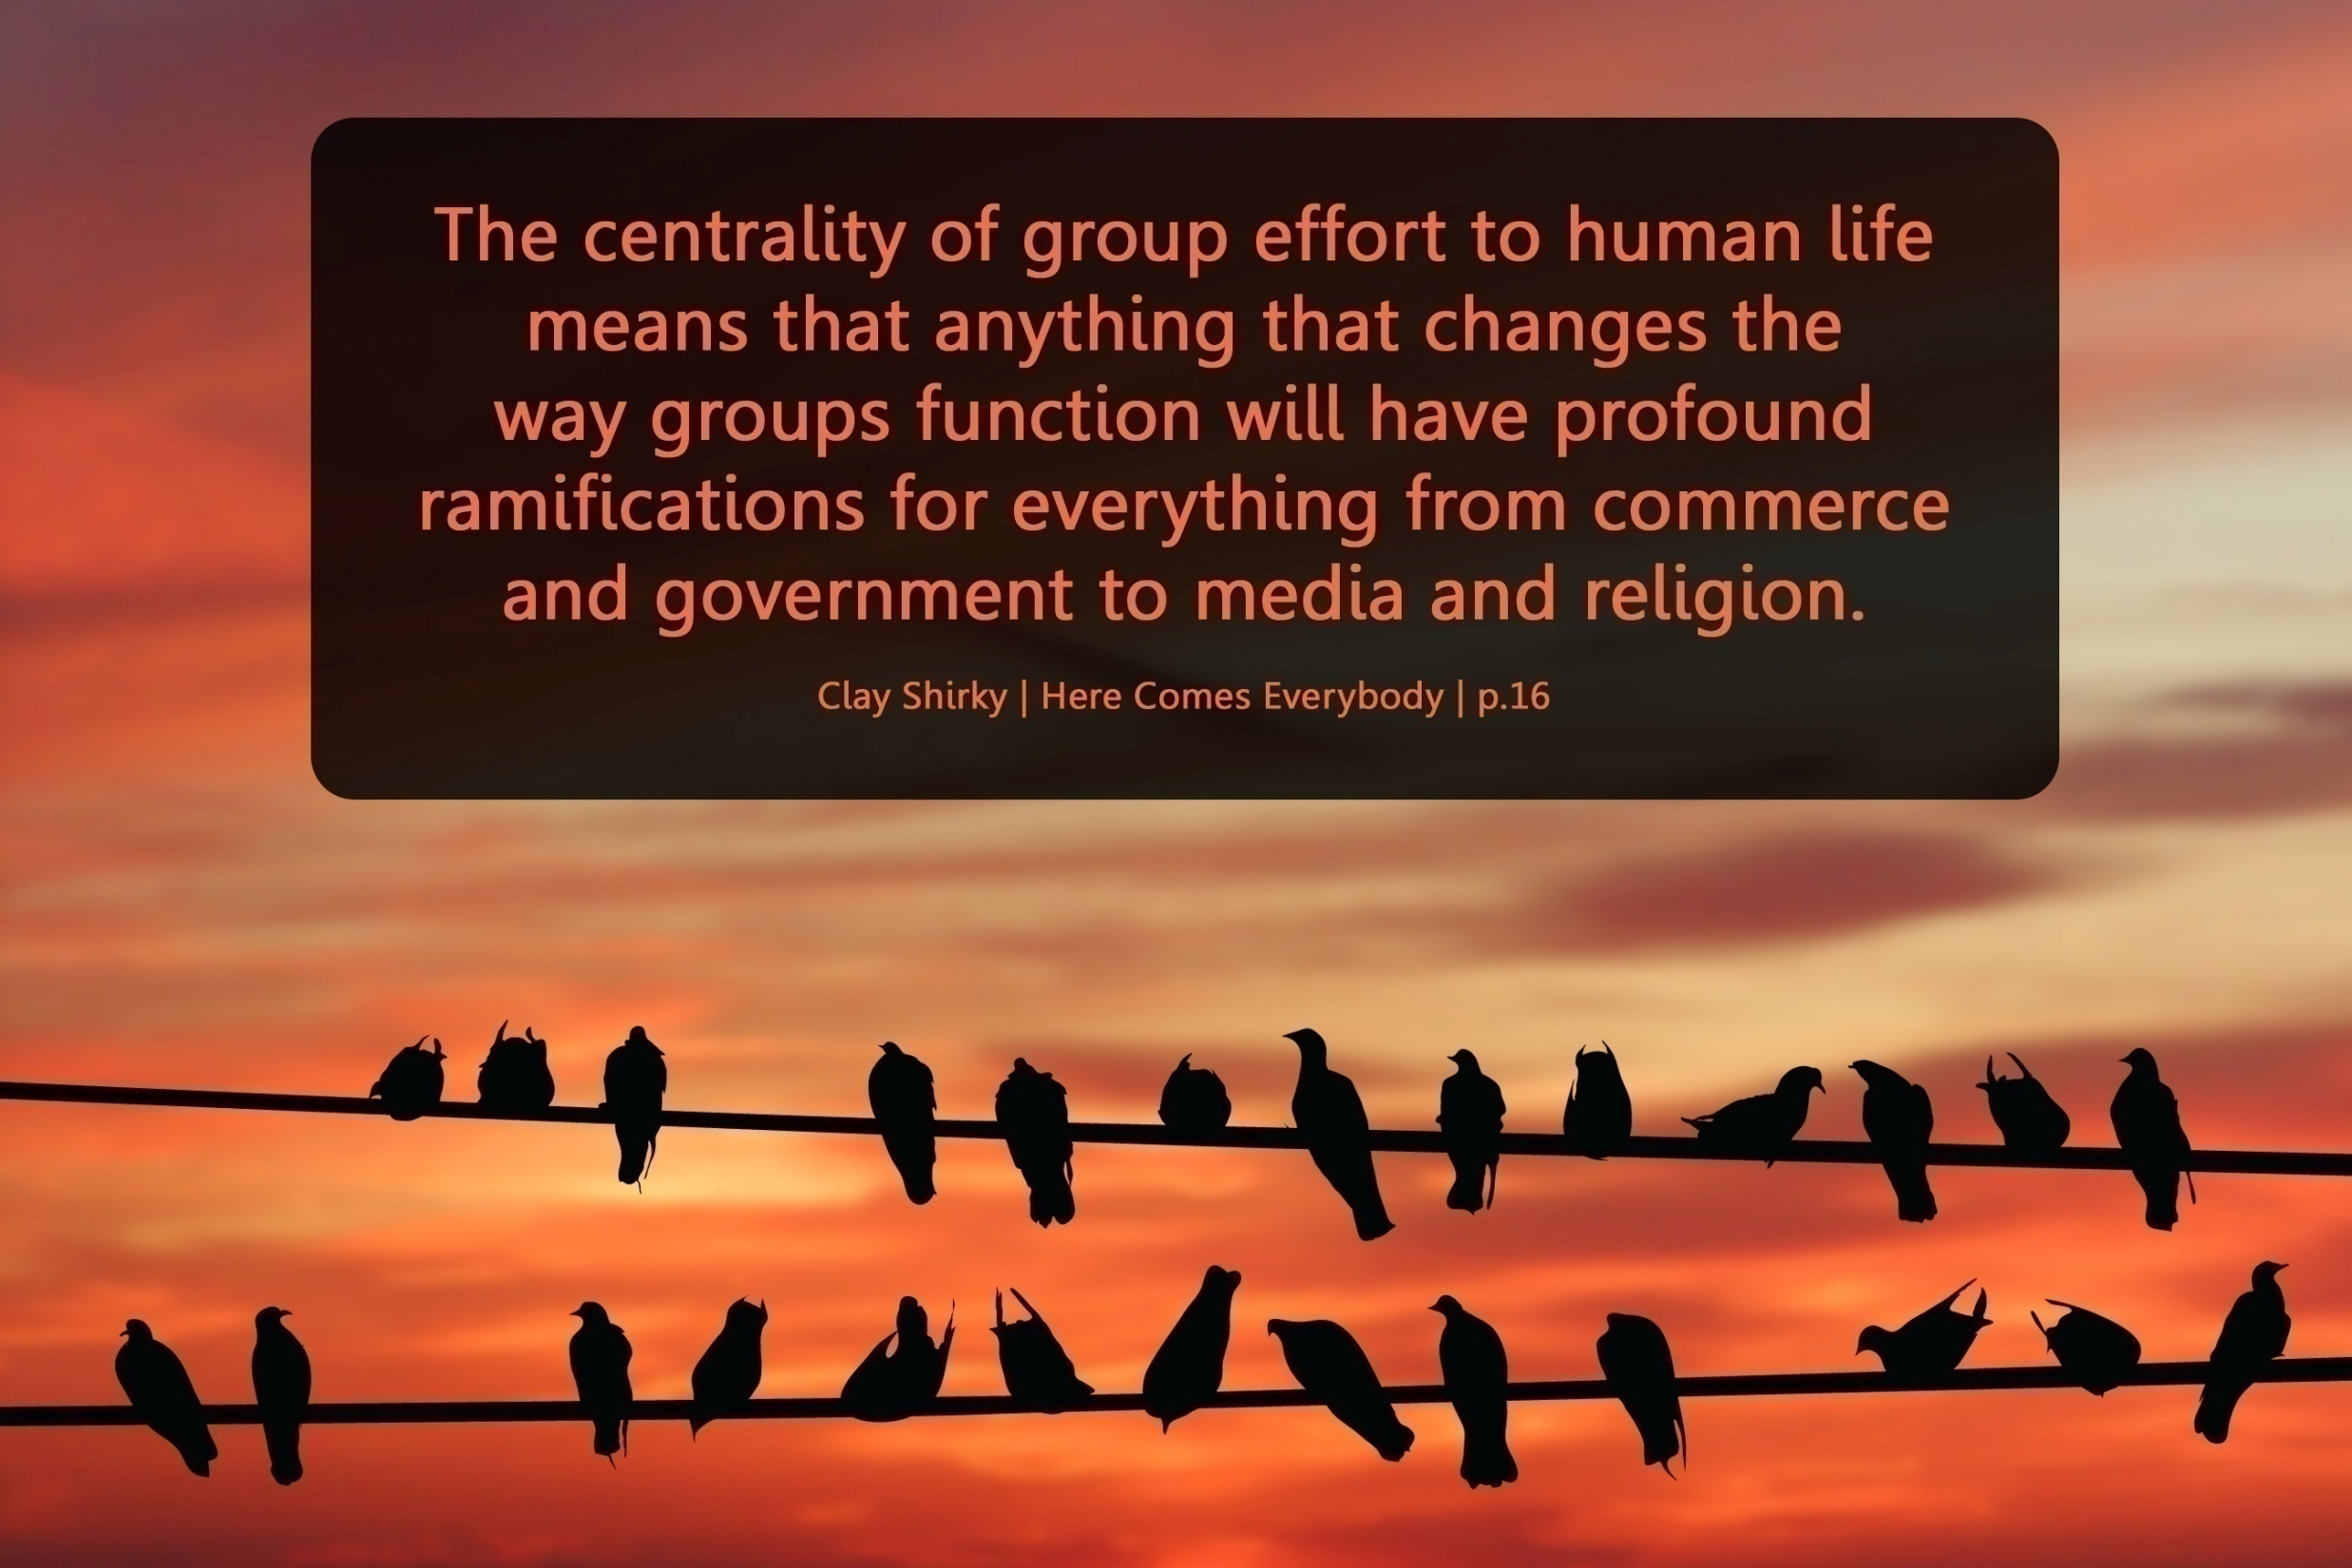

Slide 22
We are hyper-connected

Slide 23



Slide 24
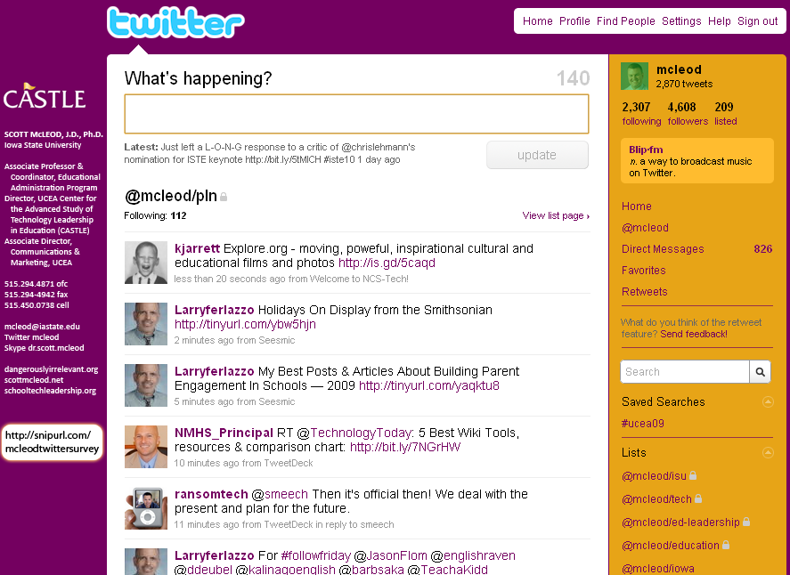

Slide 25
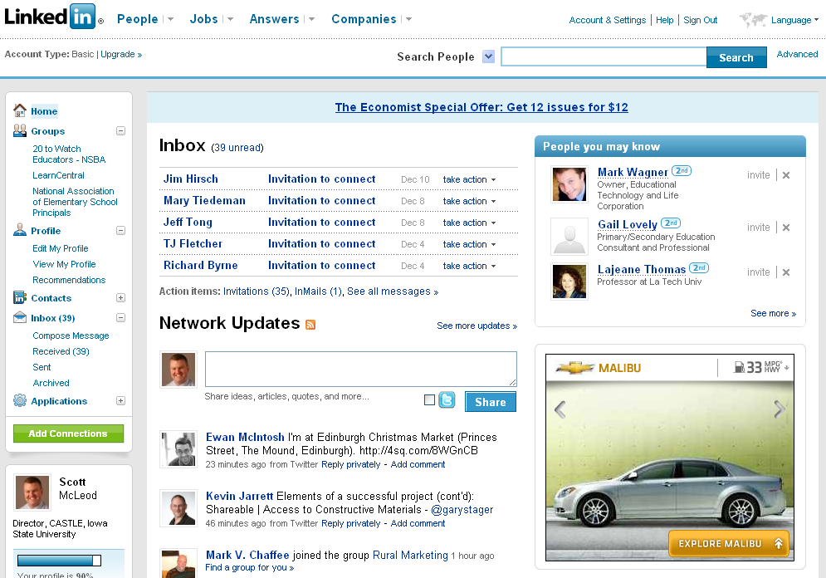

Slide 26


Slide 27
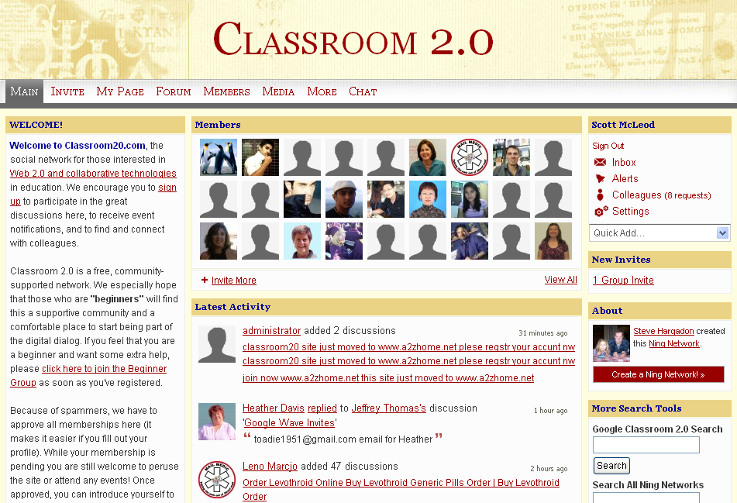

Slide 28
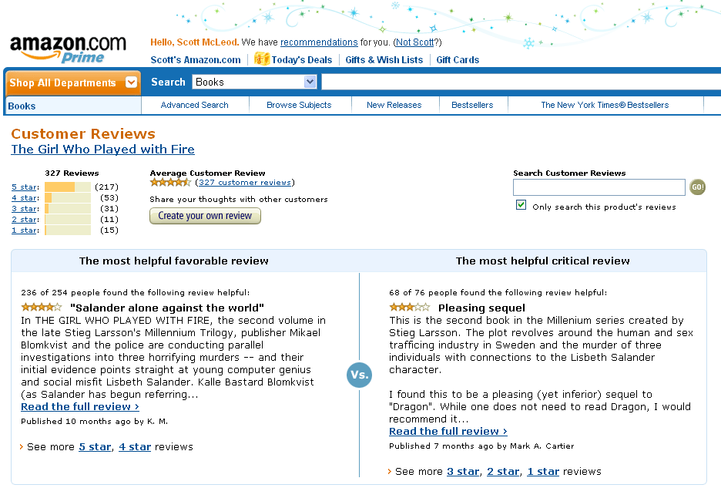

Slide 29


Slide 30
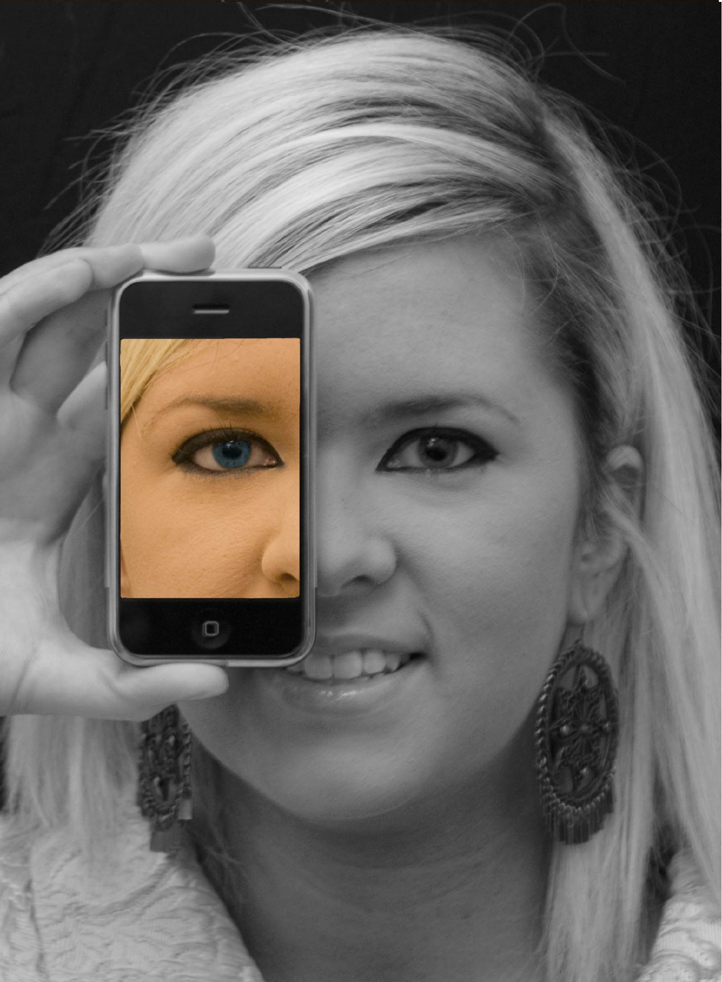

Slide 31
We all now have a voice
(and can find each other, share, connect, collaborate)

Slide 32
Anytime/anywhere content production, connection, collaboration…

Slide 33
open

Slide 34
more
accessible

Slide 35
more
convenient

Slide 36
more immediate /
real time

Slide 37
networked

Slide 38
connected

Slide 39
shared

Slide 40
collaborative

Slide 41
interactive

Slide 42
individualized

Slide 43
empowering

Slide 44
flexible

Slide 45
adaptive

Slide 46
less dependent
on ‘experts’

Slide 47
rapidly-changing

Slide 48
more
comprehensive

Slide 49
searchable

Slide 50
often ‘crowdsourced’

Slide 51
creative

Slide 52
multimodal /
multimedia

Slide 53
more efficient

Slide 54
often
less expensive

Slide 55
global

Slide 56
less dependent
on geography

Slide 57
less dependent
on physical media

Slide 58
technology-suffused

Slide 59

CHANGE
OR DIE

Slide 60
newspapers,
magazines

Slide 61
music

Slide 62
radio

Slide 63
television

Slide 64
movies

Slide 65
books,
reading

Slide 66
maps, travel,
travel agencies

Slide 67
business,
personal finance,
money management

Slide 68
medicine,
health

Slide 69
postal service

Slide 70
real estate

Slide 71
politics

Slide 72
universities

Slide 73
Information-oriented

Slide 74
P-12
schools

Slide 75
Big shift 2

Slide 76
Percentile change in
importance of task type
in U.S. economy
Abstract
Routine
Manual
Autor, D., Levy, F., & Murnane, R. J. (2003). The skill content of recent technological change:
An empirical exploration. Quarterly Journal of Economics 188, 4. [updated, D. Autor, 2008]

Slide 77
global awareness
effective speaking
critical thinking
problem solving
adaptability
information literacy
collaboration
creativity
media fluency
analytical skills
entrepeneurialism
innovation
effective writing
synthesis
curiosity

Slide 78
Growth of the creative class
Florida, R. (2002). The rise of the creative class (p. 332). New York, NY: Basic Books.

Slide 79
Growth of the creative class
Florida, R. (2002). The rise of the creative class (p. 332). New York, NY: Basic Books.

Slide 80
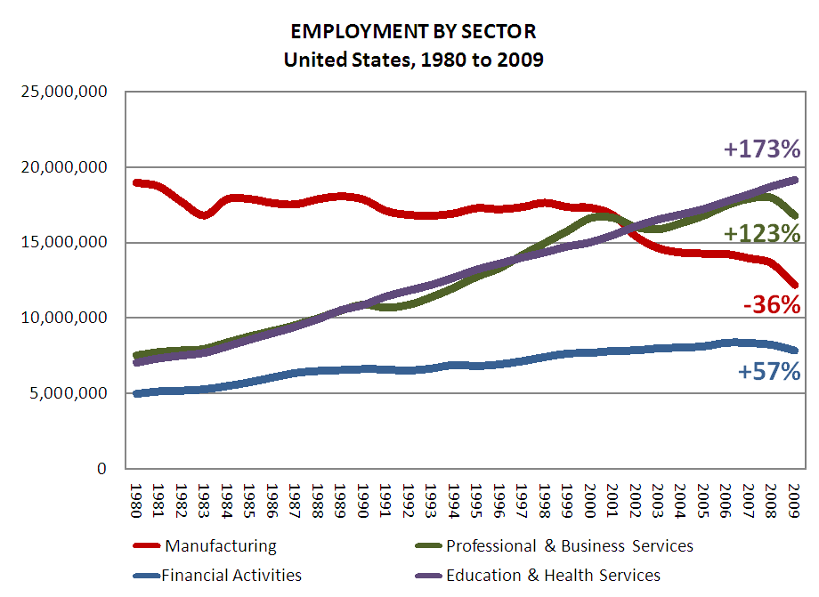

Slide 81
Globalization of economy

Slide 82
  Can someone overseas
  do it cheaper?
  Can a computer
  do it faster?

Slide 83
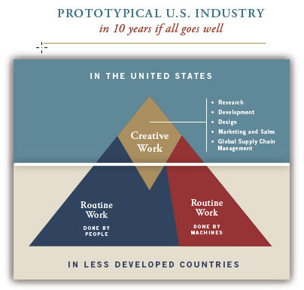

Slide 84
Hyperconnected global economy
Offshoring
Replacement of jobs with software

Slide 85
Characteristics of the job
NOT
Characteristics of the person

Slide 86
1 big problem

Slide 87
  Socially functional
  Mastery of information landscape
  Economically productive

Slide 88

Notes:
88

Slide 89
The fundamental dilemma
but now are
expected to
do this
Schools were
designed
for this …

Slide 90
What we have right now
uniqueness
uniqueness
one right answer
Notes:
90

Slide 91
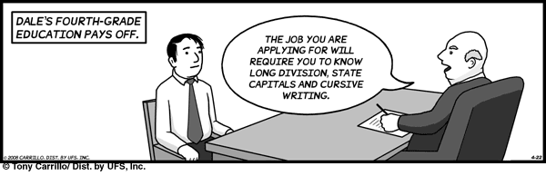
Notes:
THIS SLIDE IS COPYRIGHT-PROTECTED. I GOT SPECIAL PERMISSION FROM THE CARTOONIST, TONY CARRILLO, TO USE IT.
91

Slide 92
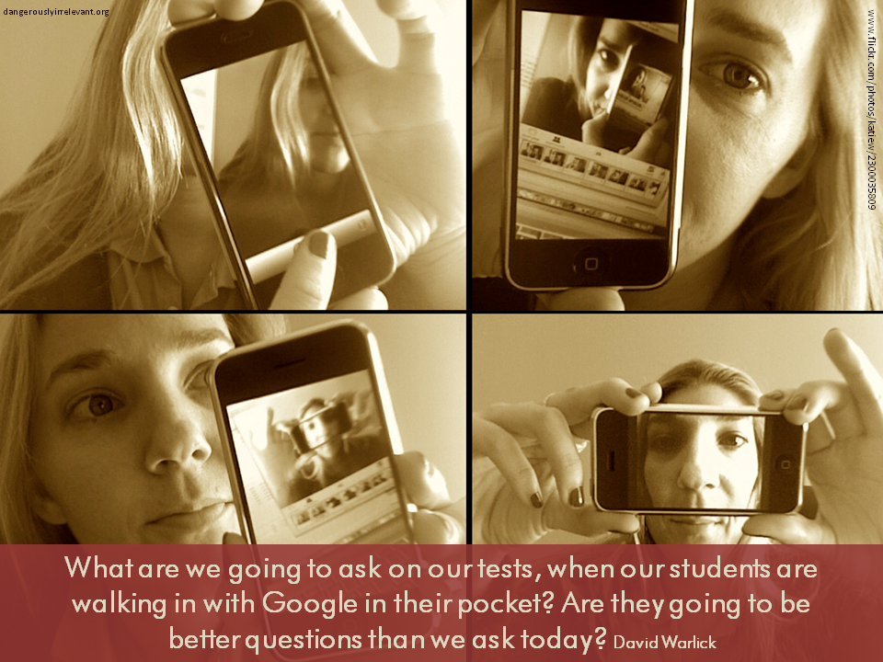

Slide 93

Notes:
93

Slide 94
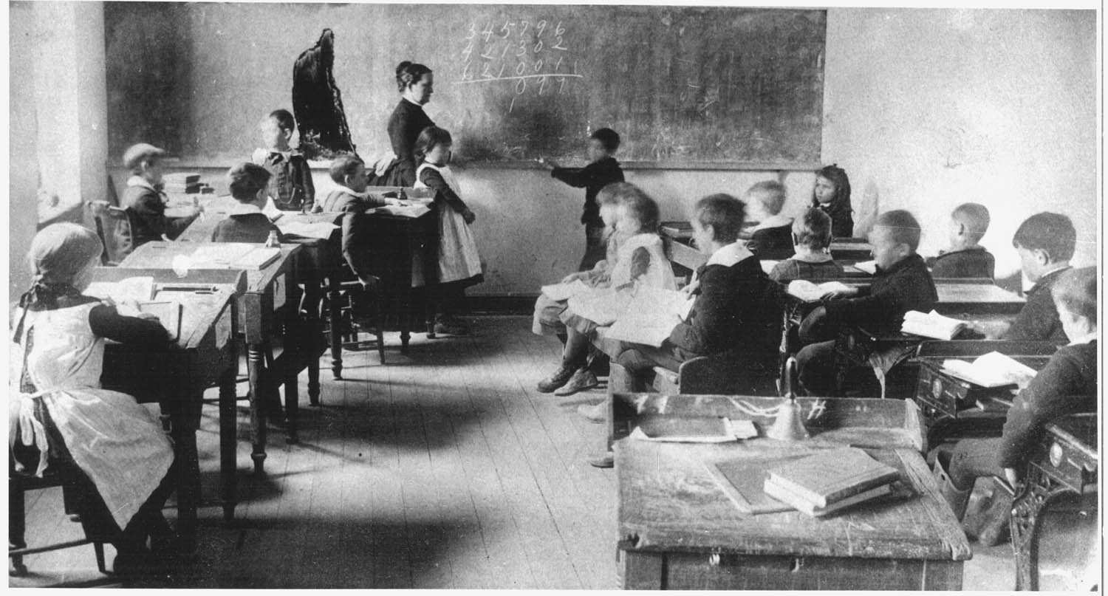
Notes:
94

Slide 95

No generation in history has ever been so
thoroughly prepared for the industrial age.
David Warlick
http://davidwarlick.com/2cents/?p=298
dangerouslyirrelevant.org

Slide 96
Takeaways

Slide 97
K-12 education is facing multiple disruptive innovations.

Slide 98
The existing educational model is not a given.

Slide 99
This is sneaking up on most school organizations.

Slide 100
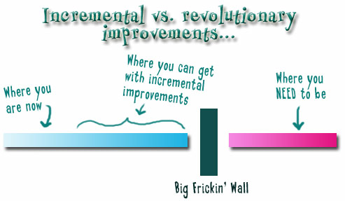
Notes:
We need to somehow
change faster
No one jumps a 20 foot chasm in two
10 foot jumps. – Miguel Guhlin
When the world changes so fast that we have no reasonable way to forecast what it will look like in a mere decade or two, all we can do is teach kids how to be adaptive – to be learners in the truest sense of the word –
We’ve always talked about preparing lifelong learners in schools, but our practices typically haven’t matched our rhetoric. It’s time to put some bite into our toothless vision statements and recognize that we have to teach kids how to learn to learn if they want to be successful in this new technology-suffused, globally-interconnected world
Credits: http://tinyurl.com/2urbsm and http://tinyurl.com/37em64 (see Guhlin comment)
http://remoteaccess.typepad.com/remote_access/
2006/06/literacy_as_bat.html (see Guhlin comment)
http://headrush.typepad.com/creating_passionate_users/2005/03/incremental_vs_.html

Slide 101
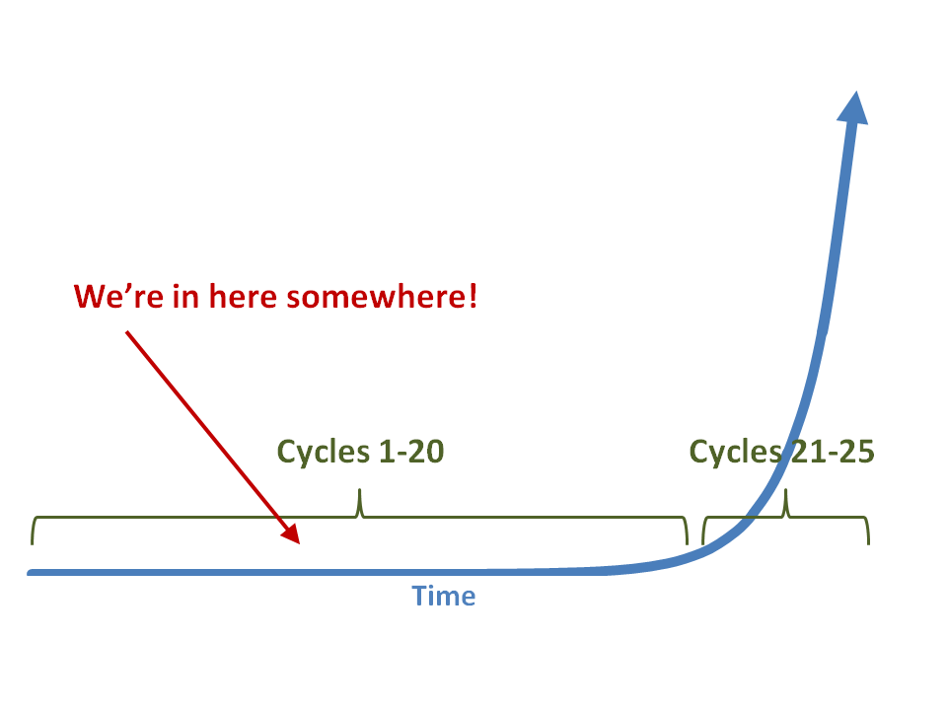

Slide 102
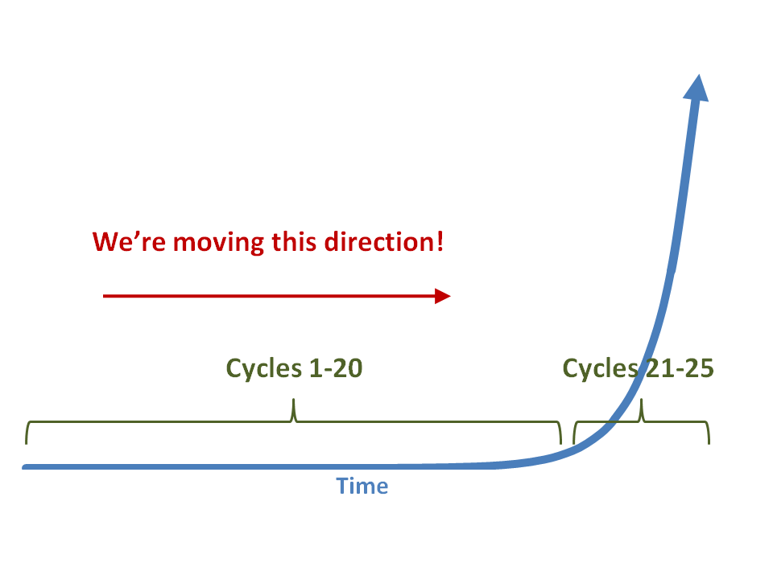

Slide 103
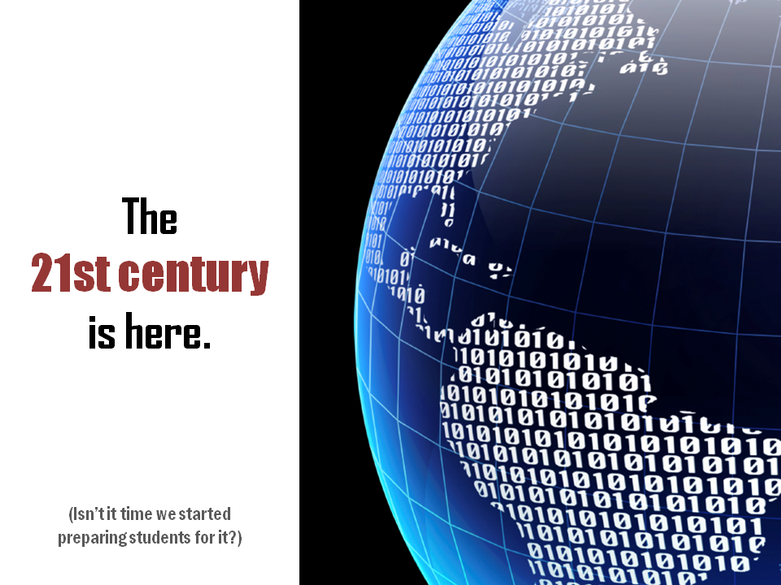

Slide 104
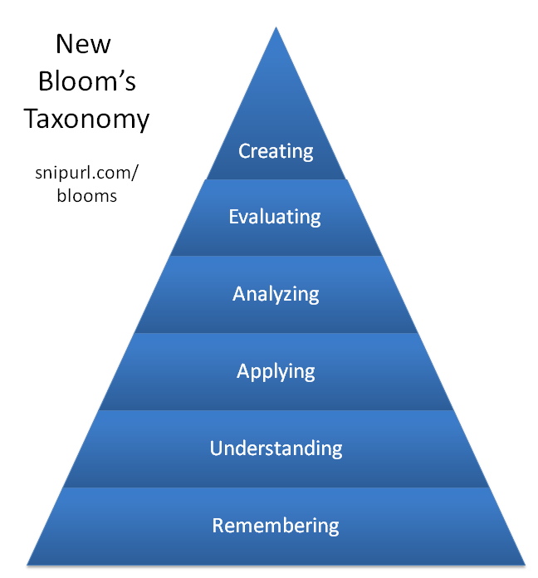

Slide 105


Slide 106

No one will thank you
for taking care of today
if you have failed
to take care of tomorrow.
Joel Barker

Slide 107
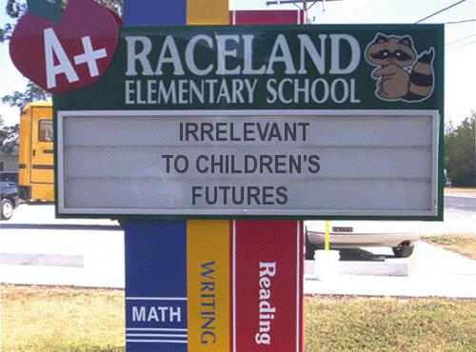
Notes:
107

Slide 108
Thank you!
Scott McLeod, J.D., Ph.D.
Associate Professor & Director, CASTLE
Iowa State University
dangerouslyirrelevant.org/nasbe.html
Notes:
108
All of my materials are licensed under a Creative Commons attribution-share alike license (http://creativecommons.org/licenses/by-sa/3.0). That means not only that you are welcome to share and/or remix my content but that you are encouraged to do so! All I ask is that you properly credit me for my content and that you not place any greater copyright restrictions than I have on the content that utilizes my material. If possible, including the URL of Dangerously Irrelevant in your content would be most appreciated.
Scott McLeod, J.D., Ph.D.
dangerouslyirrelevant.org
schooltechleadership.org
dangerouslyirrelevant.org/contact.html

