Slide 1
Effective leadership for a changing world
Dr. Scott McLeod
CASTLE

Slide 2
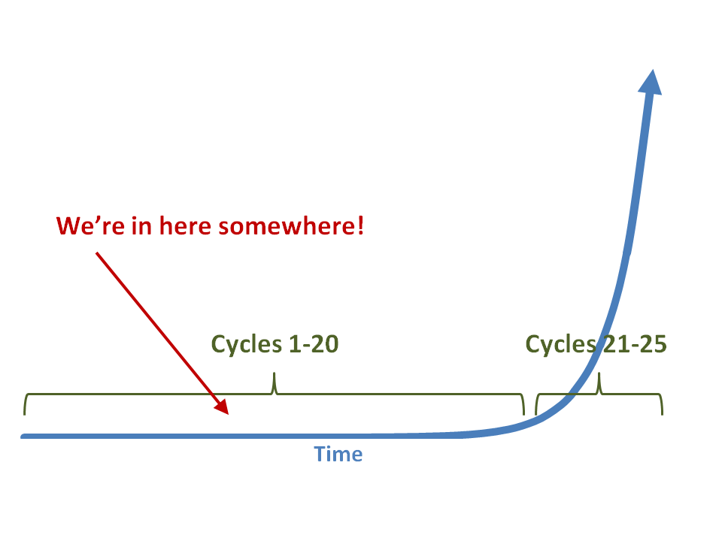

Slide 3
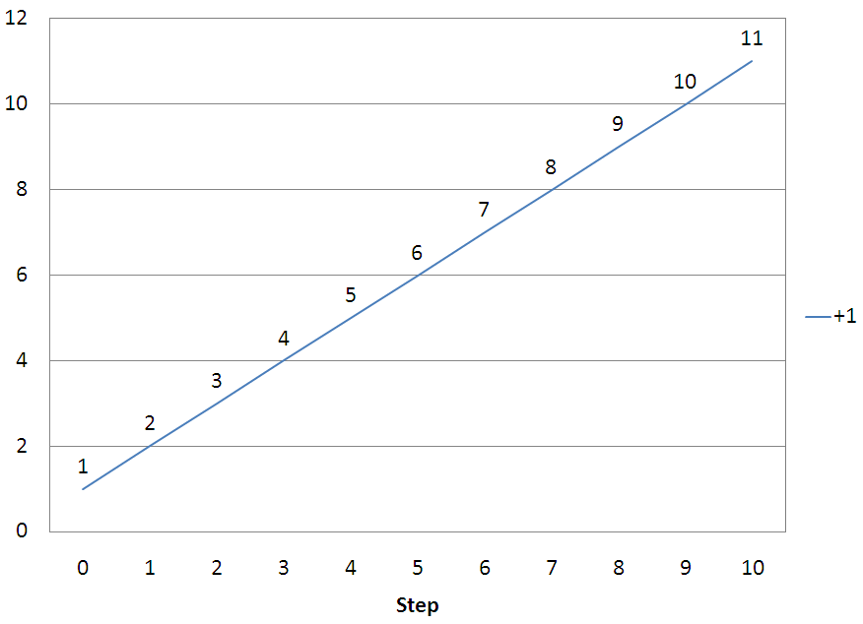

Slide 4
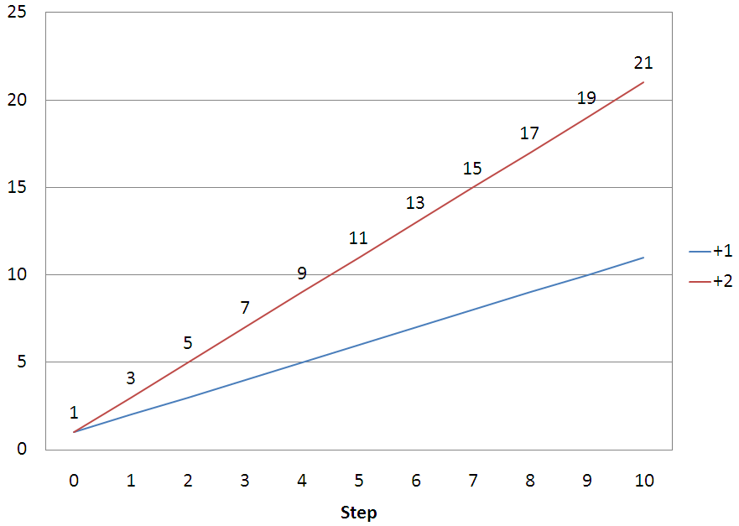

Slide 5
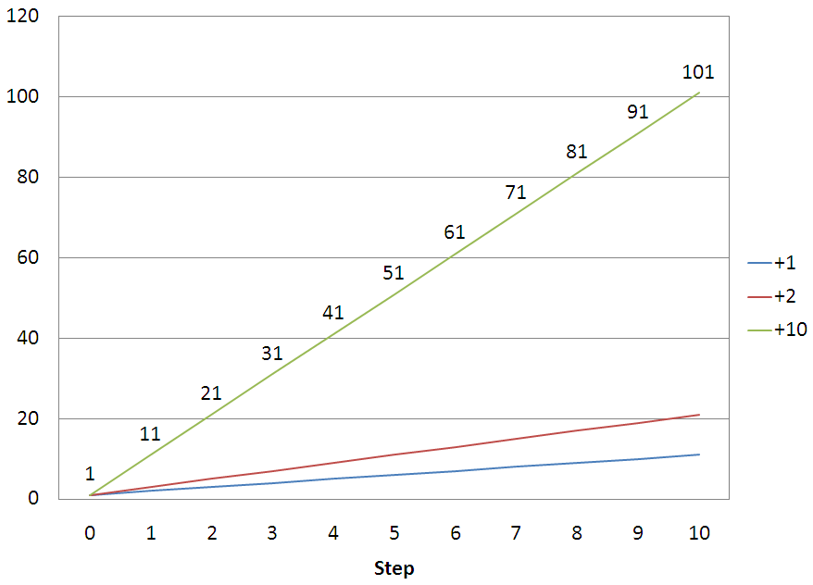

Slide 6
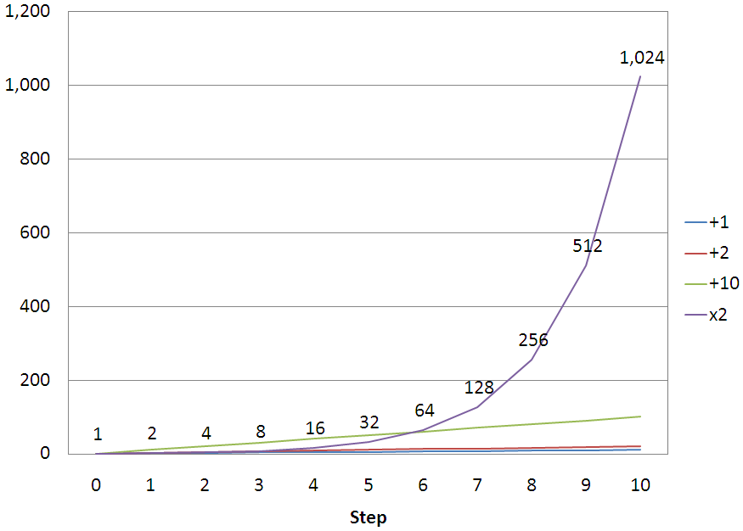

Slide 7
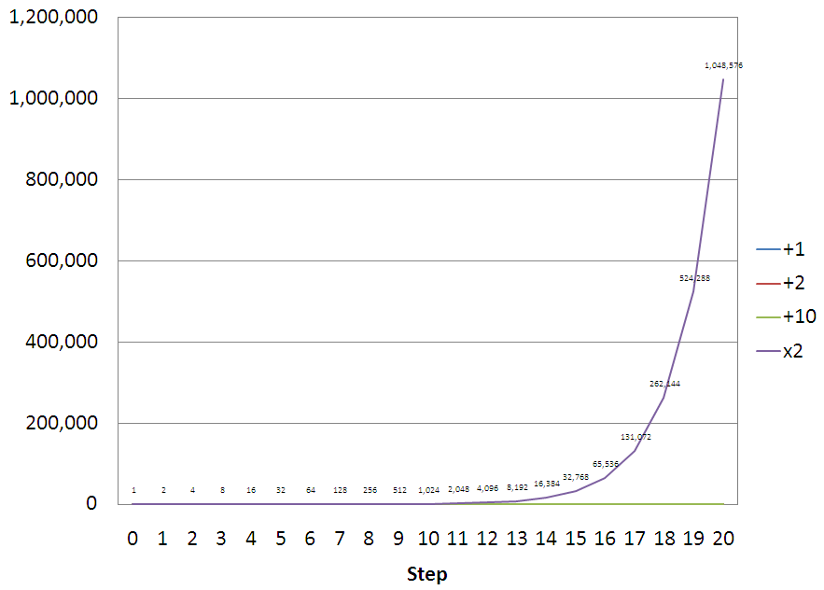

Slide 8
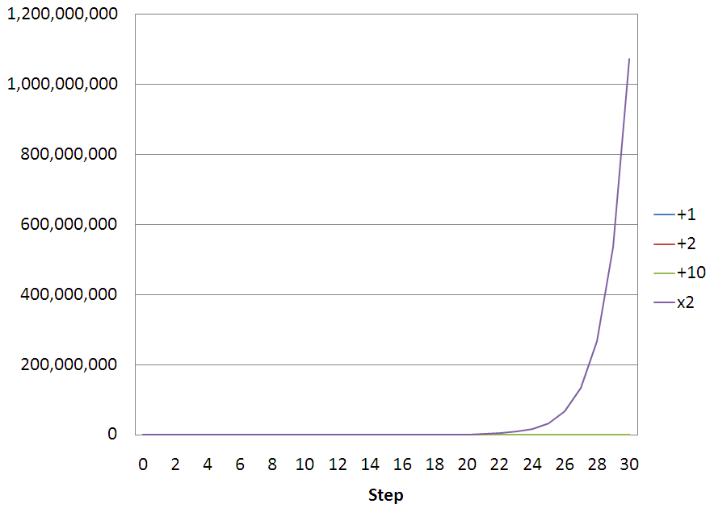

Slide 9
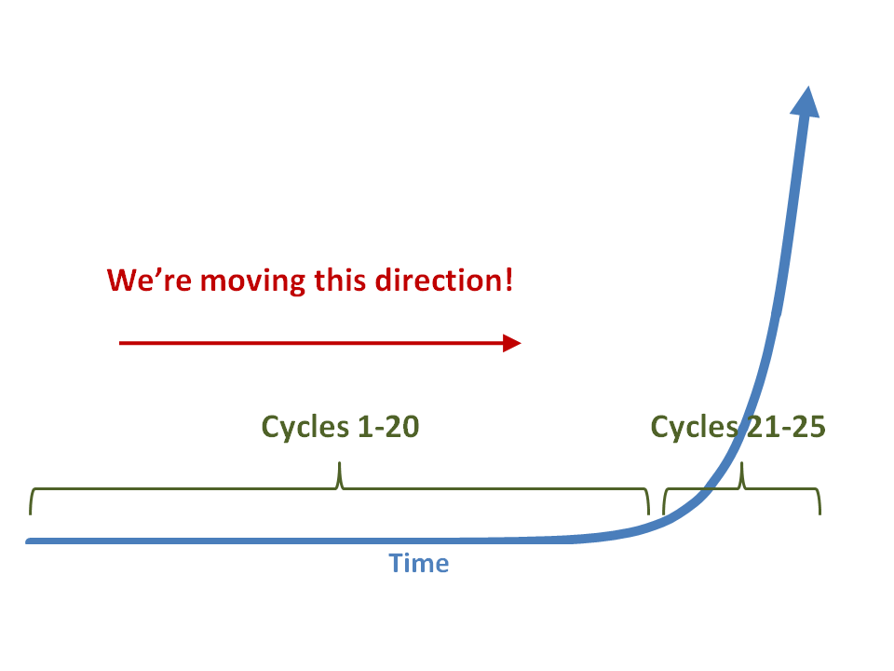

Slide 10
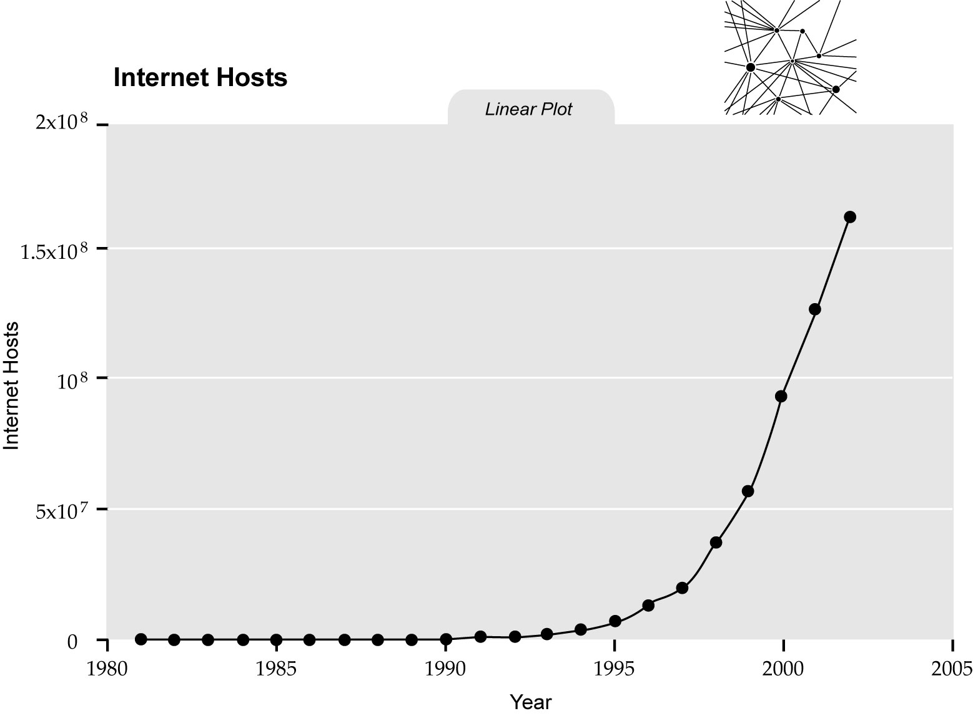
singularity.com/charts

Slide 11
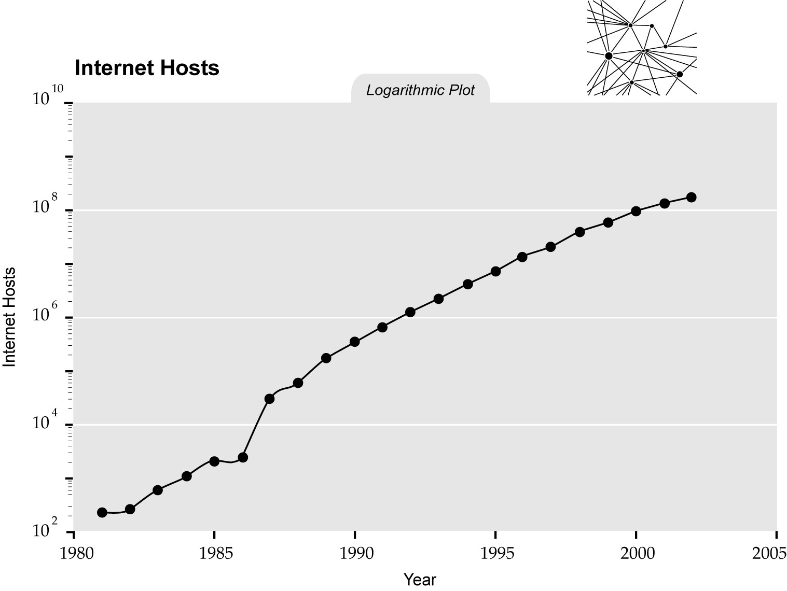
singularity.com/charts

Slide 12
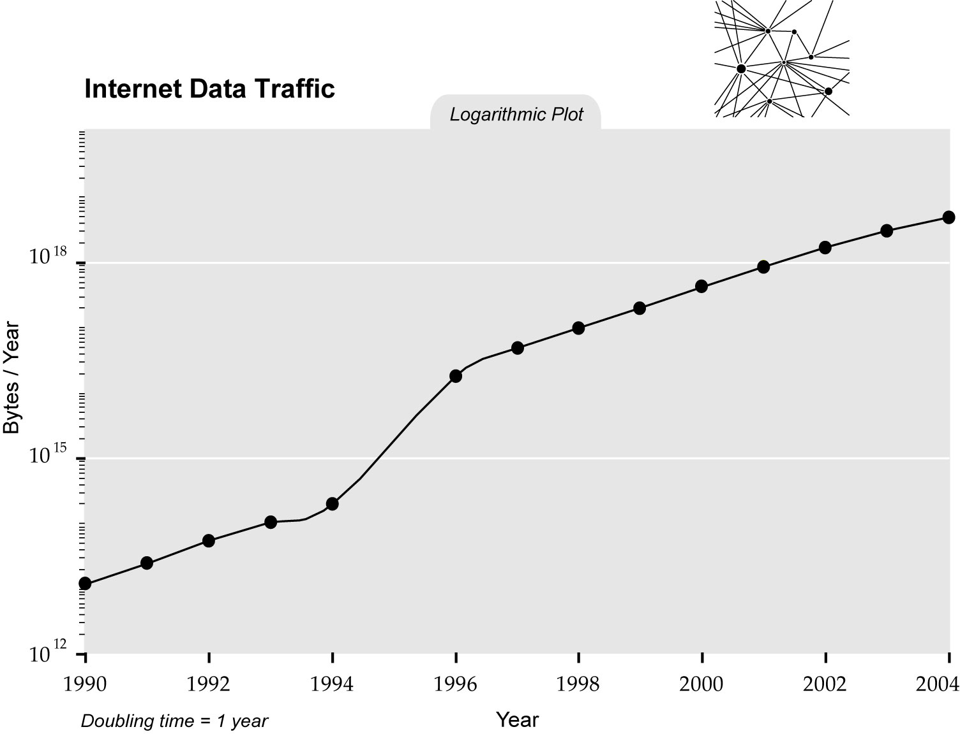
singularity.com/charts

Slide 13
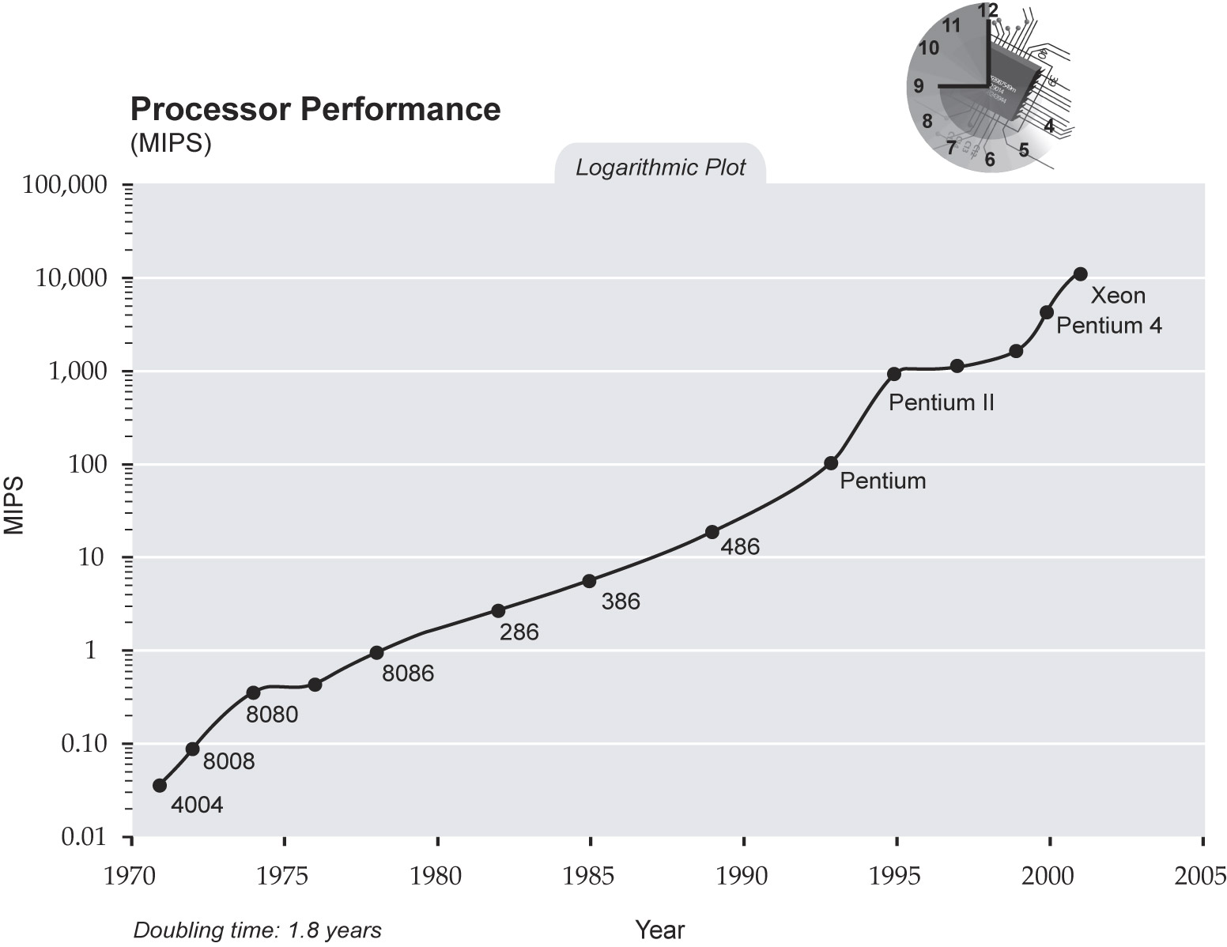
singularity.com/charts

Slide 14
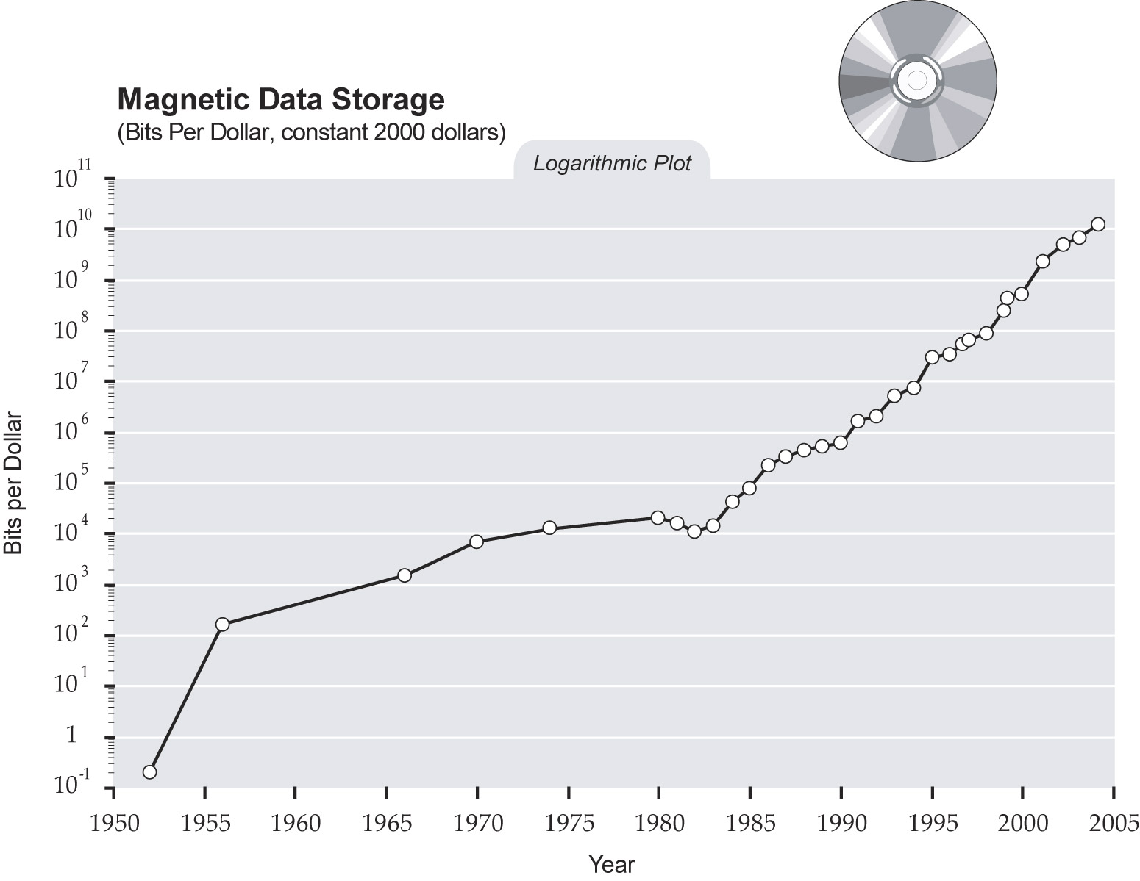
singularity.com/charts

Slide 15
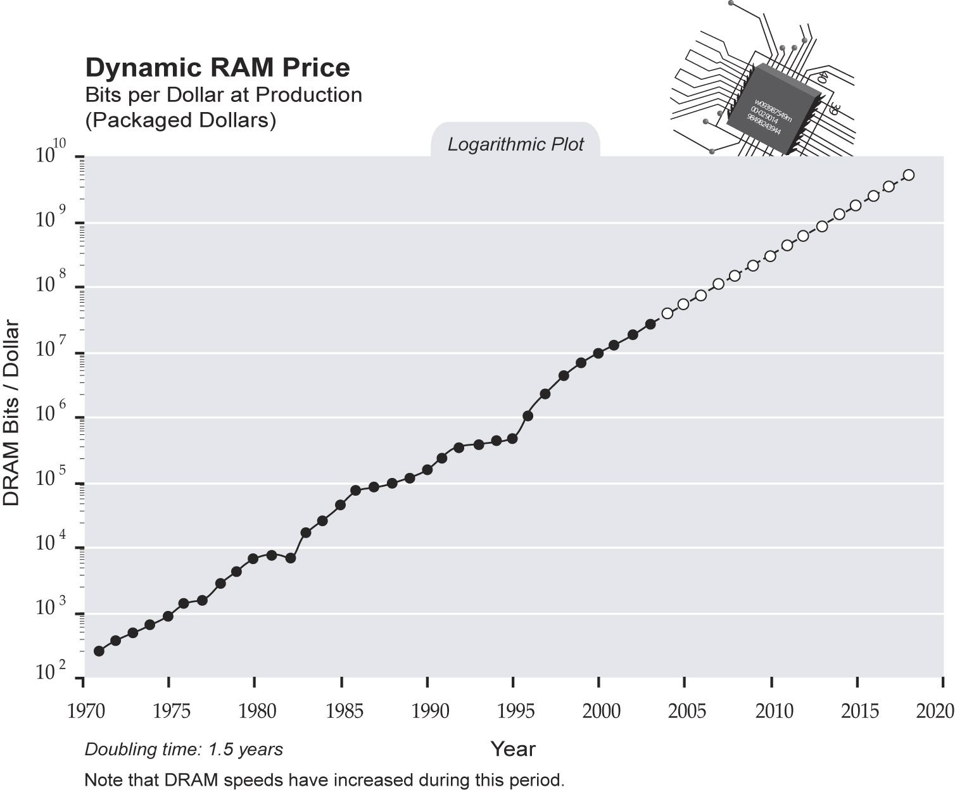
singularity.com/charts

Slide 16
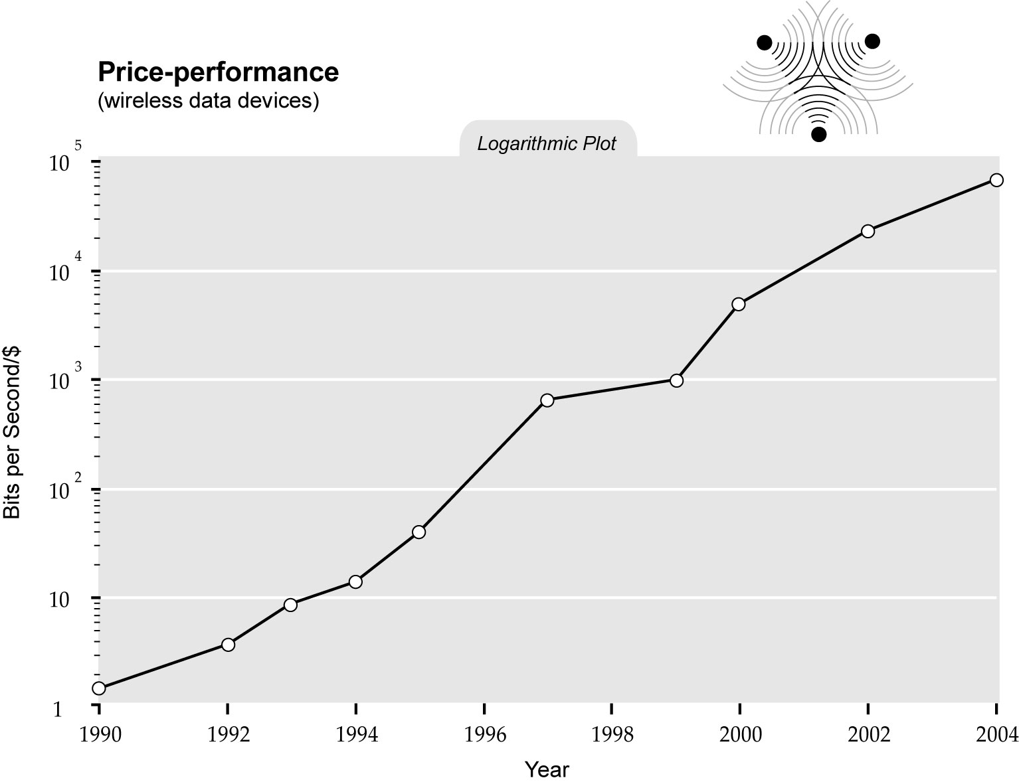
singularity.com/charts

Slide 17
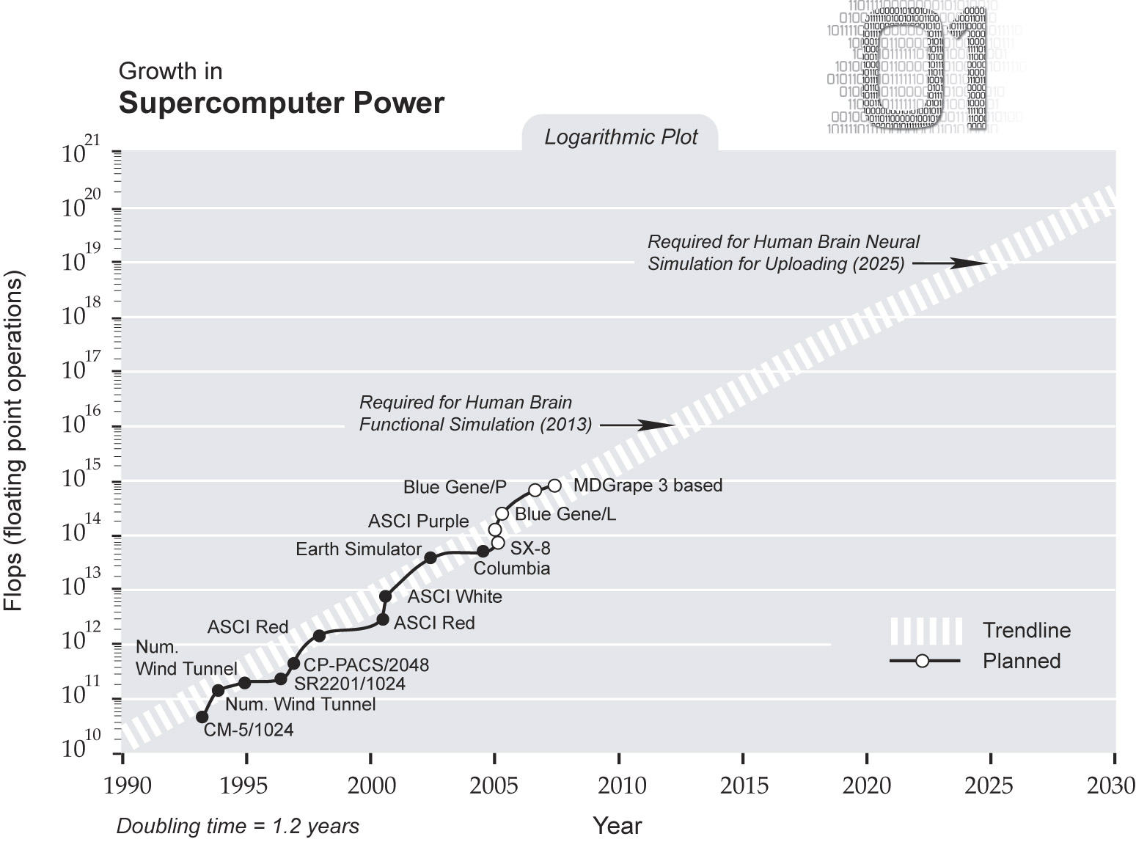
singularity.com/charts

Slide 18
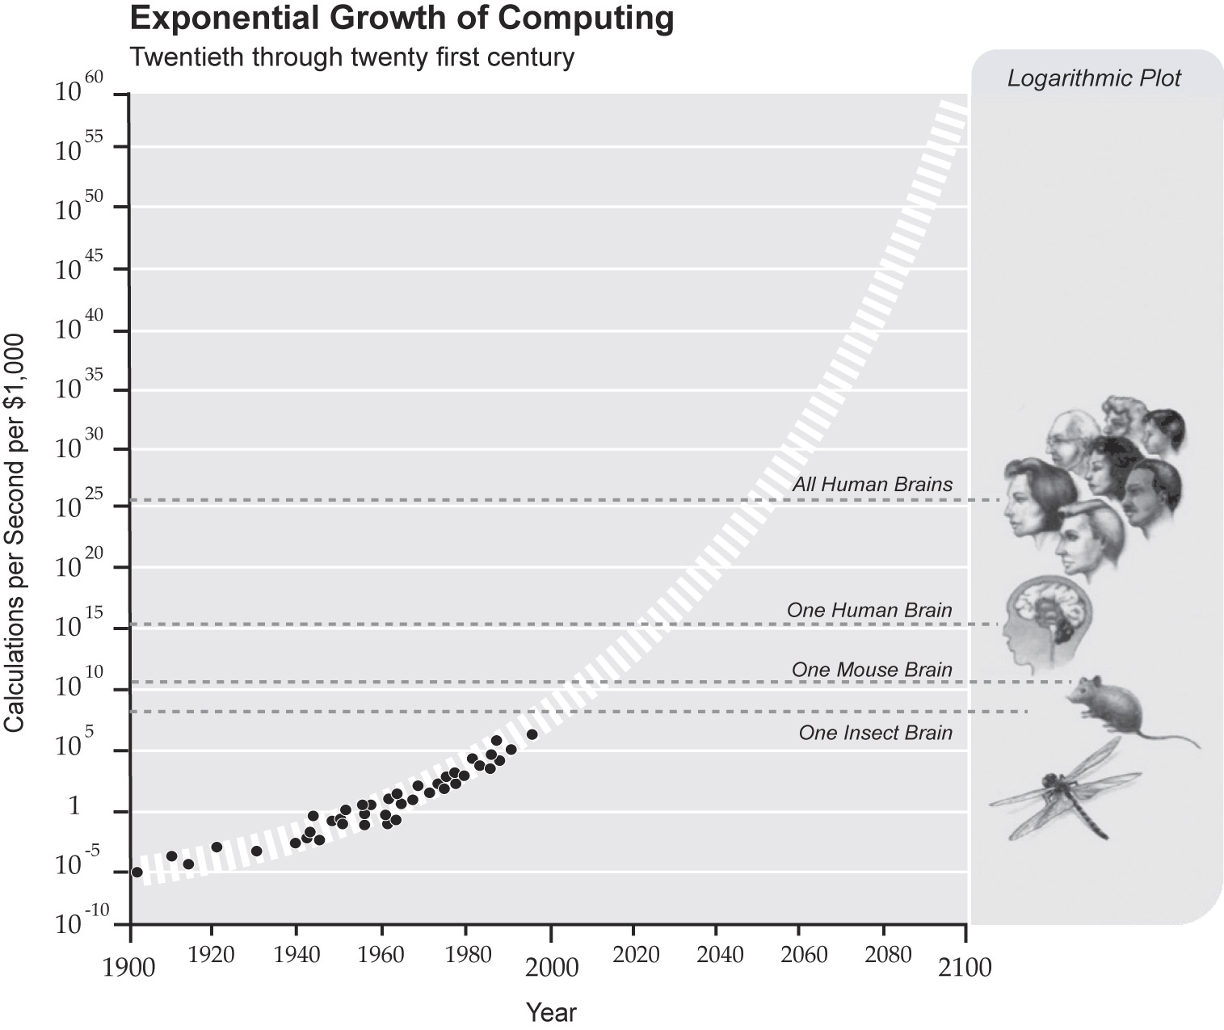
singularity.com/charts

Slide 19
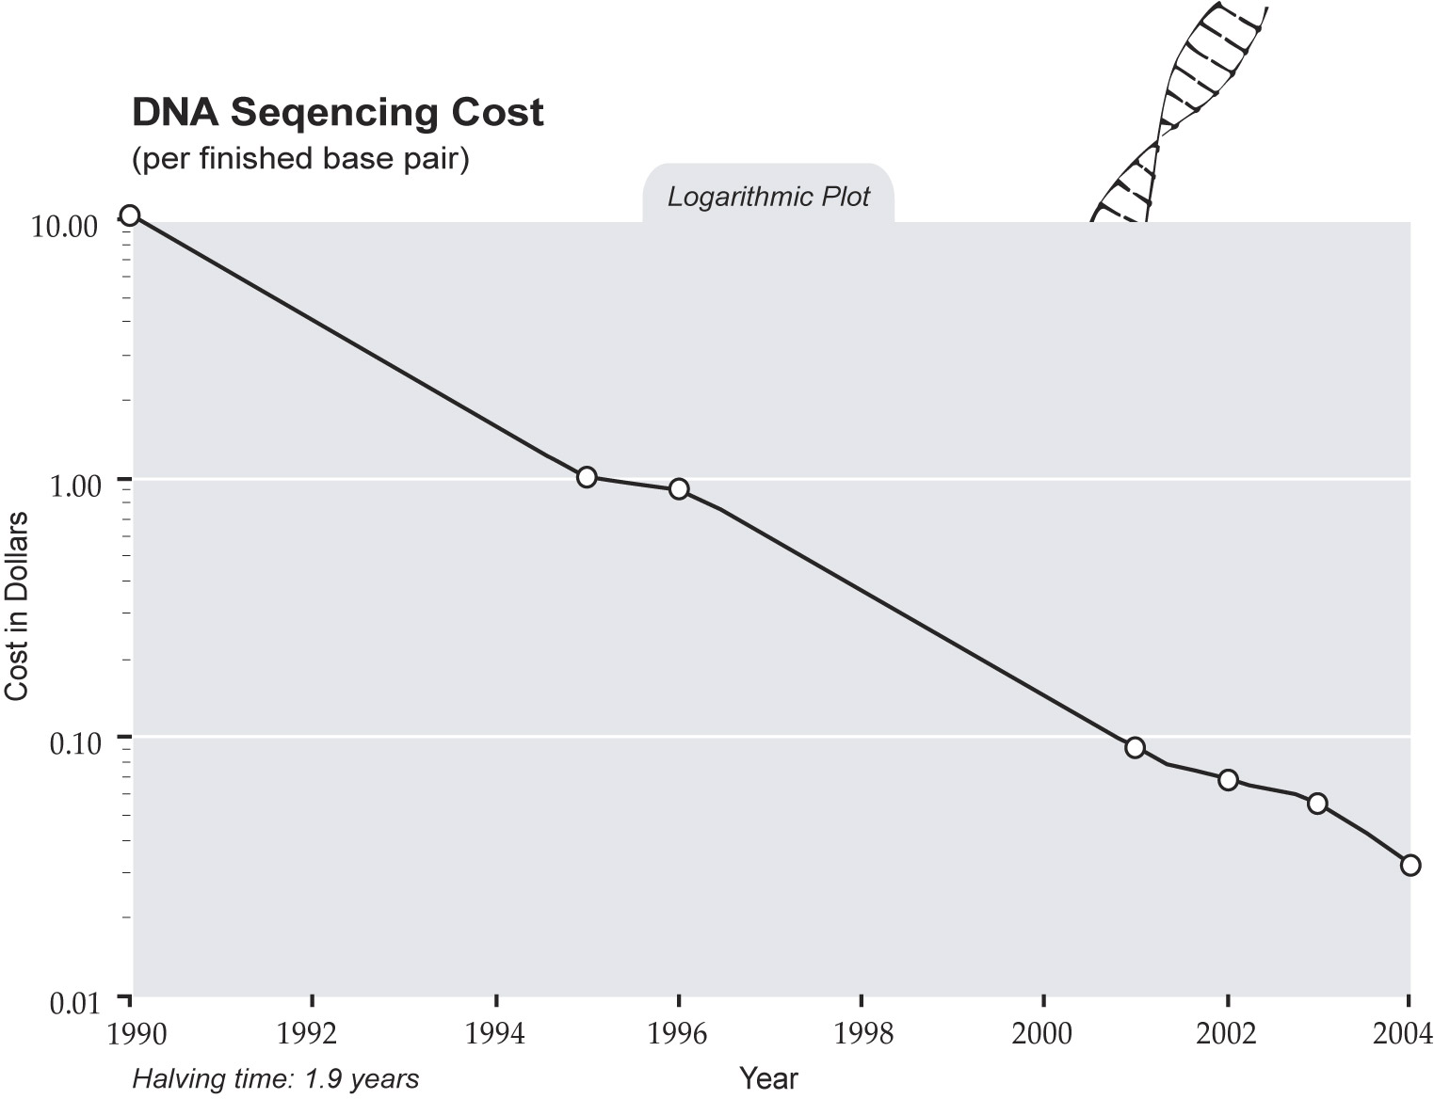
singularity.com/charts

Slide 21
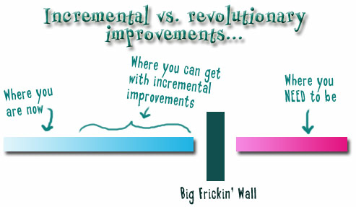
Notes:
We need to somehow change faster
No one jumps a 20 foot chasm in two
10 foot jumps. – Miguel Guhlin
When the world changes so fast that we have no reasonable way to forecast what it will look like in a mere decade or two, all we can do is teach kids how to be adaptive – to be learners in the truest sense of the word –
We’ve always talked about preparing lifelong learners in schools, but our practices typically haven’t matched our rhetoric. It’s time to put some bite into our toothless vision statements and recognize that we have to teach kids how to learn to learn if they want to be successful in this new technology-suffused, globally-interconnected world
Credits: http://tinyurl.com/2urbsm and http://tinyurl.com/37em64 (see Guhlin comment)
http://remoteaccess.typepad.com/remote_access/ 2006/06/literacy_as_bat.html (see Guhlin comment)
http://headrush.typepad.com/creating_passionate_users/2005/03/incremental_vs_.html

Slide 22
Notes:
Anticipatory v. reactionary

Slide 23
Notes:
Future oriented v. compliance oriented

Slide 24
The people in charge of leading school organizations into the 21st century …
often are the least knowledgeable about the 21st century.
dangerouslyirrelevant.org
Notes:
Licensed under a Creative Commons attribution-share alike license.
http://creativecommons.org/licenses/by-sa/3.0
Scott McLeod, J.D., Ph.D.
scottmcleod.net/contact
dangerouslyirrelevant.org
schooltechleadership.org

Slide 25
If the leaders don’t get it,
it’s not going to happen.
dangerouslyirrelevant.org
Notes:
Licensed under a Creative Commons attribution-share alike license.
http://creativecommons.org/licenses/by-sa/3.0
Scott McLeod, J.D., Ph.D.
scottmcleod.net/contact
dangerouslyirrelevant.org
schooltechleadership.org

Slide 27
Am I facilitating linear or exponential change in my school?

Slide 28
Am I modeling for students and staff these new literacies?
Notes:
Blogging
Wikis
Podcasting
Online video
Social networking
RSS readers
Active consumption AND PRODUCTION of digital content?
Student projects that are doing this stuff?
Web is now social – are you living the INTERACTIVE Web (why not?)

Slide 29
Do I truly “get it?” Am I doing what I should be?

Slide 30
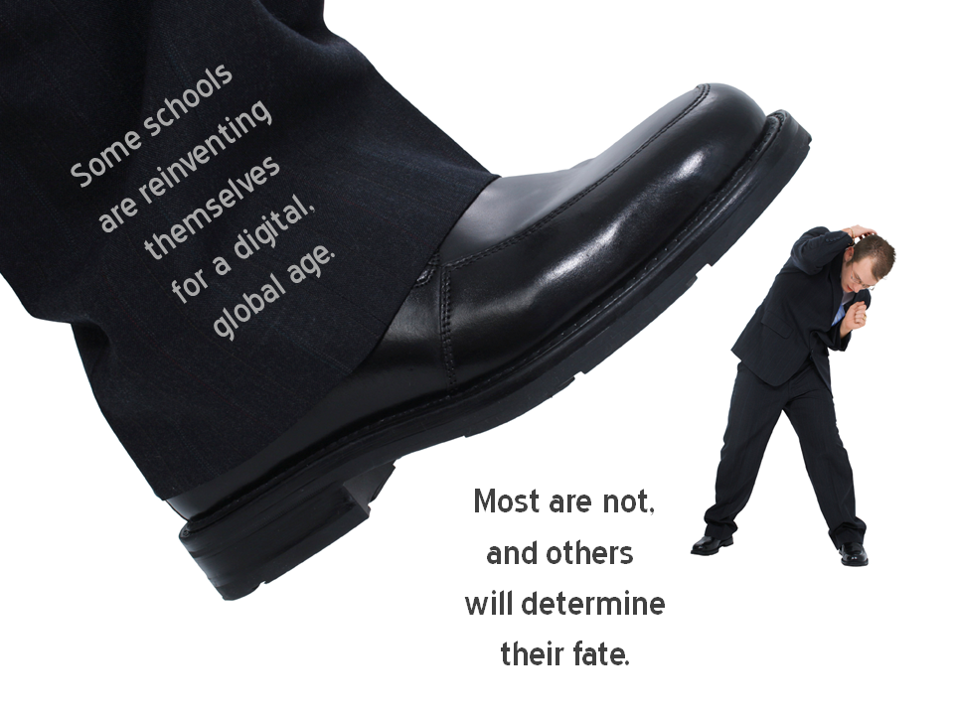
Notes:
Licensed under a Creative Commons attribution-share alike license.
http://creativecommons.org/licenses/by-sa/3.0
Scott McLeod, J.D., Ph.D.
dangerouslyirrelevant.org
schooltechleadership.org
dangerouslyirrelevant.org/contact.html

Slide 31
Thank you!
dangerouslyirrelevant.org/muscatine
Notes:
31
URL

Slide 34
No one will thank you
for taking care of today
if you have failed
to take care of tomorrow.
Joel Barker

Slide 37
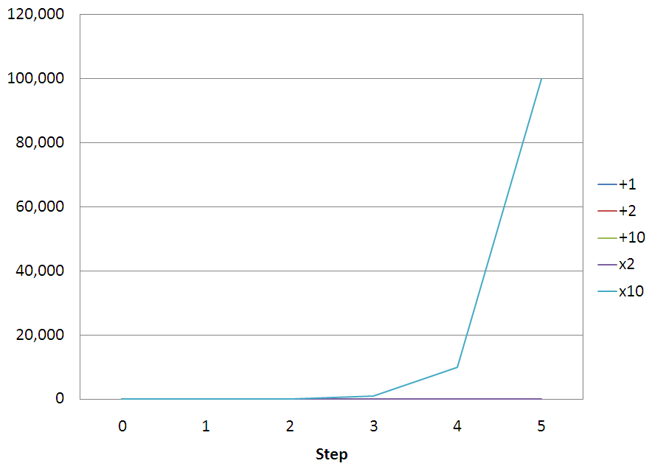

Slide 38
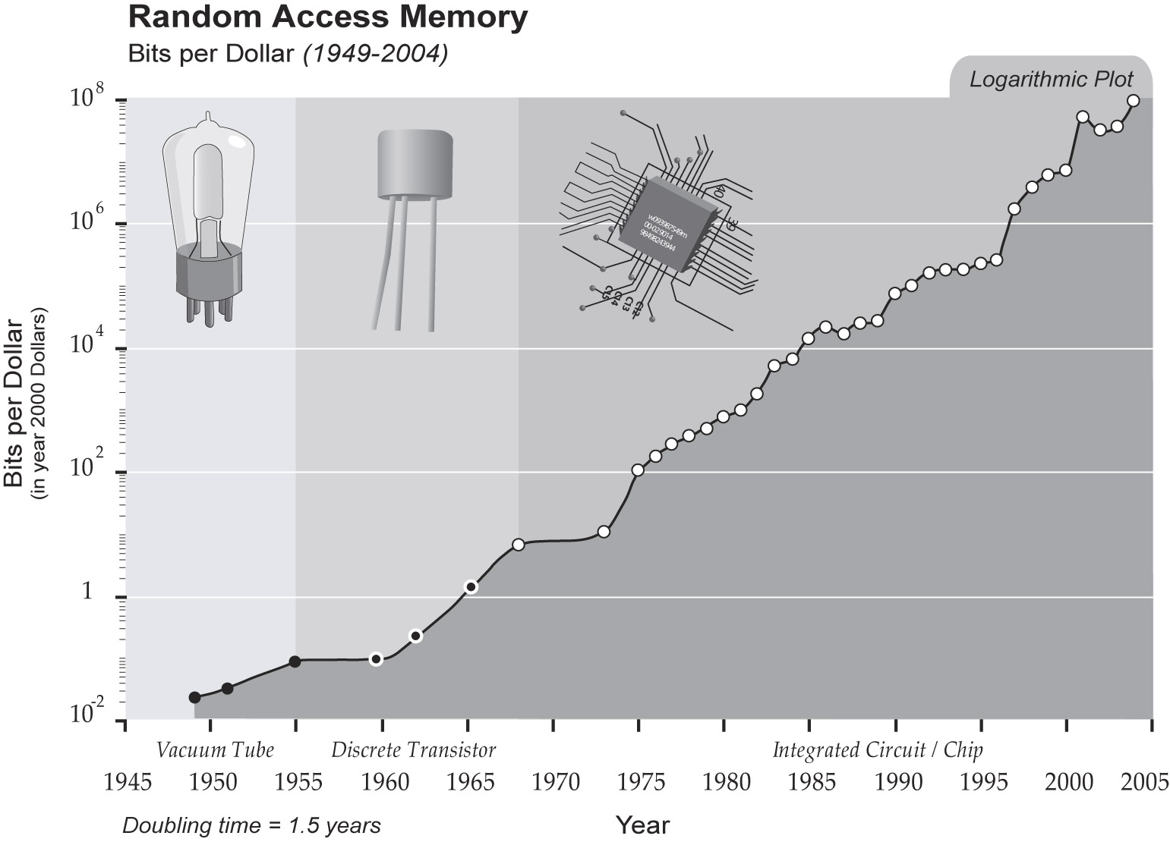
singularity.com/charts

Slide 39
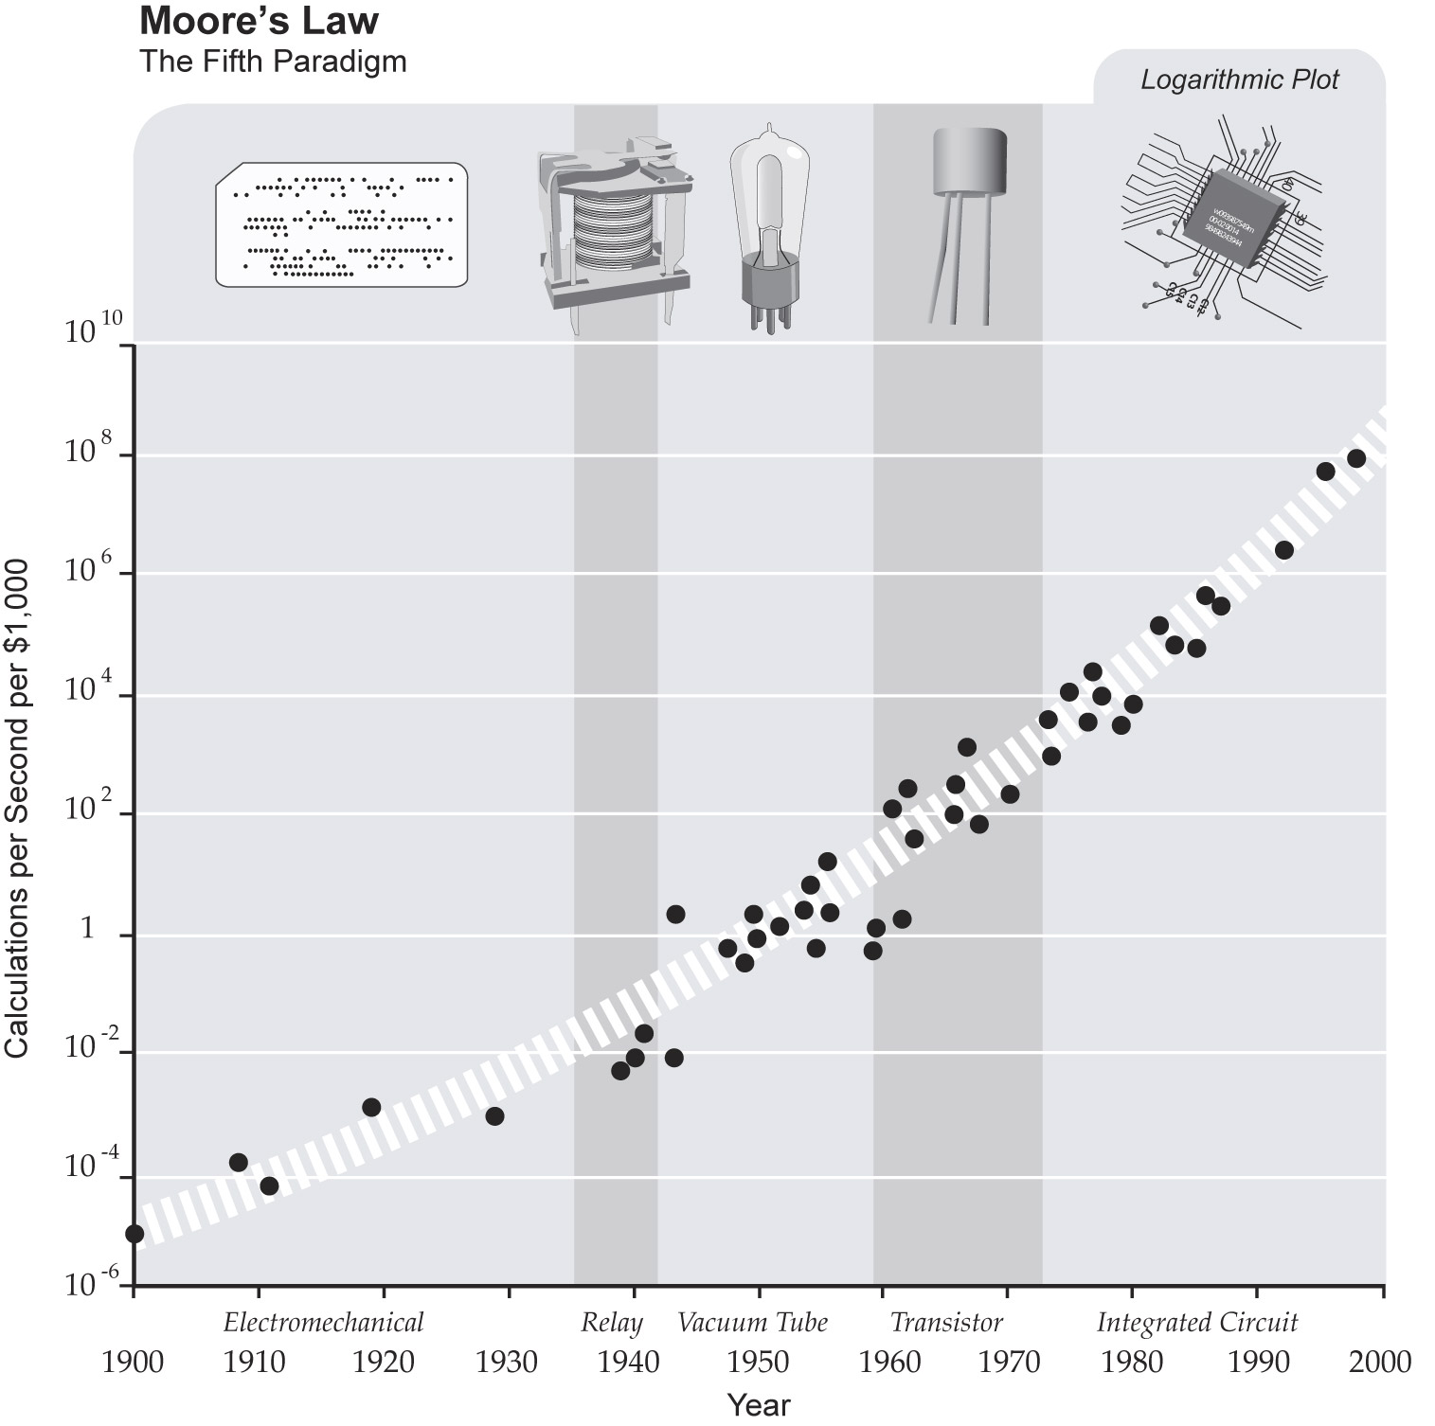
singularity.com/charts

